Slide 1

GALAXIE
GV-per-meter AcceLerator And X-ray-source Integrated Experiment
J. Rosenzweig
UCLA Dept. of Physics and Astronomy
BNL ATF User Meeting, April 26, 2012

Slide 2
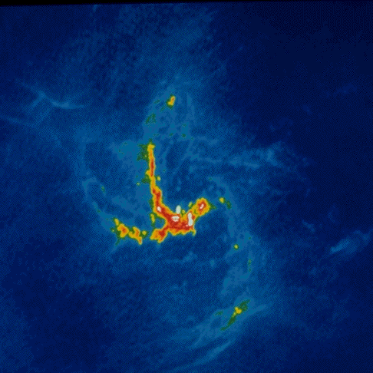
The GALAXIE Collaboration
UCLA Dept. of Physics and Astronomy
  Miao, Musumeci, Putterman, Regan, Rosenzweig (PI)
Stanford Linear Accelerator Center
  Tantawi
Penn State University
  Jovanovic
RadiaBeam Technologies
  Murokh, Boucher
Brookhaven National Laboratory (w/o DARPA funds)
  Pogorelsky, Yakimenko

Slide 3
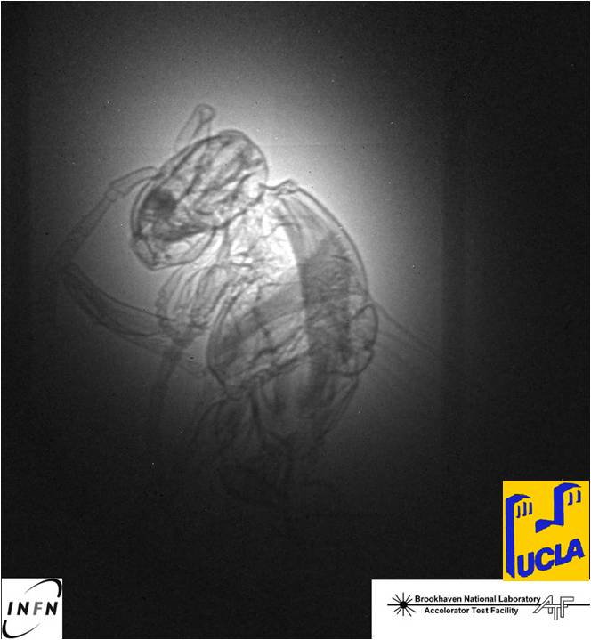


Answering the AXiS DARPA BAA
Advanced X-Ray integrated Sources (AXiS)
Compact, narrow-band, high flux X-ray source
  Utilize GV/m fields
  0.1% BW, set by imaging apps (e.g. phase contrast)
Efficient: Energy conversion 10⁻⁴
  Indicated in BAA
  Chooses FEL over ICS
  Sets FEL
Ultra-high brightness electron beams
  Pellegrini criterion on emittance
  Brightness for gain
Dielectric laser acceleration
Optical undulators (all optical system)
ICS illumination of “vespa” at BNL ATF

Slide 4
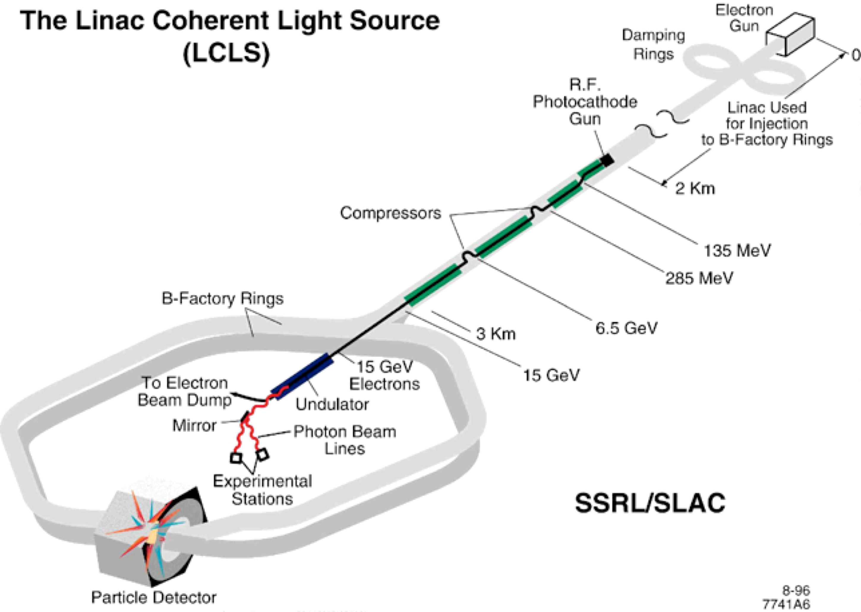
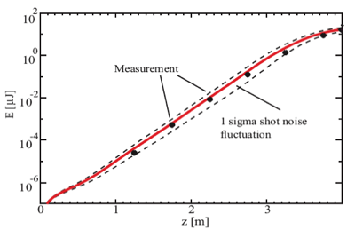
The X-ray FEL
LCLS: First hard X-ray FEL
  Based on existing linear accelerate at SLAC
    Now working at 1.5 Å!
  Many more worldwide
  UCLA performed POP expts.
Revolutionary capabilities
  Single molecule imaging
  Coulomb explosions
  Nonlinear QED
DARPA AXIS: apply to medical imaging
  Compact and inexpensive
E=14 GeV
λ_{r}=1.5 Å
Saturation at VISA
~800 nm
courtesy G. Andonian
A. Murokh, et al., Phys. Rev. E 67, 066501 (2003)

Slide 5
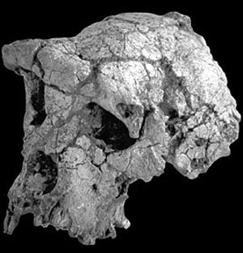

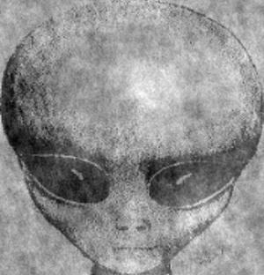
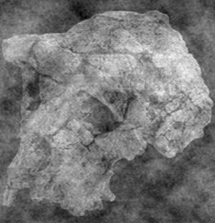
Coherence: the importance of the phase information
(a)
(b)
Amplitude of (a)
+ phases of (b)
Amplitude of (b)
+ phases of (a)

Slide 6
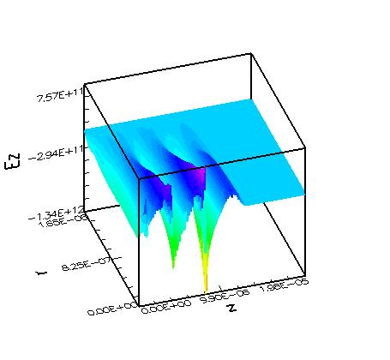
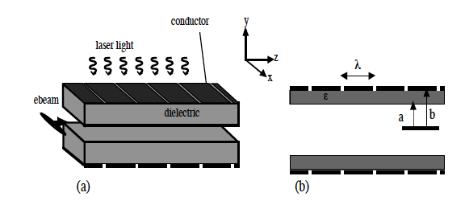
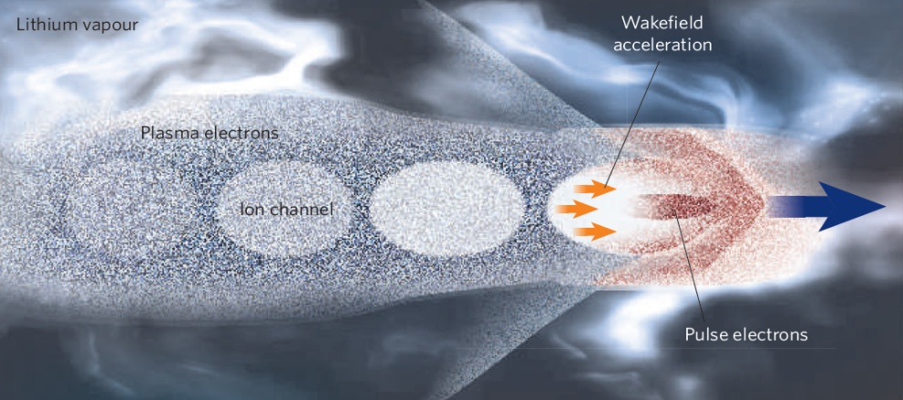
UCLA core research strength:
Advanced acceleration techniques
High intensity electron/laser beam excites dielectric structures or plasmas
GV/m to TV/m fields possible; scenario dependent
High energy densities: scaling of repetition rate difficult
Utilize resonant optical/IR structure acceleration
  Extend accelerator structure concept over 4 orders of magnitude in λ
  Married with advanced FEL: first “5th generation” light source
  Stepping stone to higher energy applications (e.g. linear collider)
>1 TVm accelerating fields in
proposed LCLS PWFA experiment
J.B. Rosenzweig, A. Murokh, and C. Pellegrini, PRL 74, 2467 (1995)

Slide 7
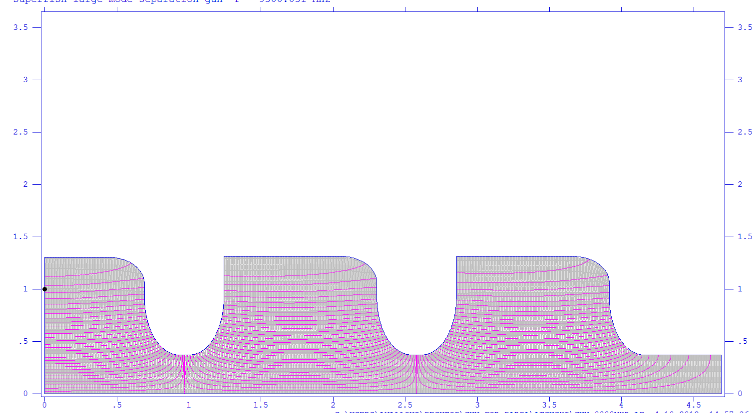
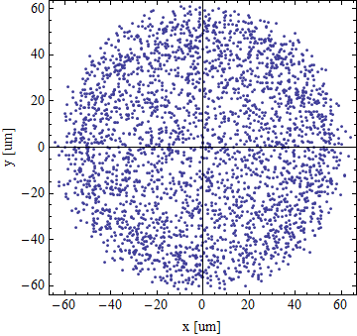
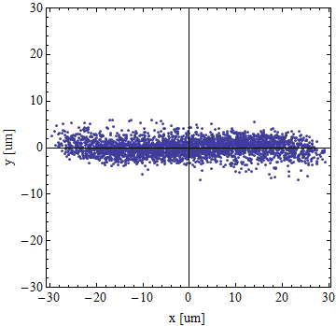
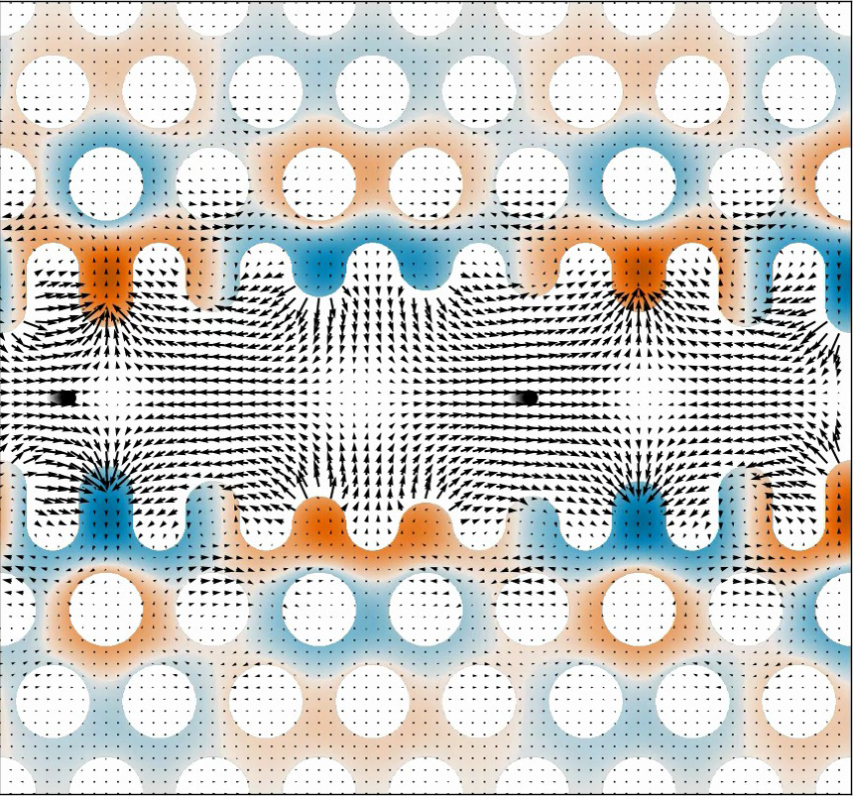
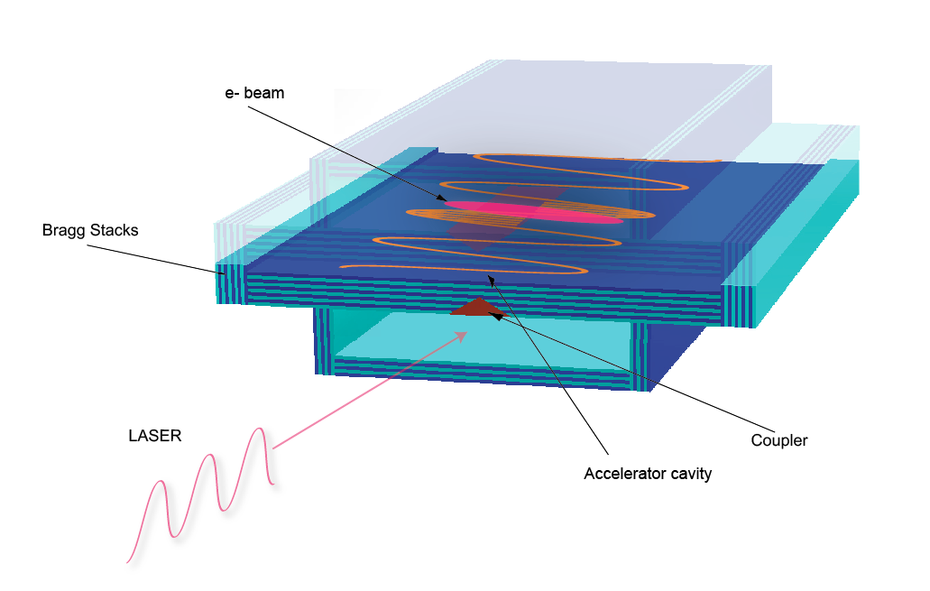
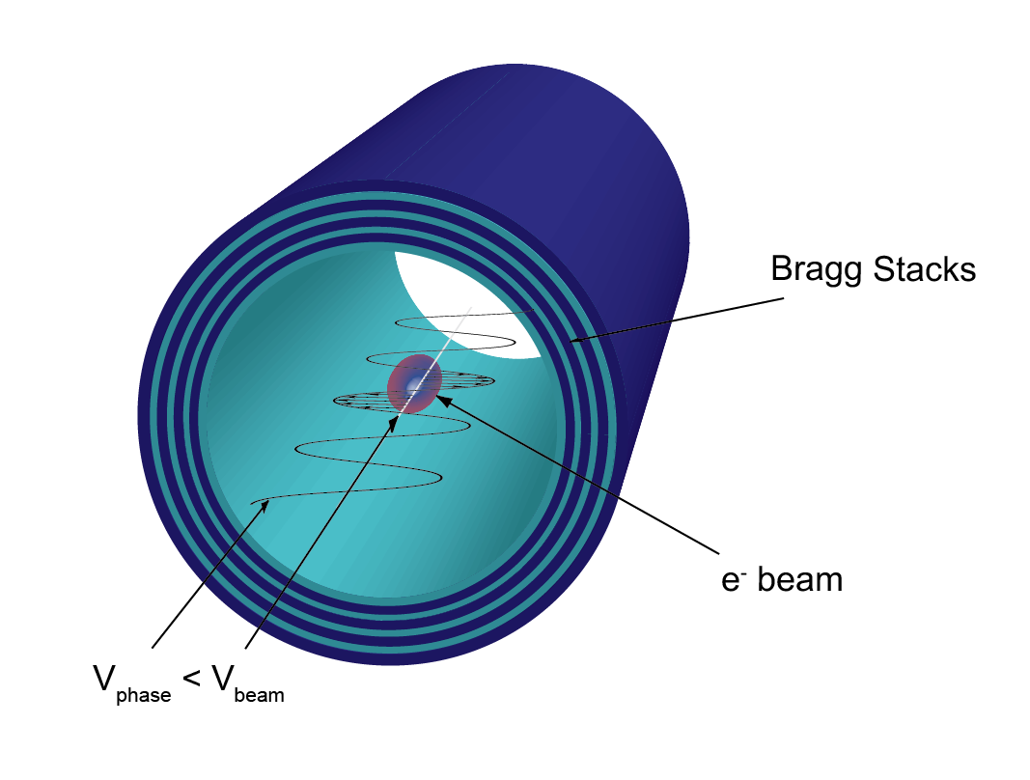
All-optical FEL
GALAXIE: Compact, High-Brightness, Monochromatic
X-rays from All-Optical, High Field Accelerators and Undulators
200 MV/m X-band RF gun w/flat
beam converter
Ultra-low emittance, optically gated electron source (magnetized beam)
Low β, relativistic photonic dielectric acceletors
Optical (or THz) undulator
Long λ laser source: 5 microns
Challenging integrated project
Photonic defect mode
bi-harmonic structure
with 2nd order focusing
and acceleration on high
spatial harmonic
Traveling wave dielectric laser
accelerator
Overmoded optical undulator

Slide 8
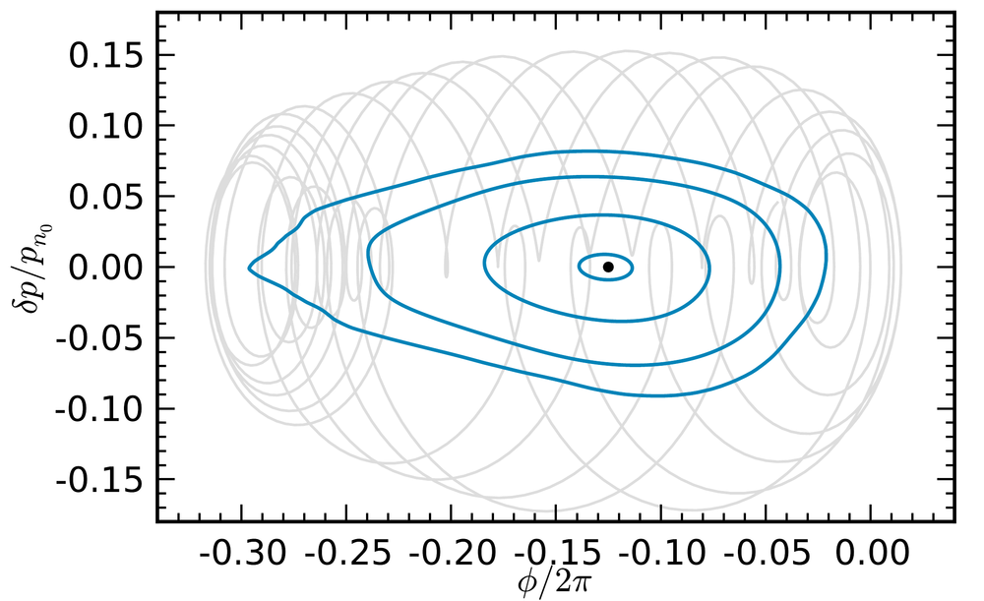
Long-wavelength (5 μm) laser system
Avoid aperture limitations
  Vertical emittance @ 1E-9 m level for 5 μm case (3E-11 m @0.8 μm)
  Spatial harmonic 2nd order focusing
More stable longitudinal acceleration (enlarged buckets)
  Complex dynamics from focusing spatial harmonic
Mitigate breakdown
  Small quantum energy
  Optimize at ~ps pulse length
Breakdown thresholds unknown (>GV/m?)
  Material investigations needed
Biharmonic photonic mode
dielectric structure
Longitudinal phase space (Poincare)

Slide 9

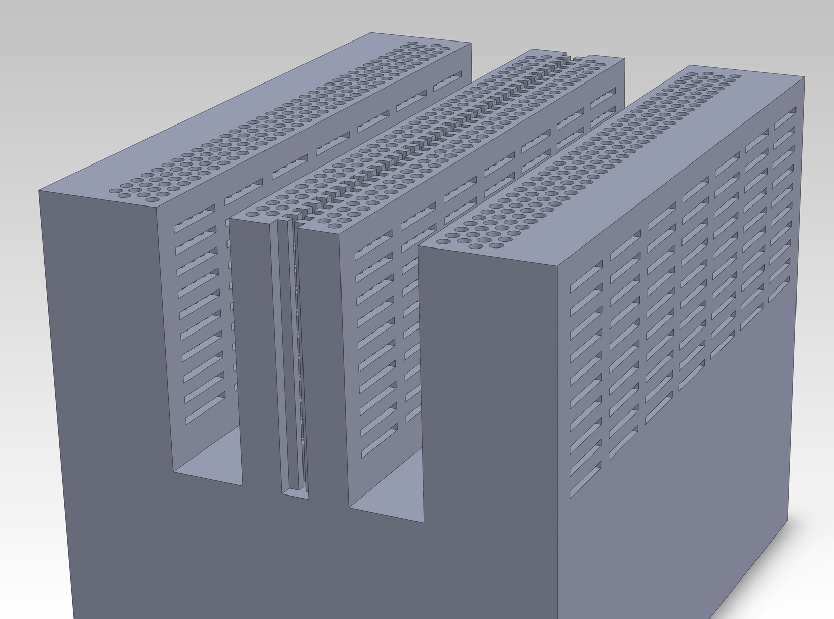
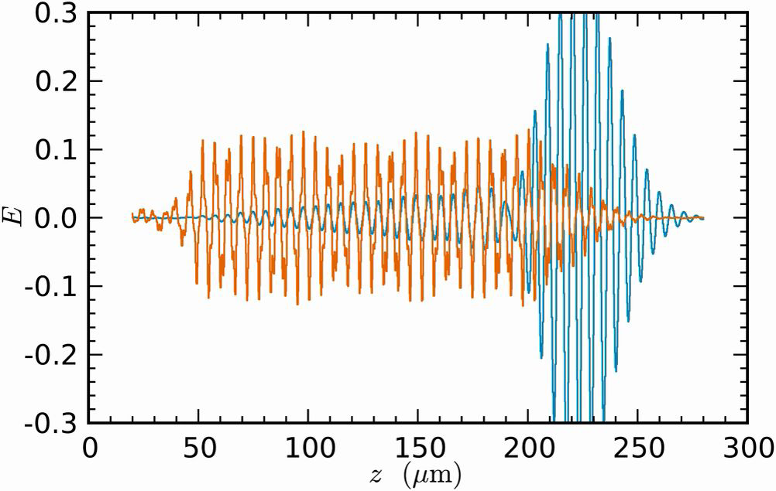
The Accelerator Structure: Bigger Picture
Proposed silicon structure
Monolithic plasma-etched
Si assembly
Coupling dynamics

Slide 10
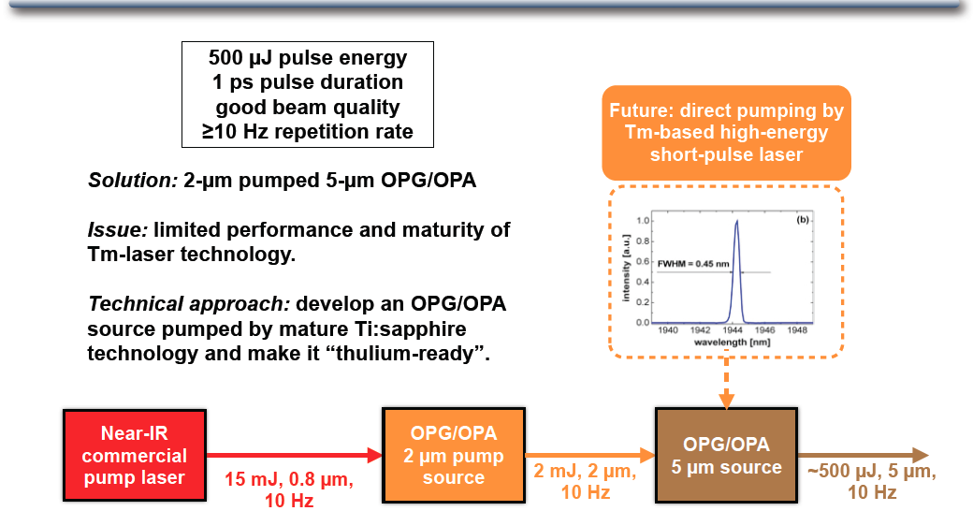
5 μm Laser Approach

Slide 11
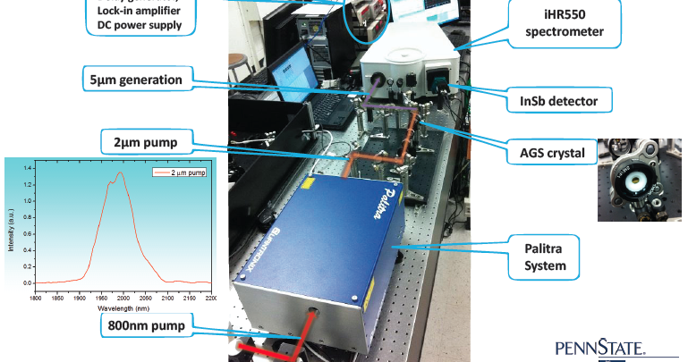
Mid-IR seed source setup
Palitra also at UCLA

Slide 12
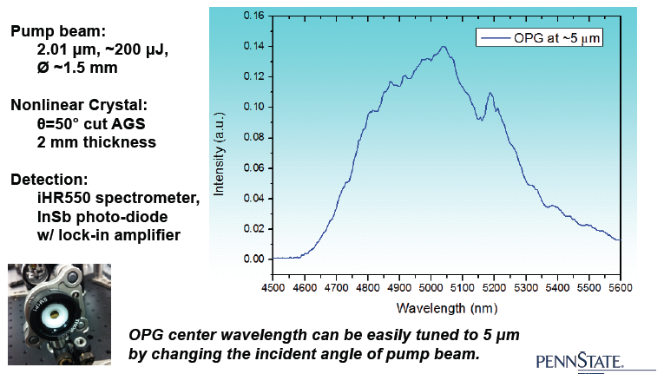
First Light at 5 μm
But we need high power for materials testing now…

Slide 13
Optical properties, breakdown at 5 μm
Limited data exists on 5 μm light interactions
  Index, loss tangent, breakdown
  Long pulses more often studied.
    For <10 ps pulses, electrons react faster than lattice
      Avalanche ionization dominant
  Single shot vs. high rep, fluence threshold
Study critical for:
  Structure (accelerator and fabrication
  Optical components: pulse, color splitters
Candidate material crystals in hand
  CaF2,MgF2,ZnSe,Ge,Si,Al₂O₃
Testing ongoing at BNL ATF

Slide 14
Diagnostic layout: Initial BNL tests
HeNe
Det - Fast
Doubling crystals ordered, receiv
(Altos Photonics/EKSMA)
ZGP and AgGaSe2
CO2 OAP
w/ Hole
CaF₂
50/50
HeNe
Sample
Cal.
HeNe Lens
Co2 Spt.
HeNe
Det - Fast
Cal.
Cal.
Reference Det.
I
Atten.
Joint project: UCLA, RadiaBeam, BNL
Red – He-Ne
Green – 10.2 um CO2
Purple – 5.1 um light
t
CO2 Laser
Event

Slide 15
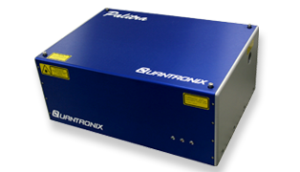
IRNWA: Infrared Network Analyzer
Precision DUT measurements of 5 μm structures
New lab developed above UCLA Pegasus
Quantronix Palitra ordered, delivered, working
Upgrading current laser to 40 mJ at 800 nm; expect 0.5 mJ at 5 μm after Palitra

Slide 16
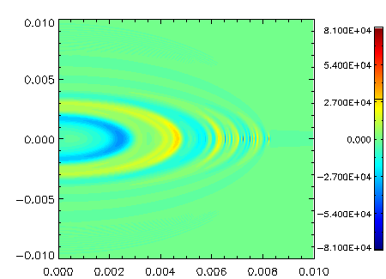
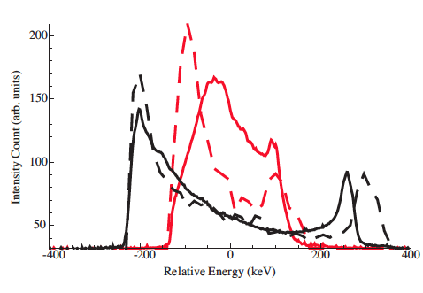
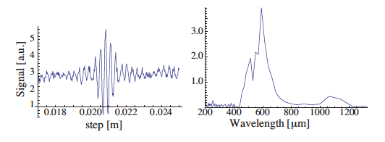
Wakefields: 1st observation of slab structure at BNL ATF
Coherent Cerenkov radiation benchmark on mode frequencies
Deceleration/acceleration observed
Start-to-end simulations w/OOPIC
  Now extended to VORPAL 3D
Under review at PRL
Continuation of work at SLAC FACET
x (m)
z (m)
Observed (solid) and simulated
(dashed) momentum spectra
CCR signal and FFT

Slide 17
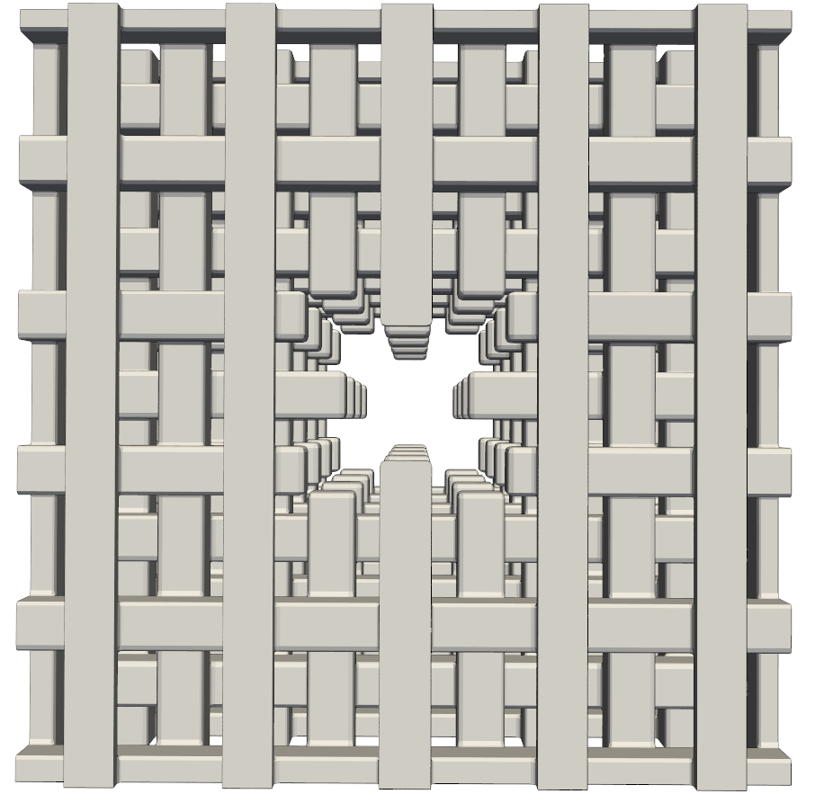
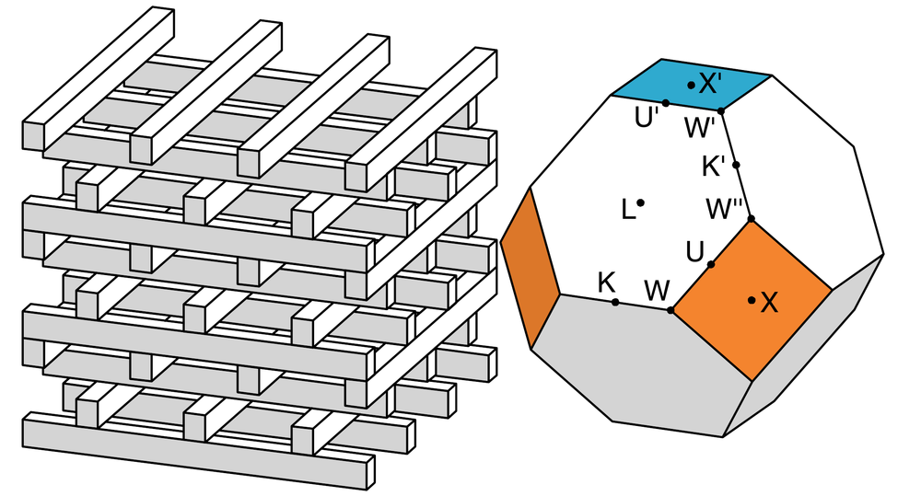
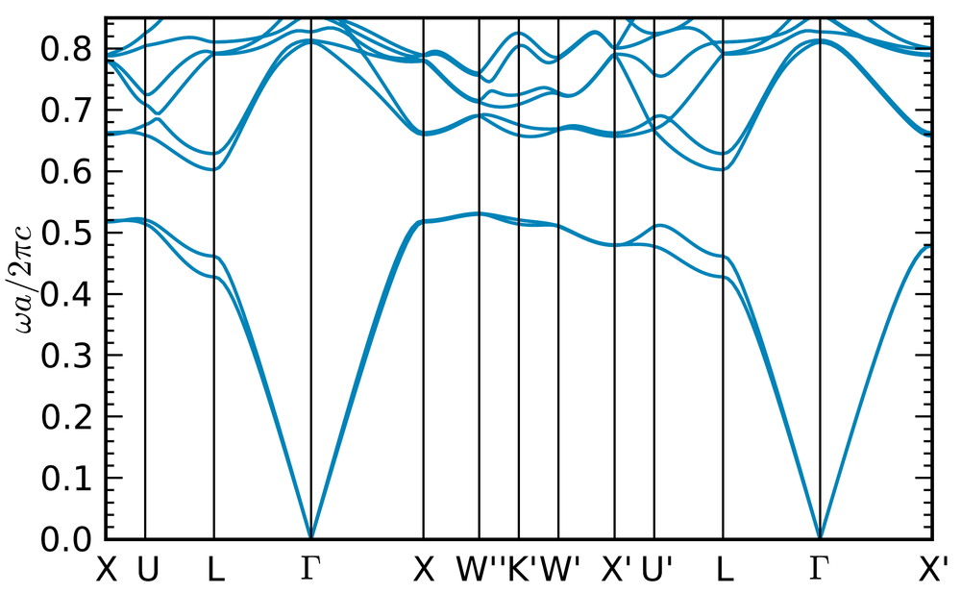
Next step: photonic structures
Bragg, GALAXIE, woodpile structures
Both ATF and FACET planned
  Convergent with HEP program
  Advantage in fabrication at THz
Narrow, wide defects
  Optimized and Cowan-style, any axis…
Defect with optimized symmetry

Slide 18
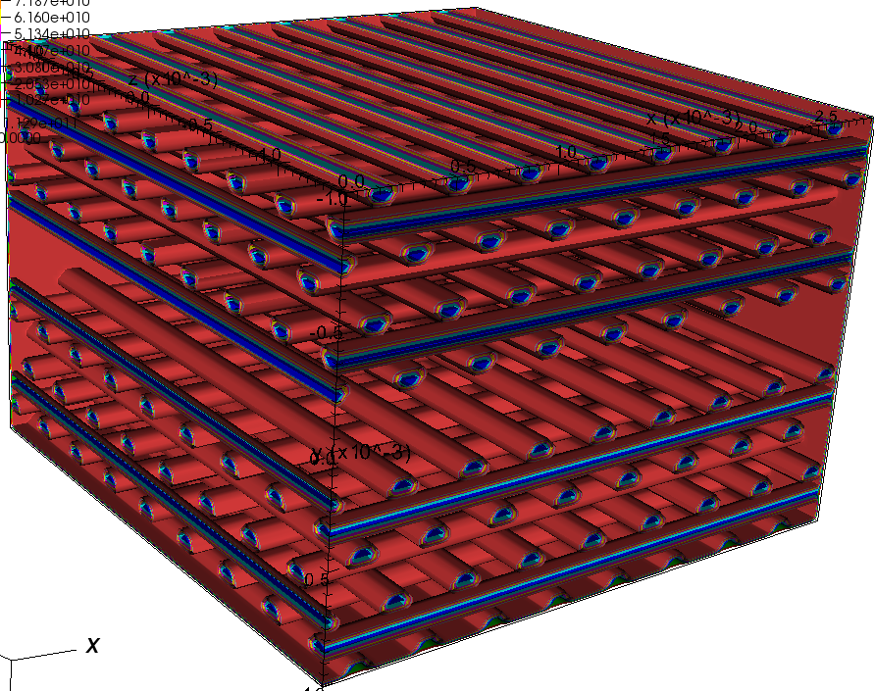
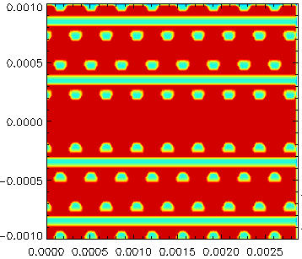
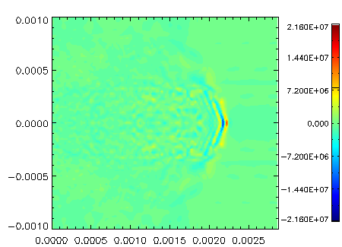
1st VORPAL simulations
a
y
beam
DIMENSIONs:
Diameter of cylindrical:125 um
Beam Channel: 250um
A=350um
C=500um
x
First version: quartz tubes…
More from Gerard Andonian presentation

Slide 19
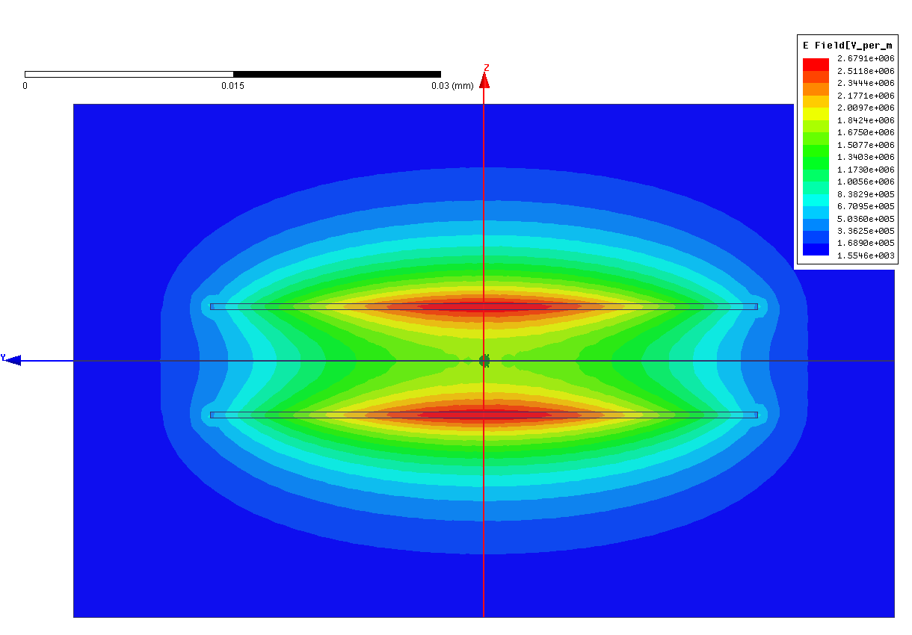
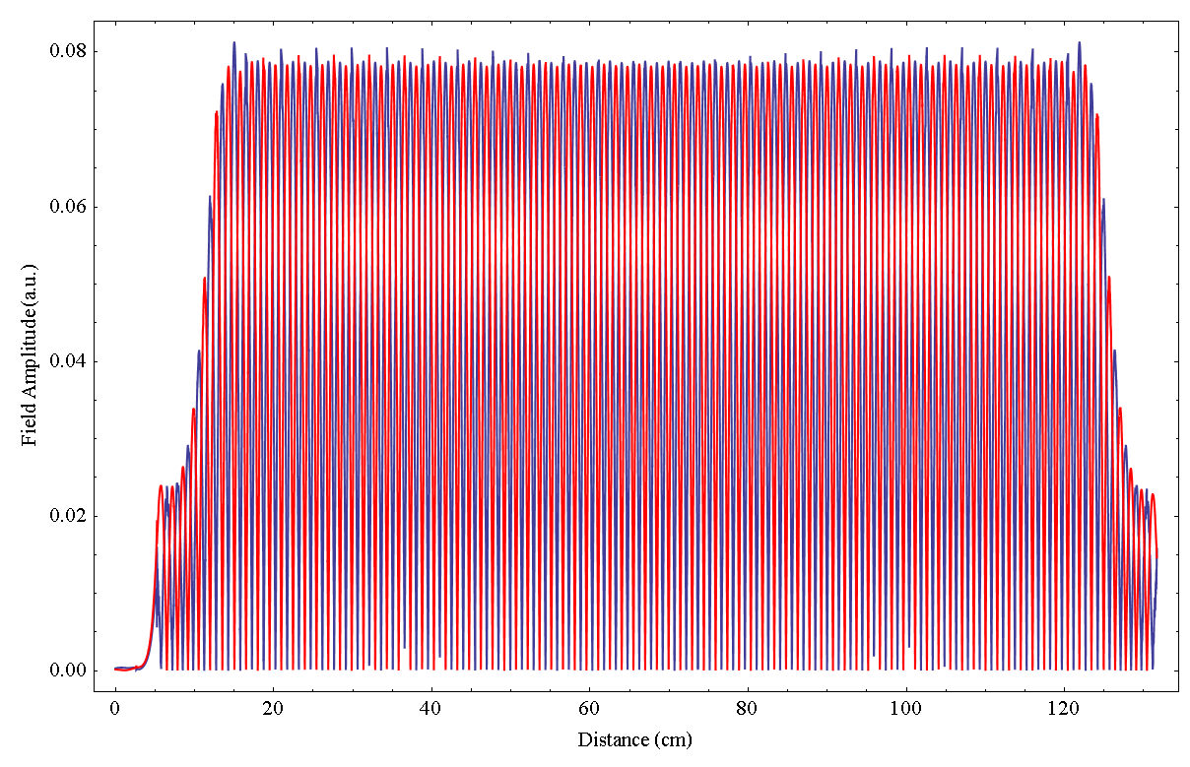
Electromagnetic undulators
Slab and cylindrical (better for FEL) geometries
Fed by 5 μm, detuned v_{φ} structure (λ_{u}=200 μm)
  Structure construction now, beam tests at BNL ATF
  S. Tantawi reports
High effective field difficult (E and B cancel)
  also examining THz SW structure
Trench
Thickness
Gap
e⁻
Width

Slide 20
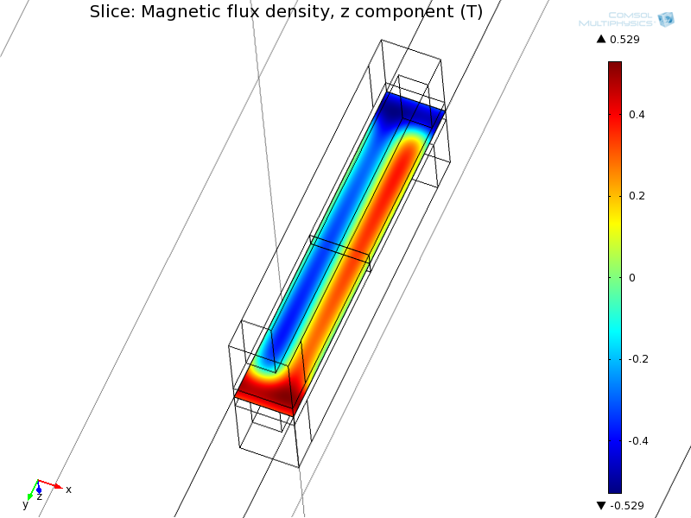
Alternative: laser cut-PM undulator
Collaboration with Arnold group (Florida)
3D nonlinear FEM using periodic BCs to simulate infinite array
(checked with RADIA at UCLA)
λ_{u}: 400 µm, B₀=0.34 T
Magnet width: 200 µm
Magnet gap: 200 µm
Undulator length: 2 cm
Material: laser cut NdFeB
Experiments planned at BNL
Initial testing at UCLA
Same setup as slab wakes
150 eV photon production
  F. O’Shea reports
Potential high impact on standard light sources

Slide 21
Conclusions
GALAXIE provides new impetus to UCLA-centered collaborative work at ATF
  5 um materials testing
  Photonic/slab structure wakes
  EM undulator
  PM microundulator
Overview complemented by more detailed presentations
Materials/undulator proposal under development
  Issued after DARPA mid-year review (May 9-10)

