Slide 1
Plasma wakefields in the quasi-nonlinear regime
J.B. Rosenzweigª, G. Andonianª, S. Barberª, M. Ferrario^{b}, P. Muggli^{c}, B. O’Sheaª, Y. Sakaiª, A. Valloniª, O. Williamsª, Y. Xiª, V. Yakimenko^{d}
ªUCLA Dept. of Physics and Astronomy, 405 Hilgard Ave. Los Angeles, CA, 90095, USA ^{b}Accelerator Division, Istituto Nazionale di Fisica Nucleare, Laboratori Nazionali di Frascati , Via E. Fermi 40, Frascati (RM) 00044, Italy
^{c}Max Planck Institute for Physics, Munich, Germany
^{d}Brookhaven National Laboratory, Upton, NY, 11973, USA

Slide 2
Background and Motivation
Measure of non linearity:
PWFA regime | Advantage | Disadvantage
Non linear | -Linear ion focusing -Acceleration independent of transverse position | -Amplitude dependent period -Large wavebreaking
Linear | -Can drive plasma oscillations resonantly | -Non linear radial focusing -Radially dependent acceleration

Slide 3
Background and Motivation
GOAL: Exploit advantages of both regimes
PWFA regime | Advantage | Disadvantage
Non linear | -Linear ion focusing -Acceleration independent of transverse position | -Amplitude dependent period -Large wavebreaking
Linear | -Can drive plasma oscillations resonantly | -Non linear radial focusing -Radially dependent acceleration
Can be achieved in the quasi non linear regime:
but
Need cold, low emittance beams which can tightly focused:
To adequately explore this regime we need the capability to produce pulse trains with high charge and low emittance….ATF!

Slide 4
Matching beam to plasma
-> Need to measure matched beta function at exit of plasma to definitively demonstrate operation in blowout regime
Equilibrium beta function inside linearly focusing ion channel:
For E = 58MeV and plasma density n_{e} = 4.5 x 10¹⁵ – 1.0 x 10¹⁶ cm⁻³:
*Focusing requirements for beamline optics are slightly relaxed as we gain additional focusing as the beam propagates through an underdense plasma density ramp

Slide 5
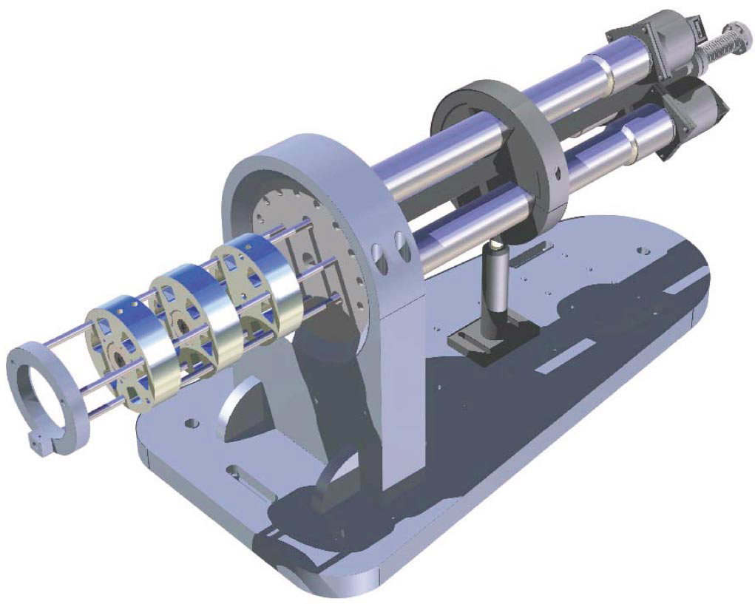
Adjustable focal length PMQ triplet
Specs:
Three 1 cm PMQs
Gradients of ~250 T/m and 500T/m
Effective focal length of ~8.5 cm @ 58MeV

Slide 6
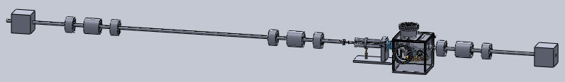
Beam optics considerations on BL2 I line
-Using a pair of EM triplets, produce a round collimated beam with a beta of 2-20 m
-Minimum beta for single focusing element:
0.5 to 3.5 mm beta, readily achievable with PMQ
βx = βy =1.5 mm

Slide 7
Matching beam to plasma
Plasma density ramp provides additional focusing, aids in matching
Focusing strength inside blown out plasma region:
Envelope equation:
Plasma density: 4.5 x 10¹⁵
Plasma rise length: 1 mm
Beam energy: 58 MeV
Normalized emittance: 1 mm mrad
Equilibrium beta function: 1.2 mm
PMQ triplet focal length: 8 cm
Beam beta function w/o plasma
(blue) and with plasma (green)
Plasma density profile

Slide 8
Chromatic effects
To generate pulse trains with spacing ~300-500 microns, need total correlated energy spread ~1%
Head of beam will feel stronger focusing than tail
Beam matching to plasma with 1% total correlated energy spread.
Gold, red and blue lines represent head, middle and tail of beam.

Slide 9
Refocusing after interaction point
Need catch and focus beam into magnetic spectrometer to measure energy loss/gain
After interaction point the beam will be extremely divergent
Inner diameter of vacuum pipe ~35 mm
-Triplet placed 40 cm (distance to 1st quad) from IP
-Following previous example, beta function of 1.6 mm at IP

Slide 10
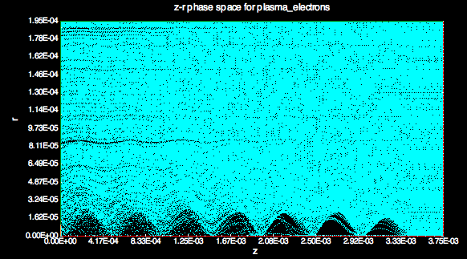
Resonantly driving plasma wakefields via bunch trains
Typical parameters for a pulse train at ATF*:
3 pulse train with 500 micron spacing
pulse charge of ~30 pC
To resonantly drive the plasma wakefields with this pulse train, use plasma with:
->
or
Matched beam gives (per pulse):
and
Simulation results using Oopicpro
Beam current (A)
Longitudinal Field (V/m)
z (mm)
Simultaneous blowout with linear wakefield response
*Andonian et al., APL 98, 202901 (2011)

Slide 11
Ramped bunch train
By using a ramped bunch train (RBT), the wakes can be driven resonantly and the transformer ratio increased well beyond 2. Requires driving the plasma at half integer multiples of the plasma wavelength, i.e. 1.5.
Decelerating field is the same inside each bunch
Tsakanov, NIMA(1999) 202-213

Slide 12
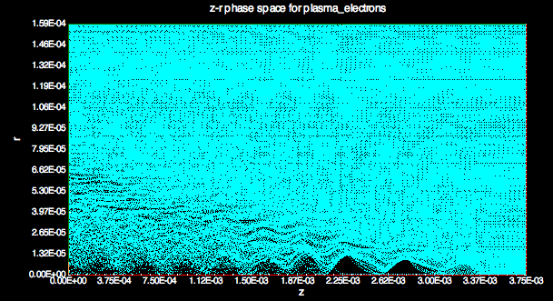
Ramped bunch train
Using the same pulse train as before, we can change the plasma density such that the bunch spacing is equal to 1.5 plasma wavelengths, i.e.
To simulate the ramp, the total charge is kept fixed but redistributed:
with
Beam current (A)
Longitudinal Field (V/m)
z (mm)
Decelerating field the same inside each bunch
Transformer ratio increased to ~4 for three pulse train

Slide 13
Conclusion
With modest beamline modifications, plasma wakefield acceleration experiments at ATF can be carried out in the so called quasi non linear regime, through which we can explore the possibility of combining blowout with a linear plasma respone.

