Slide 1
CO₂ laser system
M. Polyanskiy, I. Pogorelsky, M. Babzien, and V. Yakimenko
Notes:
Hello world

Slide 2
Historical perspective
200 MeV Protons
20 MeV Protons
30 TW
3 TW
300 GW
30 GW
3 GW
LWFA
VLA
High gradient IFEL
Thomson
X-ray imaging
Ion and
Proton
source
LACARA
PASER
Nonlinear Thomson
scattering
EUV source
HGHG
STELLA
Inverse
Cherenkov
accelerator
Thomson
X-ray source
IFEL
accelerator
1995 2000 2005 2010 2015
Notes:
2

Slide 3
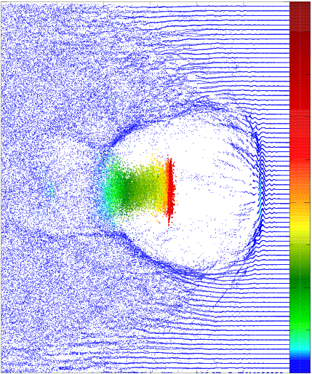
Ion acceleration
C. Palmer et al. Phys. Rev. Lett. 106:014801 (2011)
Relativistically – strong (a_{o}~10) 100-TW CO₂ laser will be a good driver for “bubble” LWFA
Ponderomotive force
drives plasma wave
The ponderomotive energy of the electron in the optical field is proportional to λ².
Assuming λ and n_{cr} as normalization parameters, CO₂ laser will produce a bubble
of 1000 times bigger volume,
at 100 times smaller plasma density,
10 times higher charge,
and better control over e-beam parameters and phasing between accelerator stages.
Electron
bunch
Laser
pulse
Notes:
3

Slide 4
Our priorities
{1,2} RELIABLE POWER
1 POWER
2 RELIABILITY
Notes:
4

Slide 5
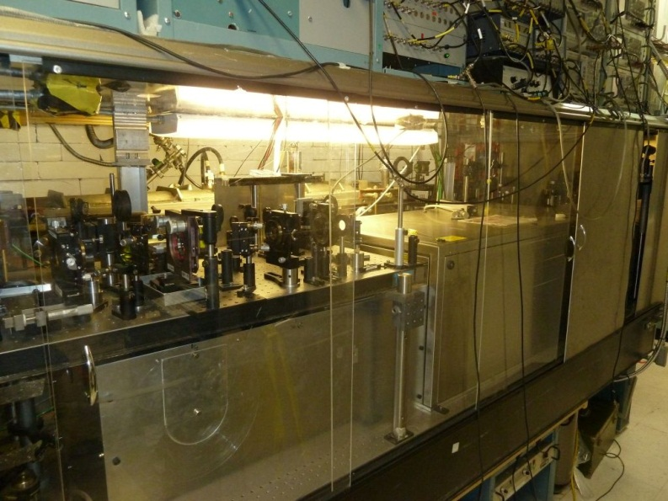
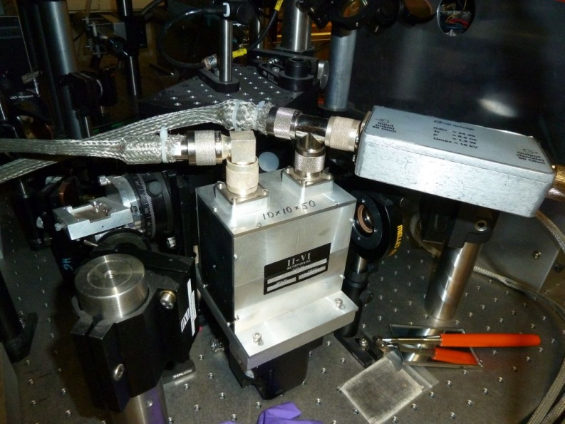
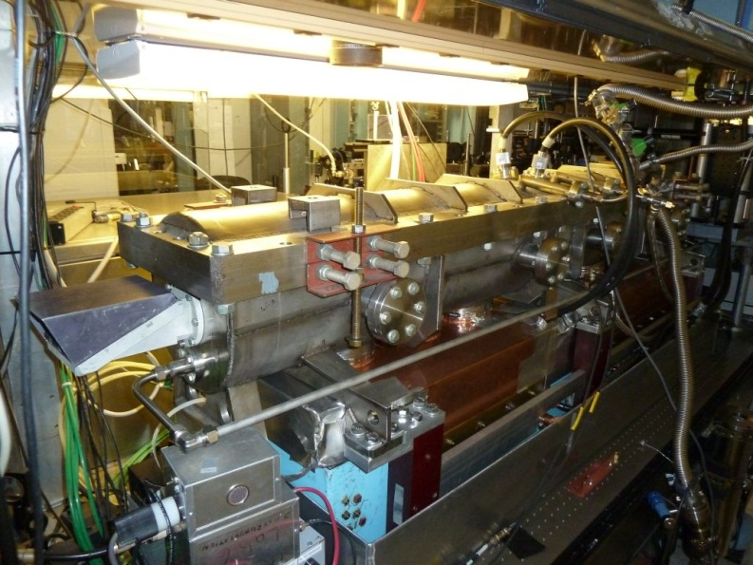
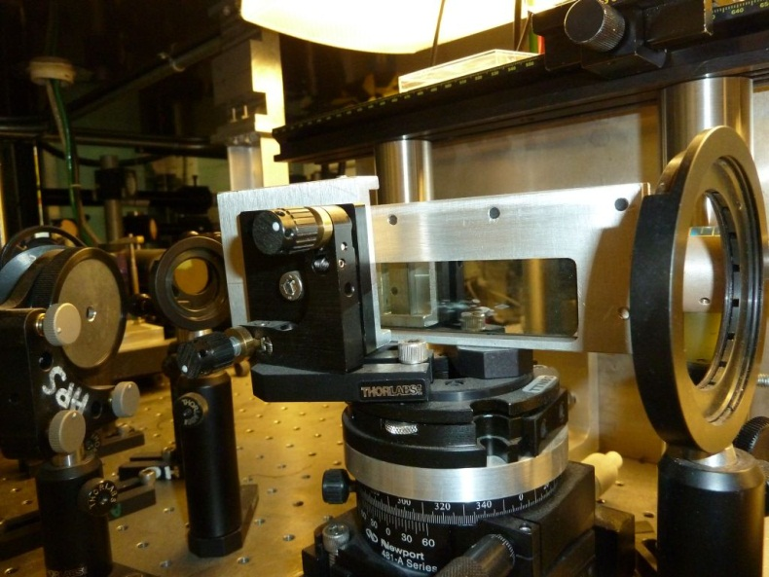
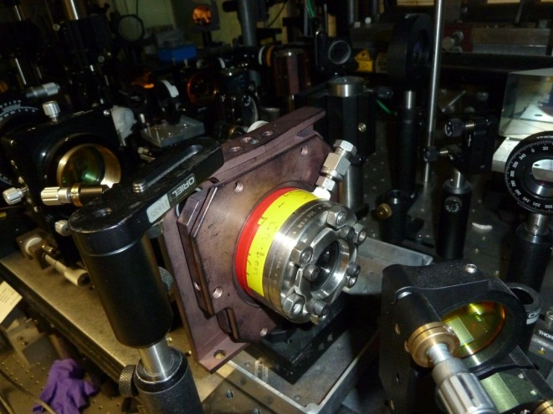
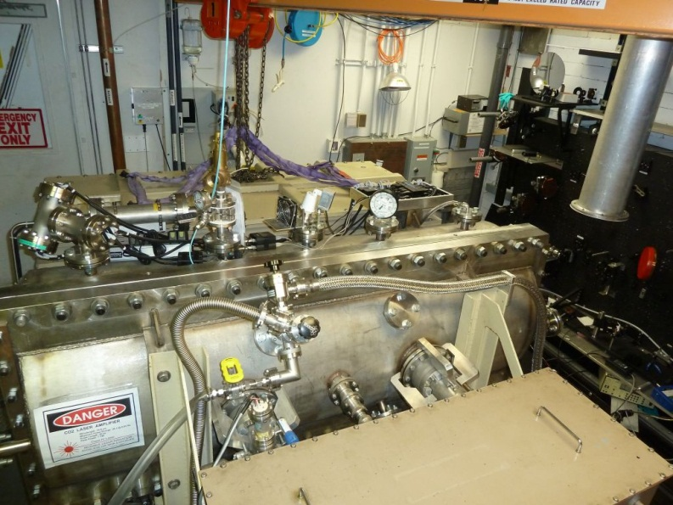
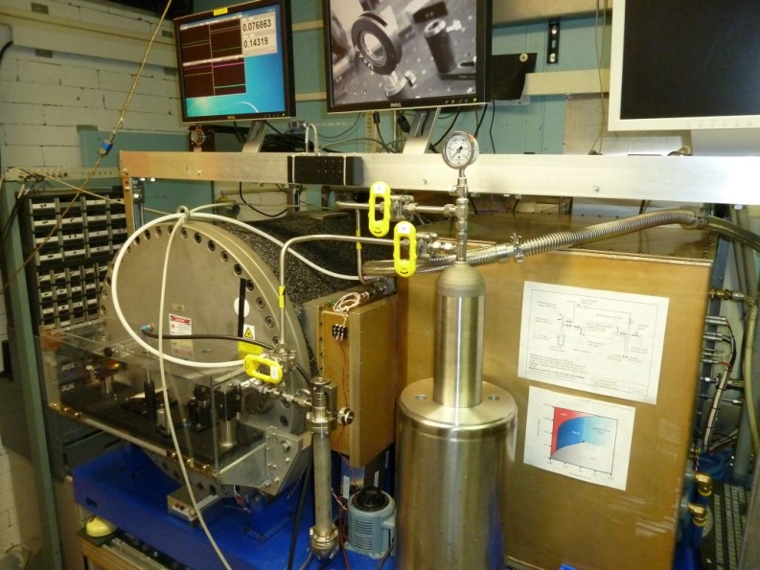

ATF’s CO₂ laser
10-ns HV
14-ps YAG
5-ps SH-YAG
OSCILLATOR
PREAMPLIFIER
MAIN
AMPLIFIER
REGEN
200 ns
20 mJ
5 ps
5 J
Plasma
mirror
Pockels cell
Kerr cell
Notes:
6

Slide 6
Increasing power: which way?
Brutal: add another amplifier section
vs.
Smart: shorten the pulse, improve energy extraction
Notes:
7

Slide 7
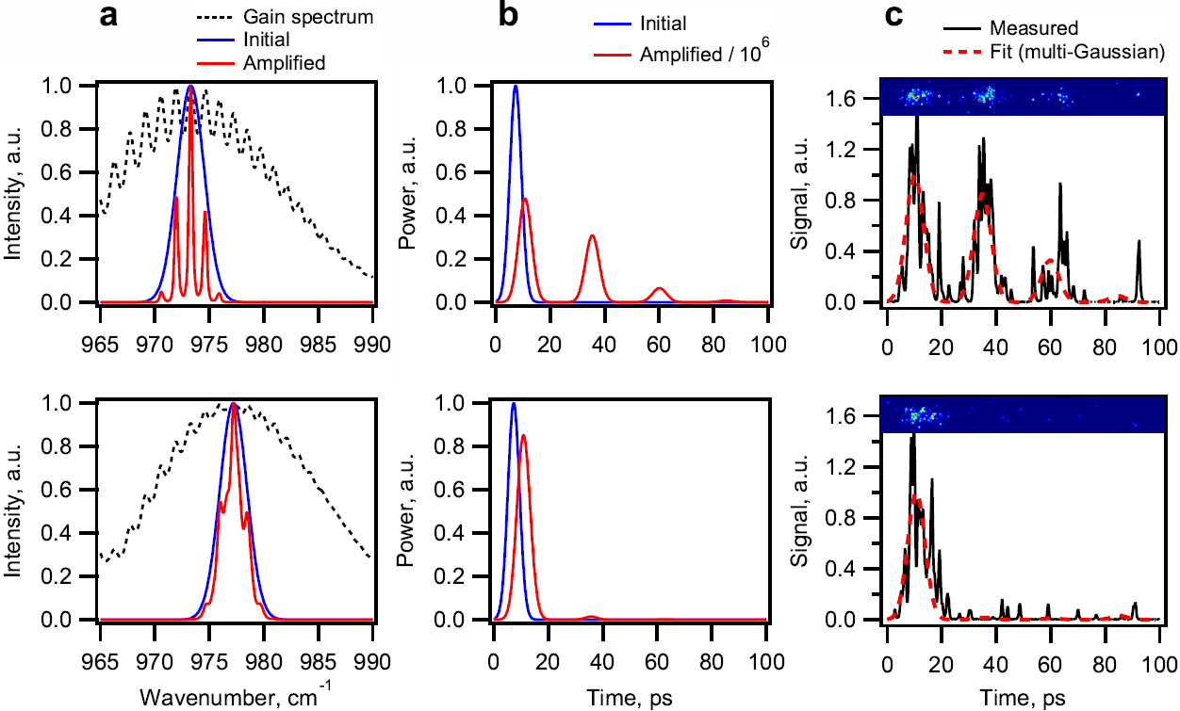
First steps: isotopic active medium
Simulations
Experiment
Natural CO₂
Isotopic CO₂
Notes:
9

Slide 8
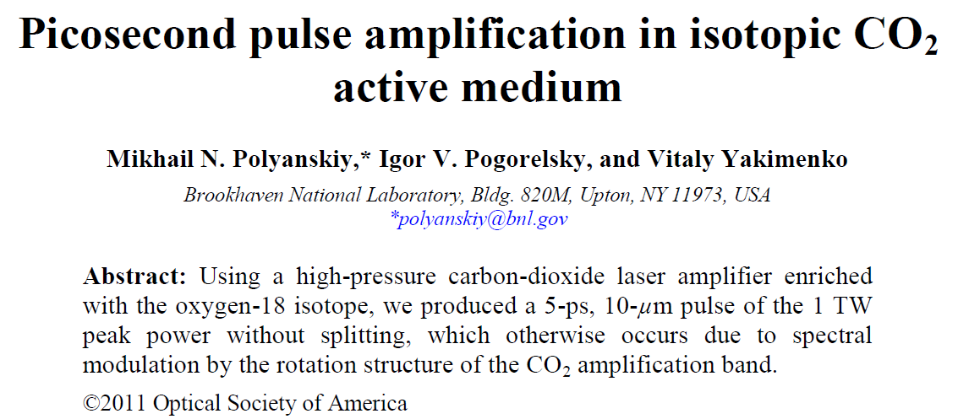
Optics Express 19:7717 (2011)
Notes:
10

Slide 9
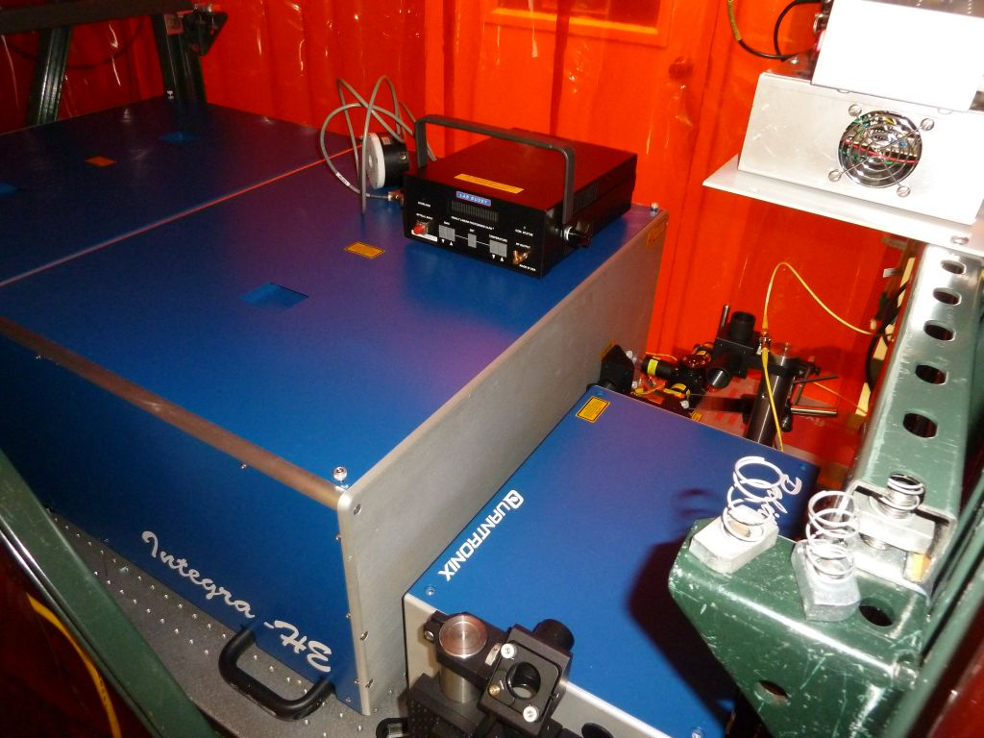
First steps: solid-state injector
SIMPLICITY & RELIABILITY
SHORT PULSE
HIGH PULSE ENERGY
HIGH CONTRAST
BETTER ENERGY EXTRACTION
SOLID-STATE
INJECTOR
MAIN
AMPLIFIER
REGEN
400 fs
40 µJ
1-2 ps
10+ J
Notes:
12

Slide 10
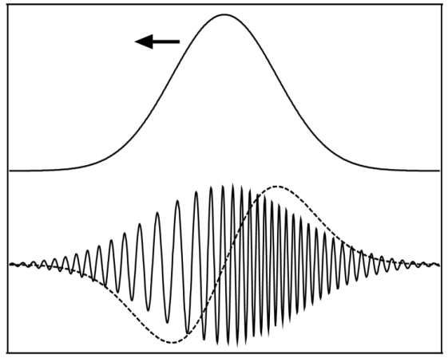
Challenge: non-linear response of IR materials
Kerr lensing (spatial effect)
low n
high n
low n
Material | n₀ | n₂ (10⁻¹⁶ cm²/W)
KCl | 1.45 | 5.7
NaCl | 1.49 | 4.4
ZnSe | 2.40 | 290
CdTe | 2.67 | -3000
Si | 3.42 | 1000
Ge | 4.00 | 2800
Pulse chirping (temporal effect)
Notes:
14

Slide 11
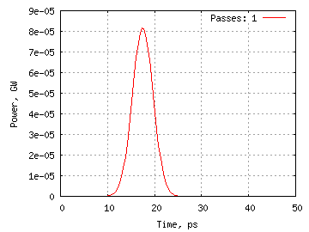
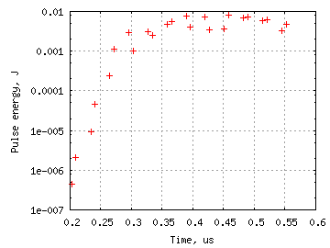
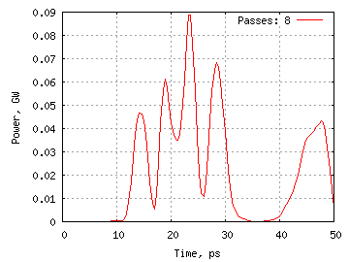
Case study: n₂ killing the pulse in regen
5-cm CdTe in a laser cavity
Notes:
15

Slide 12
Regen re-configuration
BEFORE: <1 mJ
IN
OUT
λ/4
Pockels cell
CdTe, 50 mm
(-3000×10⁻¹⁶ cm²/W)
Polarizing splitter
ZnSe, 2 mm
(290×10⁻¹⁶ cm²/W)
NaCl, 25 mm x 2
(4.4×10⁻¹⁶ cm²/W)
OUT
AFTER: 10 mJ
YAG
R=82%
Ge, 0.5 mm
(2800×10⁻¹⁶ cm²/W)
IN
NaCl, 25 mm x 2
(4.4×10⁻¹⁶ cm²/W)
Notes:
16

Slide 13

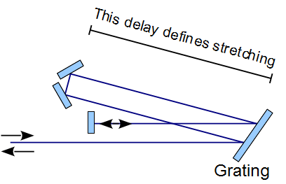
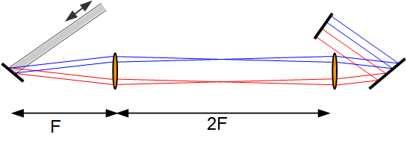

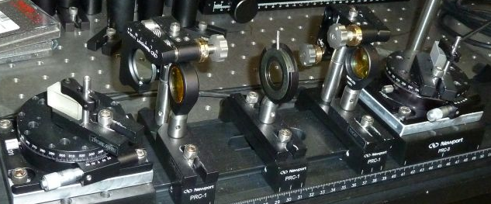
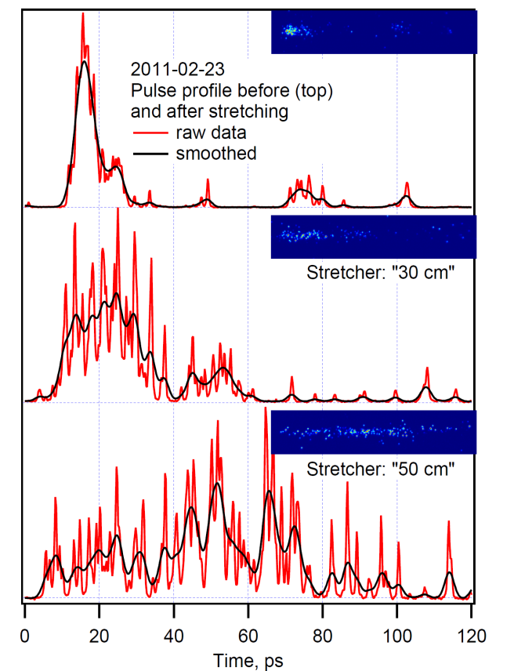

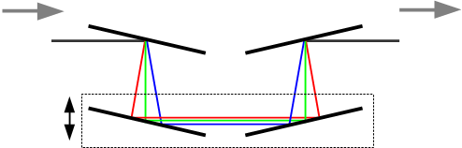
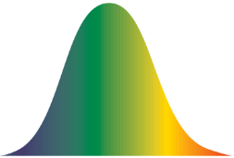
Next step: chirped pulse amplification
STRETCHER
PRELIMINARY TEST
COMPRESSOR
Notes:
19

Slide 14
Saturation effects in the active medium
Diffractive
grating
Pyrocamera
6.2 ps
INPUT
71 GHz
SPECTROMETER
OUTPUT
Linear regime (1.1 mJ → 1.4 J)
6.1 ps
72 GHz
OUTPUT
Non-linear regime (3.2 mJ → 2.7 J)
2.7 ps (?)
160 GHz
Notes:
22

Slide 15
Model simulations
SPECTRUM
PULSE PROFILE
INPUT
88 GHz (5 ps)
5 ps
OUTPUT
3.2 ps
170 GHz
(2.6 ps ?)
Notes:
23

Slide 16

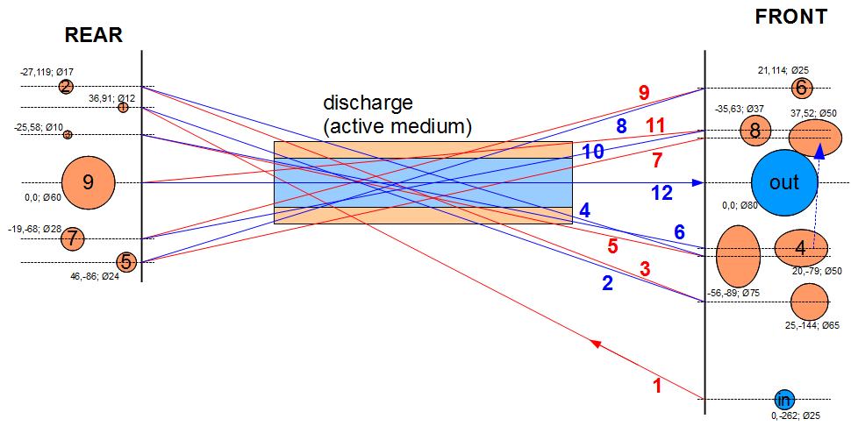
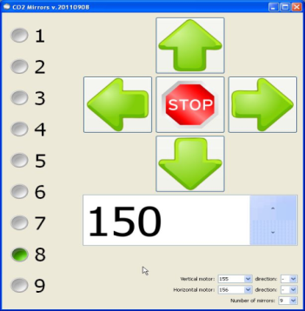
Main amplifier status
Major failure: break-down of HV fit-through between high-pressure vessel and water capacitor
Currently operating at reduced pressure and discharge voltage
Amplification loss is compensated by increasing number of passes
New mirror system featuring reliable remote control implemented
Notes:
25

Slide 17

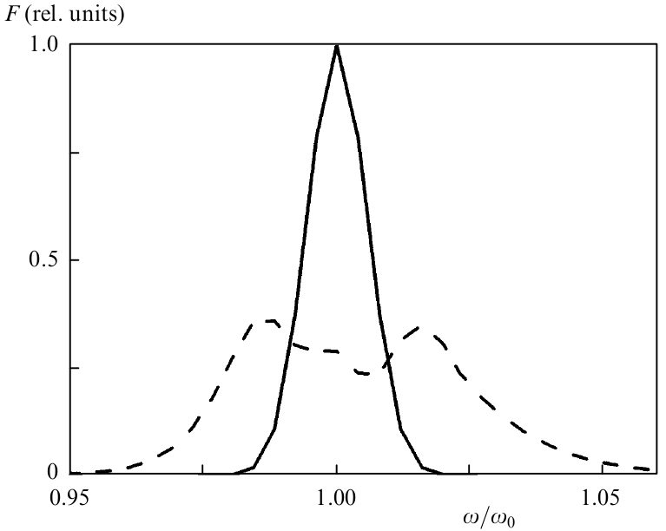
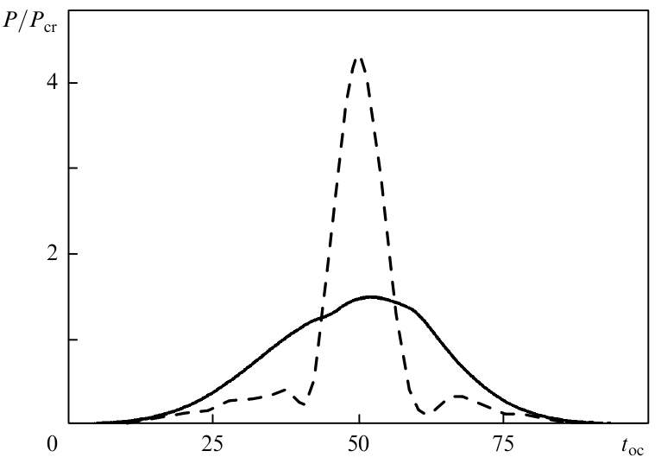

Long-term vision: compression to sub-ps
Spectra
Pulse profile
Laser-induced ionization shifts phase of the wave resulting in a chirp. Subsequent pulse compression results in 3~4 times pulse shortening.
Gordienko et al. Quantum Electronics, 39:663 (2009)
Notes:
27

Slide 18
Long-term vision: optical pumping
Solid-state ErCr:YSGG (2.79 μm) laser
High pressure
No CO₂ dissociation in the discharge
Direct and fast pumping of laser transition in CO₂
  N₂-free mixture
  Efficient energy extraction in single pass
  Eliminating self-lasing
An amplifier producing ~5 mJ output in a 3-ps pulse when pumped by a 300-mJ ErCr:YSGG laser demonstrated theoretically
Gordienko et al. Quantum Electronics, 40:1118 (2010)
Notes:
28

Slide 19
Summary
Priority: support user’s experiments via providing reliable power
Approach to increasing power: get maximum from available amplifiers
Isotopic regen is routinely operated providing a true single pulse
New all-solid-state injector will improve system performance and reliability
Non-linear effects in optical materials becoming an issue. Regen re-configuration provided 10 mJ (2 GW) pulses before the main amplifier
Chirped-pulse amplification was a breakthrough in solid-state lasers; we expect similar impact on ultrashort-pulse gas lasers
Non-linear amplification regime in the main amplifier presumably provide pulse shortening to ~3 ps (well below resolution limit of our 20+ years old streak camera)
Main amplifier recovered from a major failure; new remotely-controlled mirror system implemented
Long-term roadmap is being considered
Notes:
30

Slide 20

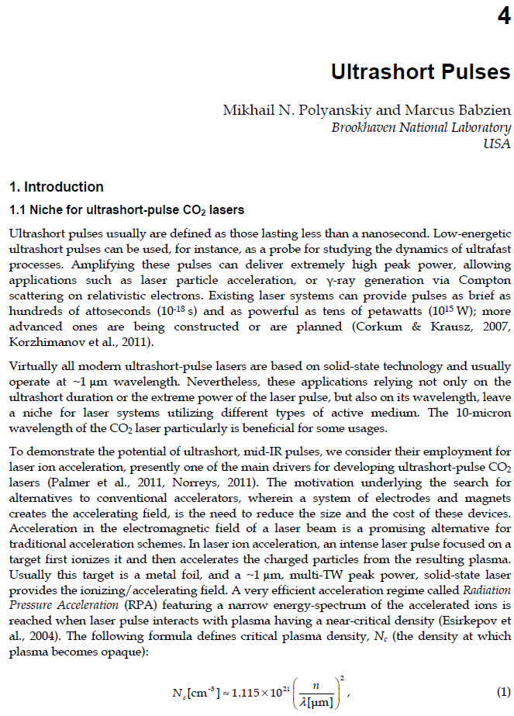
P.S.
Polyanskiy and Babzien “Ultrashort Pulses” in
“CO₂ Laser - Optimization and Application”, InTech (2012)
Notes:
30

