Slide 1
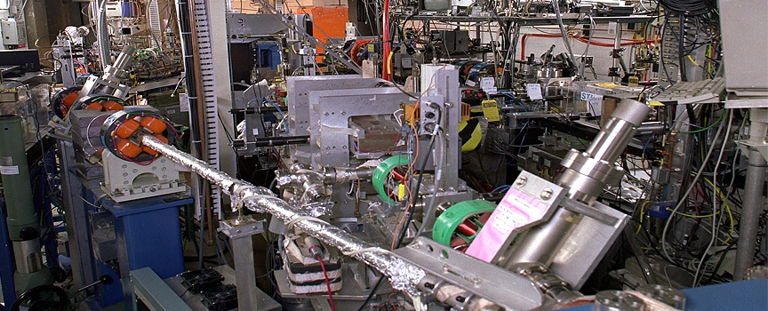








ATF Program Advisory Committee and ATF Users' Meeting 2012
Shock-wave proton acceleration
from a hydrogen gas jet

Slide 2


Collaborators
Imperial College, Laser Plasma Interactions Group
C.A.J. Palmer, N. Dover, Z. Najmudin
BNL, Accelerator Test Facility
I.V. Pogorelsky, M. Babzien, M.N. Polyanskiy,
V. Yakimenko (+postdoc vacancy)
SUSB, Stony Brook University
P. Shkolnikov, N. Cook (+postdoc vacancy)
LMU Munchen/Max-Planck-Institutfur Quantenoptik
J.Schreiber
Laboratoire d’ Optique Applique (LOA), Ecole Polytechnique, France
S. Kahaly, F.Sylla, A. Flacco, V. Malka
Univ. of Strathclyde, UK
P. McKeana, D. Carroll, C. Brenner
Rutherford Appleton Laboratory, UK
D. Neely

Slide 3
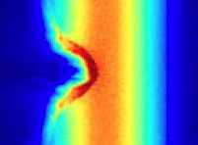

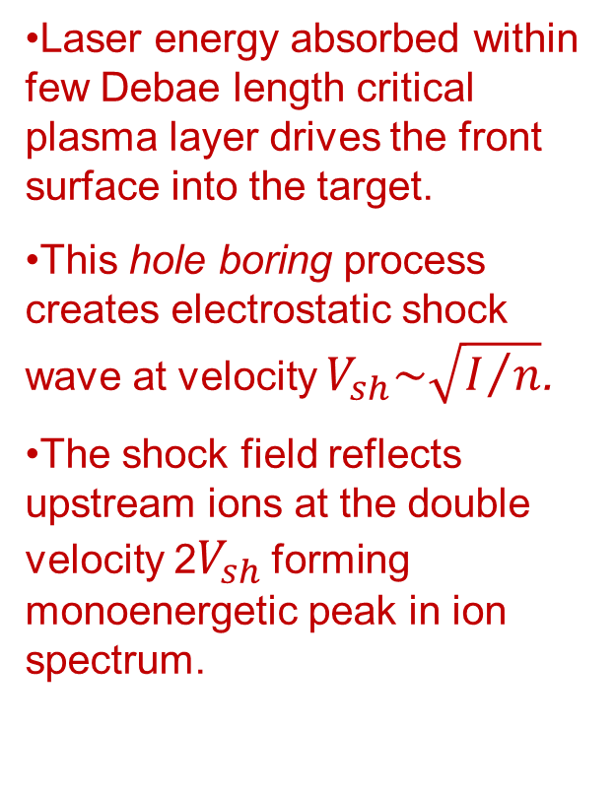
Shock Wave Acceleration
Laser energy absorbed within few Debae length critical plasma layer drives the front surface into the target.
This hole boring process creates electrostatic shock wave at velocity $V_{sh}\sim \sqrt{I/n}$.
The shock field reflects upstream ions at the double velocity 2$V_{sh}$forming monoenergetic peak in ion spectrum.
n_{e}
n_{cr}
laser
V_{sh}
2V_{sh}
V
2V

Slide 4
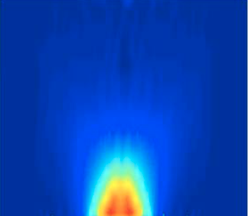
Benefits from combining gas jet with a CO₂ laser
@λ =10 µm, n_{cr} = 10¹⁹ cm⁻³ - 100 times lower than for a solid sate laser. Gas-jets operate at this density region allowing to attain the most efficient regime for RPA and SWA.
Gas jet - pure source (compared to solid targets which become quickly covered in impurities).
Can employ H, He and other species difficult to make in other targets.
Can run at high repetition rate.
Possibility for optical probing of over-critical plasma interactions.
For 532nm, n_{cr} ~ 4x10²¹ cm⁻³ (easy transmitted through the gas jet).

Slide 5
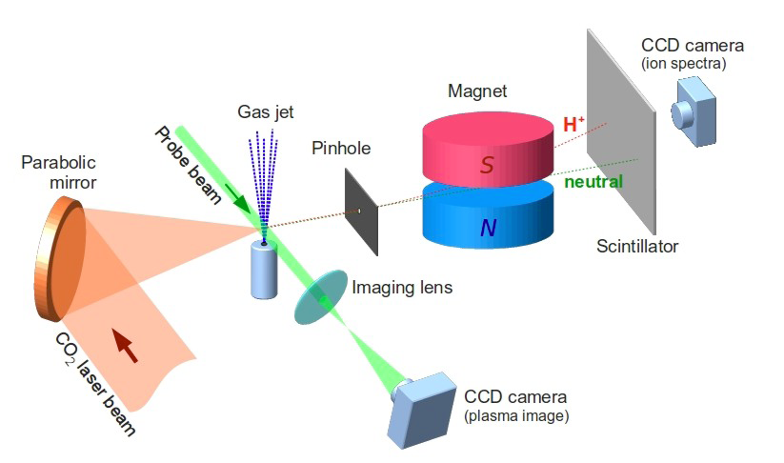
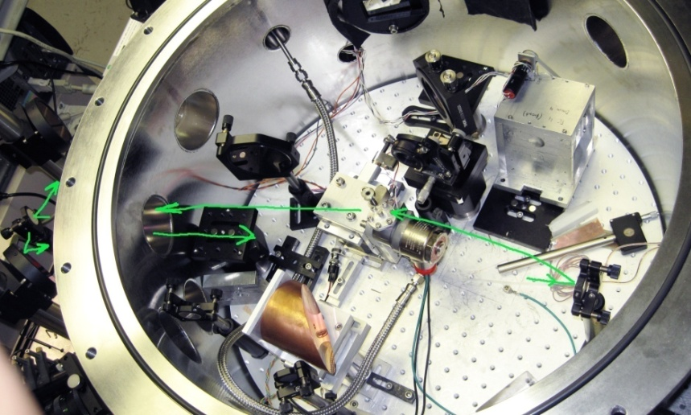
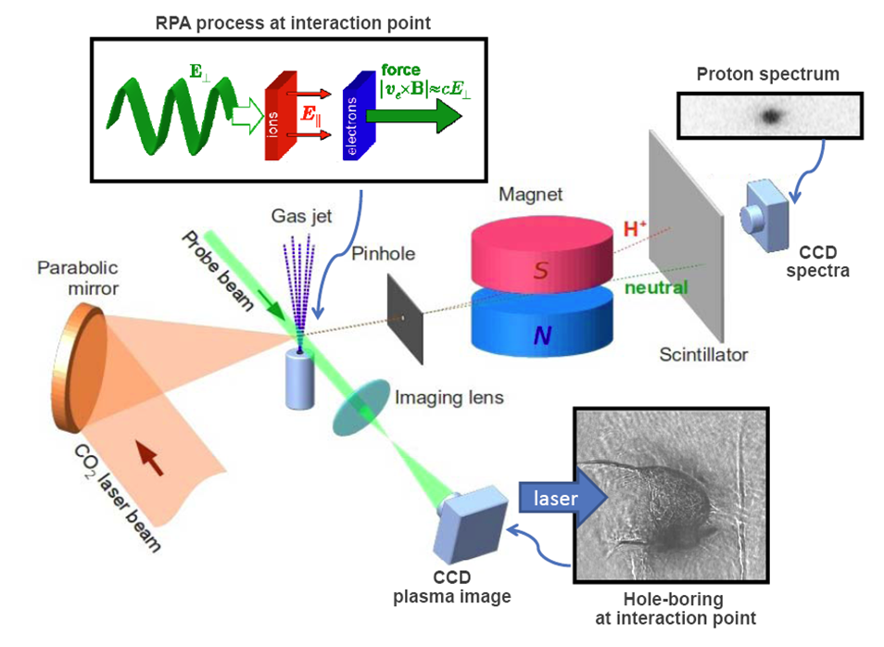
BNL experiment with gas jet

Slide 6
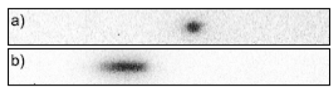

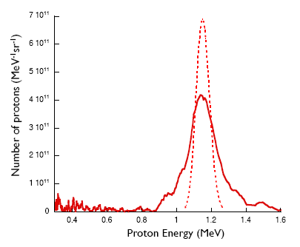
Monoenergetic protons from
Hydrogen gas jet
jet
5% energy spread
5x10⁶ protons within 5-mrad
spectral brightness 7×10¹¹ protons/MeV/sr (300× greater than previous laser- generated ion beams)
foil
deconvoluted
simulation
C. A. J. Palmer, et al, Phys. Rev. Lett. 106 (2011) 014801.

Slide 7
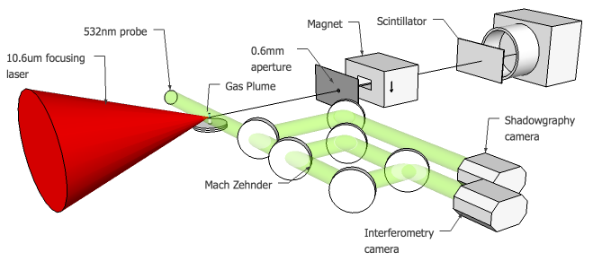
Optical probing
Helium Gas
Shadowgram-> shows d²n/dr²
Interferometry phase map -> shows density line integral

Slide 8
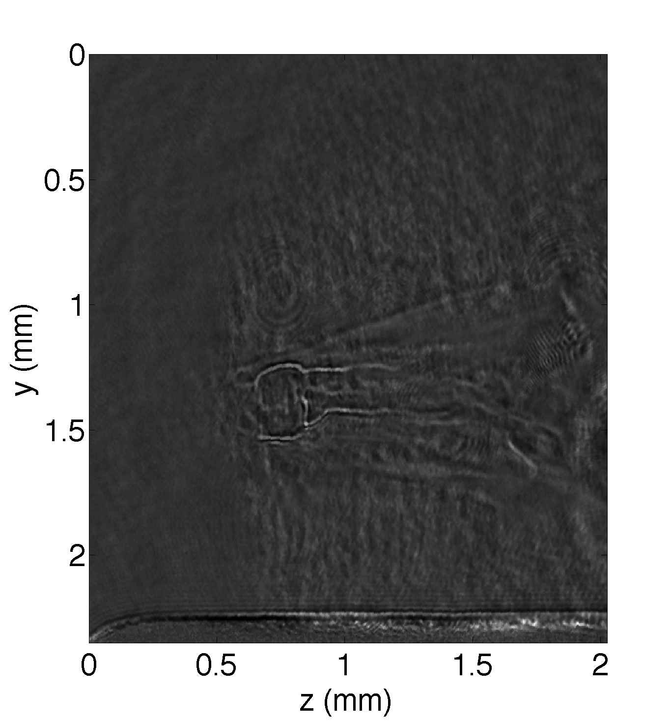
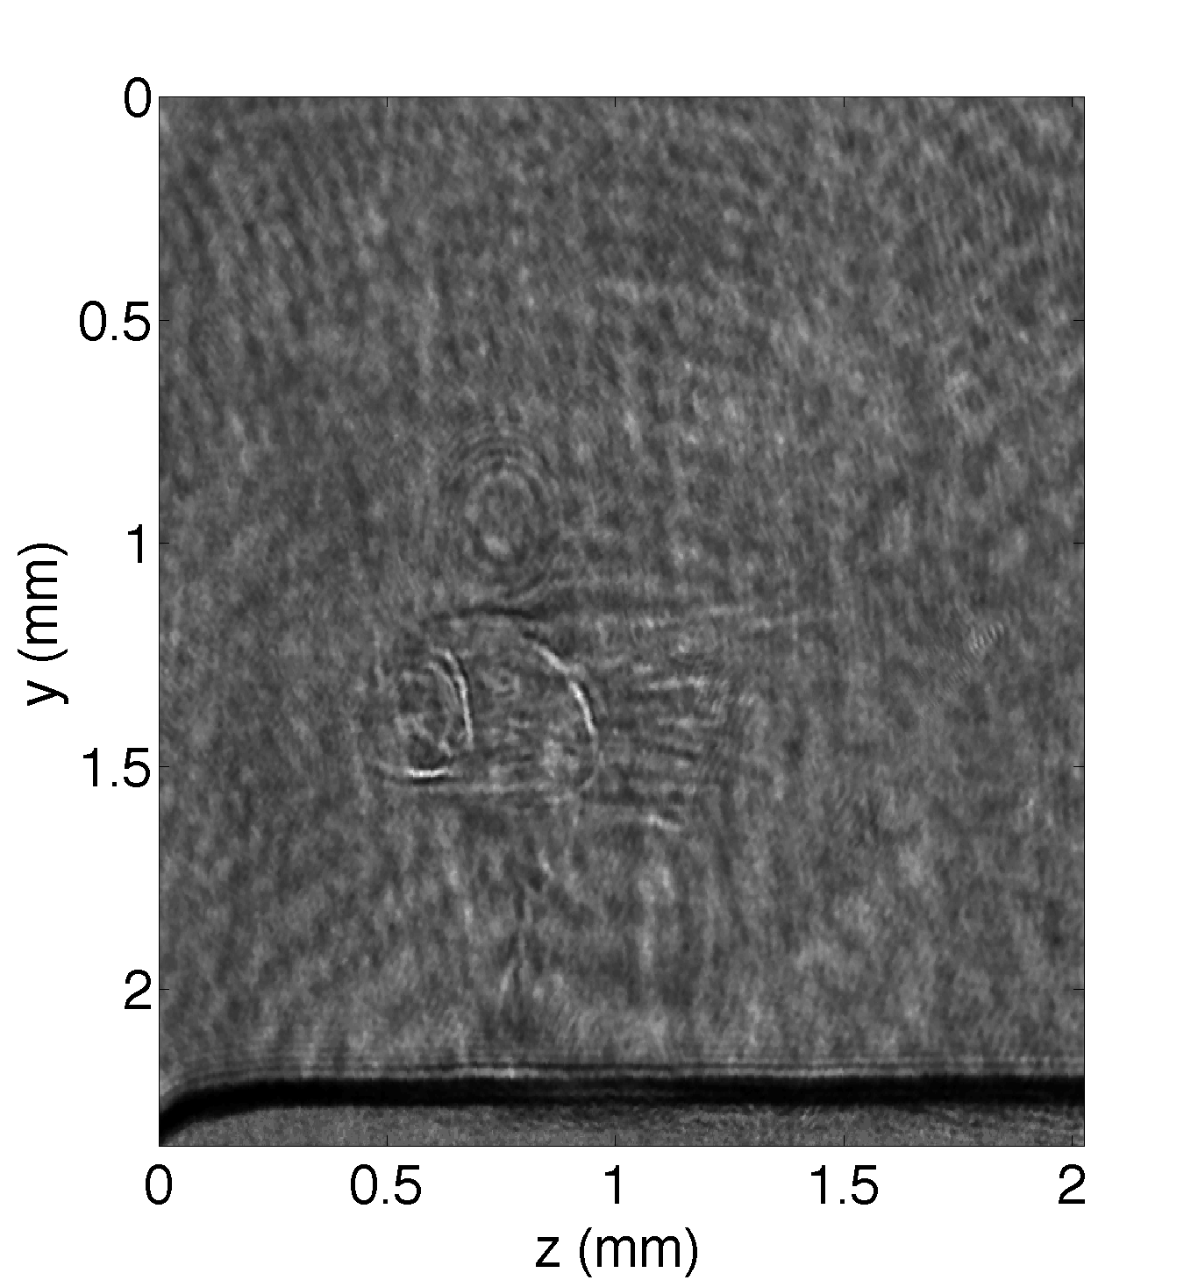
Probe Images
Probe time t_{p} ~ 180 ps afterinteraction
Peak electron density n_{e}=1.8n_{c}
Peak electron density n_{e}=3n_{c}
Helium Gas
Initial critical surface
Sharp density gradient at rear of plasma
Initial critical surface
Nozzle
Nozzle

Slide 9
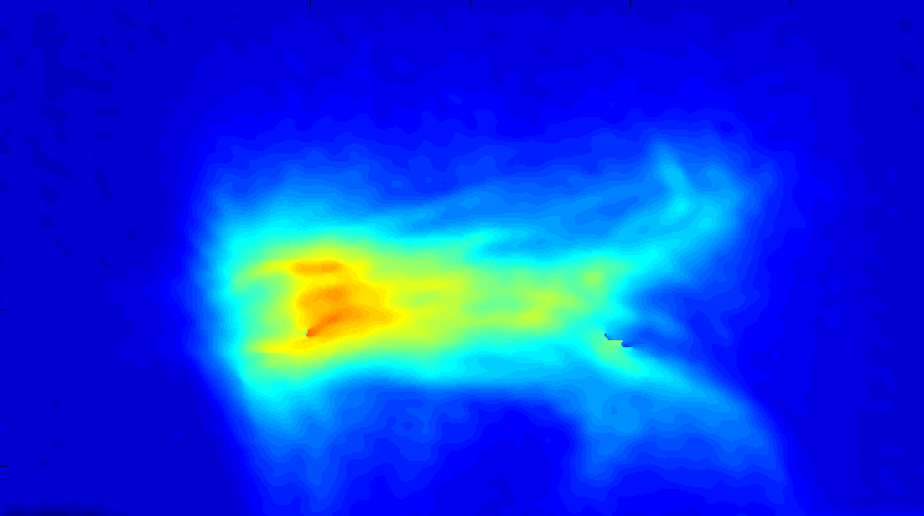
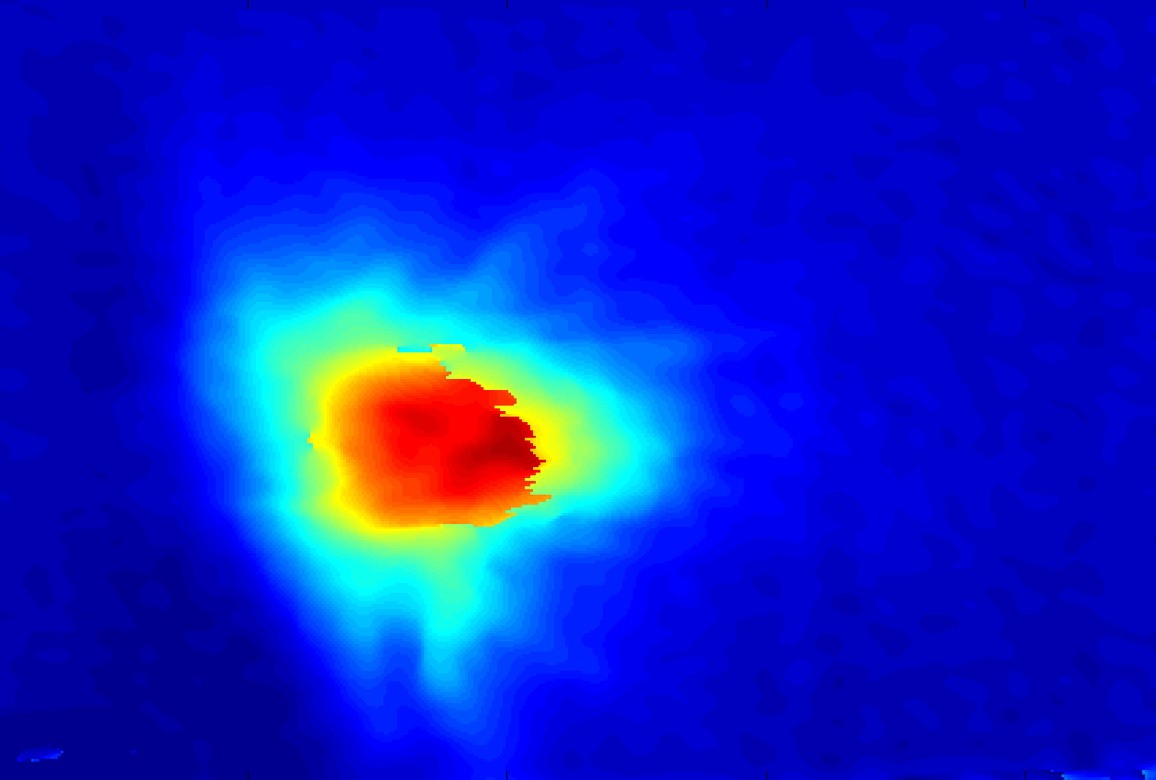
Probe Images
Probe time t_{p} ~ 180 ps afterinteraction
Peak electron density n_{e}=1.8n_{c}
Peak electron density n_{e}=3n_{c}
Helium Gas
Initial critical surface
Sharp density gradient at rear of plasma
Initial critical surface
Nozzle
Nozzle

Slide 10
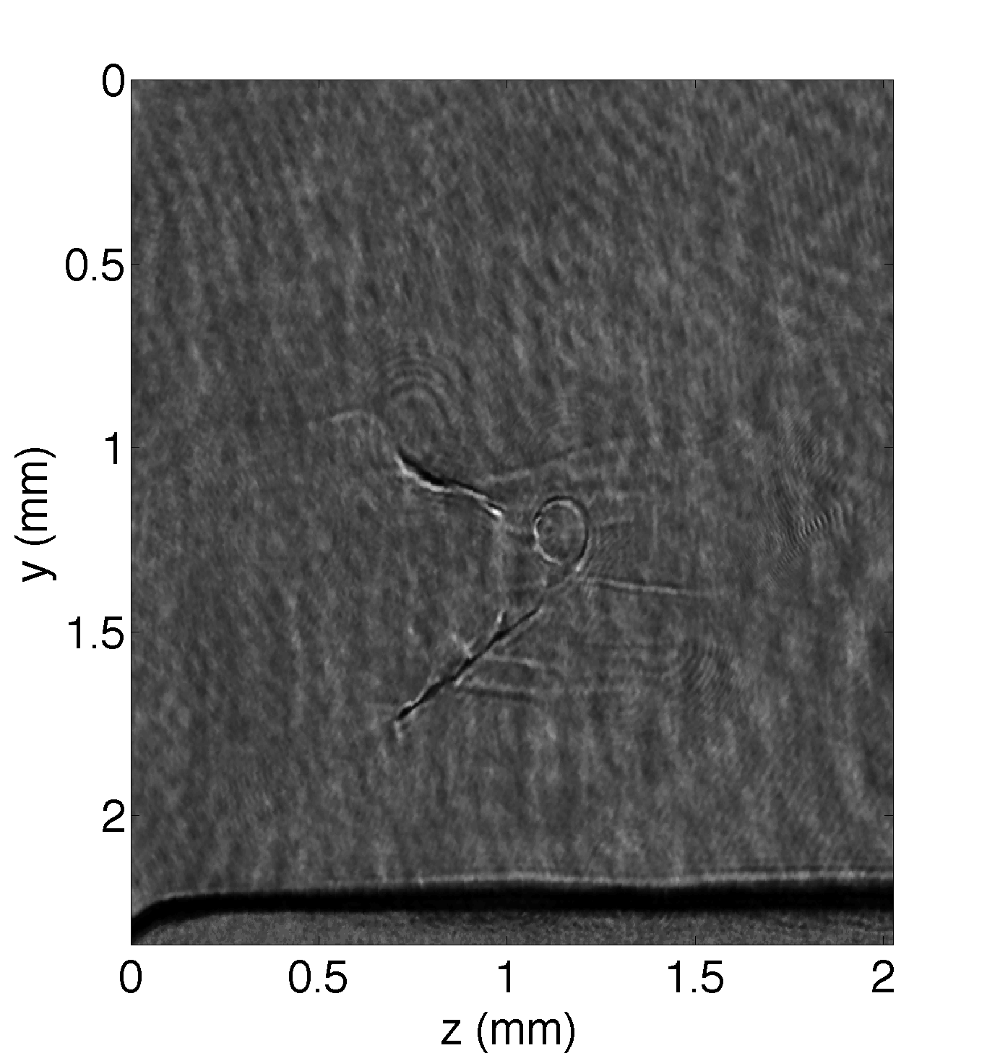
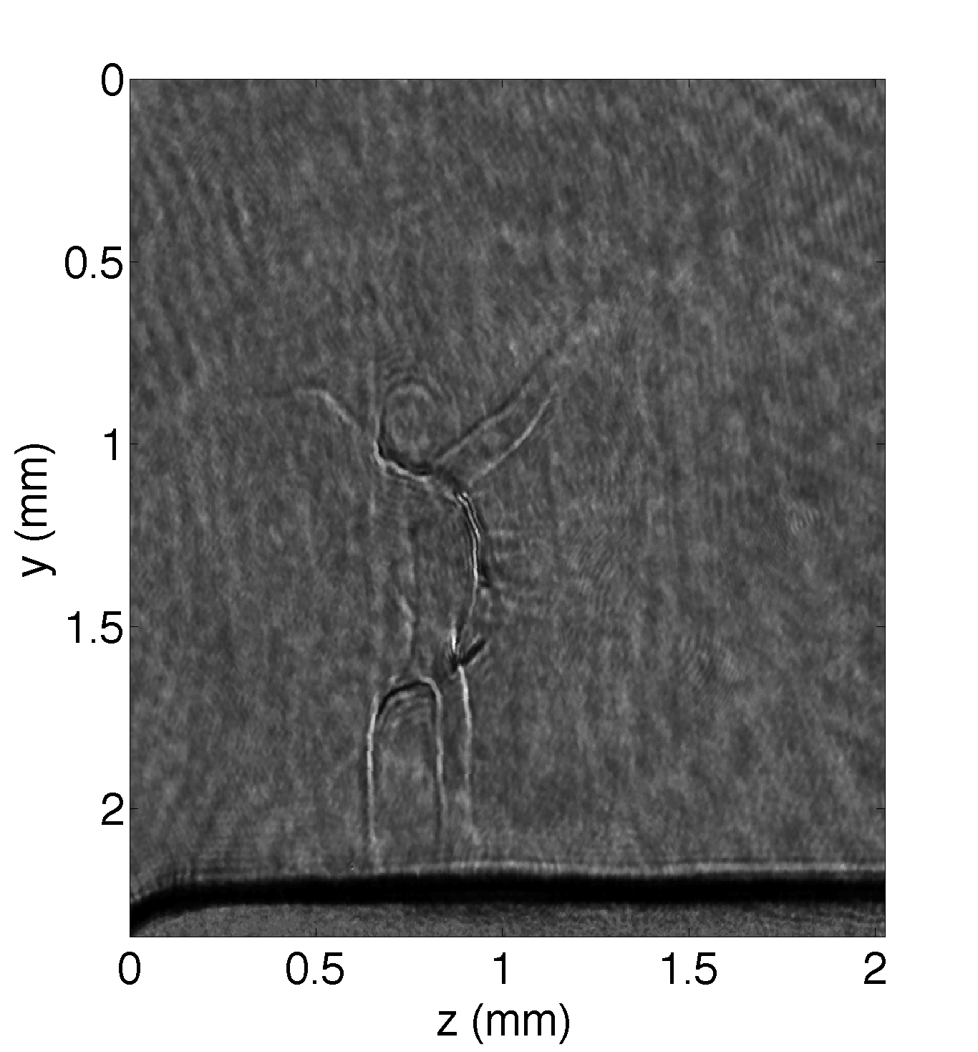
Probe Images
Probe time t_{p} ~ 1500 ps afterinteraction
Peak electron density n_{e}=1.8n_{c}
Peak electron density n_{e}=3n_{c}
Helium Gas
Initial critical surface
Plasma bubble / post soliton
Initial critical surface
Nozzle
Nozzle

Slide 11
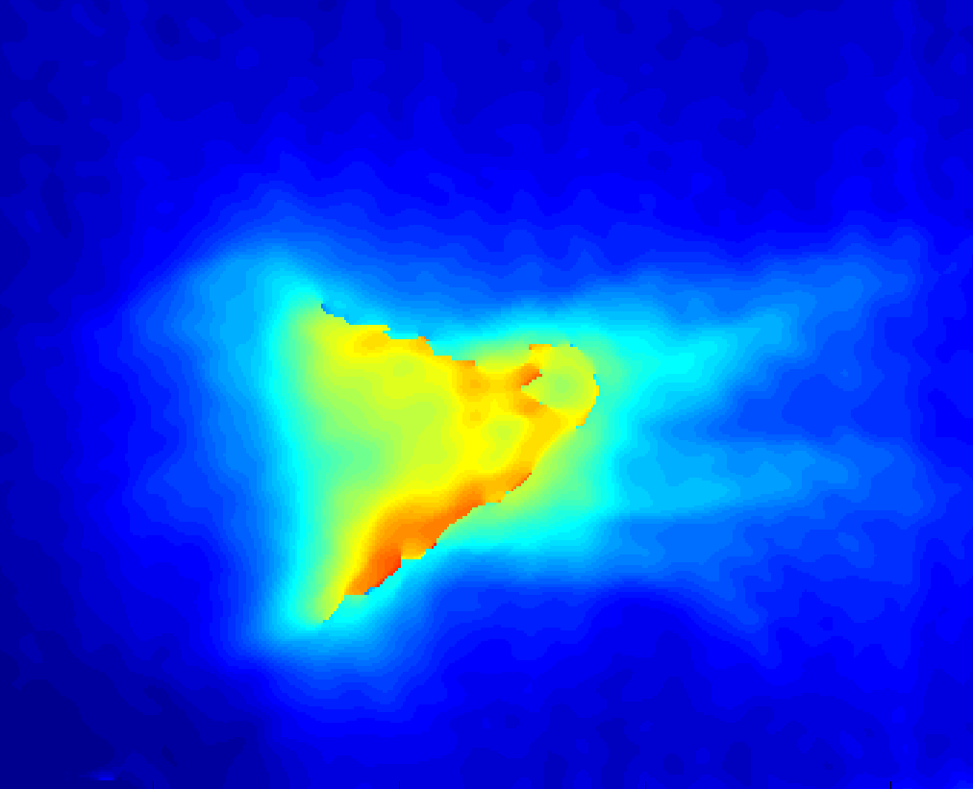
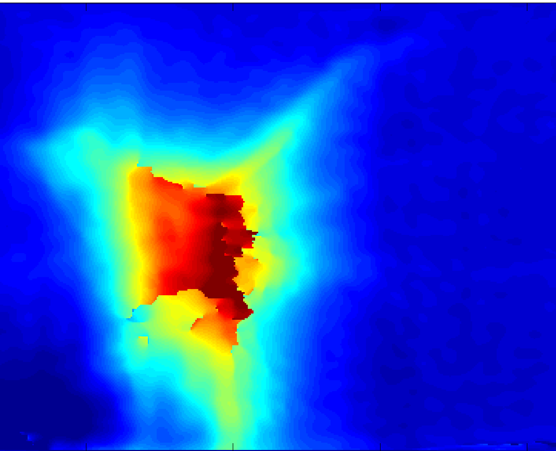
Probe Images
Probe time t_{p} ~ 1500 ps afterinteraction
Peak electron density n_{e}=1.8n_{c}
Peak electron density n_{e}=3n_{c}
Helium Gas
Initial critical surface
Plasma bubble / post soliton
Initial critical surface
Nozzle
Nozzle

Slide 12
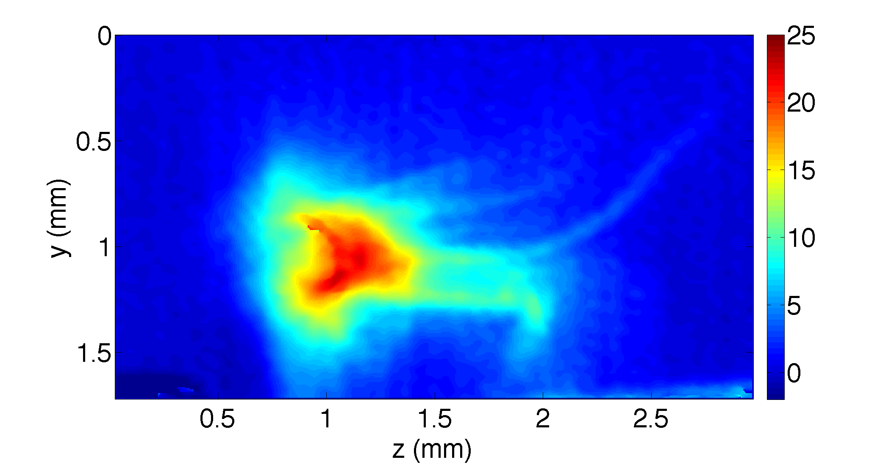
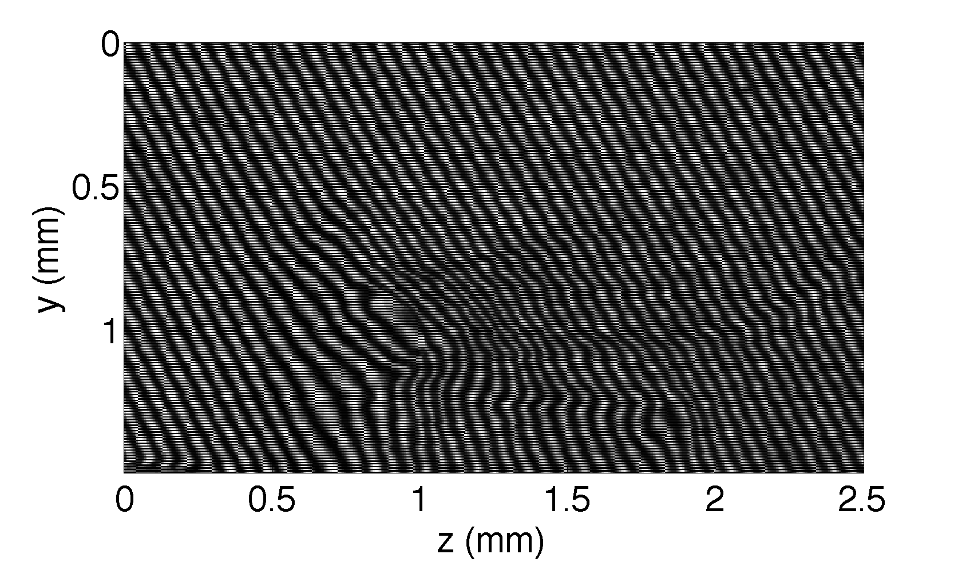
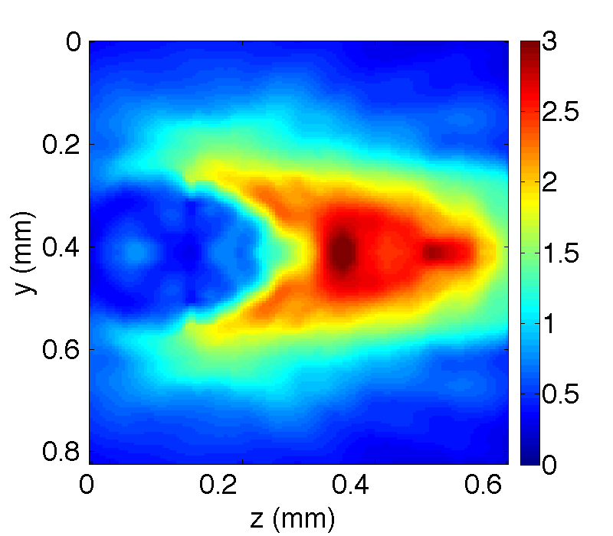
Interferogram processing
Red -> high phase shift
Phase Unwrapping
n_{e}/n_{c}
Phase is related to electron density, so a numerical Abel inversion gives radial density map (assuming cylindrical symmetry)

Slide 13
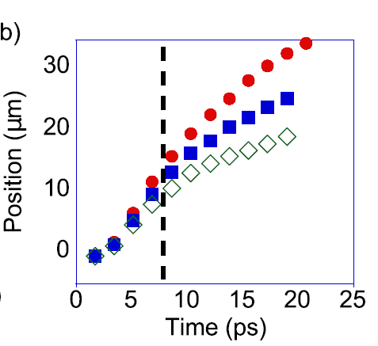
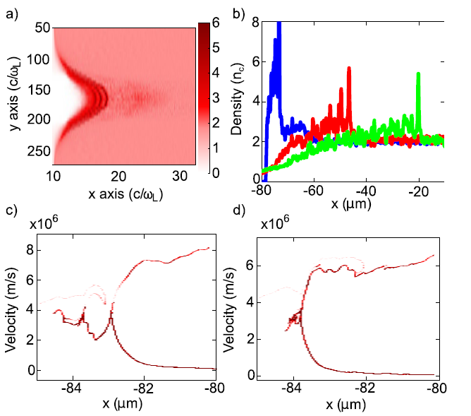
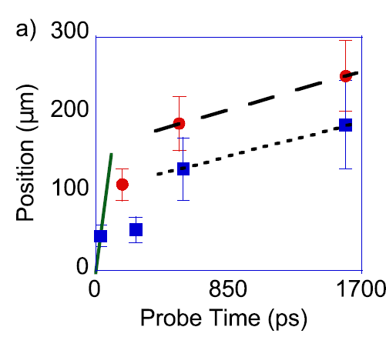
PIC simulations (He²⁺)
Measuring
shock velocity
Plasma density at 9ps
5ps
15ps
30ps
n_{e}=1.8n_{cr}
T_{ei}=5KeV
T_{ei}=1KeV
Ion phase space

Slide 14
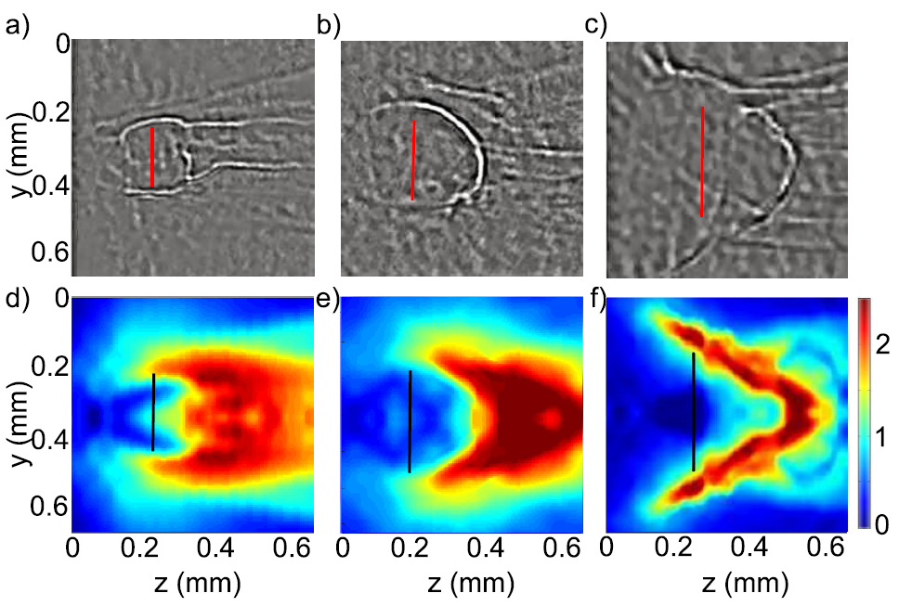
Measuring shock velocity (n_{e}=1.8 n_{cr})
200 ps
500 ps
1600 ps
n_{cr}

Slide 15
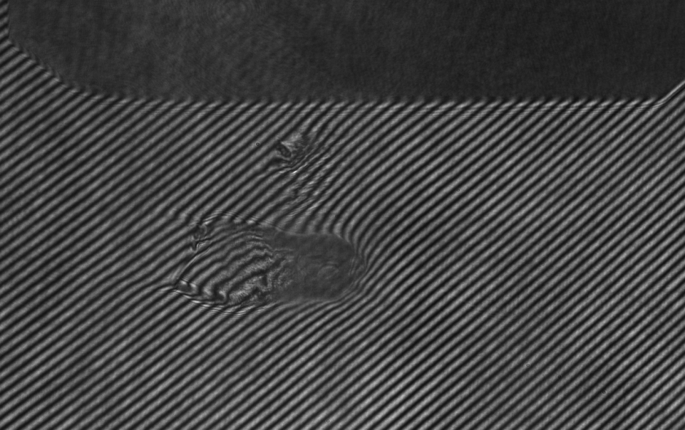
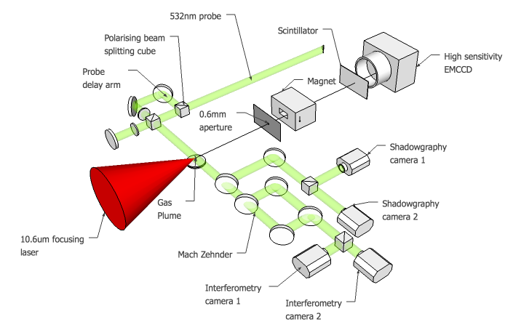
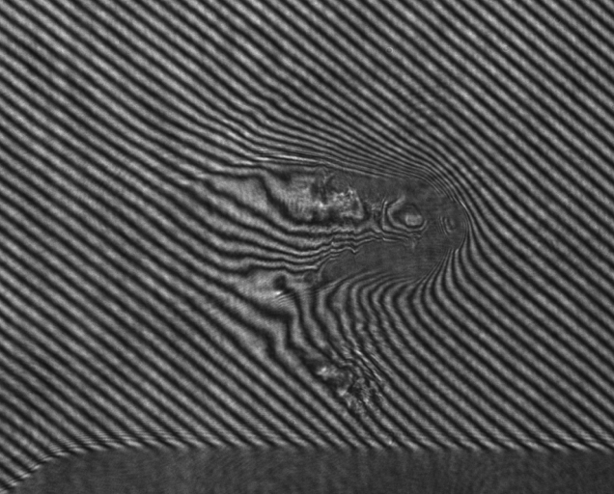
New development: Dual-probe
first results
Probe pulses 200 ps apart

Slide 16



20 ps
20 ps
New development: Dual drive pulses
Regular CO₂ amplifier
Isotopic CO₂ amplifier
Isotopic, dual-pulse
variable
Oscillator
Pockels cell
3 bar pre-amplifier
200 ns
PS
10 ns
Partial
reflector
14 ps YAG
Ge switch
Kerr cell
2×5 ps
5 ps
PS
200 ps
Ge switch
14 ps YAG
10 bar isotopic
amplifier
5 ps SH-YAG
1:1
Pulse splitter
1 TW
8 bar final amplifier

Slide 17
Measuring the azimuthal magnetic field
Still coming….
Motivation
Capturing the rich physics of transport in overdense laser plasma
Correlation of self generated B field with forward ion acceleration
Space resolved time evolution of B field over a wide density range
Measurement of Magnetic-Field Structures in a Laser-Wakefield Accelerator
M. C. Kaluza et al. http://arxiv.org/abs/1007.3241

Slide 18
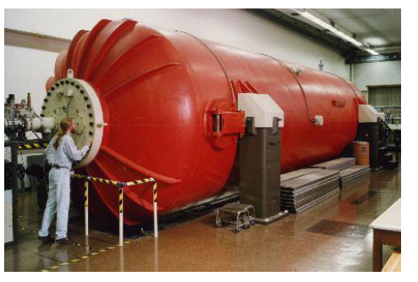
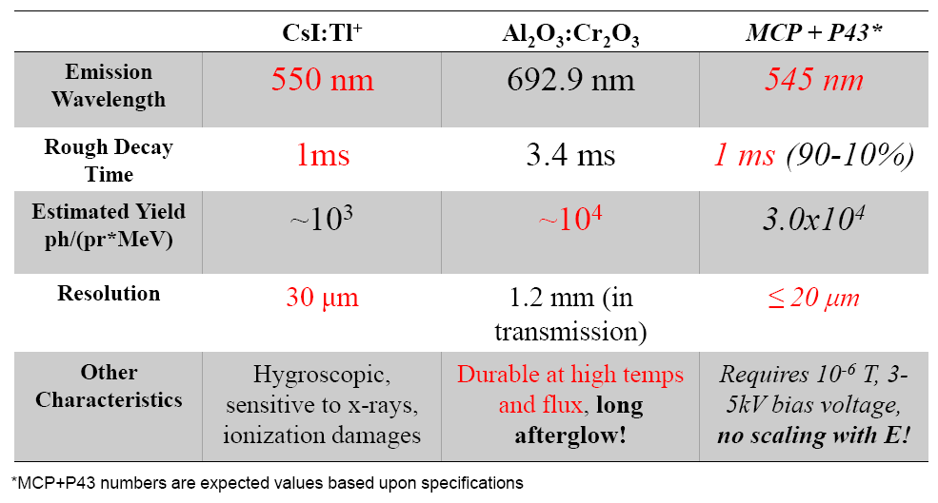
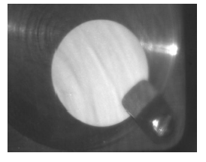
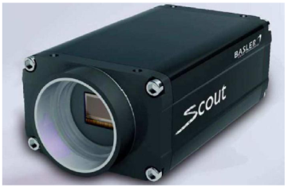
Scintillator Tests at Stony Brook
Tandem Van de Graaf accelerates protons and heavy ions to ~15 MeV/u
Goal: Select a material which best satisfies:
•produces adequate light under impact of a small number (10⁴-10⁶) of mid-energy (1-20 MeV) protons
•Has an adequate resolution to determine beam properties
•Inexpensive and robust for extended use

Slide 19
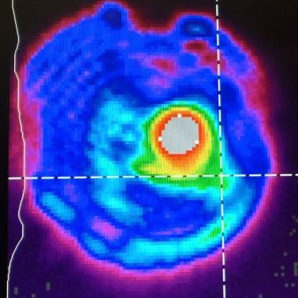
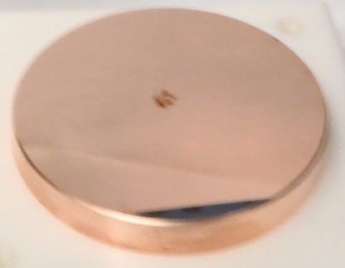
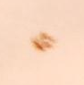


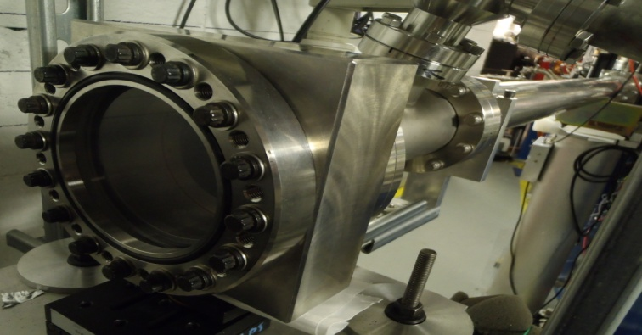
Addressing specific problems: Filamentation
6ps
Spectrum broadening in saturated amplifier implies proportional pulse shortening. This explains severe self-focusing due to Kerr-effect.
6ps
3”
3ps?
~2”
Effective Focal length, z_{f}
Type of Gas | n₂ cm²/W
He | 7.41x10⁻²¹
Ar | 9.67x10⁻²⁰
N₂ | 1.08x10⁻¹⁹
O₂ | 1.52x10⁻¹⁸
refractive index n=n₀+n₂I
Courtesy of S. Tochitsky, UCLA
Possible solutions:
Evacuated beam transport
Stretching/compression

Slide 20
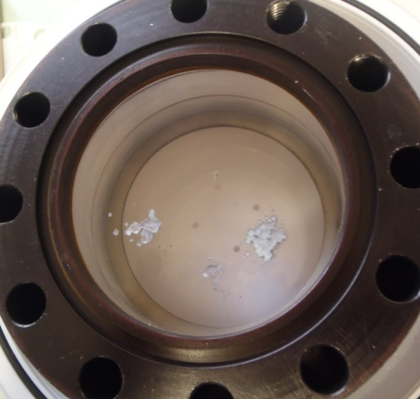
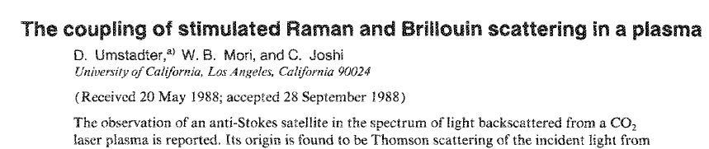
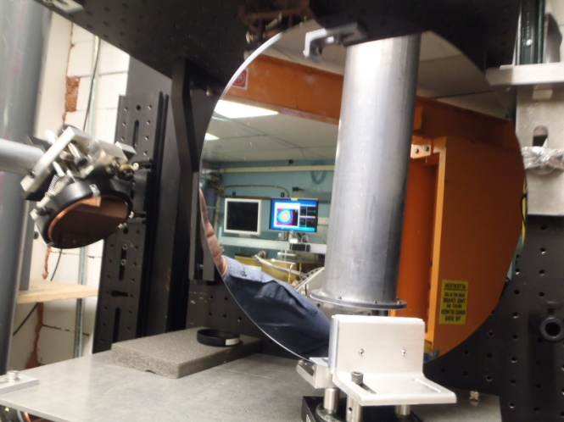
Addressing specific problems: Plasma reflections
Phase-conjugated self-amplified reflection of laser light due to stimulated Brillouin scattering on ion acoustic waves in plasma.
30cm

Slide 21
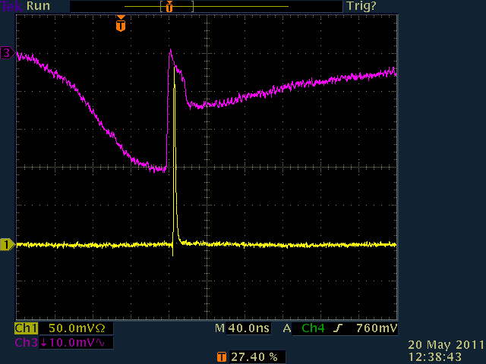
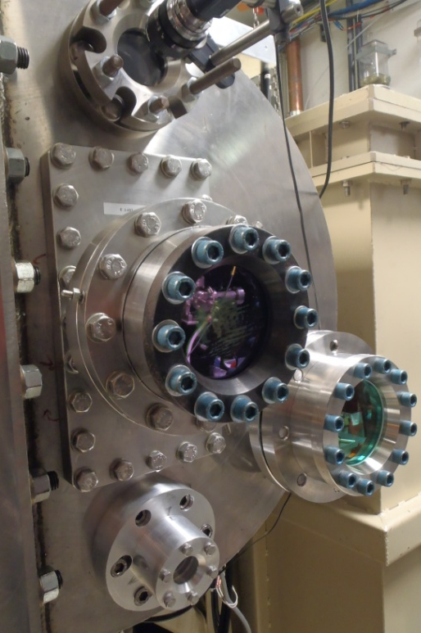
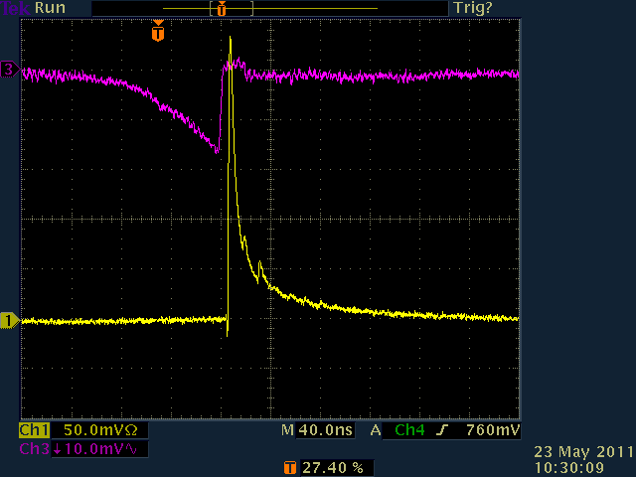
Semiconductor switch
T
Ge / Si
Controlled CO₂
absorption in Si
R
CO₂
CO₂
100 ns
2.5 mJ/cm²
YAG
YAG (1.06 µm)
CO₂
100 ns
5 mJ/cm²
YAG (1.06 µm)
Nonlinear CO₂
absorption in Si

Slide 22
Summarizing
We continue in-depth study of SWA process.
New developments:
  Dual optical probing
  Dual CO₂ laser pulse
  Suppression of filamentation in laser transport
  Suppression of parasitic reflections from plasma
  Scintillator studies (for Thomson parabola)
New resources:
  LDRD grant
  DOE grant to SUNY SB
  2 postdocs coming soon
Ongoing laser power upgrade should result in proportionally higher ion energies.

