Slide 1
The HYSPEC Polarized Beam Spectrometer
Barry Winn, Mark Hagen,
Mark Lumsden, Melissa Graves-Brook
David Anderson, Xin Tony Tong
B2.5, rm G, 3:15-3:30 PM

Slide 2
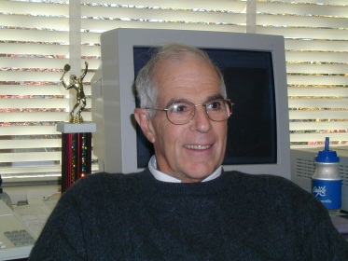
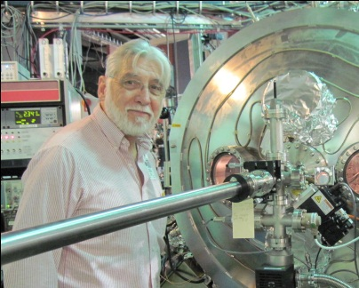



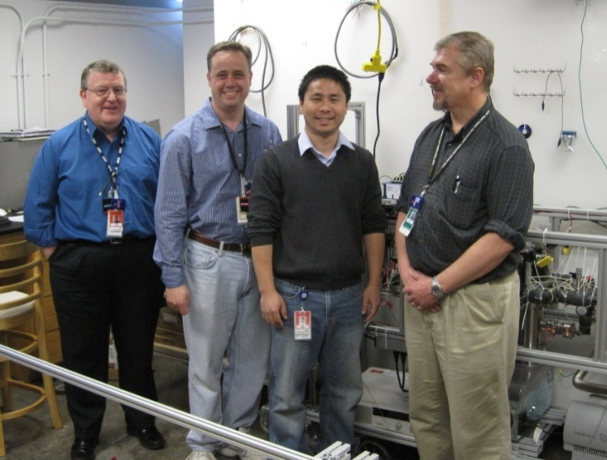
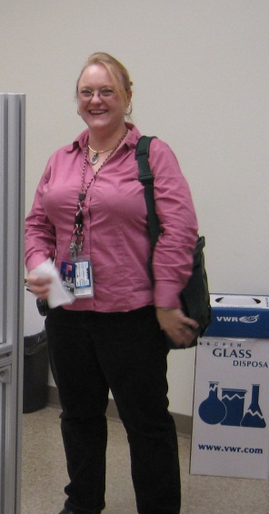
HYSPEC History and People
Initial Proposal:
Principal Investigators &
BNL Engineer:
IDT Executive also includes:
At ORNL:
Instrument construction
complete
Commissioning with
unpolarized neutrons
mostly done
Polarized neutron
commissioning beginning
Steve Shapiro
Bill Leonhardt
Igor Zaliznyak
R. McQueeny J. Rhyne M. Kenzelmann
Mark Barry Tony David
Hagen Winn Tong Anderson
Melissa
Graves-Brook

Slide 3
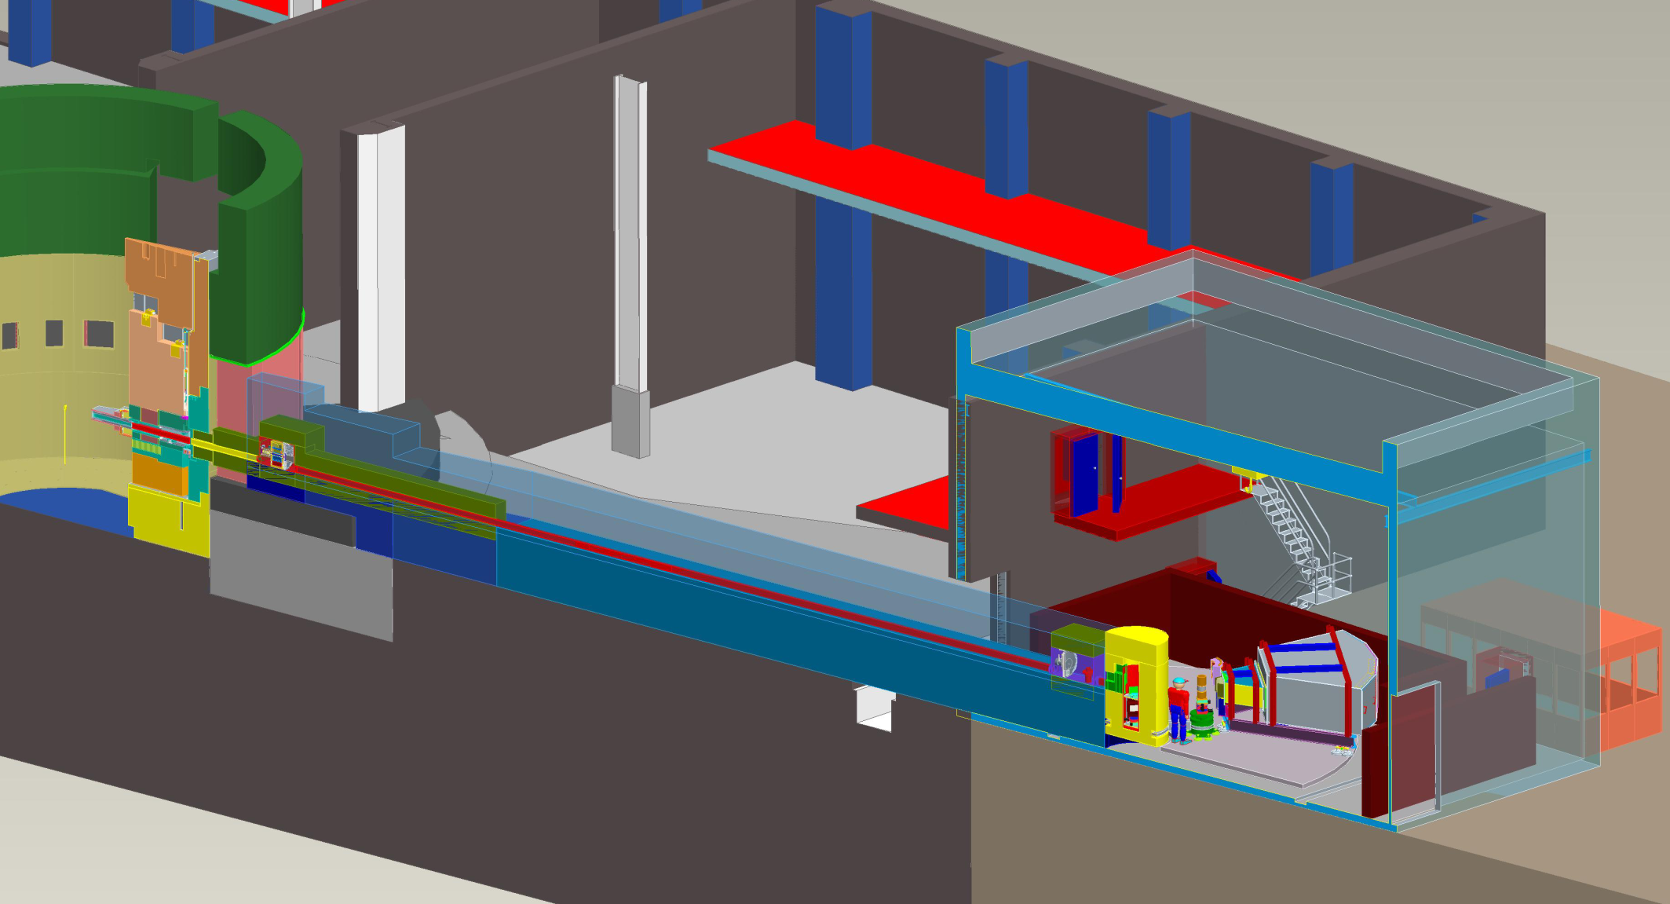
Hybrid Spectrometer: a cross between
A direct geometry spectrometer that selects Ei and E resoultion, and measures variable Ef of scattered neutrons using ToF

Slide 4
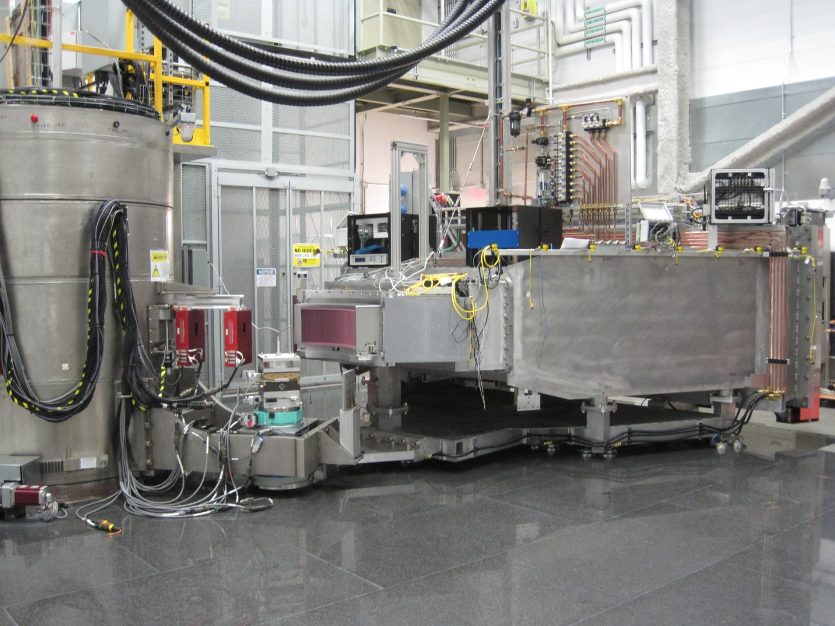
Hybrid Spectrometer: a cross between
…and a
triple-axis spectrometer’s vertical focusing array
and a variable
direction final
flight path
60º x 15º
r = 4.5 m
Ar flight path

Slide 5
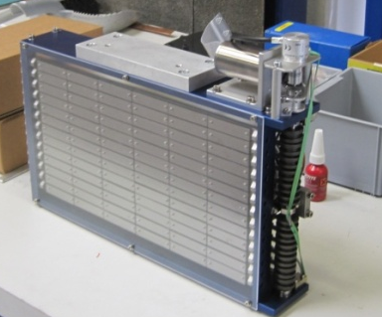
The focusing element focuses neutrons from a vertical trumpet guide system
15 cm high guide, PG focusing array focused at sample with ~2 cm high spot size
Gold foil measurement at sample position,
1.8 m between focus element and sample, Ei=15 meV, Fermi Chopper frequency 180 Hz : 4.2E5 c/s/MW/cm²
Vanadium incoherent isotropic scatter to detector array at 70º
Pyrolitic
Graphite
3.8 meV < Ei < 95 meV

Slide 6
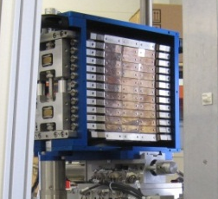
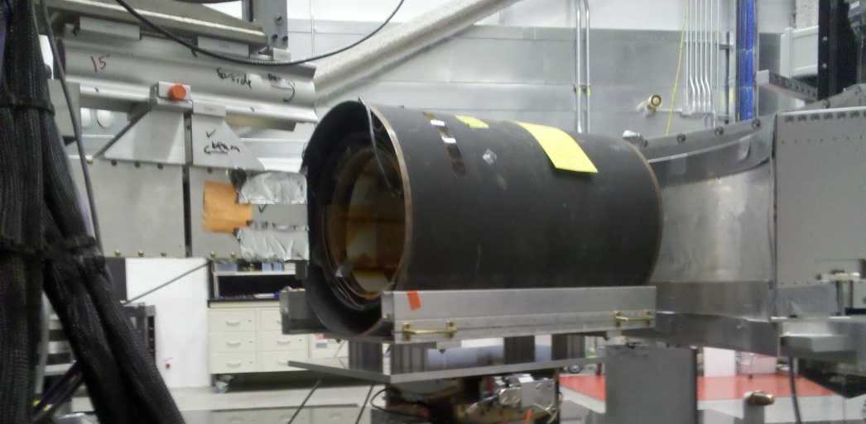
And we have the option to polarize the incident beam with a Heusler crystal array
Heusler
(polarizing)
Energy(meV) | Flipping Ratio of Heusler and guide fields pre-sample
50 | 23.01
14.59 | 25.44
7.5 | 28.41

Slide 7
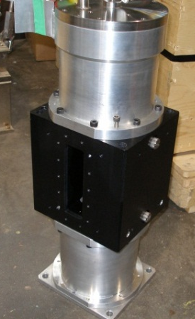
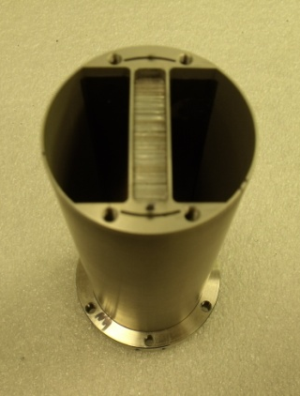
Flux / Resolution tradeoff using Fermi Chopper
Frequency
Straight-blade Fermi chopper,
30-420 Hz
V rod 6.4 mm diameter

Slide 8
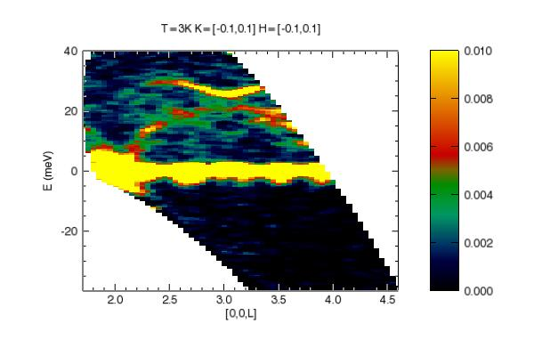
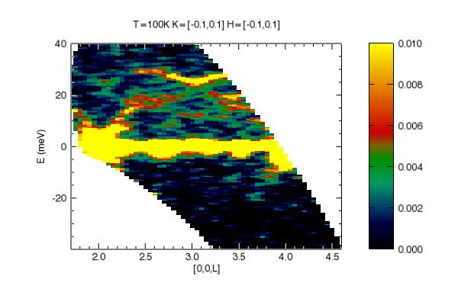
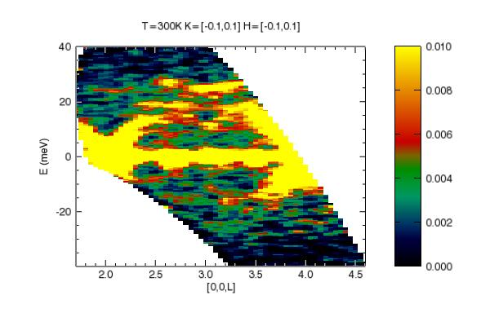
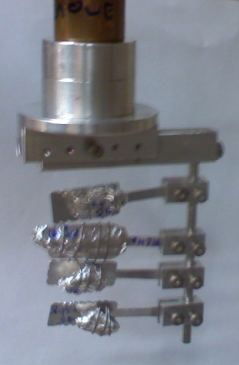
Useful to study phonon excitations on single crystals
FeSb₂, Ei=51.58 meV, Fermi chopper 420 Hz, High Detector Vessel angle,
Multiple sample θ, 30 min/angle, Mantid to NxSPE, Dave Mslice: T=3, 100, 300 K
I. Zaliznyak (BNL), A. Savici, A. Christianson, B. Winn, M. Hagen, R. Hu and C. Petrovic (in preparation)

Slide 9
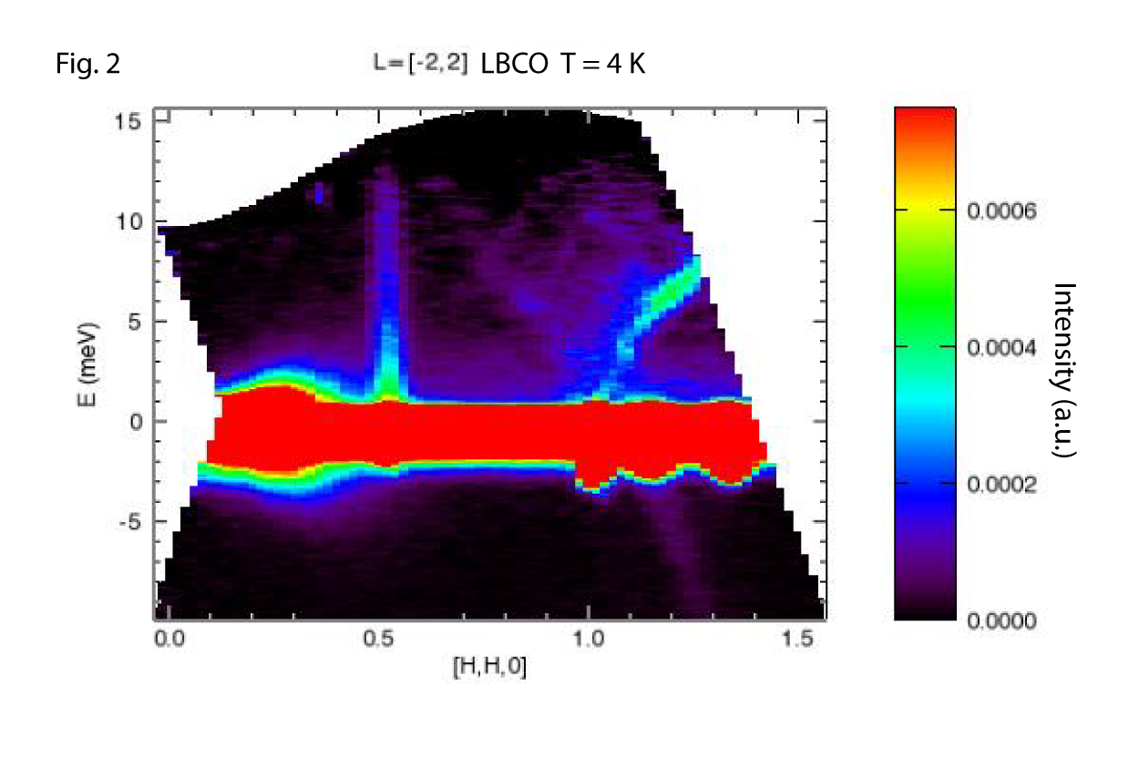
Or magnetic excitations in single crystals or powders
Very dispersive magnetic excitations in the ground state of the quantum magnet La(2-x)Ba(x)CuO4 with x=0.025 can be seen emanating out of ~ 1/2 1/2 L. These particular data, taken with HYSPEC at T=4 K, integrate over much of the direction normal to L, that is normal to the two dimensional copper-oxide planes in this layered magnet. These spin excitations are gapless and are known to extend to very high energies (~ 200 meV). Acoustic phonons can also be seen emanating out of the nuclear zone centers near 11L.
K. Fritsch, B. Gaulin (McMaster U), in preparation

Slide 10
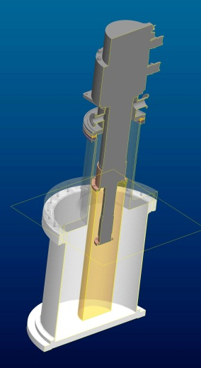
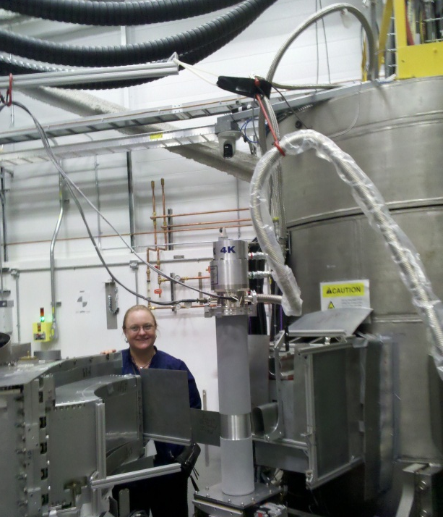
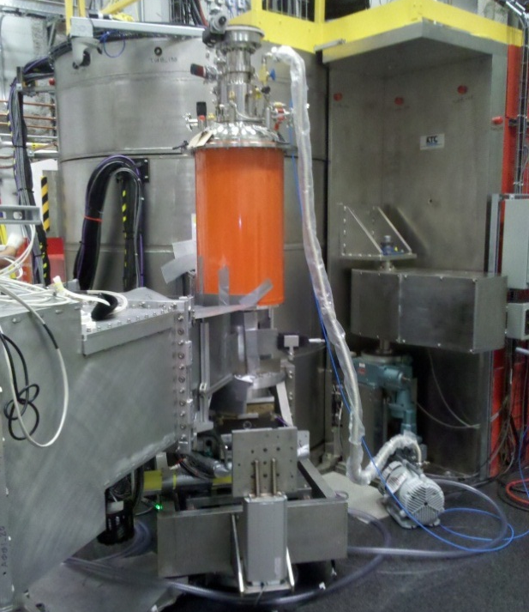
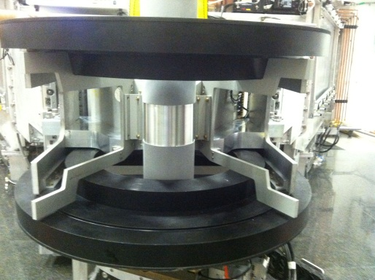
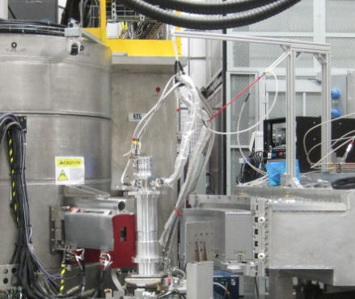
Getting ready for your samples
Dedicated
Cryostat
Larger OVC’s and new heat shields for both CCR’s
Spare CCR
Dedicated closed cycle refrigerator compatible with ³He polarization analysis

Slide 11
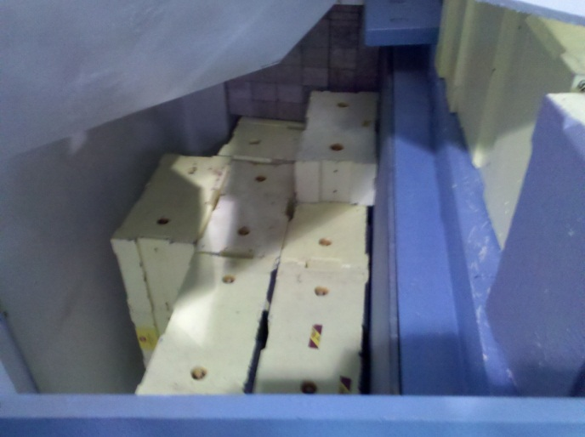
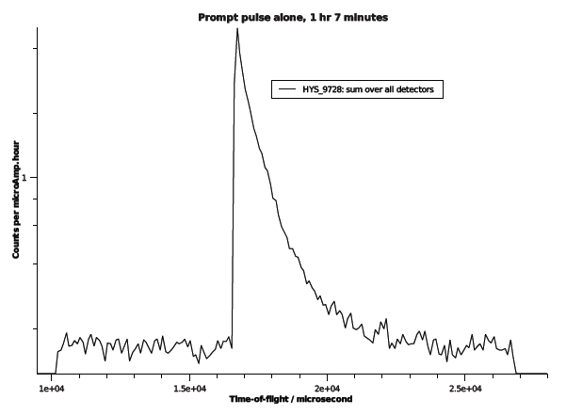
Minimizing background…
70% already removed by shielding BL 10 near monolith
One frame shown (1/60 sec), with HYSPEC shutters closed
Leading edge coincides with subsequent spallation events
Tail is epi-cadmium
(>500 meV)
Ei not yet useful at
4 meV, 9 meV and
27-38 meV
STILL HUNTING!

Slide 12
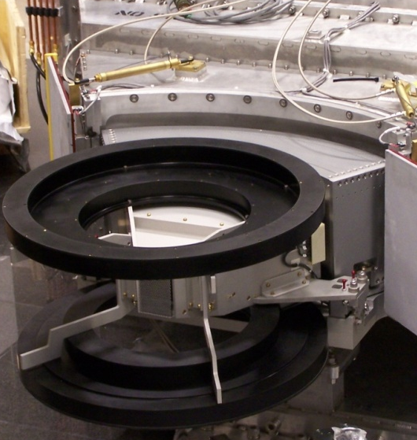
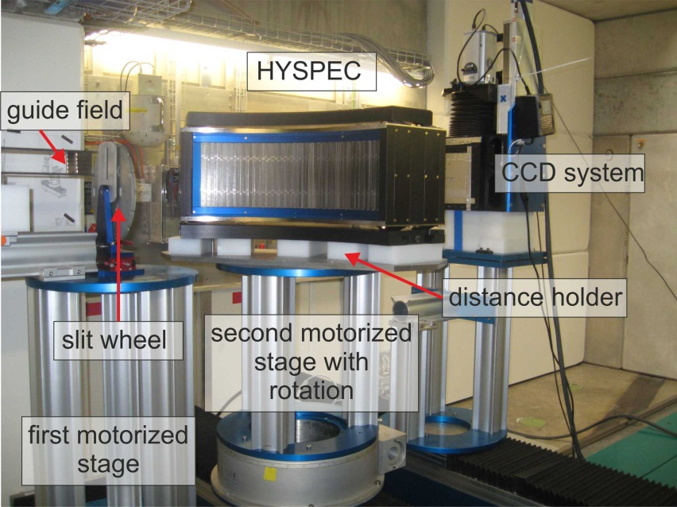
And preparing to commission for polarization analysis
Option 1: 3He polarization analyzer
and Filling Station
Option 2: Polarizing supermirror
array from PSI
Status: See T Tong’s talk, Wednesday at 11:00 AM, B4.2, and D. Brown’s poster Tuesday at BP2.8

Slide 13
Summary
Unpolarized commissioning mostly complete
Polarized commissioning has begun
  Through spring 2013
Limited availability in user program in spring 2013
  Unpolarized neutrons only
Expanding Instrument Team at ORNL

Slide 14
It takes a village
Engineering & Design
  J. Terrell, R. Huerto
Installation
  R. Connatser, S. Proffitt
  D. Engle, W. Dawkins, C. Fletcher, S. Vasques, J. Brackett
  HAZELWOOD
Electrical & Controls
  J. Moss, R. Saethre
  A. Groff, R. Morgan
  Research Mechanics
Interlocks & Safety
  P. Wright, J. Proulx
  G. Rowland, P. Abston
Vacuum
  J. Price, C. Stone, R. Morton
Choppers
  W. McHargue, J. Garrett
DAS
  A. Parizzi, T. Thompson, G. Greene, M. Ruiz-Rodrigues
  M. Yao, J. Kohl, M. Sundaram, P. Zivanovic
Data Reduction & Analysis
  S. Campbell, A. Savici

