Slide 1
Early Career Resource Group

Slide 2
Overview
ECRG At-a-Glance
Membership and Mission Statement
ECRG History
Our Concerns
Current Activities and Looking Forward
Group Actions
Plans for the Future
Resources to get Involved

Slide 3
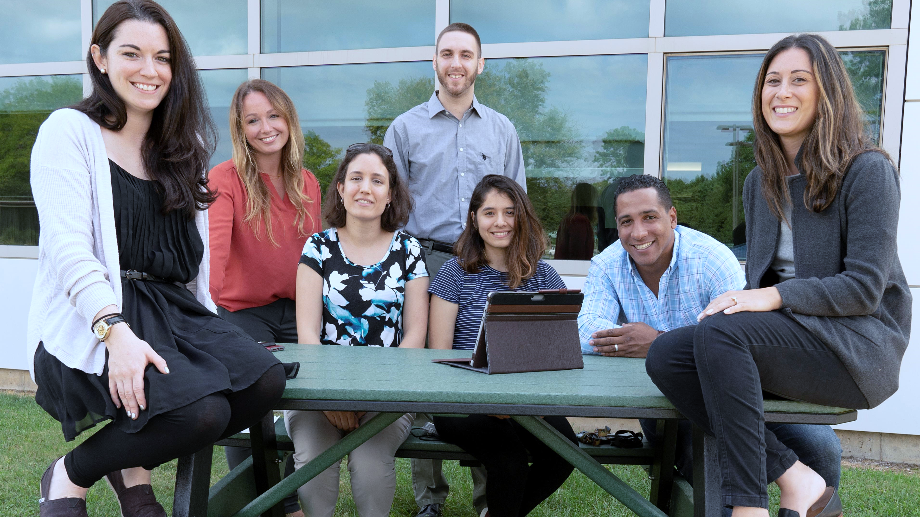
Who We Are
We are a group of employees who represent the Laboratory’s next generation of leaders, scientists, and support staff. Many of us are new to the Lab or new to our fields/positions at the Lab, while others are experienced staff who are interested in supporting and building collaborative relationships with the Lab’s next generation.

Slide 4
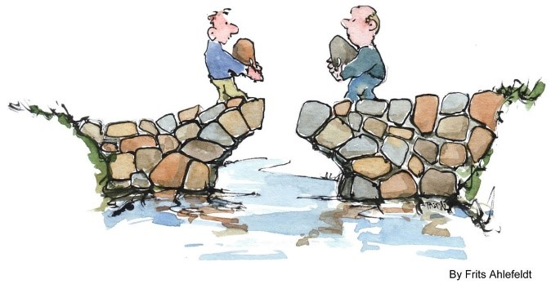
What’s Our Goal?
Our mission is to proactively prepare for the growth and development of future leaders at all levels at BNL by:
Attracting the talent and insight of diverse perspectives;
Retaining talent through an inclusive environment;
Developing talent through professional growth opportunities and transferring the pipeline of knowledge; and
Promoting collaboration between early career scientific and support staffs by providing a platform to discuss issues and propose ideas for the future

Slide 5
ECRG: A Brief History
Grassroots, employee driven effort in December 2018
Premise of our group is based on the results of a staff-created survey and collective concerns for the Lab’s future
The importance of our group is echoed by management in FY19 Inclusion & Diversity Plan:
“BNL’s aging workforce drives the need for the Lab to recruit new talent and develop the early career workforce…A new ERG for the early career workforce was established and is expected to help leadership better understand recruiting, retention, and quality of life issues for early career talent.”
Notes:
Based on feedback from staff-created survey collected from early career employees and collective concerns for the Lab’s future, with a wave of retirements on the horizon

Slide 6
What Are Our Concerns?
Difficulty attracting early career staff
Lack of professional growth and career development opportunities
Reduction of work-life benefits that are attractive to staff
Lack of participation in social activities/clubs/sports
Issues with acceptance of flexible work schedules (varies by department) and grade restrictions
Lack of Business Agility
Notes:
As megan mentioned we have a hot button list, it’s a live document and always changing.
Our main concerns are about actracting early career staff,
Growth and professional development, worklife balance, bera clubs, flexible work schedles, and business agility
So you can see while some of our ocncerns can be uniquew to young early career employees: ie child care, we have a lot of overlap with the general concerns of the lab community like sucession planning.

Slide 7
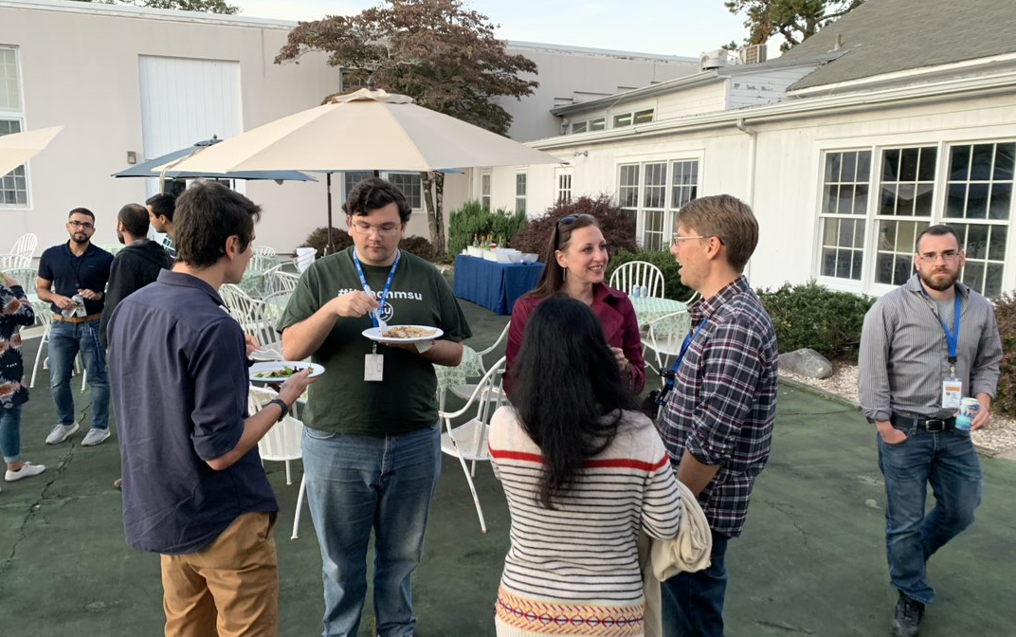
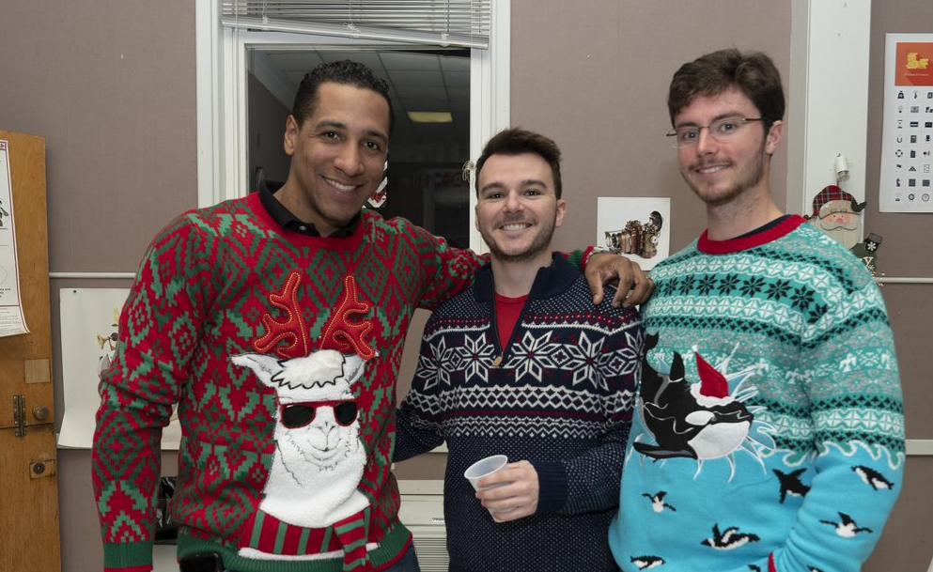
What We Do
Discussion: We host group meetings to discuss issues/ideas and provide a pipeline to senior leadership.
Networking: We coordinate social/professional networking events to help build an early career workforce community, foster retention and bridge the gap between the science and support.
Notes:
How to we keep up with peoples concerns?
Bimonthly well-attended general member we participated in
What do we do with this information?
The whole idea is that ECRG helps to act as a pathway for people’s voices to be heard by Laboratory leadership.
Quarterly I&D Management Steering Committee meetings
Culture IQ Survey Focus Groups
External Advisory I&D Meetings
Rebranding Initiative Focus Groups
Networking: Coordinated well-attended social/professional networking events to help build an early career workforce community, foster retention and bridge the gap between the science and support staff.
Monthly offsite social networking events
Onsite end of fiscal year BBQ, including Lab leadership attendance

Slide 8
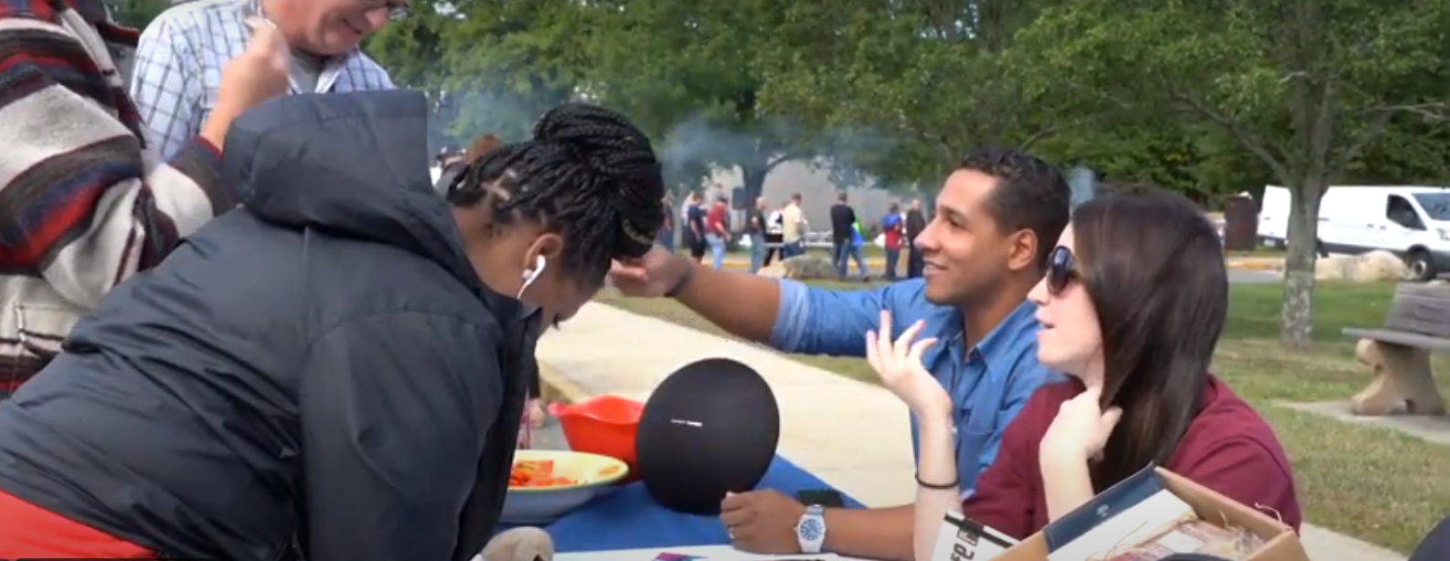
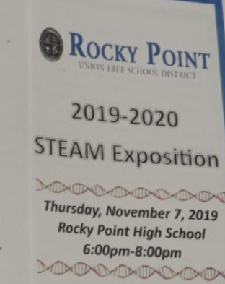
What We Do
Outreach: We coordinate outreach events with the local community. We participate and promote BNL internal events.
Resources: We provide information to members on work/life balance and professional development at BNL, as well as other resources and relevant current events.
Notes:
Outreach: Coordinated outreach events with the local general and academic community and promoted BNL internal events.
Alive B4 5 activities fair
Developed ECRG brochure also utilized during new-employee orientation
Habitat for Humanity builds
Rocky Point School District STEAM Night
Stony Brook University Career Fair
Long Island Association- Young Professionals Committee Meetings
Resources: Provided information to members on work-life balance and professional development activities at the Lab, as well as other resources and current events.
Discovery Park and Upton Square
Microsoft Teams
BNL’s Mentoring Program

Slide 9
Plans for the Future
ECRG’s goals for the coming years will focus on:
Growing membership and support
Hosting guest speakers and trainings
Promoting awareness for the BNL mentoring program and mentoring opportunities
Hosting professional development courses
Collaborating with similar groups at other DOE Laboratories
Collaborating with HR to explore potential cross-training program.
Continuing to provide a platform to discuss “hot button” issues
Notes:
ECRG’s goals for the coming years will focus on:
Growing membership and support through continued collaborative events and outreach
Hosting guest speakers and trainings that align with ECRG’s vision
Assisting in promoting awareness and advising for the BNL mentoring program and other mentoring opportunities
Exploring opportunities to host professional development courses at BNL
Exploring opportunities to collaborate with similar groups at other DOE Laboratories
Collaborating with Human Resources in growing the next generation of staff at BNL. Exploring the potential for a early career cross-training program.
Continuing to provide a platform for the early career staff and its supporters to discuss “hot button” issues, including inclusion and diversity and facilitating a pathway to senior leadership

Slide 10
Want to get Involved?
Contact us:
bnlecrg@bnl.gov
ECRG SharePoint Site:
https://brookhavenlab.sharepoint.com/sites/ecrg

Slide 11
Questions?

