Slide 1
Proposal ID:UEDE-Beam-308095
Intelligent laser control with uncertainty quantification for electron beam generation.
PI: Aasma Aslam
Collaborators: University of New Mexico (Mariana A Fazio, Salvador Sosa Guitron, Sandra Biedron, Manel Martínez-Ramón), Brookhaven National Laboratory (Marcus Babzien)
Funding source:
Center for Bright Beams (CBB), support of the National Science Foundation and Technology Center (NSF), Status: Funded.

Slide 2
Founding source: Center for Bright Beams (CBB).
Status: Funded.
We have funding from the Center for Bright Beams (CBB), support of the National Science Foundation and Technology Center (NSF), and collaborations with BNL, we will research and develop intelligent controls of the drive laser systems to better control the output from high-brightness photocathode RF electron guns.
This research used resources of the Brookhaven National Laboratory's Accelerator Test Facility (ATF), which is a DOE Office of Science User Facility. Additionally, this research used resources of the Argonne Leadership Computing Facility, which is a DOE Office of Science User Facility.

Slide 3
Two DOE facilities are involved: ATF and ALCF
Accelerator Test Facility (ATF)
Argonne Leadership Computing Facility (ALCF)
The combination of machine hardware, advanced computing for simulation, and data science for surrogate modelling, training of neural networks and data analysis is inspired by our past work and our participation on DOE meetings, workshops and reports such as AI for Science (https://www.anl.gov/ai-for-science-report).
Notes:
We expect to collect data from the virtual cathode (images), from the energy meter, from the available downstream electron-beam diagnostics to incorporate into our learned model.

Slide 4
Requirements and Hazards
Special equipment
Adaptive optics
Specific Hazards
The ATF class 4 drive laser presents an eye damage hazard as a result of direct, diffuse or indirect beam viewing.
All laser work envisioned for this experiment will be consistent with the hazard controls already in place and documented for the facility drive laser.

Slide 5
Experimental Time Request
CY2021 Time Request
Capability | Setup Hours | Running Hours
ATF Facility | 30 | 60
Time Estimate for Remaining Years of Experiment (including CY2021)
Capability | Setup Hours | Running Hours
ATF Facility | 30 | 60

Slide 6
Overall goal
Improved electron beam quality from the photocathode gun by AI-enhanced control of the drive laser.
It’s a one year research project with CBB funding.

Slide 7
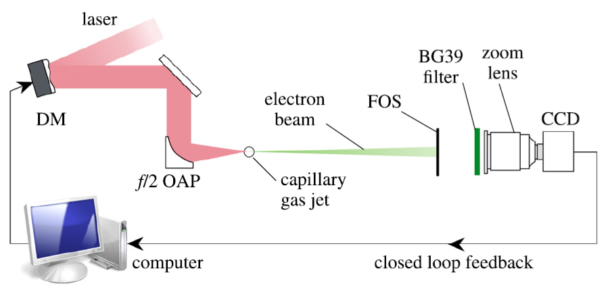
Past experience to apply to the ATF
We were impressed by University of Michigan work and began working with them.
Using Genetic Algorithm the peak charge density was increased by a factor of 20 compared with the initial electron beam profile before optimization.
Courtesy: Z. H. He, B. Hou, G. Gao, V. Lebailly, J. A. Nees, R. Clarke, K. Krushelnick, A. G. R. Thomas
Nature Communications 6:7156 (2015); Physics of Plasmas 22, 056704 (2015)

Slide 8
Past Experience to apply to the ATF
Based on the novelty of experimental setup, we started a collaboration with the University of Michigan on their femtosecond laser system.
Since it takes long time to experimentally iterate the input parameters to find an optimized output, we offered an AI-inspired solution.
We suggested Neural Network (NN) based modeling to find optimized input parameters in different conditions.
Notes:
Dr. Karl Krushelnick, Dr. Yong Ma and his group provided 12000 data points that were randomly recorded for experiment.
We received set of numerical data but images would also be useful if available.
After exploring the new numerical data, we found a method to investigate this data.
We developed a model using 10 layers and 15-layers of feed forward neural network and found a correlation between input and outputs.

Slide 9
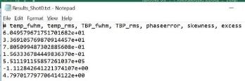
Past Experience to apply to the ATF
Femtosecond Oscillator: A setup for generating ultra-short laser pulses.
Dazzler AOPDF: The Dazzler system is an acousto-optic programmable dispersive filter. It enables the separate control of both the spectral amplitude & the spectral phase.
Laser
Lamda Cube Laser: Focuses the laser within a volume of cube of the laser wavelength, to concentrate intensity of the laser.
Frog Auto-Correlator: Measures different parameters of the laser after passing from lamda cube, like fwhm, rms etc. Frequency resolved optical gating, used to temporary characterize the pulses. It enables both the phase and the amplitude of the pulse be retrieved simultaneously.
Notes:
One run with DAZZLER as the control and FROG as the diagnostic.
12000 shots with random DAZZLER settings and FROG as the diagnostic to measure laser pulse shape/
We use these parameters to characterize
the quality of the pulse shape.
In general the smaller the better.

Slide 10
Overview
In this research, using a liquid crystal (on Silicon) spatial modulator, we want to perform active, adaptive control of the drive laser transverse profile on the photocathode in the main ATF linear accelerator system.
To optimize and stabilize the electron beam (length, charge distribution, transverse profile, etc.) by applying a machine learning (ML) based control for the drive laser of the photocathode RF electron gun.
We will create a surrogate model by using computational nodes from ALCF (Argonne National Leadership Computing Facility).
Notes:
MLP represents a feedforward neural network where sets of inputs are fed to the hidden layer through connections between them which represent the strength or weight. A multi-layer perceptron (MLP) has the same structure as a single layer perceptron with one or more hidden layers.
We expect to collect data from the virtual cathode (images), from the energy meter, from the available downstream electron-beam diagnostics to incorporate into our learned model.
MLP (Multilayer Perceptron) ( For different number of layers).
Model of the electron beam system
Developing the surrogate model (Feedforward Neural Network (FFNN))

Slide 11
.
Abstract
In this project, Brookhaven National Lab and the University of New Mexico (UNM) will test control of a laser system. The quality of the laser pulses drives the quality of the electron beam.
The high brightness electron gun is also the ideal test bed for the impact of the laser quality on the electron beam quality.
The experiment conducted at BNL facilities employs a 1.6-cell photocathode RF gun operating at a resonant frequency of 2856 MHz to produce 2-5 MeV electrons driven by a frequency-quadrupled Nd:YAG laser (266 nm) generates the picosecond electron pulses through the photoelectric effect from a copper cathode.
We will optimize and stabilize the electron beam (length, charge distribution, transverse profile, etc.).
Notes:
We will develop a surrogate model for laser control, a neural network-based control system that is being developed for electron control of an RF electron gun at the Brookhaven National Laboratory (BNL).

Slide 12
UV Transport, Delivery, and Diagnostics
UV is generated in the laser room, and transported through vacuum transport line to gun hutch near photoinjector
Diagnostics consist of energy (joulemeter), timing (photodetector), profile and position (CCD’s) measurements
Instrument suite enables measurement of correlations between laser and electron beam parameters
Active control of laser energy, phase, and position already in place
Notes:
Add exep

Slide 13
Argonne Leadership Computer Facility
Our AI for accelerators projects have allocations at the ALCF’s THETA supercomputer.
We currently use THETA for:
Deep learning and optimization.
Surrogate models.
Training of AI-based controllers.
Multiple computation resources and experimental user facilities are available at DOE labs like ORNL, LANL, SLAC, etc.
THETA is a 11.69 petaflops system based on the second-generation Intel® Xeon Phi™ processor, 281,088 cores.
For more information: https://www.alcf.anl.gov/theta
Notes:
Oak Ridge National Laboratory, Los Alamos National Laboratory, Stanford Linear Accelerator Center,

Slide 14
AI-controls and diagnostic of laser
Control of the laser using NN
Inputs:
5 joulemeter channels throughout laser
Laser position and transverse profile at cathode
Electron beam energy spectrum, transverse and longitudinal emittance scans
Laser-RF phasemeter
Outputs:
Laser energy
Laser phase
Spatial light modulator

Slide 15
Detailed scientific case
In modeling the system, the primary aim is to investigate several model structures and use these to inform the controller design. While elements of the system can be modeled analytically or with other data-driven techniques, by using NNs we will also set the stage for NN-centric controllers.
The major objectives are
The combination of surrogate model’s inputs
The choice of data training sets
The AI System.
To improve the laser shaping delivered onto the cathode
To better control the electron beam emittance and overall beam quality for tailoring user experiments
In addition to training and testing with gathered data, a few studies in online updating during operation will be conducted as well.

Slide 16
Experimental detail: Adaptive optics
A liquid crystal on silicon (LCOS) modulator operating as a spatial intensity control permits adjustment of beam profile
Electron emission from photocathode sensitive only to laser intensity, not wavefront
Near-tophat profile on cathode is highly multimode, requiring high-resolution modulator
Laser beam transport already incorporates necessary relay imaging from amplifiers to cathode
Placement of modulator at intermediate object plane allows control of beam profile at cathode and compensation of undesired distortion from optical imperfections in the laser system
Computer interface closes feedback loop for adaptive control and rapid change of beam profile (e.g. micro-spots for gun electrical center measurement or cathode QE mapping)

Slide 17
Experimental detail: Virtual cathode
A beam pickoff samples laser at gun vacuum entrance window
Enables placement of a fluorescent screen in the diagnostic beam at the conjugate image plane
Screen serves as a permanent alignment monument and profile monitor
Beam profiles at the conjugate image plane and on cathode are equivalent
Spent beam camera at gun output window images cathode and permits comparison with monument as well as inspection of cathode surface

Slide 18
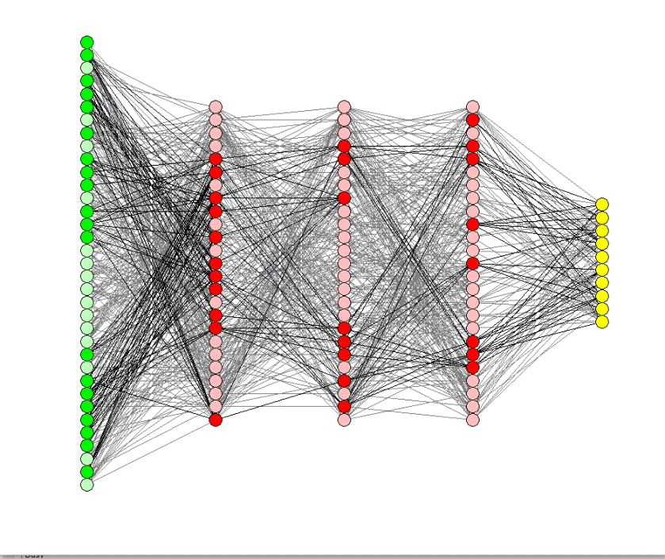
Experimental detail: Feed Forward Neural Networks (FFNNs)
We are planning to apply Feedforward Neural Network (FFNN) with a different number of layers and with different Inputs.The feed-forward model is the simplest form of a neural network as information is only processed in one direction. While the data may pass through multiple hidden nodes, it always moves in one direction and never backward. Schematic for the internal structure of the feedforward Neural Network is given below:
Inputs
Outputs
Hidden layers

Slide 19
Experimental detail: Feed forward Neural Networks
An Artificial Neural Network (ANN) is made up of many interconnected neurons:
How each neuron works?
Each neuron takes in some floating point numbers (e.g. 1.0, 0.5, -1.0) and multiplies them by some other floating point numbers (e.g. 0.7, 0.6, 1.4) known as weights (1.0 * 0.7 = 0.7, 0.5 * 0.6 = 0.3, -1.0 * 1.4 = -1.4). The weights act as a mechanism to focus on, or ignore, certain inputs.

Slide 20
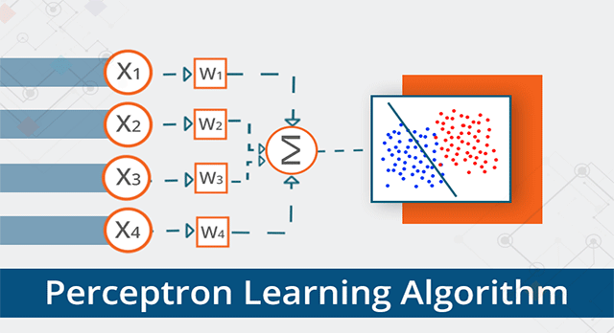
The neuron’s output value (e.g. -0.05) is often an input for another neuron.
Experimental detail: Steps for Feed forward Neural Networks
The output of the perceptron’s acts as the final prediction.

Slide 21
Outcomes:
Our surrogate model will learn system relationships (e.g. dynamic models), to do perform rapid computations, and to act as controllers.
We plan to continue our research in this area to develop advanced controllers based on artificial intelligence and machine learning for a wide variety of control problems found in laser control.

Slide 22
References
Accelerator Test Facility.” BNL, www.bnl.gov/atf.
Z. H. He, B. Hou, G. Gao, V. Lebailly, J. A. Nees, R. Clarke, K. Krushelnick, A. G. R. Thomas Nature Communications 6:7156 (2015); Physics of Plasmas 22, 056704.
A. Aslam, S. Biedron, M. Martinez-Ramon, S. Sosa, Y. Ma, J. Murphy, K. Krushelnick, "Convolutional neural network-based control of plasma dynamics by spatial deformation of the ultrafast pulsed laser wavefront," manuscript in preparation for Nuclear Instruments and Methods A.
Zhu, P., Zhu, Y., Hidaka, Y., Wu, L., Cao, J., Berger, H., ... & Tobey, R. I. (2015). Femtosecond time-resolved MeV electron diffraction. New Journal of Physics, 17(6), 063004.
Wang, X. J., Qiu, X., & Ben-Zvi, I. (1996). Experimental observation of high-brightness microbunching uin a photocathode rf electron gun. Physical Review E, 54(4), R3121.
Zhou, F., Ben-Zvi, I., Babzien, M., Chang, X. Y., Doyuran, A., Malone, R., ... & Yakimenko, V. (2002). Experimental characterization of emittance growth induced by the nonuniform transverse laser distribution in a photoinjector. Physical Review Special Topics-Accelerators and Beams, 5(9), 094203.

