Slide 1



Characterization of the collinear wakefield accelerator module
A new proposal:
Funded by LDRD at ANL
drhgfdjhngngfmhgmghmghjmghfmf
PI: A. Zholents, APS/ANL
W. Jansma, S. Lee, A. Nassiri, S. Sorsher, K. Suthar, E. Trakhtenberg, G. Waldschmidt (APS/ANL)
S. Siy, N. Behdad, J. Booske (University of Wisconsin)
M. Fedurin, K. Kusche (ATF/BNL)
G. Mouravieff, S. Oliphant (Servometer)
ATF User meeting, January 20, 2022

Slide 2
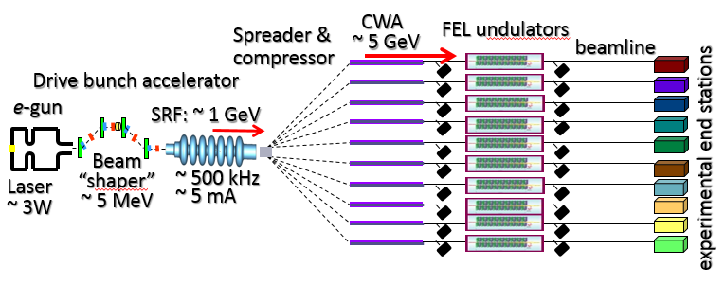
A big picture …
A concept of a high repetition rate multi-user FEL facility based on a collinear wakefield accelerator CWA

Slide 3
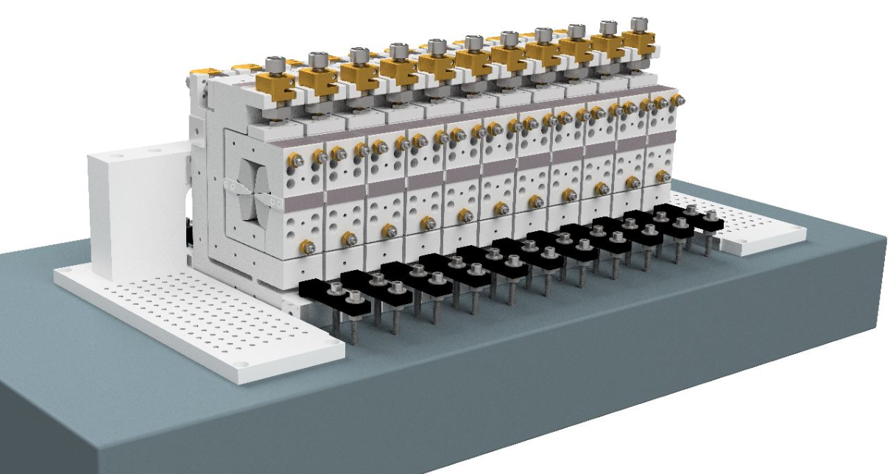
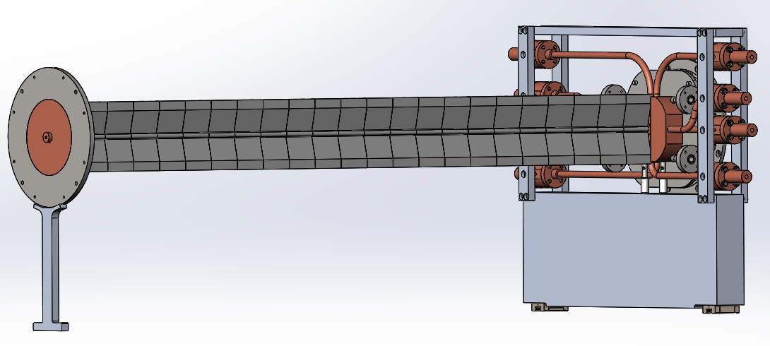
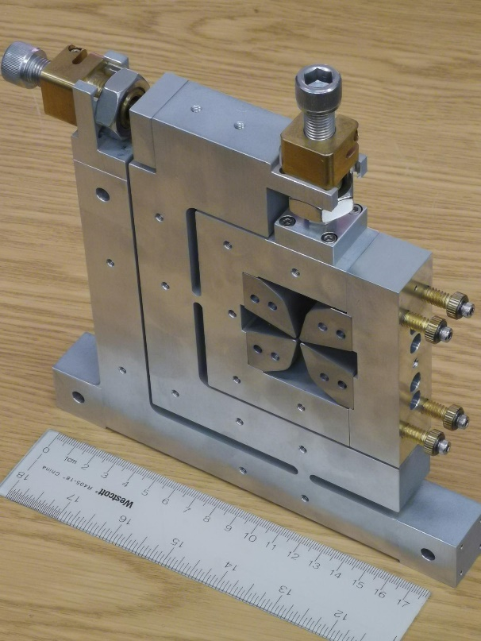
Collinear Wakefield accelerator module
Transition Section
Corrugated Tube
0.5 m
e-
30-cm long prototype chamber, ID = 2 mm (in fabrication)

Slide 4

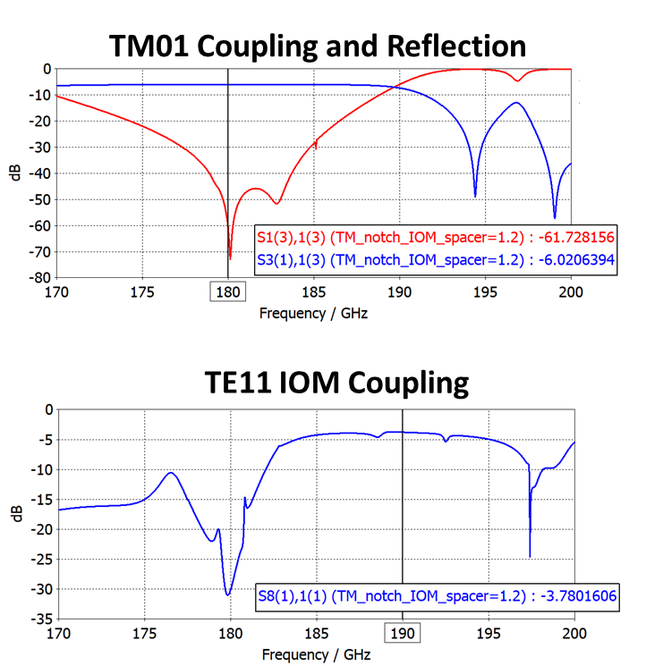
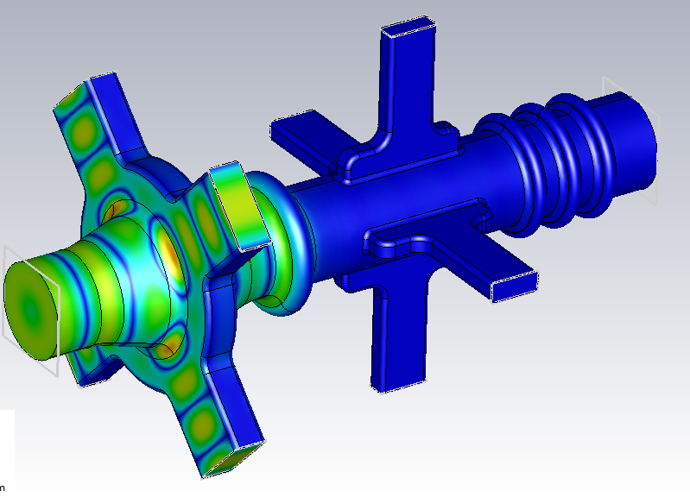
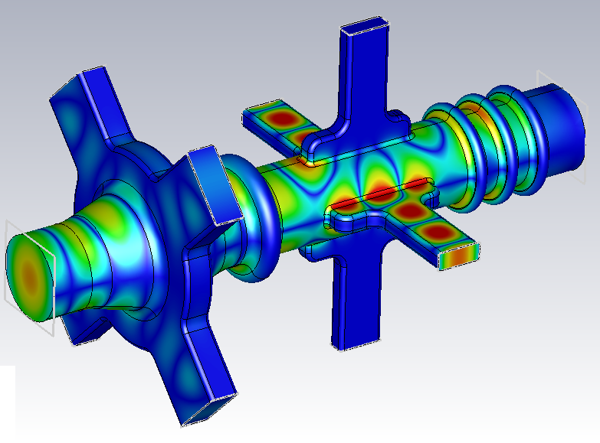
Physics design of the Transition Section
Plots show vacuum that TS holds
Design Highlights
180GHz TM01 electric field
Excellent separation of TM01 and TE11 modes.
Wide bandwidth to accommodate fabrication errors.
99.98% TM01 power extraction in coupler.
84% TE11 power extraction in IOM.
coupling
reflection
Notch
IOM
Notch
Coupler
190GHz TE11-Y electric field

Slide 5
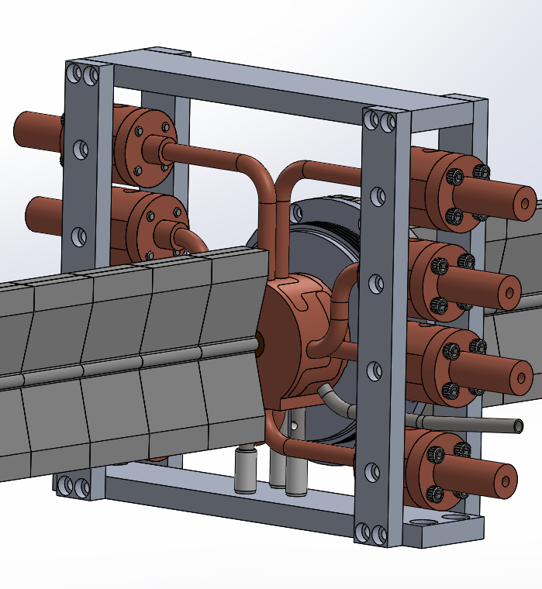
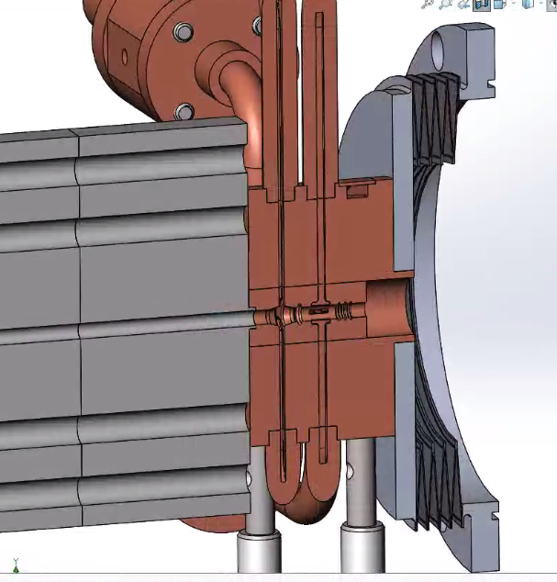
Transition Section Mechanical Design
Diamond windows
This area contains
all design features
20.86mm
Brazed joint
Support

Slide 6
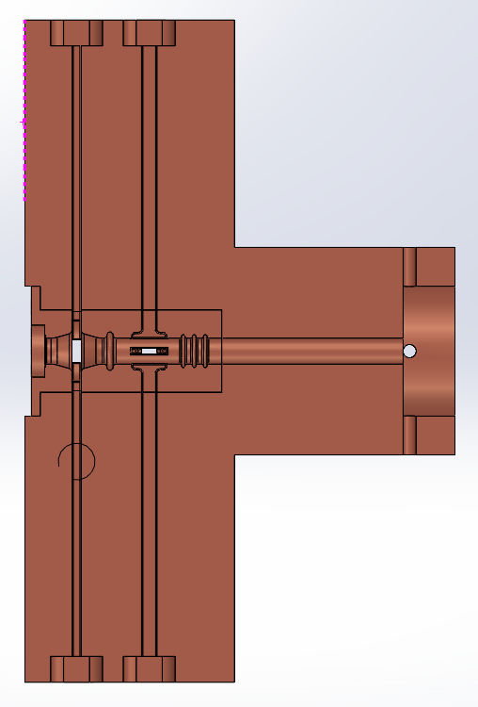
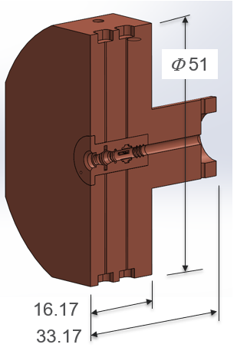
Transition Section Mechanical Design
Fundamental mode coupler
holder
Integrated offset monitor
main part
1.0~1.025 mm
10 mm
φ4.0 mm
0.5 mm
Notch filters

Slide 7
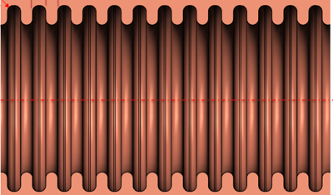
ATF Experiment Goals
First goal
  Measure frequency of output THz signal from transition section ports (fundamental mode coupler and IOM)
  Measure energy modulation in the bunch due to the wakefield
  Estimate power of THz signal
Second goal
  Verify that transition section removes all fundamental power
  Measure any HOM power that is not removed by transition section
1) Corrugated waveguide
2) Translation stage
3) Transition section
4) Collimator
5) Spectrometer magnet (horizontal)
6) Diagnostic screen
7) TPX window
8) Michelson interferometer
9) Bolometer
10) Dog-leg lattice
11) Energy collimator
10
3
4
2
5
6
e⁻
1
11
7
8
9

Slide 8
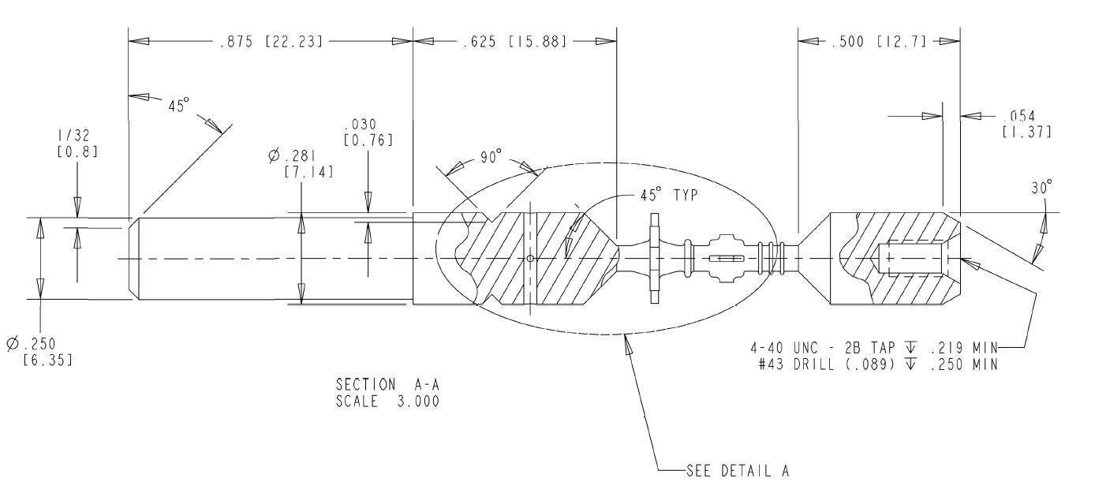
Mechanical Design of the mandrel

Slide 9
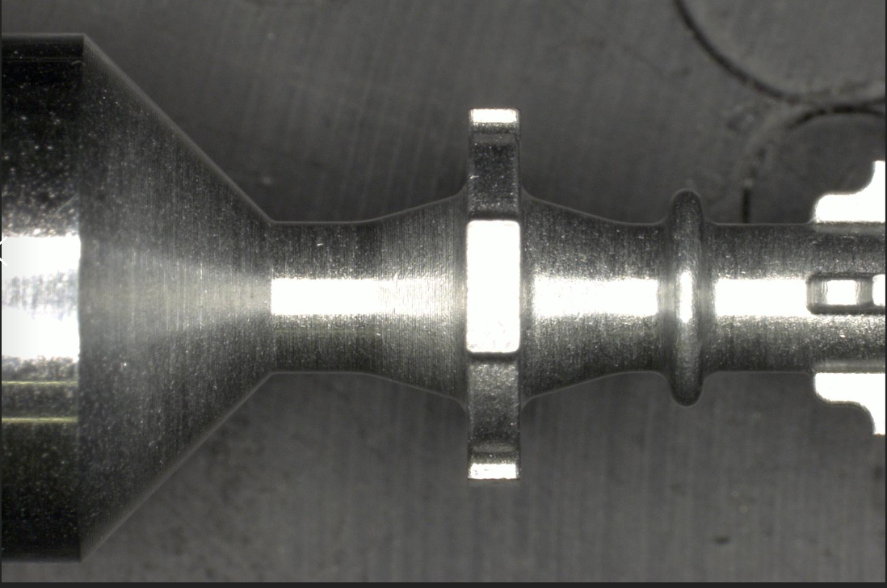
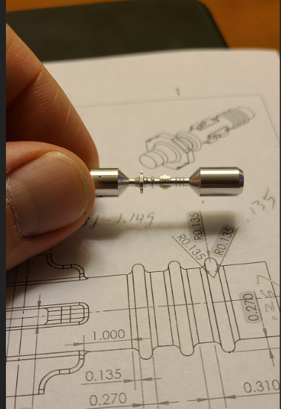
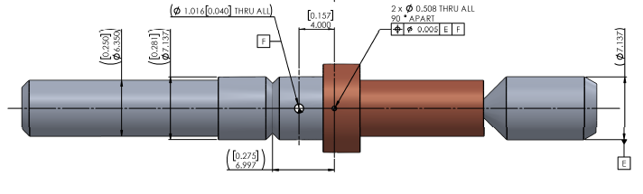
Transition Section fabrication
A fragment of aluminum mandrel
Aluminum mandrel
Plated mandrel after machining

Slide 10
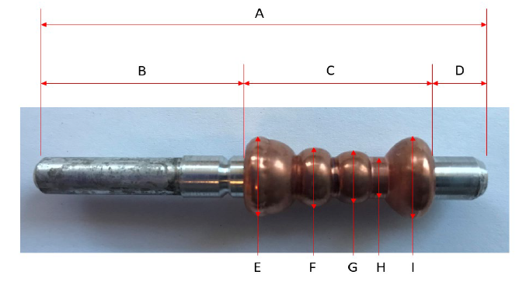
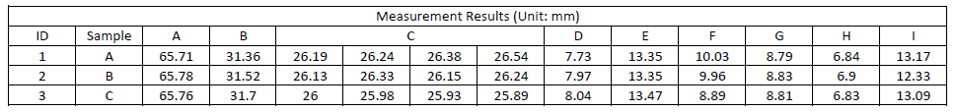
Transition Section fabrication
Received three trial products
Expect fabrication to be completed by May 2022

Slide 11
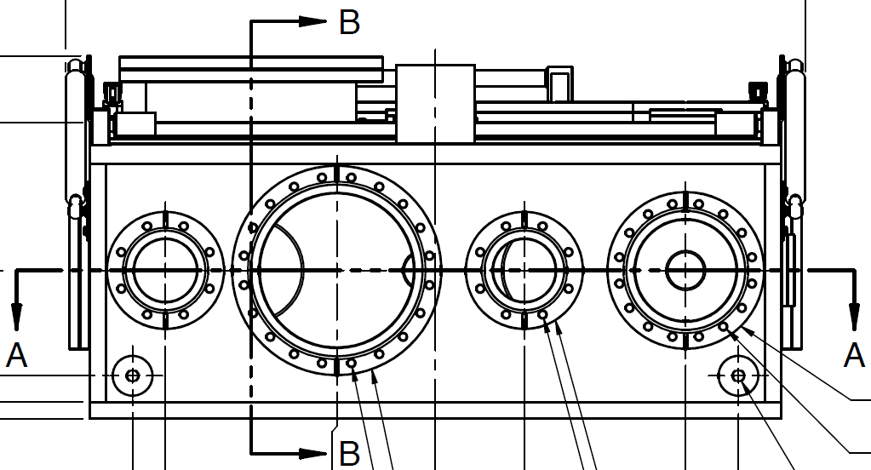
ATF Experimental Setup (under consideration)
Experimental Chamber
1
2
3
e⁻
300 mm
4
4
Space needed to collect radiation from angle-cut beampipe
.
1) Beampipe: vac chamber - transition
2) Beampipe: transition – transition
3) Beampipe: transition – angle cut
4) Transition waveguide with shutters
96 mm
261 mm
442 mm
598 mm

Slide 12
ATF Experimental Setup (under consideration)
Experimental setup for 2 transition sections
1)
1
2
e⁻
300 mm
Purpose:
Standard measurements
Verify fundamental power removed by transition section
Experimental setup with angle-cut beampipe
2)
1
2
e⁻
300 mm
Purpose:
Measure HOM power

Slide 13
ATF Experimental Setup (under consideration)
3)
Experimental setup with angle-cut beampipe
e⁻

Slide 14
Electron Beam Requirements
5

Slide 15
Special Equipment Requirements and Hazards
Electron Beam
    shaped bunch using mask technique (likely),
    LiHe bolometer/interferometer setup,
    TPX windows
    vertical translation stage (levered at the beam height)
    the horizontal slit,
    diagnostic screen,
    alignment laser(s)
    single shot THz spectrometer – a new instrument
Hazards & Special Installation Requirements
  No known hazards

Slide 16
Experimental Time Request
CY2022 Time Request
Capability | Setup Hours | Running Hours
Electron Beam Only | 32 hours^{*)} | 48 hours^{*)}
Laser* Only (in FEL Room)
Laser* + Electron Beam
*) we may need a second run using two shifts for a setup and three shifts for the experiment
Time Estimate for one year experiment (including CY2022)
Capability | Setup Hours | Running Hours
Electron Beam Only | 32 hours | 48 hours
Laser* Only (in FEL Room)
Laser* + Electron Beam
The goal is to complete the experiment in FY’2022. Completion of student’s PhD thesis depends on obtaining the data.

