Slide 1
Proposal # 310077 Simulation‐aided Instrument Optimization using Artificial Intelligence and Machine Learning Methods
PI: Maksim Rakitin,
Co-PIs: Mikhail Fedurin, Yonghua Du
Brookhaven National Laboratory
LDRD#22-031 PS/EPS (“Received”)
January 20, 2022

Slide 2
Experiment Goals at ATF:
Collect e-beam tunning data (PS set/read, BPM read )
Process collected data
Create AI based e-beam tuning optimization procedures
Apply beam optimization on e-beam to match real beam to requested beam parameters
Integrate beam optimization to ATF control system

Slide 3
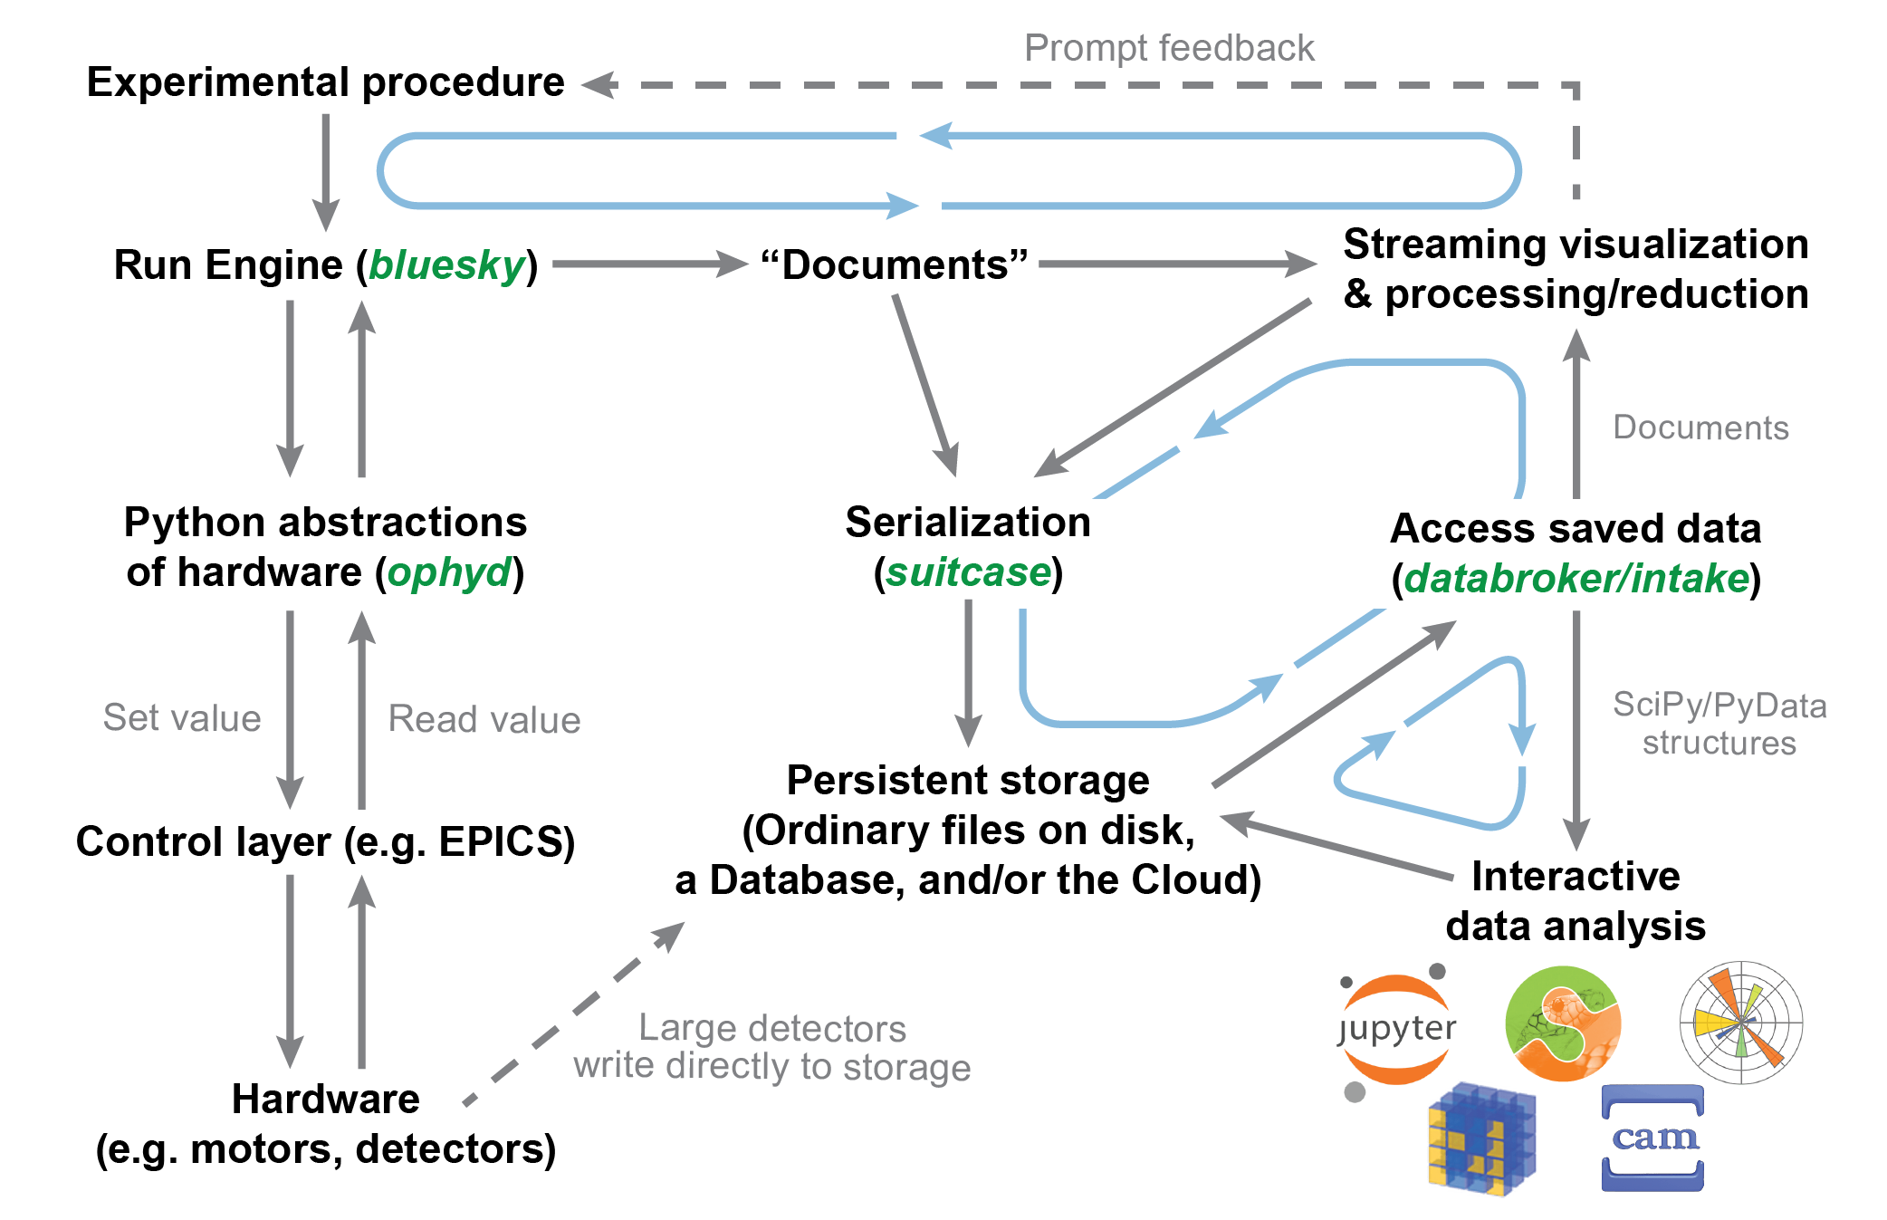
Experiment overview: Bluesky
Bluesky https://blueskyproject.io/bluesky: data collection framework
Ophyd https://blueskyproject.io/ophyd: hardware abstraction library
Databroker https://blueskyproject.io/databroker: user-friendly interface for retrieving
stored data and metadata from multiple sources
Contributors:
NSLS-II
APS
LCLS-II
ALS
…

Slide 4
Experiment overview: Sirepo
Sirepo: an open-source cloud-based software interface for X-ray source and optics simulations (https://journals.iucr.org/s/issues/2018/06/00/il5006)

Slide 5
Experiment overview: Sirepo-Bluesky library
Maksim S. Rakitin, Abigail Giles, Kaleb Swartz, Joshua Lynch, Paul Moeller, Robert Nagler, Daniel B. Allan, Thomas A. Caswell, Lutz Wiegart, Oleg Chubar, and Yonghua Du "Introduction of the Sirepo-Bluesky interface and its application to the optimization problems", Proc. SPIE 11493, Advances in Computational Methods for X-Ray Optics V, 1149311 (21 August 2020) https://doi.org/10.1117/12.2569000
https://github.com/NSLS-II/sirepo-bluesky

Slide 6
Optimization: Genetic Algorithm
https://github.com/NSLS-II/bloptools
https://github.com/NSLS-II-TES/profile_sirepo

Slide 8
Electron Beam Requirements
Parameter | Units | Typical Values | Comments | Requested Values
Beam Energy | MeV | 50-65 | Full range is ~15-75 MeV with highest beam quality at nominal values | 55
Bunch Charge | nC | 0.1-2.0 | Bunch length & emittance vary with charge | 0.5
Compression | fs | Down to 100 fs (up to 1 kA peak current) | A magnetic bunch compressor available to compress bunch down to ~100 fs. Beam quality is variable depending on charge and amount of compression required. NOTE: Further compression options are being developed to provide bunch lengths down to the ~10 fs level | 300
Transverse size at IP (σ) | μm | 30 – 100 (dependent on IP position) | It is possible to achieve transverse sizes below 10 um with special permanent magnet optics. | 100
Normalized Emittance | μm | 1 (at 0.3 nC) | Variable with bunch charge | 1.5
Rep. Rate (Hz) | Hz | 1.5 | 3 Hz also available if needed | 1.5
Trains mode | --- | Single bunch | Multi-bunch mode available. Trains of 24 or 48 ns spaced bunches. | Single bunch

Slide 9
Special Equipment Requirements and Hazards
Electron Beam
No specific requirements
Large installation (chamber, insertion device, etc.): No large installation
Cryogens: No needs
Introducing new magnetic elements: None
Introducing new materials into the beam path: None
Any other foreseeable beam line modifications: None

Slide 10
Experimental Time Request
CY2022 Time Request
Capability | Setup Hours | Running Hours
Electron Beam Only | 0 | 40
Laser* Only (in Laser Areas) | 0 | 0
Laser* + Electron Beam | 0 | 0
Time Estimate for Full 3-year Experiment (including CY2022)
Capability | Setup Hours | Running Hours
Electron Beam Only | 20 | 80
Laser* Only (in Laser Areas) | 0 | 0
Laser* + Electron Beam | 0 | 0
* Laser = Near-IR or LWIR (CO₂) Laser

