Slide 1
Unraveling the Origin of Coherent Helicity-Dependent Spin-Phonon Oscillations in the van der Waals Ferromagnet CrI₃
Min-Cheol Lee,¹ Prashant Padmanabhan,¹ Mariana Fazio,² Finn L. Buessen,³ R. Tutchton,¹ Kevin W. C. Kwock,¹ Sam Gilinsky,¹ Sandra Biedron,² Michael A. McGuire,⁴ Srinivasa R. Singamaneni,⁵ Dmitry A. Yarotski,¹ Antoinette J. Taylor,¹ Arun Paremekanti,³ Jian-Xin Zhu,¹ and Rohit P. Prasankumar¹
¹Center for Integrated Nanotechnologies, Los Alamos National Laboratory
² ECE Department, University of New Mexico
³ Department of Physics, University of Toronto
⁴ Materials Science and Technology Division, Oak Ridge National Laboratory
⁵ Department of Physics, University of Texas at El Paso

Slide 2
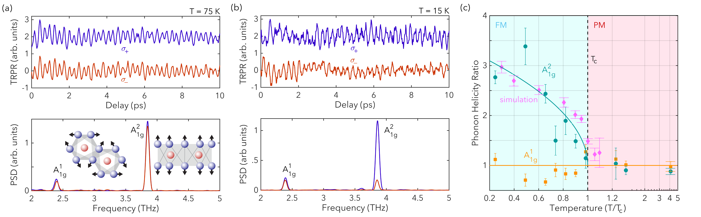
Outline
Overview of magnetic 2D nanomaterials
  Properties of the ferromagnetic (FM) van der Waals (vdW) crystal CrI₃
Revealing coherent helicity-dependent spin-phonon oscillations in bulk CrI₃
Using ultrafast electron diffraction (UED) to reveal the origin of helicity-dependent oscillations in CrI₃
Future plans

Slide 3
Magnetic 2D Nanomaterials
MOKE and PL on monolayer CrI₃
B. Huang et al, Nature (2017) ; K. Seyler et al, Nature Phys. (2018)
C. Gong and X. Zhang, Science (2019)
Two-dimensional (2D) transition metal dichalcogenides (TMDs) have attracted a great deal of attention over the past decade
  Layer-dependent optical and electronic properties, including a direct bandgap when thinned down to a single atomic layer
  2D magnetic crystals such as CrI₃ and Cr₂Ge₂Te₆ exhibit ferromagnetic (FM) or antiferromagnetic (AFM) order along with both semiconducting and metallic behavior (C. Gong and X. Zhang, Science (2019); K. S. Burch et al, Nature (2018))
  Static optical measurements have shed light on their properties
Relatively few ultrafast optical experiments have been done on these novel 2D magnets, providing an exciting opportunity to learn more about their properties!
Ultrafast FM exchange enhancement in CrSiTe₃
A. Ron et al, Phys. Rev. Lett. (2020)

Slide 4
CrI₃ at a Glance
Van der Waals semiconductor with 1.2 eV optical gap
Rare example of a material hosting magnetic order from the bulk to the monolayer limit
Bulk and odd number of layers are ferromagnetic, bilayers are antiferromagnetic
  Intimate coupling between structure and magnetic order yields unusual phenomena
  FM magnetization along c-axis
Nonreciprocal second harmonic generation (SHG) due to time and inversion symmetry breaking in bilayers
Little known about the coupling between spin and lattice degrees of freedom on ultrafast timescales or under non-equilibrium conditions
M. A. McGuire, et al., Chemistry of Materials 27, 612 (2015)
B. Huang, et al., Nature 546, 270 (2017)
Z. Sun, et al., Nature 572, 297 (2019)

Slide 5
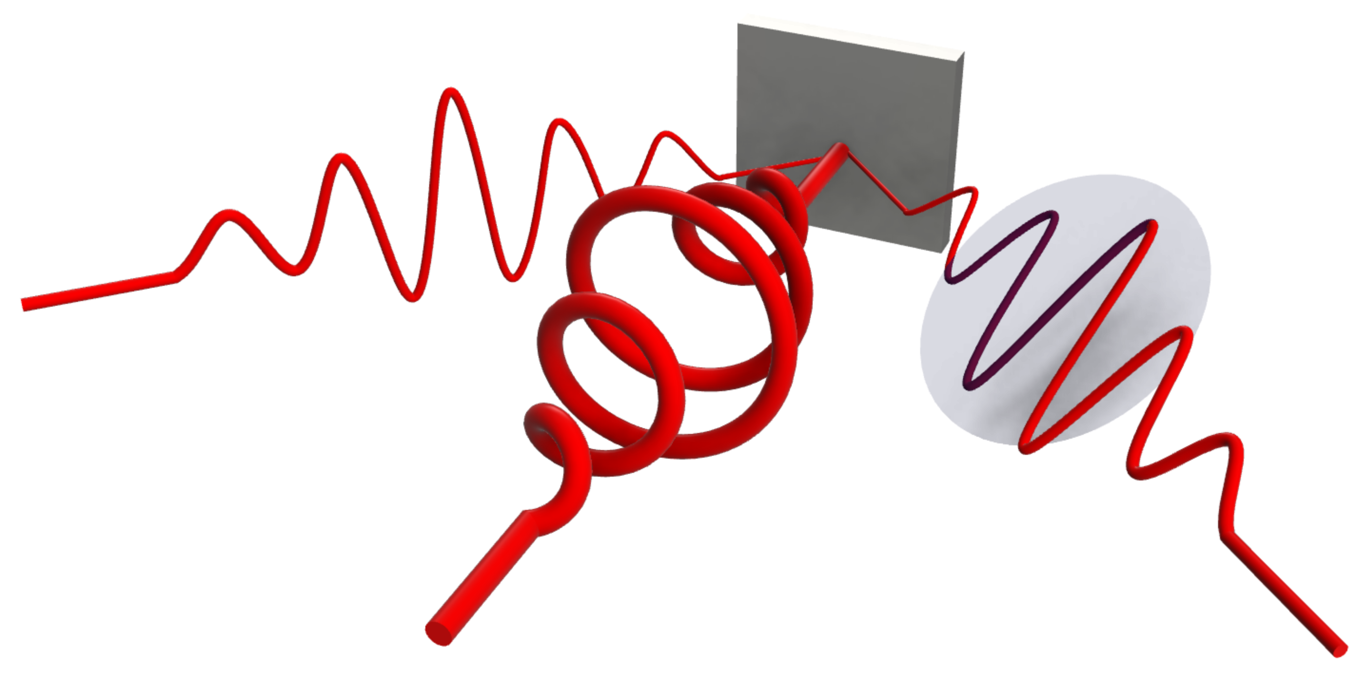
Time-Resolved Polarization Rotation Microscopy
Magneto-optical Kerr effect
M
$$θ_{k}$$
Probe
Pump

Slide 6
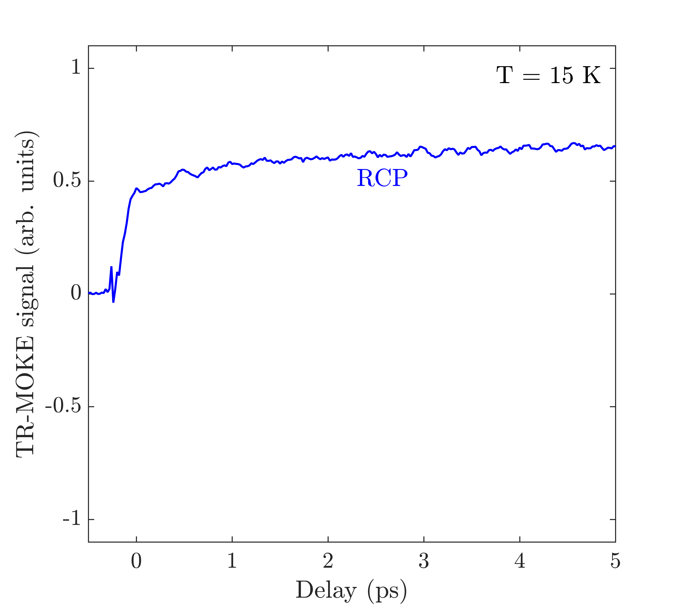
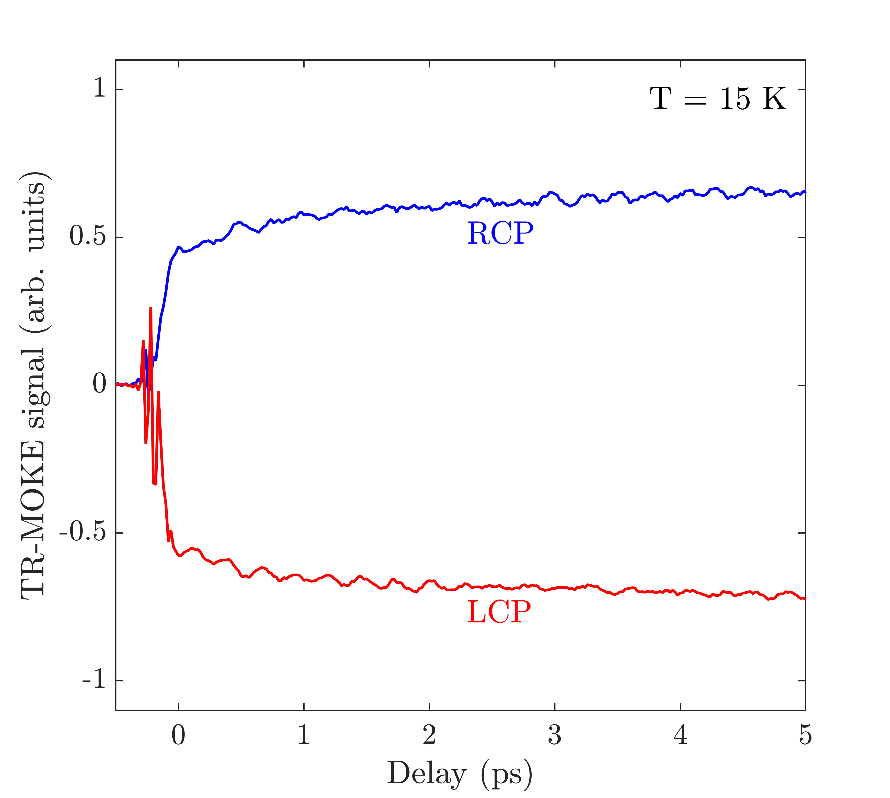
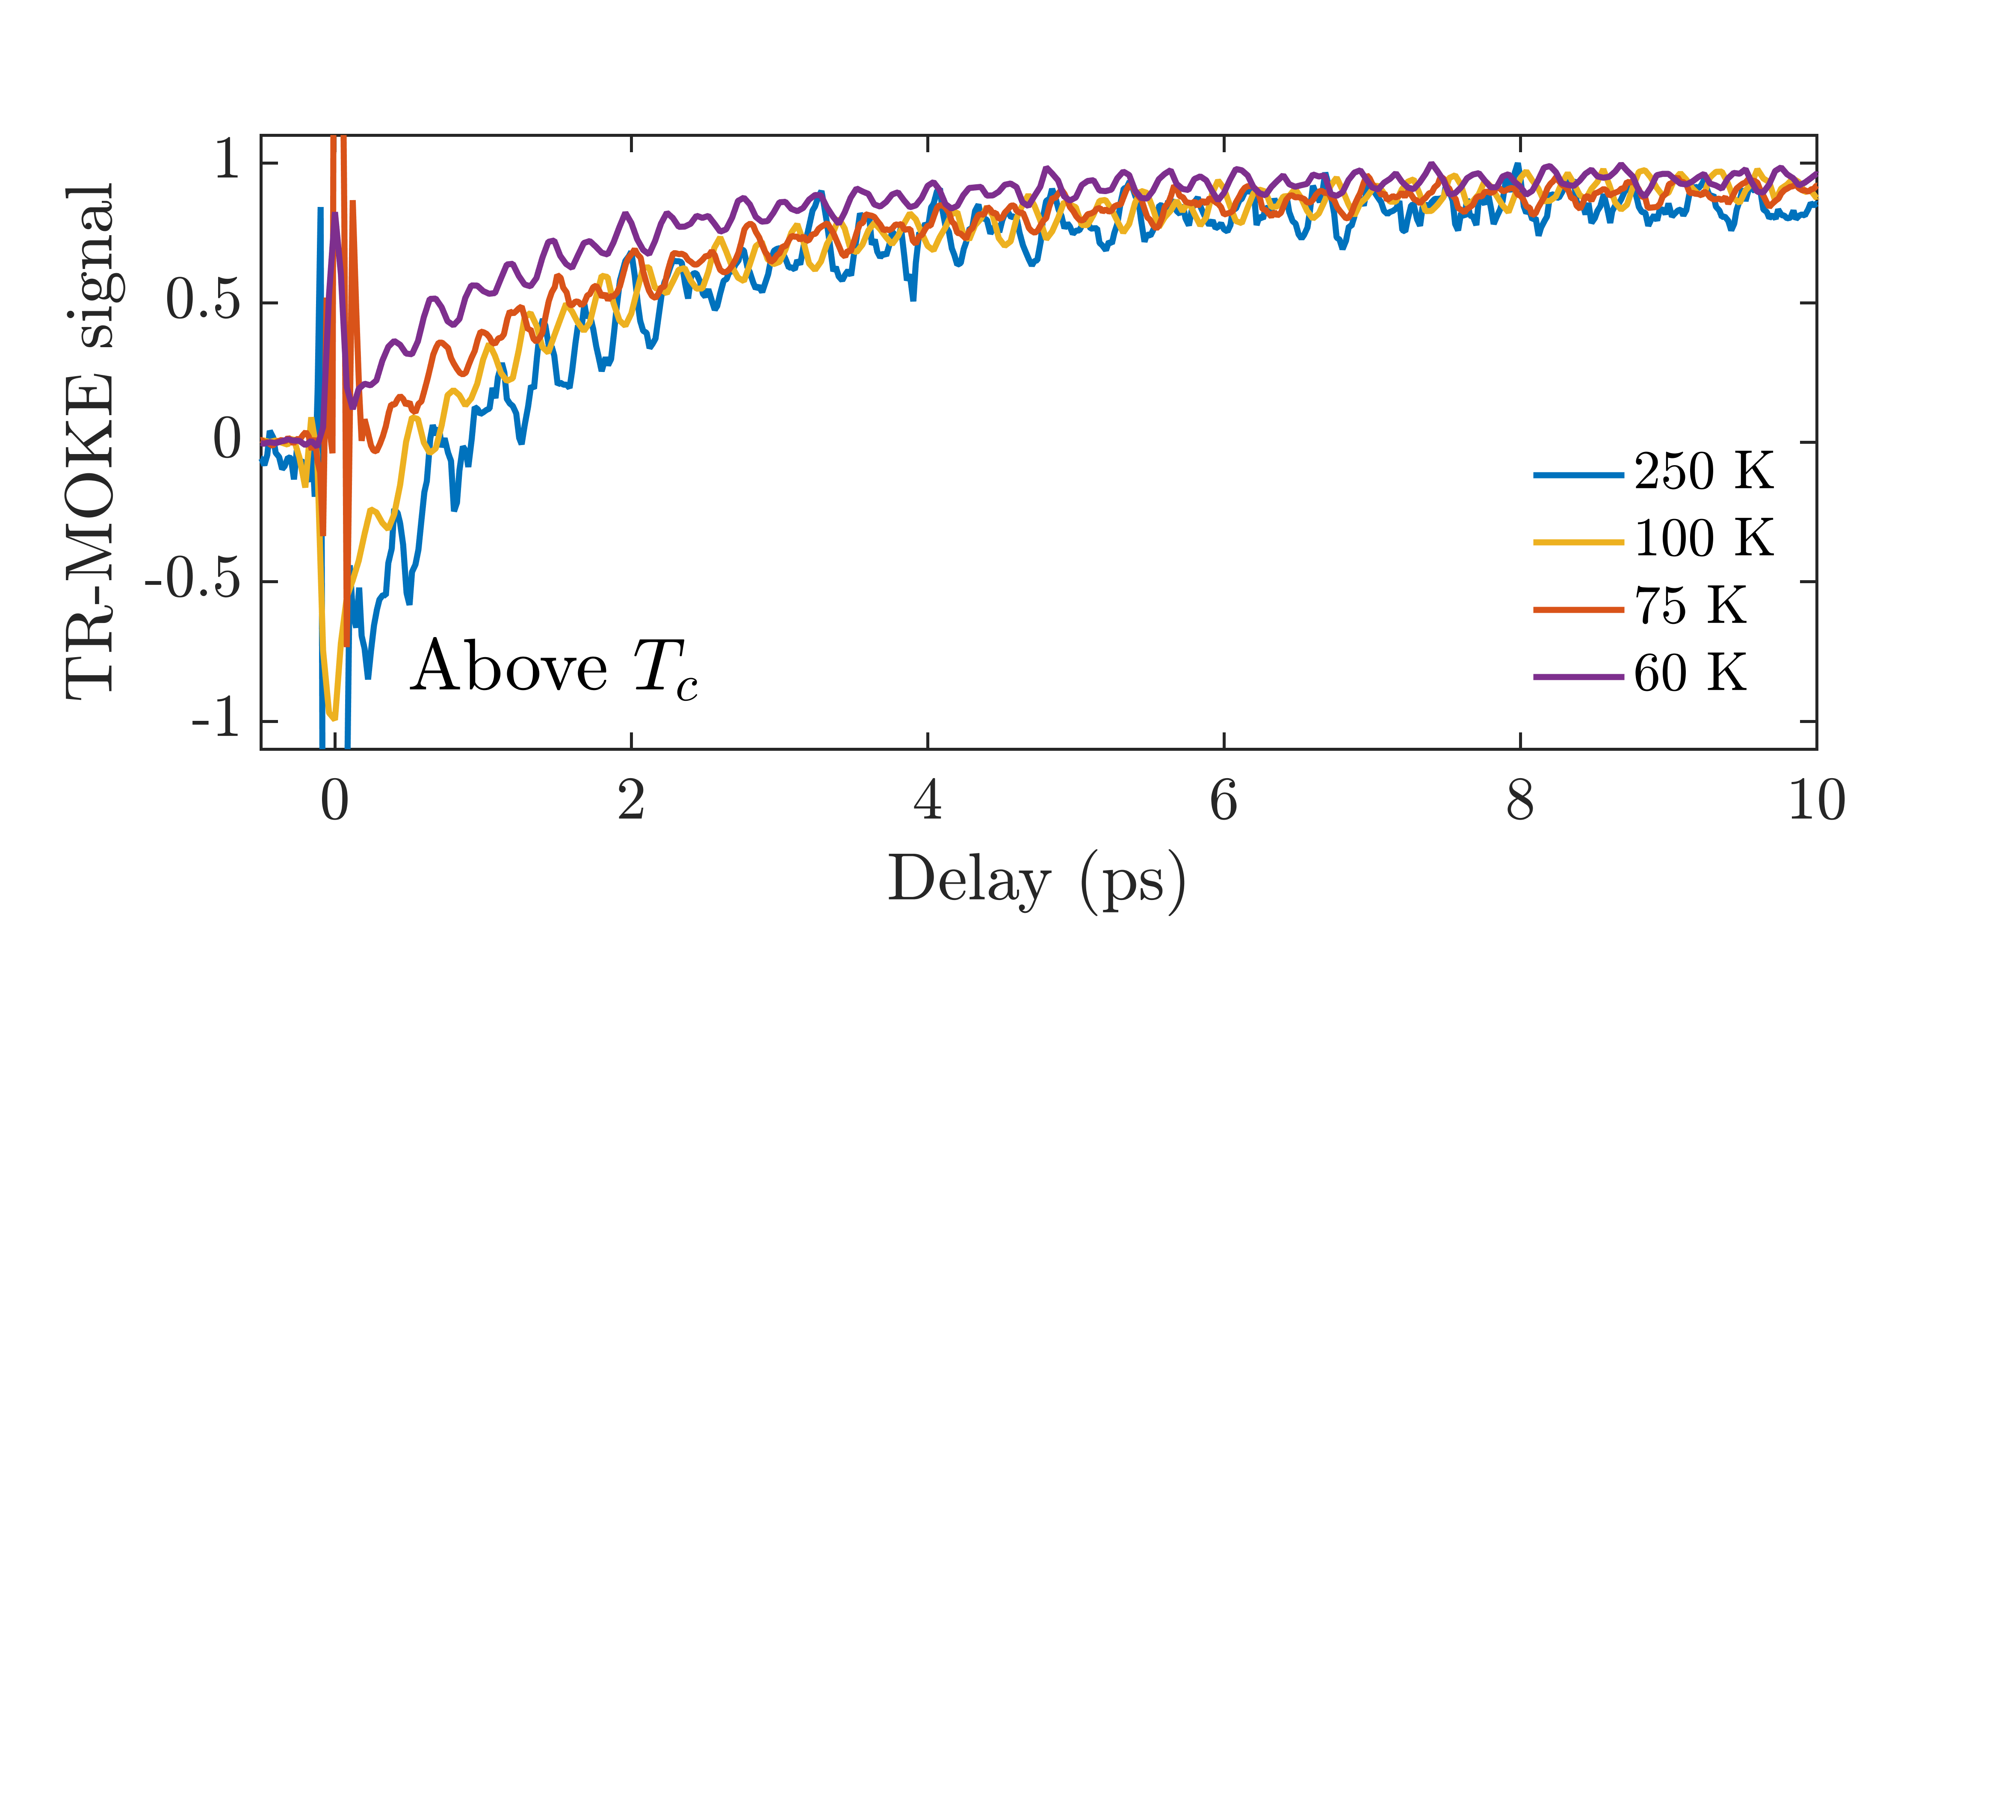
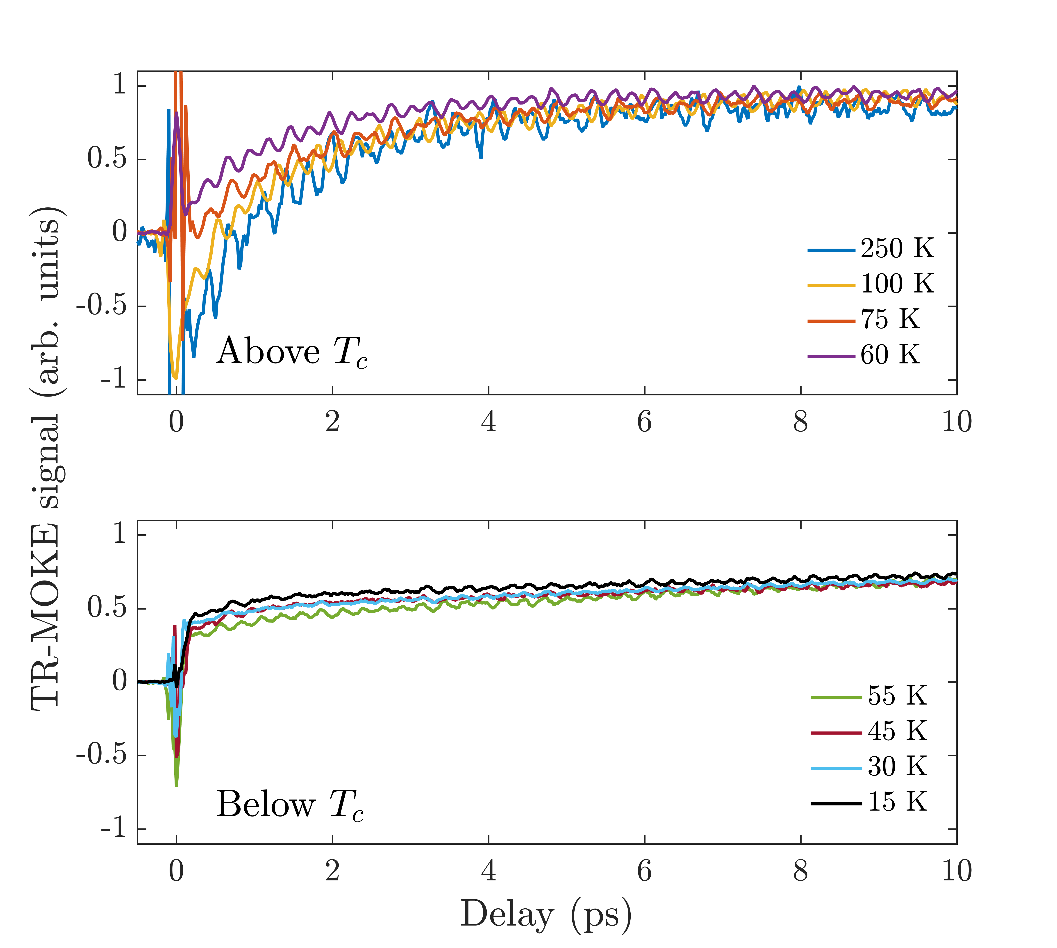
Magnetization Dynamics in Bulk CrI₃
RCP Pump
RCP Pump
coherent oscillations
RCP Pump
Time-resolved polarization rotation at 800 nm
Significant change in incoherent dynamics above and below T_{C} = 61 K
Signal switches polarity with pump helicity
Strong coherent oscillations at THz frequencies
P. Padmanabhan et al., https://arxiv.org/abs/2010.04915
Notes:
Polar MOKE is sensitive to out-of-plane magnetization

Slide 7
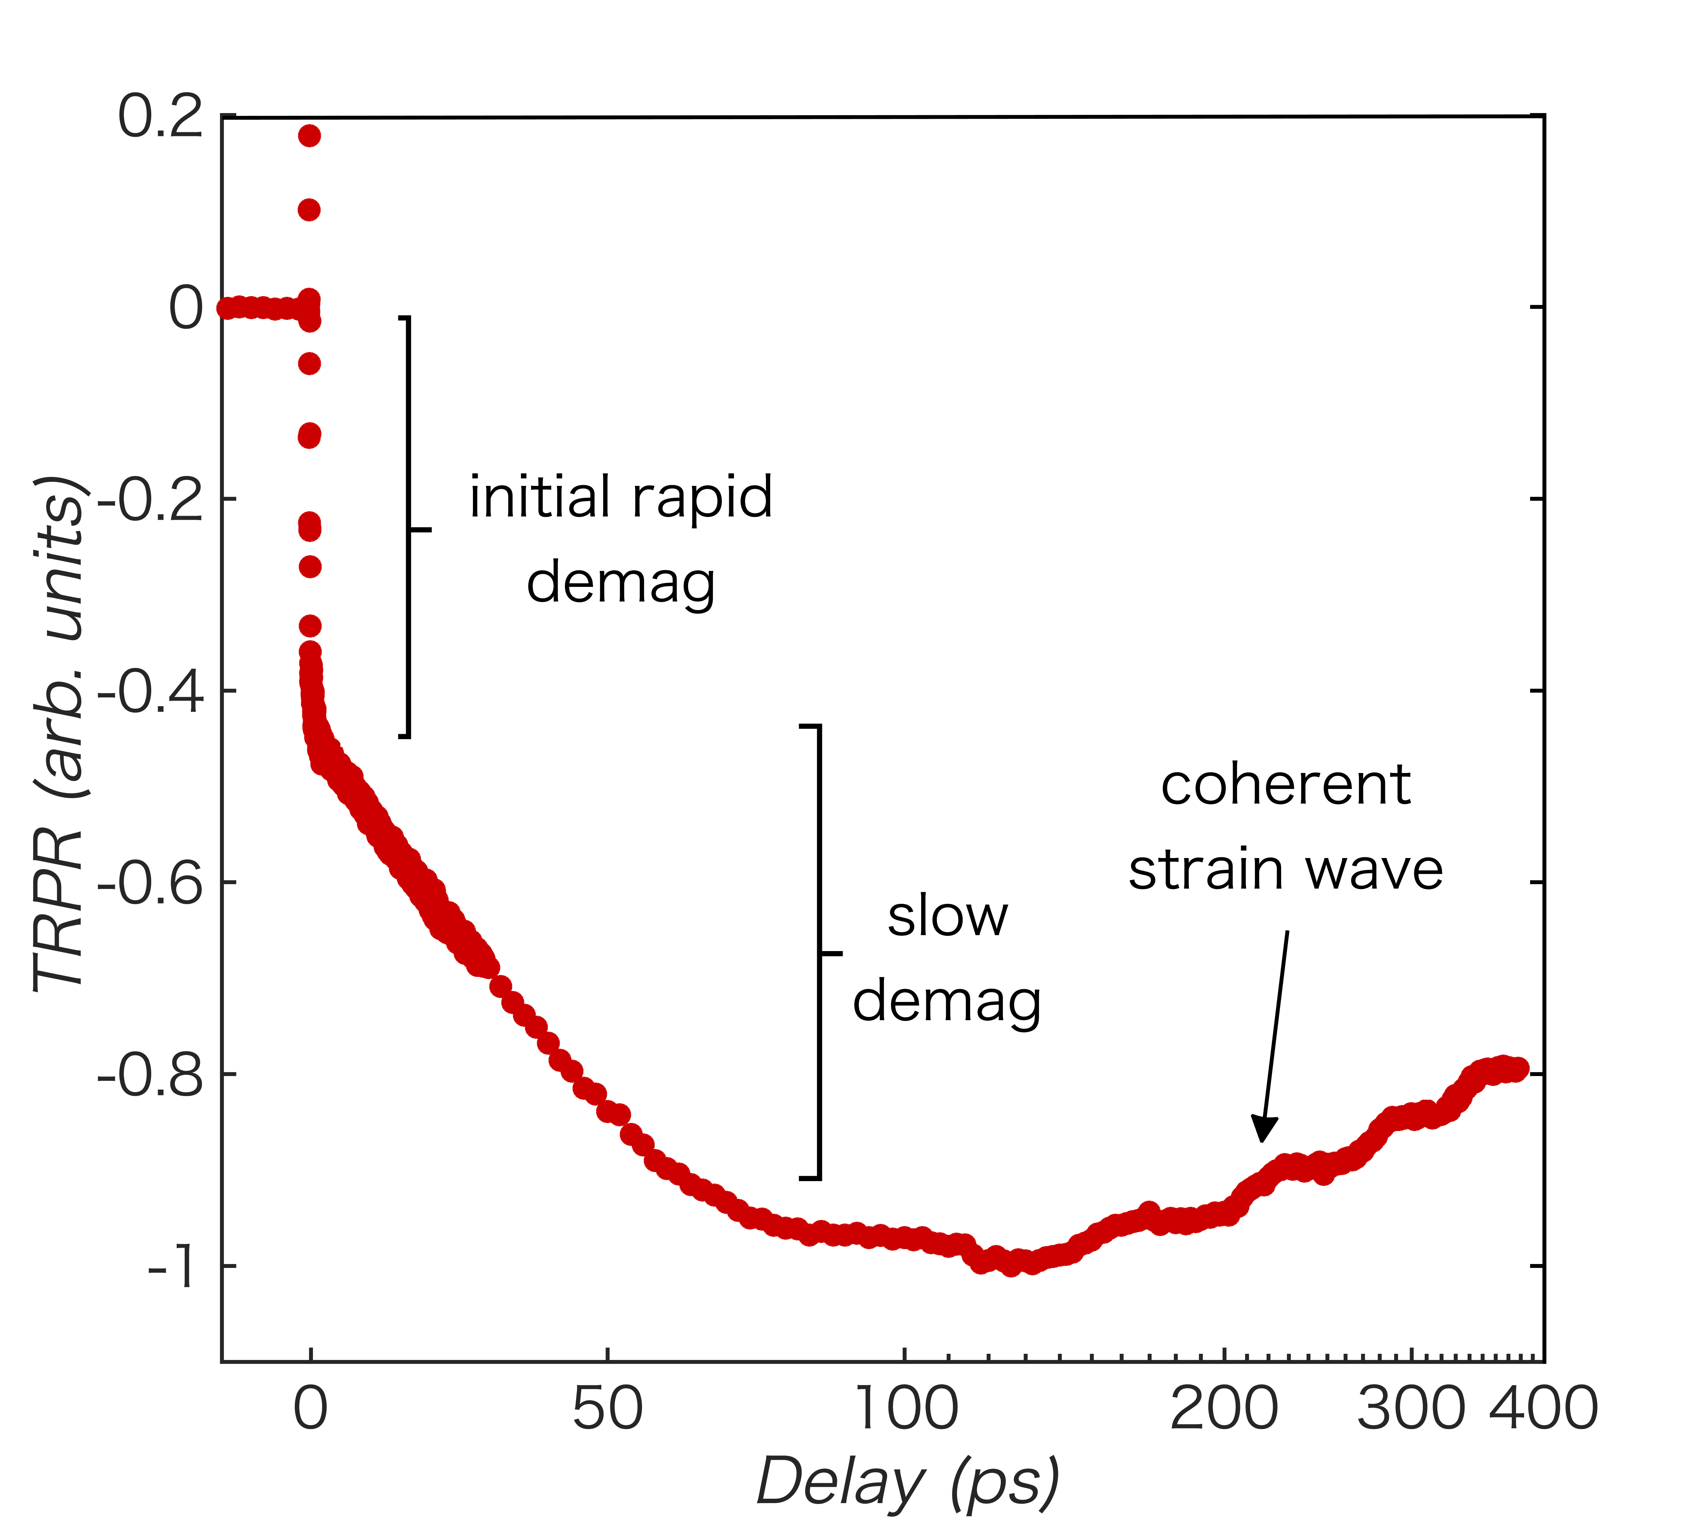
Long-Time Dynamics in the FM Phase
                Initial rapid picosecond (ps) demagnetization
Slower demagnetization occurs on a ∼100 ps timescale
Coherent strain wave due to impulsive heating
Why do we see two-step (type-II) demagnetization dynamics?
Can we model these dynamics?
T = 15 K

Slide 8
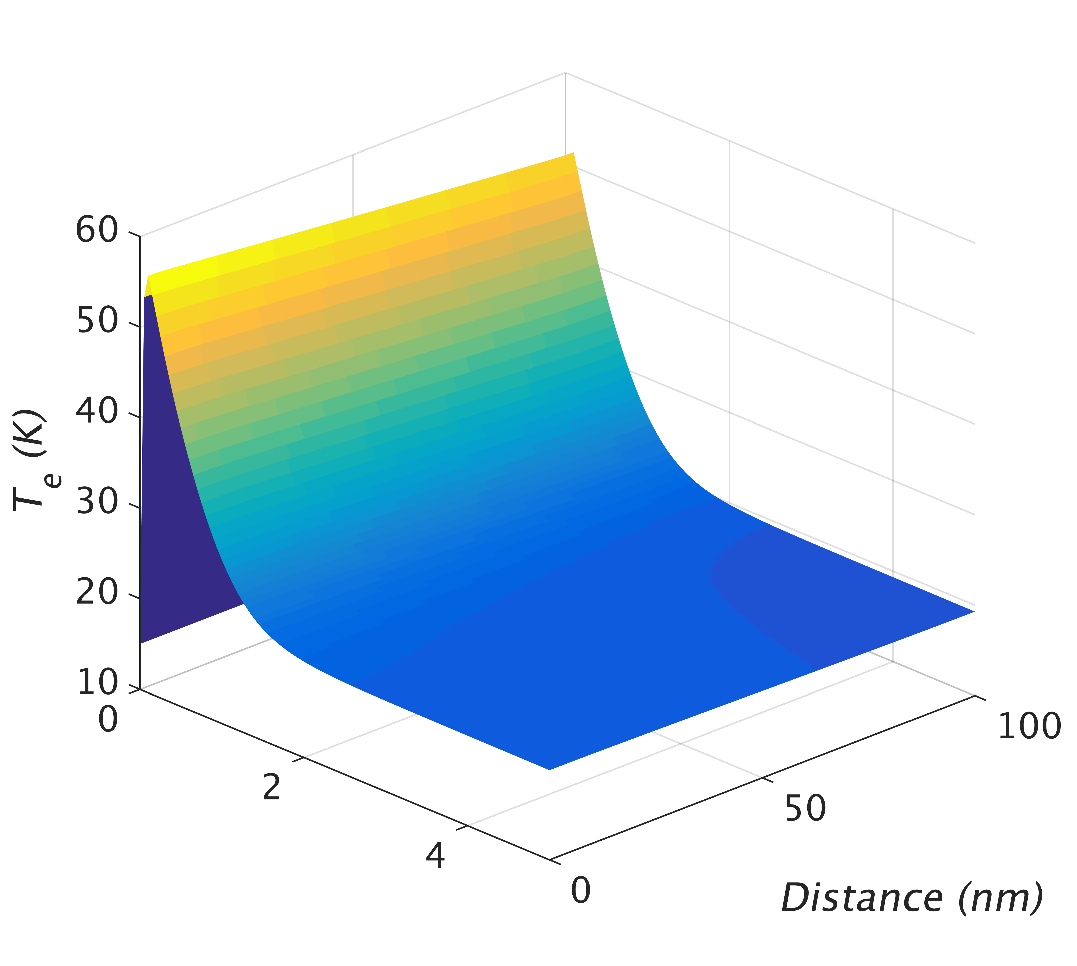
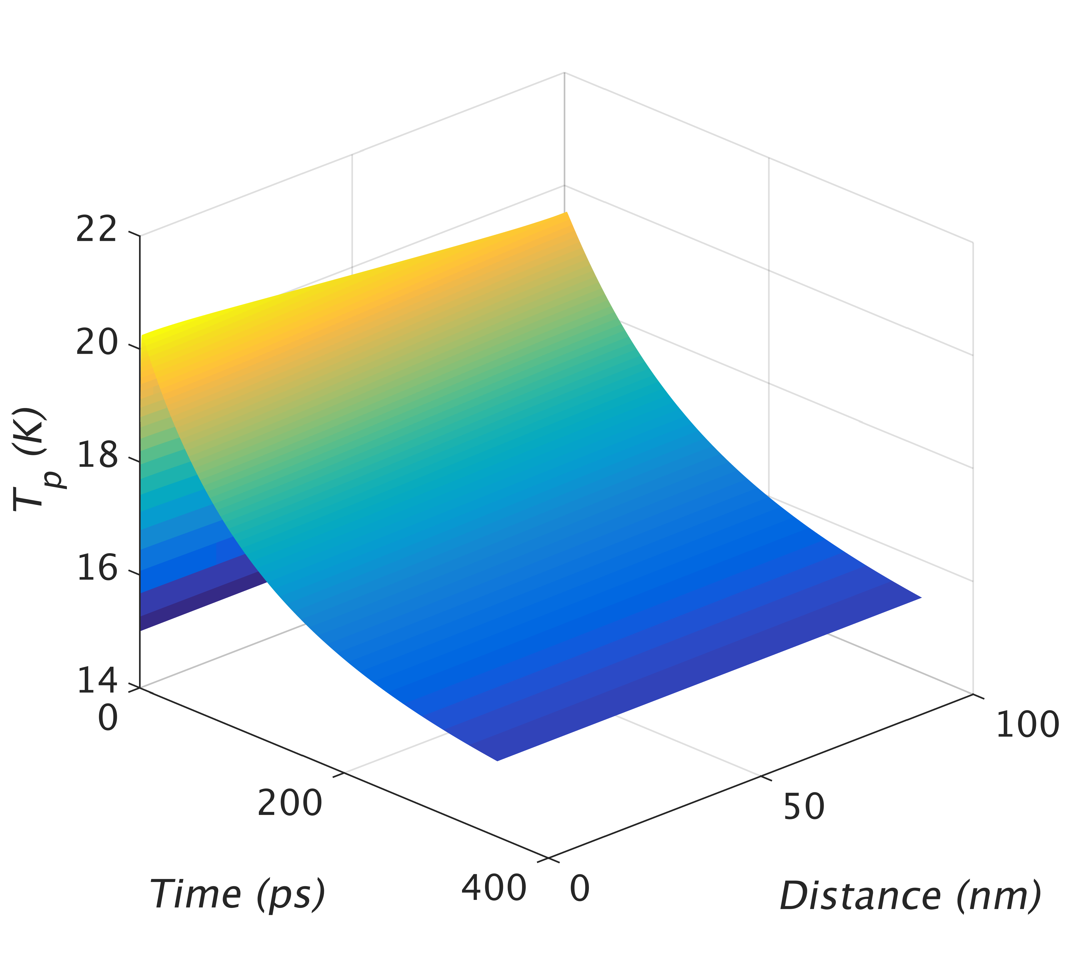
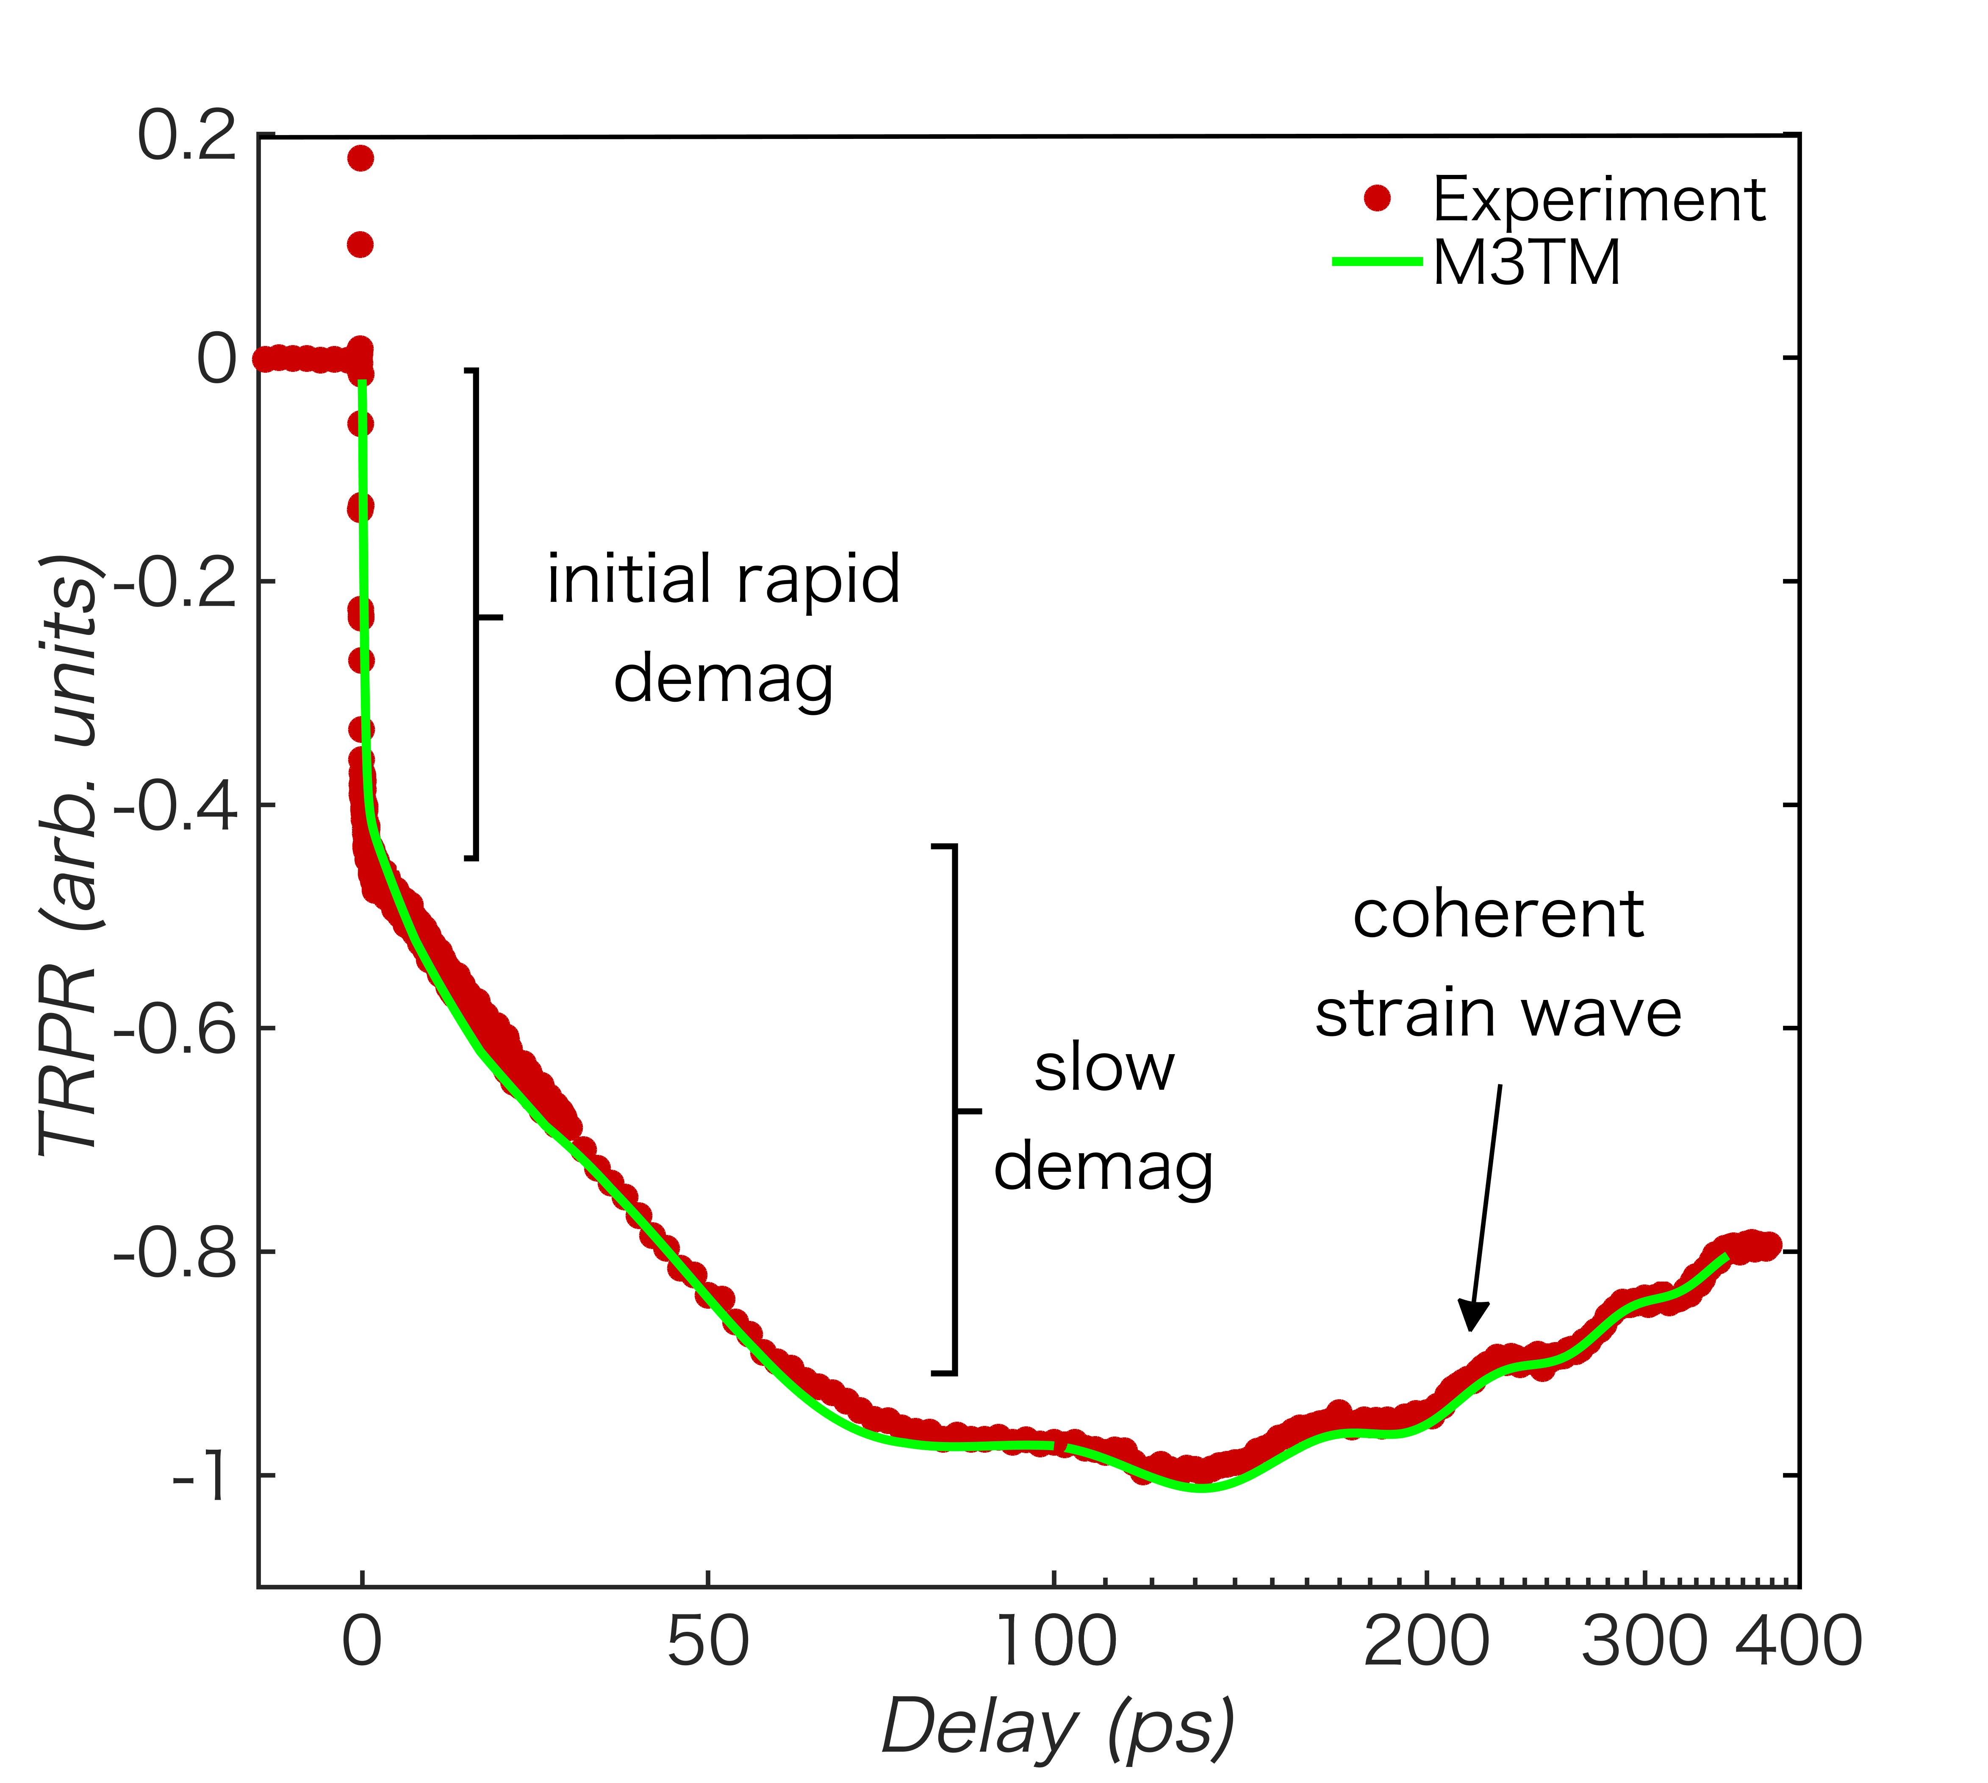
Modeling Demagnetization with the Microscopic Three-Temperature Model
Strong spin-orbit coupling allows for demagnetization that can be driven by Elliott-Yafet scattering and modeled with the M3TM
B. Koopmans et al., Nature Mater. 9, 259 (2010)
Notes:
R is a material-specific scaling factor for the demag rate and depends on a_sf, the probability that an electron spin-flips after emission/absorption of a phonon
Type-II demag: initial rapid demag on left due to spin-flip scattering, slower e-ph coupling on middle figure, but if initial demag isn’t completed during e-ph thermalization, then the rate gets slower since the system temperature is lower after e-ph equilibration

Slide 9
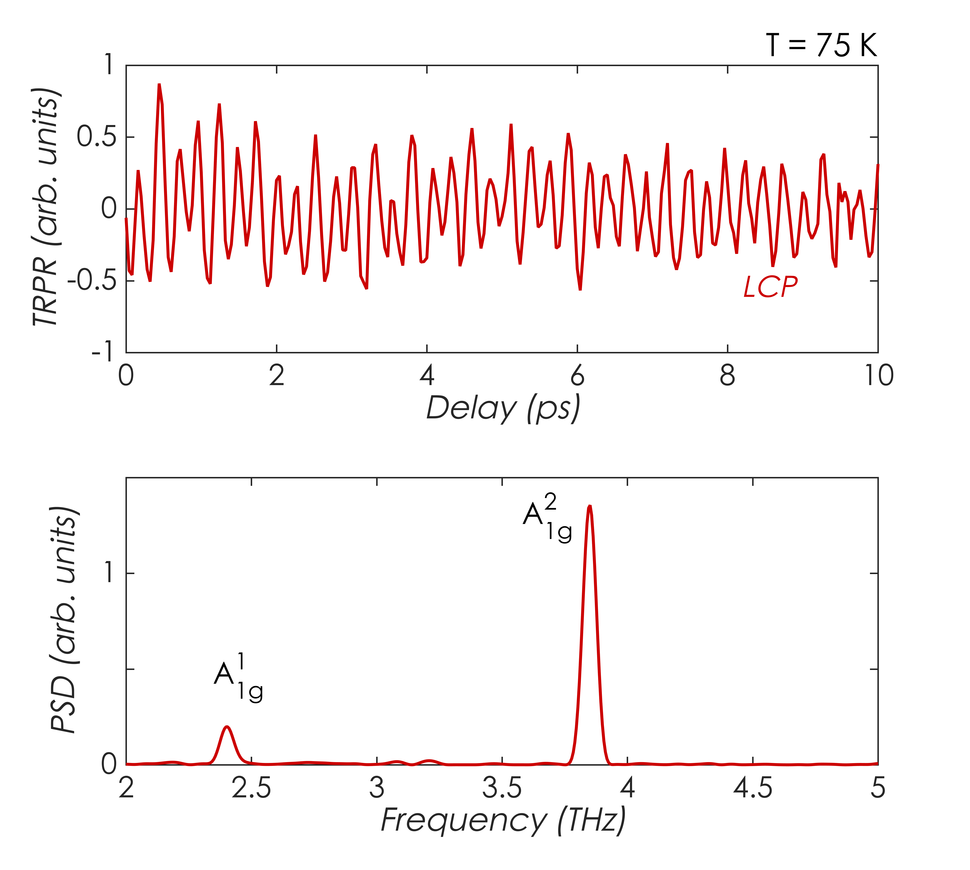
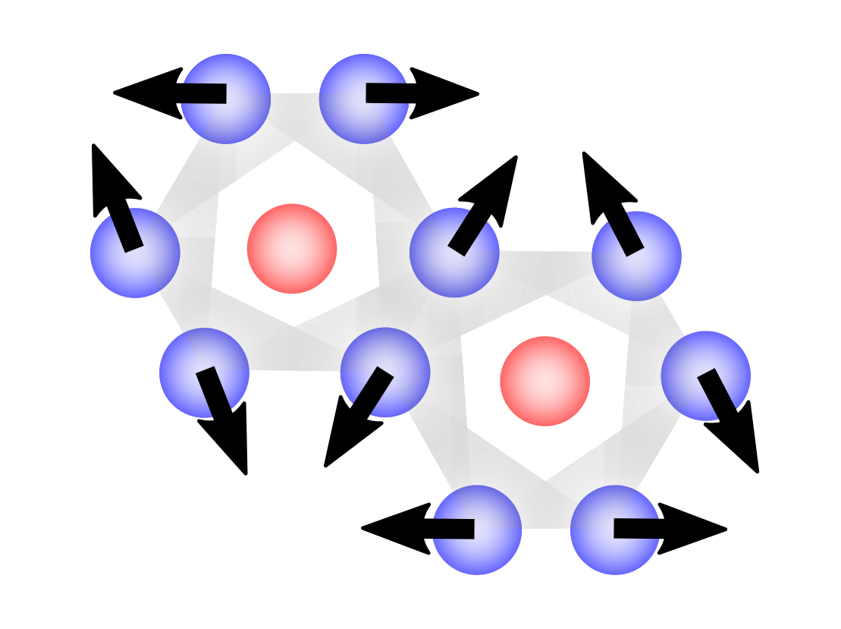
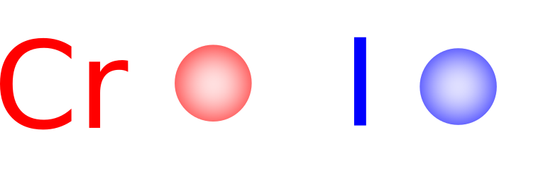
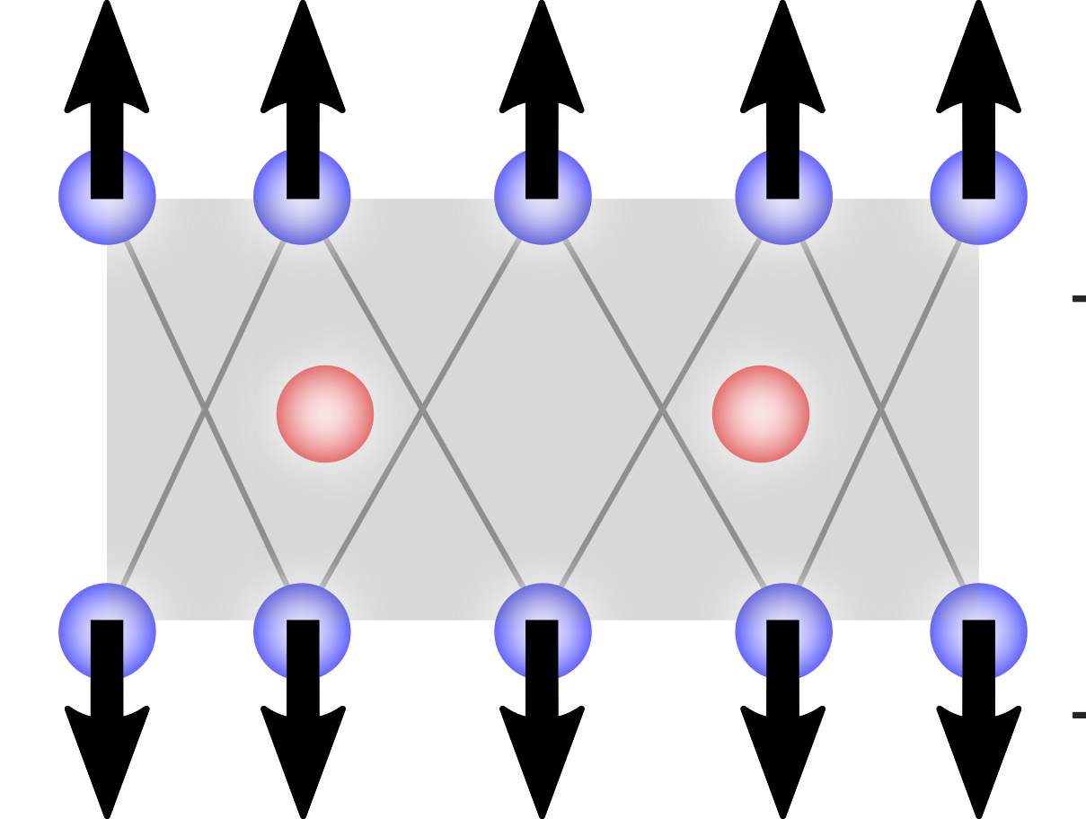


A Closer Look at the Coherent Modes
$A_{1g}^{1}$ (~ 2.4 THz)
ab-plane iodine atom oscillations
$A_{1g}^{2}$ (~ 3.9 THz)
c-axis iodine atom oscillations
Coherent oscillations correspond to A_{1g} symmetry phonon modes
What happens if we change the pump polarization?
L. Webster, et al., Phys. Chem. Chem. Phys. 20, 23546 (2018)
Notes:
Relatively small c-axis distortions, not necessarily lattice constant, pm (hundredths of an angstrom), time-dependent modulations of the Iodine octahedra
Why do we show the 75 K data vs. 15 K here?

Slide 10
Pump Helicity Dependence of Coherent Modes
Above T_{c}, nearly equivalent amplitude for both modes under RCP and LCP pumping
Below T_{c}, higher energy mode has substantially lower amplitude under LCP pumping
P. Padmanabhan et al., https://arxiv.org/abs/2010.04915

Slide 11
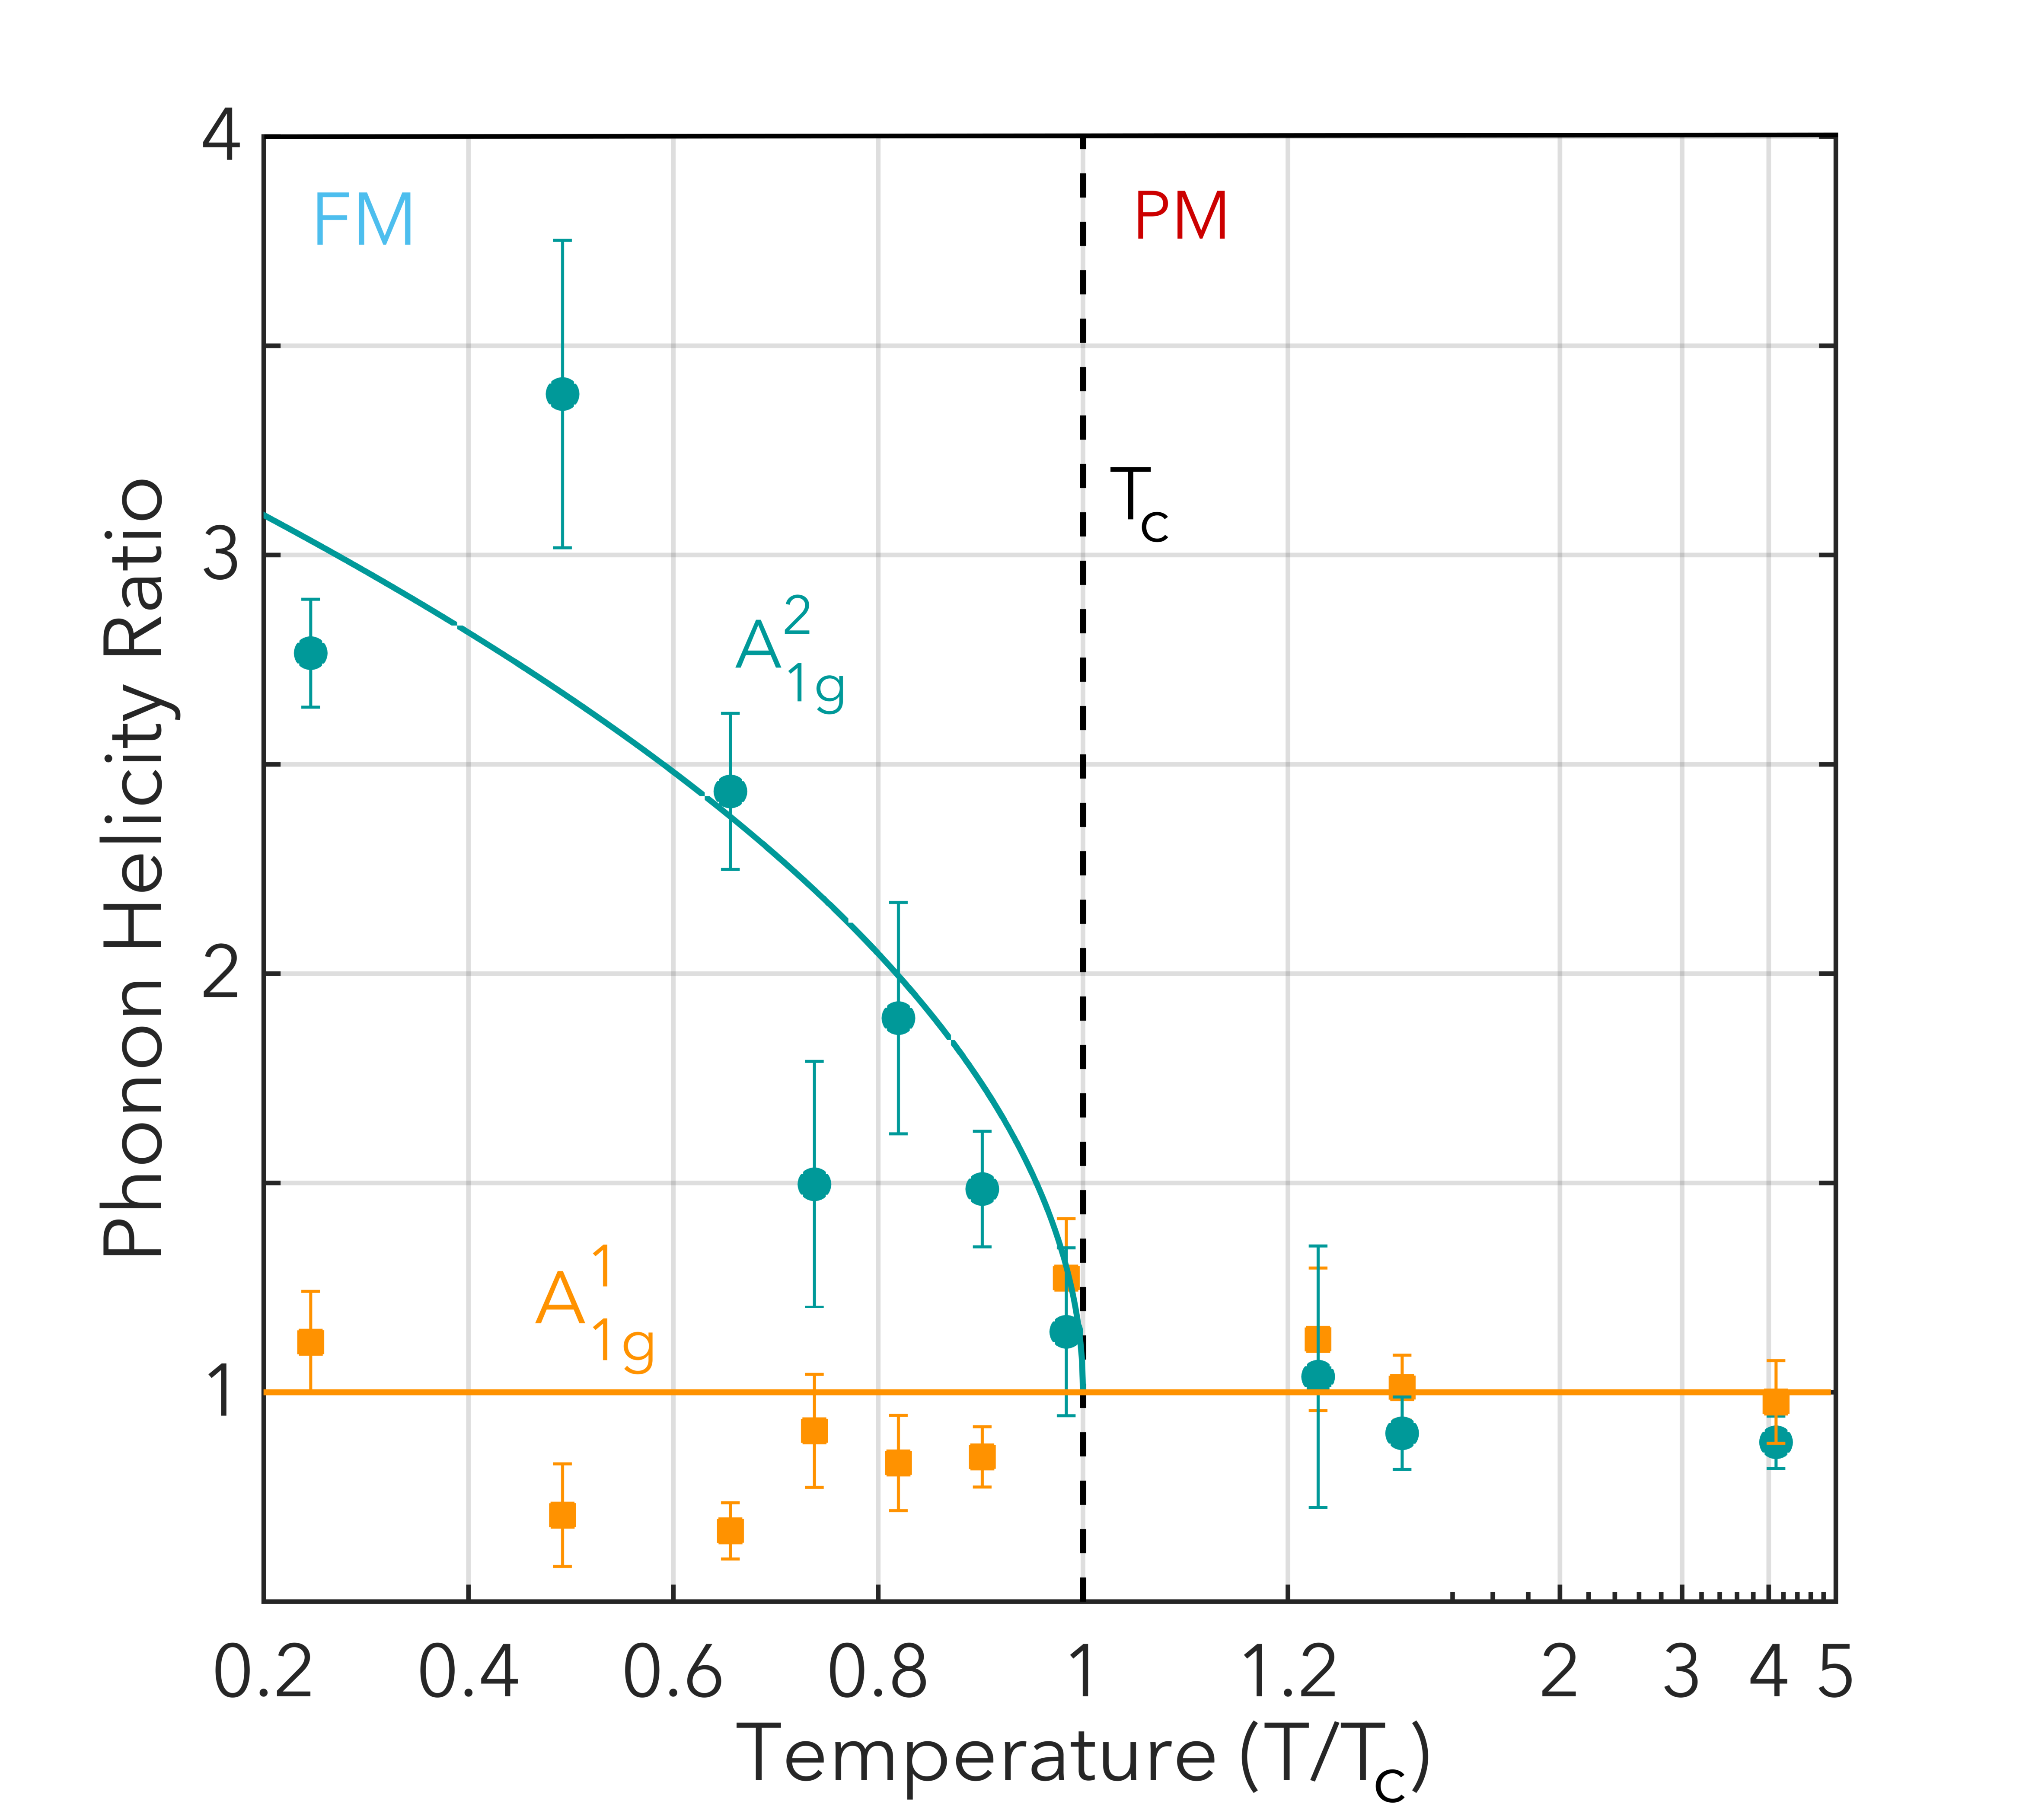
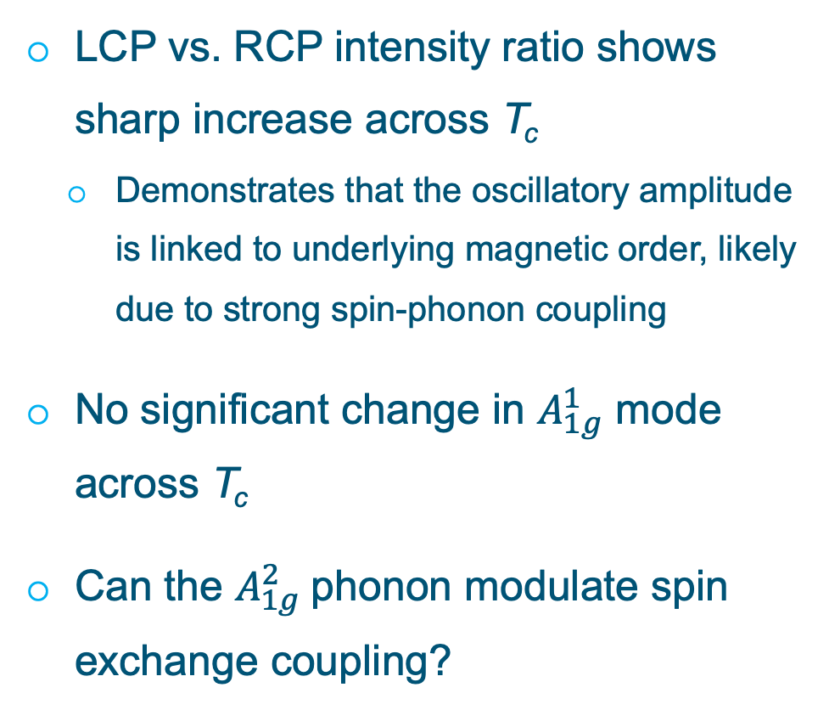
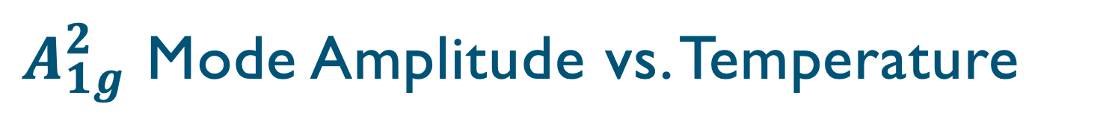
$A_{1g}^{2}$ Mode Amplitude vs. Temperature
LCP vs. RCP intensity ratio shows sharp increase across T_{c}
  Demonstrates that the oscillatory amplitude is linked to underlying magnetic order, likely due to strong spin-phonon coupling
No significant change in $A_{1g}^{1}$ mode across T_{c}
Can the $A_{1g}^{2}$phonon modulate spin exchange coupling?
P. Padmanabhan et al., https://arxiv.org/abs/2010.04915

Slide 12
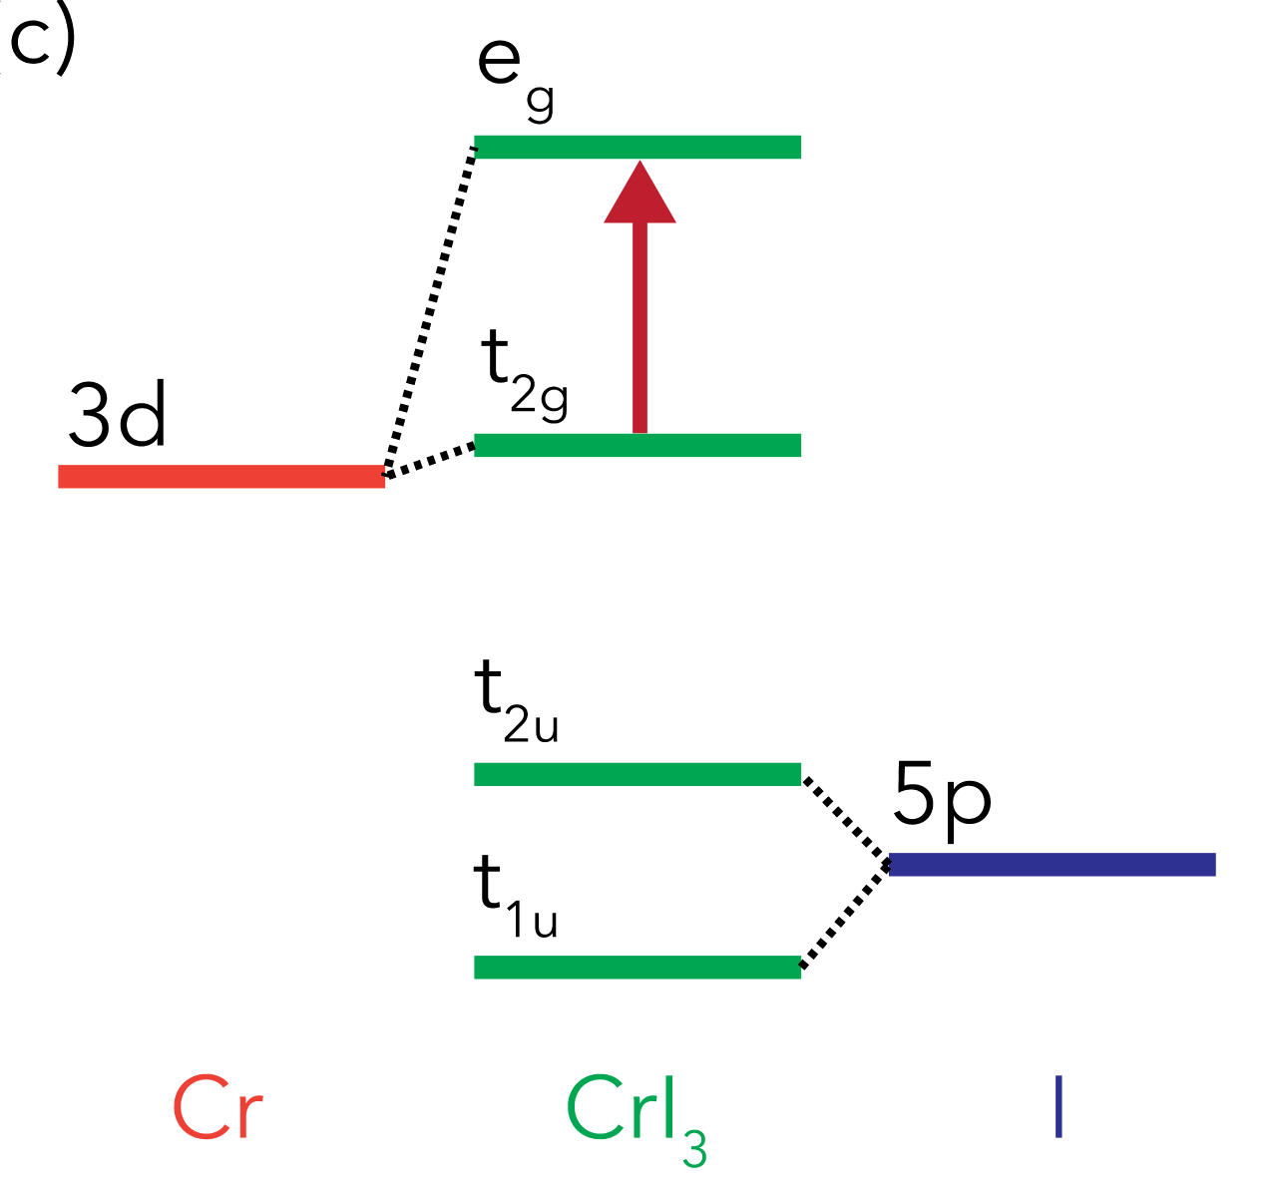
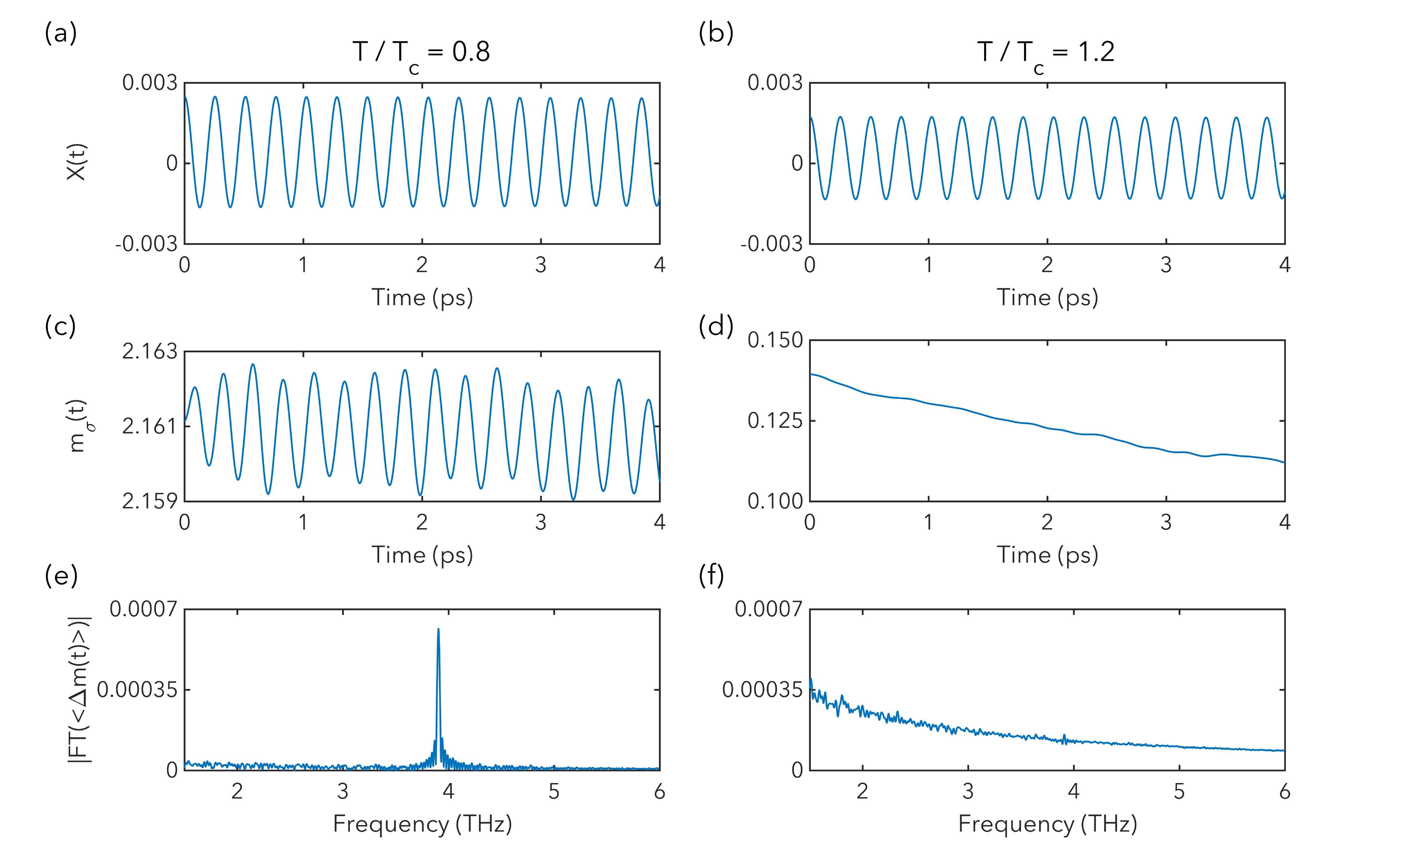
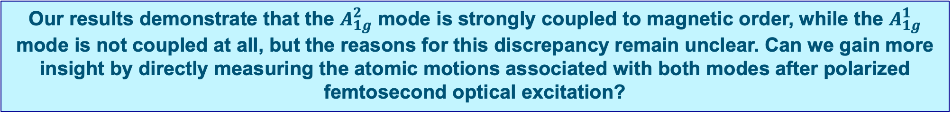
Capturing Spin-Phonon Coupling in CrI₃
Model Equations
Our results demonstrate that the $A_{1g}^{2}$ mode is strongly coupled to magnetic order, while the $A_{1g}^{1}$ mode is not coupled at all, but the reasons for this discrepancy remain unclear. Can we gain more insight by directly measuring the atomic motions associated with both modes after polarized femtosecond optical excitation?
Notes:
Pump pulse provides a helicity-dependent lattice distortion, Q=Q+psi1(1+sig*psi2*m), where Q is lattice displacement
Last term in Hamiltonian is off-diagonal symmetric exchange
Note that we could neglect coupling to other exchange terms besides J_H
DFT says that changes in Q change E by 3.2 meV/nm of displacement for A_1g(2) phonon

Slide 13
Proposed Ultrafast Electron Diffraction Experiments on CrI₃
H ll c
Optical pump
(800 nm; 1.55 eV)
Electron
probe
CrI₃

Slide 14
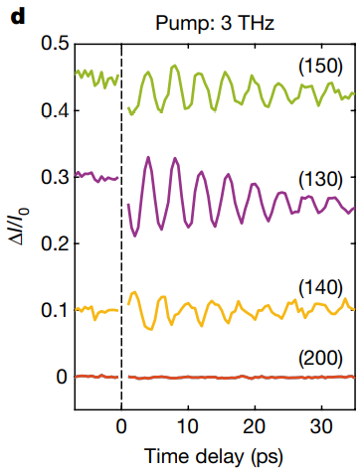
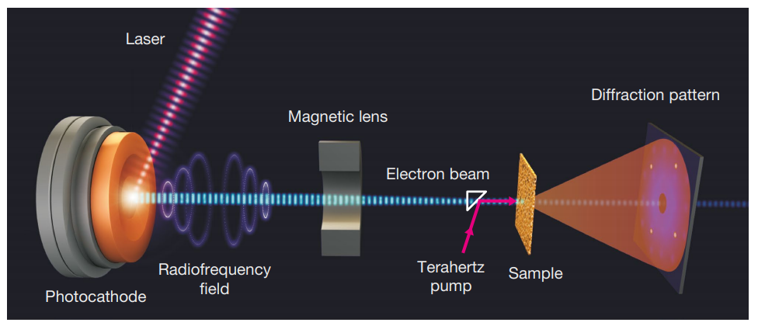
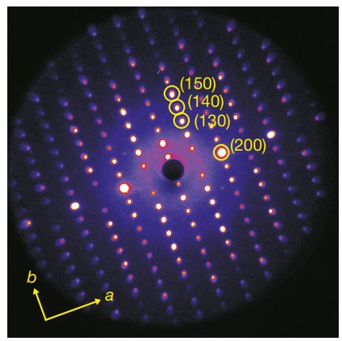
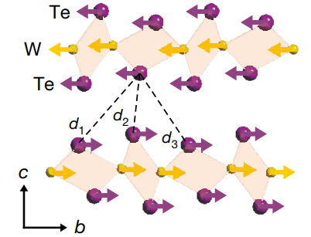
Using UED to Study Coherent Phonons in Quantum Materials
Nature 565, 61 (2019)
THz pump, UED probe experiments were performed at SLAC on the Weyl semimetal WTe₂
Temporally resolved dynamics at Bragg peaks
Observed coherent acoustic phonon oscillations due to a shear mode, which drives a topologically distinct metastable state

Slide 15
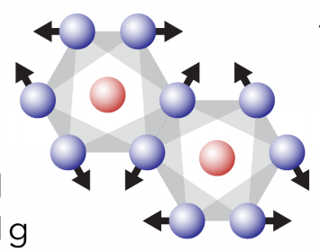
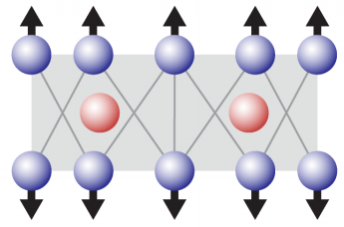
Using Bragg Diffraction to Probe the A_{1g} Modes in CrI₃
Simulating changes in X-ray Bragg diffraction peaks
by a lattice modulation of ~ ±1 pm
+
Q = (-6 8 4)
A_{1g}¹
in-plane mode
(79 cm⁻¹)
X-ray diffraction intensity (a. u.)
+
Q = (0 0 9)
A_{1g}²
-
out-of-plane mode
(129 cm⁻¹)
MeV-UED is more beneficial than time-resolved X-ray diffraction for studying lattice dynamics, due to its high spatial resolution (< 0.5 Å)
Notes:
Presumably the (-6 8 4) peak corresponds to the A1g(1) mode, and the (009) peak corresponds to the A1g(2) mode?

Slide 16
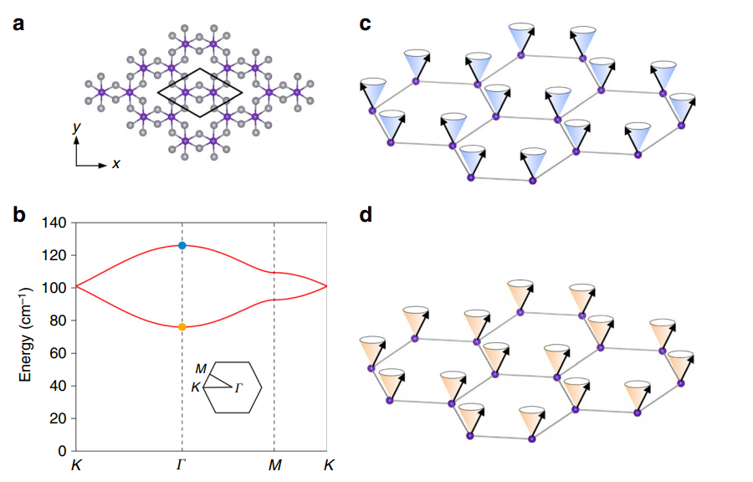
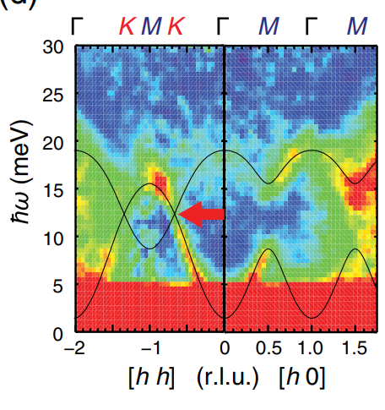
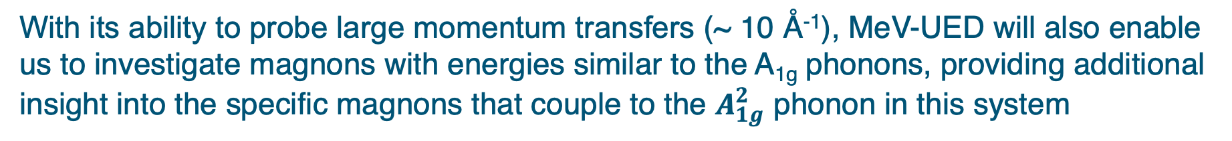
Phonon and Magnon Dispersion of CrI₃
Inelastic neutron scattering
Magnon dispersion
Nat. Commun. 9, 5122 (2018)
Phys. Rev. X 8, 041028 (2018)
With its ability to probe large momentum transfers (~ 10 Å⁻¹), MeV-UED will also enable us to investigate magnons with energies similar to the A_{1g} phonons, providing additional insight into the specific magnons that couple to the $A_{1g}^{2}$ phonon in this system

Slide 17
Special Equipment Requirements and Hazards
Special equipment:
None.
Hazards:
Potential hazards include the laser of the MUED instrument and the cryogenic system necessary to cool the samples to the desired temperatures (<60 K). We would also like to apply an external magnetic field up to 1 T if possible. We will work with our BNL collaborators to exercise the necessary precautions.

Slide 18
Experimental Time Request
CY2021 Time Request
Capability | Setup Hours | Running Hours
UED Facility | 16 | 32
Time Estimate for Remaining Years of Experiment (including CY2021)
Capability | Setup Hours | Running Hours
UED Facility | 32 | 80

Slide 19
Conclusions and Future Directions
Ultrafast optical microscopy revealed strong helicity-dependent coherent phonon oscillations in bulk CrI₃
Pump helicity dependence of higher energy A_{1g} phonon below T_{c} demonstrates its strong coupling to the magnetization, while lower energy A_{1g} phonon has no measurable coupling
MeV-ultrafast electron diffraction can provide new insight into spin-phonon coupling in CrI₃:
By directly resolving the relevant atomic motions for both phonon modes as a function of temperature and pump polarization, we can shed light on the differences in coupling between both phonon modes
We can take advantage of the ability of MeV-UED to track magnon dynamics, enabling us to determine the coupling of specific magnons to specific phonons
We plan to extend these studies to few-layer CrI₃, providing even more insight into this hotly studied material
P. Padmanabhan et al., https://arxiv.org/abs/2010.04915

Slide 20
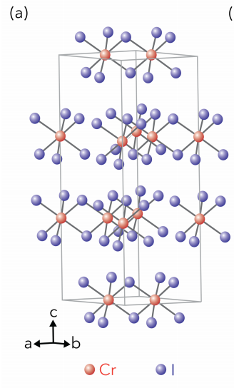
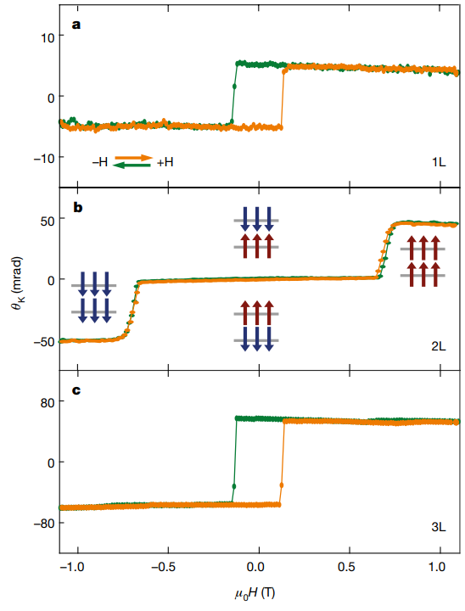
Layer-Dependent Magnetic Properties of CrI₃
Magneto-Optical Kerr effect
M
Nature 546, 270 (2017).
Monolayer:
Ferromagnetic
(T_{C} = 45 K)
c
Bilayer:
Antiferromagnetic
(T_{N} = 61 K)
c
Bulk:
Ferromagnetic
(T_{C} = 61 K)
c
An external magnetic field (~1 T) can switch the 2D magnetism of vdW CrI₃.

Slide 21
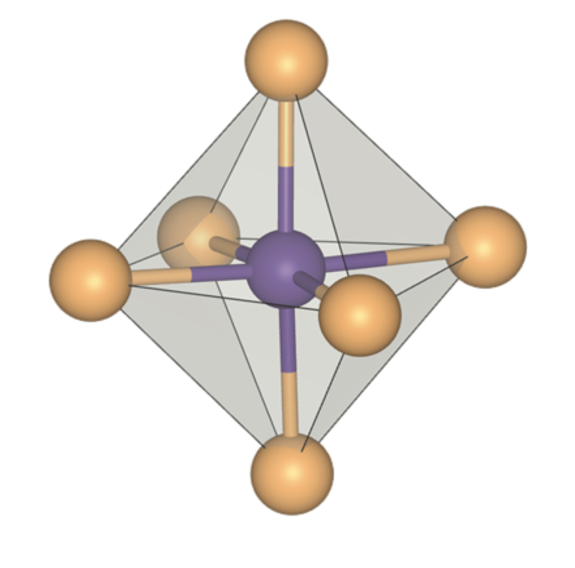
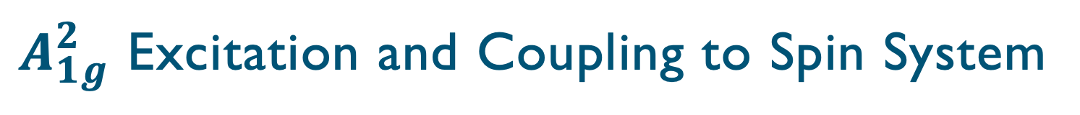
$A_{1g}^{2}$ Excitation and Coupling to Spin System
I. Lee, et al., Phys. Rev. Lett. 124, 017201 (2020)

