Slide 1
ATF status report and plans
Vitaly Yakimenko
April 26, 2012

Slide 2
Beam allocation:
October 2010-April 2012
Total: 284 shifts

Slide 3
ATF Organization Chart
DOE BES
J. Misewich, ALD –(Contact)
DOE HE,
S. Vigdor, ALD – (Contact)
R. Palmer
ATF Program Director
T. Ludlam
Chair, Physics Department
External program committee
W. Leemans, Chair
L. Littenberg
HEP Ass. Chair, Physics Dept.
V. Yakimenko
Director ATF, Accelerator
K. Tuohy
Group Secretary
Management/
oversight
I. Pogorelsky,
Physicist,
Laser
M. Fedurin
Physicist,
Accelerator
A. Karostoshevsky,
Mechanical designer
Full time staff
M. Polyansky,
Physicist,
Laser
C. Swinson
Research Associate,
Accelerator
M. Montemagno
Engineer Electrical
Part time
M. Babzien
Engineer,
Laser
R. Malone
Computer Control
Temp/LDRD
G. Stenby
Technician
Electr./Mech.
K. Kusche
Safety Engineer
New people
P. Jacob
Technician
Mech./Laser

Slide 4
Expected changes
DOE BES
J. Misewich, ALD –(Contact)
DOE HEP,
ALD – (Contact)
I. Ben-Zvi
ATF Program Director
Department Chair
External program committee
W. Leemans, Chair
V. Yakimenko
Director ATF, Accelerator
K. Tuohy
Group Secretary
Management/
oversight
I. Pogorelsky,
Physicist,
Laser
M. Fedurin
Physicist,
Accelerator
A. Karostoshevsky,
Mechanical designer
Full time staff
M. Polyansky,
Physicist,
Laser
C. Swinson
Research Associate,
Accelerator
M. Montemagno
Engineer Electrical
Part time
M. Babzien
Engineer,
Laser
R. Malone
Computer Control
Temp/LDRD
G. Stenby
Technician
Electr./Mech.
Olivier Tresca
Research Associate
Laser Ion Generation
K. Kusche
Safety Engineer
New people
P. Jacob
Technician
Mech./Laser

Slide 5
Journal Publications (last 18 months)
2012 - S. Antipov, et al. "Experimental demonstration of wakefield effects in a THz planar diamond accelerating structure ", Appl. Phys. Lett. , 100, 132910
2012 - F. H. O’Shea, et al. "Single Shot Diffraction of Picosecond 8.7 keV X-ray Pulses", Phys. Rev. ST Accel. Beams 15, 020702
2012 - S. Antipov, et al. "Experimental Observation of Energy Modulation in Electron Beams Passing through Terahertz Dielectric Wakefield Structures", Phys. Rev. Lett. , 108,144801
2012 - M. N. Polyanskiy and M. Babzien, "Ultrashort pulses," in: CO2 laser – optimization and application, D. C. Dumitras (ed.), InTech, ISBN 978-953-51-0351-6, pp 139-162
2011 - M. N. Polyanskiy et al. "Picosecond pulse amplification in isotopic CO2 active medium", Optics Express, Vol. 19 Issue 8, pp.7717-7725, 2011
2011 - Z. Najmudin et al. "Observation of impurity free monoenergetic proton beams from the interaction of a CO2 laser with a gaseous target", Phys. of Plasma ,18 ,056705
2011 - I. V. Pogorelsky, et al. "Laser induced cavities and solitons in overcritical hydrogen plasma" Laser Physics, 21:1288-1294
2011 - M. Endrizzi et al. "Quantitative phase retrieval with picosecond X-ray pulses from the ATF" Optics Express, Vol. 19 Issue 3, pp.2748-2753
2011 - V. Yakimenko et al. "Proton-based driver for the plasma wake-field accelerator with TeV reach", Plasma Phys. Control. Fusion, 53, 085010
2011 - G. Andonian et al. "Resonant excitation of coherent Cerenkov radiation in dielectric lined waveguides", Appl. Phys. Lett. , 98, 202901
2011 - C. A. J. Palmer et al. "Monoenergetic Proton Beams Accelerated by a Radiation Pressure Driven Shock ", Phys. Rev. Lett. , 106, 014801
2010 - P. Muggli, et al. "Simple method for generating adjustable trains of picosecond electron bunches", Phys. Rev. ST Accel. Beams 13, 052803
2010 - P. Oliva, et al. "Quantitative evaluation of single-shot inline phase contrast imaging using an inverse Compton x-ray source", Appl. Phys. Lett. 97, 134104
At least six papers are in the review process or close to submission

Slide 6







Students who worked at ATF
(last 18 months)
B. Allen USC
E. Arab UCLA
S. Barber UCLA
K. Boratay UT Austin
C. Brenner Strathclyde Univ
D. Carrol Strathclyde Univ
N. Cook SUNY SB
N. Dover Imperial college
J. Duris UCLA
Yu. Fang USC
A. Flacco Ecole Polytechnique
S. Kahalu Ecole Polytechnique
B. O'Shea UCLA
F. O'Shea UCLA
A. Ovodenlo UCLA
C. Palmer Imperial college
Yu. Sakai UCLA
L. Shao UCLA
M. Streeter Imperial college
F. Sylla Ecole Polytechnique
E. Threlkeld UCLA
O. Williams UCLA

Slide 7

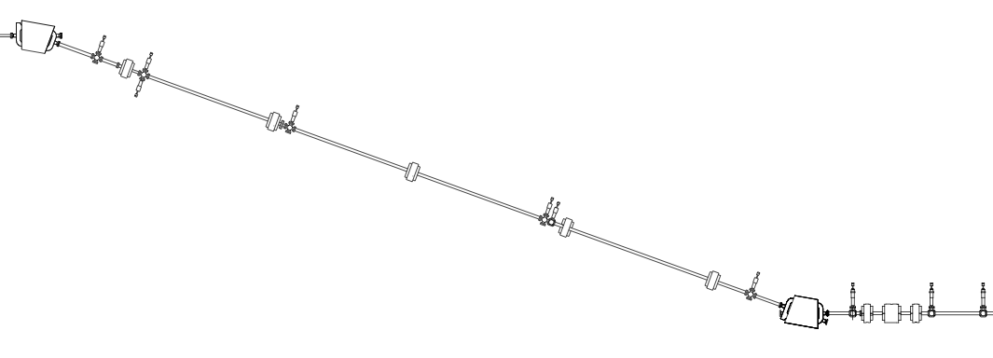


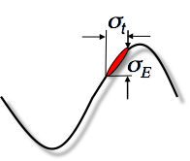

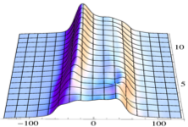
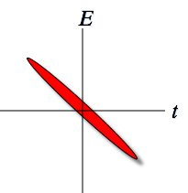
New beam capabilities:
Used for experiments:
  Extremely stable chirped beam to characterized ~10⁻⁵ energy variation (CSR suppression studies)
Collimated beam parts
Energy spectrum after dipole with plates open and closed
Transmitted beam slice
head
tail
Measured beam energy spectrum as function of the gap between the shielding plates
tail
head
Plates gap [mm]
Energy [KeV] /time

Slide 8
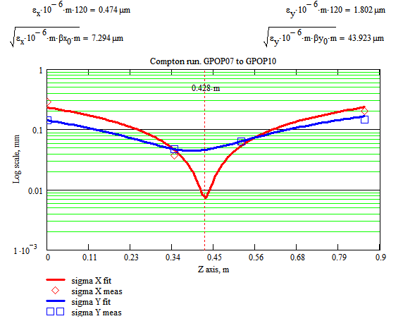
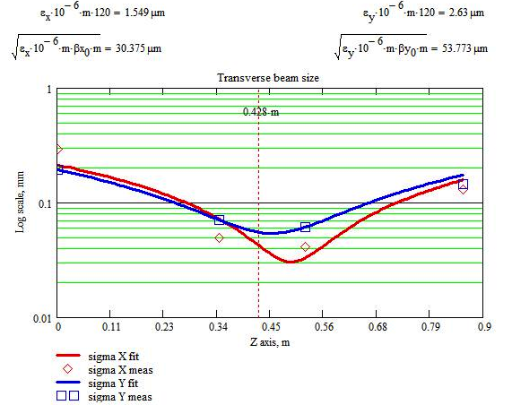
New beam capabilities:
Used for experiments:
  Extremely stable chirped beam to characterized ~10⁻⁵ energy variation (CSR suppression studies)
  ~30 microns (RMS) beam in PWFA, DWFA and Compton location characterized with four screen

Slide 9
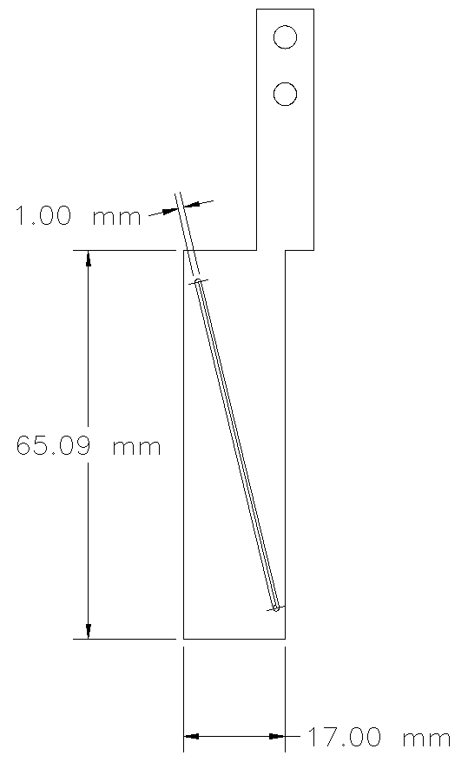
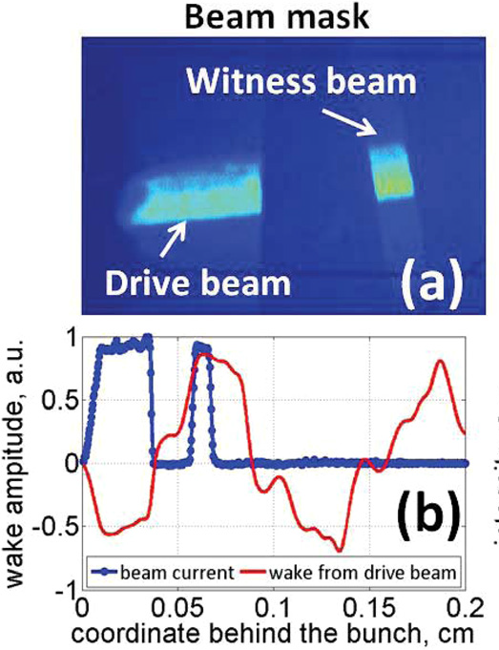
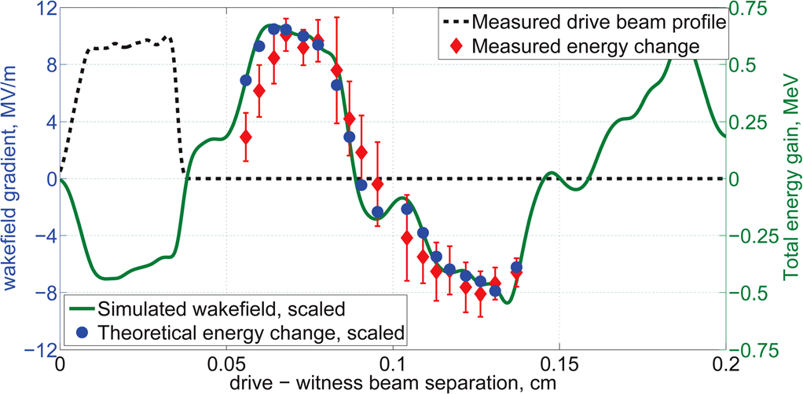
New beam capabilities:
Used for experiments:
  Extremely stable chirped beam to characterized ~10⁻⁵ energy variation (CSR suppression studies)
  ~30 microns (RMS) beam in PWFA, DWFA and Compton location characterized with four screen
  Continuously tunable spacing between drive and witness bunches for short range wakefield characterization (DWFA structures)

Slide 10
New beam capabilities:
Used for experiments:
  Extremely stable chirped beam to characterized ~10⁻⁵ energy variation (CSR suppression studies)
  ~30 microns (RMS) beam in PWFA, DWFA and Compton location characterized with four screen
  Continuously tunable spacing between drive and witness bunches for short range wakefield characterization (DWFA structures)
  ~5 microns (RMS) beam focused with PMQs and characterized with in vacuum microscope with ~1 micron optical resolution (optical acceleration structures)
σ_{x} = 7 μm
σ_{y} = 15 μm

Slide 11
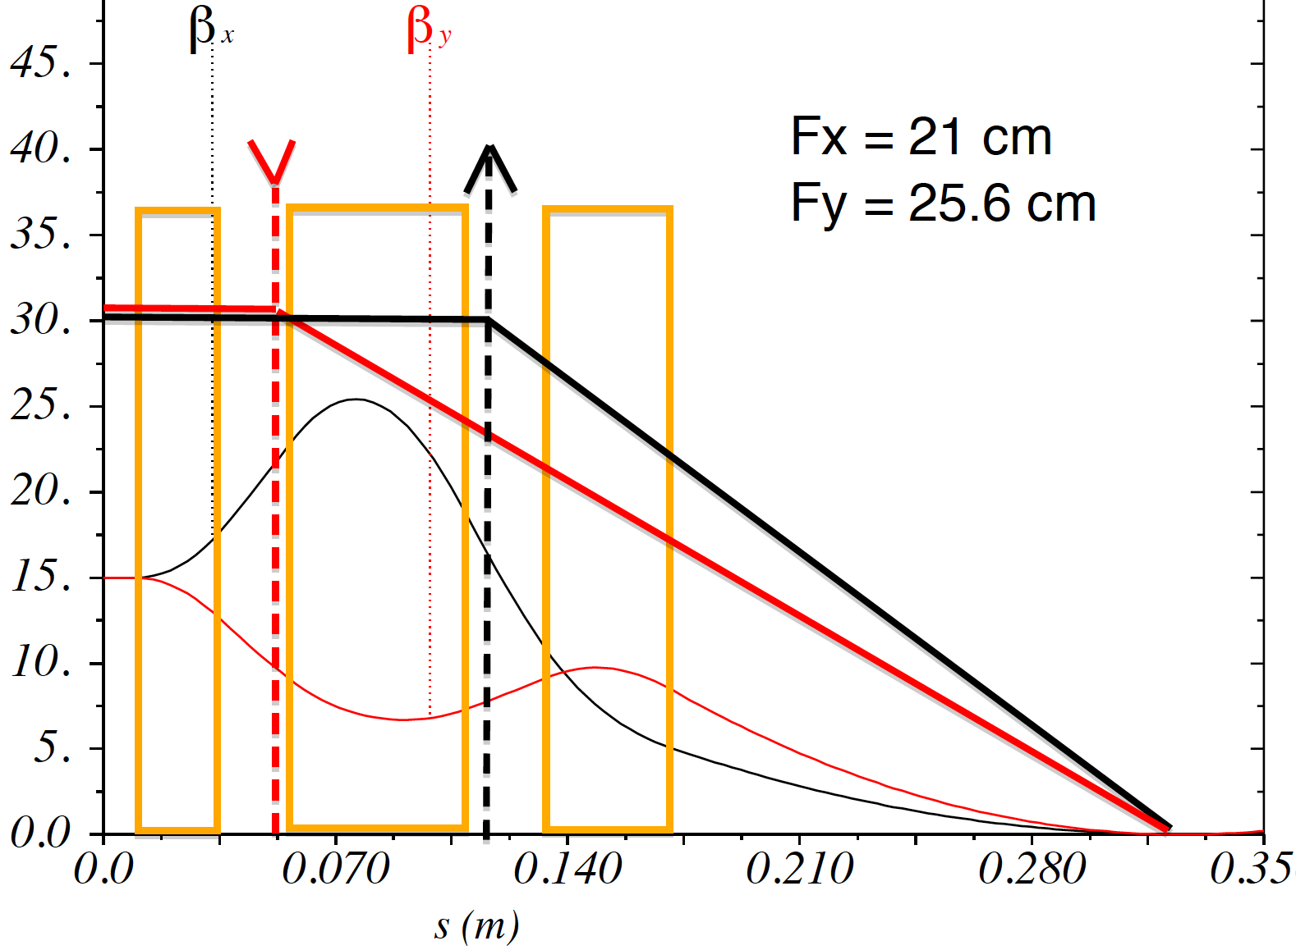
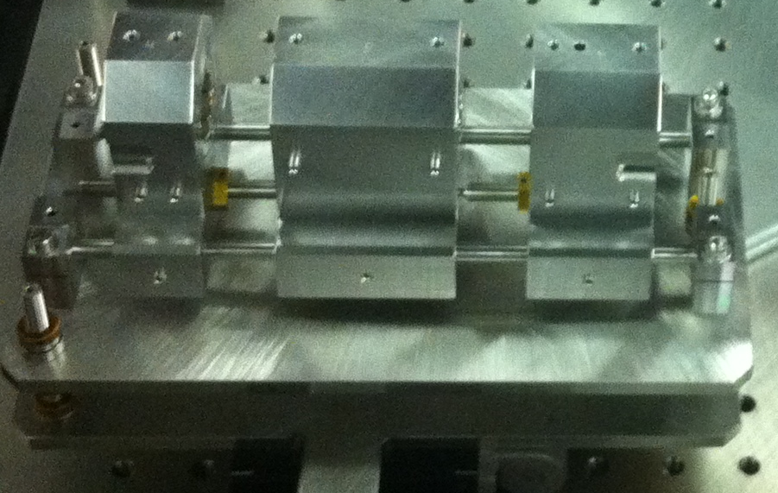
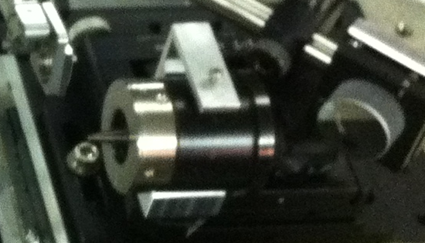
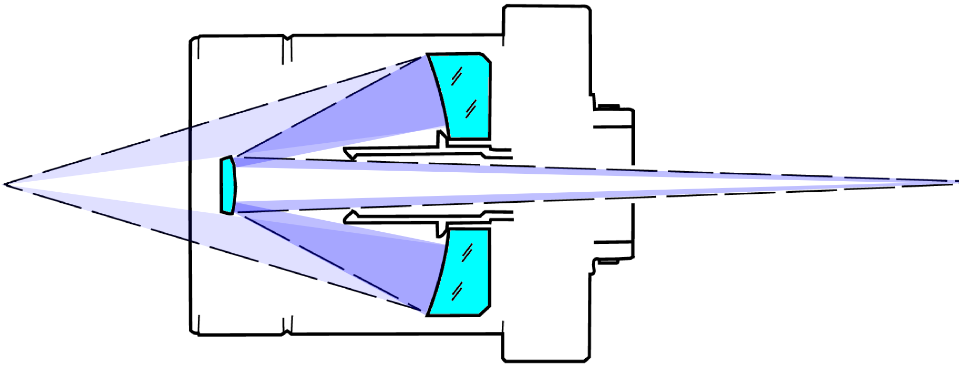
μbeam
σ_{x} = 7 μm
σ_{y} = 15 μm
σ_{x} = 7 μm
σ_{y} = 115 μm
PMQ triplet set to have equivalent to thing lens matrix
β_{x} = 3 mm
β_{y} = 3 mm
Reflective objective
optical resolution: 1.25 μm
calibration:
0.63 μm/pix

Slide 12
New beam capabilities:
Used for experiments:
  Extremely stable chirped beam to characterized ~10⁻⁵ energy variation (CSR suppression studies)
  ~30 microns (RMS) beam in PWFA, DWFA and Compton location characterized with four screen
  Continuously tunable spacing between drive and witness bunches for short range wakefield characterization (DWFA structures)
  ~5 microns (RMS) beam focused with PMQs and characterized with in vacuum microscope with ~1 micron optical resolution (optical acceleration structures)
Plans:
  X band deflecting cavity

Slide 13
New laser capabilities:
(10mJ/5ps high rep rate; 5J/5ps)
CO₂ laser
  Ti:Sapphire seed system being commissioned
  Regenerative amplifier rebuild with Pockels cells replaced by Ge Switches => ~10x output intensity.
  Electromechanical control of main amplifier mirrors.
  Change in main amplifier configuration after studies of saturation effects.
Plans:
  Shorter pulse/ more stable output with new seed
  Si switch to protect windows damage from amplified back reflection (laser plasma interaction).
  Main amplifier maintenance: to re-optimize/restore discharge energy.
  Chirped pulse amplification studies.
  ~100fs timing distribution for ATF subsystems: photo injector laser; CO2 seed laser, RF systems…

Slide 14
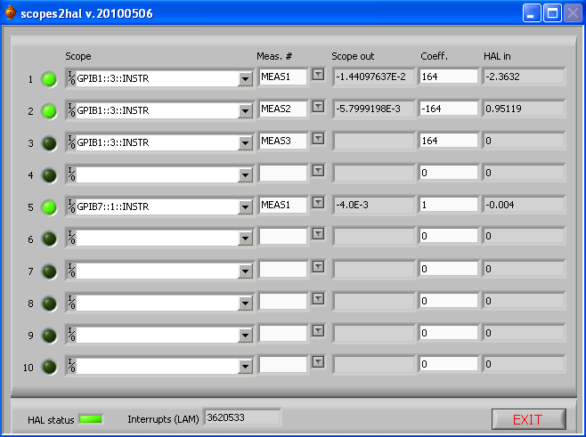
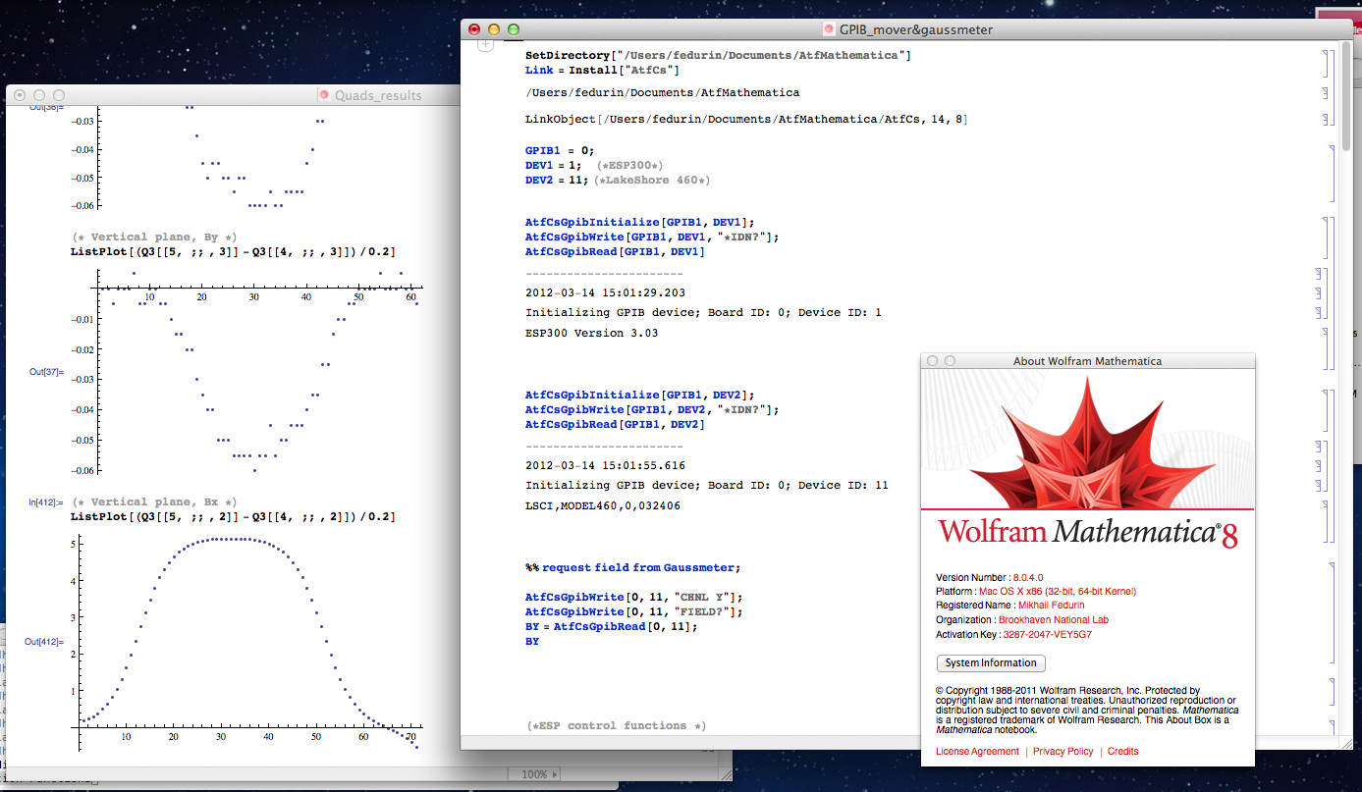
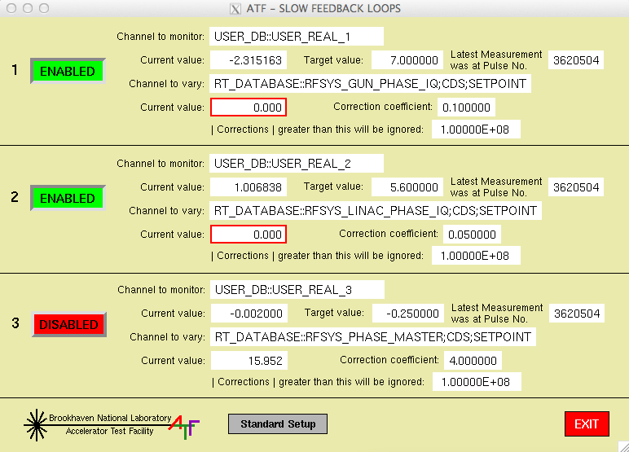
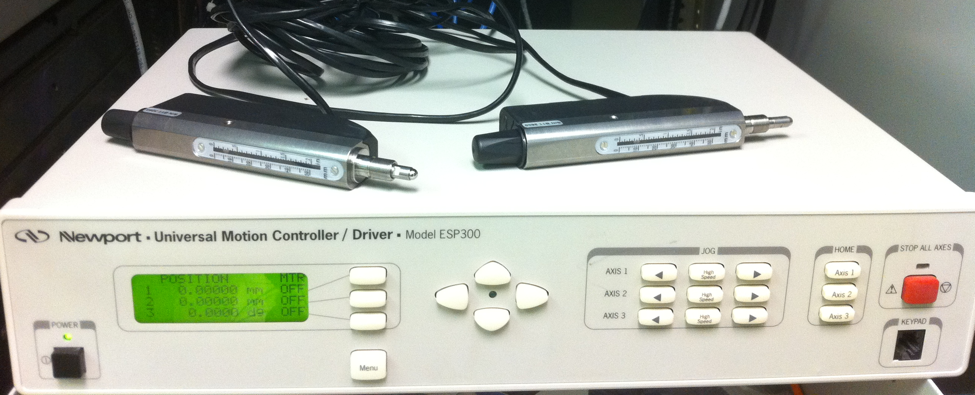
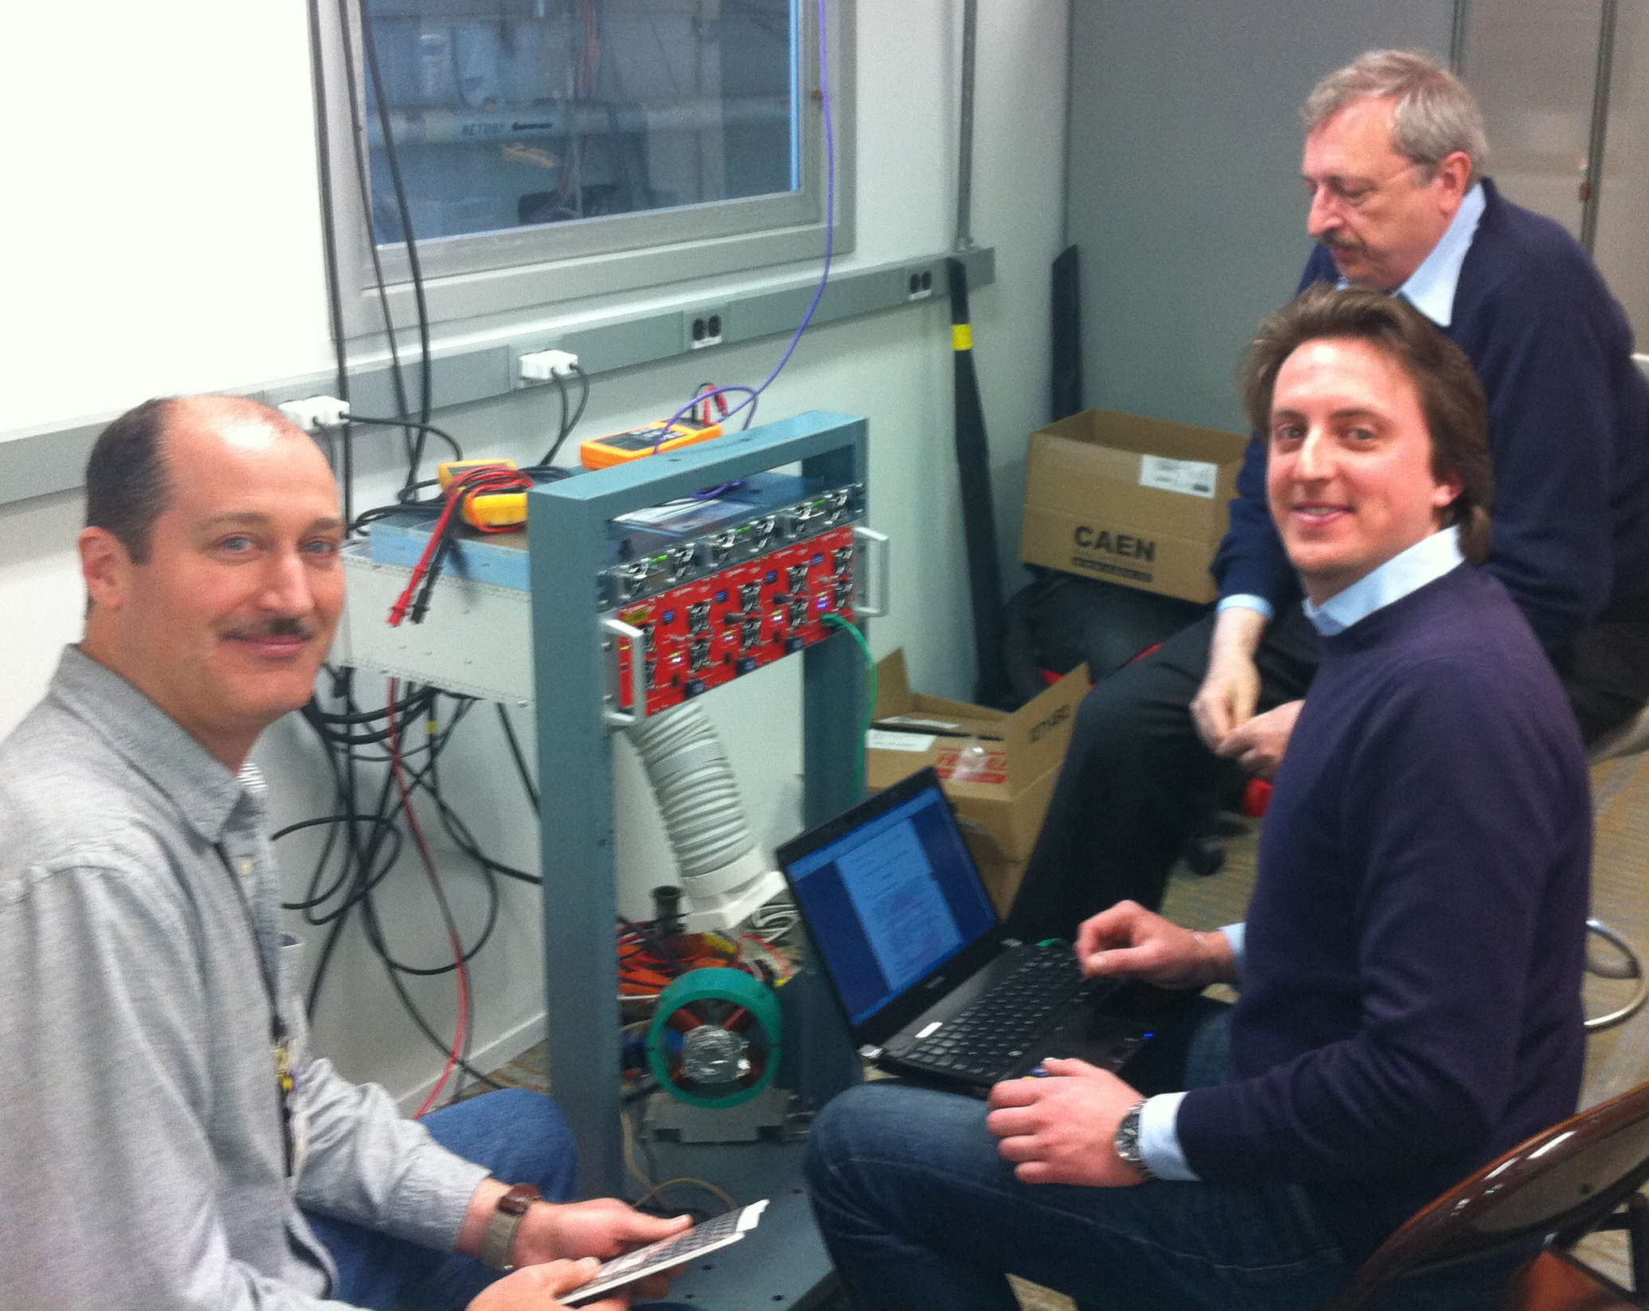
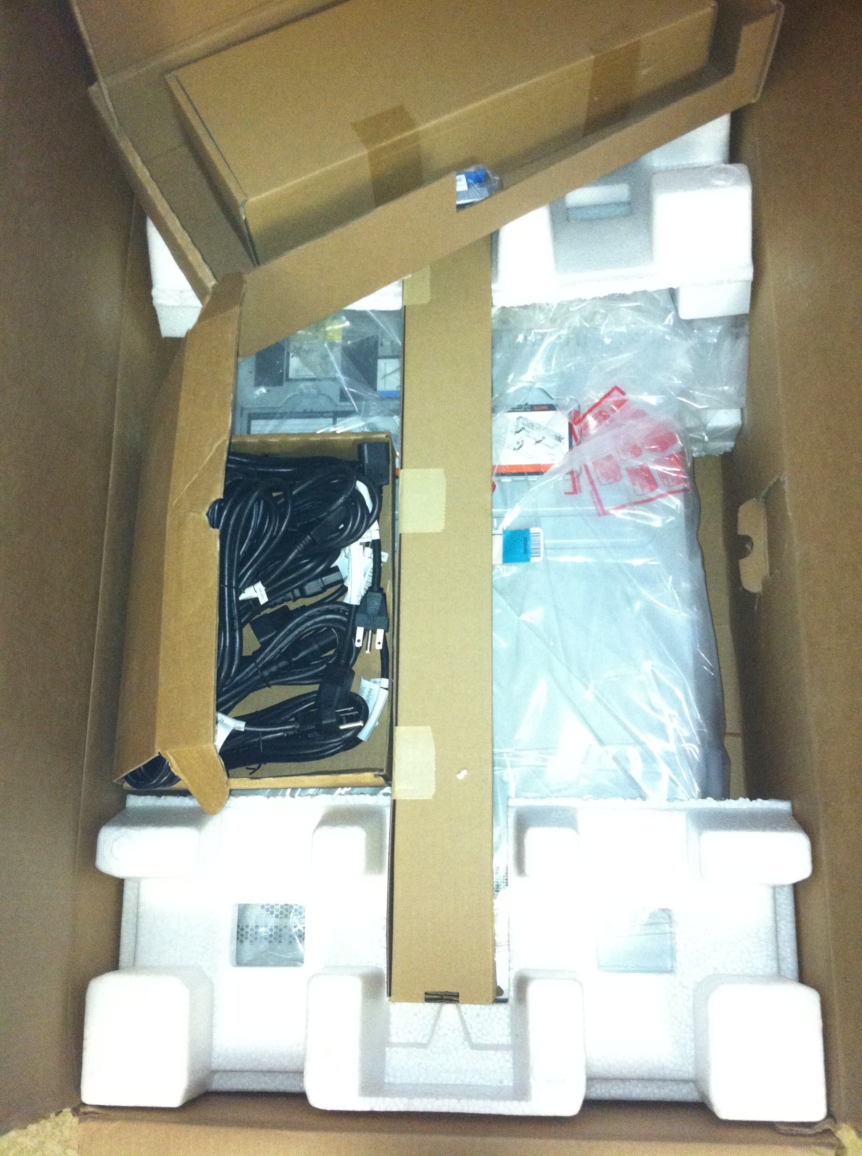
Control system
Changes:
  Feedbacks
  Step motors
  Mathematica
Plans:
  Power supplies
  Control computer
  CAMAC-> ???
  FG overhaul (currently: 8 analog and 10 digital)

Slide 15
New Space
Phase I: ATF capabilities (100MeV) in the new experimental space
Phase II: Energy upgrade to 300 MeV
Phase III: Energy upgrade to 500 MeV
Phase I and II can be completed in 4 years with no noticeable interruption to current ATF operations.
Total floor space – increase from 5,000 ft² to 15,000 ft²
Number of independent experimental halls – increase from 1 to 5
Number of beamlines – increase from 3 to 6 with potential for further “branching”
E-beam energy – increase from 100 MeV to 300 MeV (with the potential for further upgrade to 500 MeV)
Laser room space - increase from 1500 ft² to 4000 ft² to allow for further laser upgrades
User experimental preparation space - increase from 700sf (presently shared with laser experiments) to dedicated 1400 ft² room
Dedicated Linac and RF test space – Newly introduced, 1300 ft² to allow for high gradient R&D and testing.
Notes:
15

Slide 16
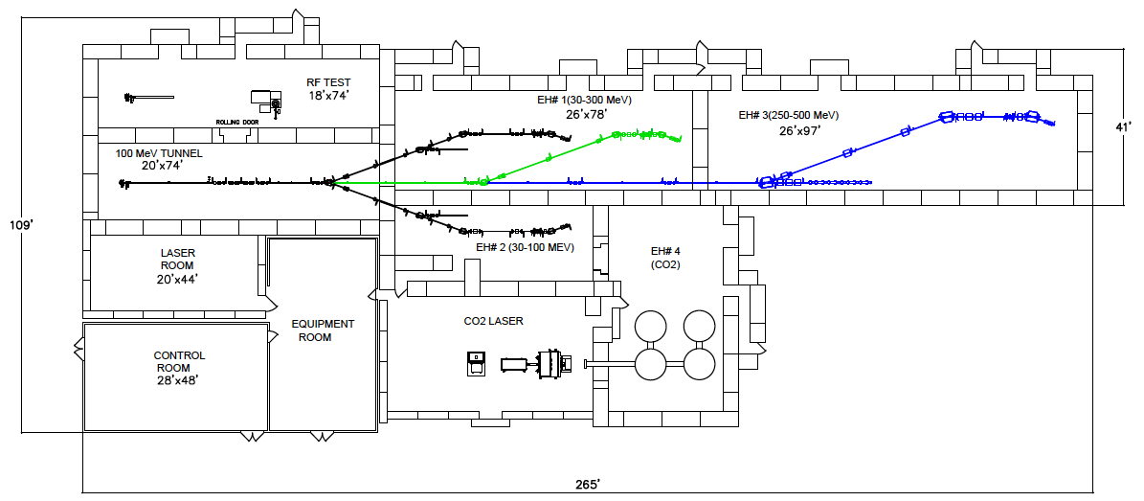
New Space (Current and Proposed layouts)
Space for CO2 chirped pulse amplification and experiments
3 x experimental areas
Independent experimental halls
Energy upgrade for nonlinear PWFA, GV/m DWFA and ~MeV gamma beams
Notes:
16

Slide 17
New Capabilities:
Space for CO₂ pulse re-compression after chirped pulse amplification
Shielded area for experiments with ion beams
300MeV =>
  Plasma wakefield experiments in nonlinear and pseudo nonlinear regimes
  Experiments with mono energetic ~MeV class gamma ray beams
  ~2 micron electron beams for structure based laser acceleration experiments
500MeV =>
  Compact X ray FEL experiments
  High intensity MeV class gamma ray beams
New quadrupole power supplies => shorter beam setup
Updated equipment => more efficient facility maintenance
Notes:
17

Slide 18
Conclusion:
Very busy times at ATF: Activity doubled in last 3 years (publications, active experiments, new proposals, students …)
New modes of e-beam operations were main results driver in the past 18 months
High demands/expectations for experiments depending on CO₂ laser performance utilizing latest laser state. Balanced approach is planned to serve:
  Ion beams generated with CO₂ beam experiments: (studies with tunable split beam, short pulse, higher energy with chirped pulse …)
  Studies of interactions with electron beam (Rubicon, Compton, VLA…)
  Experimental activities with Regenerative Amplifier output.
  Further laser developments.
Hardware updates are carried out in a evolutionary manner to keep reliable/relevant operations of 20 year old facility
There is a queue of hardware updates to enhance facility capabilities
Lack of space is the major limitation at ATF.

