Slide 1

Sub-femtosecond bunch length diagnostic
ATF Users Meeting
April 26, 2012
Gerard Andonian, A. Murokh, J. Rosenzweig, P. Musumeci, E. Hemsing, D. Xiang, F. O’Shea, I. Pogorelsky, V. Yakimenko

Slide 2
Motivation
Bunch length/profile measurements
  Compression techniques to generate sub-ps pulses with high current
  Characterization of Sub-ps pulses
  Machine performance optimization
  Benchmark theoretical and computational models
  Understand beam variations in emittance, current
Bunch length measurement techniques currently limited to ~10 fs
  Coherent radiation interferometry
  Electro-Optical sampling
  RF Deflector
Femtosecond resolution required for investigation of ultra short pulses
  Microbunching instability of COTR
  Single-spike SASE FEL beam
  Properties of attosecond x-ray production
  Temporal properties of echo-enabled FELs

Slide 3
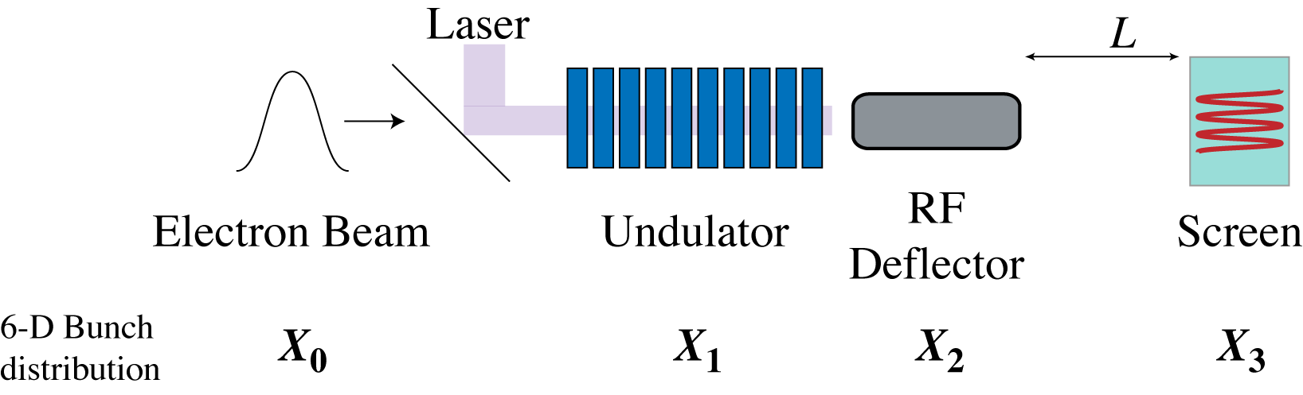
Schematic Description
Laser (TEM₁₀ mode)/e-beam interaction in planar undulator
  Angular modulation of beam
  Dependent on longitudinal bunch coordinate
RF deflector provides vertical streak to observe modulation for long bunches
Angular modulation observable on distant screen (x’ -> x)
  Resolvable with standard optics
Scheme provides enhanced resolution over RF deflector alone.

Slide 4
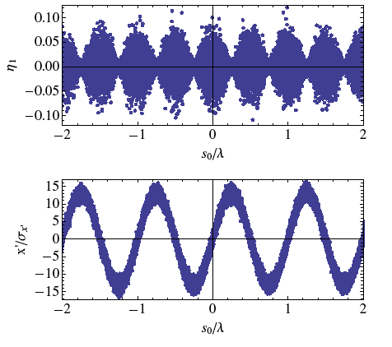
General 1-D Treatment
Electron/laser interaction in undulator
Zholents and Zolotorev, NJP 10, 025005 (2008)
-Attosecond pulse lengths in a SASE FEL by selective lasing of electrons due to angular modulations.
TEM₁₀ mode (“dipole”)
Motion in undulator
Energy exchange
Energy modulation
Panofsky-Wenzel Theorem
Angular modulation

Slide 5
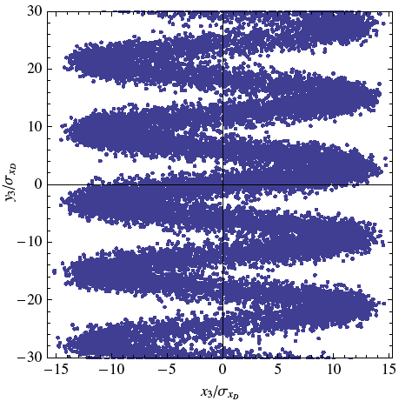
Quasi 1-D Analytical Treatment
Transformation at deflector
After drift
Initial Beam Distribution
Beam Distribution at screen

Slide 6
Bunch length diagnostic
Resolution set by magnitude of imprinted angular modulation
  Constraint: must be larger than intrinsic beam divergence
Practical diagnostic resolution set by angular modulation by each component in scheme
  RF deflector
  Optical modulator (undulator)
  Ability to resolve screen
Constraints
  Angular modulation must be larger than intrinsic beam divergence
  Imposed beam deflections must be larger than “unperturbed” beam size at screen
  May require collimators (loss of charge)
Resolution enhancement
  Dynamic range enhancement

Slide 7
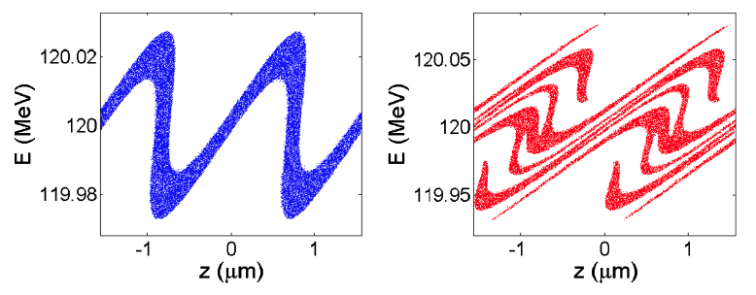
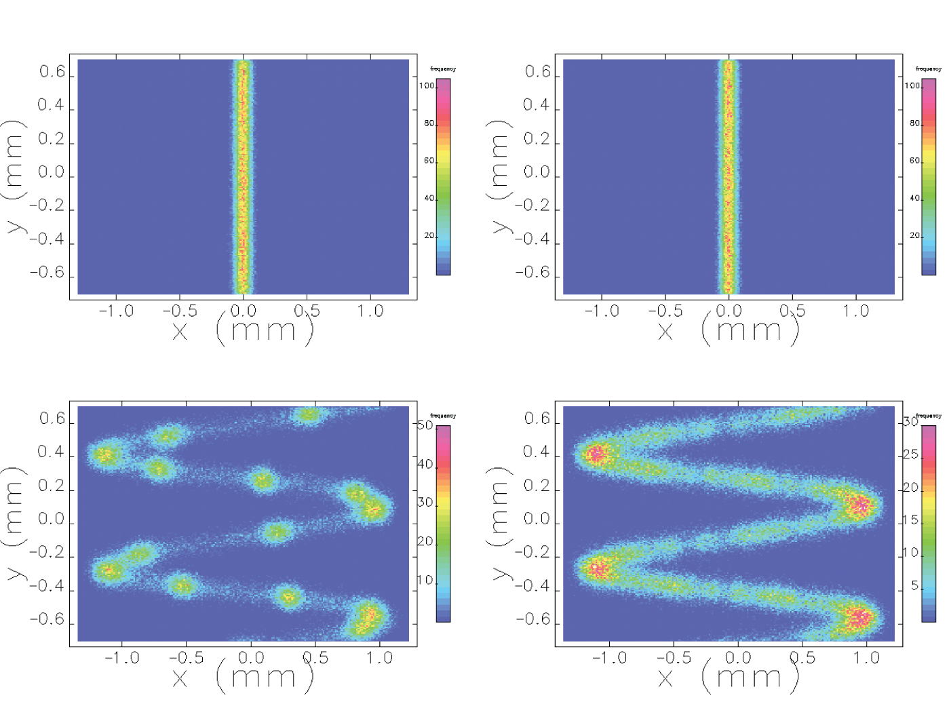
Echo-enabled FEL at SLAC NLCTA
Simulations performed with Elegant
Experiment conducted at NLCTA (D.Xiang, et al., SLAC)
  E-beam modulation provided by ~800nm laser and first undulator
  Sent through chicane with large R56
    Fine longitudinal structure imposed
  E-beam modulated by ~1600nm laser in second undulator
  Density modulation at short wavelength in second chicane
Diagnostic
  Coherent radiation at harmonics of seed lasers
  Not trivial to determine if the radiation is from interplay of two lasers or individual laser
  Time-domain measurement provides straightforward evidence of EEHG
Parameters (simulation)
  E = 120MeV, ε_{n}= 1mm-mrad
  V_{d} = 8MV, λ_{RF} = 2.6 cm
  K = 6.0, N_{U}=3, λ_{U}=6 cm
  λ=10.6um, P_{L}=500GW
  Resolution ~ .6fs
Phase Space after last chicane for ~1600nm laser only (left) and for interplay of two lasers (right)
Transverse distribution at screen. TOP: Only deflector turned on. BOTTOM: Deflector and laser modulation on.

Slide 8
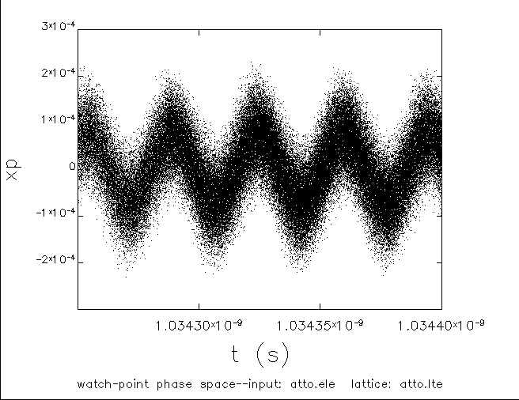
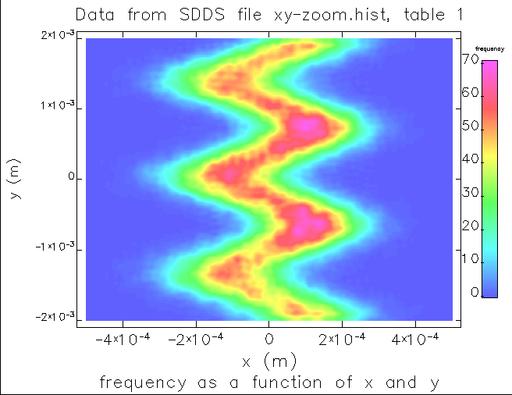
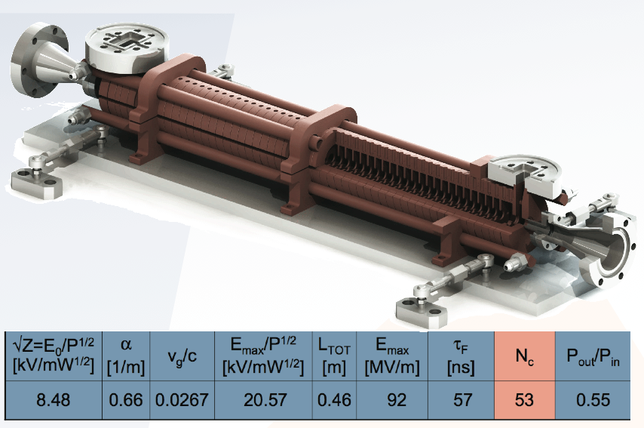
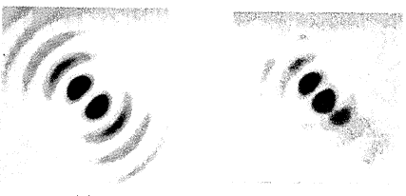
POP at BNL ATF
(Current Proposal)
Simulations performed with Elegant
High brightness facility rich in e-beam laser interactions
  CO2 laser e-beam interactions
Parameters (simulation)
  E= 44 MeV, Q= 500pC, ε_{n} = 1mm-mrad
  λ_{u}=3cm, N= 10, B₀= 1.0T, K = 3.0
  λ = 10.6 um, P_{L} = 300MW
  V_{d} = 10MV, L_{d} = 46cm
X-band deflector
  Built by RadiaBeam for BNL ATF
  Optimized for ~100MeV beams
  Freq. = 11.424 GHz
  <10 fs temporal resolution
  Install in 2012
TEM₁₀ laser mode
  Previous experience from Inverse Cerenkov Acceleration experiment
    W. Kimura, PRL 74,546 (1994)
    Required radial polarization
Undulator
  Design (LCLS-like)
Angular modulation (left) and beam distribution at screen (right)
Rendering of XTD for ~10fs temporal resolution at ATF
TEM₁₀–like mode simulated (left) and imaged (right) at BNL ATF

Slide 9
Challenges
Nonlinear resolution
  Resolution at turning points is “smeared”
  Try to move beam away from “low-resolution” part of curve to linear (“high-resolution”)
  Shift laser phase by π/2
  Multi-shot statistics
Diagnostic is better for lower energy beam in current scheme
  Modulation scaling ~ 1/γ²
Diagnostic favors long wavelength, high power laser
  Scaling ~ P_{L}^{1/2}
  BNL ATF
  Fundamental laser mode suppression
Demanding beam properties
  Emittance, spot size
  Requires beam collimators which may reduce total detectable signal at screen

Slide 10
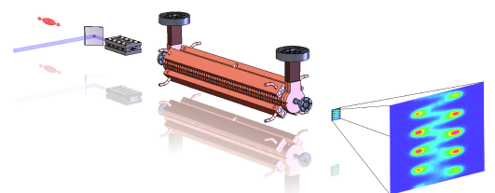
Summary
Rendering of design for Proof-of-Principle experiment
Bunch length resolution on sub-fs is plausible with existing technologies
  Enhanced resolution over deflector alone
Next steps: Prep for Proof-of-principle experiment at BNL ATF
  Determine location of experiment along beamline
  Demonstrate TEM₁₀ mode at high power

