Slide 1
Fiber Mesh Diagnostic (FMD) for Transverse profile measurements
Project Status Report
April 26, 2012
BNL ATF Users Meeting
G. Andonian, R. Agustsson, A. Murokh, J. Rosenzweig, M. Rueals, R. Tikhoplav, S. Wu, RadiaBeam Technologies

Slide 2
Outline
Motivation
Status Report
  Fabrication
    Fiber feed-through, bundling
    Detector
  Experiment at UCLA
Measurement at BNL ATF

Slide 3
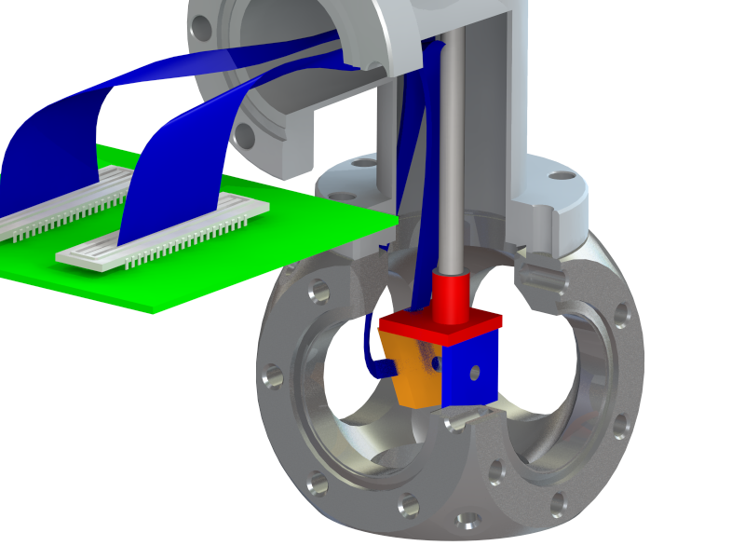
Motivation
Facilities require better resolution on beam transverse profile
  Current techniques require scintillating materials or OTR
  Resolution limited to <30µm,
    Require imaging optics
    Blooming, limited depth-of-focus, etc.
  COTR can contaminate data for compressed bunches
Exploit advances in fiber industry, nano-fabrication techniques
Fibers mesh laid across beam path
  Cerenkov radiation is collected/analyzed
Fiber-mesh diagnostic (FMD)
  adequate photon yield
  minimal real-estate
  FOV is arbitrarily large
  Sub-10µm resolution
    With appropriate fiber choice

Slide 4
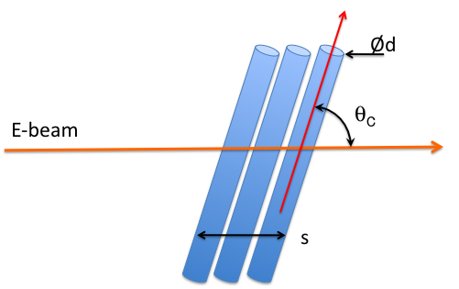
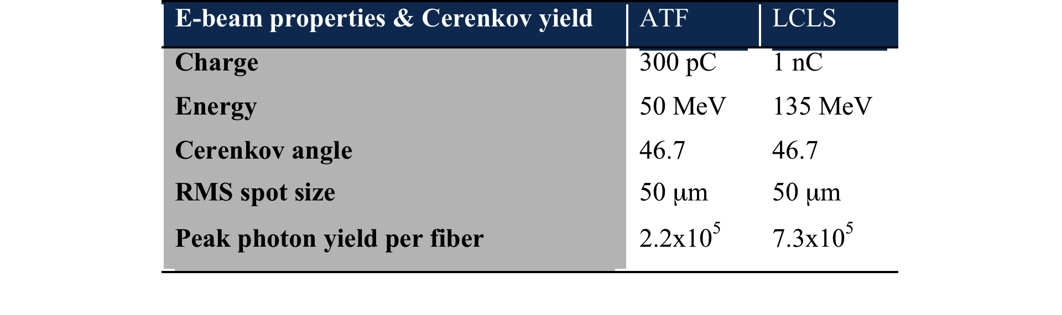

Angular Acceptance and yield
Typical fibers n~1.5
  θ_{c}~47º
  Angular acceptance peaked at θ_{c}
  Rotation of fibers can increase/decrease acceptance
Photon yield
  N_{ph}~10⁵
Cerenkov radiation from single e⁻
Avg Photon flux per e⁻
Total Photon yield

Slide 5
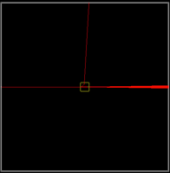
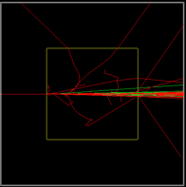
Radiation dose on fiber
Background radiation (analytic)
  ATF parameters
    Dose ~0.7kGy per shot
  For 1 hr operation
    Dose ~100MGy
Crosstalk (simulations)
  Monte Carlo (GEANT4)
  SiO₂ fibers
  No significant crosstalk for up to 1mm
  Avg. dose = 1.37x10⁻⁶ Gy per e⁻
  Total dose ~ 2kGy per shot
FMD is viable in lab environment
Energy deposited by single e⁻
Dose rate per shot per area
100µm thick fiber (left) and 1mm thick fiber (right). Red lines are e⁻ trajectories.

Slide 6
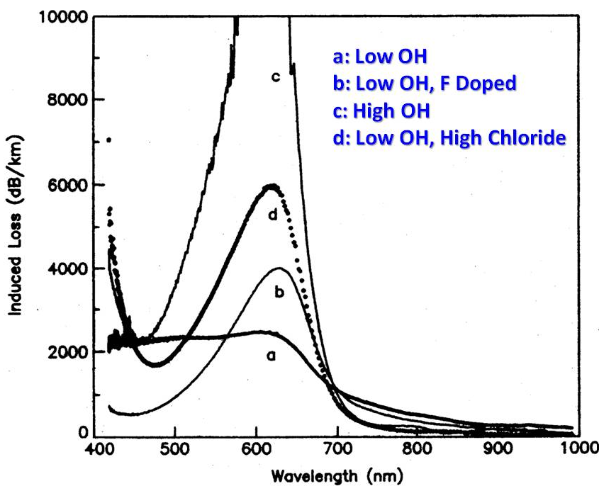
Fiber selection
Resolution
  core <10µm
  Cladding 125µm (industry standard)
  Coating removed
Chemical content
  Doping (low OH preferred)
  Improved transmission
  Life expectancy (F-doped)
Irradiation expt results
  Fujikura rad-resistant fibers
    50µm core, 125µm cladding
  Sterigenics (San Diego, CA)
    Exposures from 10kGy-1MGy
  3 wavelengths tested
    658nm (blue curve)
    808nm (red curve)
    1313nm (green curve)
Fiber losses
vs wavelength
D. Griscom
Fiber Irradiation results

Slide 7
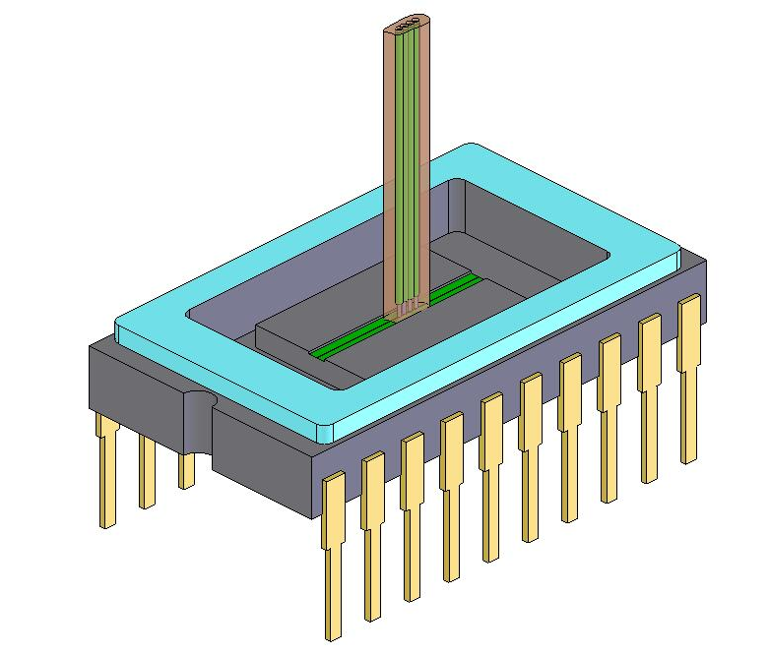
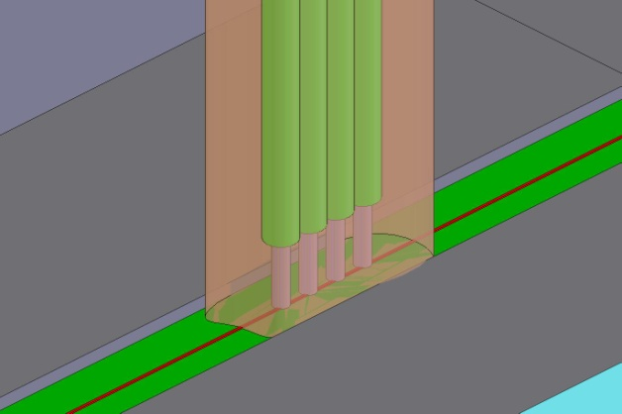
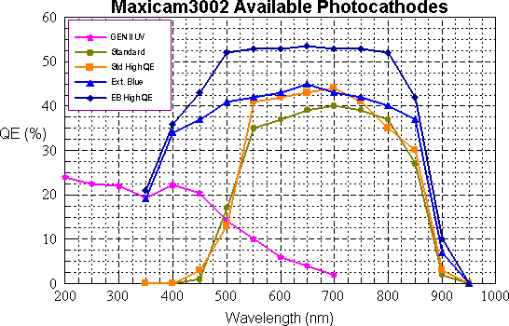
Detector
Linear CCD`
  Pixel size~10µm
    Adjacent pixels stay dark (cladding ~125µm)
  Reduce crosstalk
Fiber preparation
  Fiber coatings must be stripped
  Fiber ends polishing
  Epoxy adhesive
Single fiber detectors considered, but costly
  PMTs
  Used for POC test at UCLA
Coupling scheme renderings
Typical linear CCD responsivity

Slide 8
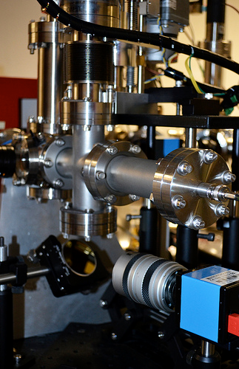
Individual fiber POC experiment
UCLA Pegasus lab – Oct 2011
  Tested single fibers
  Single mode (8.6um ID)
  Multi mode (50um ID)
  Goal 1: Measure Cerenkov angle
  Goal 2: Test rotary stages and actuators assembly and DAQ
Diagnostic
  Dual photomultiplier tubes
  PMTs in bunker, use 15m of fiber optic to transmit signal to control room
  CCD imaging to measure rotation
Beam Parameters
  Q = 30pC
  Energy = 5 MeV
  Emittance = 1 um
  Measurement after the dipole bend
  Good agreement with theoretical predications

Slide 9
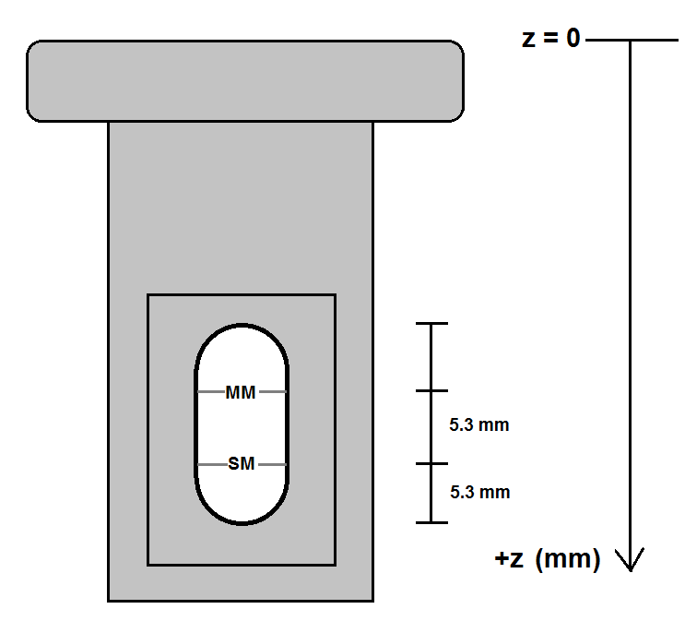
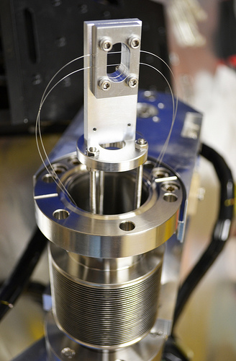
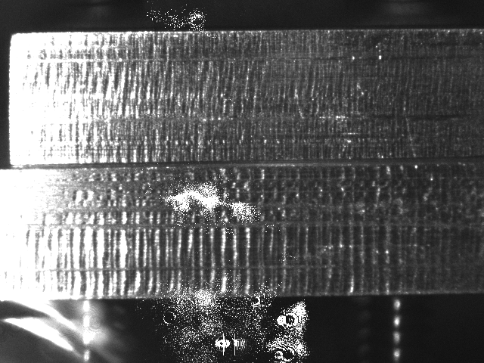
Fiber Holder

Slide 10
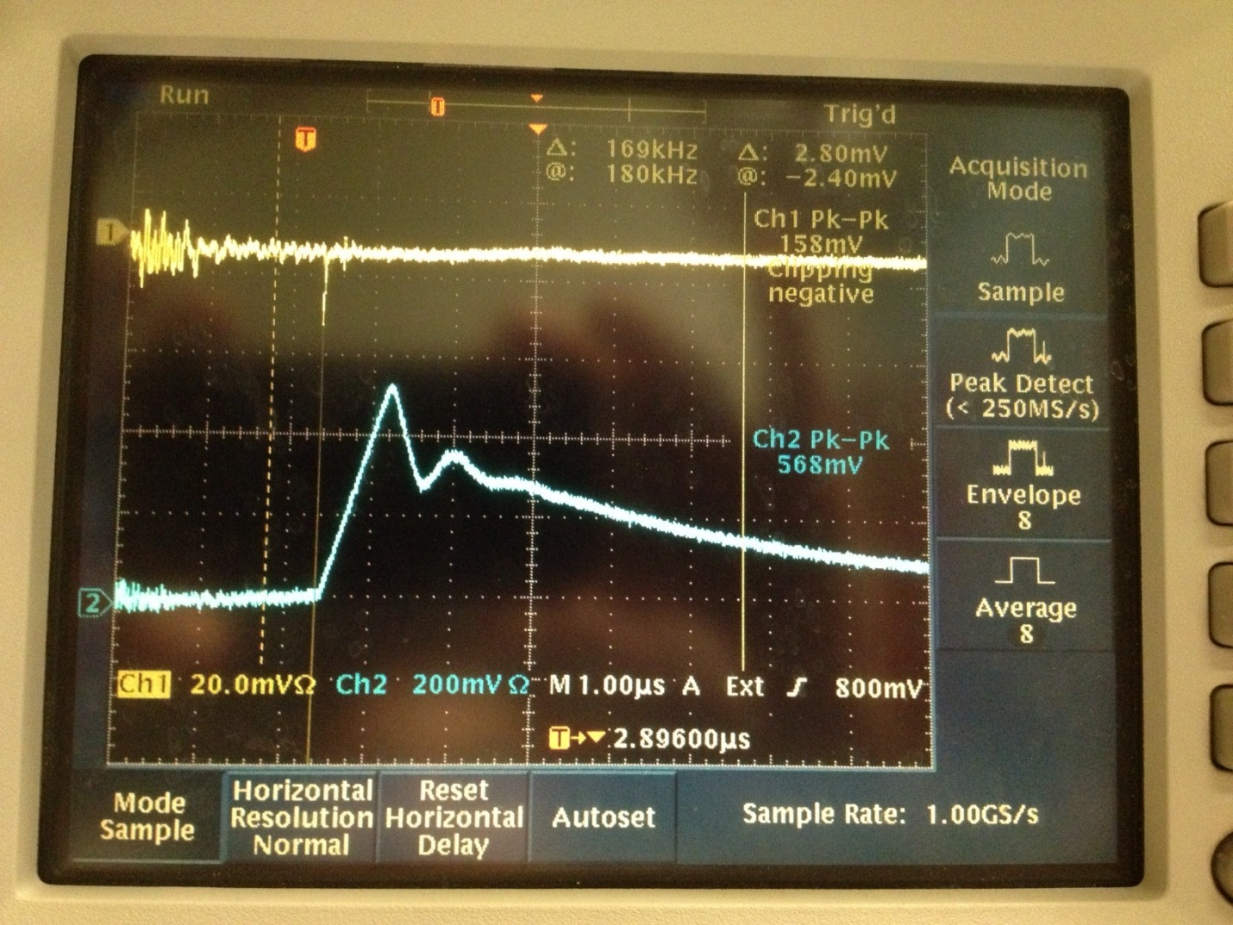
Preliminary Experimental Results
Cerenkov Angle observed
4 ports (2 SM, 2 MM)
  Reasonable gain on PMT
Limitations
  Charge cutoff by geometry at ~45 deg
  New holder design
  Camera placement constraint
Repeat single measurement with upgrades
Energy calibration of PMT

Slide 11
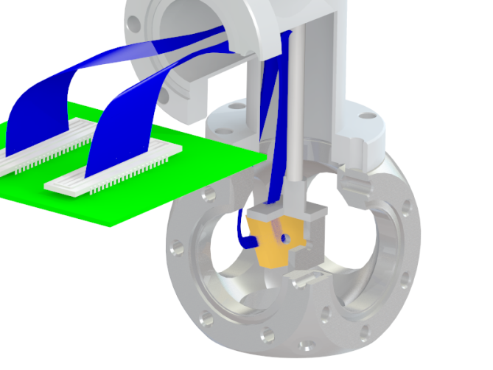
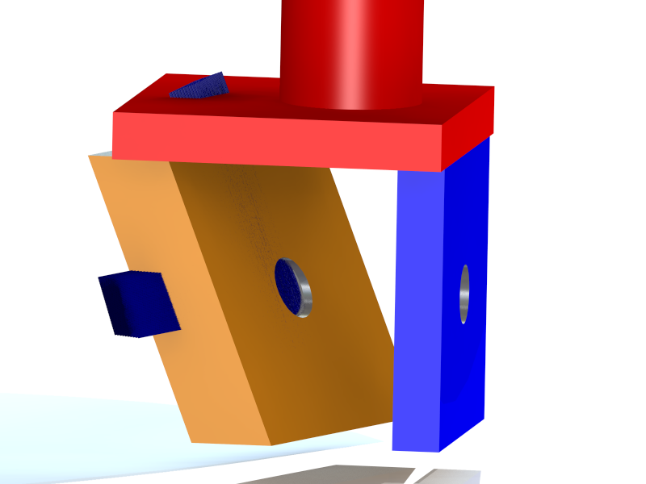
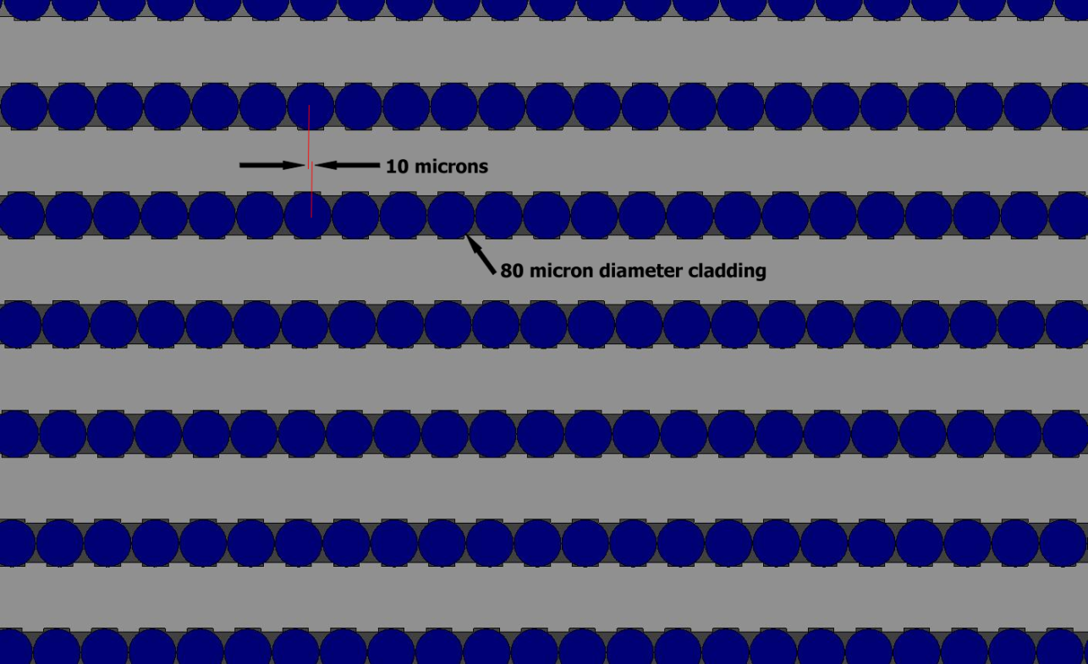
Fabrication Issues
Fiber holder
  Fiber core 8.6µm, cladding 125µm
  Need ~10µm shift
  Need 12+ layers
  Careful Assembly techniques
  Both x and y axes
Coupling out of UHV to CCD board
  Feedthrough
Precision angular alignment of holders
  Tip/tilt stage

Slide 12
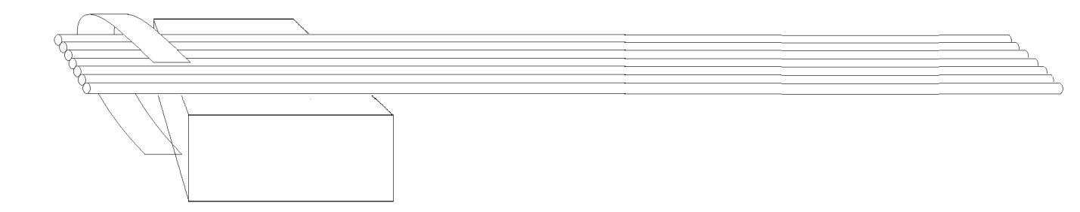
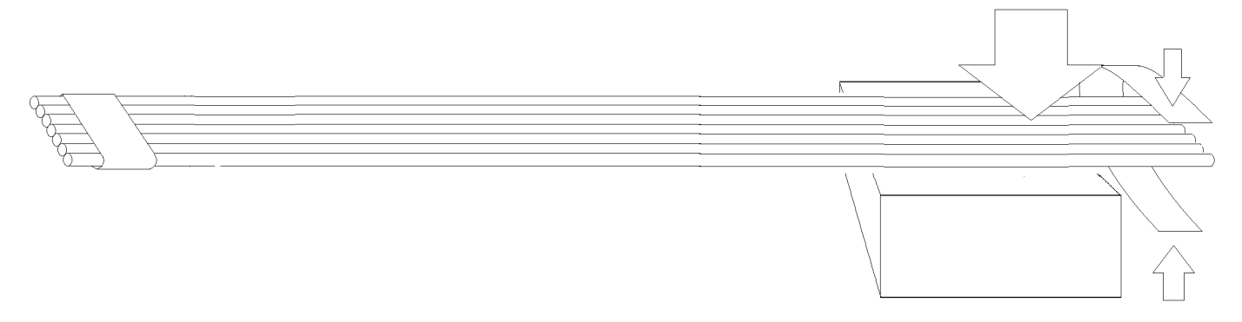
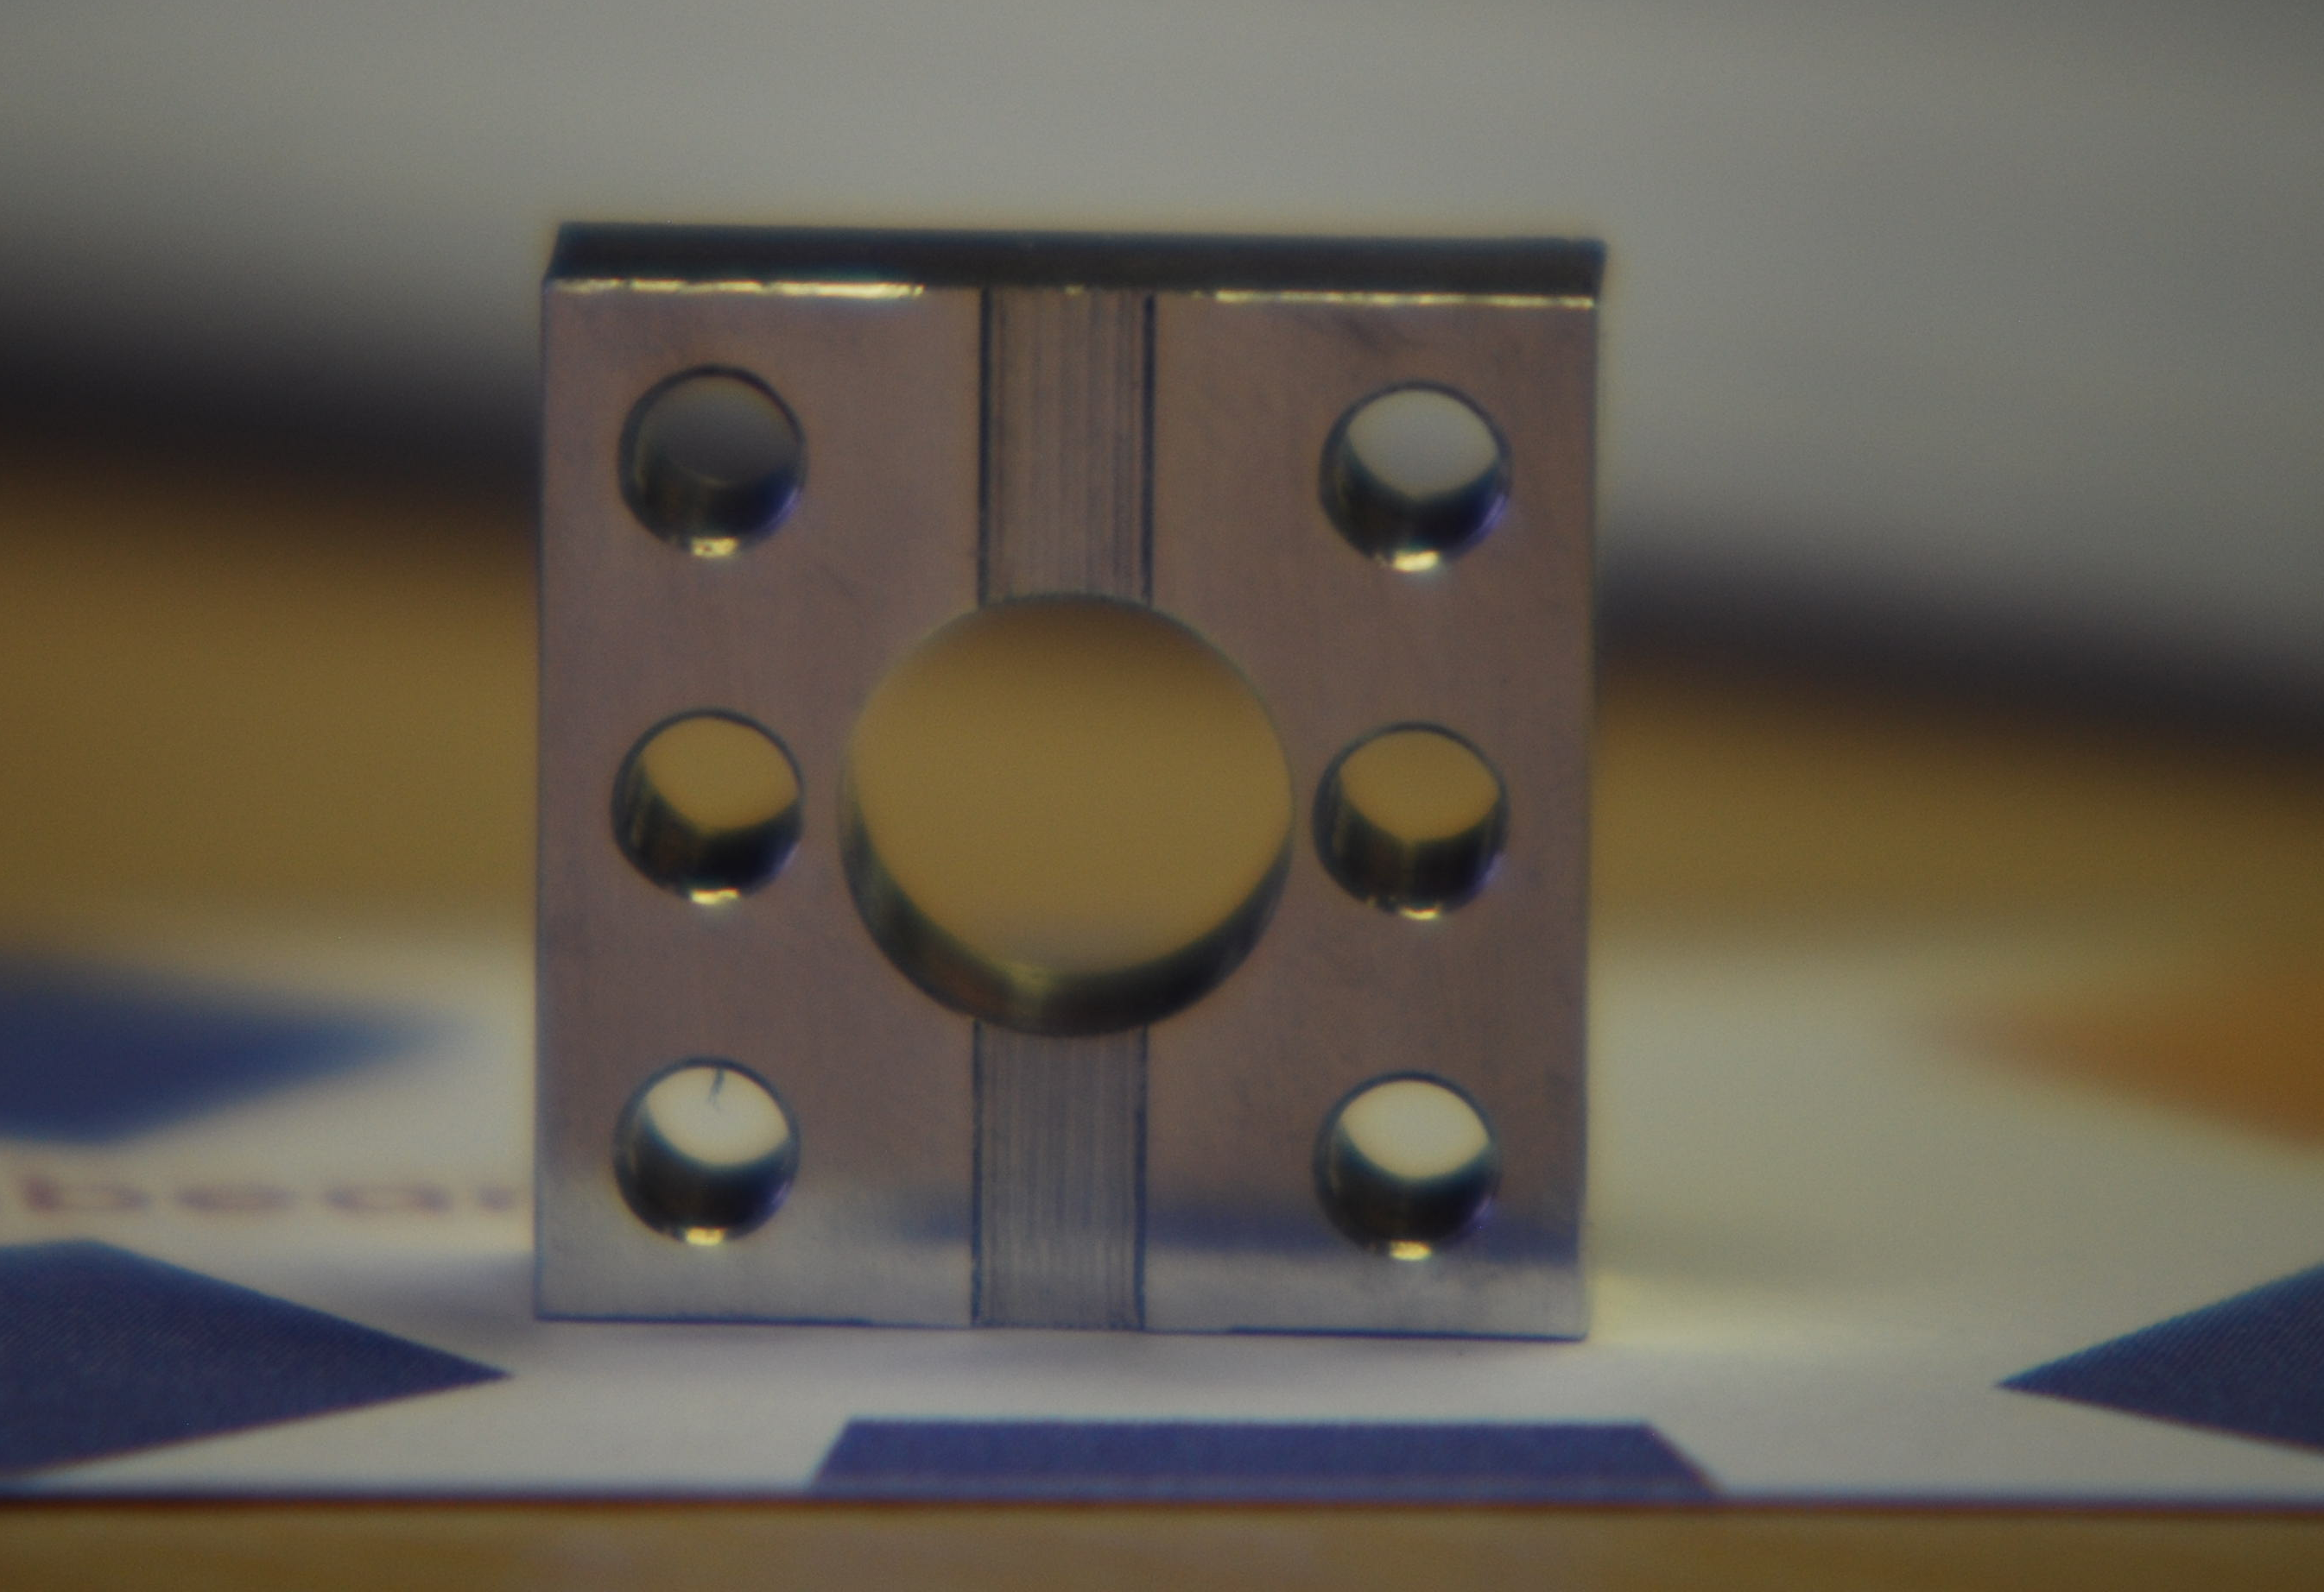
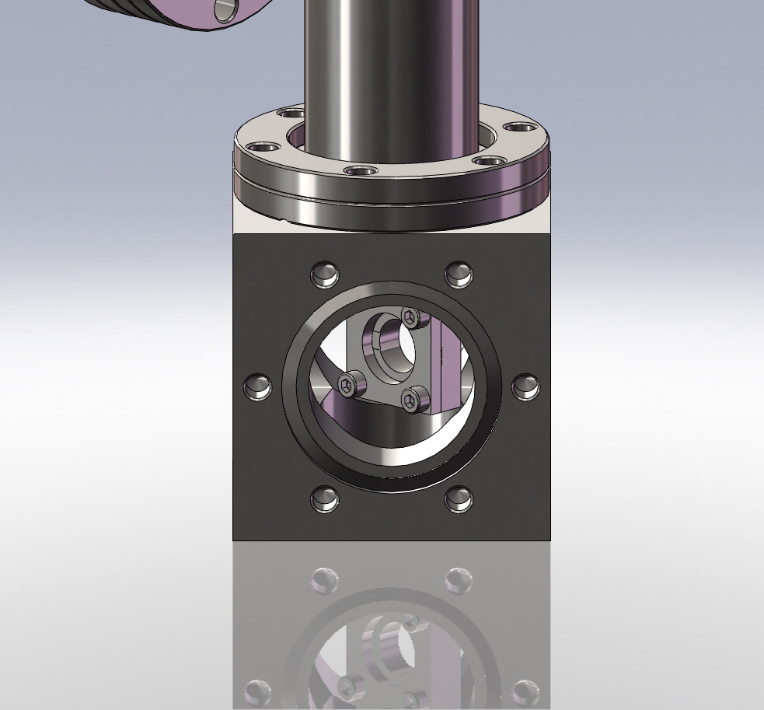
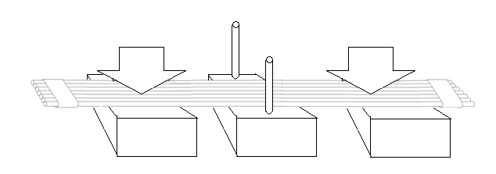
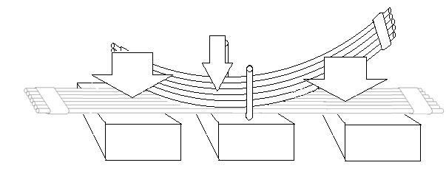
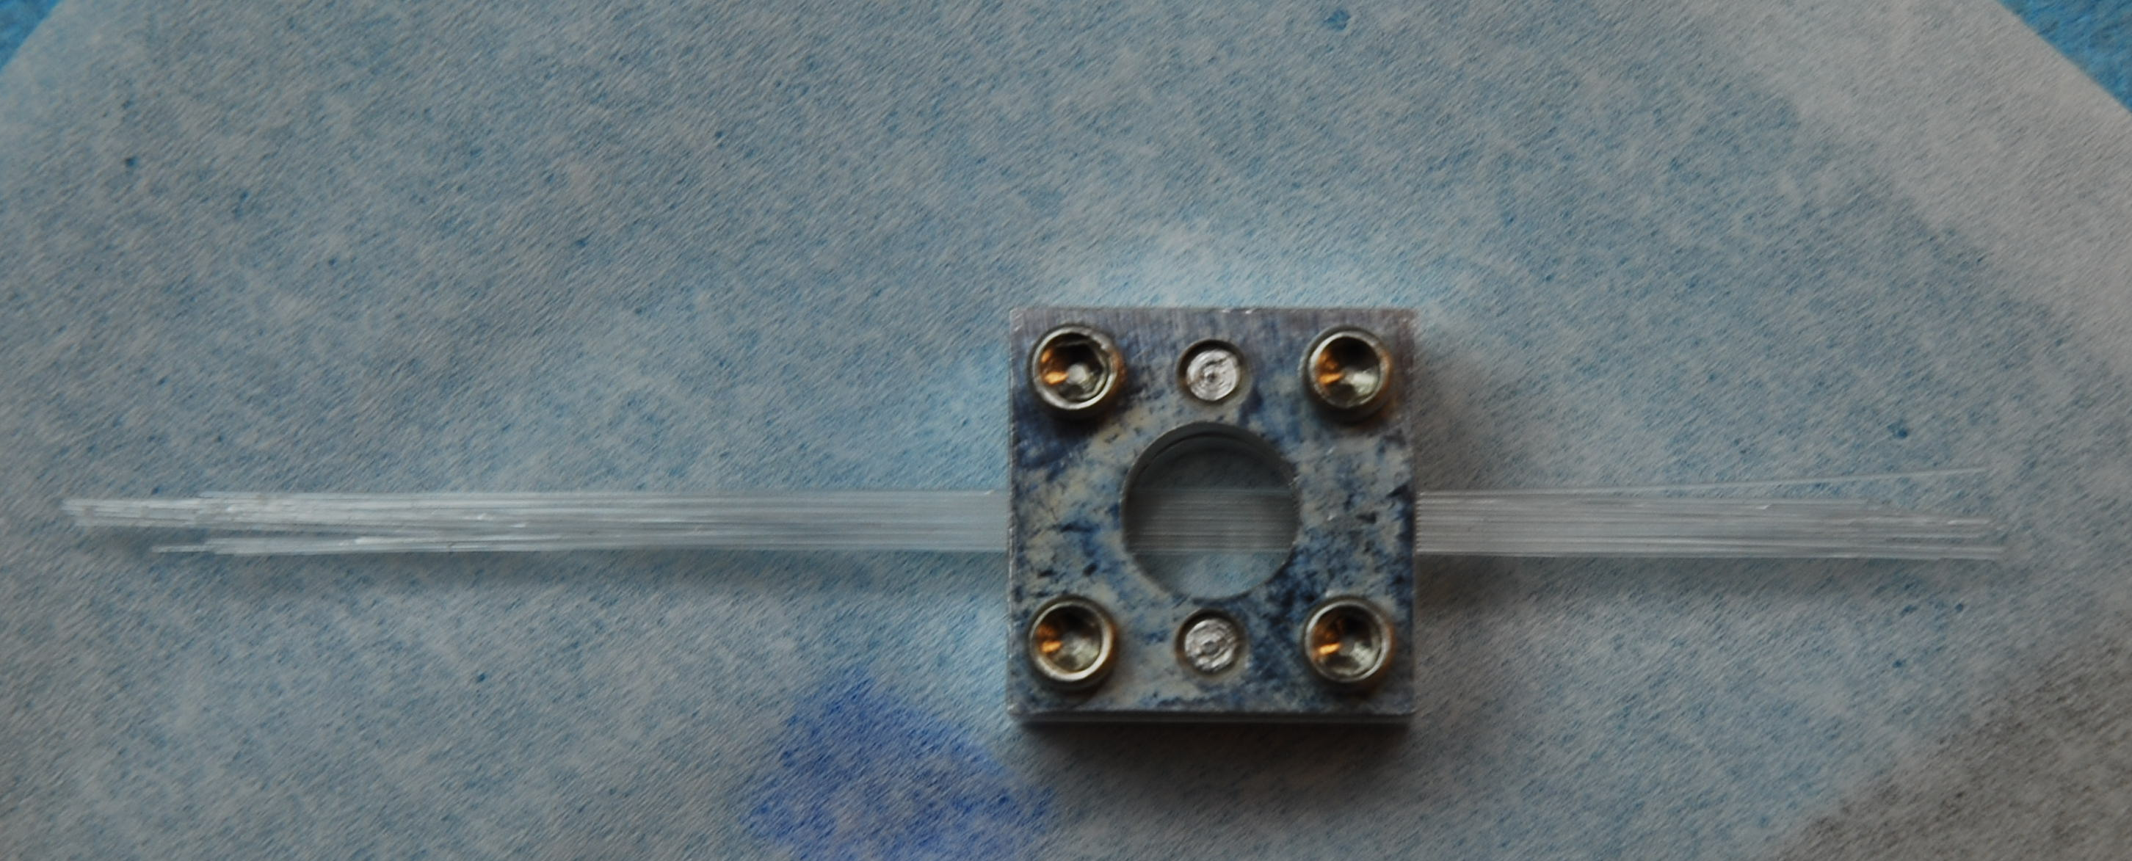

Fiber holder and bundling
a
Assembly procedure
  Special assembly jig
  Spacing
b
c
Holder
Rendering
d
Holder with 2 (x12) layers of fibers

Slide 13
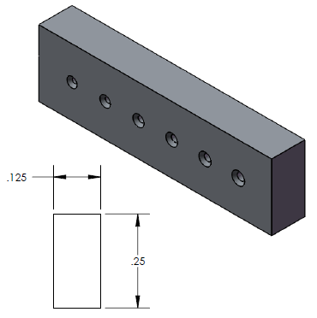
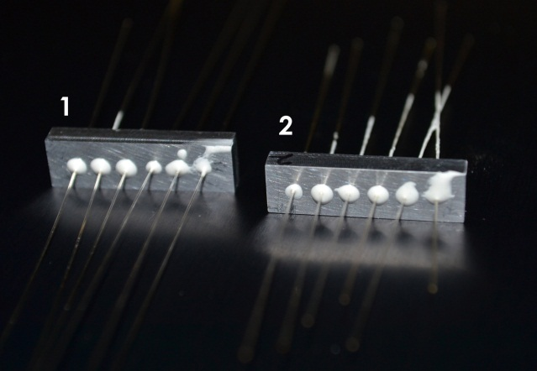
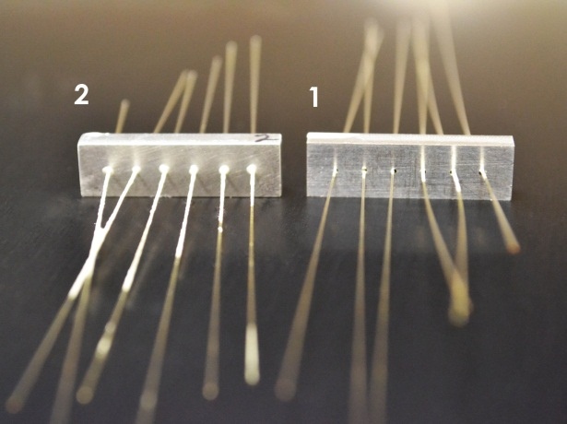
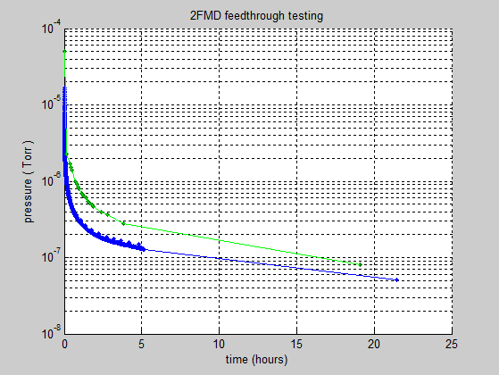
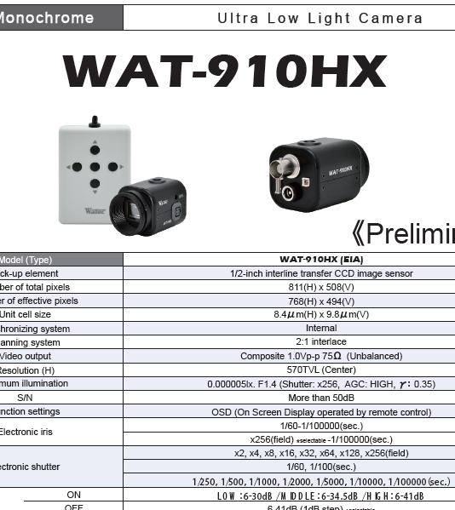
Fiber feed-through
Investigated “tentacle” feedthroughs on large chambers from vendors
  Up to 50 per “cube” – custom and costly
In-house solution more viable
  Good for 5E-8 Torr UHV
  Leak rate <10E-11
.023” hole diameter optimal for Fujikura fibers
CCD (fiber coupled)-
Wilco imaging
8E-8 Torr after 19h for holder
5E-8 Torr after 22h for blank

Slide 14
Conclusions
FMD has potential for high-res diagnostic
Milestones
  Irradiation results
  Fabrication procedures (engineering)
  POC experiment at UCLA
  Vacuum levels 5E-8
  DAQ (CCD array is leading candidate, PMT array too costly)
Competitive to present profile measurements
  ATF has long history of testing beam profile monitors
For ATF study
  Assembly of 1 dimension (8x10 layer) fibers
  DAQ issues ironed out in POC test
  Goal 1: Compare to YAG screen (or OTR)
  Goal 2: Measure lifetime of fibers
  Timeline:
    Installation Late 2012 (~1 week for install, ~1 week for testing)
    Move to 2 dimensions (x and y) in 2013

