Slide 1
Dielectric Wakefield Accelerator:
Experimental program at ATF
G. Andonian, E. Arab, S. Barber, A. Fukasawa, B. O’Shea, J.B. Rosenzweig, D. Stratakis, A. Valloni, O. Williams, UCLA
P. Muggli, MPI
M. Babzien, M. Fedurin, K. Kusche, R. Malone, V. Yakimenko, BNL
April 26, 2012
Status Report
BNL ATF Users Meeting

Slide 2
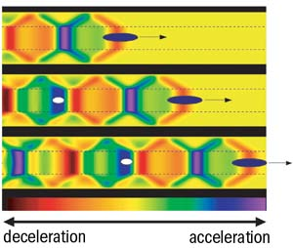
Overview
High gradient DWA applications
  HEP
  Radiation Source
  Advanced accelerator for future FEL
    ~GV/m fields reduce size of machine
    Larger scales (THz), relax emittance, higher charge beams
Relevant Issues in DWA research
  Determine achievable field gradients
  High energy gain in acceleration
  Transformer ratio enhancement
  Resonant excitation of structure
  Dielectric/metal heating issues
  Cladding composition, dielectric material and thickness
  Alternate geometries (planar)
  Periodic structure development (1D, 3D)
  Transverse modes and beam-breakup
Accelerating gradient scales with high charge, short beams

Slide 3
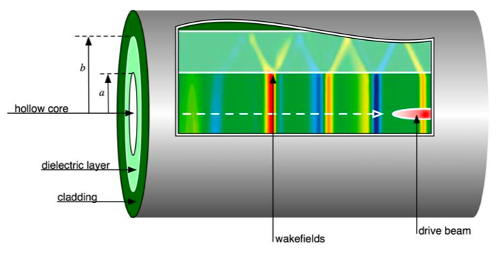
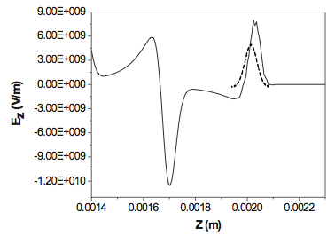
Dielectric Wakefield Accelerator
Electron bunch (β ≈ 1) drives wake in cylindrical dielectric structure
  Dependent on structure properties
  Generally multi-mode excitation
Wakefields accelerate trailing bunch
Design Parameters
Peak decelerating field
Transformer ratio (unshaped beam)
Ez on-axis, OOPIC

Slide 4


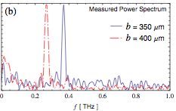
Previous UCLA experimental work
SLAC FFTB 2008
SLAC FFTB
  Study breakdown limits
  Q~3nC, E=28.5GeV, σ_{z}~20µm
  SiO₂, a=100,200µm, b=325µm, L=1cm
  Beam can excite fields up to 13GV/m
UCLA Neptune
  CCR as a tunable THz source
  Q~200pC, E=14MeV, σ_{z}~200µm,
  PMQs to focus down to σ_{r}~80µm
  Varied outer radius (b=350µm,400µm),L=1cm
  ~10µJ of THz, narrowband
UCLA experience in…
  Preparation and fabrication of DWA structures,
  Mounting, alignment of structures
  Beam preparation (Short focal length PMQs)
  Collection and measurement of emitted CCR
M. Thompson, et al., PRL 100, 214801 (2008)
UCLA Neptune 2009
A. Cook, et al., PRL 103, 095003 (2009)

Slide 5
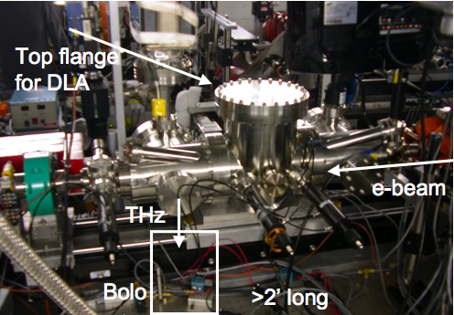
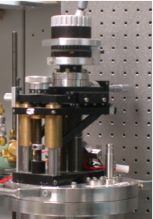
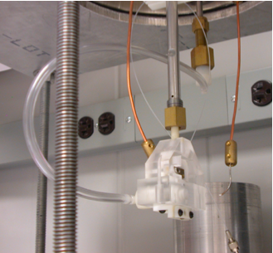
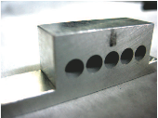
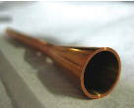
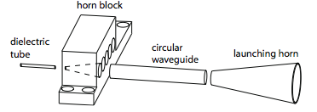
DWA Experiment layout at ATF
Pulse train generated in F-line with mask
Phase feedback loop (0.5deg)
CTR measurement of multipulse bunch spacing
DWA mount and alignment in chamber (5-axis mount)
CCR measurement
Hole in OAP allows simultaneous energy spectrum measurement
Top view
Actuator
Capillary mount + horn

Slide 6
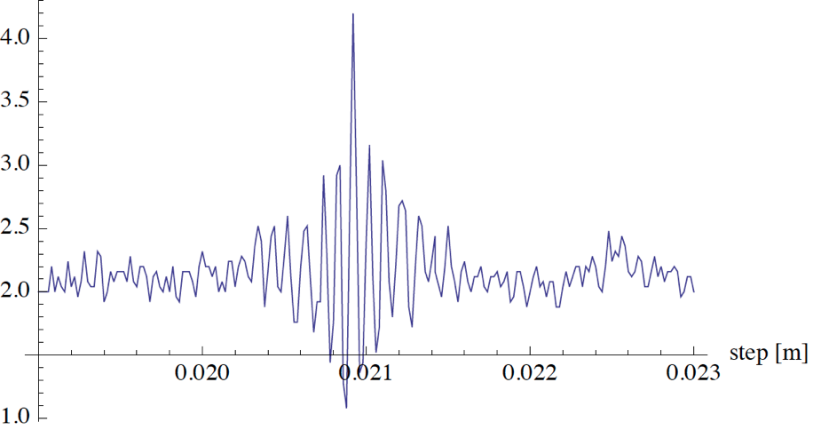
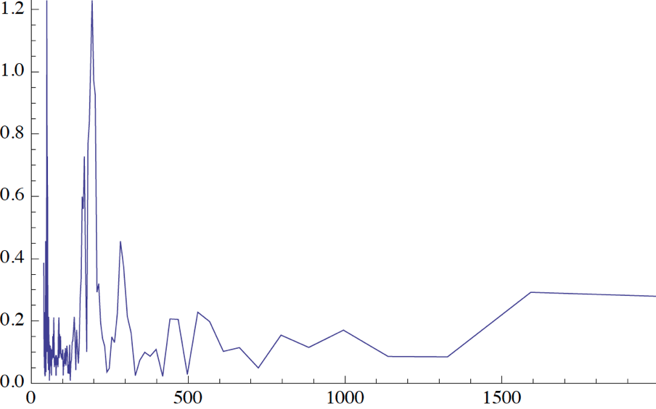
Resonant excitation of higher-order modes
Si0₂ tubes (Al coating)
  a=100µm, b=150µm
Pulse train
  Rigid mask in F-line area to generate train
  Sextupole correction to mitigate chromatic aberrations, pulse train periodicity
Wakes without mask (long bunch) give only fundamental λ (ΤΜ₀₁)
  ~490 μm, per prediction
Resonant wake excitation, CCR spectrum measured
  Excited with 190 μm spacing (2nd “harmonic”=TM₀₂)
  Suppression of fundamental
Developed techniques to characterize structures
CCR autocorrelation
  G. Andonian, et al., Appl. Phys. Lett. 98, 202901 (2011)
2nd “harmonic”
Fundamental (@noise level)
Frequency spectrum
OOPIC simulations

Slide 7
Slab Symmetric DWA Structure
Gap = 240µm
SiO₂ (e=3.8)
240µm thick
Al coating
2cm long
Same diagnostic setup as tube DWA
  Horn has 12deg flare angle
CCR interferometry
TM01 mode (~1800µm)
  Long pulse
TM02 mode (~600µm)
  Pulse train (confirmed with CTR)
“Background” (no slab) shows peak
  Due to CDR through transport
a)Interferogram and b) FFT with no slab (long pulse)
c)Interferogram and d) FFT with slab
Interferogram and FFT for pulse train
tuned to TM02 mode

Slide 8
Beam structure and acceleration
Slab modes characterized and agreed with analytical prediction
Q=500pC, E=59MeV, ε_{n} = 2mm-mrad
Gradient < 10MV/m
CTR interferometry to study long bunch structure
  Kramers Kronig reconstruction
  Minimal phase assumption
  Apodization
  Multi-Gaussian fit
Profile ultimately allows for observation of acceleration
  Trailing peak serves as “witness” beam at correct phase (λ/2 ~ 900µm) to sample E_{acc}
Beam core decelerated
Trailing peak accelerated by 150keV over 2cm
CTR inteferogram and Current profile
Energy Spectrometer Images
No structure
With DWA slab
Projections

Slide 9
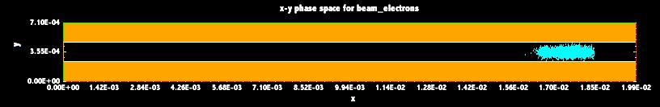
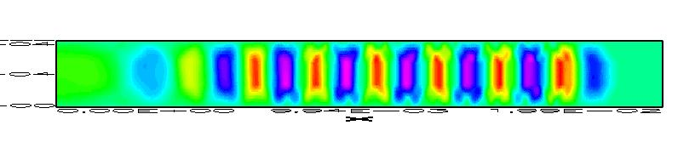
Start-to-End Simulations
Simulations
PARMELA
  Beam structure
  1. Current profile distribution (K.K.)
  2. Measured energy spectrum w/o slab
  Two projections of the longitudinal phase space
  Constrains input phase space
OOPIC
  2D Cartesian mode
  Q = .55nC, σ_{x}=250µm, phase space
  Fields ~10MV/m
Good agreement
  No 3D effects (variation in x)
OOPIC model of slab
OOPIC model of fields in slab
Simulations and Measurements

Slide 10
Slab DWA experiment Summary
Observation of acceleration/deceleration in a slab symmetric structure at THz frequencies
Robust analytical treatment, start-to-end suite of codes
  describe the physical phenomena observed
  supports theory from beam generation/manipulation
  wakefield generation in the DWA
  subsequent acceleration
Novel beam preparation and diagnosis techniques
  tailored specifically for the ribbon-like beam and planar geometry DWA scenario
Tunable source for narrowband THz radiation
  broader impact in the THz community and materials science
Submitted to PRL (under review)
Foundation for more sophisticated geometry

Slide 11
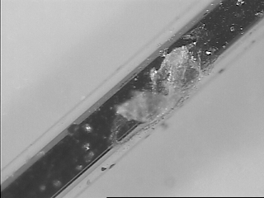
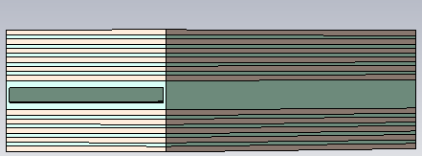
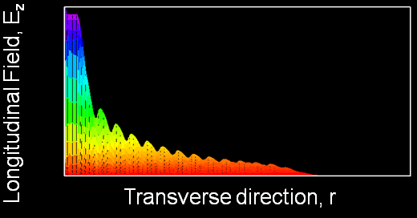
Bragg structure (slab symmetry)
1D – photonic structure
Motivation
  FFTB experiment showed that beam can vaporize the Al cladding in DWA
  Explore alternate designs that allow mode confinement without metal: Bragg arrays
  Alternate layers of quartz and high-epsilon material
  Explore more robust materials (diamond, sapphire, ZTA, etc.)
Photo from FFTB experiment
OOPIC sims show 10⁻³ decay
Planar Bragg accelerator (PBA)
D. Stratakis (UCLA)

Slide 12
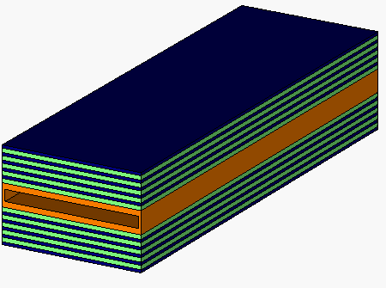
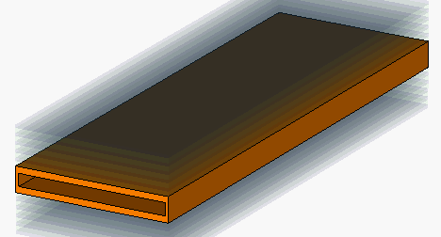
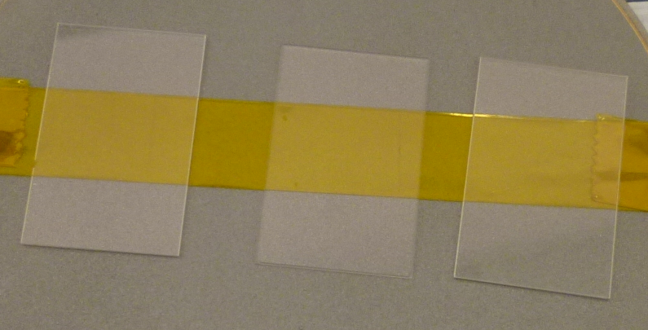
Bragg comparison to metal cladding
Multi-layer stack (10-30) of alternate high and low index films
All reflected components from the interfaces interfere constructively, which results in a strong reflection
The strongest reflection occurs when each material of the two is chosen to be a quarter of wavelength thick
Design two slabs: (1) with metal cladding and (2) with Bragg cladding
Metal
Bragg
Orange: Quartz (180 µm) or diamond (145 µm)
Green: Lithium Tantalate (50 µm)
Blue: Quartz (210 µm)
Gap: 240 µm

Slide 13
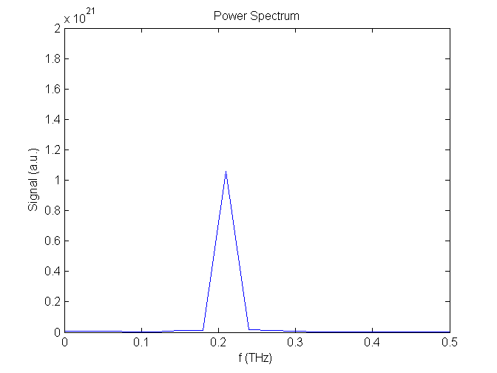
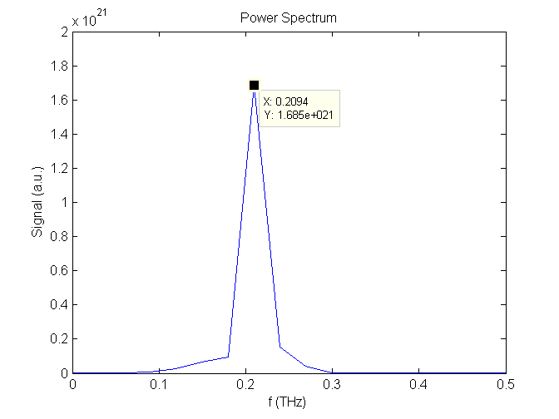
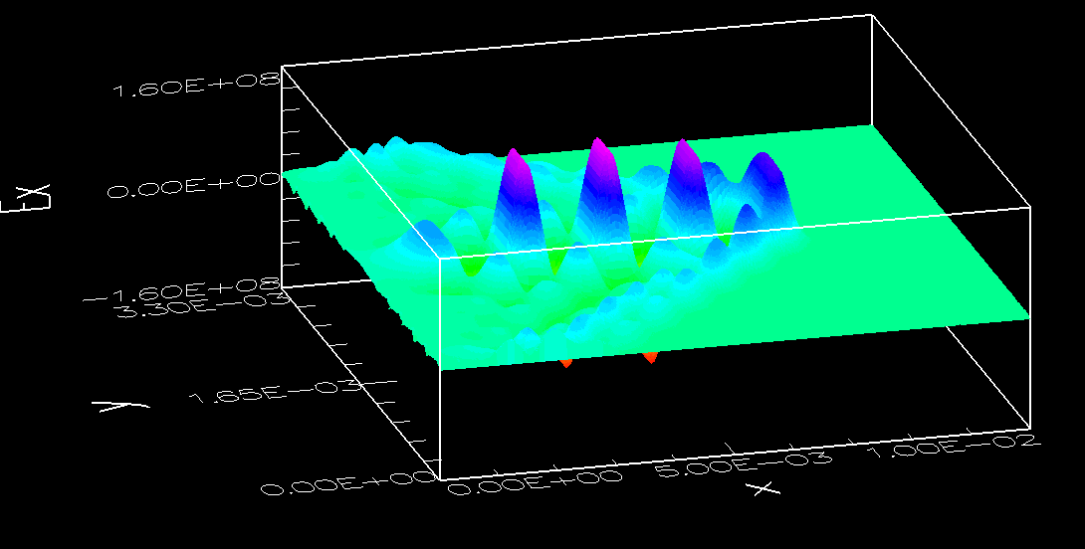
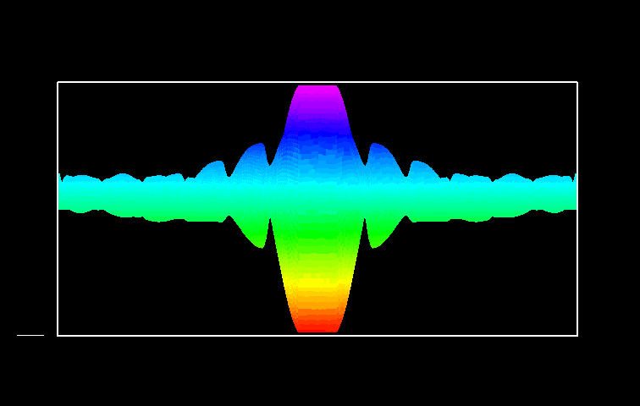
Comparisons
OOPIC simulations
  Metal cladding (single peak at 210GHz)
  Bragg structure (single peak at 210 GHz)
Bragg structure shows Ez drops by 10³
LiTaO₃ Bragg tested at ATF
  Absorption lines in THz
  THz spectroscopy setup at UCLA (S. Barber)
  Material studies
210GHz
210GHz
Bragg cladding
All-metal clad
Raw autocorrelation
Longitudinal field
Transmission coefficient
E_{z}
Freq (Hz)

Slide 14
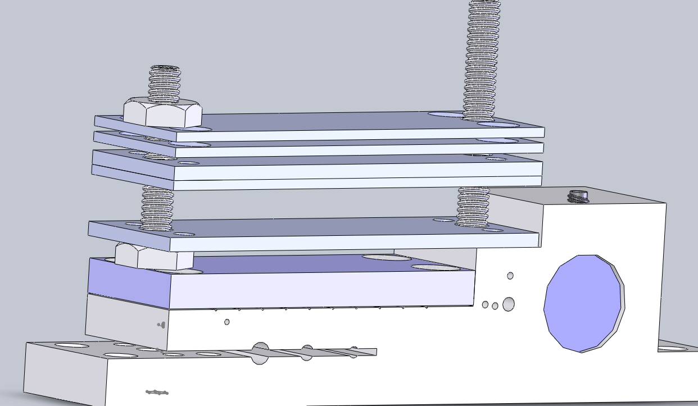
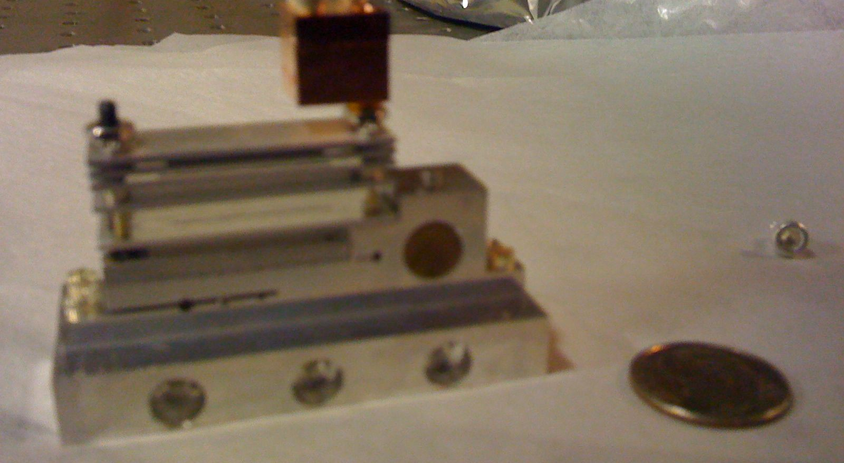
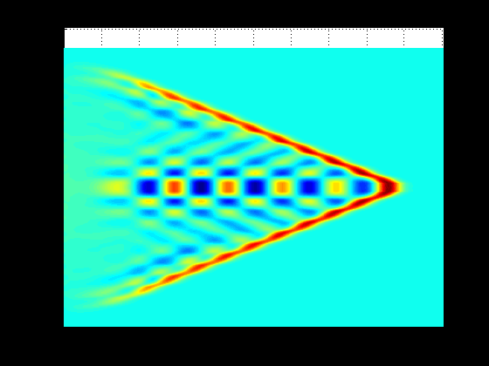
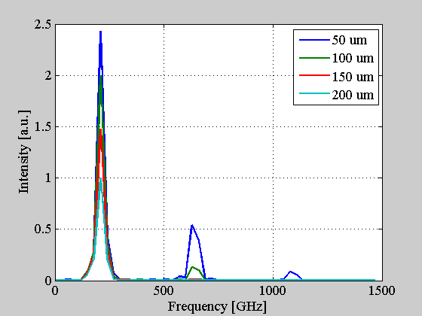
Engineering Bragg DWA holder
ZTA Bragg (ceramic)
  ZTA (ε=10.6)
  Quartz (ε=3.8)
Holder used at BNL ATF
  Interchangeable with FACET chamber
  Breakdown studies due to higher field
  Accommodates more samples
  Modular for different structures, materials
OOPIC sims of Ez and first few modes as a function of bunch length

Slide 15
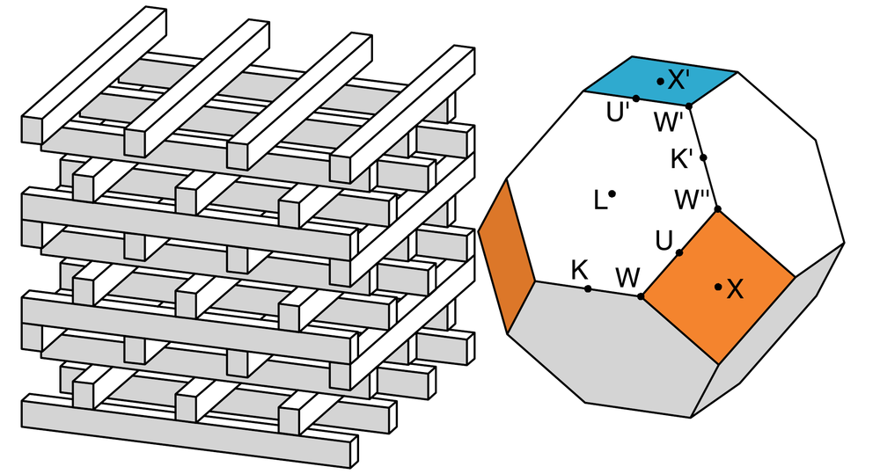
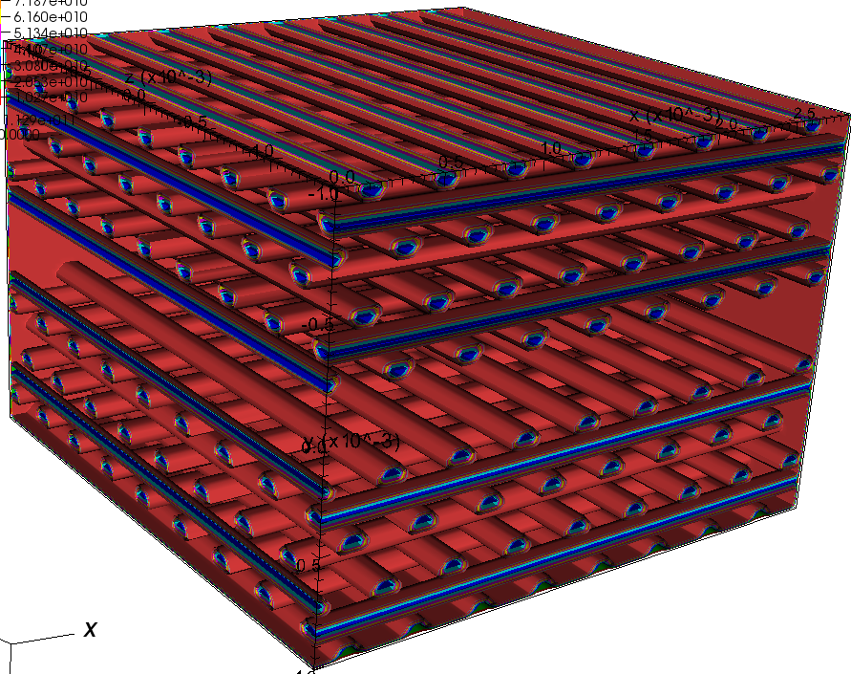
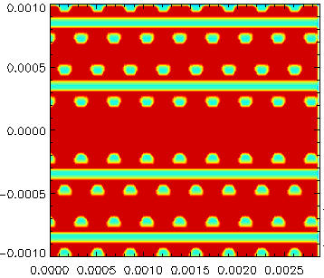
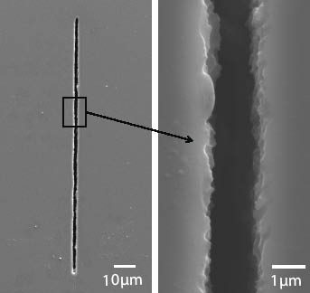
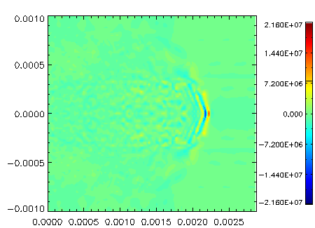
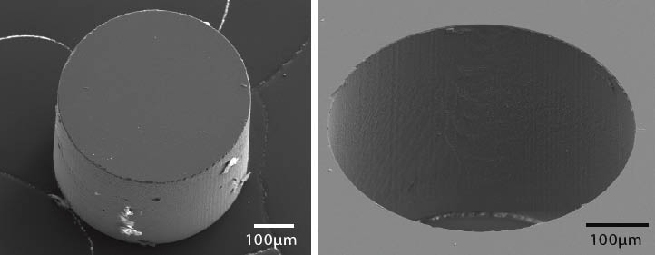
Advanced Structures
Woodpile (3d photonic structure)
  Take advantage of advances in photonic structure development
  Allows control of fields in both transverse dimensions
1raft = 1.5cmx1.5cmx125um
  8 rows/structure → 960 fibers to assemble
250um (2xD) beam channel
Microfabrication techniques
  Feasibility of structure
SiO2 fibers for structure
  Sapphire also under consideration
Mode confinement at 0.6THz
Vorpal model
Channel: 250um
A=350um
C=500um
1µm wide, 125µm deep
Ez distibution (and log plot)

Slide 16
Conclusions
Experimental Progress in DWA studies at ATF
  CTR and CCR studies
  Fundamental plus higher order mode for characterization in THz
  Tubes
  Slab geometry
    Elliptical beams
    Acceleration
  Bragg (1D photonic structures)
  Woodpiles (3D photonic structures) under study
  New materials
Leverage off recent results
  Continue to build experience in
    Fabrication, mounting DWA
    Radiation collection, transport
    Energy modulation measurements
Application as high power, narrowband THz source
Thank you ATF

