Slide 1
First Observation of Self-Modulation Instability Seeding at ATF
Yun Fang
University of Southern California, Los Angeles, 90089
Patric Muggli
Max Planck Institute for Physics, Munich, Germany
Warren Mori
University of California, Los Angeles, 90095
V. Yakimenko, M. Fedurin, K. Kusche, M. Babzien, C. Swinson, R. Malone
Brookhaven National Laboratory, Upton, NY 11973
Work supported by US Dept. of Energy

Slide 2
OUTLINE
Introduction of Self-Modulation Instability (SMI)
Investigation of the beam charge through simulation to study energy modulation with the available electron bunch at ATF
Experimental observation of periodic energy modulation in various plasma densities
Seeding of SMI through energy modulation
Study of instability seeding effect involved in the experiment

Slide 3
Motivation of Studying SMI
Proton Bunches produced at LHC will have up to 7TeV/particle, 100 kJ/bunch, much higher than the current lepton bunches (60J/bunch, 100GeV/particle)→ can be used as the drive bunch in PWFA ?
A.Caldwell proposed the idea of of proton-driven PWFA and demonstrated the possibility of producing a TeV electron bunch in a single acceleration stage using a short (~100um) proton bunch driver. (A. Caldwell et al., Nature Physics 5, 363 (2009); B. E. Blue’s thesis (2003))
However, such short proton bunches are not available (~12cm).
Kumar et al. suggested that self-modulation could radially modulate a long bunch into small beamlets on the scale of λ_{pe,} resulting in the resonant excitation of large amplitude accelerating wakefields.
SMI is interesting beam-plasma interaction physics
Take advantage of electron bunches and experimental infrastructure available at SLAC and BNL-ATF to study the physics of SMI.

Slide 4



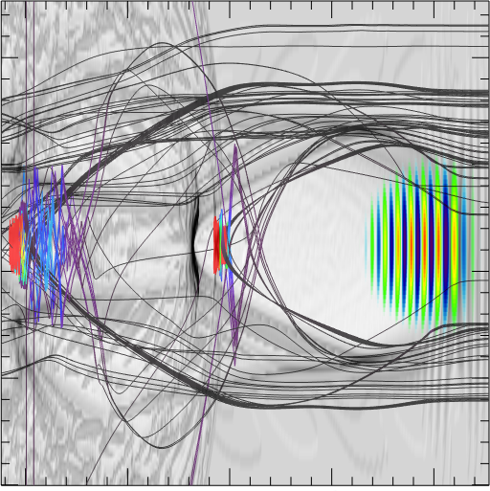
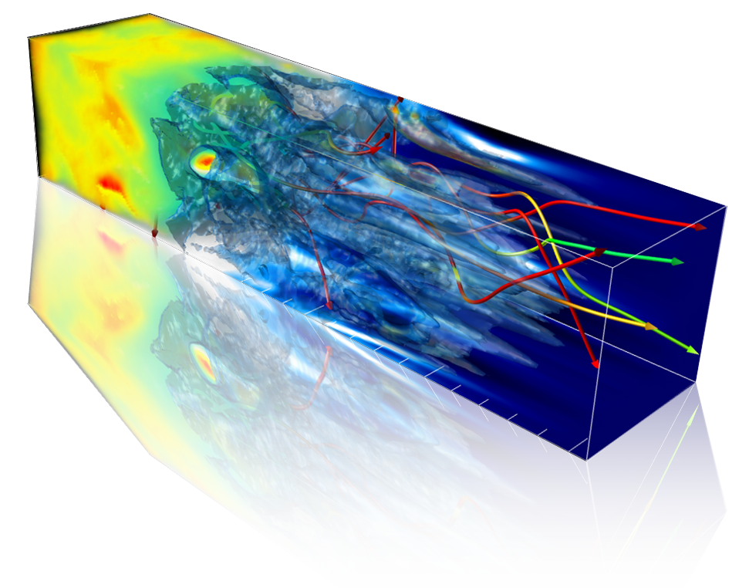

OSIRIS 2.0
osiris framework
Massivelly Parallel, Fully Relativistic
Particle-in-Cell (PIC) Code
New Hybrid algorithm
Visualization and Data Analysis Infrastructure
Developed by the osiris.consortium
UCLA + IST
New Features in v2.0
High-order splines
Binary Collision Module
Hybrid code
Boosted frame
PML absorbing BC
Vector processor optimization (SSE)
Energy and momentum conserving field interpolation
Higher order and dispersion free solvers
OpenMP/MPI hybrid
3D Dynamic Load Balancing
Parallel I/O
Ricardo Fonseca: ricardo.fonseca@ist.utl.pt
Frank Tsung: tsung@physics.ucla.edu
http://cfp.ist.utl.pt/golp/epp/
http://plasmasim.physics.ucla.edu/

Slide 5
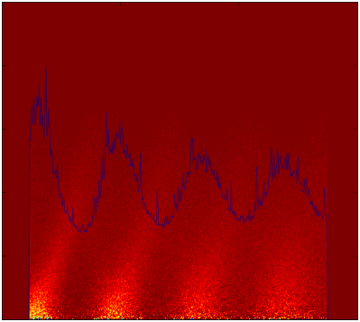
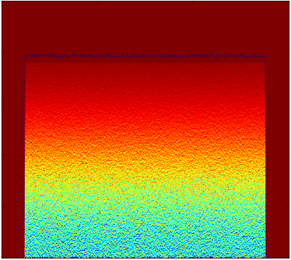
Self Modulation Instability (SMI)
z=0 cm
z=13.5 cm
×10⁻⁴
×10⁻³
L^{beam}/ λ_{pe}=4
0
SMI
0
1.5
1.5
3
3
1
4
Growth (ξ)
Focusing Field (MV/m)
-1
Growth (z)
-4
4
20
Resonant Excitation!
0
Ez (MV/m)
-4
-20
Demonstrated by simulation, by never by experiments yet!
No diagnostics to measure directly the radial modulation
Energy modulation is measurable, and is the seed for radial modulation

Slide 6
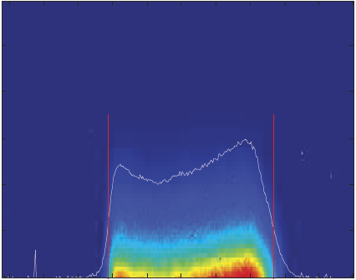
ATF Beam Parameters & Simulation Parameters
Electron Bunch
L^{beam} :: 960um (Square)
σ_{r} :: 120um
E :: 58.3MeV
ΔE :: 0.481MeV (correlated)
ε_{N} :: 13mm-mrad
Q :: 50pC / 1nC
Front
<
Back
57.8
58.3
58.8
Energy (MeV)
Peak E_{z} along z:
Q=50pC
N=1.36
Q=1nC
N=27.2
Plasma
L^{plasma} :: 20cm (2cm in exp.)
n₀ :: 1.941×10¹⁶cm⁻³
(variable)
(for L^{beam}/ λ_{pe}=2, n_{b}/n_{p}<<1)
Saturated @ z=2cm
Low Energy
2D Simulation Box
No Growth @ z=2cm !
N_{cells} :: 320×300
Dims :: 1222um × 458um
2×2 beam e⁻+2×2 plasma e⁻
At z=2cm: Q=50pC has no SMI growth
Q=1nC reaches the saturation of SMI

Slide 7
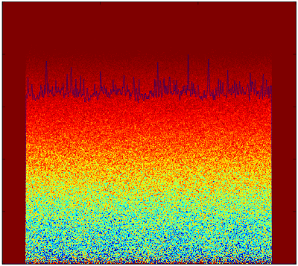
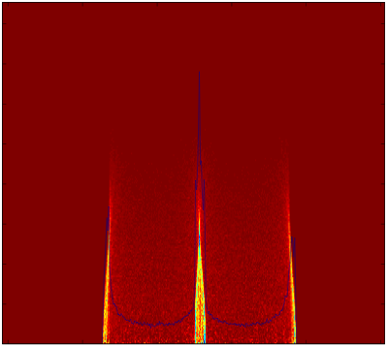
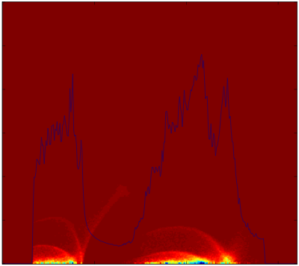
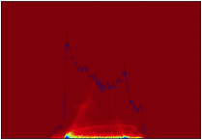
“50pC” vs. “1nC” at the plasma exit (z=2cm)
L^{beam}/ λ_{pe}=2
Beam Image
Energy Spectrum
×10⁻³
×10⁻²
0
0
✔
Q=50pC
No radial Modulation!
Measurable!!
1.5
1
3
2
57.8
58.3
58.8
Q=1nC
0
0
✗
Not measurable!
Lose modulation feature!
300
200
1
1
r (um)
100
2
2
0
0
500
1000
54
58
62
ct –z (um)
Energy (MeV)
Q=50pC is chosen in the experiment due to the energy modulation feature!

Slide 8
Energy Modulation-Simple Model (IFEL)
Q=50pC, L^{beam}/ λ_{pe}=2
Low
Energy
High
Back
Front
Deceleration
Periodic E_{z}
Energy Gain/Loss:
Acceleration
The energy beamlets are formed when the energy gain/loss is small compared to the initial energy spread of the beam
L^{beam}/ λ_{pe} E_{z}
E_{z} decreases from 6 to 1.2MV/m
Q=50pC

Slide 9
Simulations at Various Plasma Densities
In experiment, the plasma density can be varied: 10¹⁴ ~10¹⁷cm⁻³ (capillary discharge)
L/λ_{pe} | Plasma Density (cm⁻³) | n_{b0}/n₀
1 | 1.21×10¹⁵ | 0.0030
2 | 4.85×10¹⁵ | 0.00074
3 | 1.09×10¹⁶ | 0.00033
4 | 1.94×10¹⁶ | 0.00019
5 | 3.03×10¹⁶ | 0.00012
z=2cm
At z=2cm, no SMI growth for various plasma densities
Initial E_{z} decreases with n₀, ranging between 4-2MV/m, as desired for the energy modulation to be visible.

Slide 10


Experimental Setup
Energy Spectrometer
Beam Line 2
Plasma
Dipole
Dipole
Quadruple
Energy Slit
e- beam
Rf Gun
Linac
Quadrupole
Dipole
Use the same experimental setup as the PWFA experiments

Slide 11
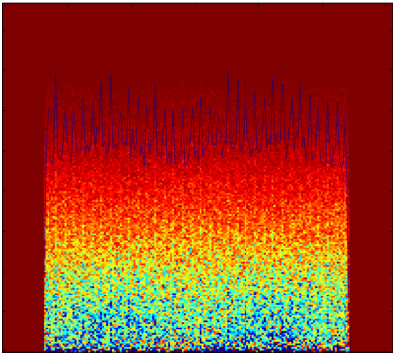
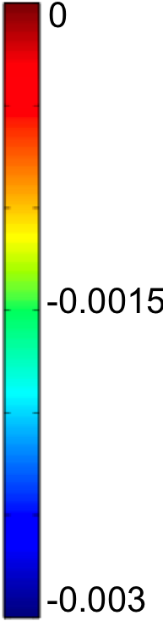
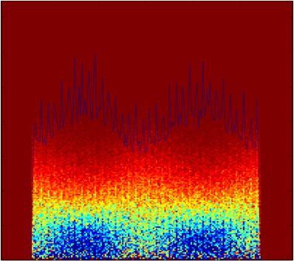
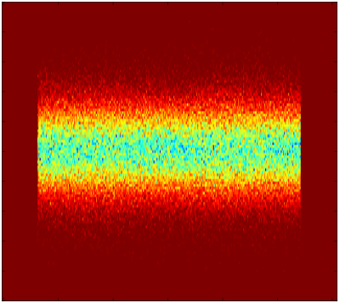
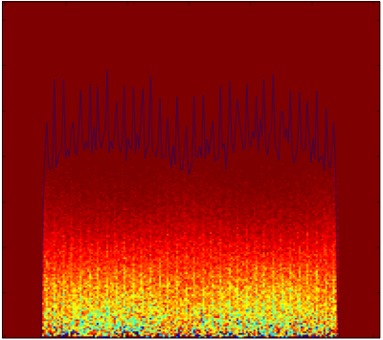
Energy Modulation: Seed for SMI
Seed of self modulation: Energy Modulation Longitudinal Wakefields Transverse Wakefields Radial Momentum Self Modulation
Transverse velocity at z=2cm
Beam image in vacuum
a.u
a.u
0
400
No modulation @L^{vacuum}=0cm
v_{r} /c
200
0
High modulation @L^{vacuum}=7.5cm
600
×10⁻³
0.06
5
300
Propagate in Vacuum
v_{θ}/c
0
0
1400
Low modulation @L^{vacuum}=25cm
r (um)
700
-5
0.12
0
500
1000
0
500
ct –z (um)
0
ct –z (um)
1000
Transverse modulation could be observed downstream the plasma!

Slide 12
Beam Transverse Sizes Measured in Experiment
Beam image recorded 25cm downstream the plasma, n_{p}=7.6×10¹⁶cm⁻³
σ_{x, off} =367um
σ_{x,,on} = 489um
σ_{y, off} =262um
σ_{y,,on} = 438um
Defocusing by the plasma also observed in lower plasma densities
Defocusing might be caused by the overshoot of focused particles
Need to look into simulations

Slide 13
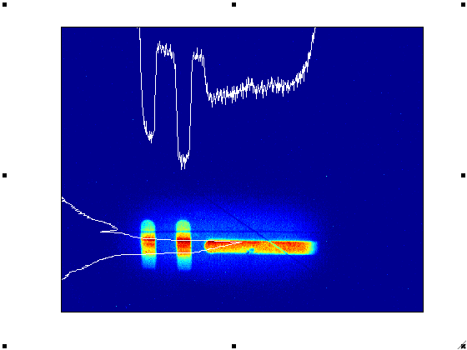

Instability Seeding: “Sharp” vs. “Round”
Initial E_{z} is very important in our previous energy modulation study
Current rise at the beam front is critical to the initial E_{z} amplitude
In the experiments, the bunch current rise is round, instead of being perfectly sharp as assumed in simulations
Fix λ_{pe} so that L=2 λ_{pe} vary ΔL, E_{z0}=E_{z}(ΔL=0)
Experiment Image
Front
Back
ΔL
L
E_{z}/E_{z0}
Transverse Size (pixel)
ΔL/L=0.06
0
100
200
300
400
L/λ_{pe}=1
L/λ_{pe}=5
Experimental region
Energy (pixel)
ΔL/λ_{pe}
Large ΔL/λ_{pe}→ less rapid current rise→ lower initial E_{z}→ slower saturation
In the experiment, ΔL/λ_{pe} <0.3 →E_{z}/E_{z0} >0.9→well seeded instability
ΔL/L=0.371
Notes:
The round edge profile is close to what we have in the expt. Since only the front edge matters for the instability seeding, so we ignore the tail part.

Slide 14
Conclusions
Simulations show the 50pC ATF beam is subject to periodic energy modulation at 2cm propagation distance, which is an important evidence of SMI seeding.
Simulations show that SMI does not grow significantly over the 2cm plasma for 50pC ATF beam
Experiment demonstrates the first observation of SMI seeding through energy modulation
Simulations show well-seeded instability in the experiments
Simulations show that 1nC ATF beam is radially modulated over 2cm plasma.
No diagnostics to measure directly the radial modulation

Slide 15
Thank you !
Thank you to ATF!

