Slide 1
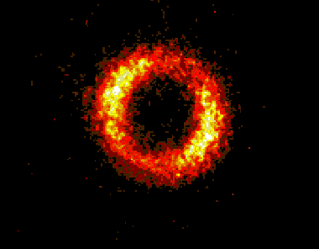
Status of Compton Scattering at ATF
ATF Users Meeting
April 2012
Oliver Williams

Slide 2
Why we like Compton Scattering
Sub-picosecond x-rays for dynamics studies
  e.g. melting and shocks
Easy tuning of energy and polarization
  Ferromagnetic materials, XMCD
Access to hard x-rays and gamma rays
  Nuclear materials, positron production
High peak brightness in small footprint

Slide 3
Compton Experience at ATF
First observation of 2nd harmonic
Energy determined by K-edges
Single-shot phase contrast imaging
Single-shot static diffraction
BW determined by Bragg spectrometer

Slide 4
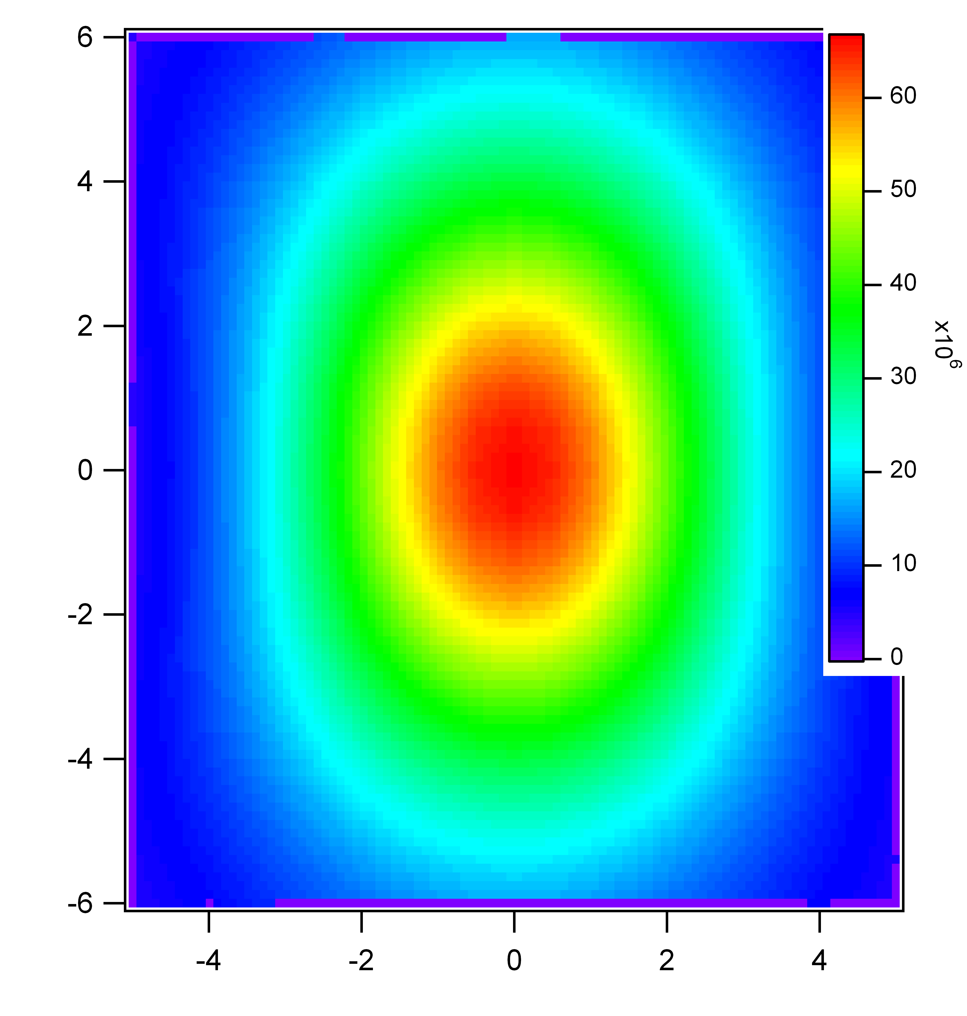
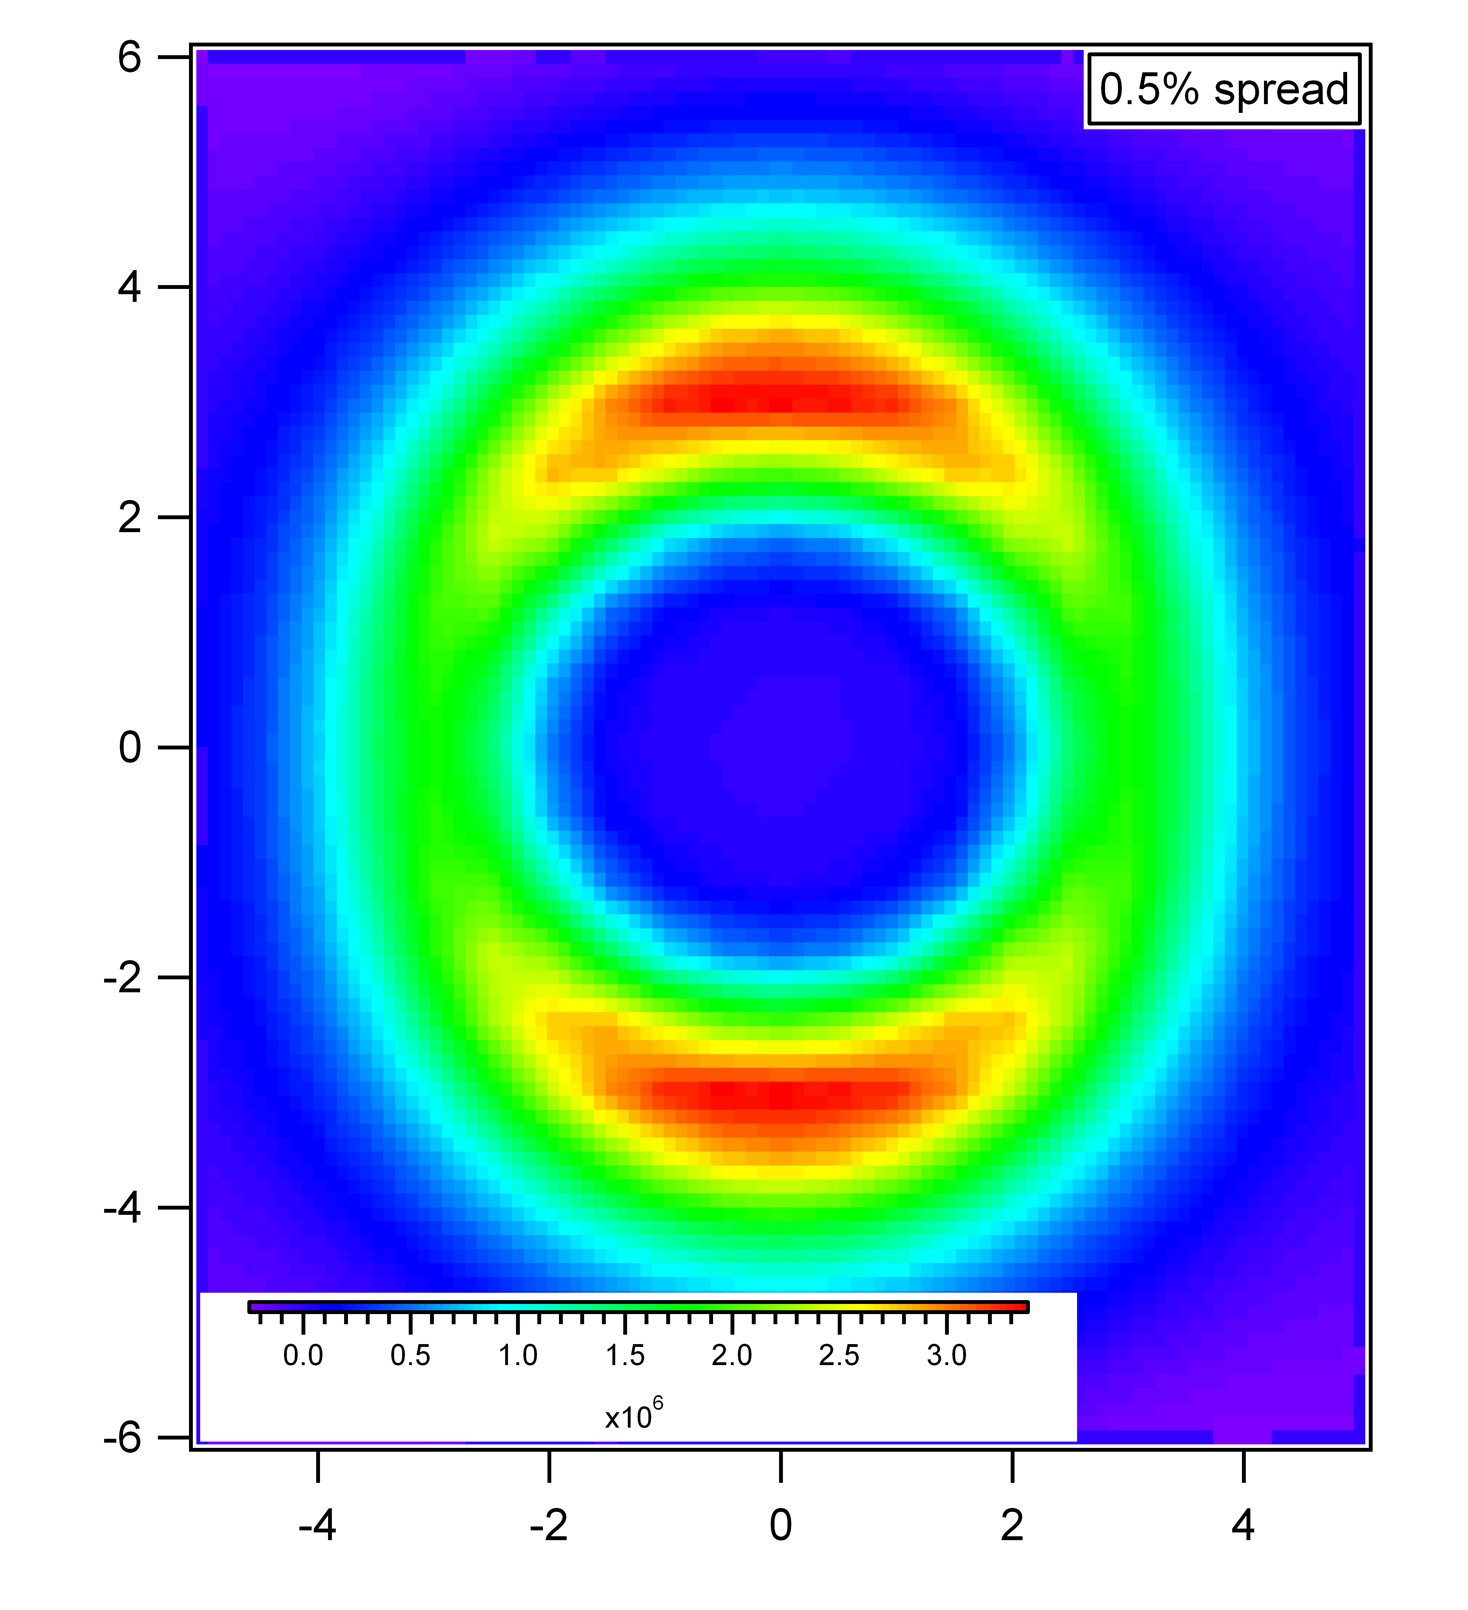
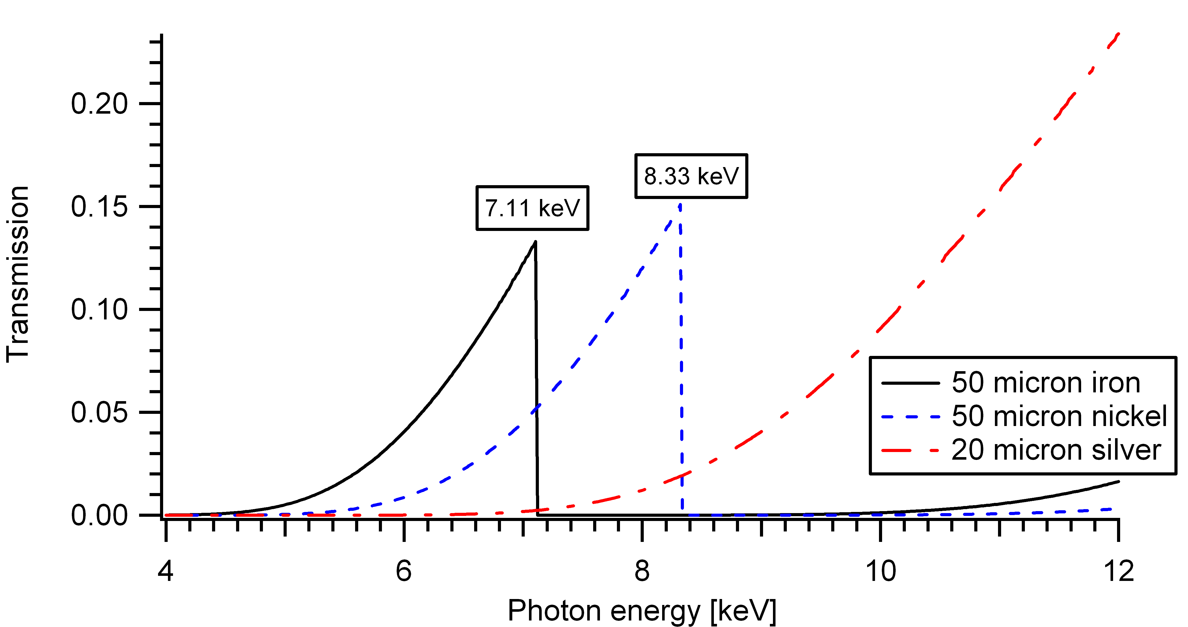
Energy Measurement Using K-edge
Characterized x-rays via K-edge foil
ICS photons have angular-energy relation (“undulator eqn.”):

Slide 5
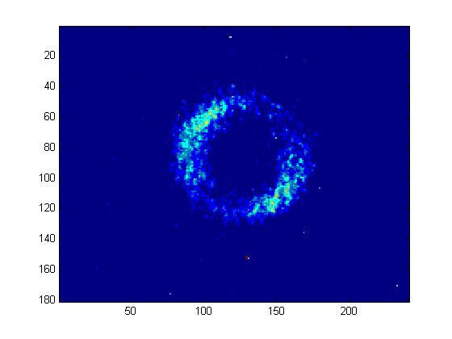
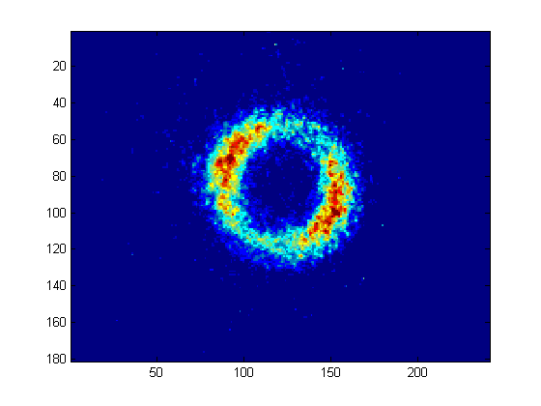
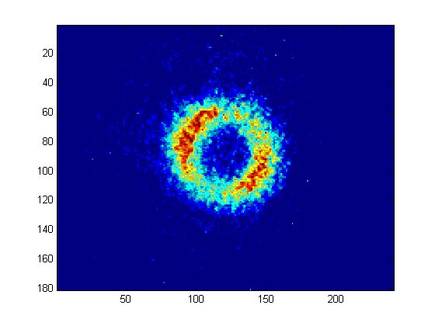
72 MeV
70 MeV
68 MeV

Slide 6
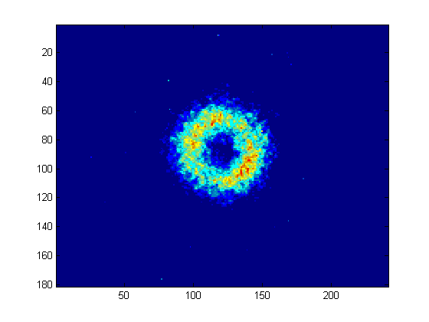
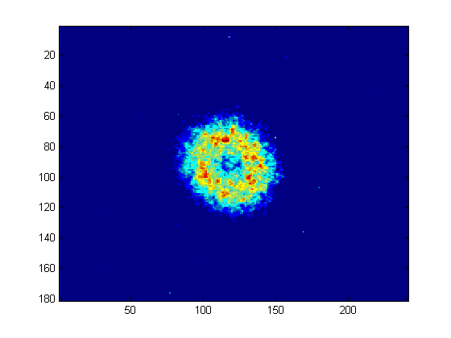
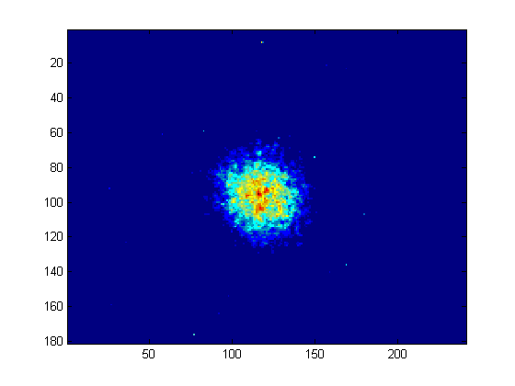
66 MeV
65 MeV
64 MeV

Slide 7
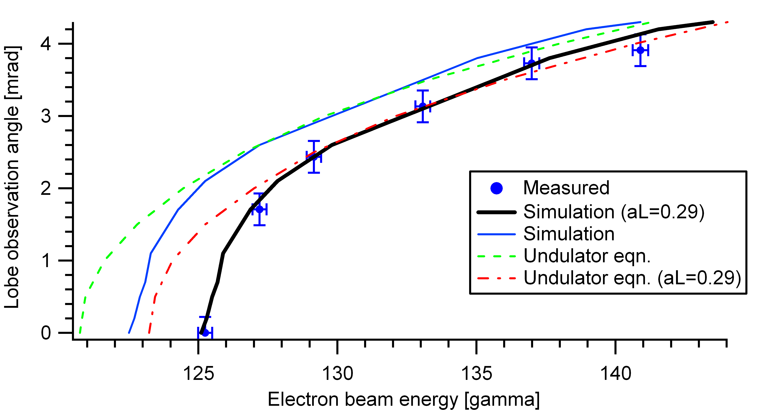
Lobe observation angle
ΔE_{e}=1.3 MeV => ΔE_{x}= 290 eV
-Fit simulation curve to data by adding energy offset (~290 eV)
Energy offset could be due to absolute e-beam energy calibration or nonlinear induced red-shifting (a_{L}>0) (more likely)

Slide 8
Static Bragg Diffraction
X-rays pass through 1 mrad slit
Si-diode measured 6x10⁷ photons
Nickel foil (K-edge: 8.33 keV) used to verify x-ray energy ~8.7 keV
4” Si <111> wafer
Bragg angle=13.25º
MCP detection efficiency: ~1%

Slide 9
Single-shot diffraction
10⁴ photons diffracted from 4” Si <111> wafer
Detection limited to ~100 photons due to MCP efficiency
New MCP ordered with 10x better detection efficiency

Slide 10
BW determined from Bragg scan
Good agreement with simulation gives rms BW = 2.6% with central energy of 8.7 keV

Slide 11
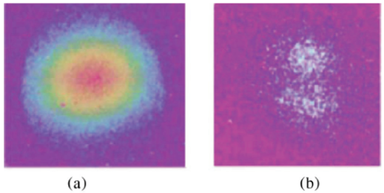
Nonlinear Compton
Riding on prior success of harmonic production at ATF
Same set up but more powerful laser
Will help act as benchmark for laser power

Slide 12
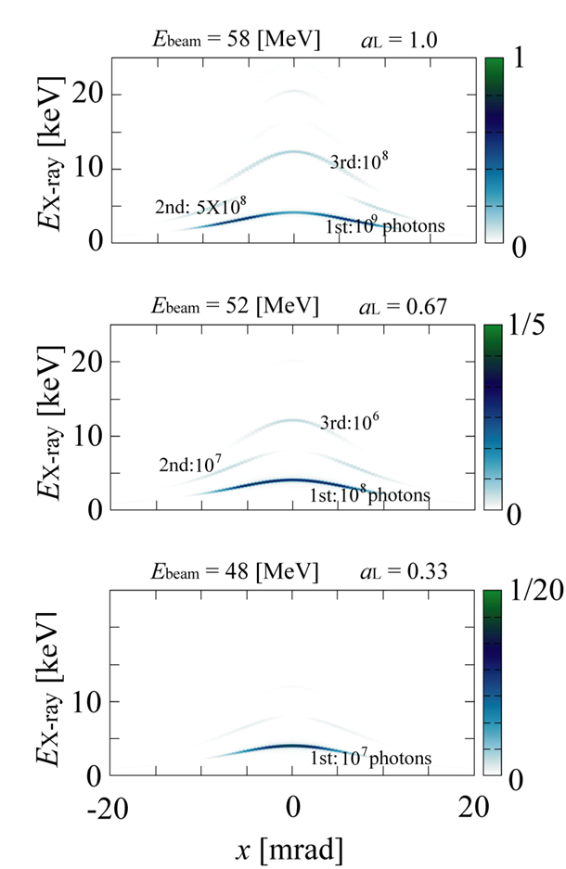
2nd Harmonic and Beyond
Need more photons!
Deserves revisit due to new laser parameters
  2006: 4 J, 30 ps
  2012: 5 J, 5 ps
  8x more power!
Using foils of various K and L edges

Slide 13
Angular Distributions-Harmonics & Red shifting (60 MeV)
aL=1
aL=0.75
aL=0.5
No
foil
Fe

Slide 14
aL=1
aL=0.75
aL=0.5
Cu
Au

Slide 15
Summary
Spectral diagnostic experience will assist in studying spectrum of harmonics and fundamental in nonlinear regime
Heavy demand on CO2 laser performing optimally for 3rd and 4th harmonics
Photon limit must be pushed for dynamics
Sets stage for other provocations: 2-color (10 um AND 1 um) laser ICS???

