Slide 1
The HYSPEC Polarized Beam Spectrometer
Mark Hagen, Barry Winn,
Melissa Graves-Brook
Neutron Scattering Science Division
David Anderson, Xin Tony Tong
Neutron Facilities Development
Division

Slide 2
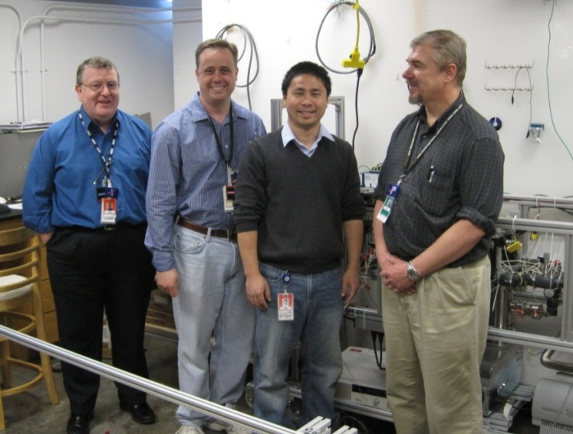
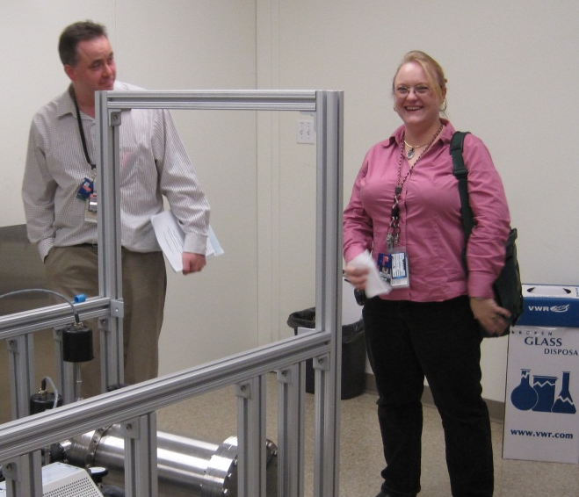
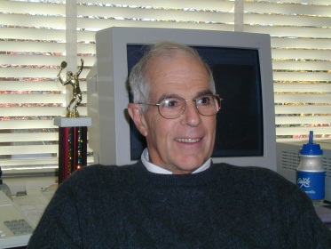
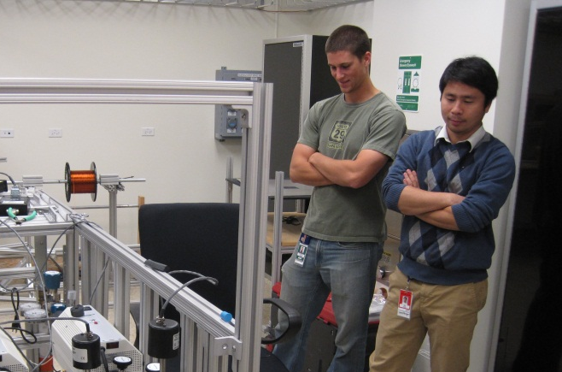
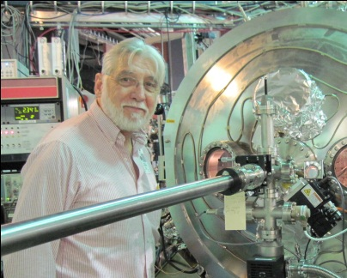
HYSPEC People
At Oak Ridge Nat. Lab.
Instrument team:
Mark Hagen
Barry Winn
Melissa Graves-Brook
Lead Engineer:
David Anderson
³He Polarization:
Xin “Tony” Tong
Nick Thomas
Daniel Brown
At Brookhaven Nat. Lab.
Principal Investigators:
Steve Shapiro
Igor Zaliznyak
Lead Engineer:
Bill Leonhardt
Mark Barry Tony David
Hagen Winn Tong Anderson
Melissa
Graves-Brook
Steve Shapiro
Igor Zaliznyak
Nick
Thomas
Bill Leonhardt

Slide 3
Outline
What you’ve seen
What’s Hidden
What’s Coming
What’s Next

Slide 4
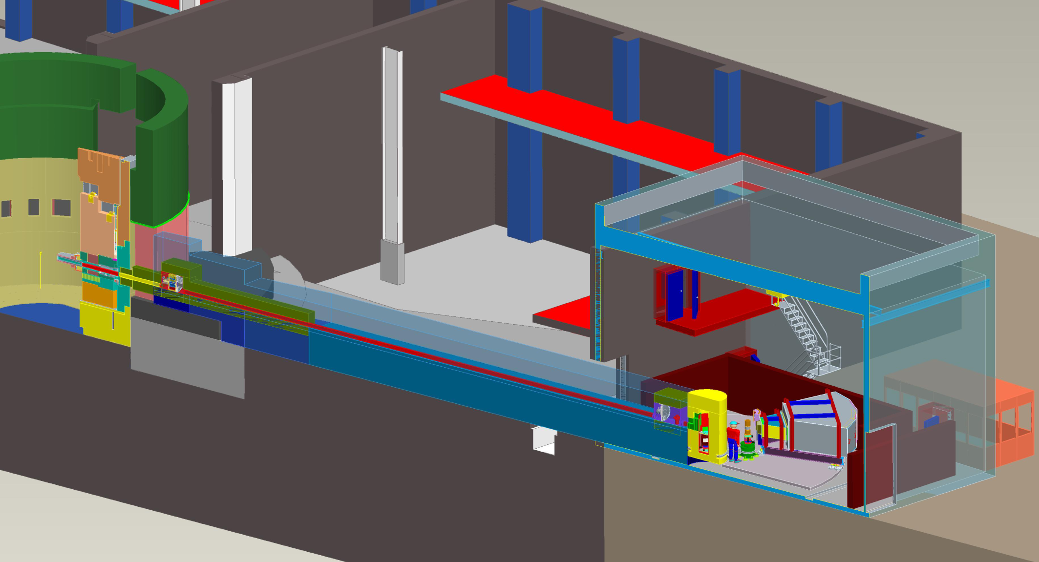
Instrument Overview
Installed/Installing
Designed
In fabrication
In design
Control Cabin
External Building
Shutter
Chopper Box B
FocusingCrystals
6-15m
Shielding
Chopper Box B
Shielding
CVI
Curved Beam Guide
Chopper Box A
15-33m Shielding
Detector Vessel
& Analyzer
Drum Shield
Dance
Floor
Sample
Stage

Slide 5
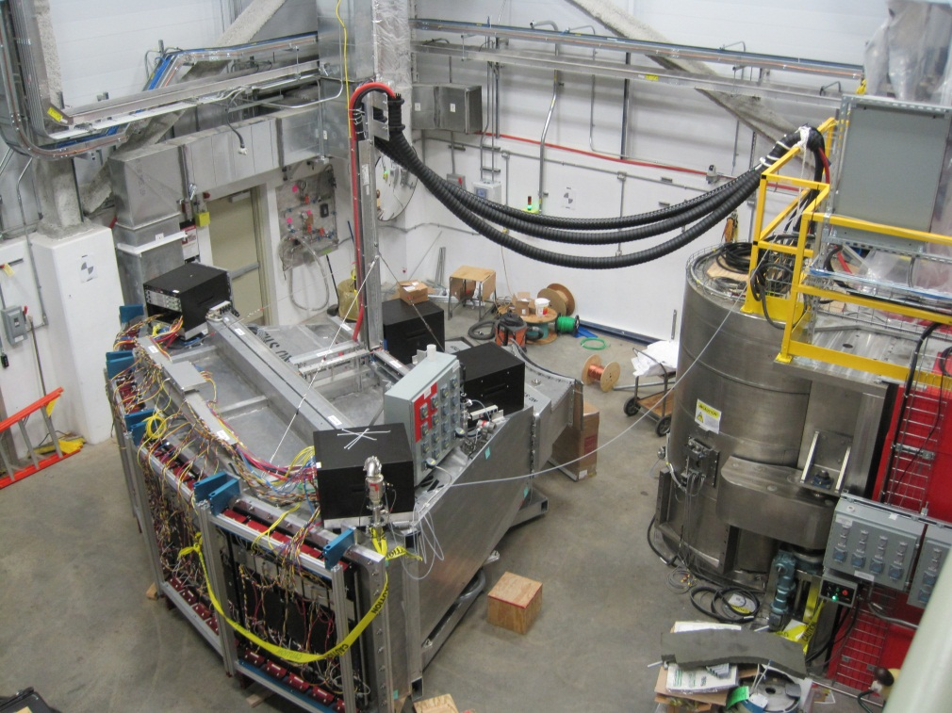
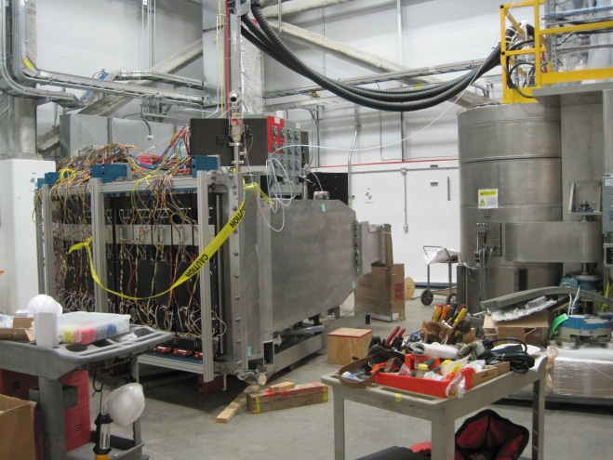
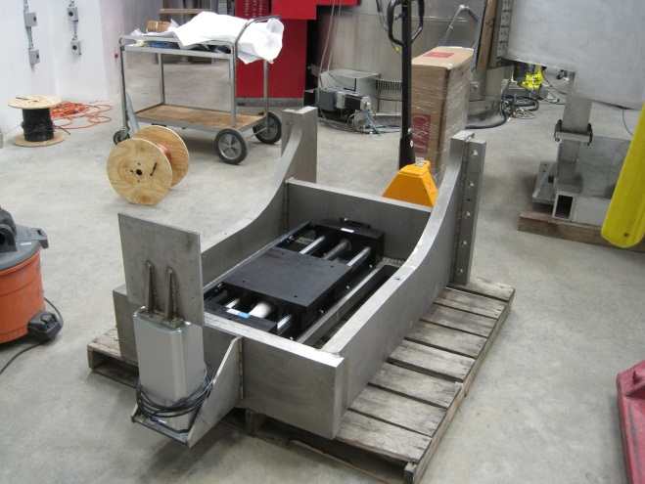
What You’ve Just Seen…

Slide 6
What’s Hidden…

Slide 7
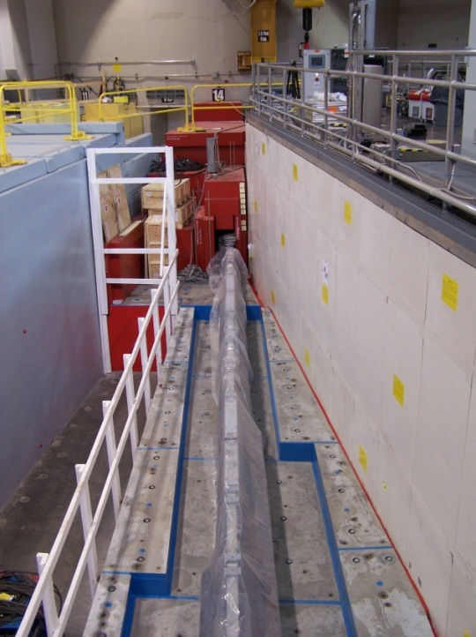
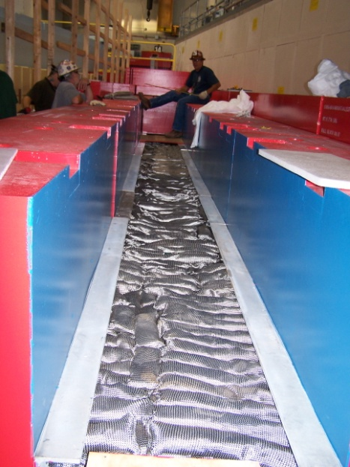
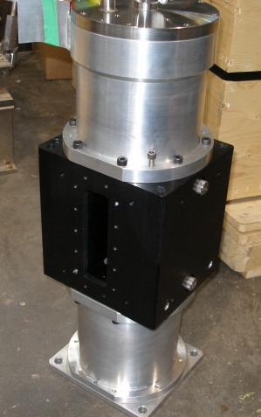
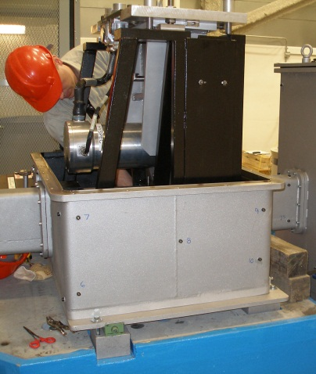
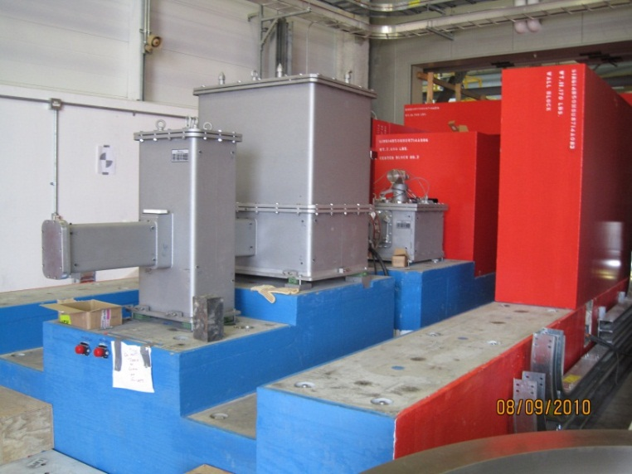
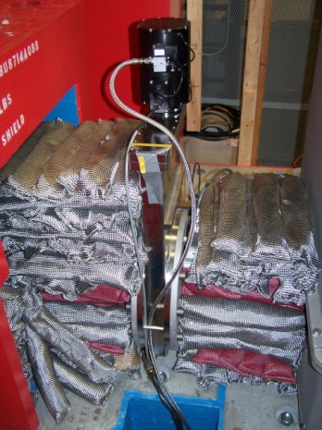
Choppers, Monitors, Shutters,
Guides, Cables, Pipes & Socks

Slide 8
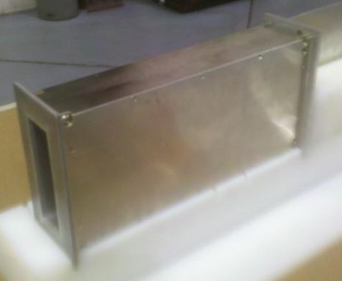
Magnetic Guide Field in Drum Shield Exit Port
To preserve polarization of neutrons from Heusler
NdFeB magnets on the sides, steel top & bottom
Both drum shield (shown) and tertiary shutter
Inner lining: Maxus boron loaded aluminum
480 Gauss at entrance, 7 Gauss 30 cm away

Slide 9
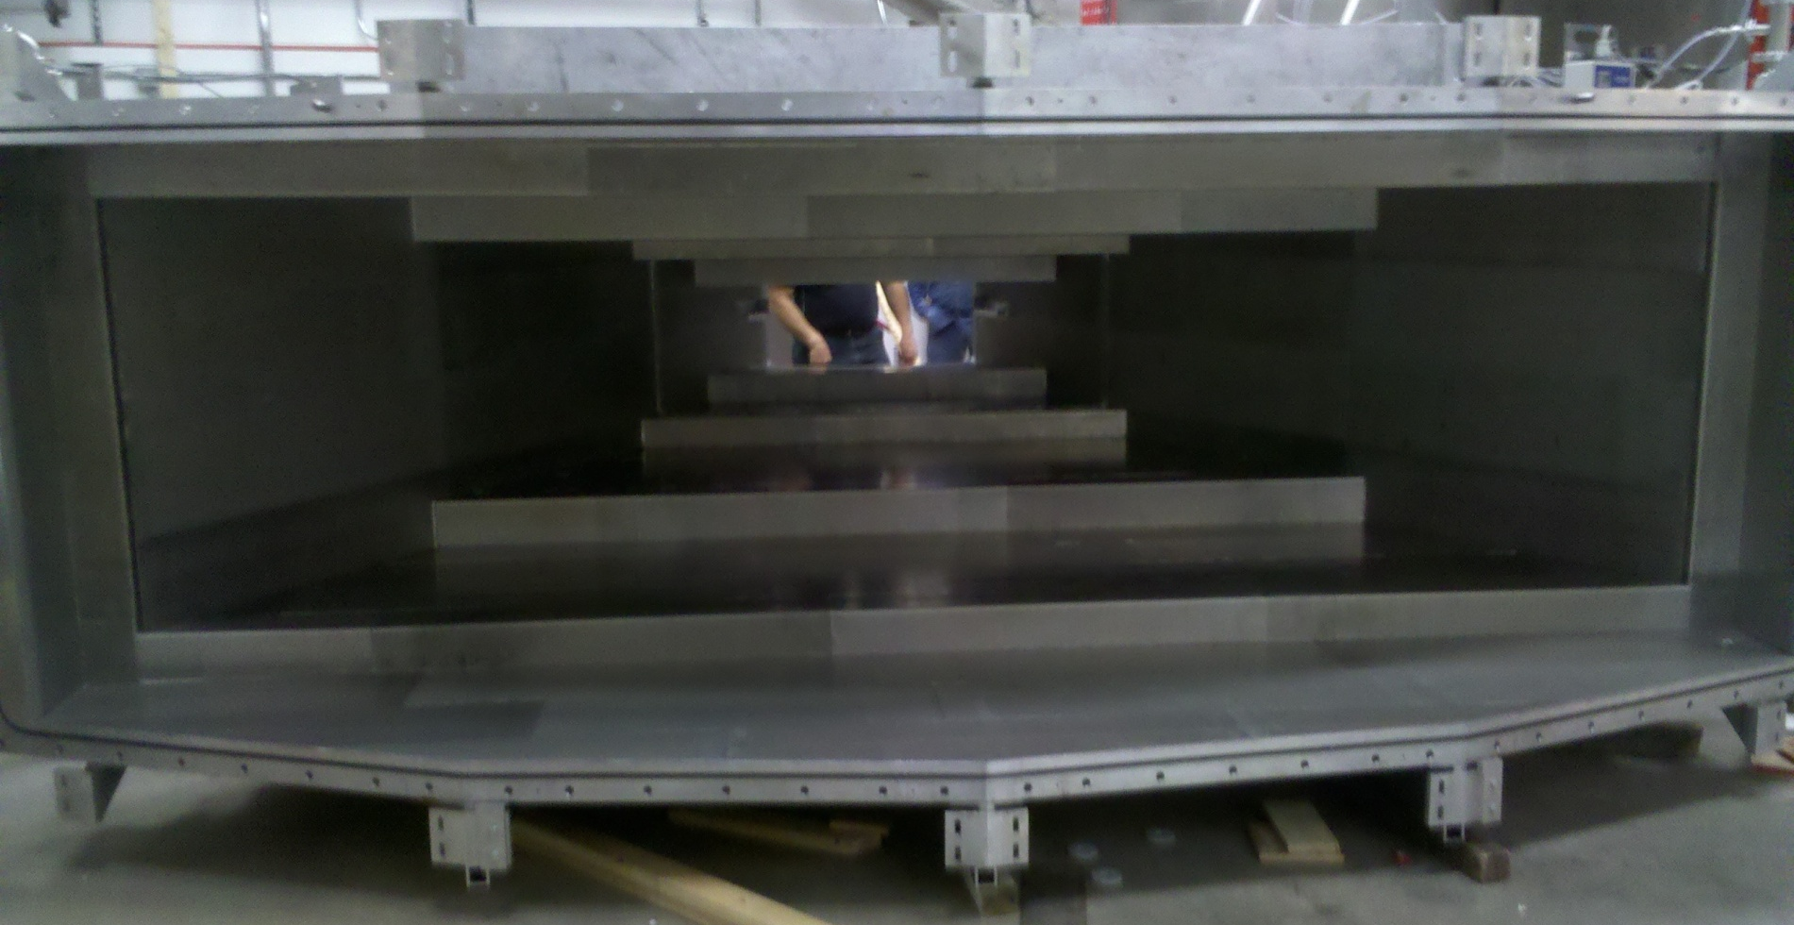
Cadmium Shielding inside Detector Vessel
1.5 mm thick cadmium

Slide 10
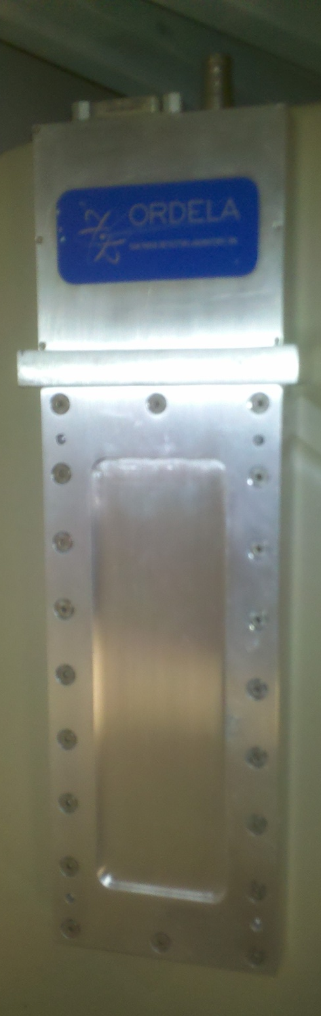
Neutron Monitor #3
Calibrated at HFIR, so under radioactive material control
To be mounted on optical rail outside drum shield

Slide 11
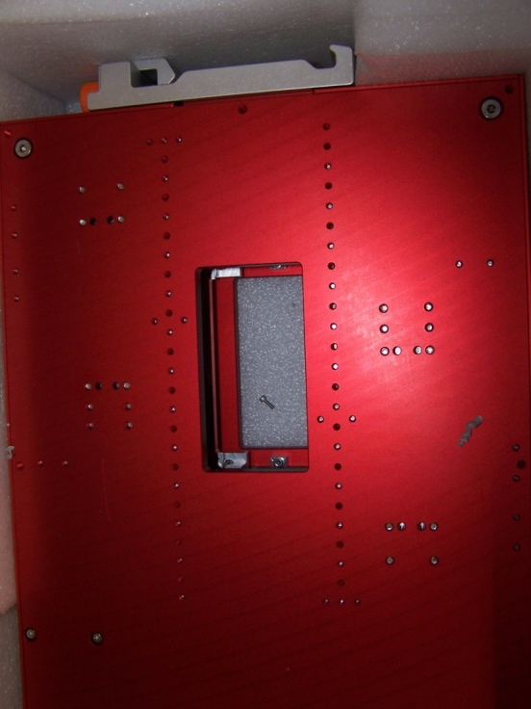
Apertures
Absorber blades: CBBC with BN paint, to be installed
Have two

Slide 12
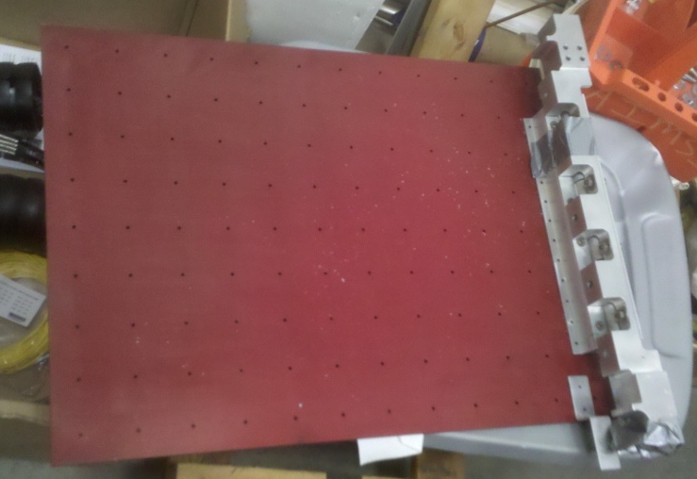
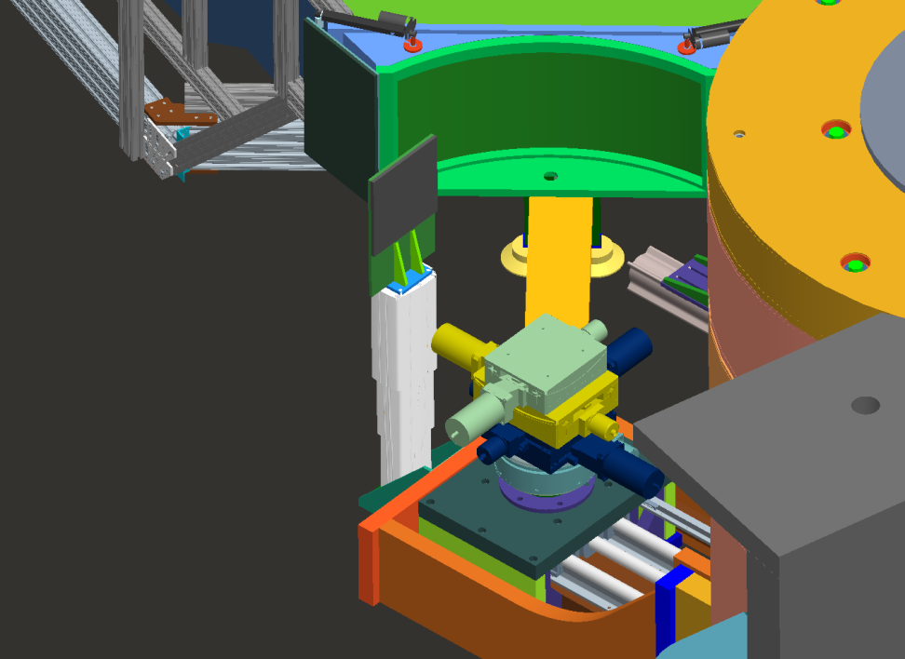
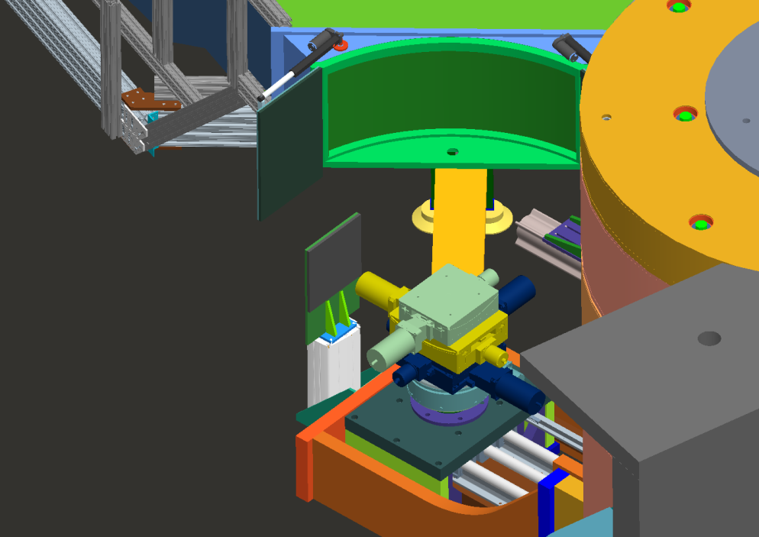
Flapping Ears
CBBC panels with BN paint ready to attach

Slide 13
What’s Coming…

Slide 14
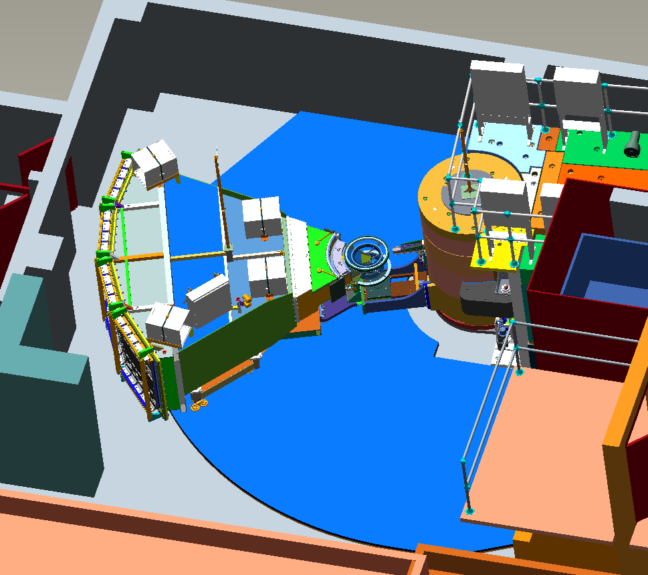
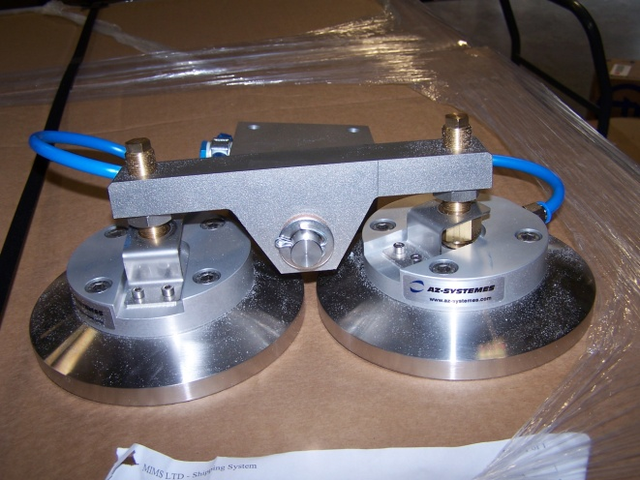
Tanzboden
Granite tiles in US
Installers arrive next week
Air pads here, too

Slide 15
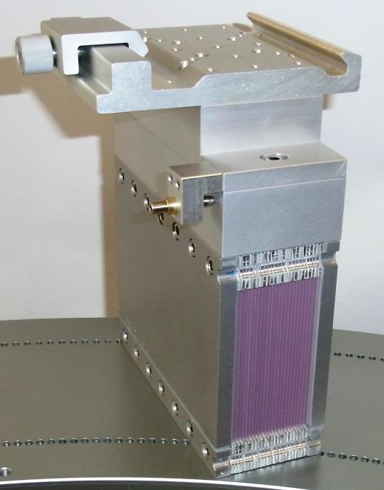
Soeller Collimators
Both 20’ & 40’
JJ-Xray design through assembly
Dimensional Inspection Reports imminent

Slide 16
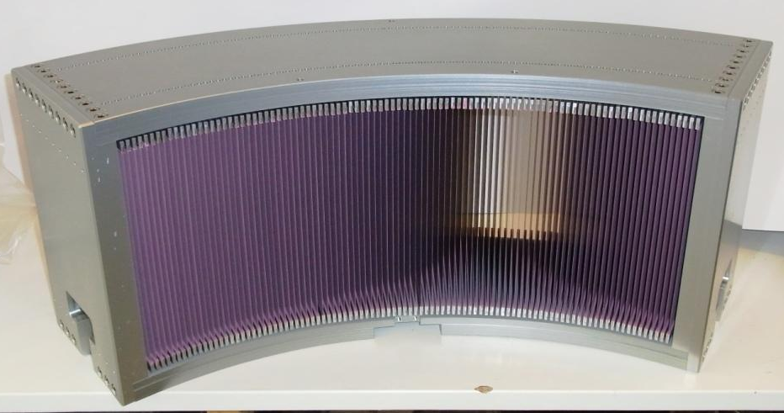
Fine Radial Collimator
Pane angle spacing: 40’
JJ-Xray design through assembly
Dimensional Inspection Reports imminent

Slide 17
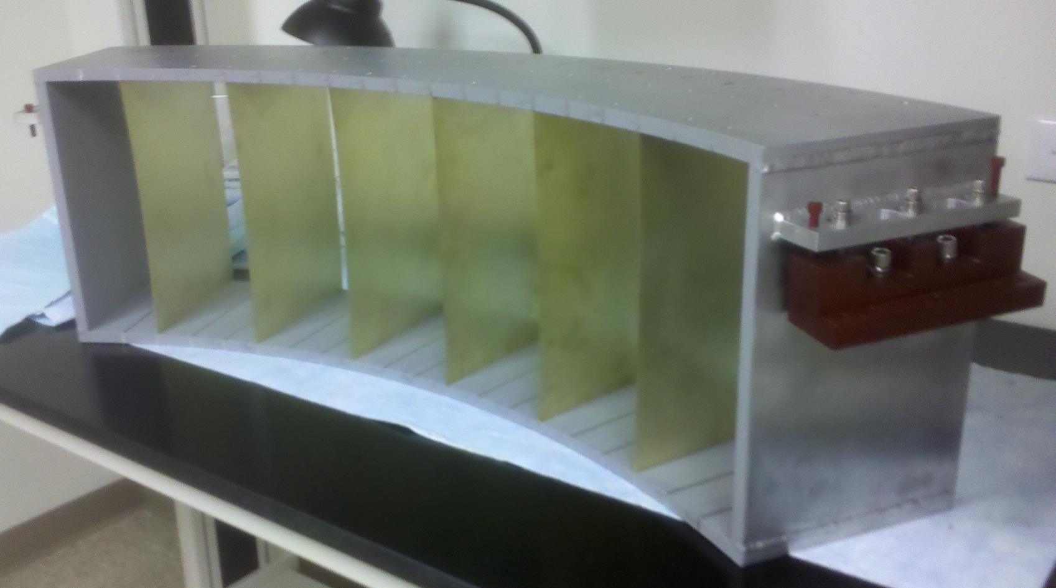
Coarse Radial Collimator
Frame assembled by ORT-E
On-Site
Cd coated blade installation awaiting final installation

Slide 18
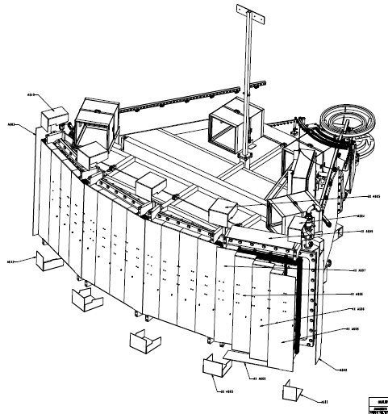
Cadmium shielding at back
In addition to ½” thick CBBC panels behind tubes on 8-packs
Cadmium thickness 1.5 mm
Not shown: Cadmium sheet between 8-packs

Slide 19
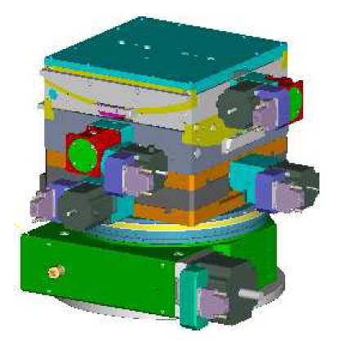
Sample rotation, tilt and translation
Huber: final design through assembly

Slide 20
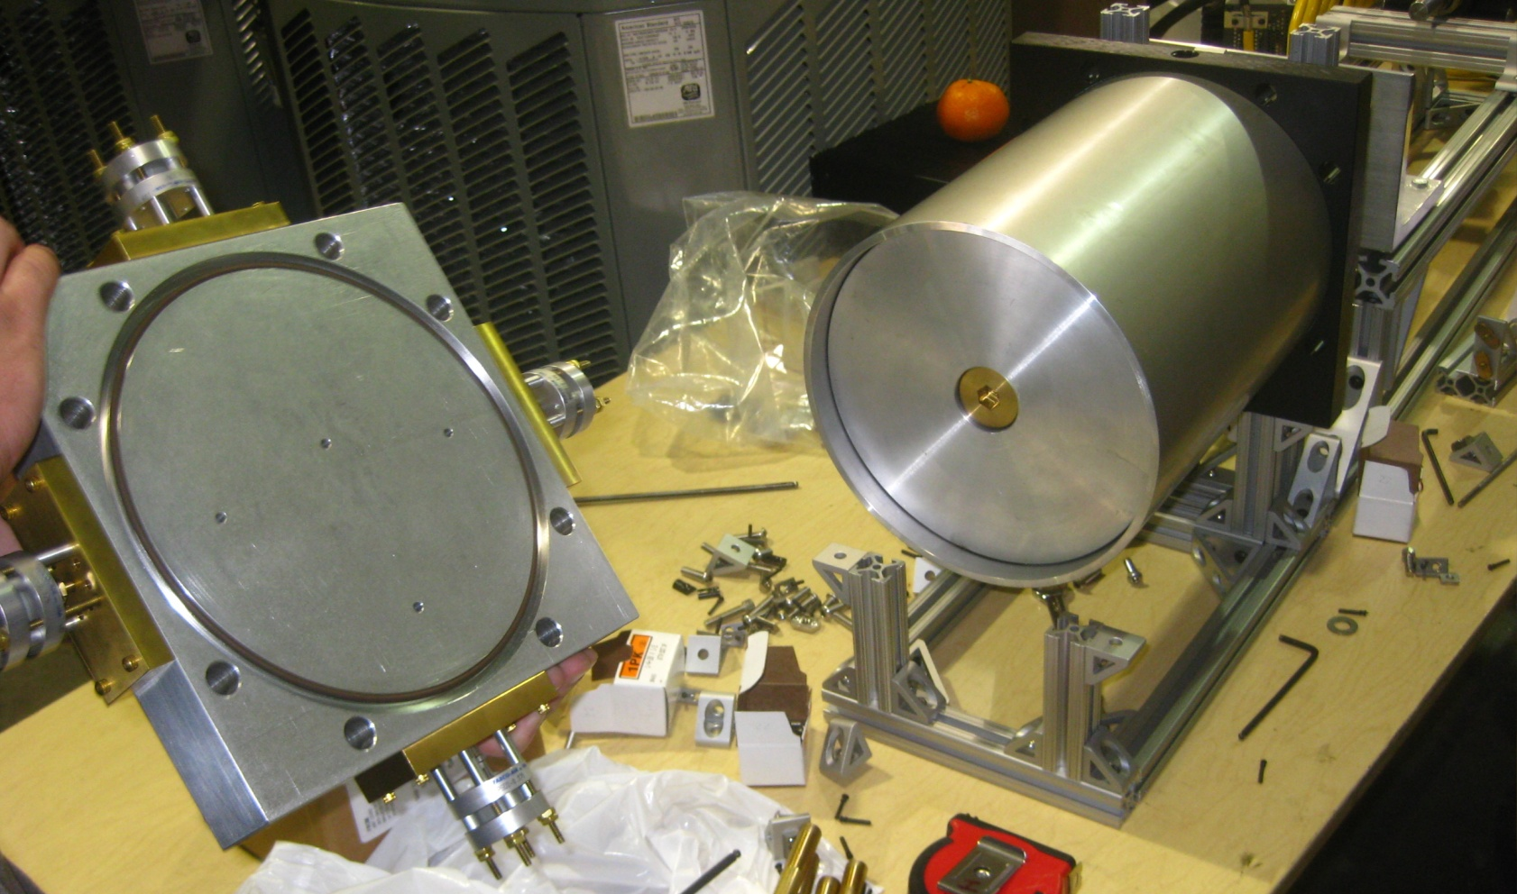
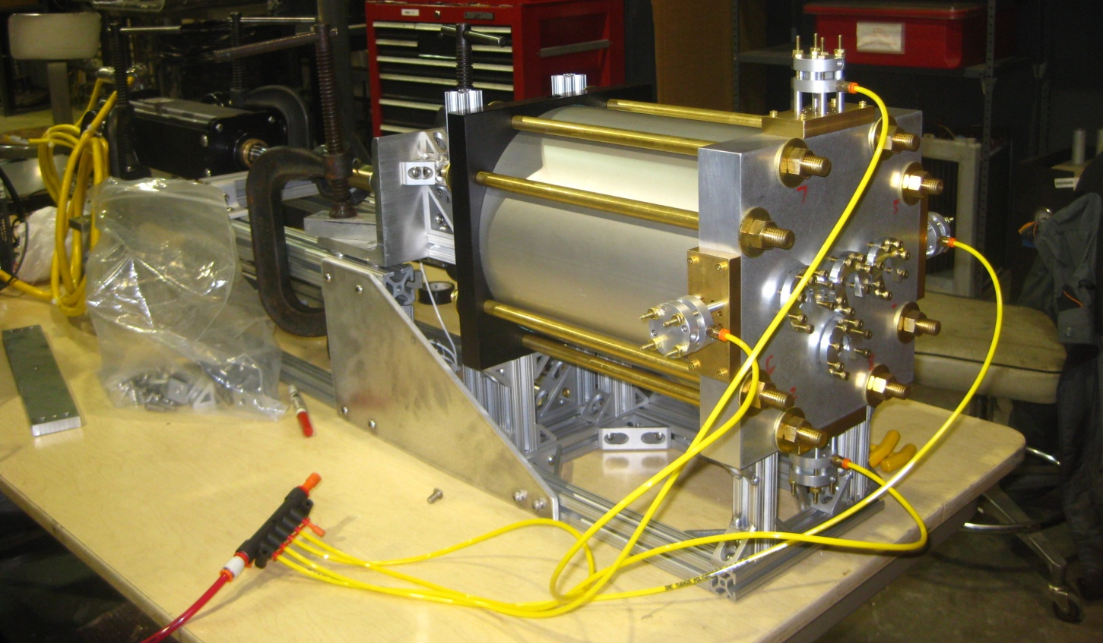
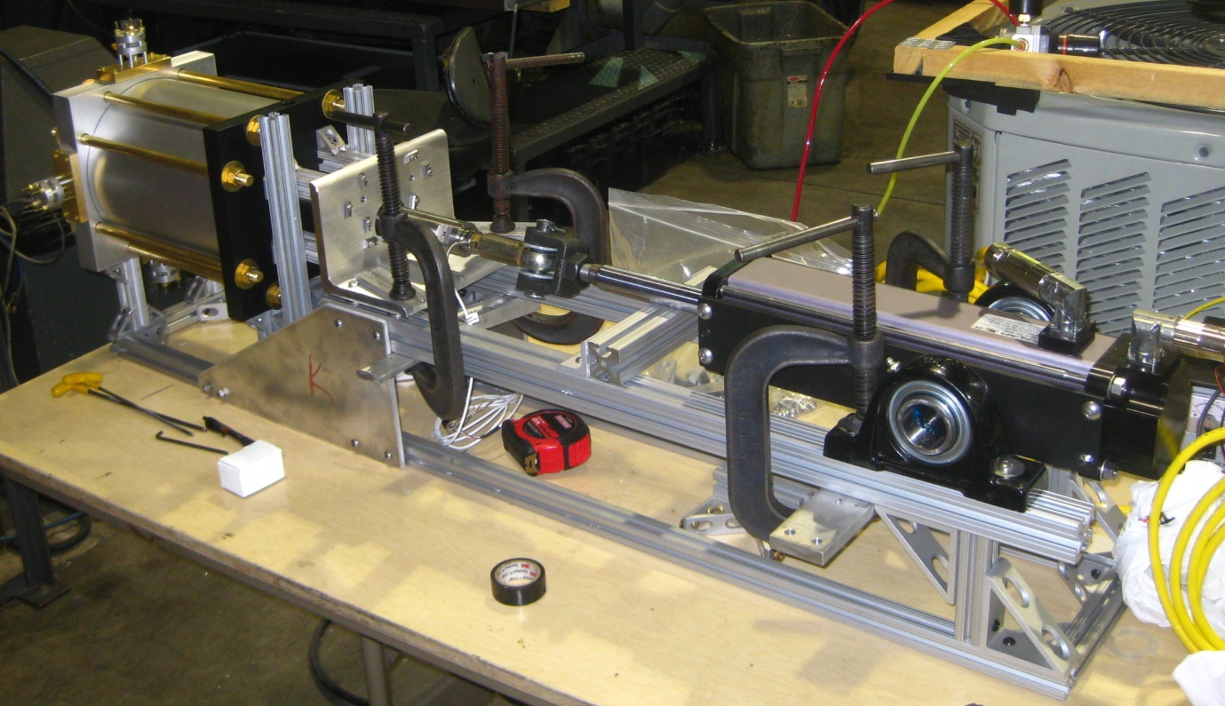
Polarized 3-He Transfer Mechanism
Basic Design: Nick Thomas
Final Design & Fabrication: Vacuum Technology International, Oak Ridge
Assembly & Testing now: Nick Thomas & Dan Brown

Slide 21
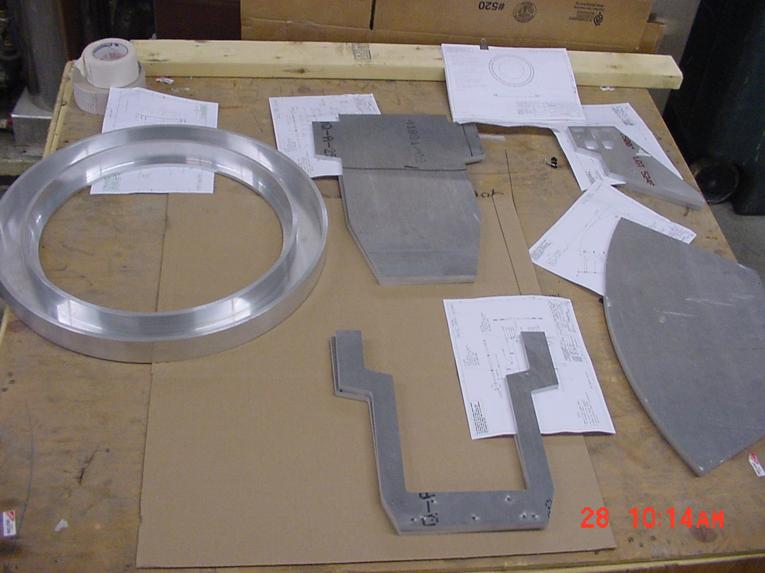
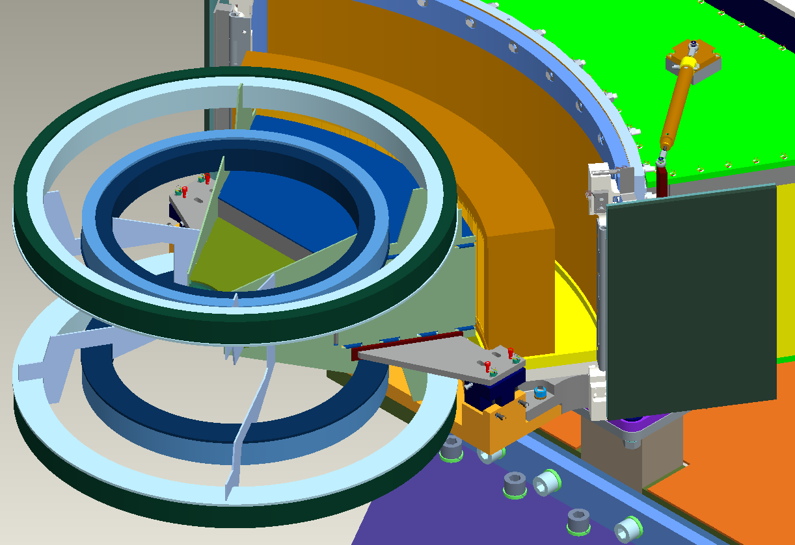
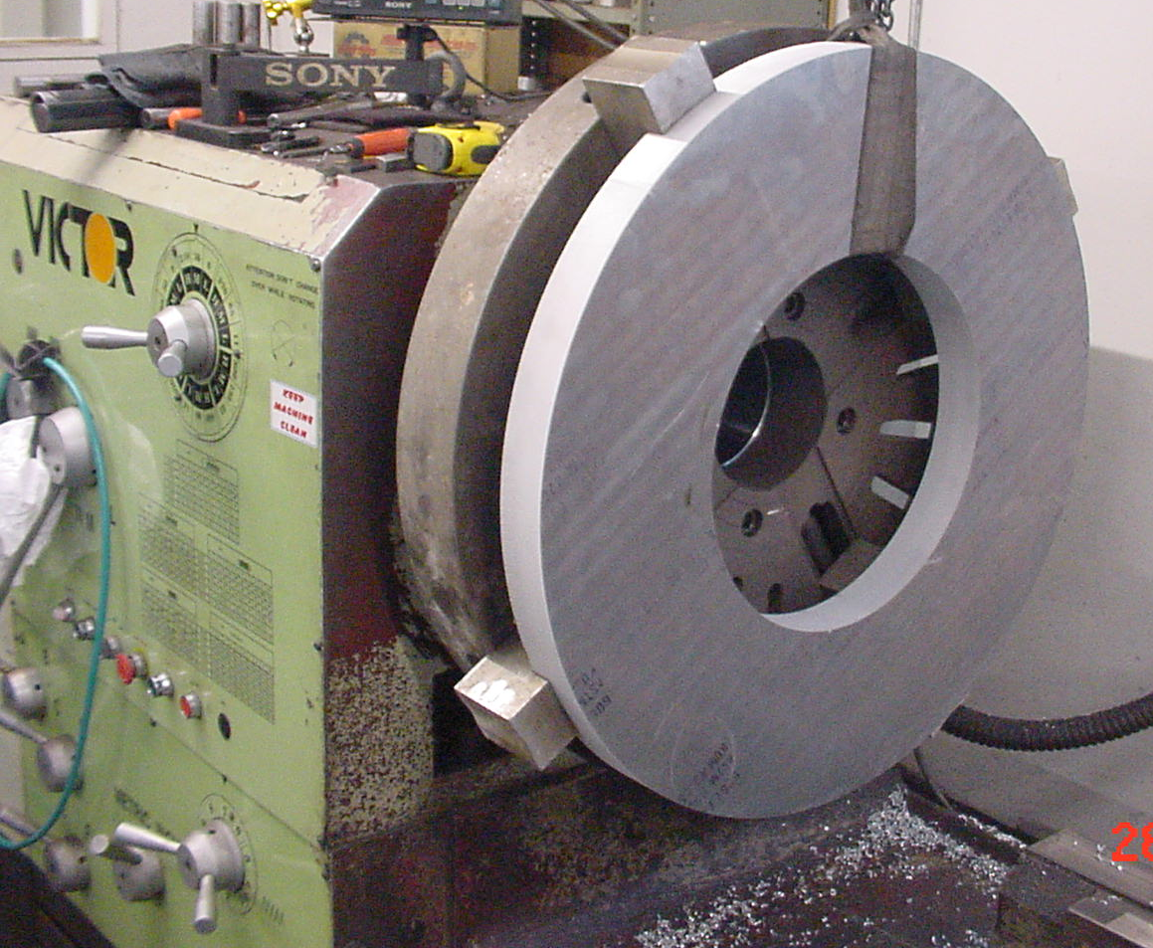
Helmholtz-Like Coil
Technicoil: Final Design through Assembly
Currently in Fabrication

Slide 22
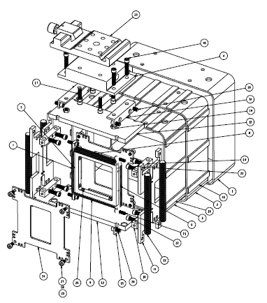
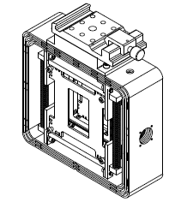
Mezei Flipper
1.5 cm gap, 1 mm diameter Al wire
Fabricated parts arrive April 28

Slide 23
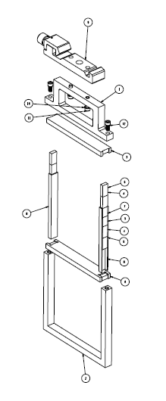
Guide Field, rail mount
NdFeB magnets and steel
Parts arrive at ORNL April 28

Slide 24
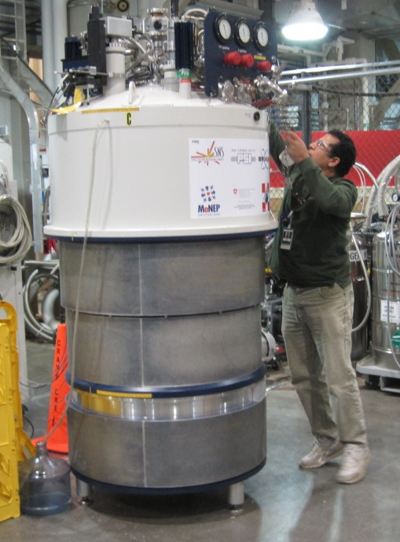
‘L’ Shield at rolling door
Yellow Temporary Blocks currently in target building
Enables transport of largest sample environments

Slide 25
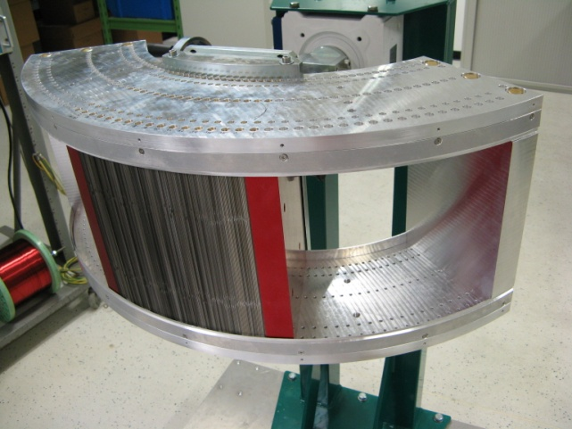
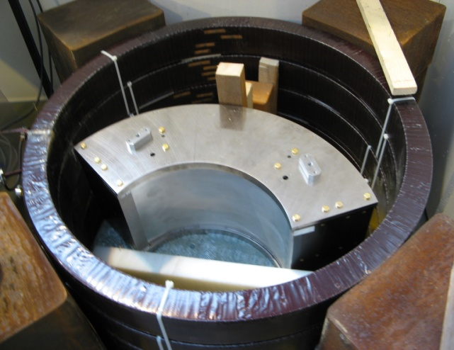
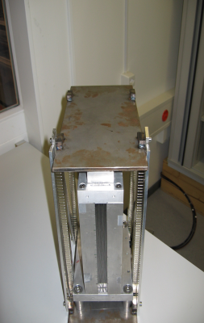
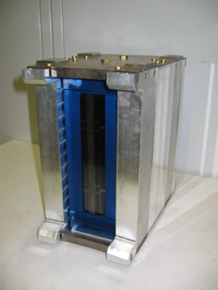
Supermirror Polarization Analyzer
Current Status:
780 out of 960 polarizers produced so far
~100 polarizers per month
200 polarizers installed in housing & tested
on BOA (optics beamline at SINQ, PSI)
Anticipated completion in ~March 2011,
followed by tests at SINQ
Supermirror analyzer assembled with around 200 supermirrors
supermirror analyzer inside the magnetisation unit (500 G)
Prototype I ( 1.8 deg)
Prototype II ( 4.0 deg)

Slide 26

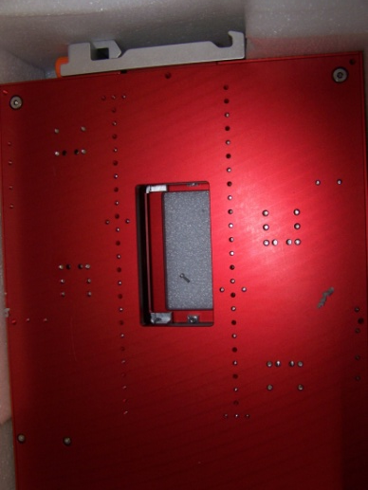
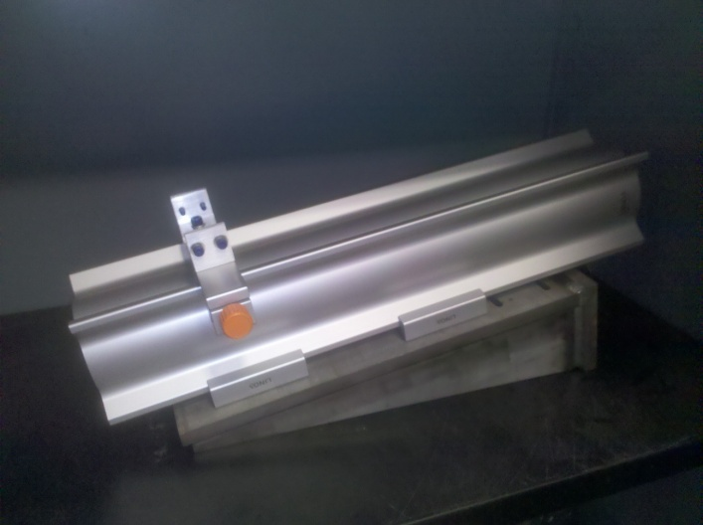

Optical Rail Components
20’
40’

Slide 27
What’s Next: Schedule
Construction complete in June 2011
Motion and Integrated testing in June 2011
IRR in Summer 2011
Neutrons in August 2011
Unpolarized commissioning through 2011
Polarized commissioning in 2012A

Slide 28
IDT Experiments
During commissioning
  HYSPEC’s Extended Commissioning Plan
  (plan to demonstrate science-readiness)
  requires an experiment by reviewers
    Whose results may have high scientific impact
    Which exploits either the unique or the improved capabilities of HYSPEC
During operations

