Slide 1
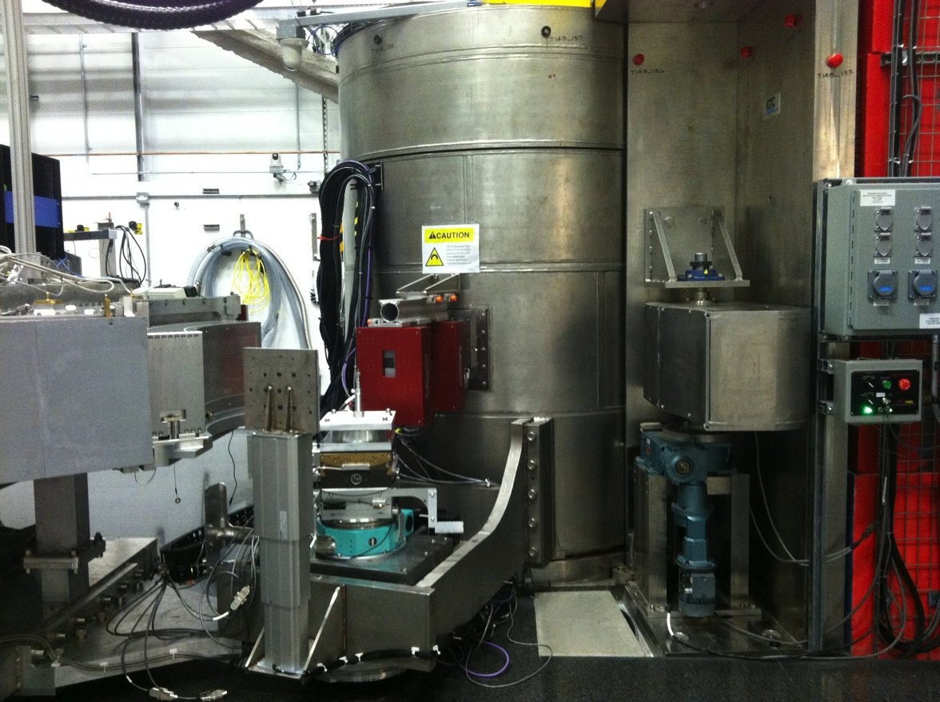
BL14B – HYSPEC Component Facts and Function
A source of Visual Definitions and Operating Parameters created by Melissa K. Graves-Brook.

Slide 2
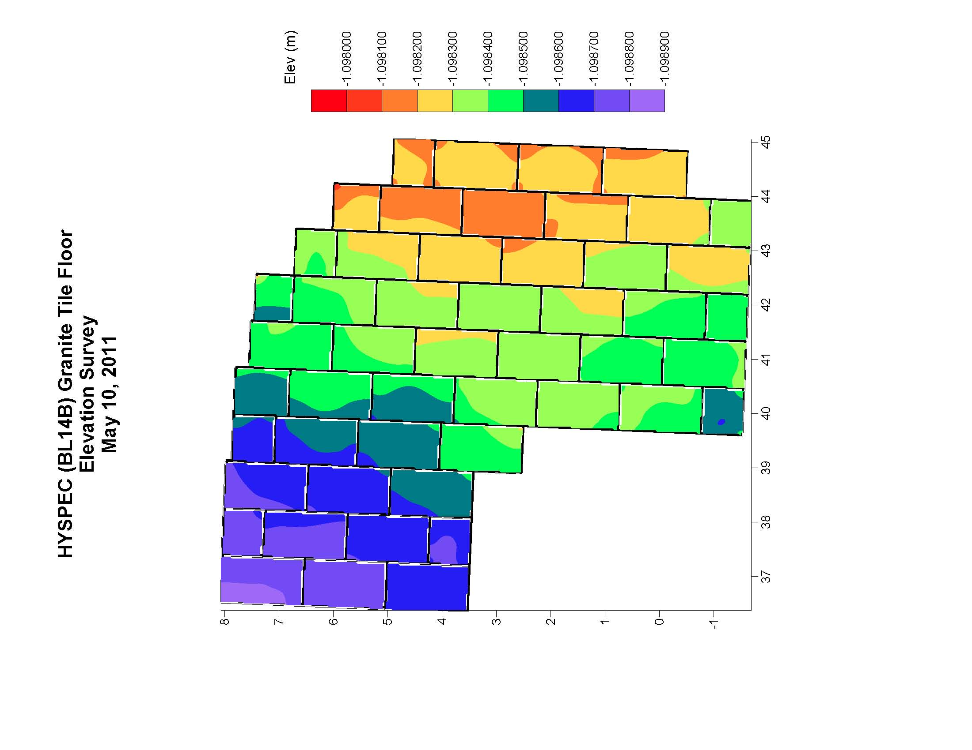
An integral component is the HYSPEC Granite Dance Floor. This was installed with great care and precision. There is less than a millimeter deviation from one corner to the other!
BL13
Side
Drumshield
HYSPEC Lift

Slide 3
HYSPEC (BL14B) Granite Tile Floor Elevation Survey, May 10, 2011
 |  |  | Elevation |  |  |  |  | Elevation |  |  |  |  | Elevation |  |  |  |  | Elevation
Point ID | Z (meters) | X (meters) | Y (meters) |  | Point ID | Z (meters) | X (meters) | Y (meters) |  | Point ID | Z (meters) | X (meters) | Y (meters) |  | Point ID | Z (meters) | X (meters) | Y (meters)
A1_1 | 36.540819 | 8.065158 | -1.098816 |  | B1_1 | 37.415143 | 8.032127 | -1.098784 |  | C1_1 | 38.278436 | 7.991184 | -1.098727 |  | D1_1 | 39.139759 | 7.836749 | -1.098658
A1_2 | 37.343468 | 8.026639 | -1.098760 |  | B1_2 | 38.209134 | 7.998903 | -1.098729 |  | C1_2 | 39.079777 | 7.958055 | -1.098723 |  | D1_2 | 39.945423 | 7.799655 | -1.098538
A1_3 | 37.278360 | 6.579416 | -1.098722 |  | B1_3 | 38.178553 | 7.304778 | -1.098631 |  | C1_3 | 39.016192 | 6.507173 | -1.098669 |  | D1_3 | 39.912165 | 7.107291 | -1.098579
A1_4 | 36.487655 | 6.612183 | -1.098728 |  | B1_4 | 37.383954 | 7.342155 | -1.098729 |  | C1_4 | 38.221061 | 6.537035 | -1.098689 |  | D1_4 | 39.118161 | 7.142473 | -1.098704
A1_5 | 36.884795 | 7.261577 | -1.098798 |  | B1_5 | 37.770697 | 7.670139 | -1.098775 |  | C1_5 | 38.642553 | 7.241278 | -1.098685 |  | D1_5 | 39.534965 | 7.471572 | -1.098648
A2_1 | 36.481832 | 6.538682 | -1.098725 |  | B2_1 | 37.380293 | 7.271405 | -1.098714 |  | C2_1 | 38.216865 | 6.472257 | -1.098727 |  | D2_1 | 39.112736 | 7.070465 | -1.098704
A2_2 | 37.276852 | 6.501225 | -1.098734 |  | B2_2 | 38.183875 | 7.236153 | -1.098630 |  | C2_2 | 39.015573 | 6.435302 | -1.098603 |  | D2_2 | 39.915335 | 7.036308 | -1.098625
A2_3 | 37.217226 | 5.055941 | -1.098704 |  | B2_3 | 38.112872 | 5.788893 | -1.098696 |  | C2_3 | 38.955441 | 4.980319 | -1.098581 |  | D2_3 | 39.847465 | 5.582117 | -1.098595
A2_4 | 36.419374 | 5.091243 | -1.098785 |  | B2_4 | 37.322626 | 5.817293 | -1.098764 |  | C2_4 | 38.158511 | 5.012894 | -1.098663 |  | D2_4 | 39.051063 | 5.615413 | -1.098697
A2_5 | 36.849071 | 5.800445 | -1.098763 |  | B2_5 | 37.761696 | 6.449345 | -1.098711 |  | C2_5 | 38.602480 | 5.729243 | -1.098636 |  | D2_5 | 39.525805 | 6.362884 | -1.098579
A3_1 | 36.416061 | 5.016651 | -1.098703 |  | B3_1 | 37.309991 | 5.746806 | -1.098717 |  | C3_1 | 38.155307 | 4.945272 | -1.098690 |  | D3_1 | 39.051222 | 5.543896 | -1.098658
A3_2 | 37.210306 | 4.977757 | -1.098681 |  | B3_2 | 38.113981 | 5.711297 | -1.098638 |  | C3_2 | 38.953435 | 4.913285 | -1.098603 |  | D3_2 | 39.846962 | 5.509757 | -1.098559
A3_3 | 37.156037 | 3.706777 | -1.098701 |  | B3_3 | 38.053918 | 4.263578 | -1.098641 |  | C3_3 | 38.890431 | 3.456909 | -1.098460 |  | D3_3 | 39.786241 | 4.057570 | -1.098480
A3_4 | 36.376878 | 3.926082 | -1.098659 |  | B3_4 | 37.255196 | 4.291723 | -1.098674 |  | C3_4 | 38.088014 | 3.489613 | -1.098520 |  | D3_4 | 38.989417 | 4.092786 | -1.098513
A3_5 | 36.795375 | 4.303305 | -1.098629 |  | B3_5 | 37.694647 | 4.990803 | -1.098648 |  | C3_5 | 38.516365 | 4.182513 | -1.098581 |  | D3_5 | 39.428688 | 4.813468 | -1.098546
 |  |  |  |  | B4_1 | 37.250677 | 4.222310 | -1.098690 |  |  |  |  |  |  | D4_1 | 38.982764 | 4.027261 | -1.098502
 |  |  |  |  | B4_2 | 38.049897 | 4.189860 | -1.098645 |  |  |  |  |  |  | D4_2 | 39.779731 | 3.991900 | -1.098484
 |  |  |  |  | B4_3 | 38.023174 | 3.498670 | -1.098602 |  |  |  |  |  |  | D4_3 | 39.721559 | 2.537726 | -1.098272
 |  |  |  |  | B4_4 | 37.230455 | 3.672342 | -1.098693 |  |  |  |  |  |  | D4_4 | 38.937482 | 2.861700 | -1.098495
 |  |  |  |  | B4_5 | 37.643953 | 3.892185 | -1.098708 |  |  |  |  |  |  | D4_5 | 39.334602 | 3.311135 | -1.098435

Slide 4
HYSPEC (BL14B) Granite Tile Floor Elevation Survey, May 10, 2011
 |  |  | Elevation |  |  |  |  | Elevation |  |  |  |  | Elevation |  |  |  |  | Elevation
Point ID | Z (meters) | X (meters) | Y (meters) |  | Point ID | Z (meters) | X (meters) | Y (meters) |  | Point ID | Z (meters) | X (meters) | Y (meters) |  | Point ID | Z (meters) | X (meters) | Y (meters)
E1_1 | 40.013418 | 7.812614 | -1.098599 |  | F1_1 | 40.873457 | 7.560119 | -1.098406 |  | G1_1 | 41.740534 | 7.433973 | -1.098515 |  | H1_1 | 42.576854 | 6.696094 | -1.098378
E1_2 | 40.812171 | 7.776430 | -1.098470 |  | F1_2 | 41.669967 | 7.521408 | -1.098496 |  | G1_2 | 42.531521 | 7.395498 | -1.098247 |  | H1_2 | 43.377435 | 6.660074 | -1.098342
E1_3 | 40.774532 | 6.846103 | -1.098475 |  | F1_3 | 41.608024 | 6.042784 | -1.098485 |  | G1_3 | 42.516919 | 6.765299 | -1.098412 |  | H1_3 | 43.347112 | 5.965332 | -1.098295
E1_4 | 39.982355 | 6.878474 | -1.098560 |  | F1_4 | 40.813684 | 6.073584 | -1.098471 |  | G1_4 | 41.711425 | 6.798587 | -1.098521 |  | H1_4 | 42.545978 | 6.002324 | -1.098383
E1_5 | 40.373449 | 7.310073 | -1.098530 |  | F1_5 | 41.240681 | 6.802123 | -1.098412 |  | G1_5 | 42.137115 | 7.109640 | -1.098488 |  | H1_5 | 42.956903 | 6.305832 | -1.098402
E2_1 | 39.969073 | 6.813784 | -1.098558 |  | F2_1 | 40.807732 | 6.004947 | -1.098438 |  | G2_1 | 41.708072 | 6.733774 | -1.098478 |  | H2_1 | 42.543483 | 5.929936 | -1.098352
E2_2 | 40.774513 | 6.779944 | -1.098489 |  | F2_2 | 41.612345 | 5.977420 | -1.098430 |  | G2_2 | 42.511902 | 6.699723 | -1.098429 |  | H2_2 | 43.338607 | 5.903901 | -1.098353
E2_3 | 40.708838 | 5.324698 | -1.098413 |  | F2_3 | 41.541711 | 4.520795 | -1.098325 |  | G2_3 | 42.440924 | 5.247119 | -1.098373 |  | H2_3 | 43.280895 | 4.442224 | -1.098237
E2_4 | 39.912645 | 5.357728 | -1.098614 |  | F2_4 | 40.748434 | 4.554864 | -1.098426 |  | G2_4 | 41.645250 | 5.274425 | -1.098346 |  | H2_4 | 42.486708 | 4.475321 | -1.098278
E2_5 | 40.382022 | 6.138516 | -1.098463 |  | F2_5 | 41.178022 | 5.257576 | -1.098389 |  | G2_5 | 42.094806 | 5.930420 | -1.098410 |  | H2_5 | 42.940340 | 5.161087 | -1.098297
E3_1 | 39.906425 | 5.282174 | -1.098665 |  | F3_1 | 40.742289 | 4.485338 | -1.098321 |  | G3_1 | 41.644203 | 5.205533 | -1.098336 |  | H3_1 | 42.479940 | 4.406197 | -1.098299
E3_2 | 40.705224 | 5.251596 | -1.098428 |  | F3_2 | 41.543205 | 4.450183 | -1.098250 |  | G3_2 | 42.445418 | 5.177197 | -1.098414 |  | H3_2 | 43.281378 | 4.368568 | -1.098253
E3_3 | 40.644727 | 3.796291 | -1.098417 |  | F3_3 | 41.475616 | 2.997813 | -1.098268 |  | G3_3 | 42.380650 | 3.719191 | -1.098271 |  | H3_3 | 43.214854 | 2.922177 | -1.098154
E3_4 | 39.844268 | 3.834252 | -1.098546 |  | F3_4 | 40.679291 | 3.032748 | -1.098382 |  | G3_4 | 41.586847 | 3.754196 | -1.098364 |  | H3_4 | 42.420132 | 2.956081 | -1.098295
E3_5 | 40.277434 | 4.527691 | -1.098528 |  | F3_5 | 41.128439 | 3.771123 | -1.098316 |  | G3_5 | 42.003774 | 4.460848 | -1.098307 |  | H3_5 | 42.873026 | 3.587994 | -1.098256
E4_1 | 39.841356 | 3.760642 | -1.098562 |  | F4_1 | 40.678421 | 2.961143 | -1.098392 |  | G4_1 | 41.580260 | 3.678942 | -1.098361 |  | H4_1 | 42.411061 | 2.883563 | -1.098279
E4_2 | 40.642629 | 3.733332 | -1.098413 |  | F4_2 | 41.479455 | 2.931650 | -1.098328 |  | G4_2 | 42.381724 | 3.661746 | -1.098325 |  | H4_2 | 43.214843 | 2.849759 | -1.098155
E4_3 | 40.581080 | 2.278176 | -1.098381 |  | F4_3 | 41.415515 | 1.477102 | -1.098331 |  | G4_3 | 42.316554 | 2.193700 | -1.098319 |  | H4_3 | 43.149893 | 1.394049 | -1.098239
E4_4 | 39.855452 | 2.307653 | -1.098391 |  | F4_4 | 40.616906 | 1.509469 | -1.098362 |  | G4_4 | 41.517318 | 2.227636 | -1.098316 |  | H4_4 | 42.354220 | 1.433647 | -1.098305
E4_5 | 40.260662 | 2.986701 | -1.098359 |  | F4_5 | 41.044825 | 2.184719 | -1.098371 |  | G4_5 | 41.928655 | 2.931315 | -1.098380 |  | H4_5 | 42.785461 | 2.155442 | -1.098233
E5_1 | 39.893308 | 2.234209 | -1.098354 |  | F5_1 | 40.608828 | 1.437618 | -1.098389 |  | G5_1 | 41.512664 | 2.162587 | -1.098356 |  | H5_1 | 42.347262 | 1.360836 | -1.098296
E5_2 | 40.577734 | 2.206370 | -1.098376 |  | F5_2 | 41.413056 | 1.408095 | -1.098307 |  | G5_2 | 42.307843 | 2.123167 | -1.098333 |  | H5_2 | 43.142068 | 1.330282 | -1.098271
E5_3 | 40.512888 | 0.749676 | -1.098361 |  | F5_3 | 41.351742 | -0.045244 | -1.098381 |  | G5_3 | 42.249563 | 0.678742 | -1.098267 |  | H5_3 | 43.086787 | -0.115832 | -1.098315
E5_4 | 39.717820 | 0.790329 | -1.098501 |  | F5_4 | 40.553976 | -0.013871 | -1.098437 |  | G5_4 | 41.450938 | 0.702806 | -1.098320 |  | H5_4 | 42.290744 | -0.091307 | -1.098326
E5_5 | 40.233608 | 1.541787 | -1.098319 |  | F5_5 | 40.960051 | 0.660081 | -1.098442 |  | G5_5 | 41.876667 | 1.403853 | -1.098299 |  | H5_5 | 42.705220 | 0.582738 | -1.098330
E6_1 | 39.719222 | 0.717823 | -1.098335 |  | F6_1 | 40.547433 | -0.086950 | -1.098445 |  | G6_1 | 41.447750 | 0.640117 | -1.098444 |  | H6_1 | 42.286860 | -0.159136 | -1.098327
E6_2 | 40.514355 | 0.686683 | -1.098416 |  | F6_2 | 41.346863 | -0.115962 | -1.098417 |  | G6_2 | 42.236937 | 0.606539 | -1.098324 |  | H6_2 | 43.079770 | -0.196479 | -1.098311
E6_3 | 40.449855 | -0.768354 | -1.098421 |  | F6_3 | 41.287570 | -1.574382 | -1.098390 |  | G6_3 | 42.185706 | -0.839098 | -1.098404 |  | H6_3 | 43.023779 | -1.648743 | -1.098338
E6_4 | 39.653251 | -0.734581 | -1.098479 |  | F6_4 | 40.491318 | -1.539787 | -1.098315 |  | G6_4 | 41.391425 | -0.816875 | -1.098436 |  | H6_4 | 42.220238 | -1.617302 | -1.098343
E6_5 | 40.079881 | -0.040783 | -1.098408 |  | F6_5 | 40.968762 | -0.845794 | -1.098455 |  | G6_5 | 41.825433 | -0.162607 | -1.098424 |  | H6_5 | 42.671696 | -0.948160 | -1.098266
E7_1 | 39.650703 | -0.809075 | -1.098570 |  |  |  |  |  |  | G7_1 | 41.386059 | -0.883027 | -1.098471
E7_2 | 40.443757 | -0.843611 | -1.098527 |  |  |  |  |  |  | G7_2 | 42.178556 | -0.916851 | -1.098459
E7_3 | 40.419528 | -1.539289 | -1.098405 |  |  |  |  |  |  | G7_3 | 42.152335 | -1.612335 | -1.098386
E7_4 | 39.615725 | -1.503244 | -1.098421 |  |  |  |  |  |  | G7_4 | 41.358900 | -1.579523 | -1.098450
E7_5 | 40.065412 | -1.183802 | -1.098587 |  |  |  |  |  |  | G7_5 | 41.786821 | -1.291890 | -1.098498

Slide 5
HYSPEC (BL14B) Granite Tile Floor Elevation Survey, May 10, 2011
 |  |  | Elevation |  |  |  |  | Elevation
Point ID | Z (meters) | X (meters) | Y (meters) |  | Point ID | Z (meters) | X (meters) | Y (meters)
I1_1 | 43.414843 | 5.992453 | -1.098206 |  | J1_1 | 44.238673 | 4.899464 | -1.098168
I1_2 | 44.214713 | 5.954748 | -1.098031 |  | J1_2 | 45.042525 | 4.862485 | -1.098206
I1_3 | 44.179875 | 5.170532 | -1.098163 |  | J1_3 | 45.012163 | 4.164447 | -1.098153
I1_4 | 43.383657 | 5.205849 | -1.098248 |  | J1_4 | 44.206779 | 4.201261 | -1.098147
I1_5 | 43.768937 | 5.532438 | -1.098253 |  | J1_5 | 44.598417 | 4.516508 | -1.098219
I2_1 | 43.377311 | 5.138270 | -1.098236 |  | J2_1 | 44.205287 | 4.130054 | -1.098114
I2_2 | 44.180711 | 5.105190 | -1.098132 |  | J2_2 | 45.004300 | 4.094164 | -1.098135
I2_3 | 44.117209 | 3.650105 | -1.098134 |  | J2_3 | 44.941595 | 2.614755 | -1.098143
I2_4 | 43.321209 | 3.682688 | -1.098201 |  | J2_4 | 44.146710 | 2.648896 | -1.098173
I2_5 | 43.737020 | 4.346648 | -1.098192 |  | J2_5 | 44.579425 | 3.418843 | -1.098249
I2_6 | 43.377189 | 5.135592 | -1.098264 |  | J3_1 | 44.141375 | 2.581117 | -1.098173
I3_1 | 43.311532 | 3.614845 | -1.098202 |  | J3_2 | 44.945840 | 2.553556 | -1.098177
I3_2 | 44.117599 | 3.579953 | -1.098221 |  | J3_4 | 44.077080 | 1.093527 | -1.098150
I3_3 | 44.051121 | 2.123793 | -1.098236 |  | J3_5 | 44.487443 | 1.880871 | -1.098243
I3_4 | 43.263987 | 2.163188 | -1.098201 |  | J4_1 | 44.072431 | 1.030854 | -1.098168
I3_5 | 43.696025 | 2.862213 | -1.098149 |  | J4_3 | 44.816622 | -0.495623 | -1.098255
I4_1 | 43.253428 | 2.090019 | -1.098163 |  | J4_4 | 44.002669 | -0.456086 | -1.098195
I4_2 | 44.048892 | 2.058999 | -1.098224 |  | J4_5 | 44.420696 | 0.199157 | -1.098215
I4_3 | 43.991261 | 0.595130 | -1.098195
I4_4 | 43.188281 | 0.637318 | -1.098245
I4_5 | 43.596233 | 1.329677 | -1.098219
I5_1 | 43.185146 | 0.571496 | -1.098250
I5_2 | 43.981068 | 0.532478 | -1.098224
I5_3 | 43.925518 | -0.917845 | -1.098348
I5_4 | 43.123963 | -0.891033 | -1.098334
I5_5 | 43.548477 | -0.212369 | -1.098244
I6_1 | 43.123966 | -0.955807 | -1.098302
I6_2 | 43.927667 | -0.982791 | -1.098349
I6_3 | 43.893177 | -1.686113 | -1.098306
I6_4 | 43.091305 | -1.653200 | -1.098301
I6_5 | 43.479341 | -1.374093 | -1.098388

Slide 6
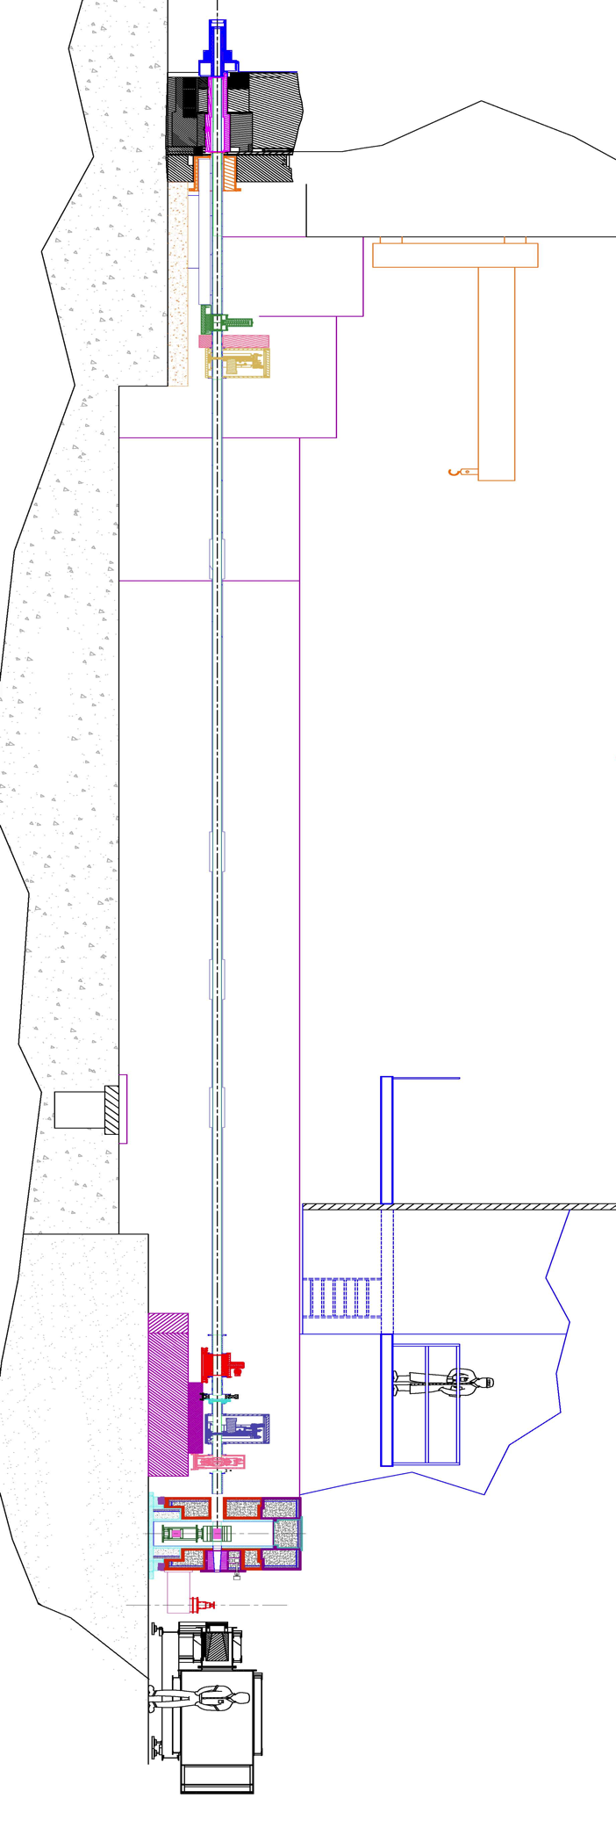
Detector Tubes – Nom(1.4) = 44892.7 mm;
Nom(1.8) = 45292.7 mm;
Distance S2 to Det. = 4512.7 mm
S2 DV Rotation Stage –
MSD 1.4 = 40380 mm; MSD 1.8 =4-0780 mm
Secondary Shutter – 2320, 3260, 4200 mm
T1B Chopper - 36460 mm
Fermi Chopper - 37170 mm
Monochromator - 38980 mm
T1A Chopper - 9400 mm
T0 Chopper - 8500 mm
Gate Valve -
Gate Valve -
Secondary Shutter – 34725 mm

Slide 7
Key Component Distances
Beam Line Components
Pyrolytic Graphite Monochromator Limits
Mon1 = 35.64 m
Mon2 = 37.40 m
Mon3 = Variable on X-rail
T0 = 8.5 m
T1A = 9.4 m
T1B = 36.46 m
Fermi = 37.17 m
Monochromator = 39.00 m
Rotation Stage
M1PG (23.5015 to -22.9988)
Translation Stage
MTPG (9.737 to -8.535)
Tilt Stage
MGPG (11.754 to -11.748)
Focusing Element
MFPG (1.7 to -0.1)
MEL (590.3 to 15.4)
MELPG = 29

