Slide 1
Prompt pulse impact

Slide 2
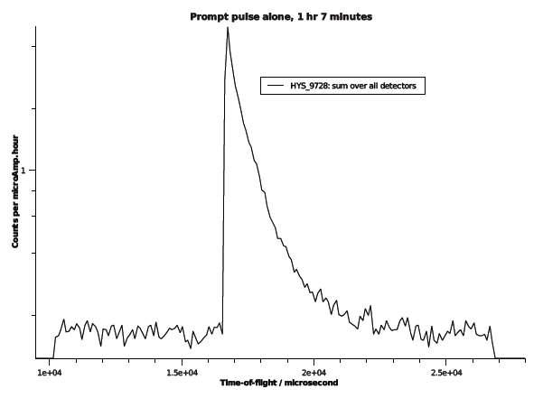
Assumes 3 ms tail (although visible to 5 ms)

