Slide 1
HYSPEC
Recent progress and polarization analysis capabilities
WINS 2014, May 2014
ORNL: B. Winn, V. Ovidiu Garlea, M. Graves-Brook, Peter Jiang, X. (Tony) Tong
BNL: L. Passell, S.M. Shapiro, I. Zaliznyak
PSI: U. Filges, Michel Kenzelmann
ESS: M. Hagen (formerly ORNL)

Slide 2
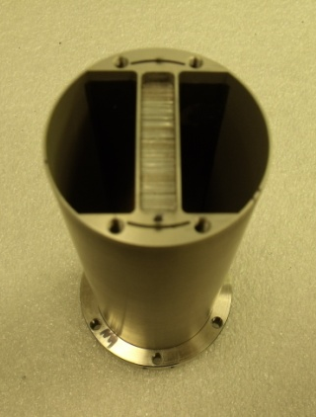
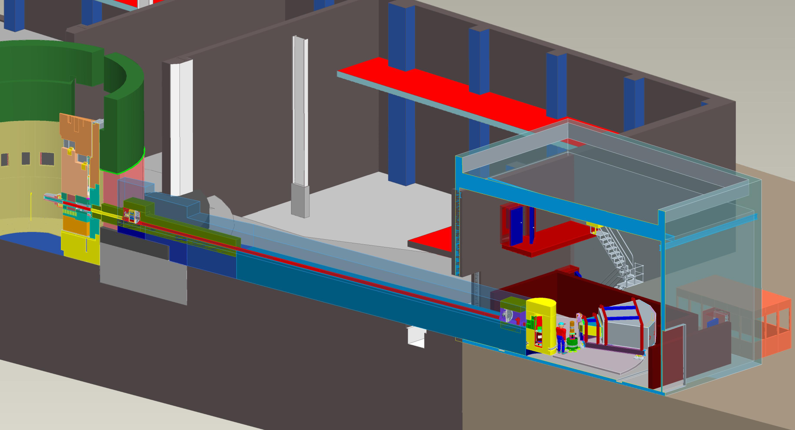
Hybrid Spectrometer: a cross between a direct geometry spectrometer…
Short strait blade Fermi chopper at L1=37.2 m to select E_{i}, and trade off between E resolution and flux via frequency range 60-420 Hz
Measures variable E_{f} of scattered neutrons using ToF
L2=3.6 m, L3=4.5m

Slide 3
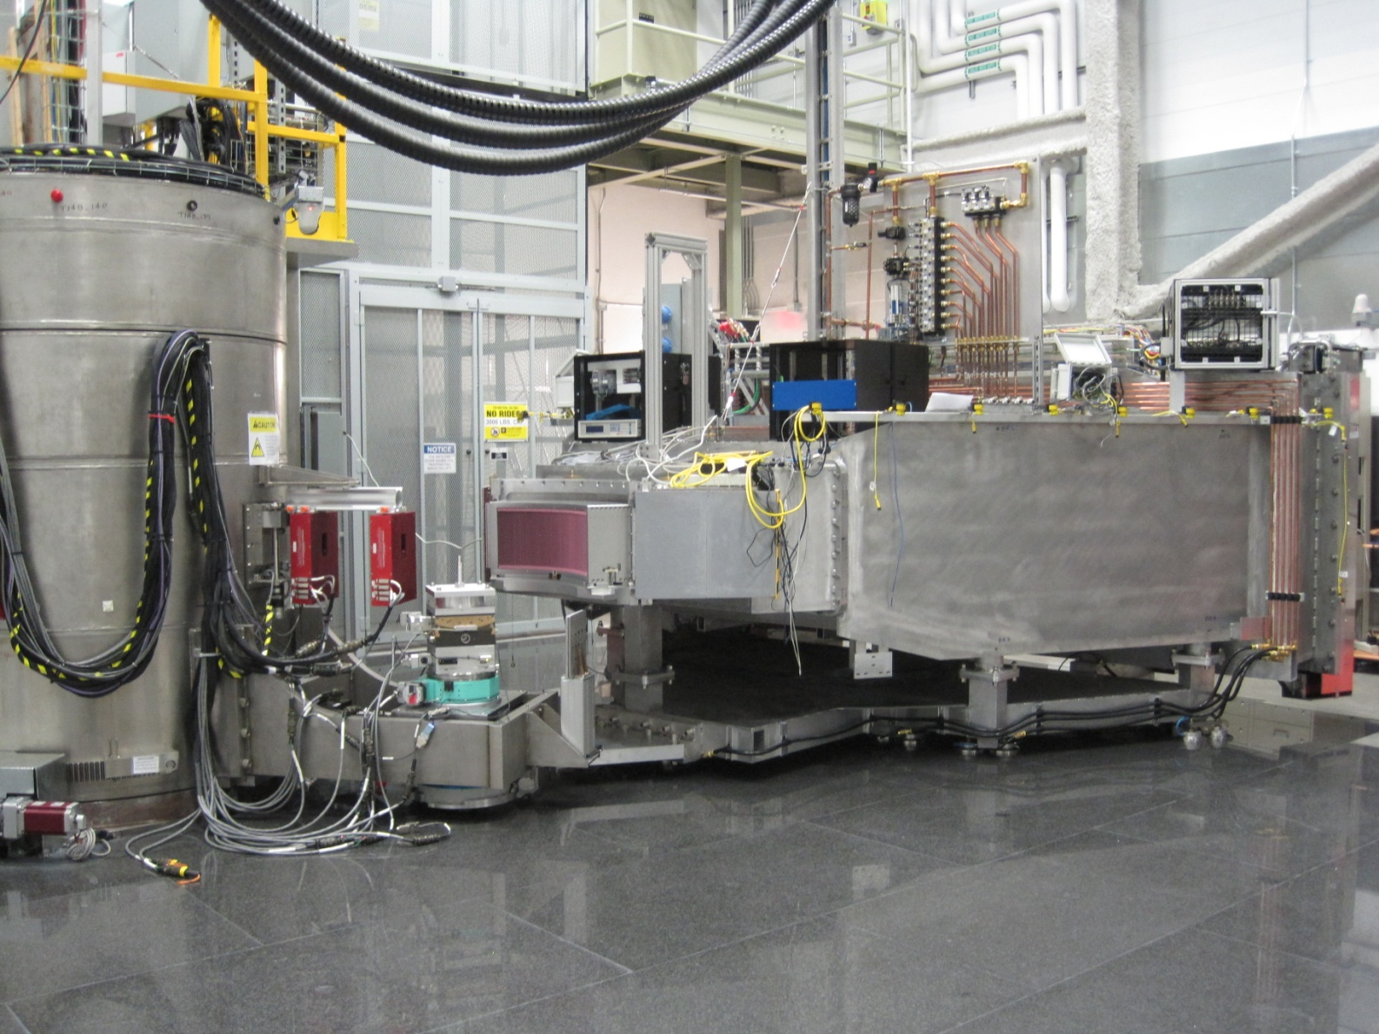
…and a Triple Axis Spectrometer
Vertical focusing array: choice between PG and Heusler
Incident beam
Scattered beam
Configurable region about sample
Variable Direction Ar flight path for scattered beam
60º x 15º, r = 4.5 m

Slide 4
Intensity at sample, V scatter
15 cm high beam from guide vertically focused to sample ~2.5 cm x 2.5 cm FWHM
4.2E5 n/s/MW/cm²: Gold foil measurement at sample position, PG focus array to sample 1.8 m, Ei=15 meV, Fermi 180 Hz
Plot: Vanadium incoherent isotropic scatter integrated over detector array at 40º < 2Θ < 100º, PG & Heusler
3.8 meV < Ei < 50 meV
Common Ei’s:
3.8, 7, 15, 20, 27, 35 meV
Rare Ei: 50 meV

Slide 5
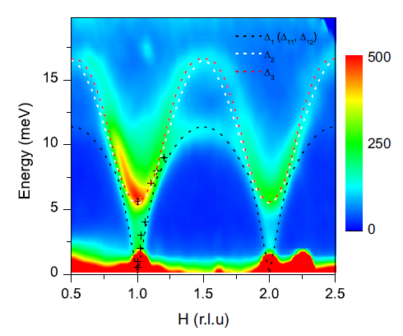
Active in User Program, Unpolarized
Y_{0.7}Lu_{0.3}MnO₃ at 4K: dotted lines show calculated spin wave dispersion with magnetoelectric coupling¹
 | #
 | Experiments
Spring 2013 | 6
Fall 2013 | 17
Spring 2014 | 16
Fe_{1.09(1)}Te: :Bragg peaks visible at 5 K indicate increased Fe displacements from high-symmetry positions in the a-b plane²
¹ W. Tian et al., Phys. Rev. B 89, 144417 (2014)
²D. Fobes et al., Phys. Rev. Lett, accepted

Slide 6
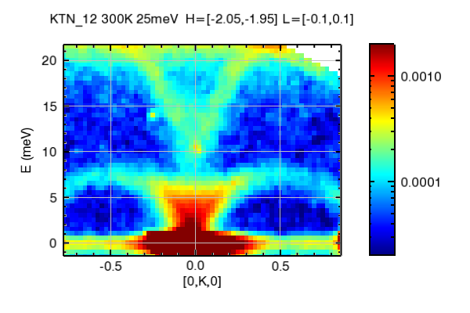
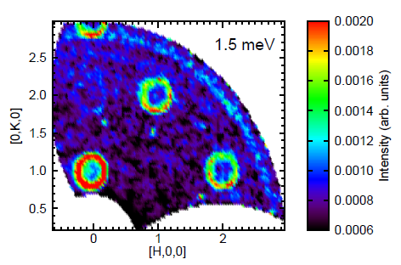
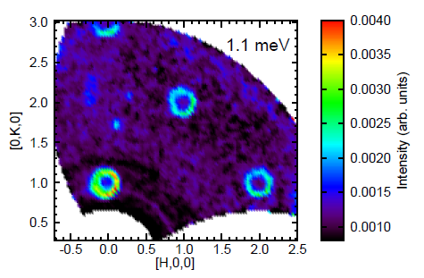
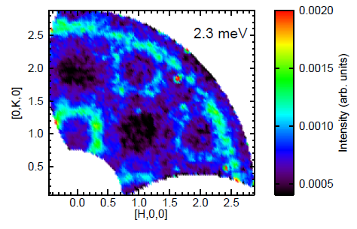
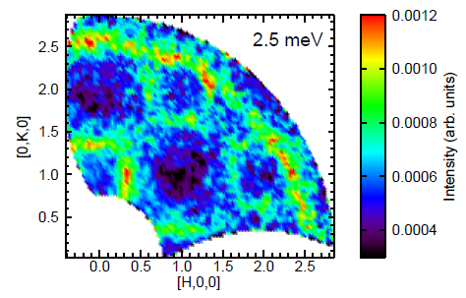
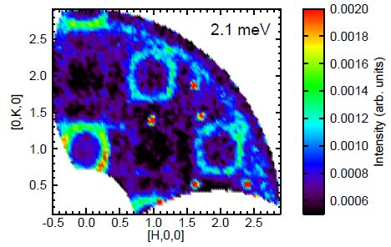
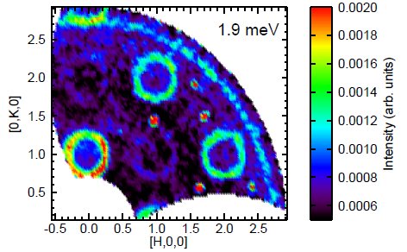
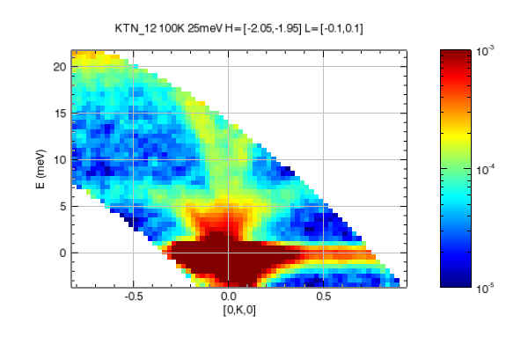
More Science
Spin waves in
S=1/2 square lattice
antiferromagnet K₂V₃O₈¹
¹ M. Lumsden, A. Christianson, in preparation,
Ei=7 meV 180 Hz s2=-45º +/-0.1 meV, L integrated. s1~90º range 0.5º step
²O. Delaire et al, in preparation, TO branch softens on cooling from 300 to 120 K, approaching the Curie temperature for the ferroelectic transition at ~80 K
TO branch softening in KTa_{0.88}Nb_{0.12}O₃²

Slide 7
Fits into HFIR/SNS capabilities at Oak Ridge National Lab
(Green: Supports Polarization Analysis )
ARCS
Cold Moderator / 2 meV < Ei < 100 meV
HYSPEC
Thermal Moderator / 5 meV < Ei < 2000 meV
1-3% elastic E resolution / less flux
CNCS
SEQUOIA
3-5% elastic E resolution / high flux
CTAX
HB1A, HB1, HB3
Highest time-averaged flux, limited solid angle
Direct Geometry Spectrometers
Triple- Axis Spectrometers
Stone et al, Rev. Sci. Instrum. 85 p 045113 (2014)

Slide 8
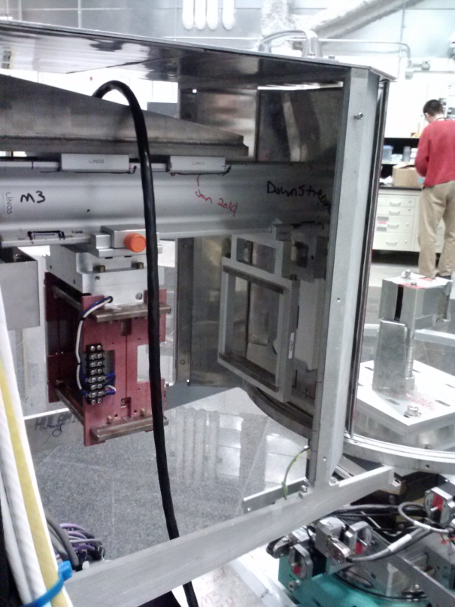
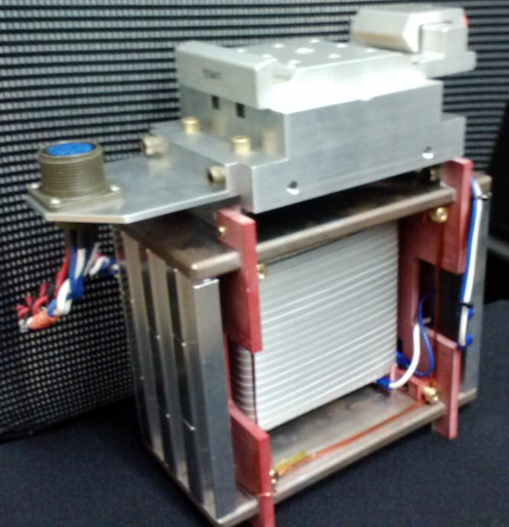
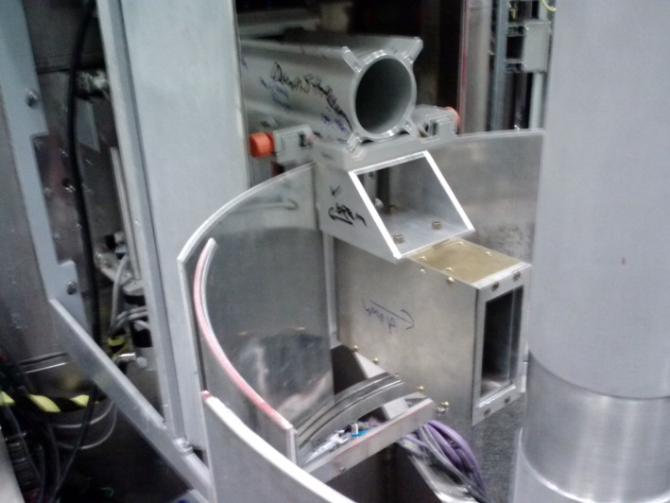
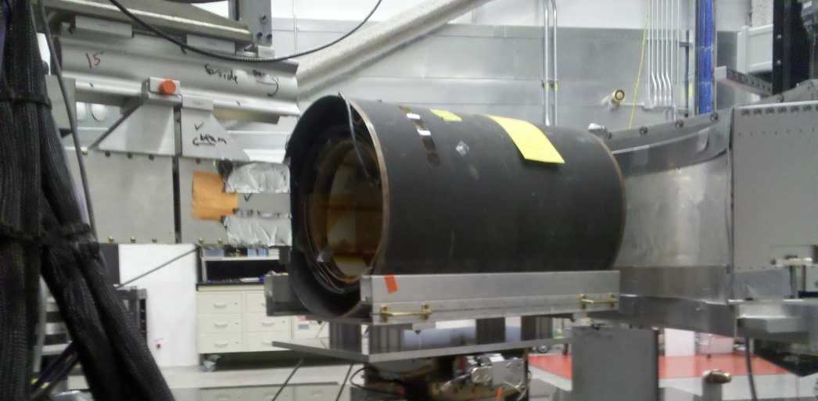
Polarization Capabilities
Typical Configuration
Polarizer option 1: Heusler focusing array
Flipper option 1: Mezei
³He cell, Heusler single crystal and polarizing supermirror array for characterization of polarized beam
Heusler focusing element, Mezei flipper, Polarizing supermirror array at sample, 15 meV, best flipping ratio 23
Scattered beam
Incident beam
Sample
Nonmagnetic materials about sample. Mostly aluminum, titanium and stainless steel
Magnetic Guide Field assemblies

Slide 9
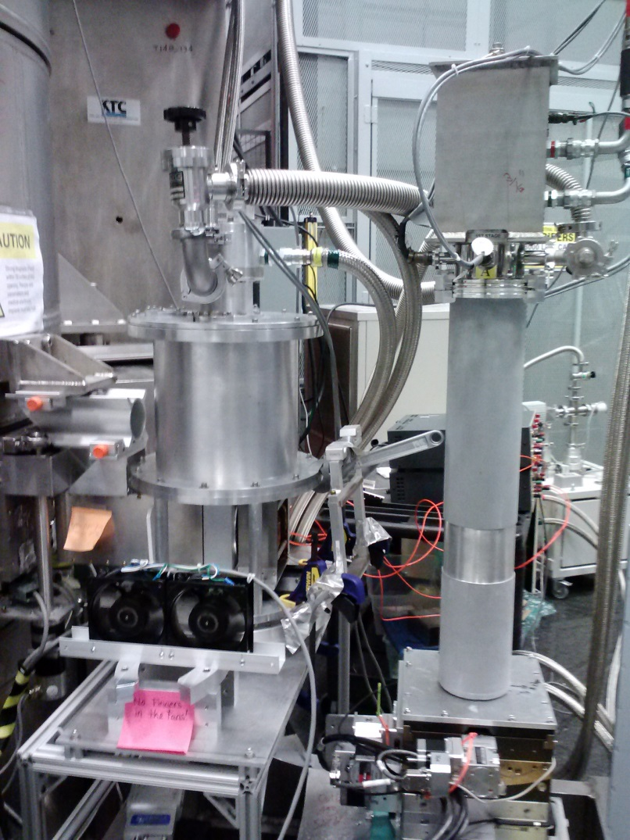
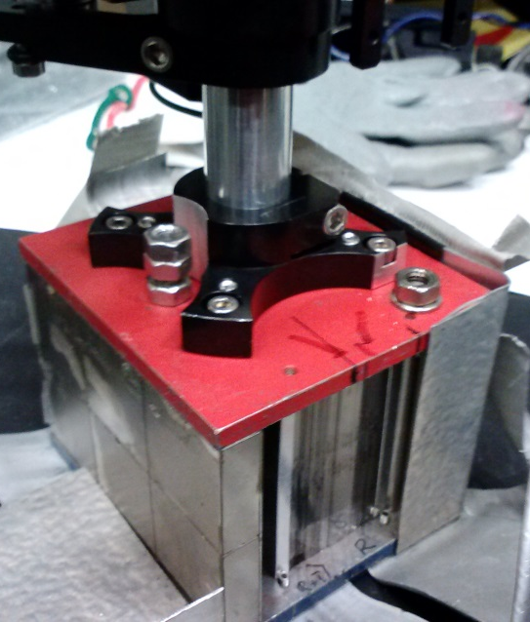
Alternatives, polarized beam
PG focusing element for unpolarized beam
Polarizer option 3: Polarizing supermirror array, either reflection or transmission
Demonstration only. Considering possible flux advantage over Heusler focus array (~3x at 50 meV).
~13.2 flip with supermirror at sample and 15 meV
~3.9 with Heusler at sample and 25 meV
~2.7 with Heusler at sample and 50 meV
Demonstration only. Considering development for use with cryo-magnets.
32.7 system-wide flip ratio with supermirror at sample, 15 meV
Polarized beam
Unpolarized beam
Polarized beam
Polarized beam
¹X. Tong et al, Rev. Sci. Instrum, 83, 075101
²T. Wang et al, Neutron spin manipulation devices using YBCO films, IOP conference series accepted from the Neutron optics, polarisation and detectors meeting in Munich 2013
Polarizer option 2: in situ Spin Exchanged Optical Pumped ³He cell¹
Flipper Option 2: High Tc Cryo-Flipper ²

Slide 10
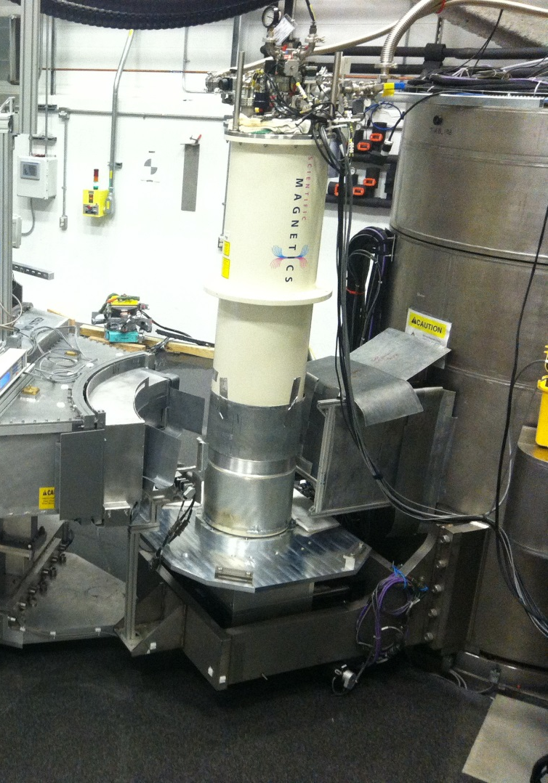
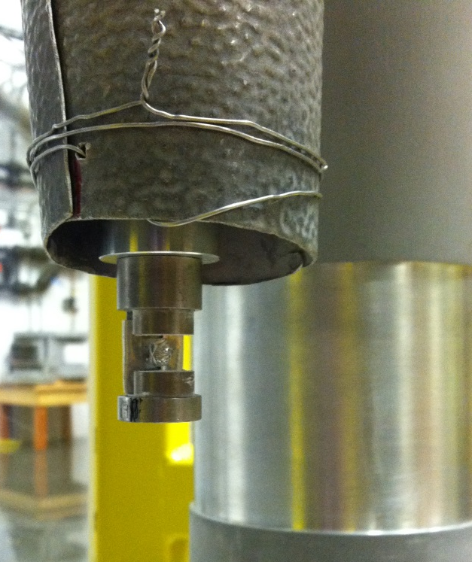
Half Polarized Experiments
Sample
Vertical bore, single crystal and powder
Horizontal field permanent magnet prototype. Flexibility during polarization commissioning
Rb₂Fe₂O(AsO₄)₂

Slide 11
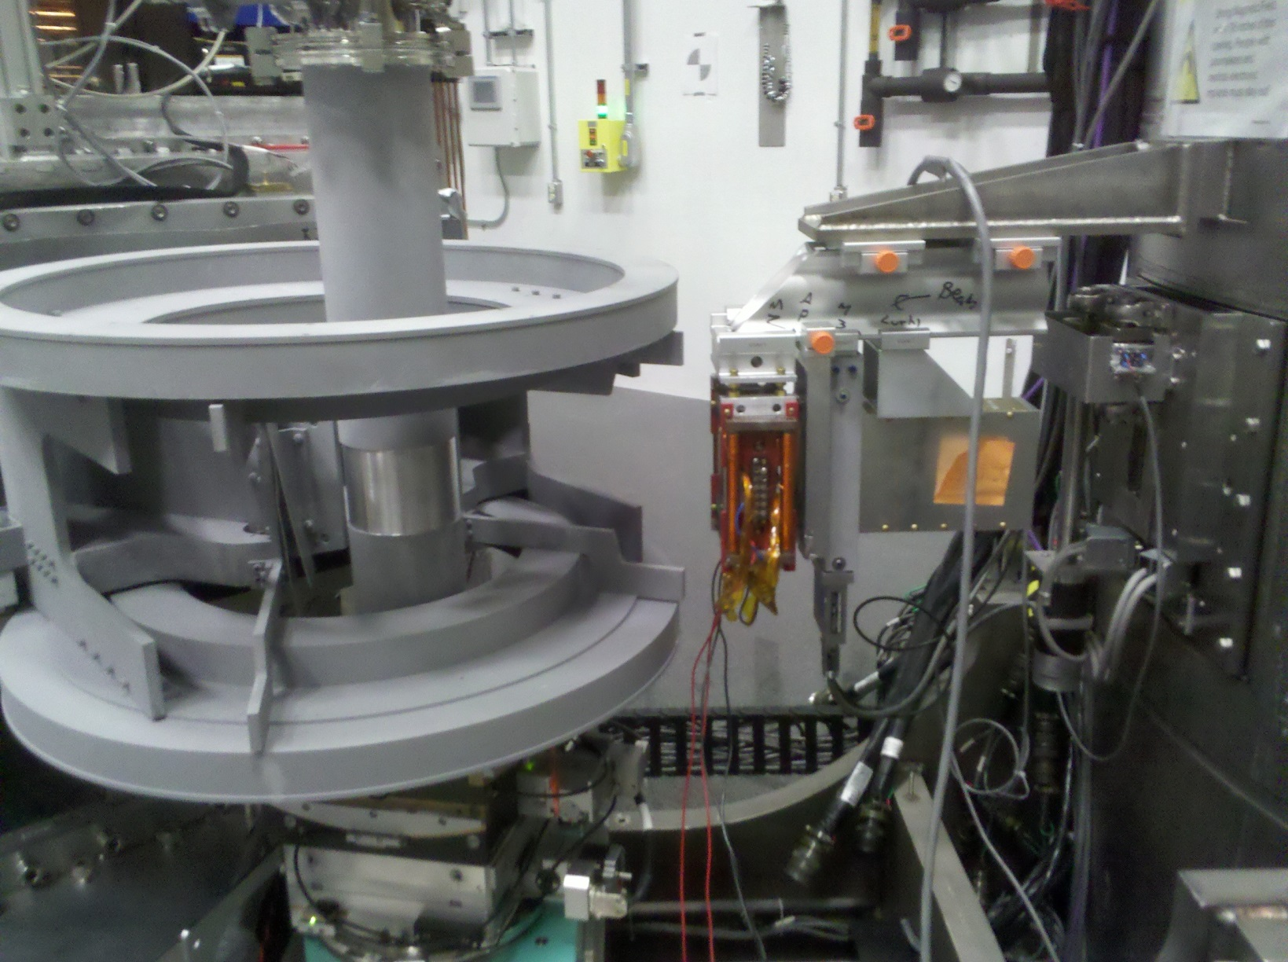
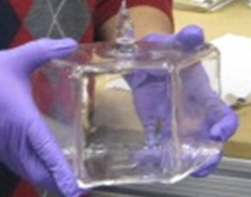
Polarization Analysis option 1: ³He
Polarization analyzer: 3He cell optically pumped via spin exchange (SEOP)
Ultimate goal: wide-angle quartz cell. Same depth for all scatter angles
Analyzed beam
Scattered beam
Incident beam
Cannot directly SEOP, so:
Drop in cells now
Automated transfer
Scattered beam
Sample
Abberation-corrected Helmholtz-like coils, vertical bore, uniform field centered on analyzer cell, also surrounding sample

Slide 12
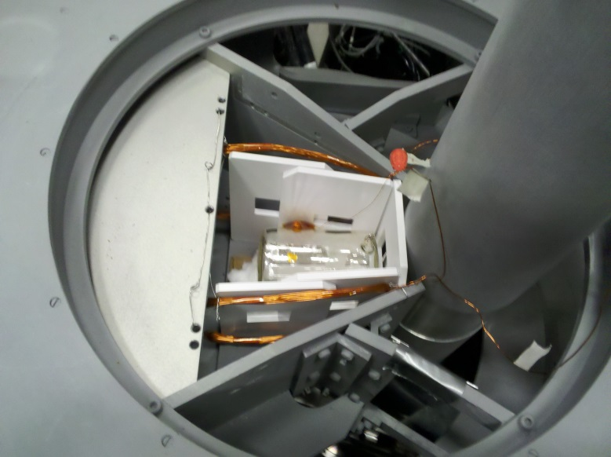
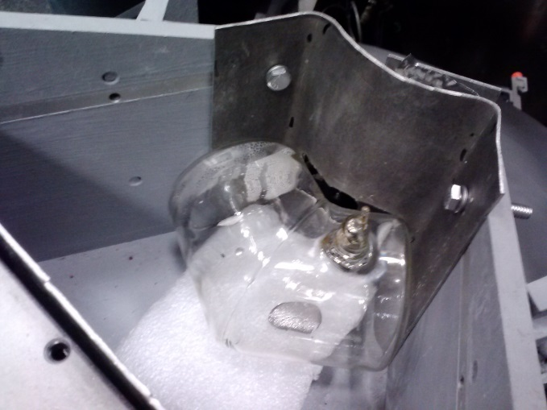
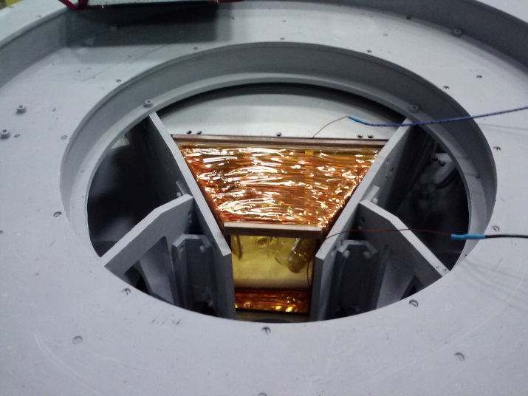
Drop-in-cell Polarization Analysis
Cylindrical cell, limited solid angle
‘banana’ cell made at NCNR
Lifetimes up to 100 hr
Direct beam transmission flip ratios
Through pinhole at sample
At 3.8 meV: unfocused: 16.3
focused: 21.8
Vanadium scatter measured ratio 1.47
Adiabatic Fast Passage coil to flip ³He

Slide 13
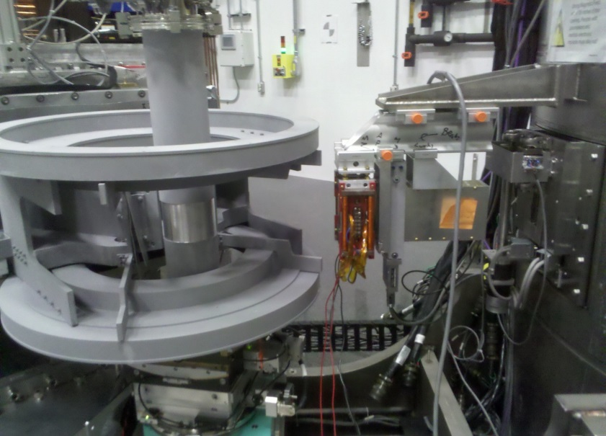
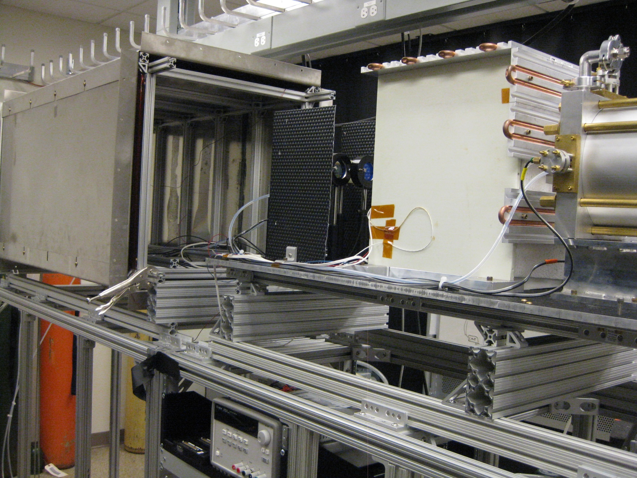
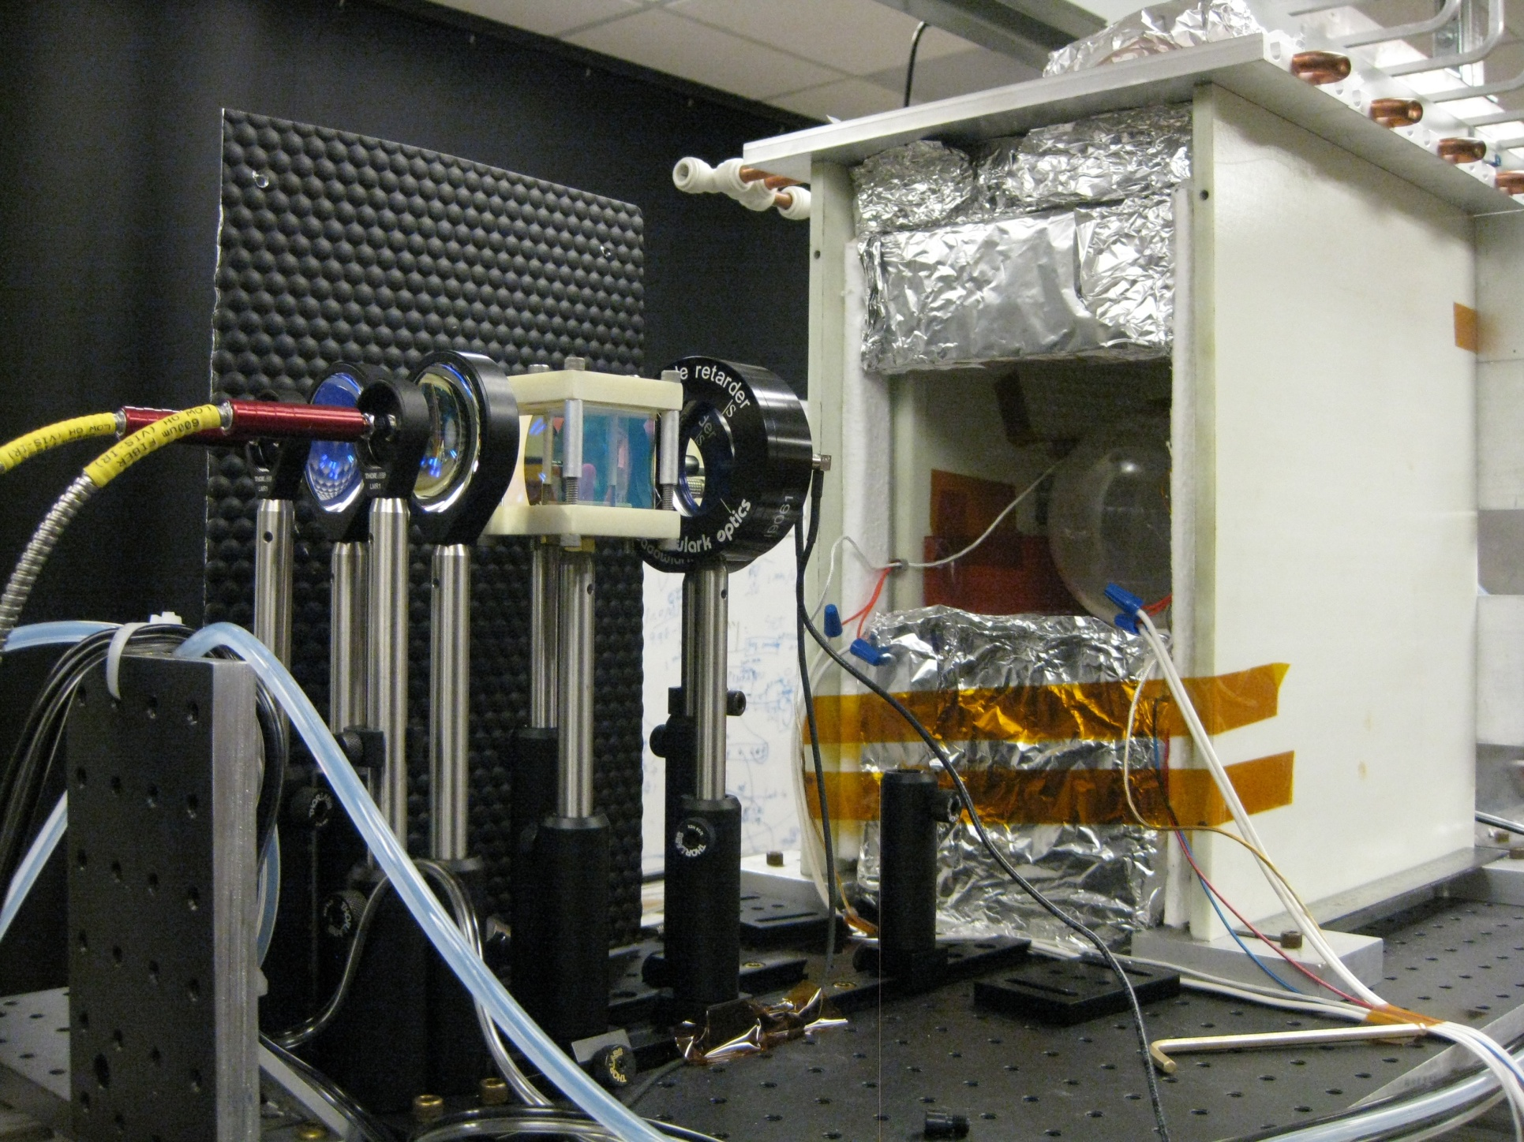
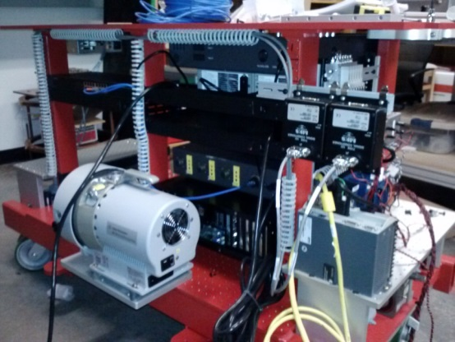
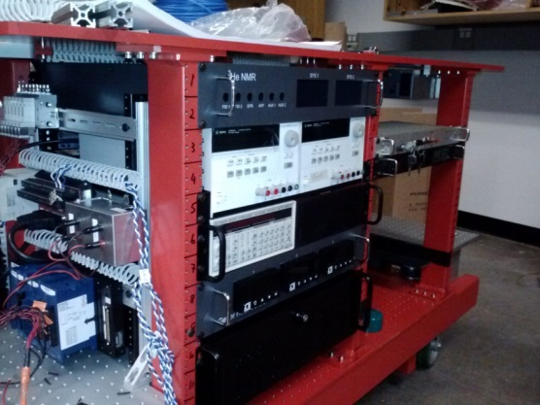
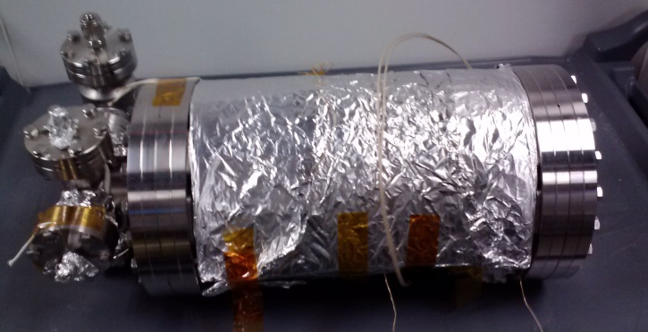
Auto-Refill, Vary Pressure
Rev. Sci. Instrum. 84, 065108 (2013), C. Y. Jiang, et al.

Slide 14
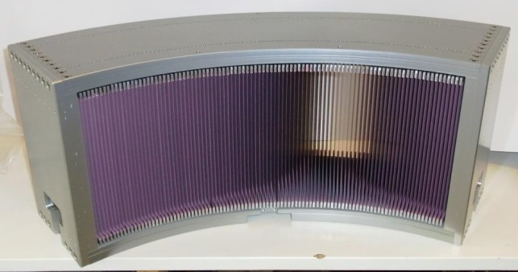
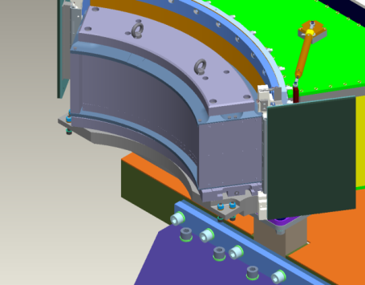
Polarization analysis #2: PSI Polarizing Supermirror Array
Remove radial collimator
Scattered beam
Scattered beam
Analyzed beam
- 0.5 meV < Ef < 20 meV
+ Larger sample environments
+ Larger magnetic fields at sample

Slide 15
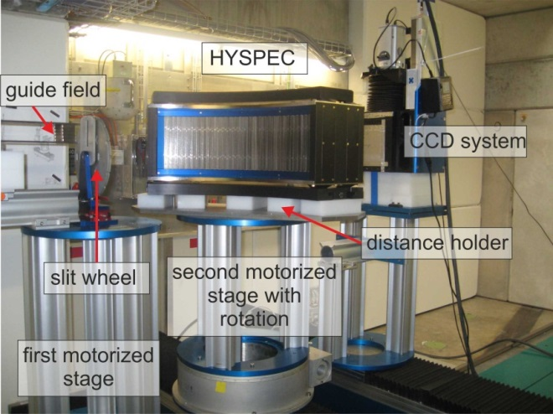
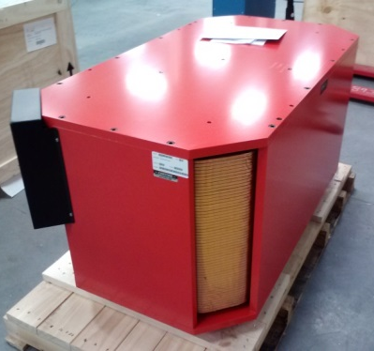
Performance and Preparations
960 supermirrors, 60º
U. Filges
BOA beamline at SINQ
Ready to ship
New magnetization unit at HYSPEC

Slide 16
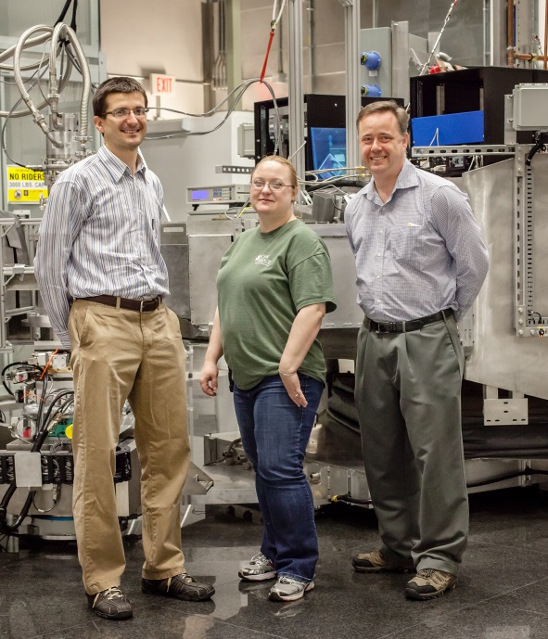
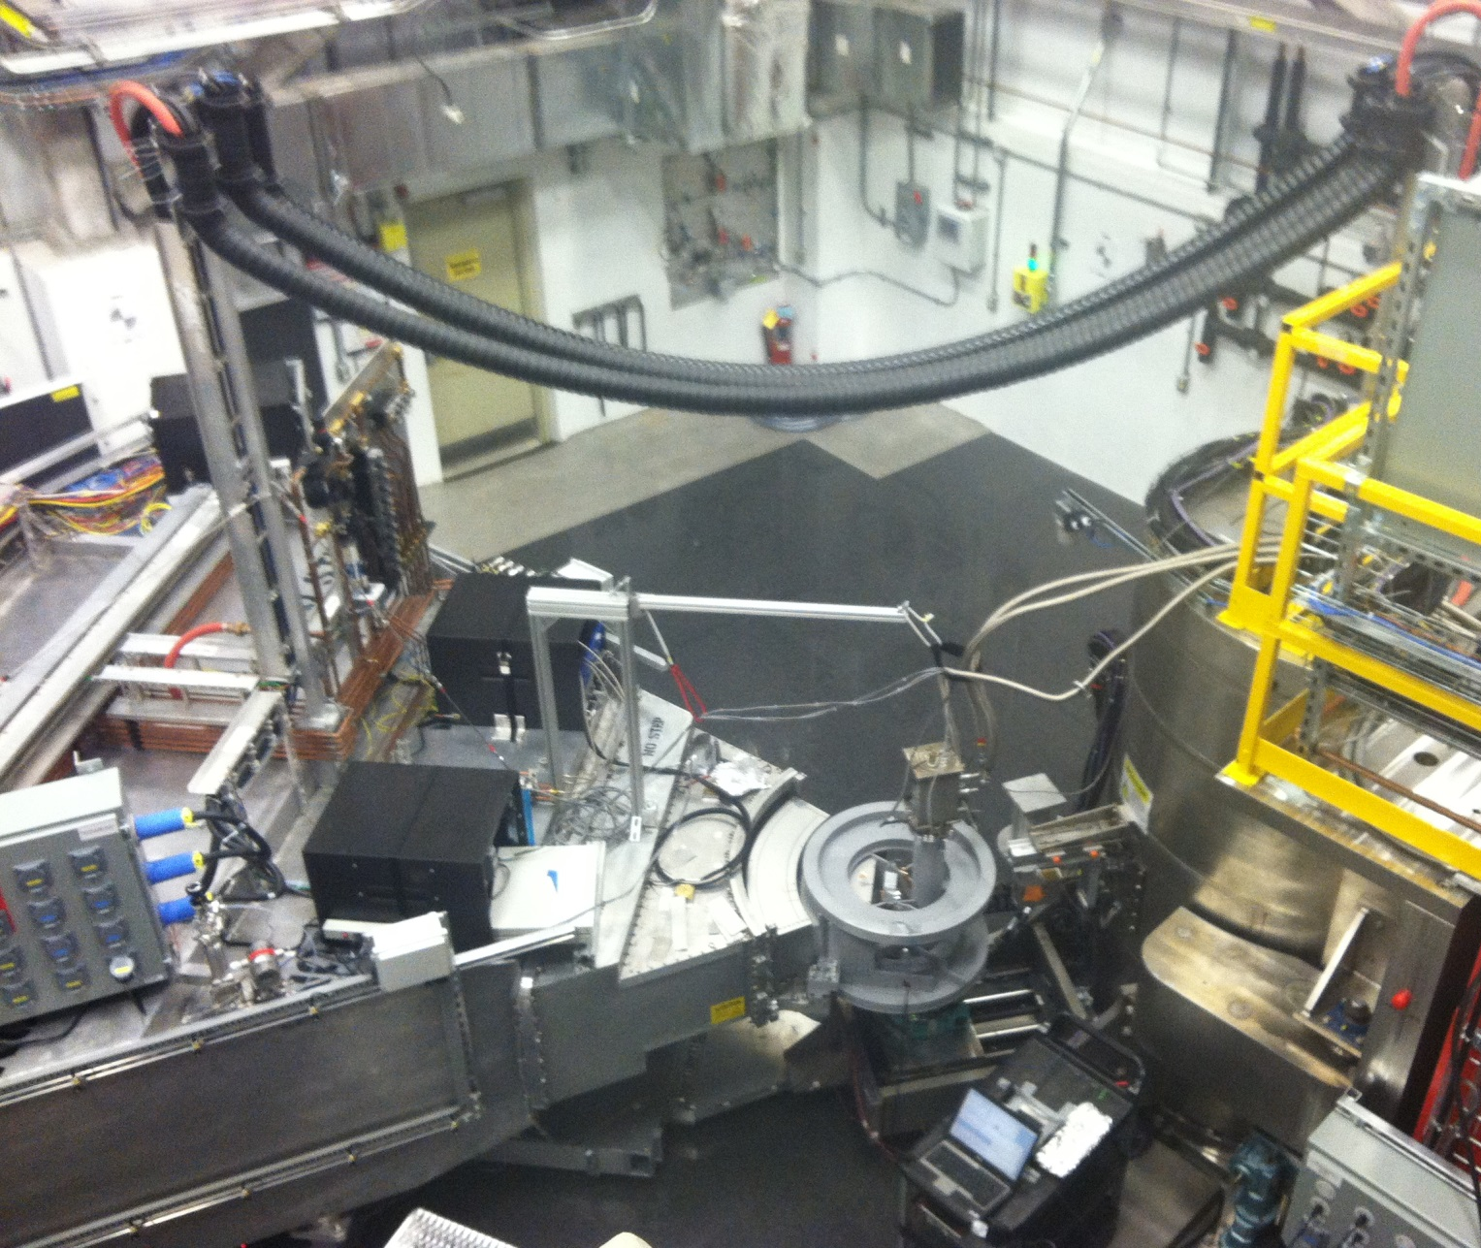
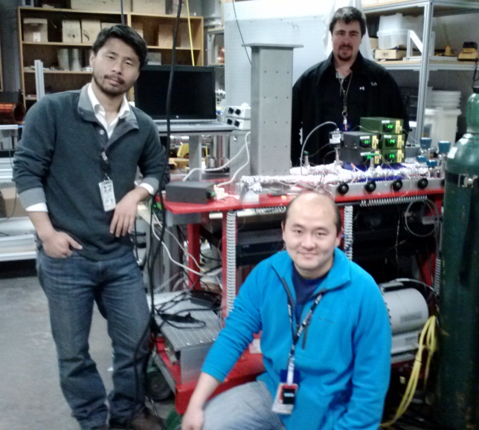
HYSPEC History & Team
Inception: BNL₁
Design and Development₂:
Instrument Development Team
BNL: S. M. Shapiro, I. A. Zaliznyak, L. Passell, V. J. Ghosh, W. J. Leonhardt
PSI: U. Filges (polarizing supermirror array analyzer)
ORNL: M. E. Hagen, D. Anderson, T. Tong
Many support teams
Install & Unpolarized Commissioning:
ORNL: MEH, M.Graves-Brook, B. Winn
Significant IDT & ORNL staff support
User Program & Polarization Commissioning:
ORNL: MGB, BW, O. Garlea, T. Tong, P. Jiang, D. Brown
[1] I. Zaliznyak, V. Ghosh, S. M. Shapiro, L. Passell, Physica B 356, 150 (2005).
[2] S. M. Shapiro, I. A. Zaliznyak, L. Passell, V. J. Ghosh, W. J. Leonhardt, M. E. Hagen, Physica B, 385-386, 1107 (2006).

