Slide 1
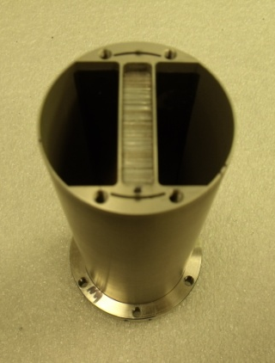
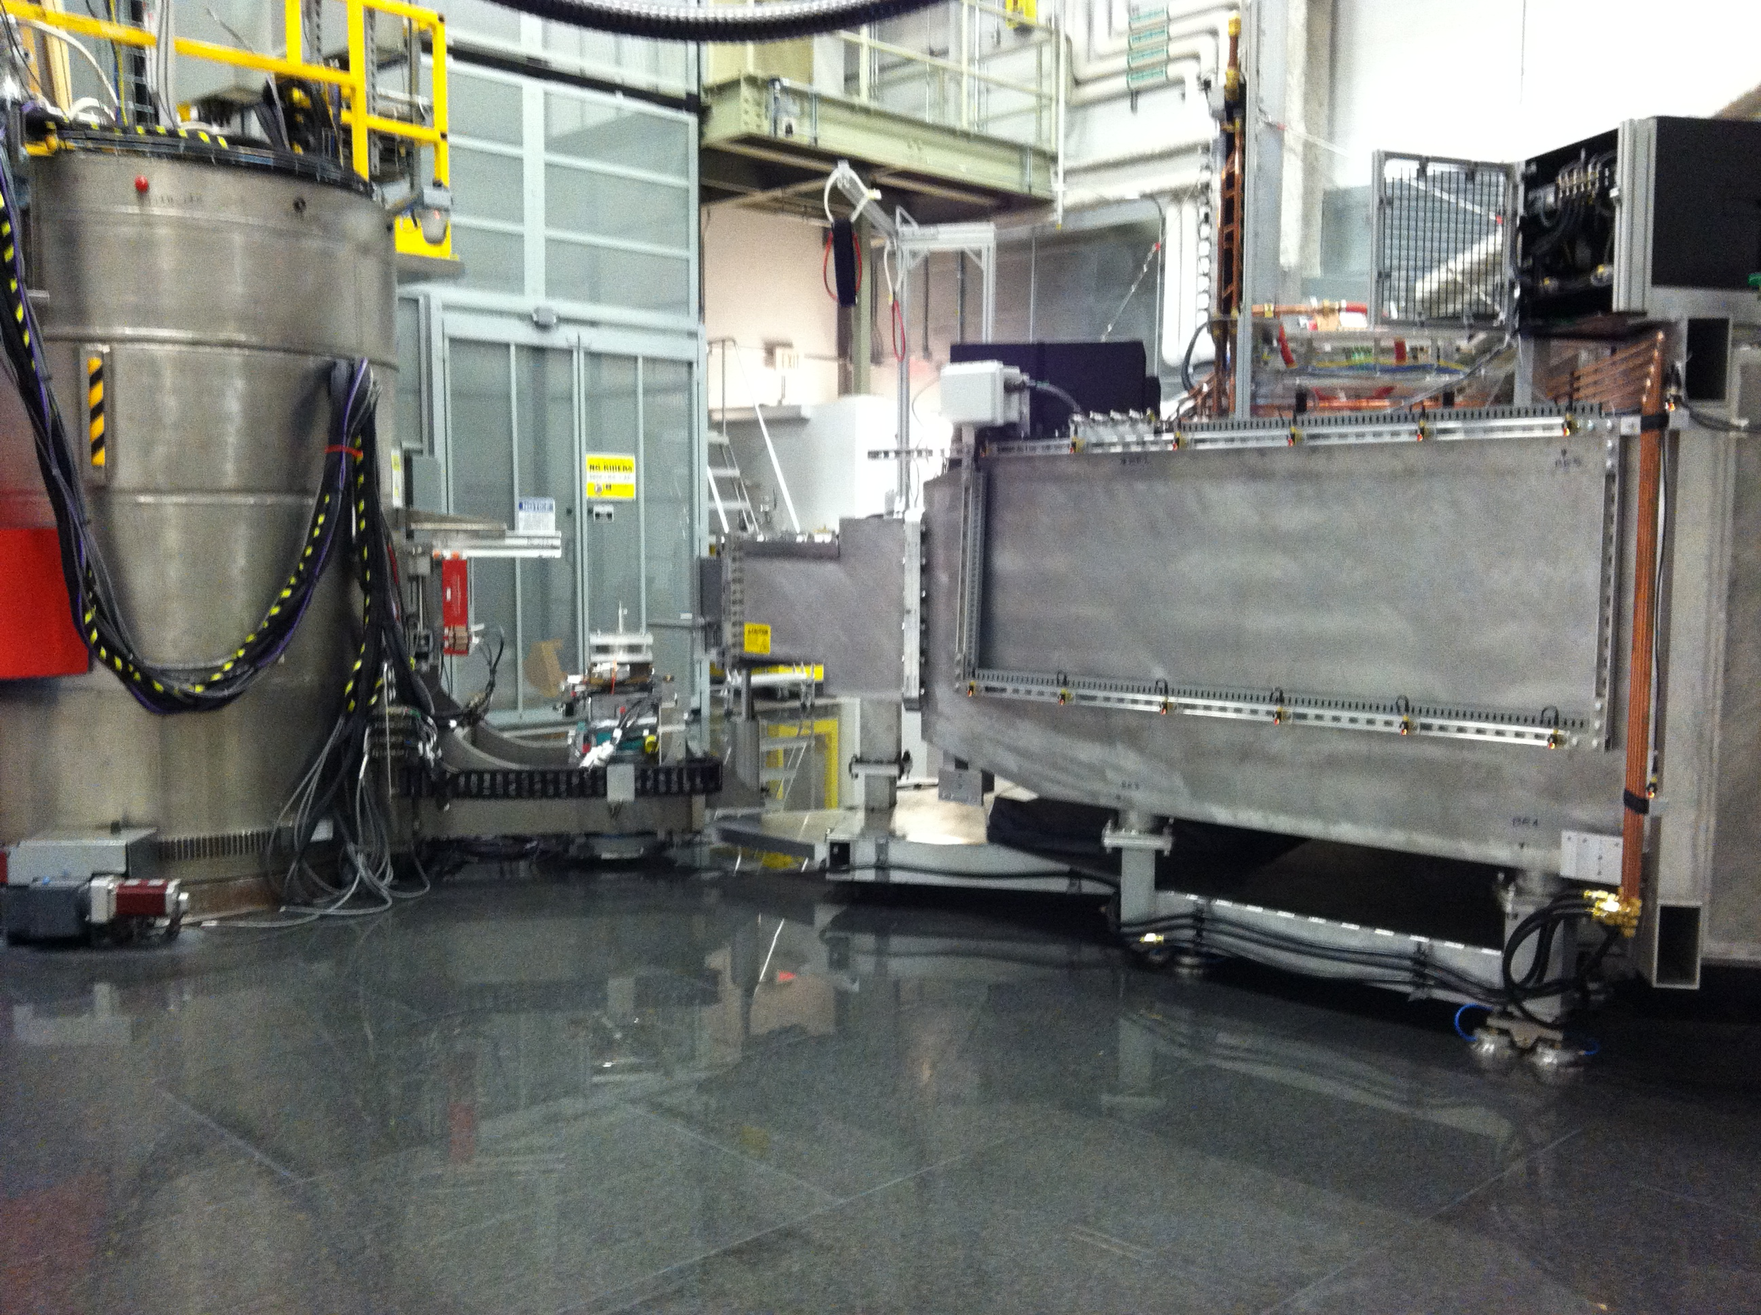
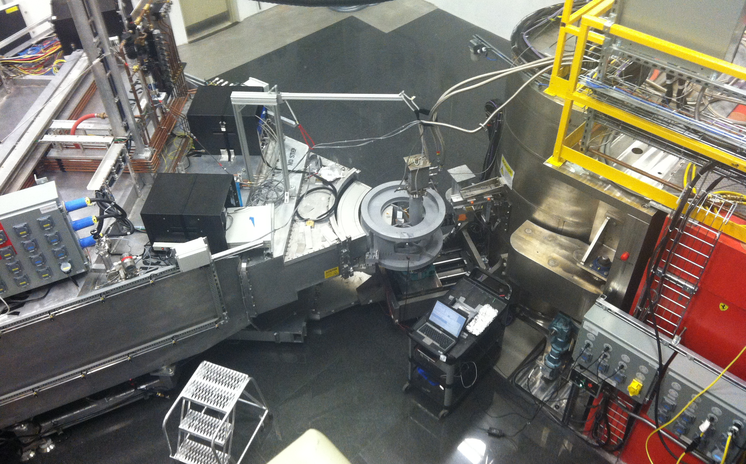
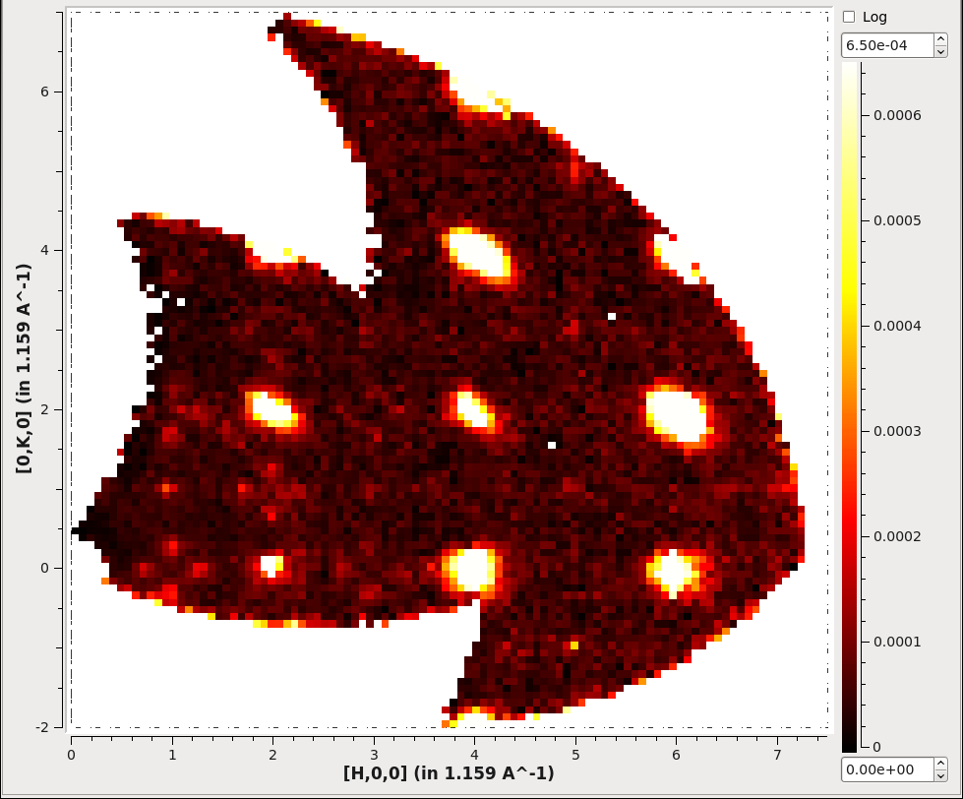
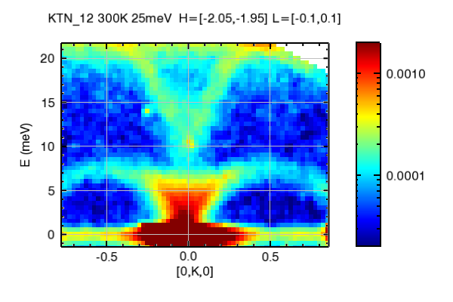
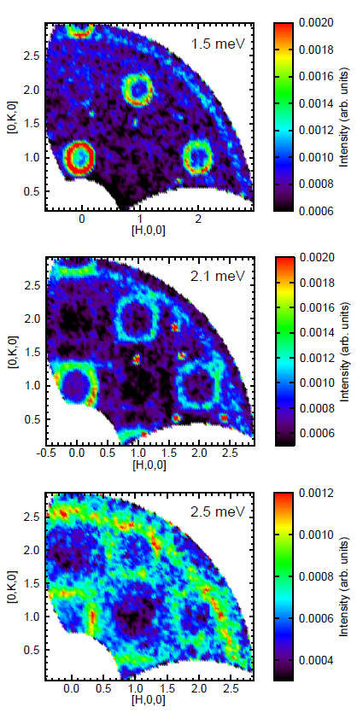
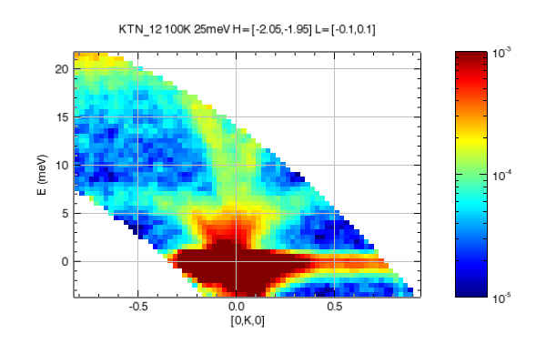
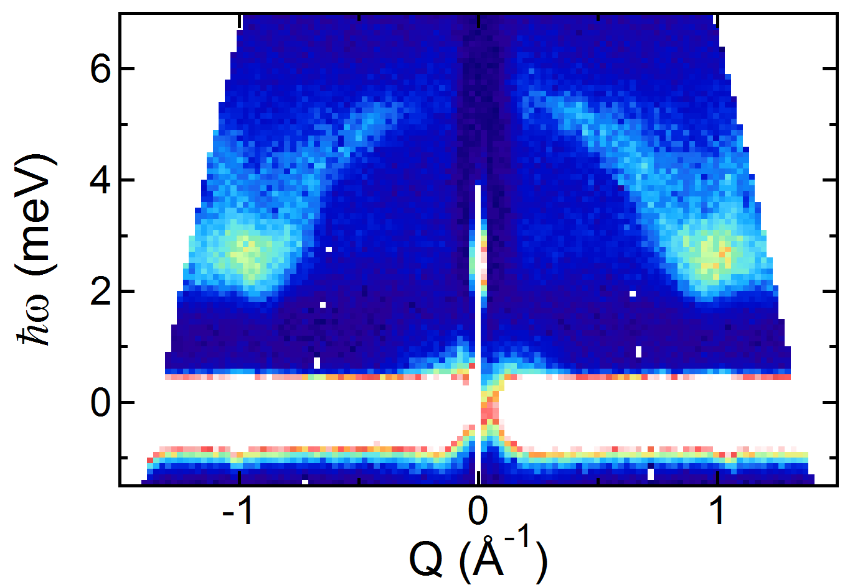
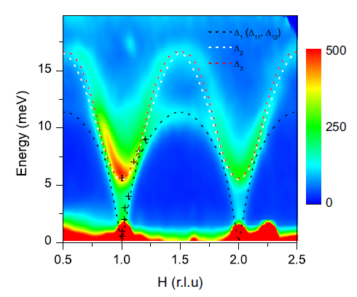
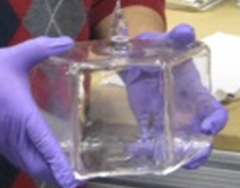
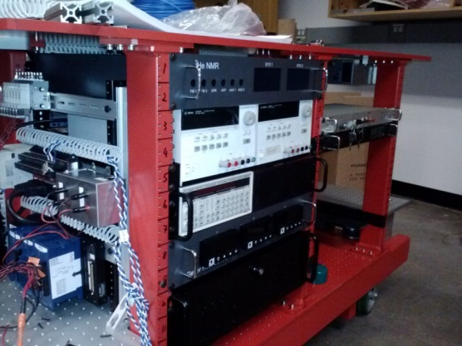
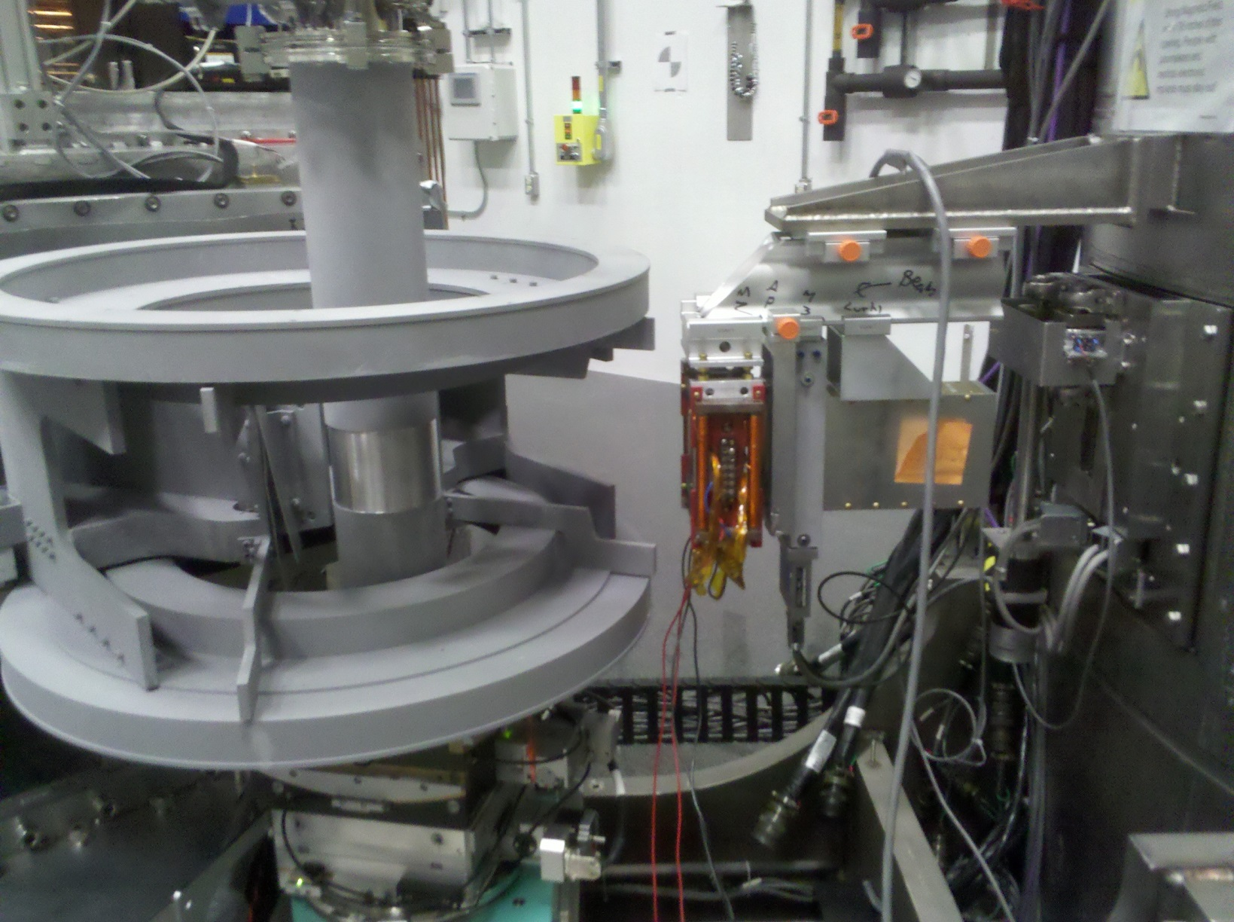
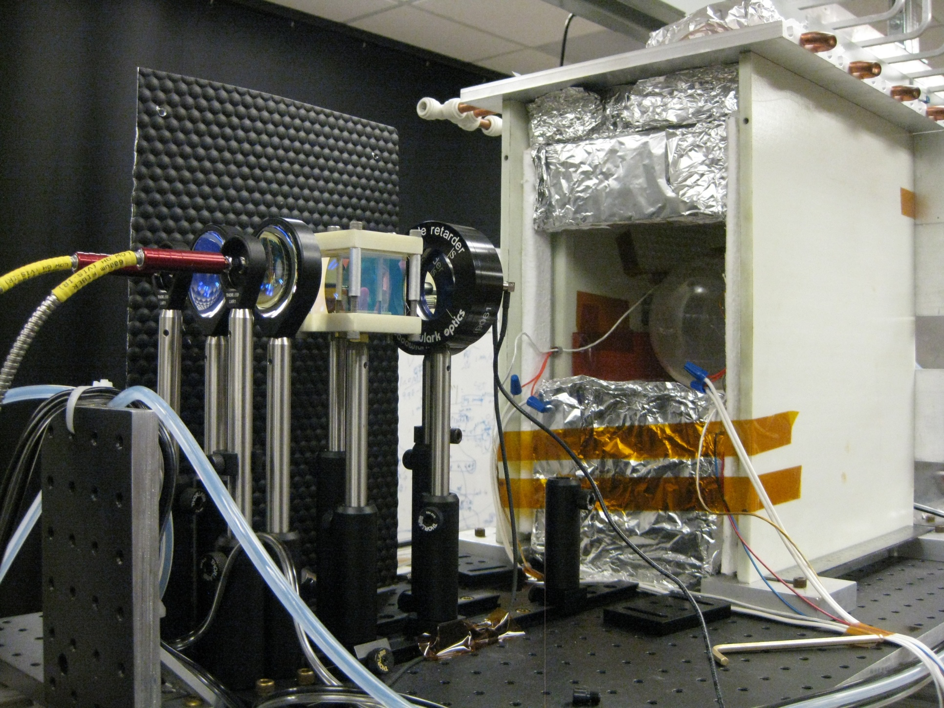
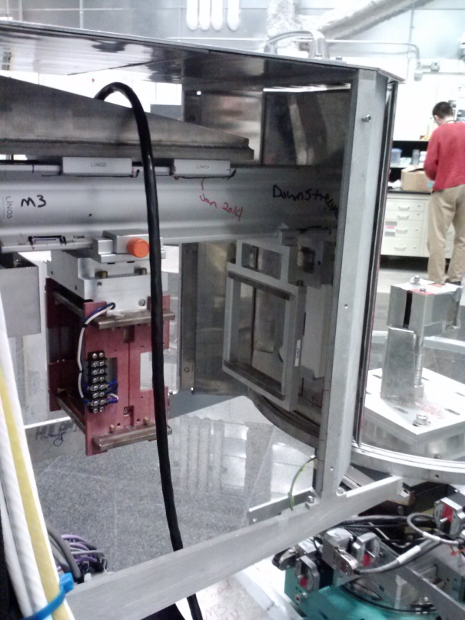
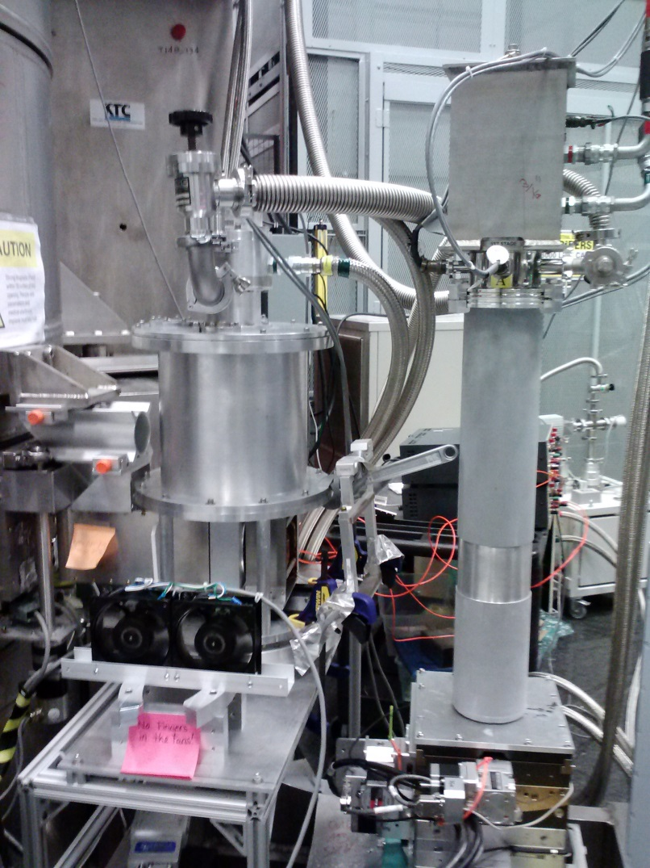
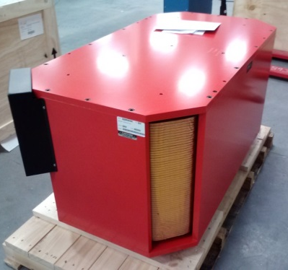
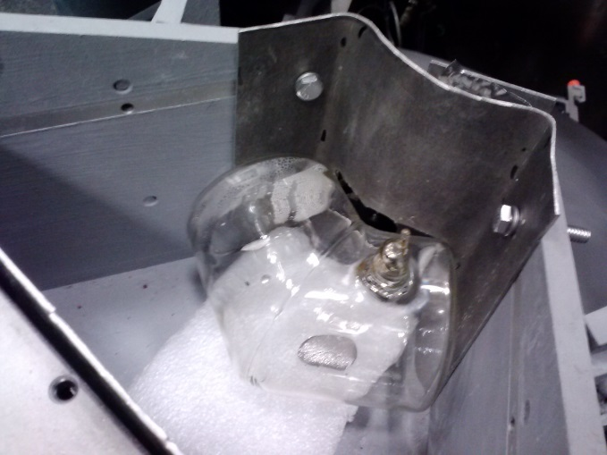
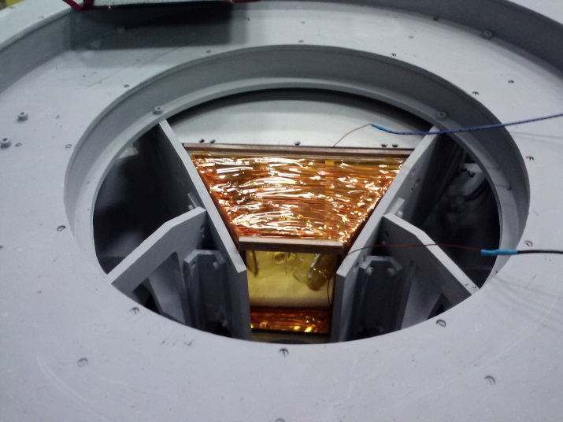
HySpec: new spectrometer is hosting users and preparing for polarization analysis
Barry Winnª, Uwe Filges^{b}, V. Ovidiu Garleaª, Melissa Graves-Brookª, Mark Hagen^{a,c}, Peter Jiangª, Michel Kenzelmann^{b}, Larry Passell^{d}, Stephen M. Shapiro^{d}, Xin Tongª, Igor Zaliznyak^{d}
At its core, a Direct Geometry Spectrometer..
Hybrid
Spectrometer:
the high-flux, coarse energy resolution, cold neutron choice among SNS direct geometry spectrometers¹
 | (m)
L1 | 37.2
L2 | 3.6
L2* | 1.8
L3 | 4.5
..using features of a Triple Axis Spectrometer:
-Vertical Bragg focusing
-Variable final flight path
Fermi chopper,
30-420 Hz
 | (deg)
Horizontal Acceptance | 60
Vertical Acceptance | 15
Vertical Divergence* | 4.7
Intensity at 15 meV, 180 Hz | 4.20E+05
(n/s/cm^2/MW)
Elastic Resolution (FWHM) | 2-5% Ei
Incident Energy Range (meV) | 3.8-50
User Program with
unpolarized neutrons
HOPG
vertical focusing
Combining data sets at different detector vessel positions is trivial using Mantid⁸. La_{1.75}Sr_{0.25}NiO₄ data measured⁹ at detector angle ranges 5-65º and 60-120º.
 | User
 | Experiments
Spring 2013 | 6
Fall 2013 | 17
Spring 2014 | 16
Fe_{1.09(1)}Te: symmetry forbidden (1,0,0) & (0,1,0) reflections below ~60 K reveal presence of bond-order wave transition, suggesting ferro-orbital coupling³
KTa_{0.88}Nb_{0.12}O₃:
TO branch softening⁴
Y_{0.7}Lu_{0.3}MnO₃ at 4K: dotted lines show calculated spin wave dispersion with magnetoelectric coupling in this multiferroic²
K₂V₃O₈: Spin waves in
S=1/2 square lattice
antiferromagnet⁵
Detector vessel range -30º to 30º is used to measure CrCl₂¹
Commissioning and Development with
Polarized neutrons
Polarization Analyzer option 1: ³He Analyzer Cell Spin-Exchange Optically Pumped
SEOP station attached to detector vessel, with mechanical transfer of polarized gas to optimum shape quartz wide-angle cell⁷
Aberration-corrected coils centered on sample, uniformity to 3E-5 cm⁻¹
Heusler vertical focusing and polarizing
Status: all parts delivered, assembly and offline testing underway
Polarization Analyzer Option 2: Polarizing Supermirror array
Drop-in analyzer cell commissioning with neutrons, NIST banana cell and RF flipping
Incident beam flipping ratio
at 15 meV
with Mezei flipper | 23
with high T_{c} cryo flipper⁶ | 32
Status: Remanent field array ready to ship from PSI. Magnetizer delivered and tested at HYSPEC.
ª Oak Ridge National Laboratory
^{b} Paul Scherrer Institut
^{c} European Spallation Source
^{d} Brookhaven National Laboratory,
¹ RSI 85, 045113 (2014)
² PRB 89, 144417 (2014)
³ PRL 112, 187202 (2014)
⁴ O Delaire et al in prep
⁵ M Lumsden et al in prep
⁶ T. Wang et al, accepted, IOP, Neutron optics & Detectors
⁷ RSI 84, 065108 (2013)
⁸ http://dx.doi.org/10.5286/SOFTWARE/MANTID
⁹ J. Tranquada et al; acquired May 2014

