Slide 1
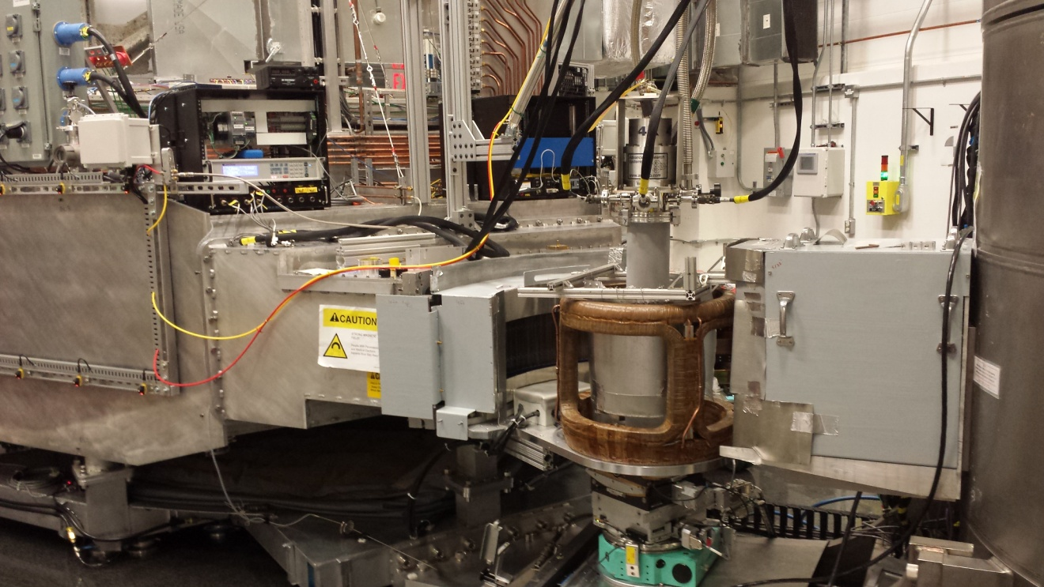
Polarized inelastic neutron scattering on HYSPEC HYbrid SPECtrometer at SNS
Igor Zaliznyak
Condensed Matter Physics and Materials Science Division PNCMI, July 6, 2016

Slide 2
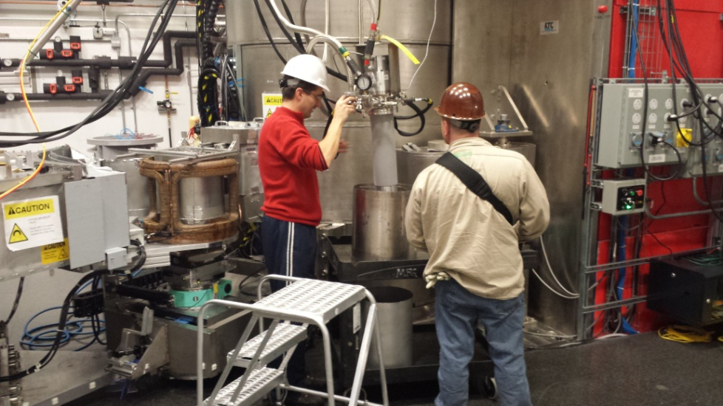
Related presentations
At PNCMI 2016
  B. Winn: “3D Polarization Analysis with a Polarizing Supermirror Array Analyzer at HYSPEC” – Session 9
  A. Savici: “Data processing workflow for time of flight polarized neutrons inelastic measurement” – Session 3
At ACNS 2016
  O. Garlea: “The first results from the HYSPEC polarization analysis capability”

Slide 3
History: HYSPEC timeline
http://neutrons.phy.bnl.gov/HYSPEC
  2000
    The Concept of the Hybrid Spectrometer proposed at BNL
  2001
    Direct Geometry Hybrid Spectrometer presented to SNS EFAC
    HYSPEC Instrument Development Team (IDT) formed
  2002
    HYSPEC IDT filed Letter of Intent with SNS
    HYSPEC proposal submitted to DOE
  2003
    DOE CD0, HYSPEC is approved as part of the SING project
  2004
    HYSPEC’s placement approved on BL14B;Design&Engineering begins
  2005
    DOE CD2, HYSPEC’s performance baseline approved
  2006
    DOE CD3, construction begins
  2011
    DOE CD4, HYSPEC commissioning & operation begins
  2013
    HYSPEC enters SNS User Program
  2015
    Polarized beam operation on HYSPEC is commissioned

Slide 4
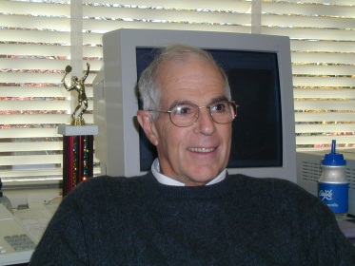

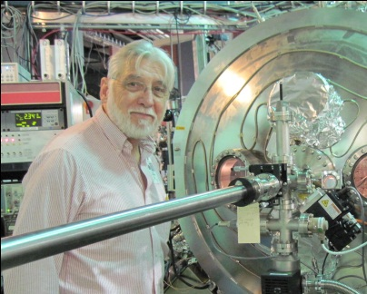

HYbrid SPECtrometer, HYSPEC:
BNL Instrument Design Group
Steve Shapiro, co-PI
Larry Passell, advisor
Igor Zaliznyak, PI
Bill Leonhardt, engineer
Vinita Ghosh, scientist – MC simulations

Slide 5
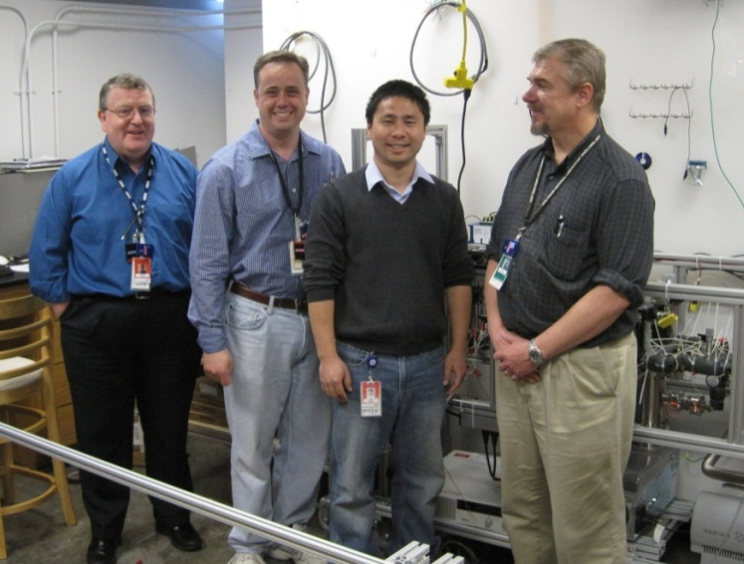
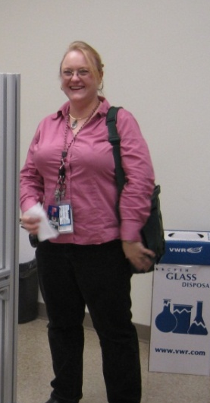
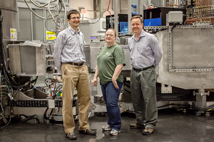
HYbrid SPECtrometer, HYSPEC –ORNL Instrument Team
HYSPEC: SNS Instrument Construction Team (… - 2013)
HYSPEC SNS Instrument Team now
Mark Hagen Barry Winn Tony Tong David Anderson
Lead Scientist Scientist Scientist Engineer
(now @ ESS)
Melissa Graves-Brook
Science Associate
Ovidiu Garlea, Scientist
Joined in May, 2013
Barry Winn, Scientist

Slide 6
HYSPEC Team - 2002
http://neutrons.phy.bnl.gov/HYSPEC
Instrument Development Team
I. Zaliznyak, co-PI BNL
S. M. Shapiro, co-PI BNL
G. Shirane BNL
J. Tranquada BNL
L. Passell BNL
D. Abernathy SNS
L. Daemen Los Alamos
M. Greven Stanford
B. Gaulin McMaster
V. Kiryukhin Rutgers
Y. Lee MIT
S. Nagler ORNL
R. Osborn ANL
J. Rhyne U. Missouri
C. Stassis Ames/Iowa St.
A. Zheludev ORNL
Instrument design team
I. Zaliznyak (BNL)
S. M. Shapiro (BNL)
L. Passell (BNL)
V. J. Ghosh (BNL) Monte-Carlo simulations
S. Doran (SNS/ANL) Engineering design concept

Slide 7



HYSPEC Team - 2015
http://neutrons.phy.bnl.gov/HYSPEC
Instrument Development Team
I. Zaliznyak (co-PI, EC member BNL
S. Shapiro (co- PI, EC member) BNL
M. Kenzelmann (EC member) PSI
L. Daemen LANL
J. Fernandez-Baca ORNL
J. Gardner NIST/Indiana U.
B. Gaulin McMaster U.
M. Greven Stanford
V. Ghosh BNL
M. Hagen SNS =>ESS
M. Huecker BNL
V. Kiryukhin Rutgers
G. Lander EITU
Y. Lee MIT
S.-H. Lee U. Virginia
C. Majkrzak NIST
A. Goldman (EC member) Ames/Iowa U.
S. Nagler ORNL
R. Osborn ANL
L. Passell BNL
L. P. Regnault CEA-Grenoble
T. Sato (EC member) Tohoku University
J. Tranquada (EC member) BNL
G. Xu BNL
A. Zheludev ETH-Zurich
IDT Executive Committee
I. A. Zaliznyak, PI (BNL)
S. M. Shapiro, PI (BNL)
M. Kenzelmann (PSI)
A. Goldman (Ames/Iowa State)
T. Sato (Tohoku
J. Tranquada (BNL)

Slide 8
HYSPEC science case: polarization first
http://neutrons.phy.bnl.gov/HYSPEC
Characterization of spin-dependent cross-sections by means of polarization analysis
Coherent collective excitations in single crystals:
  lattice dynamics (phonons)
  spin dynamics (magnons, critical scattering)
Structure and dynamics of partially ordered and glassy phases
  spin glasses
  charge glasses
  correlated amorphous phases
  small angle
Study of the microscopic physical properties of samples in extreme environments:
  temperature
  pressure
  magnetic field

Slide 9
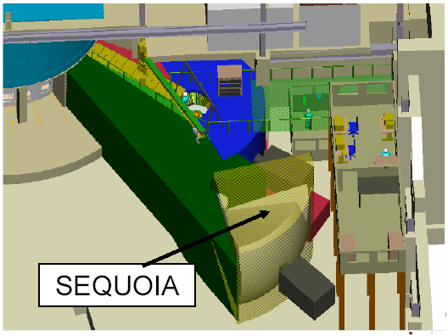
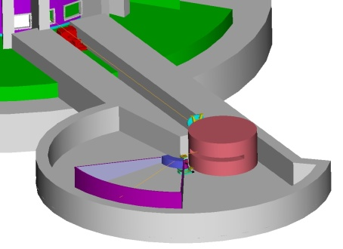
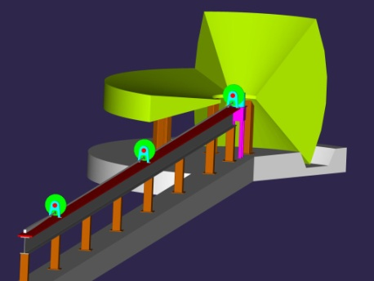
HYSPEC place among the SNS inelastic instruments.
ARCS
High energy transfer
10-1000 meV Fermi Chopper Spectrometer
  E = 10 - 1000 meV
  Q = 0.1 – 22 Å⁻¹
epithermal
High intensity at moderate resolution and medium energy transfer + polarized beam
Crystal-Focussing Hybrid Spectrometer
  E = 3.8 - 90 meV
  Q = 0.1 – 8 Å⁻¹
HYSPEC
thermal
High resolution and low energy transfer
10-100 μeV Multichopper Spectrometer
  E = 2 - 20 meV
  Q = 0.1 - 4 Å⁻¹
CNCS
subthermal

Slide 10
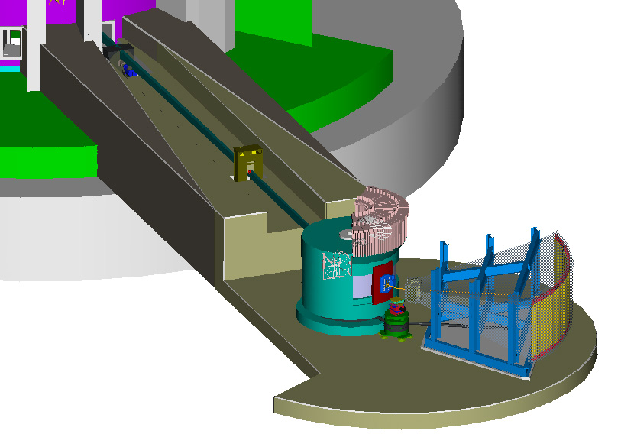
HYSPEC conceptual design - 2003
http://neutrons.phy.bnl.gov/HYSPEC
T₀ Chopper
Disc Chopper
Monochromator
Goniometer
Radial Collimator,
or Bender Polarizers
Flight Chamber (evacuated or Ar/He filled)
Detectors

Slide 11
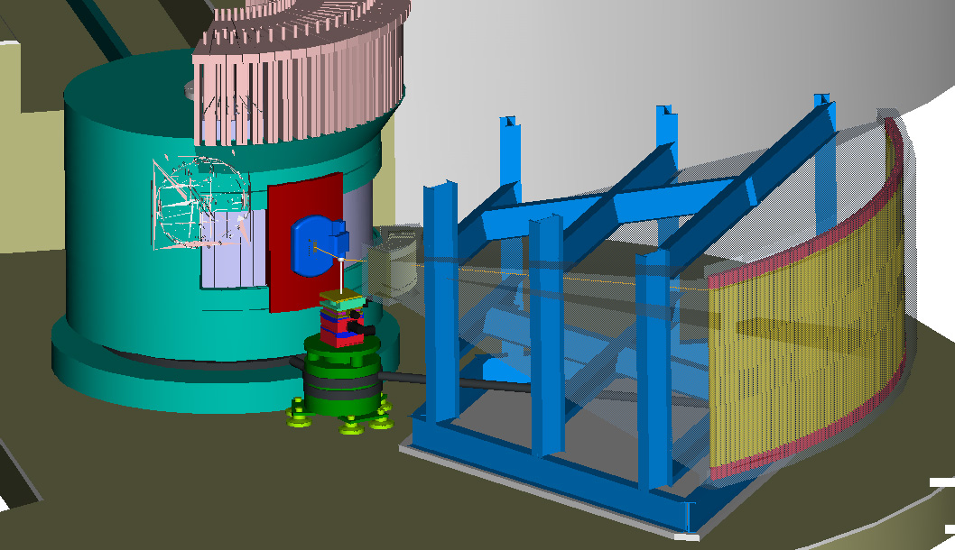
HYSPEC conceptual design - 2003
http://neutrons.phy.bnl.gov/HYSPEC

Slide 12
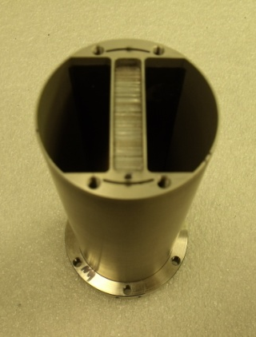
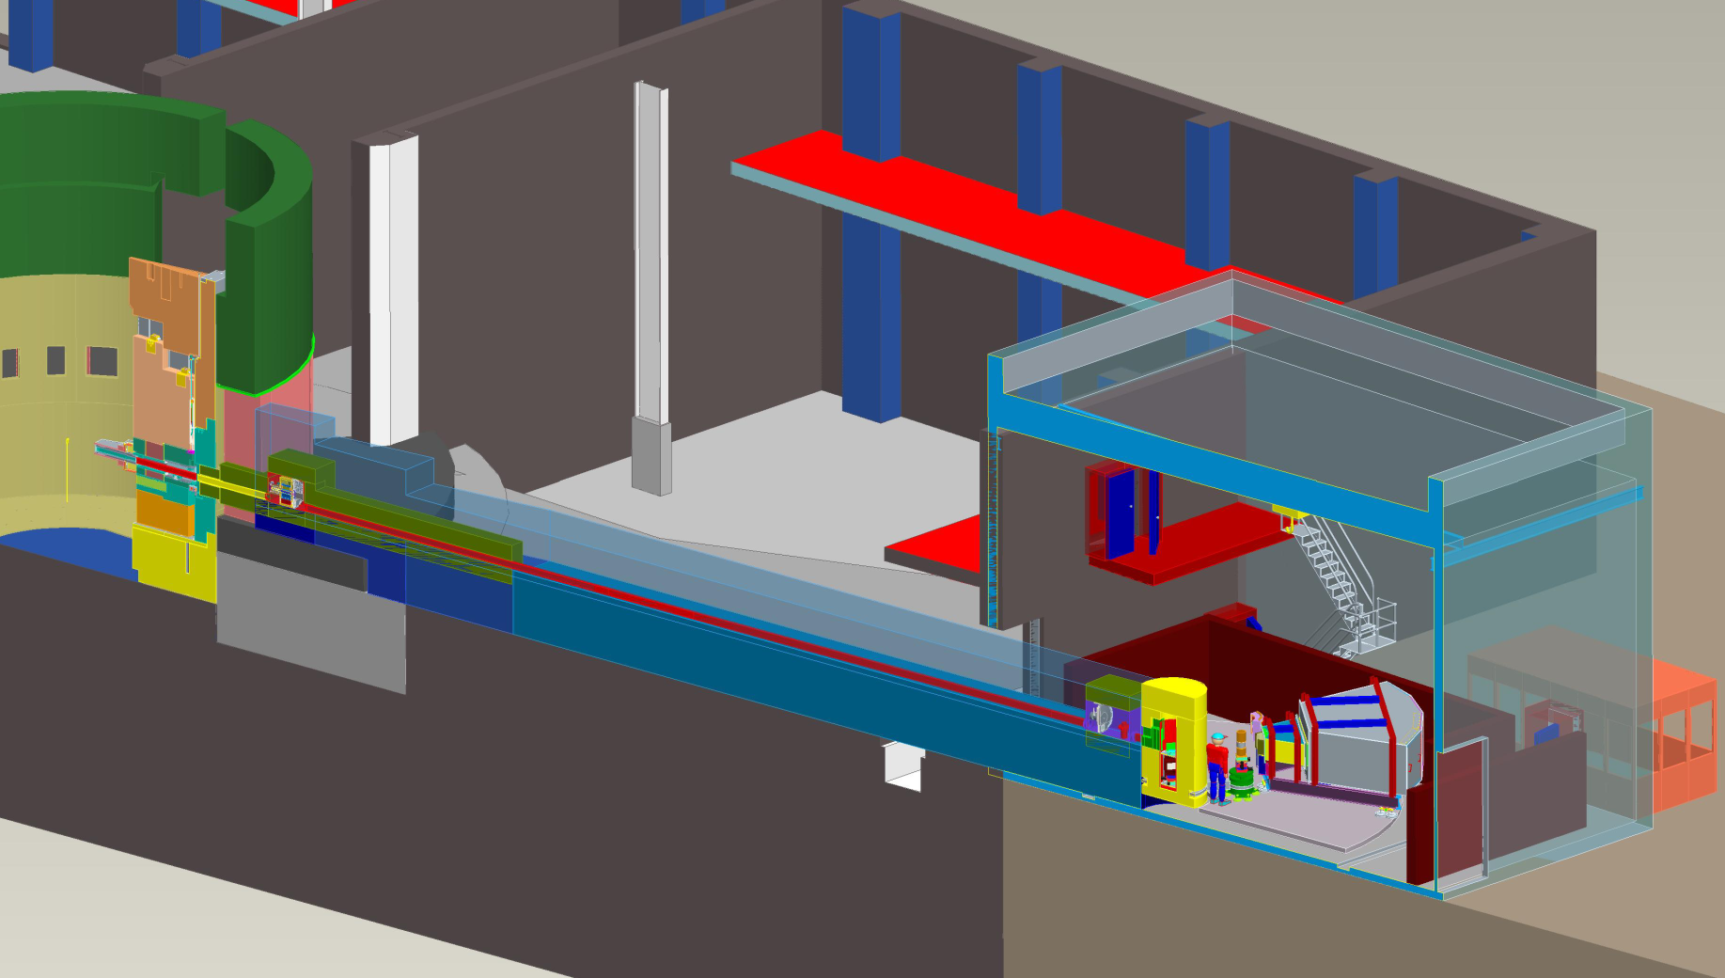
HYSPEC layout (design – 2008)
http://neutrons.phy.bnl.gov/HYSPEC
Short strait blade Fermi chopper
at L₁=37.2 m to select E_{i}: trade off between E resolution and flux via frequency range 60-420 Hz
Control Cabin
Measures variable E_{f} of scattered neutrons using ToF
L₂=3.6 m, L₃=4.5m
Shutter
HDC
Shielding
Chopper Box B
External Building
CVI
Curved Beam Guide
Chopper Box A
Concrete Shielding
Drum Shield
Detector Vessel
Sample

Slide 13
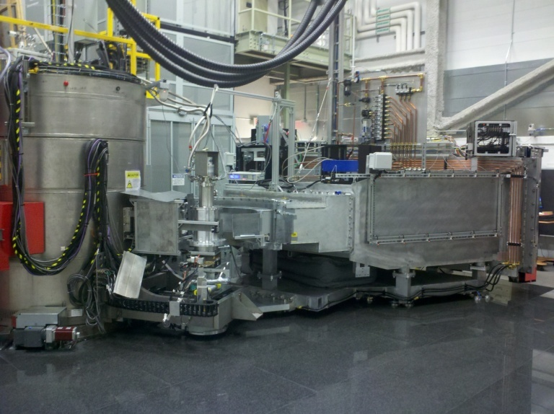
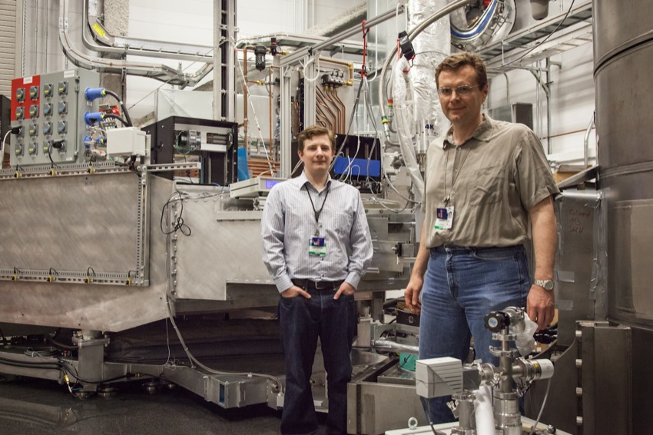
HYSPEC in operation - 2012
http://neutrons.phy.bnl.gov/HYSPEC
Commissioning Experiments,
D. Fobes and I. Zaliznyak (2012)

Slide 14
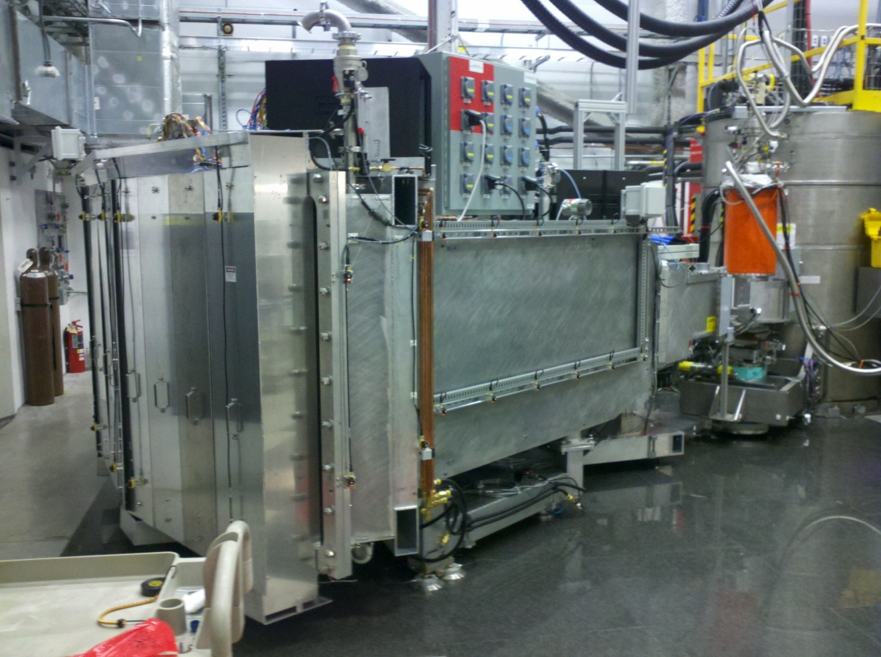
HYSPEC in operation - 2013
http://neutrons.phy.bnl.gov/HYSPEC
Tune-up complete: apertures, beam stop, shielding, shielding

Slide 15
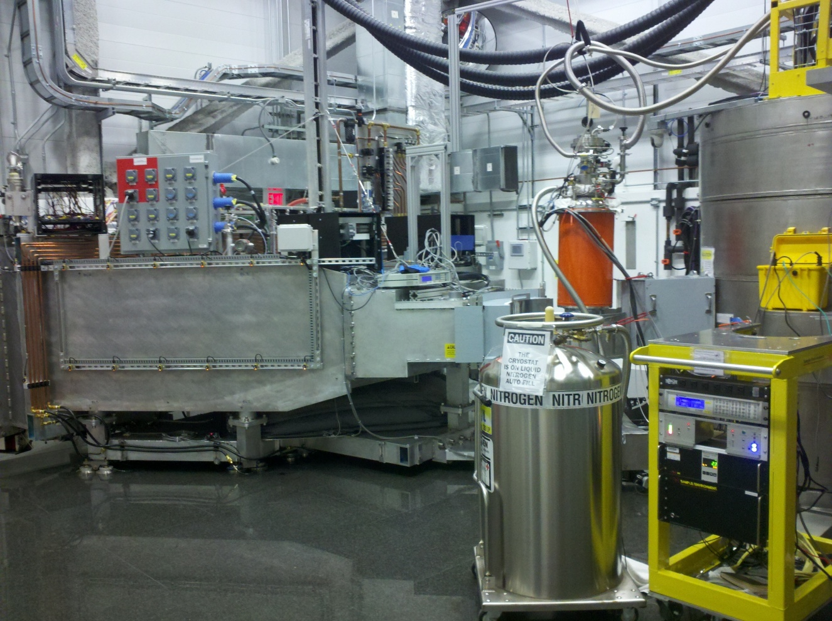
HYSPEC in operation - 2013
http://neutrons.phy.bnl.gov/HYSPEC
Tune-up complete: apertures, beam stop, shielding, shielding

Slide 16
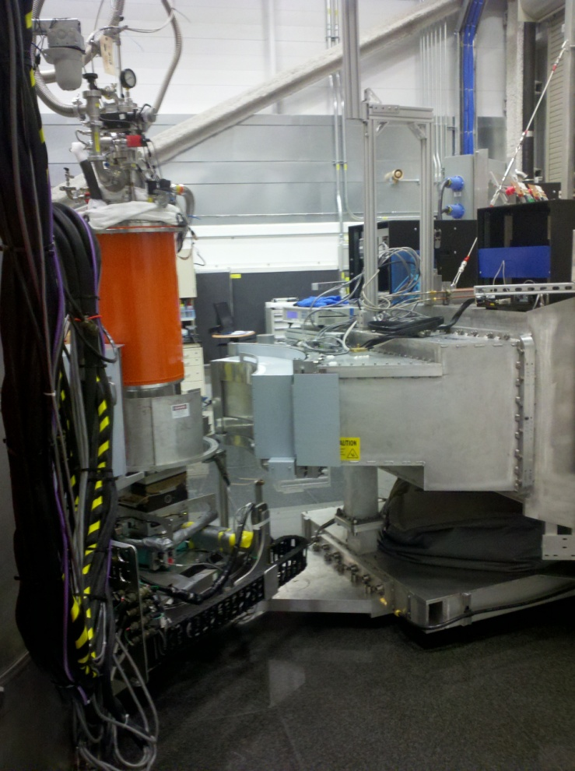
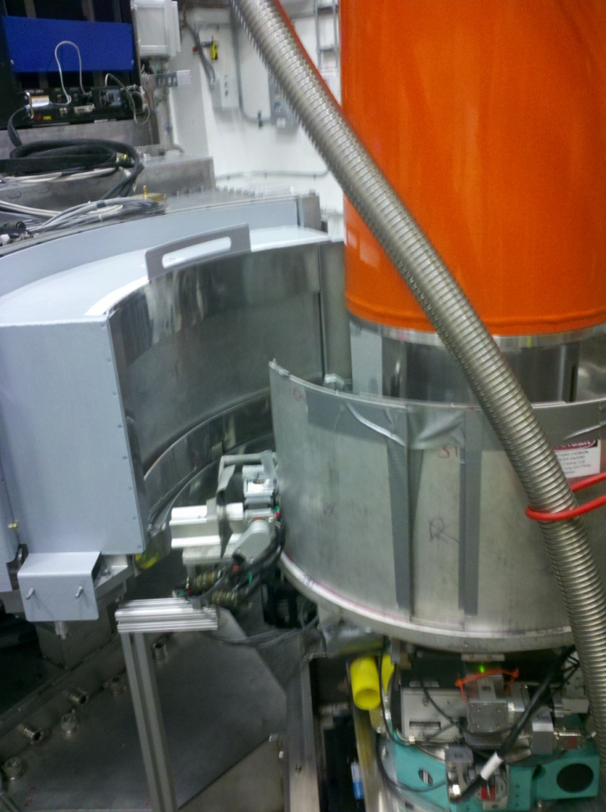
HYSPEC in operation - 2013
http://neutrons.phy.bnl.gov/HYSPEC
Tune-up complete: apertures, beam stop, shielding, shielding

Slide 17
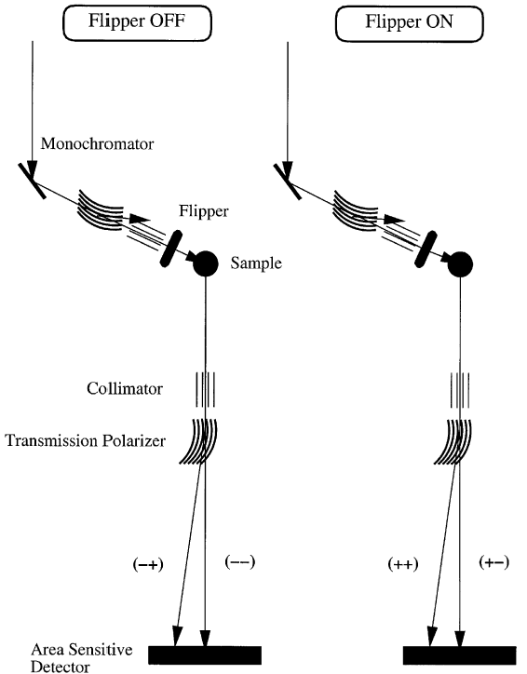
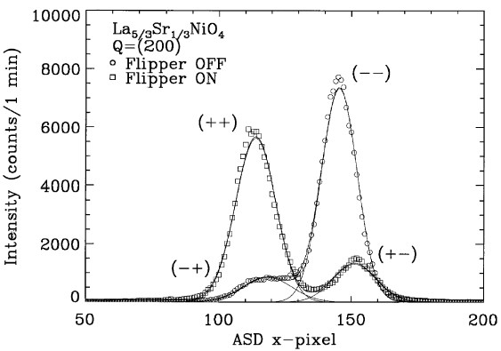
Initial HYSPEC concept for polarized beam measurement with a Position Sensitive Detector (PSD)
Heusler
S.-H. Lee, C. F. Majkrzak, Physica B 267-268, 341 (1999)

Slide 18

Initial concept for HYSPEC polarization analysis: experimental demonstration with PSD on SPINS
Nuclear and magnetic scattering intensities in La_{5/3}Sr_{1/3}NiO₄
I. A. Zaliznyak and S.-H. Lee,
in Modern Techniques for Characterizing Magnetic Materials, ed. Y. Zhu (Springer, 2005)

Slide 19
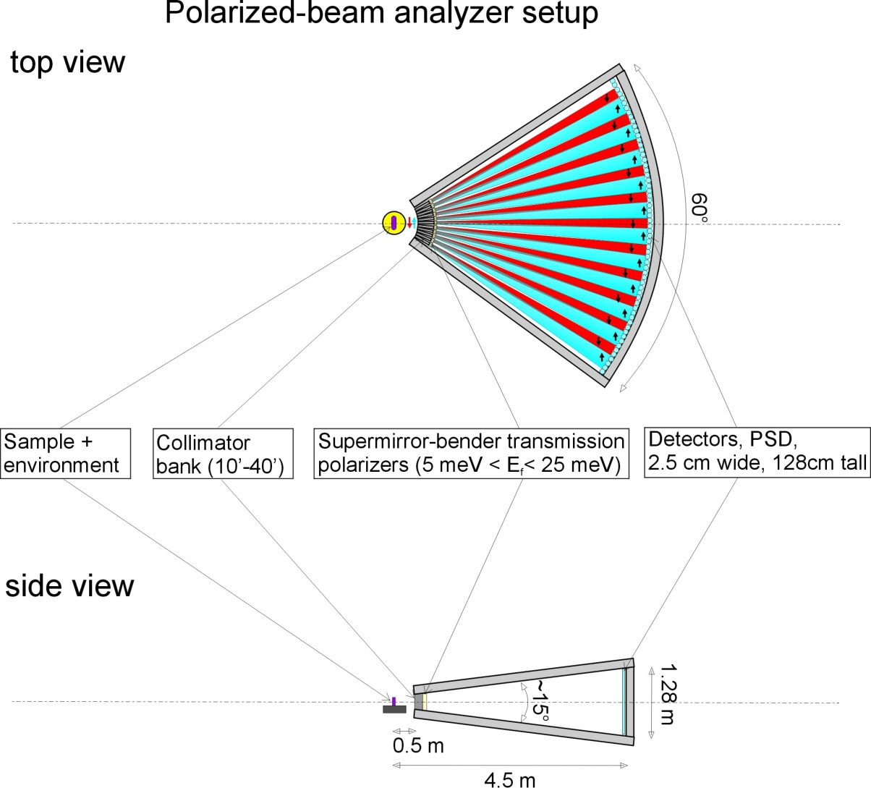
HYSPEC setup for polarization analysis (2002 design)
http://neutrons.phy.bnl.gov/HYSPEC
Polarized incident beam is supplied by reflection from the vertically focusing Cu₂MnAl (Heusler alloy) crystal monochromator
10 meV < E_{i}^{pol} < 90 meV
Polarization analysis of the scattered neutrons is performed by a set of 18-22 supermirror-bender transmission polarizers, each 2 cm wide, 5 cm thick and 15 cm high,
3.7 meV < E_{f}^{pol} < 15-25 meV
I. Zaliznyak, et. al., Physica B 356, 150-155 (2005); cond-mat/0410040.

Slide 20
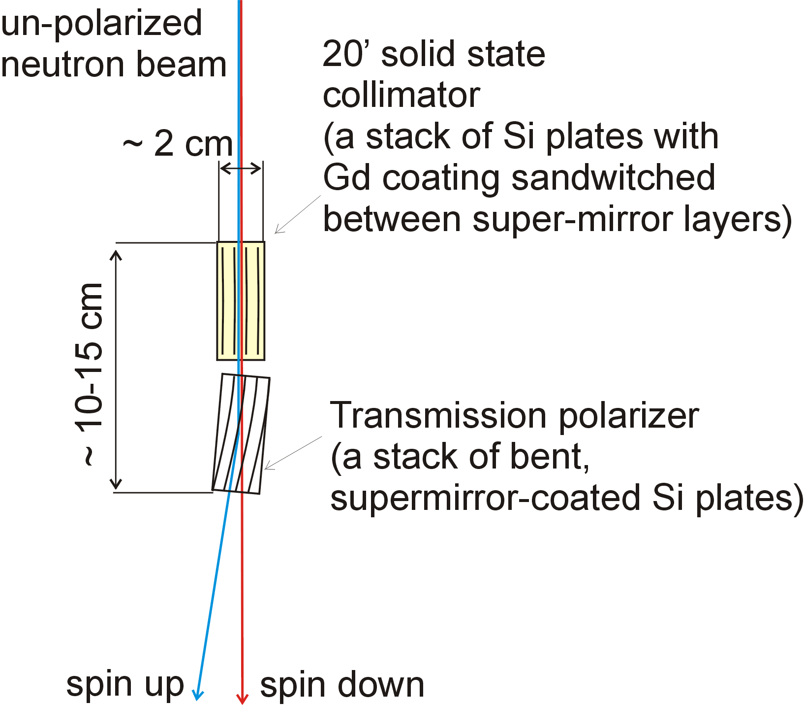
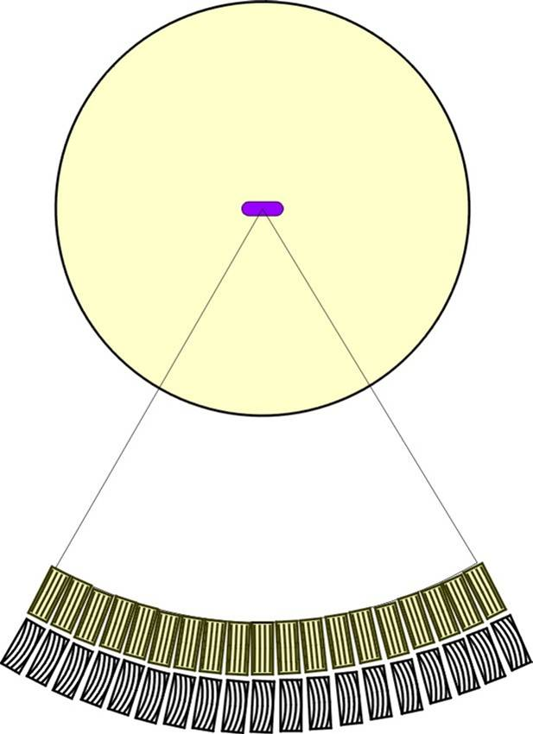
A supermirror-bender transmission polarizer setup for HYSPEC (2002)
http://neutrons.phy.bnl.gov/HYSPEC
A very compact device
(but needs a saturating magnetic field)
An array of 20 benders covers 60 deg. acceptance of the detector bank.
I. Zaliznyak, et. al., Physica B 356, 150-155 (2005); cond-mat/0410040.

Slide 21
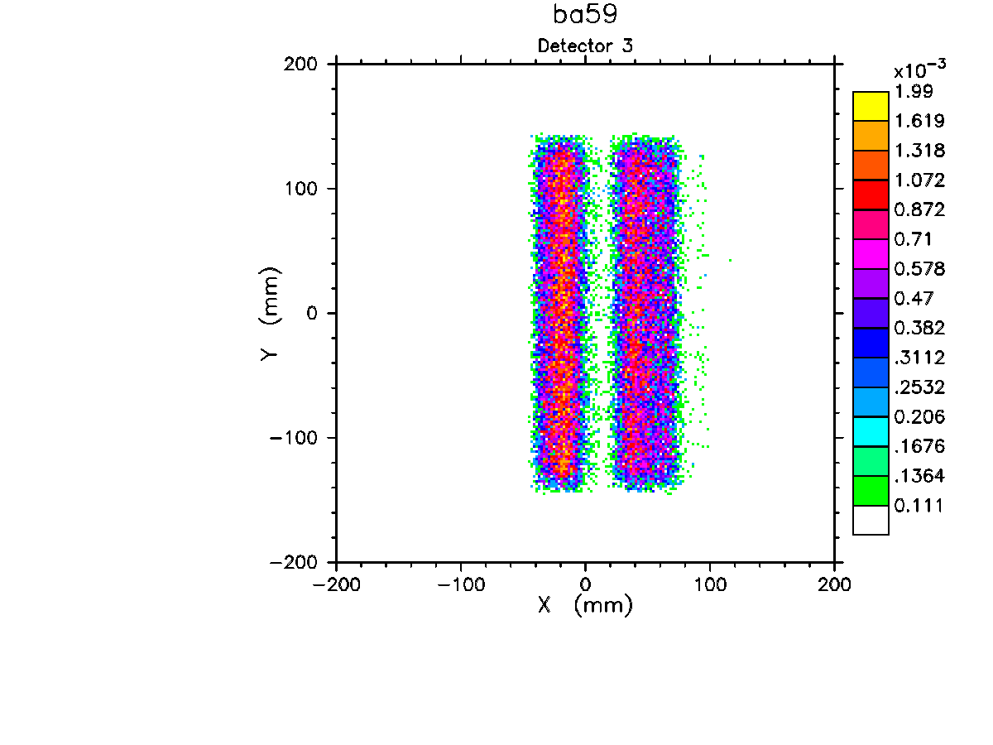
MC simulation (NISP) of HYSPEC operation in the polarized beam mode: beam separation
Simulation for the bender geometry optimized for E=14.7 meV (C. Majkrzak, 1995) Sample-to-detector distance L_{SD} is 4.5 m
I. Zaliznyak, et. al., Physica B 356, 150-155 (2005); cond-mat/0410040.

Slide 22
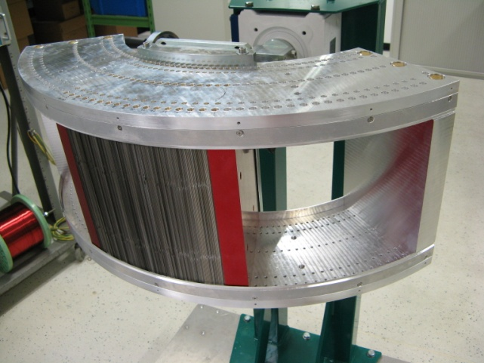
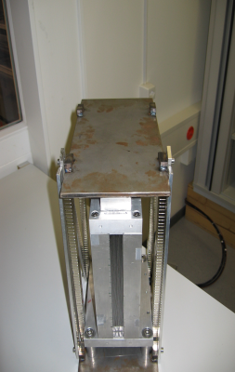
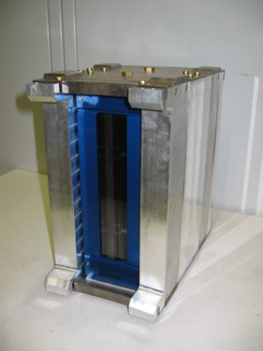
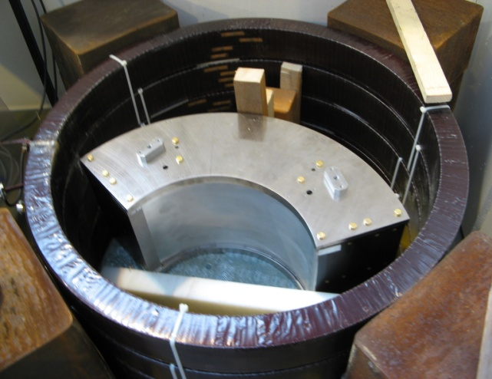
Opportunistic change of plan: PSI Supermirror Polarization Analyzer
Supermirror analyzer assembled with around 200 supermirrors
Prototype I ( 1.8 deg)
Prototype II ( 4.0 deg)
2011 status:
780 out of 960 polarizers produced
~100 polarizers per month
200 polarizers installed in housing & tested
on BOA (optics beamline at SINQ, PSI)
Anticipated completion in March 2011,
followed by tests at SINQ
supermirror analyzer inside the magnetization unit (500 G)

Slide 23
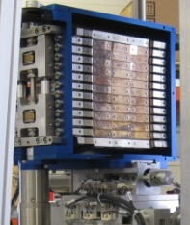
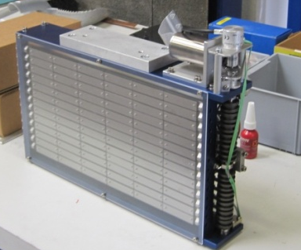
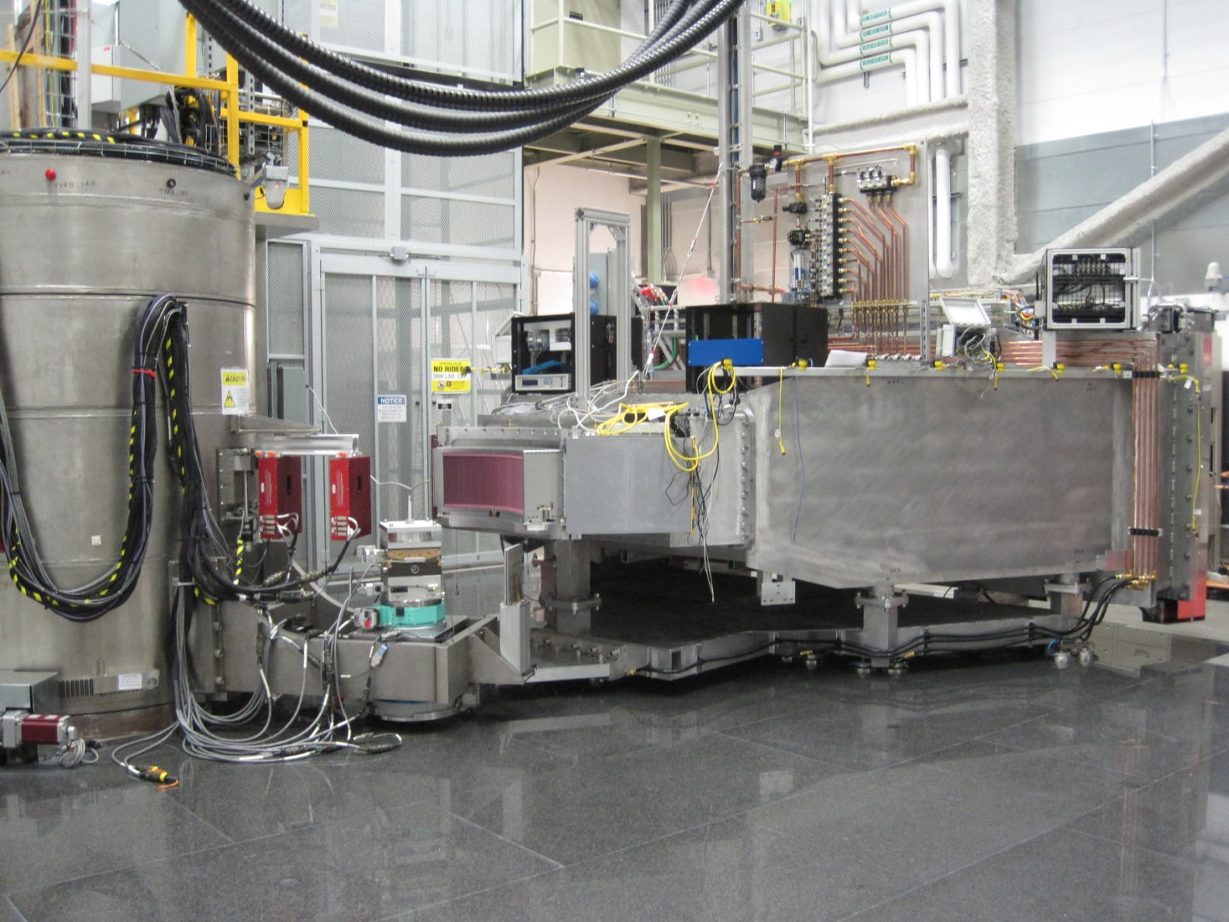
HYSPEC layout: as built (2011)
Vertically focusing crystal array: choice between PG and Heusler
Variable Direction Ar flight path for scattered beam
60º x 15º, r = 4.5 m
Configurable region about sample

Slide 24
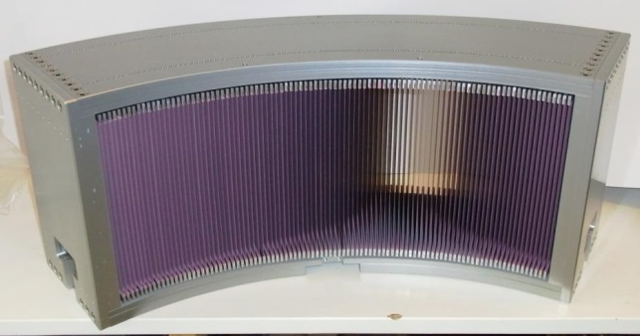
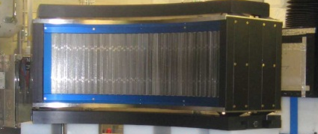
Polarized beam setup with the PSI Polarizing Supermirror Array (B. Winn)
Remove radial collimator
Put polarizing supermirror
Switch to Heusler

Slide 25
Intensity at sample, V scatterer
15 cm high beam from guide vertically focused to sample
~2.5 cm x 2.5 cm FWHM
4.2E5 n/s/MW/cm²: Gold foil measurement at sample position, PG focus array to sample 1.8 m, Ei=15 meV, Fermi 180 Hz
Plot: Vanadium incoherent isotropic scatter integrated over detector array at 40º < 2Θ < 100º, PG & Heusler
3.8 meV < Ei < 50 meV
Common Ei’s:
3.8, 7, 15, 20, 27, 35 meV
Rare Ei: 50 meV

Slide 26

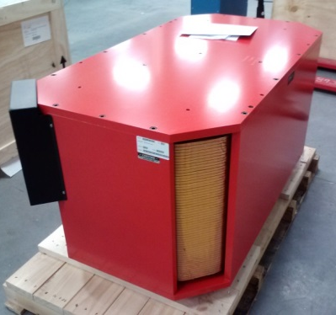
Performance of the Polarizer
960 supermirrors, 60º
U. Filges
BOA beamline at SINQ
Ready to ship
Magnetization unit at HYSPEC

Slide 27
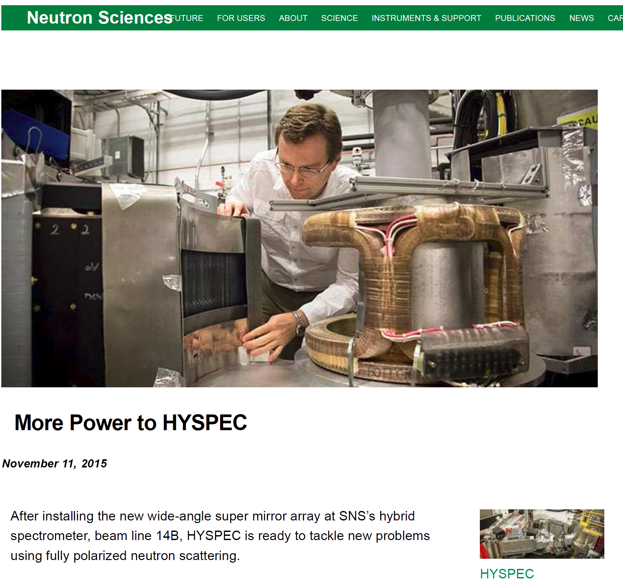
Polarized beam commissioned (2015)
https://neutrons.ornl.gov/news/supermirroruser

Slide 28
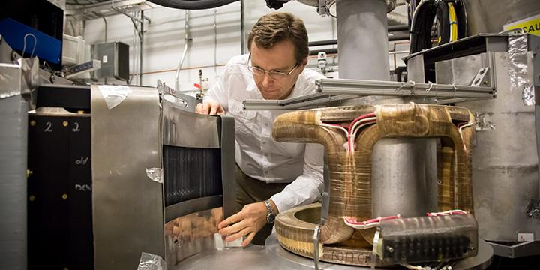
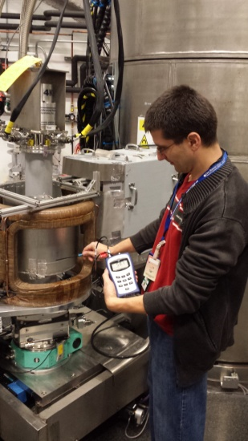
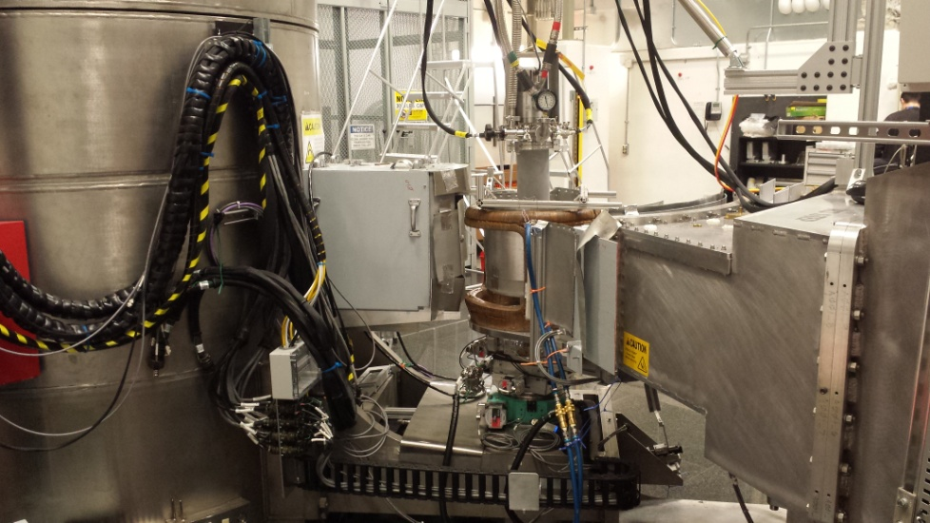
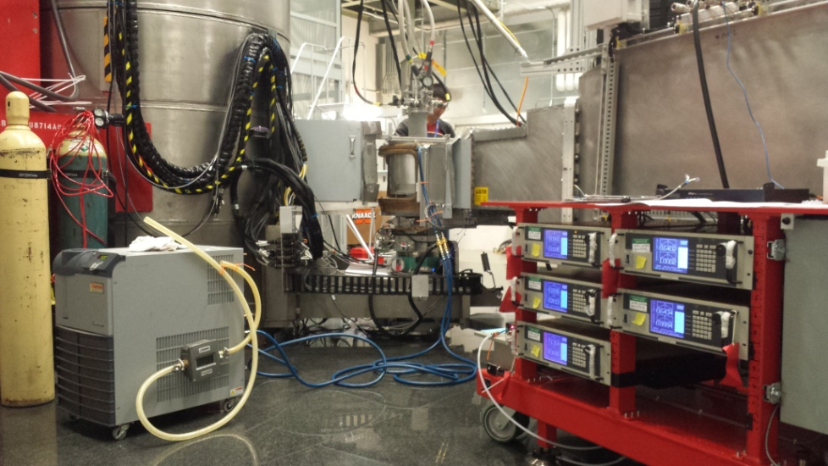
HYSPEC polarized beam setup in operation

Slide 29
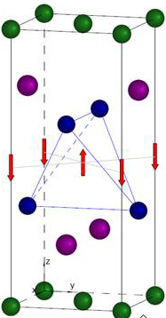
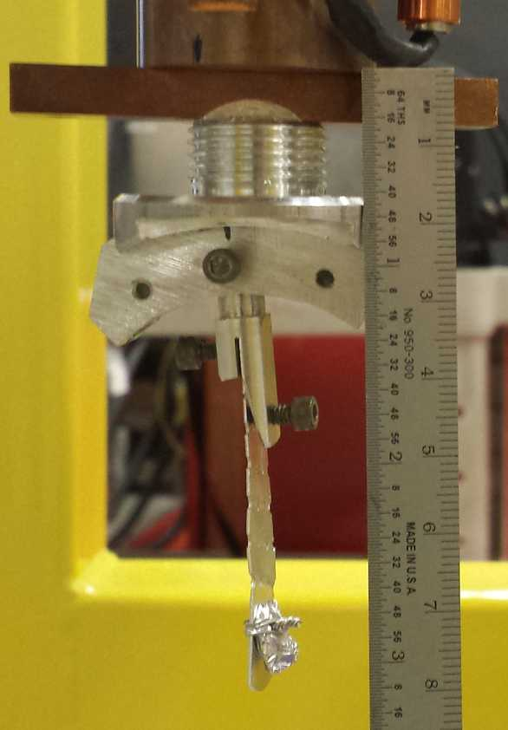
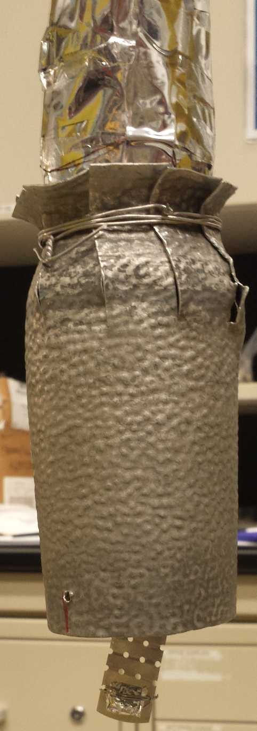
First test: antiferromagnetic structure of the layered semimetal YbMnBi₂
Bi
Yb
Bi
Mn
YbMnBi₂ (~0.5g)
single crystal

Slide 30
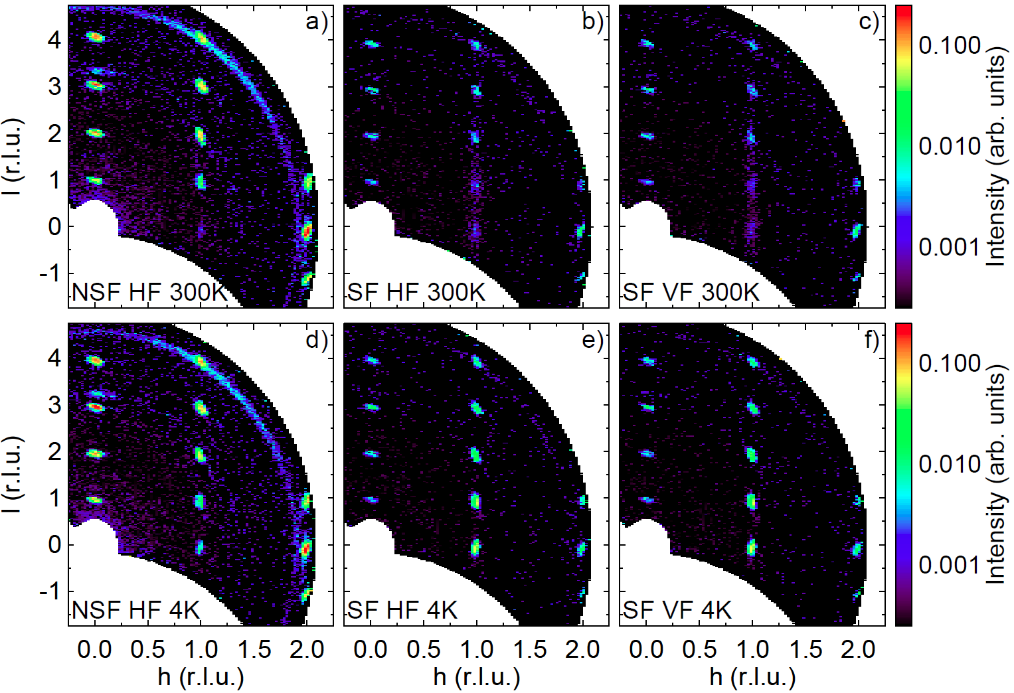
Polarized diffraction measurement of YbMnBi₂: one night on HYSPEC

Slide 31
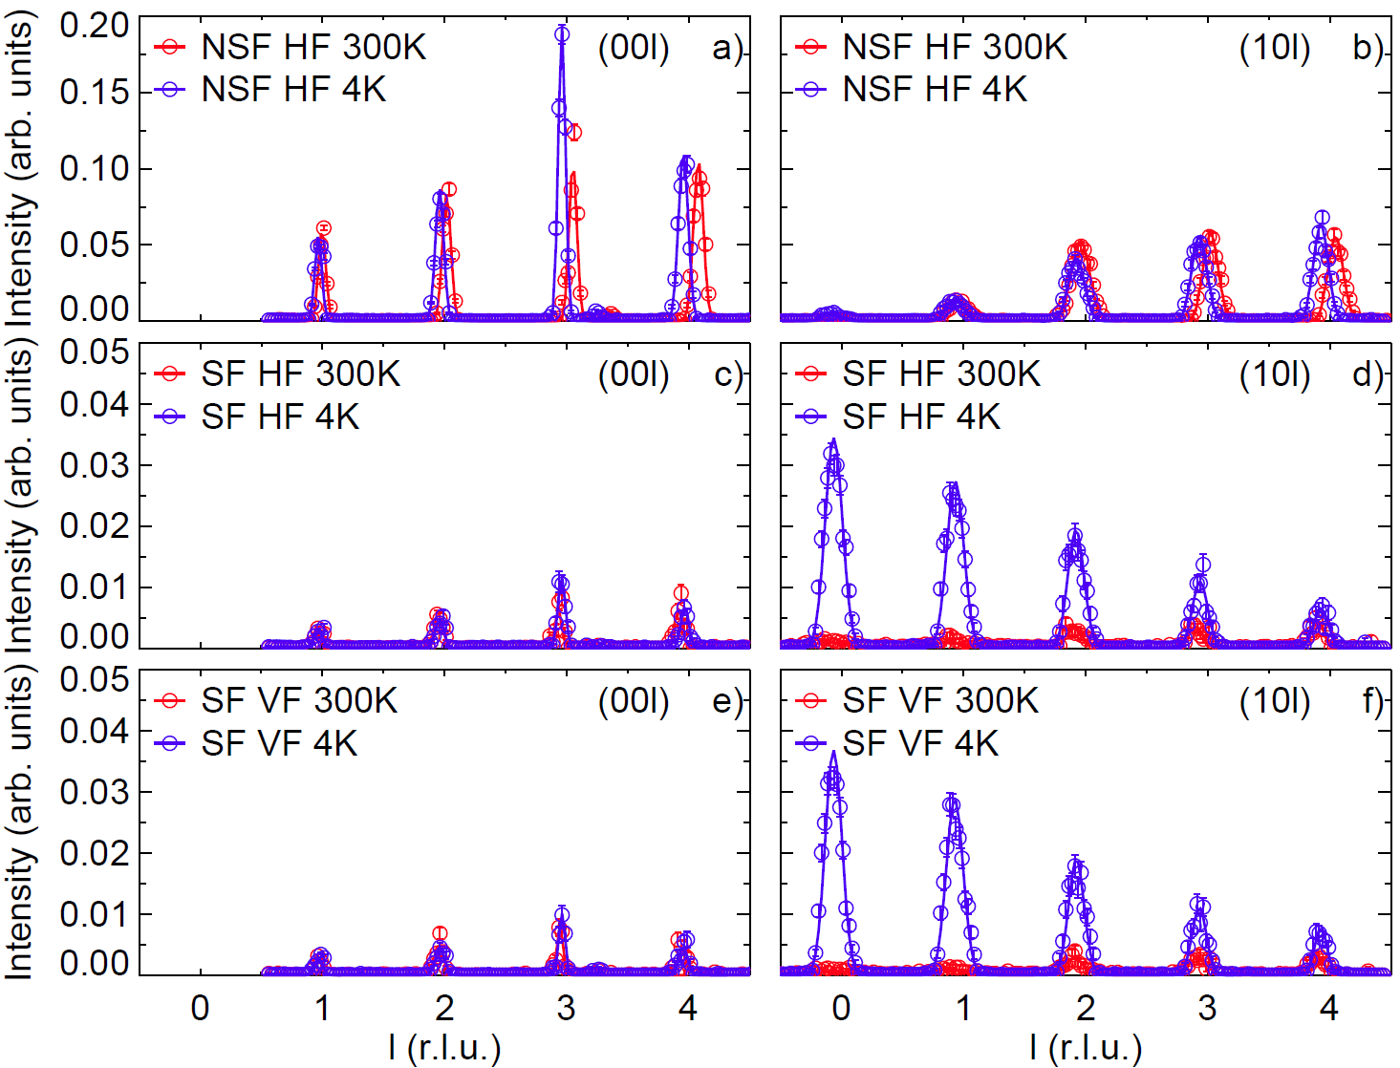
Polarized diffraction scans on YbMnBi₂ Bragg peaks

Slide 32
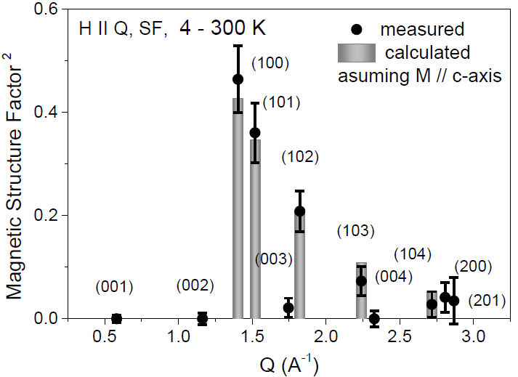
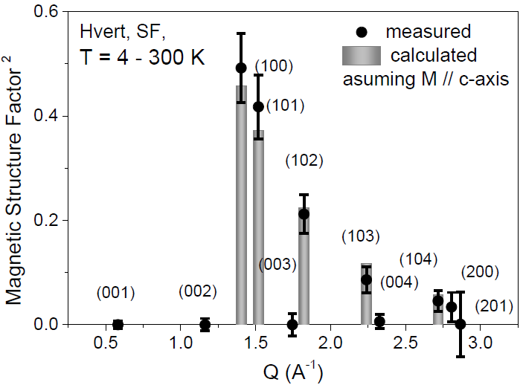
HYSPEC is not a diffractometer, but… can do diffraction, if needed
The refinement compares favorably to HB3 diffractometer
Fit of the 4K – 300 K data with P || Q.
AFM model with spins along c axis gives ordered moment amplitude of 4.37(18) µ_{B}
Fit of the 4K – 300 K data with P vertical (┴Q).
AFM model with spins along c axis gives ordered moment amplitude of 4.52(17) µ_{B}
RF-factor: 25.9, χ²(Intensity): 0.72
RF-factor: 17, χ²(Intensity): 0.46

Slide 33
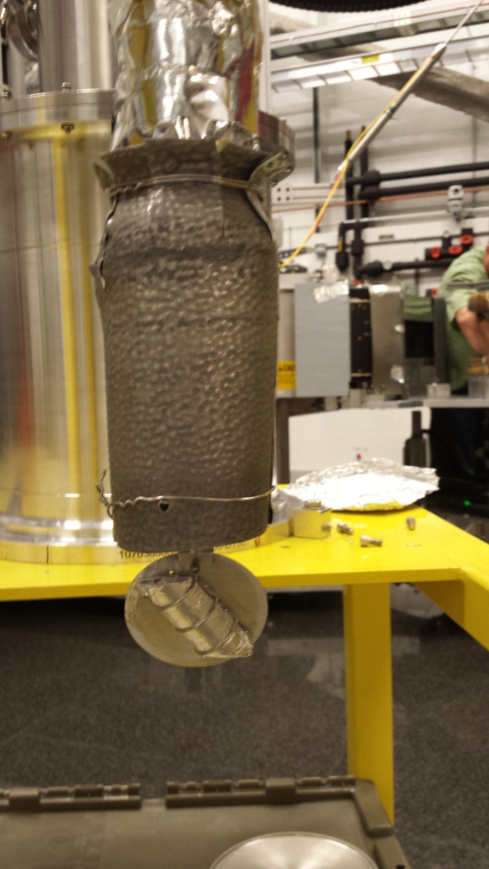
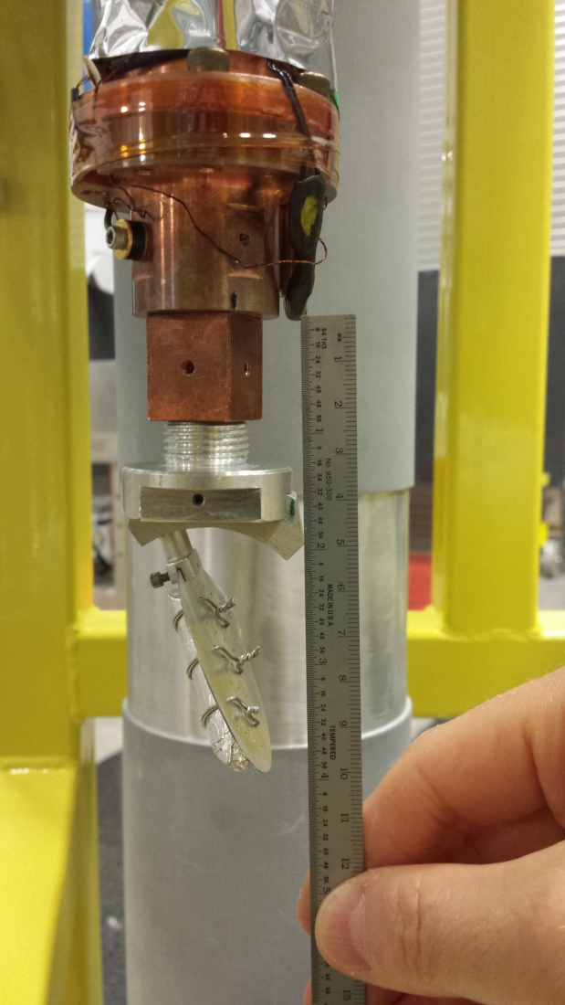

Magnetic dynamics in FeTe_{0.45}Se_{0.55} superconductor: sample geometry
Large (~ 23g) bulk single crystal, irregularly mounted on Al plate

Slide 34


Beam depolarization in superconducting FeTe_{0.45}Se_{0.55}
Sample is cooled in guide field ~ 10~20G => the beam is fully depolarized at T<Tc!
Flipping Ratio (T>Tc) = 13(1)

Slide 35


Zero field cooling: FR = 5 ~ 8
Cooled in a mu-metal shield from 16 K to 5 K
Cooled on the instrument sample table, in a compensating guide field providing zero field environment
Effect is similar: flipping ratio improved.
FR varies from 5 to 8, depending on the sample rotation angle

Slide 36


“P||Q” setup: align polarization with the middle of detector at E=0
Change of the mutual alignment of P and Q with energy transfer
E=0 meV
E=8.0(9) meV
SNS @ 1 MW. Ei = 20 meV. Each dataset is approximately 24 hours on HYSPEC: 6-8 min for each of the 191 angular positions of the sample.

Slide 37


SF and NSF at 5 K

Slide 38


SF and NSF at 5 K

Slide 39


SF and NSF at 300 K

Slide 40


SF and NSF at 300 K

Slide 41

Magnetic and non-magnetic excitations in FeTe_{0.55}Se_{0.45} by polarized neutron scattering on HYSPEC
I. Zaliznyak , O. Garlea, A. Savici, J. Schneeloch, J. Tranquada, Z. Xu , G. Xu , G. Gu
Comparison of the equivalent slices from the Spin-Flip (left) and the Non-Spin-Flip (right) data sets
Spin-Flip Scattering (magnetic) I_{SF}(Q,E) at T = 300 K
Non-Spin-Flip Scattering (phonon)
I_{NSF}(Q,E) at T = 300 K
SNS @ 1 MW. Ei = 20 meV. Each dataset is approximately 24 hours on HYSPEC: 6-8 min for each of the 191 angular positions of the sample.

Slide 42


Magnetic and non-magnetic excitations in FeTe_{0.55}Se_{0.45} by polarized neutron scattering on HYSPEC
I. Zaliznyak , O. Garlea, A. Savici, J. Schneeloch, J. Tranquada, Z. Xu , G. Xu , G. Gu
Comparison of the equivalent slices from the Spin-Flip (left) and the Non-Spin-Flip (right) data sets
Spin-Flip Scattering (magnetic) I_{SF}(Q,E) at T = 5 K
Non-Spin-Flip Scattering (phonon)
I_{NSF}(Q,E) at T = 5 K
SNS @ 1 MW. Ei = 20 meV. Each dataset is approximately 24 hours on HYSPEC: 6-8 min for each of the 191 angular positions of the sample.

Slide 43


Magnetic and non-magnetic excitations in FeTe_{0.55}Se_{0.45} by polarized neutron scattering on HYSPEC
I. Zaliznyak , O. Garlea, A. Savici, J. Schneeloch, J. Tranquada, Z. Xu , G. Xu , G. Gu
Comparison of the equivalent slices from the Spin-Flip (left) and the Non-Spin-Flip (right) data sets
Spin-Flip Scattering (magnetic) I_{SF}(Q,E) at T = 300 K
Non-Spin-Flip Scattering (phonon)
I_{NSF}(Q,E) at T = 300 K
SNS @ 1 MW. Ei = 20 meV. Each dataset is approximately 24 hours on HYSPEC: 6-8 min for each of the 191 angular positions of the sample.

Slide 44


Magnetic and non-magnetic excitations in FeTe_{0.55}Se_{0.45} by polarized neutron scattering on HYSPEC
I. Zaliznyak , O. Garlea, A. Savici, J. Schneeloch, J. Tranquada, Z. Xu , G. Xu , G. Gu
Comparison of the equivalent slices from the Spin-Flip (left) and the Non-Spin-Flip (right) data sets
Spin-Flip Scattering (magnetic) I_{SF}(Q,E) at T = 5 K
Non-Spin-Flip Scattering (phonon)
I_{NSF}(Q,E) at T = 5 K
SNS @ 1 MW. Ei = 20 meV. Each dataset is approximately 24 hours on HYSPEC: 6-8 min for each of the 191 angular positions of the sample.

Slide 45


Magnetic and non-magnetic excitations in FeTe_{0.55}Se_{0.45} by polarized neutron scattering on HYSPEC
I. Zaliznyak , O. Garlea, A. Savici, J. Schneeloch, J. Tranquada, Z. Xu , G. Xu , G. Gu
Comparison of the equivalent slices from the Spin-Flip (left) and the Non-Spin-Flip (right) data sets
Spin-Flip Scattering (magnetic) I_{SF}(Q,E) at T = 300 K
Non-Spin-Flip Scattering (phonon)
I_{NSF}(Q,E) at T = 300 K
SNS @ 1 MW. Ei = 20 meV. Each dataset is approximately 24 hours on HYSPEC: 6-8 min for each of the 191 angular positions of the sample.

Slide 46


Magnetic and non-magnetic excitations in FeTe_{0.55}Se_{0.45} by polarized neutron scattering on HYSPEC
I. Zaliznyak , O. Garlea, A. Savici, J. Schneeloch, J. Tranquada, Z. Xu , G. Xu , G. Gu
Comparison of the equivalent slices from the Spin-Flip (left) and the Non-Spin-Flip (right) data sets
Spin-Flip Scattering (magnetic) I_{SF}(Q,E) at T = 5 K
Non-Spin-Flip Scattering (phonon)
I_{NSF}(Q,E) at T = 5 K
SNS @ 1 MW. Ei = 20 meV. Each dataset is approximately 24 hours on HYSPEC: 6-8 min for each of the 191 angular positions of the sample.

Slide 47


Magnetic and non-magnetic excitations in FeTe_{0.55}Se_{0.45} by polarized neutron scattering on HYSPEC
I. Zaliznyak , O. Garlea, A. Savici, J. Schneeloch, J. Tranquada, Z. Xu , G. Xu , G. Gu
Comparison of the equivalent slices from the Spin-Flip (left) and the Non-Spin-Flip (right) data sets
Spin-Flip Scattering (magnetic) I_{SF}(Q,E) at T = 300 K
Non-Spin-Flip Scattering (phonon)
I_{NSF}(Q,E) at T = 300 K
SNS @ 1 MW. Ei = 20 meV. Each dataset is approximately 24 hours on HYSPEC: 6-8 min for each of the 191 angular positions of the sample.

Slide 48


Magnetic and non-magnetic excitations in FeTe_{0.55}Se_{0.45} by polarized neutron scattering on HYSPEC
I. Zaliznyak , O. Garlea, A. Savici, J. Schneeloch, J. Tranquada, Z. Xu , G. Xu , G. Gu
Comparison of the equivalent slices from the Spin-Flip (left) and the Non-Spin-Flip (right) data sets
Spin-Flip Scattering (magnetic) I_{SF}(Q,E) at T = 5 K
Non-Spin-Flip Scattering (phonon)
I_{NSF}(Q,E) at T = 5 K
SNS @ 1 MW. Ei = 20 meV. Each dataset is approximately 24 hours on HYSPEC: 6-8 min for each of the 191 angular positions of the sample.

Slide 49


Magnetic and non-magnetic excitations in FeTe_{0.55}Se_{0.45} by polarized neutron scattering on HYSPEC
I. Zaliznyak , O. Garlea, A. Savici, J. Schneeloch, J. Tranquada, Z. Xu , G. Xu , G. Gu
Comparison of the equivalent slices from the Spin-Flip (left) and the Non-Spin-Flip (right) data sets
Spin-Flip Scattering (magnetic) I_{SF}(Q,E) at T = 300 K
Non-Spin-Flip Scattering (phonon)
I_{NSF}(Q,E) at T = 300 K
SNS @ 1 MW. Ei = 20 meV. Each dataset is approximately 24 hours on HYSPEC: 6-8 min for each of the 191 angular positions of the sample.

Slide 50


Magnetic and non-magnetic excitations in FeTe_{0.55}Se_{0.45} by polarized neutron scattering on HYSPEC
I. Zaliznyak , O. Garlea, A. Savici, J. Schneeloch, J. Tranquada, Z. Xu , G. Xu , G. Gu
Comparison of the equivalent slices from the Spin-Flip (left) and the Non-Spin-Flip (right) data sets
Spin-Flip Scattering (magnetic) I_{SF}(Q,E) at T = 5 K
Non-Spin-Flip Scattering (phonon)
I_{NSF}(Q,E) at T = 5 K
SNS @ 1 MW. Ei = 20 meV. Each dataset is approximately 24 hours on HYSPEC: 6-8 min for each of the 191 angular positions of the sample.

Slide 51


Magnetic and non-magnetic excitations in FeTe_{0.55}Se_{0.45} by polarized neutron scattering on HYSPEC
I. Zaliznyak , O. Garlea, A. Savici, J. Schneeloch, J. Tranquada, Z. Xu , G. Xu , G. Gu
Comparison of the equivalent slices from the Spin-Flip (left) and the Non-Spin-Flip (right) data sets
Spin-Flip Scattering (magnetic) I_{SF}(Q,E) at T = 300 K
Non-Spin-Flip Scattering (phonon)
I_{NSF}(Q,E) at T = 300 K
SNS @ 1 MW. Ei = 20 meV. Each dataset is approximately 24 hours on HYSPEC: 6-8 min for each of the 191 angular positions of the sample.

Slide 52


Magnetic and non-magnetic excitations in FeTe_{0.55}Se_{0.45} by polarized neutron scattering on HYSPEC
I. Zaliznyak , O. Garlea, A. Savici, J. Schneeloch, J. Tranquada, Z. Xu , G. Xu , G. Gu
Comparison of the equivalent slices from the Spin-Flip (left) and the Non-Spin-Flip (right) data sets
Spin-Flip Scattering (magnetic) I_{SF}(Q,E) at T = 5 K
Non-Spin-Flip Scattering (phonon)
I_{NSF}(Q,E) at T = 5 K
SNS @ 1 MW. Ei = 20 meV. Each dataset is approximately 24 hours on HYSPEC: 6-8 min for each of the 191 angular positions of the sample.

Slide 53
Temperature-induced dynamical magnetism in Fe_{1.1}Te
FeTe on ARCS,
E_{i} = 100 meV
Zaliznyak, et. al., arXiv:1103.5073
Phys. Rev. Lett. 107, 216403 (2011).
10 K
80 K
I(80K)-I(10K)
30 meV
45 meV
60 meV

Slide 54
Temperature induced magnetism in Fe_{1.1}Te
Sum rule defines the effective fluctuating magnetic moment
S=3/2
S=1
Zaliznyak, et. al.,
PRL 107 216403 (2011);
PRB 85, 085105 (2012).

Slide 55






Dynamical spin response in FeTe_{1-x}S_{x}
FeTe_{1-x}S_{x} (x ≈ 0.13) on HB3.
I. Zaliznyak, et. al, PNAS 112, 10316–10320 (2015)
(hk0) zone
(hk0) zone
(h0l) zone
Fe_{1.1}Te, ARCS (E = 6 meV).
FeTe_{1-x}S_{x} (x ≈ 0.13) on HB3.

Slide 56


Magnetic and non-magnetic excitations in Fe_{1.1}Te by polarized neutron scattering on HYSPEC
I. Zaliznyak , J. Schneeloch , Z. Xu , G. Xu , G. Gu , J. Tranquada , A. Savici , O. Garlea
Comparison of the equivalent slices from the Spin-Flip (left) and the Non-Spin-Flip (right) data sets
Spin-Flip Scattering (magnetic) I_{SF}(Q,E) at T = 300 K
Non-Spin-Flip Scattering (phonon)
I_{NSF}(Q,E) at T = 300 K
SNS @ 1.3MW. Ei = 20 meV. Each dataset is approximately 20 hours on HYSPEC: 6 min for each of the 191 angular positions of the sample.

Slide 57


Magnetic and non-magnetic excitations in Fe_{1.1}Te by polarized neutron scattering on HYSPEC
I. Zaliznyak , J. Schneeloch , Z. Xu , G. Xu , G. Gu , J. Tranquada , A. Savici , O. Garlea
Comparison of the equivalent slices from the Spin-Flip (left) and the Non-Spin-Flip (right) data sets
Spin-Flip Scattering (magnetic) I_{SF}(Q,E) at T = 300 K
Non-Spin-Flip Scattering (phonon)
I_{NSF}(Q,E) at T = 300 K
SNS @ 1.3MW. Ei = 20 meV. Each dataset is approximately 20 hours on HYSPEC: 6 min for each of the 191 angular positions of the sample.

Slide 58


Magnetic and non-magnetic excitations in Fe_{1.1}Te by polarized neutron scattering on HYSPEC
I. Zaliznyak , J. Schneeloch , Z. Xu , G. Xu , G. Gu , J. Tranquada , A. Savici , O. Garlea
Comparison of the equivalent slices from the Spin-Flip (left) and the Non-Spin-Flip (right) raw data sets
Spin-Flip Scattering (magnetic) I_{SF}(Q,E) at T = 300 K
Non-Spin-Flip Scattering (phonon)
I_{NSF}(Q,E) at T = 300 K
SNS @ 1.3MW. Ei = 20 meV. Each dataset is approximately 20 hours on HYSPEC: 6 min for each of the 191 angular positions of the sample.

Slide 59


Magnetic and non-magnetic excitations in Fe_{1.1}Te by polarized neutron scattering on HYSPEC
I. Zaliznyak , J. Schneeloch , Z. Xu , G. Xu , G. Gu , J. Tranquada , A. Savici , O. Garlea
Comparison of the equivalent slices from the Spin-Flip (left) and the Non-Spin-Flip (right) raw data sets
Spin-Flip Scattering (magnetic) I_{SF}(Q,E) at T = 300 K
Non-Spin-Flip Scattering (phonon)
I_{NSF}(Q,E) at T = 300 K
SNS @ 1.3MW. Ei = 20 meV. Each dataset is approximately 20 hours on HYSPEC: 6 min for each of the 191 angular positions of the sample.

Slide 60


Magnetic and non-magnetic excitations in Fe_{1.1}Te by polarized neutron scattering on HYSPEC
I. Zaliznyak , J. Schneeloch , Z. Xu , G. Xu , G. Gu , J. Tranquada , A. Savici , O. Garlea
Comparison of the equivalent slices from the Spin-Flip (left) and the Non-Spin-Flip (right) raw data sets
Spin-Flip Scattering (magnetic) I_{SF}(Q,E) at T = 300 K
Non-Spin-Flip Scattering (phonon)
I_{NSF}(Q,E) at T = 300 K
SNS @ 1.3MW. Ei = 20 meV. Each dataset is approximately 20 hours on HYSPEC: 6 min for each of the 191 angular positions of the sample.

Slide 61


Magnetic and non-magnetic excitations in Fe_{1.1}Te by polarized neutron scattering on HYSPEC
I. Zaliznyak , J. Schneeloch , Z. Xu , G. Xu , G. Gu , J. Tranquada , A. Savici , O. Garlea
Comparison of the equivalent slices from the Spin-Flip (left) and the Non-Spin-Flip (right) raw data sets
Spin-Flip Scattering (magnetic) I_{SF}(Q,E) at T = 300 K
Non-Spin-Flip Scattering (phonon)
I_{NSF}(Q,E) at T = 300 K
SNS @ 1.3MW. Ei = 20 meV. Each dataset is approximately 20 hours on HYSPEC: 6 min for each of the 191 angular positions of the sample.

Slide 62


Magnetic and non-magnetic excitations in Fe_{1.1}Te by polarized neutron scattering on HYSPEC
I. Zaliznyak , J. Schneeloch , Z. Xu , G. Xu , G. Gu , J. Tranquada , A. Savici , O. Garlea
Comparison of the equivalent slices from the Spin-Flip (left) and the Non-Spin-Flip (right) raw data sets
Spin-Flip Scattering (magnetic) I_{SF}(Q,E) at T = 300 K
Non-Spin-Flip Scattering (phonon)
I_{NSF}(Q,E) at T = 300 K
SNS @ 1.3MW. Ei = 20 meV. Each dataset is approximately 20 hours on HYSPEC: 6 min for each of the 191 angular positions of the sample.

Slide 63


Magnetic and non-magnetic excitations in Fe_{1.1}Te by polarized neutron scattering on HYSPEC
I. Zaliznyak , J. Schneeloch , Z. Xu , G. Xu , G. Gu , J. Tranquada , A. Savici , O. Garlea
Comparison of the equivalent slices from the Spin-Flip (left) and the Non-Spin-Flip (right) raw data sets
Spin-Flip Scattering (magnetic) I_{SF}(Q,E) at T = 300 K
Non-Spin-Flip Scattering (phonon)
I_{NSF}(Q,E) at T = 300 K
SNS @ 1.3MW. Ei = 20 meV. Each dataset is approximately 20 hours on HYSPEC: 6 min for each of the 191 angular positions of the sample.

Slide 64


Magnetic and non-magnetic excitations in Fe_{1.1}Te by polarized neutron scattering on HYSPEC
I. Zaliznyak , J. Schneeloch , Z. Xu , G. Xu , G. Gu , J. Tranquada , A. Savici , O. Garlea
Comparison of the equivalent slices from the Spin-Flip (left) and the Non-Spin-Flip (right) raw data sets
Spin-Flip Scattering (magnetic) I_{SF}(Q,E) at T = 300 K
Non-Spin-Flip Scattering (phonon)
I_{NSF}(Q,E) at T = 300 K
SNS @ 1.3MW. Ei = 20 meV. Each dataset is approximately 20 hours on HYSPEC: 6 min for each of the 191 angular positions of the sample.

Slide 65


Magnetic and non-magnetic excitations in Fe_{1.1}Te by polarized neutron scattering on HYSPEC
I. Zaliznyak , J. Schneeloch , Z. Xu , G. Xu , G. Gu , J. Tranquada , A. Savici , O. Garlea
Comparison of the equivalent slices from the Spin-Flip (left) and the Non-Spin-Flip (right) raw data sets
Spin-Flip Scattering (magnetic) I_{SF}(Q,E) at T = 300 K
Non-Spin-Flip Scattering (phonon)
I_{NSF}(Q,E) at T = 300 K
SNS @ 1.3MW. Ei = 20 meV. Each dataset is approximately 20 hours on HYSPEC: 6 min for each of the 191 angular positions of the sample.

Slide 66


Magnetic and non-magnetic excitations in Fe_{1.1}Te by polarized neutron scattering on HYSPEC
I. Zaliznyak , J. Schneeloch , Z. Xu , G. Xu , G. Gu , J. Tranquada , A. Savici , O. Garlea
Comparison of the equivalent slices from the Spin-Flip (left) and the Non-Spin-Flip (right) raw data sets
Spin-Flip Scattering (magnetic) I_{SF}(Q,E) at T = 300 K
Non-Spin-Flip Scattering (phonon)
I_{NSF}(Q,E) at T = 300 K
SNS @ 1.3MW. Ei = 20 meV. Each dataset is approximately 20 hours on HYSPEC: 6 min for each of the 191 angular positions of the sample.

Slide 67


Magnetic and non-magnetic excitations in Fe_{1.1}Te by polarized neutron scattering on HYSPEC
I. Zaliznyak , J. Schneeloch , Z. Xu , G. Xu , G. Gu , J. Tranquada , A. Savici , O. Garlea
Comparison of the equivalent slices from the Spin-Flip (left) and the Non-Spin-Flip (right) raw data sets
Spin-Flip Scattering (magnetic) I_{SF}(Q,E) at T = 300 K
Non-Spin-Flip Scattering (phonon)
I_{NSF}(Q,E) at T = 300 K
SNS @ 1.3MW. Ei = 20 meV. Each dataset is approximately 20 hours on HYSPEC: 6 min for each of the 191 angular positions of the sample.

Slide 68


Magnetic and non-magnetic excitations in Fe_{1.1}Te by polarized neutron scattering on HYSPEC
I. Zaliznyak , J. Schneeloch , Z. Xu , G. Xu , G. Gu , J. Tranquada , A. Savici , O. Garlea
Comparison of the equivalent slices from the Spin-Flip (left) and the Non-Spin-Flip (right) raw data sets
Spin-Flip Scattering (magnetic) I_{SF}(Q,E) at T = 300 K
Non-Spin-Flip Scattering (phonon)
I_{NSF}(Q,E) at T = 300 K
SNS @ 1.3MW. Ei = 20 meV. Each dataset is approximately 20 hours on HYSPEC: 6 min for each of the 191 angular positions of the sample.

Slide 69


Magnetic and non-magnetic excitations in Fe_{1.1}Te by polarized neutron scattering on HYSPEC
I. Zaliznyak , J. Schneeloch , Z. Xu , G. Xu , G. Gu , J. Tranquada , A. Savici , O. Garlea
Comparison of the equivalent slices from the Spin-Flip (left) and the Non-Spin-Flip (right) raw data sets
Spin-Flip Scattering (magnetic) I_{SF}(Q,E) at T = 300 K
Non-Spin-Flip Scattering (phonon)
I_{NSF}(Q,E) at T = 300 K
SNS @ 1.3MW. Ei = 20 meV. Each dataset is approximately 20 hours on HYSPEC: 6 min for each of the 191 angular positions of the sample.

Slide 70


Magnetic and non-magnetic excitations in Fe_{1.1}Te by polarized neutron scattering on HYSPEC
I. Zaliznyak , J. Schneeloch , Z. Xu , G. Xu , G. Gu , J. Tranquada , A. Savici , O. Garlea
Comparison of the equivalent slices from the Spin-Flip (left) and the Non-Spin-Flip (right) raw data sets
Spin-Flip Scattering (magnetic) I_{SF}(Q,E) at T = 300 K
Non-Spin-Flip Scattering (phonon)
I_{NSF}(Q,E) at T = 300 K
SNS @ 1.3MW. Ei = 20 meV. Each dataset is approximately 20 hours on HYSPEC: 6 min for each of the 191 angular positions of the sample.

Slide 71


Magnetic and non-magnetic excitations in Fe_{1.1}Te by polarized neutron scattering on HYSPEC
I. Zaliznyak , J. Schneeloch , Z. Xu , G. Xu , G. Gu , J. Tranquada , A. Savici , O. Garlea
Comparison of the equivalent slices from the Spin-Flip (left) and the Non-Spin-Flip (right) raw data sets
Spin-Flip Scattering (magnetic) I_{SF}(Q,E) at T = 300 K
Non-Spin-Flip Scattering (phonon)
I_{NSF}(Q,E) at T = 300 K
SNS @ 1.3MW. Ei = 20 meV. Each dataset is approximately 20 hours on HYSPEC: 6 min for each of the 191 angular positions of the sample.

Slide 72


Magnetic and non-magnetic excitations in Fe_{1.1}Te by polarized neutron scattering on HYSPEC
I. Zaliznyak , J. Schneeloch , Z. Xu , G. Xu , G. Gu , J. Tranquada , A. Savici , O. Garlea
Comparison of the equivalent slices from the Spin-Flip (left) and the Non-Spin-Flip (right) raw data sets
Spin-Flip Scattering (magnetic) I_{SF}(Q,E) at T = 300 K
Non-Spin-Flip Scattering (phonon)
I_{NSF}(Q,E) at T = 300 K
SNS @ 1.3MW. Ei = 20 meV. Each dataset is approximately 20 hours on HYSPEC: 6 min for each of the 191 angular positions of the sample.

Slide 73


Magnetic and non-magnetic excitations in Fe_{1.1}Te by polarized neutron scattering on HYSPEC
I. Zaliznyak , J. Schneeloch , Z. Xu , G. Xu , G. Gu , J. Tranquada , A. Savici , O. Garlea
Comparison of the equivalent slices from the Spin-Flip (left) and the Non-Spin-Flip (right) raw data sets
Spin-Flip Scattering (magnetic) I_{SF}(Q,E) at T = 300 K
Non-Spin-Flip Scattering (phonon)
I_{NSF}(Q,E) at T = 300 K
SNS @ 1.3MW. Ei = 20 meV. Each dataset is approximately 20 hours on HYSPEC: 6 min for each of the 191 angular positions of the sample.

Slide 74


Magnetic and non-magnetic excitations in Fe_{1.1}Te by polarized neutron scattering on HYSPEC
I. Zaliznyak , J. Schneeloch , Z. Xu , G. Xu , G. Gu , J. Tranquada , A. Savici , O. Garlea
Comparison of the equivalent slices from the Spin-Flip (left) and the Non-Spin-Flip (right) raw data sets
Spin-Flip Scattering (magnetic) I_{SF}(Q,E) at T = 300 K
Non-Spin-Flip Scattering (phonon)
I_{NSF}(Q,E) at T = 300 K
SNS @ 1.3MW. Ei = 20 meV. Each dataset is approximately 20 hours on HYSPEC: 6 min for each of the 191 angular positions of the sample.

Slide 75
Summary
Polarized neutron surveys of a large volume of the sample’s phase space are possible despite
  Factor 20 to 80 transmission losses in the polarized setup
  Restricted field of view at the focus of the radial supermirrotr array
  Large number of corrections for transmission and deflection in the polarized setup (talks by A. Savici and B. Winn)
It’s a miracle?
  Careful experiment planning and execution
  Precise instrument and sample alignment
  Steady and maintenance-free setup
It’s a miracle!

