Slide 1
HYSPEC status
June 16, 2010

Slide 2
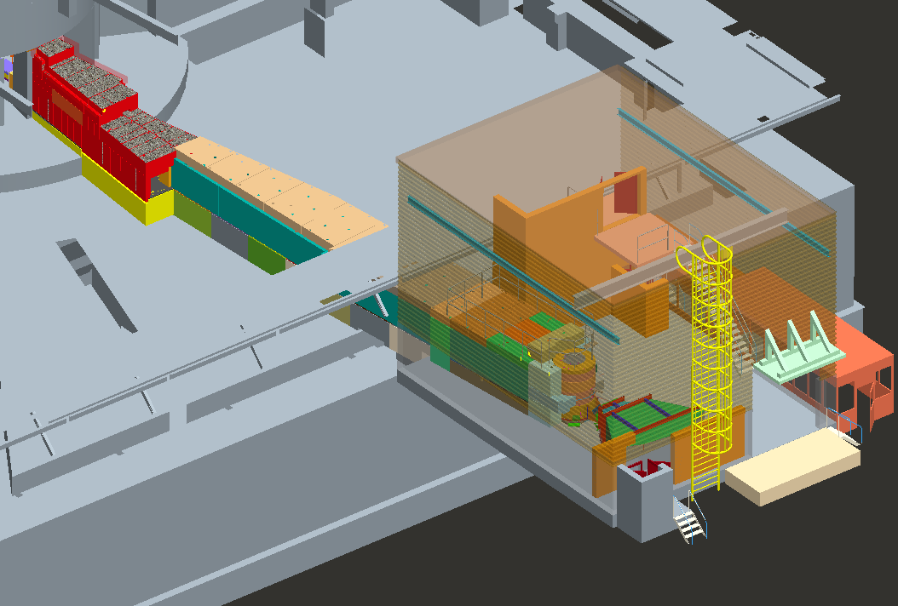
HYSPEC Overview
6~15m Shielding
External building
15~33m Shielding
Chopper Box B Shielding
Drum Shield
Sample position
Detector Vessel

Slide 3
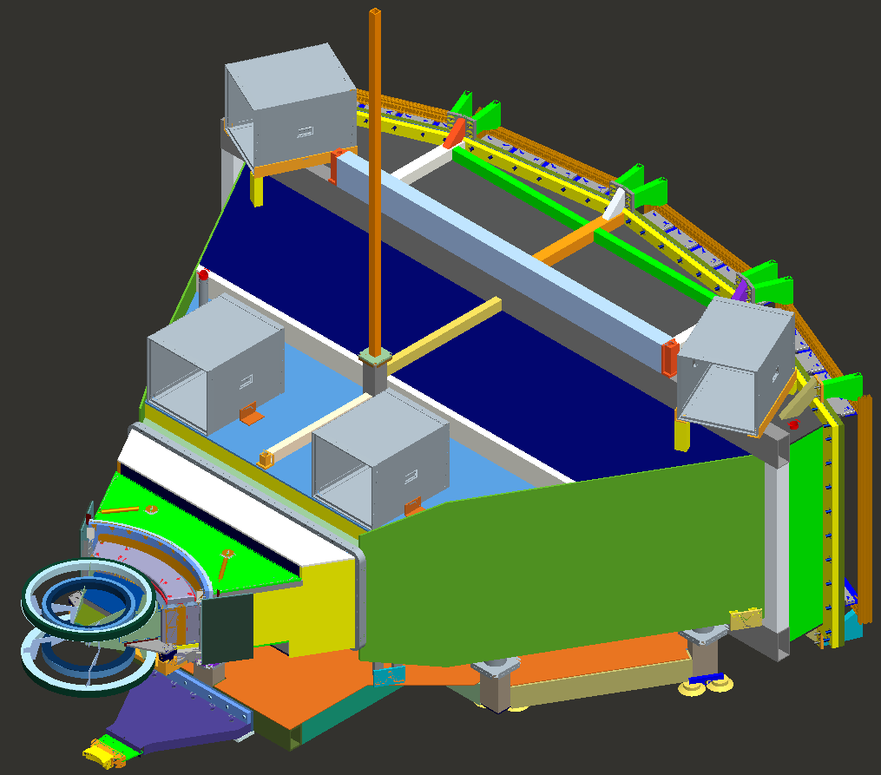
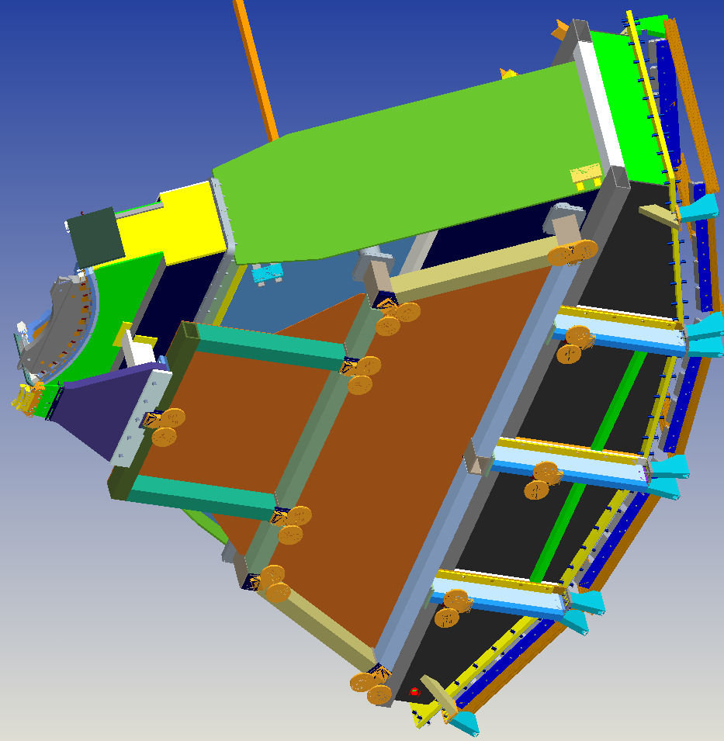
Detector Vessel, designed and in procurement

Slide 4
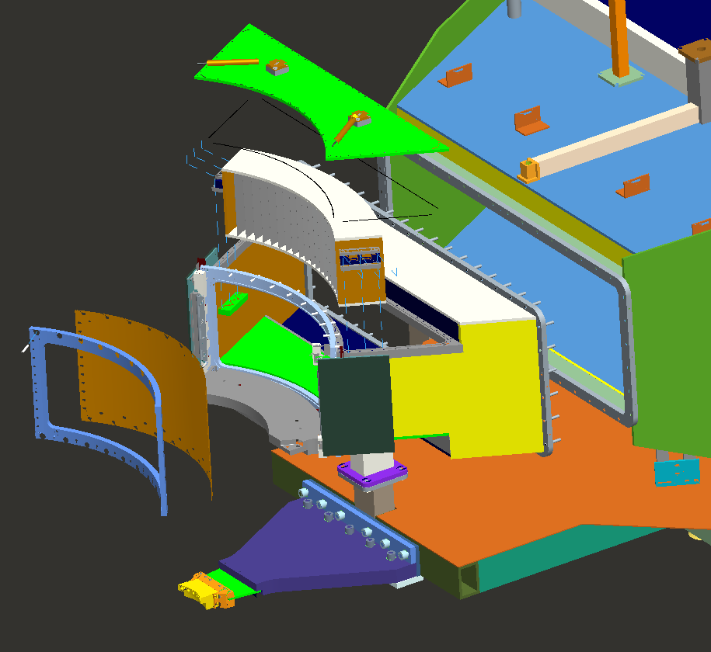
Removable hatch for course collimator access
1/8” O-Ring
Front section removable
¼” O-Ring (Hidden)

Slide 5
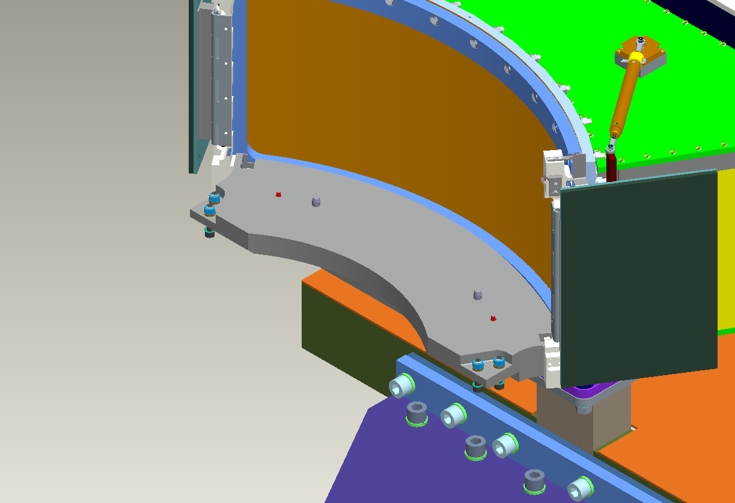
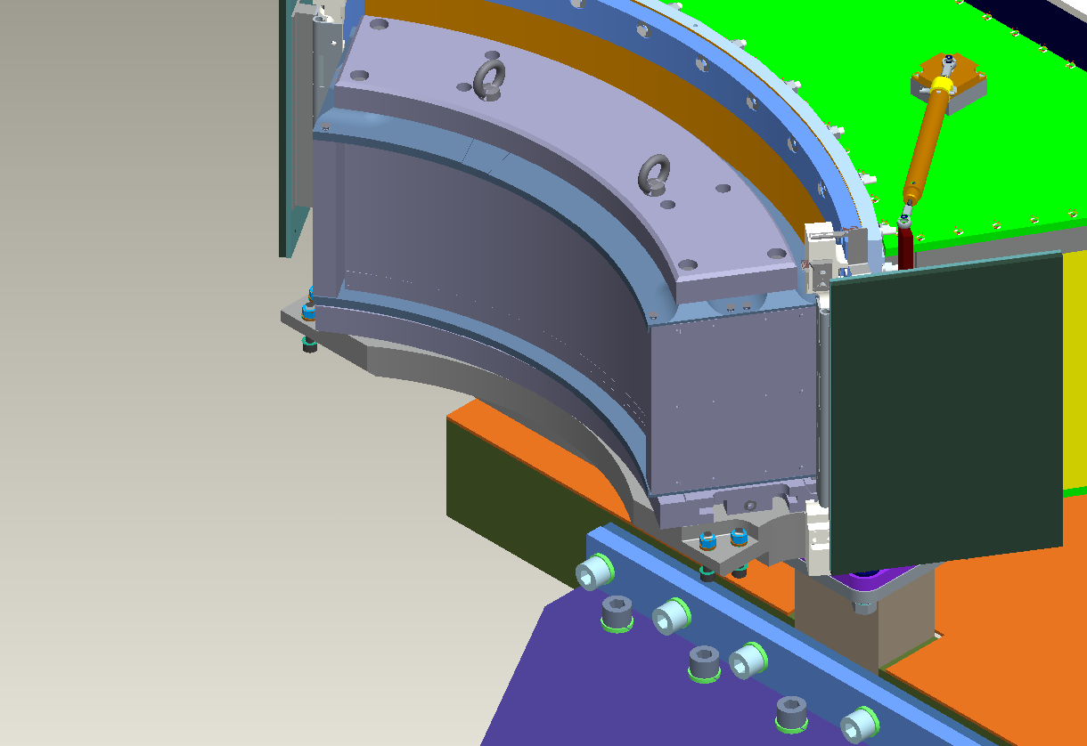
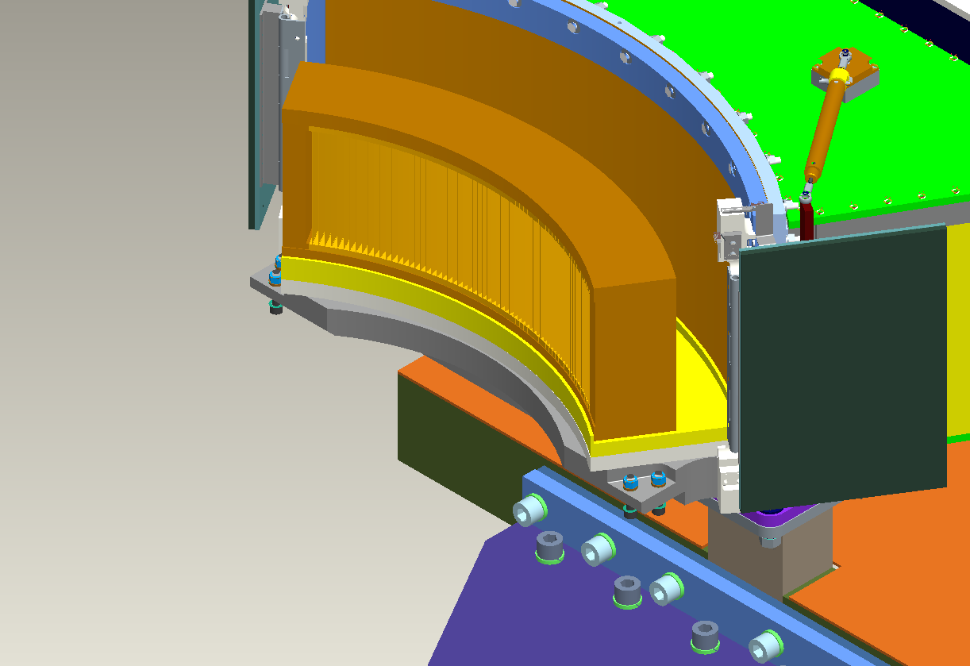
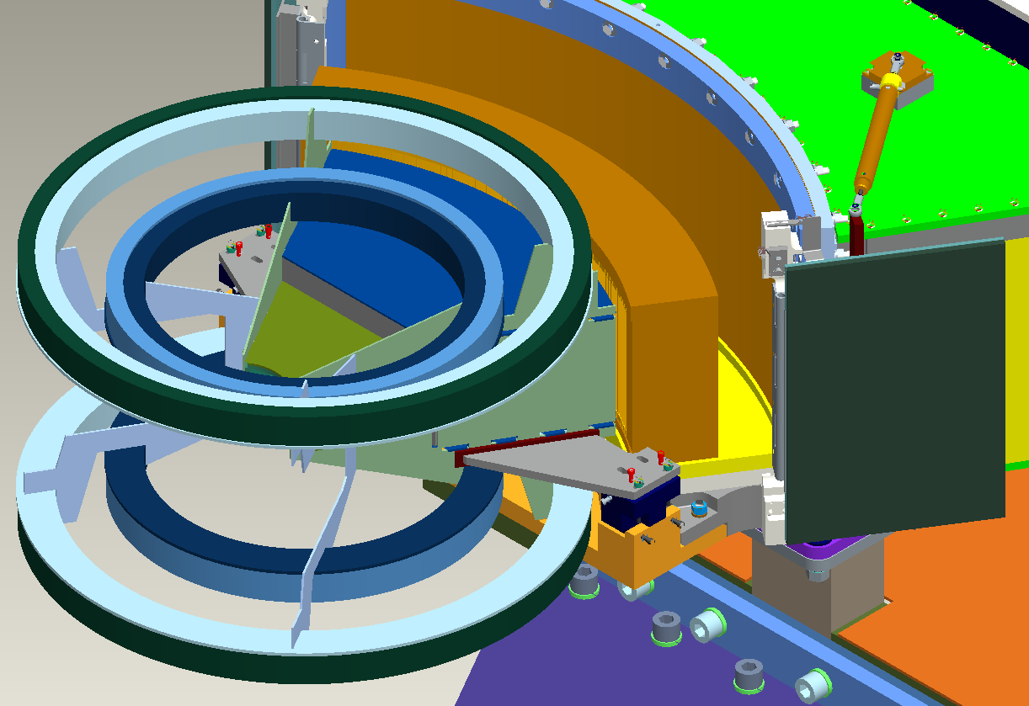

Slide 6
PIP Shield all in, & Guide installation

Slide 7
Secondary shutter being installed

Slide 8
Shield blocks delivered

Slide 9
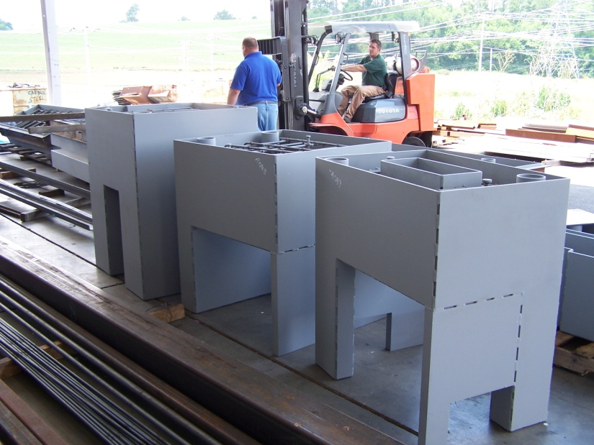
Shield blocks getting ready

Slide 10
Monochromator delivered

Slide 11
Monochromator Shield component lead pours

