Slide 1
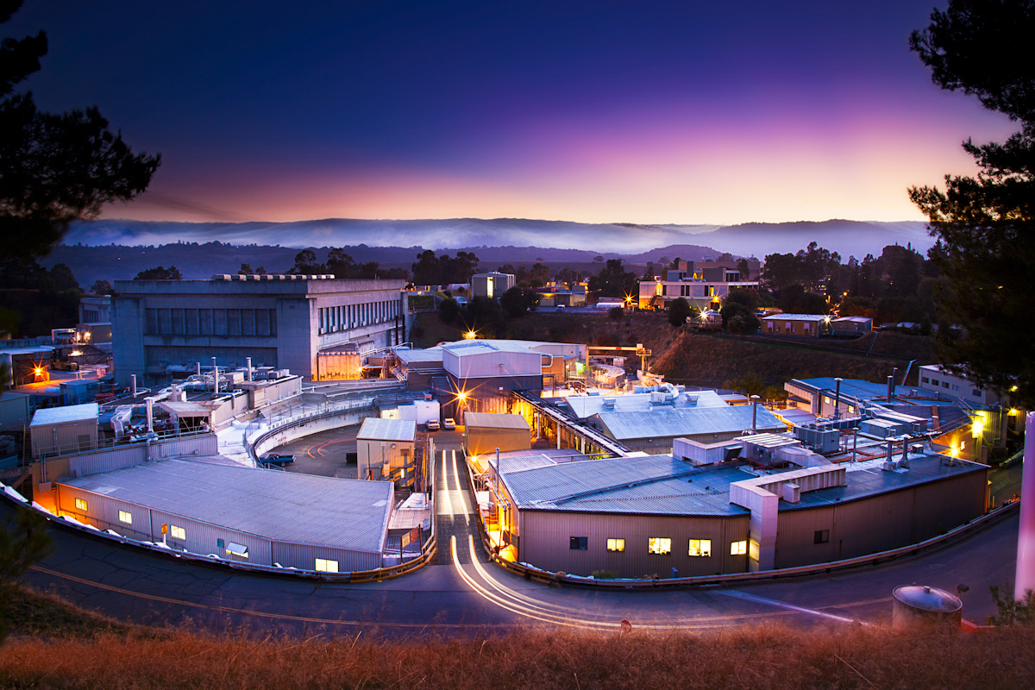
SSRL Industry
Engagement
Paul McIntyre
December 17, 2020

Slide 2
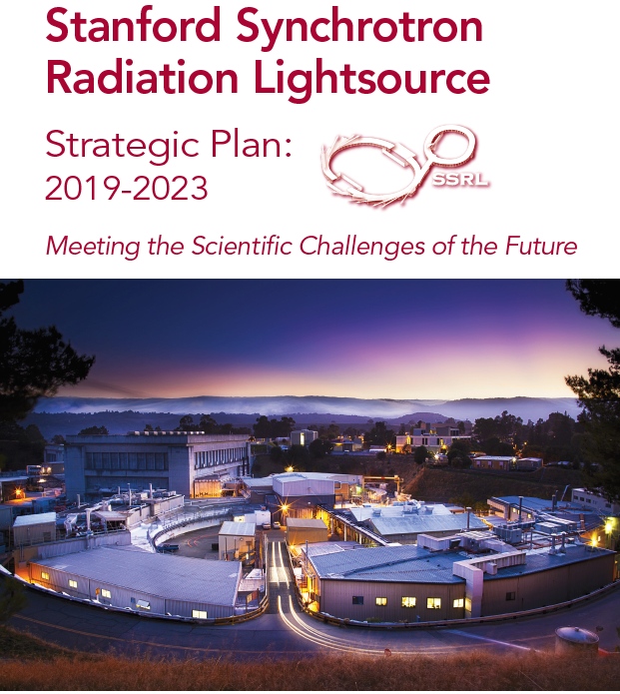
SSRL Mission: Science First Approach to Cost Effective Research and User Support
Three Scientific Foci
Accelerating Materials Design
Understanding Catalytic Function & Inter-facial Reactions with Atomic Precision
Identifying How Collective Function Emerges from Constituent Interactions
New Opportunities
Microelectronics – materials, metrology
Advanced manufacturing
Strategy development:
Outreach & collaboration with User, SLAC, and Stanford communities
Engagement with and responsiveness to BES & Office of Science planning
Review and feedback from SSRL SAC & UEC

Slide 3
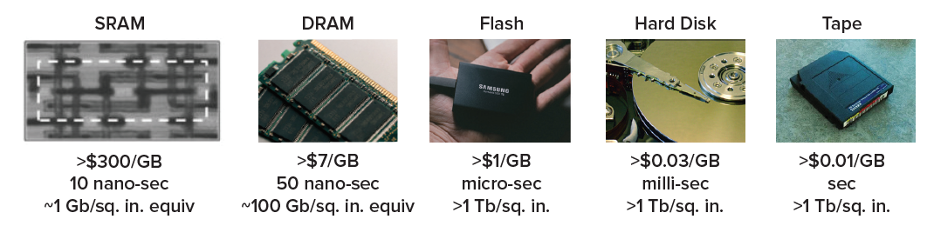
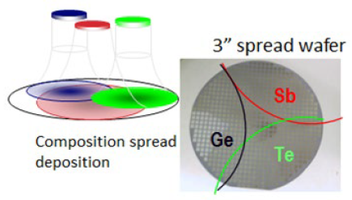
New Direction: Microelectronics – e.g. High Throughput XRD Studies of Phase Change Memory Materials
High-throughput XRD for materials
discovery, SSRL BL 1-5
PCRAM materials discovery

Slide 4
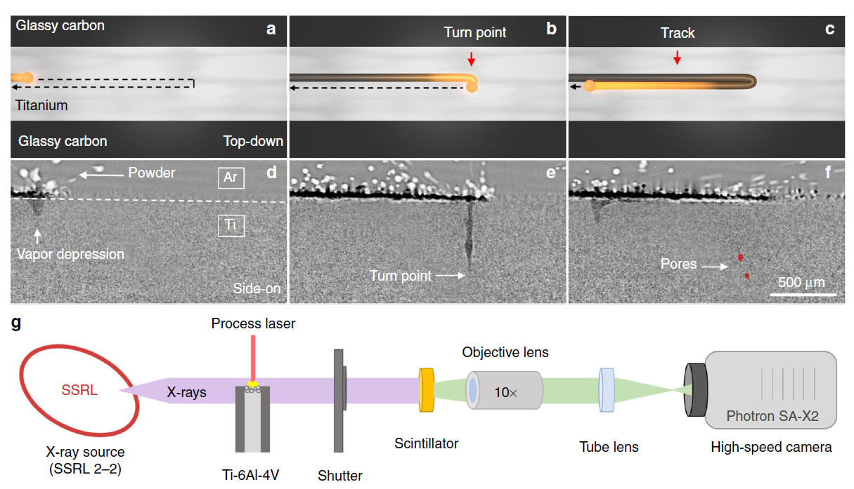
New Direction: Advanced Manufacturing – e.g. In-Situ X-ray Imaging of Laser Based Additive Manufacturing
  A.A. Martin, et al, Nat. Comm. 10, 1987 (2019)

Slide 5
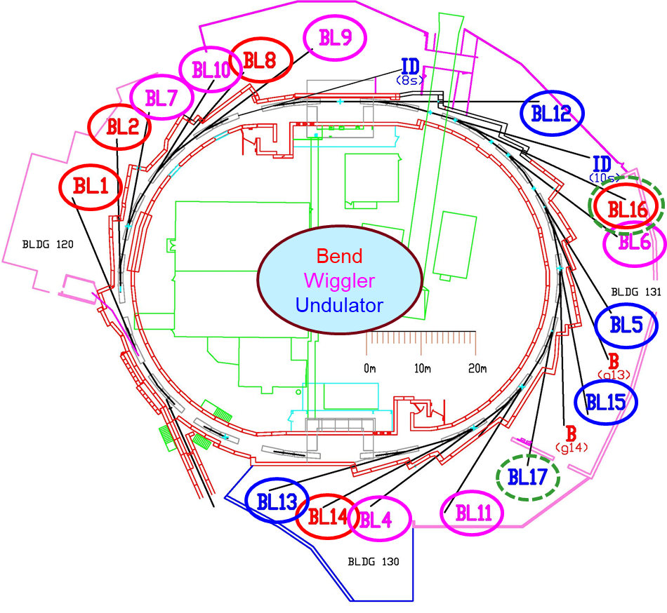
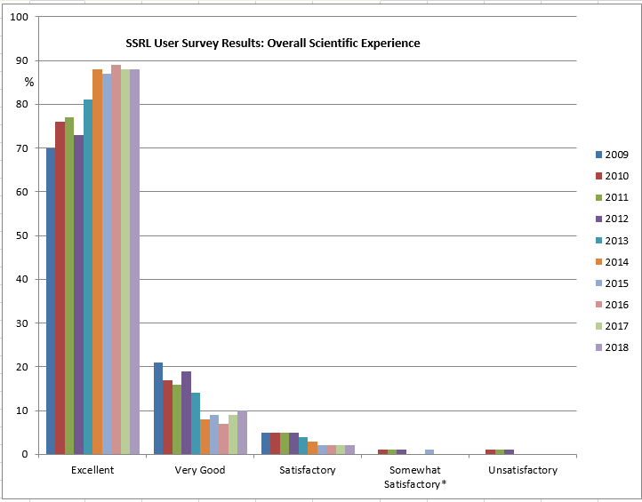
Stanford Synchrotron Radiation Lightsource Operations
SPEAR3
      3 GeV, 500 mA
      Top-off injection every 5 minutes
      9.8 nm-rad emittance → 6 nm-rad
      SPEAR3 MTBF 86 hrs
      5070 hours @ 98.7% uptime
      Injector @ 98.5% uptime, MTBF 103 hrs
SSRL operates 27 BL with 34 stations
SSRL supports ~1,700 users annually
~90 industrial users annually
~110 Ph.D. theses per year

Slide 6
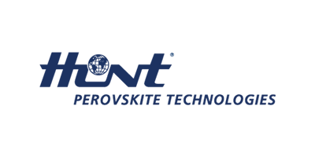
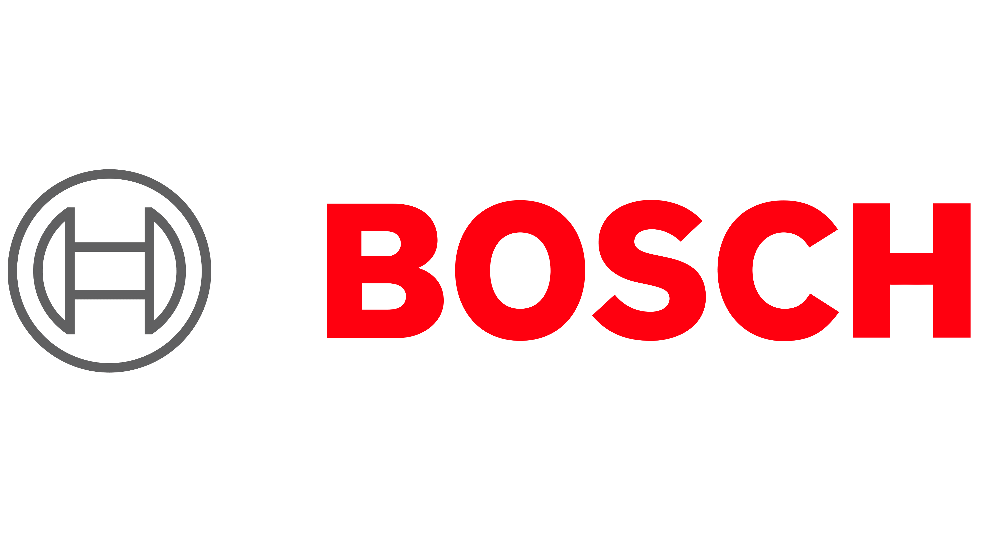

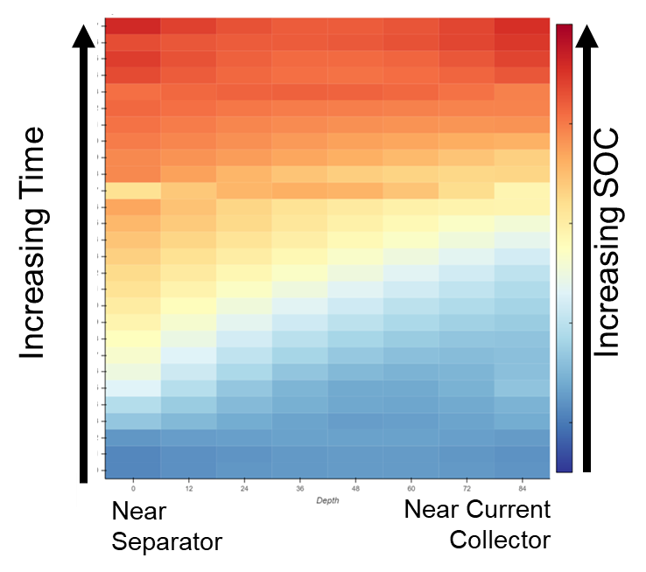
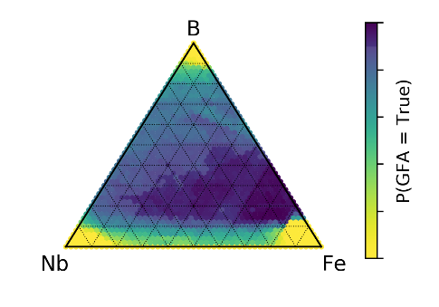
MSD at the Intersection of Basic and Applied Science
The materials science division operates a portfolio of x-ray instruments which include spectroscopy, scattering and imaging. We leverage methods developed for basic science research to address industry challenges in three thematic areas, illustrated by the examples of current and upcoming industry collaborations below
Metrology Development
Model Validation
Data Driven Discovery
Collaborative proposal to characterize currently structural motifs in next generation thin film photovoltaics.
Identify structure which has been hidden from the current SoA characterization methods.
Correlation of these structures and stability is the key to unlocking 20 year lifetimes.
High throughput scattering and spectroscopy enable characterization of thousands of devices to optimize this complex process.
Correlate to in-line metrology which can run at the manufacturing facility.
CRADA funded project to validate models for the behavior of next generation battery charging behavior. Using novel scattering methods SSRL characterized the spatial distribution of the stage of charge as a function of duty cycle, and electrode processing.
Collaborative proposals to develop, and validate the foundational tools to enable
ML driven discovery and optimization of materials. Collaborative proposals focused on three demonstrations:
Discovery of wear resistant metallic glasses
Discovery of thermoelectric materials
Closed loop discovery of synthesis routes to high performing catalysts

Slide 7
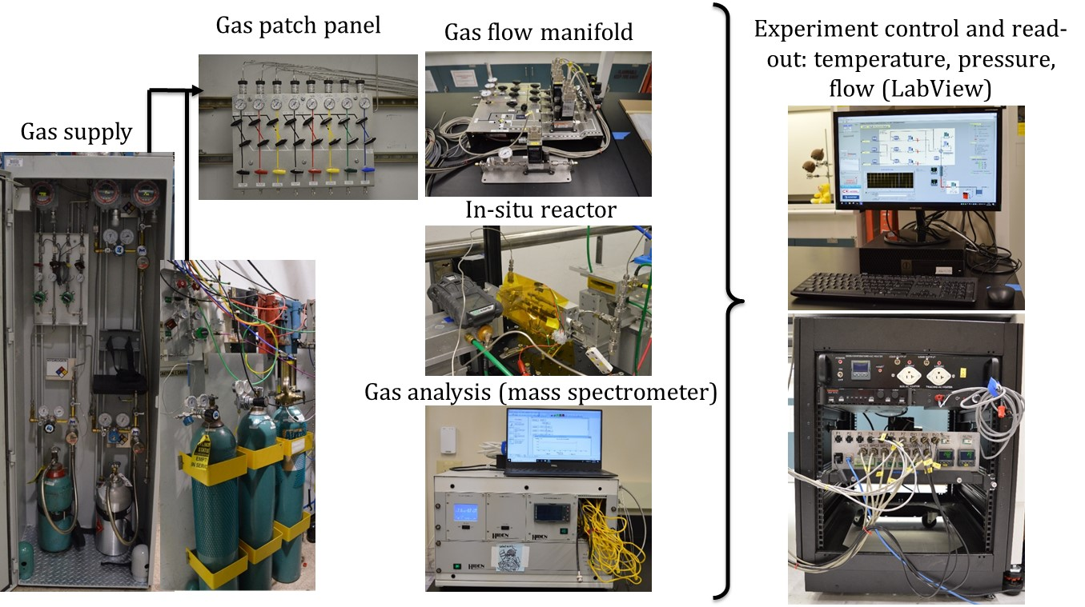
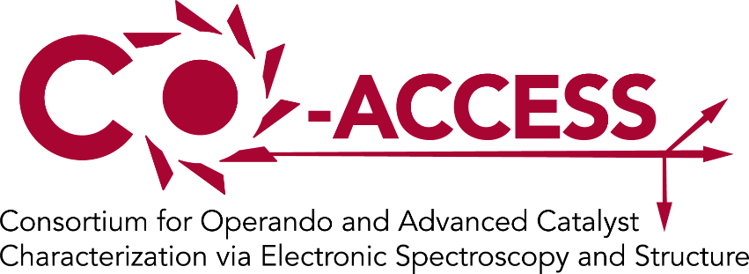
Catalysis Industrial Research at SSRL
Co-ACCESS provides suite of in-situ/operando catalyst characterization capabilities and knowledge to foster industrial research
CAP with UOP/Honeywell
Several companies access SSRL via GU proposal system: e.g. Clariant, Toyota Research of North America, PPG.
Several companies access SSRL via collaborations with universities e.g. BASF, Chevron, ExxonMobil.

Slide 8

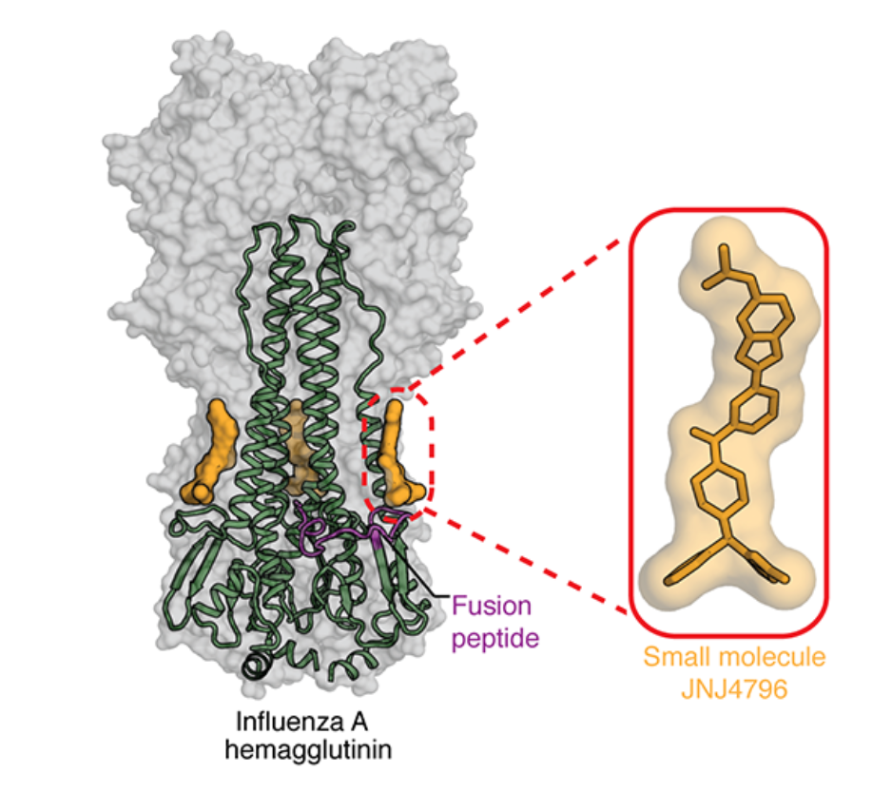

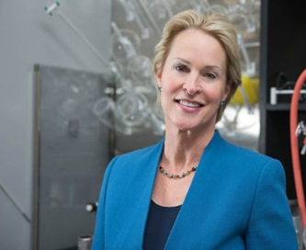
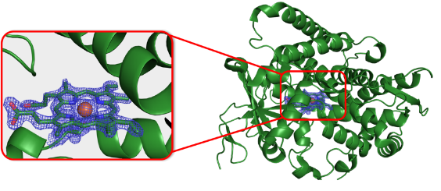

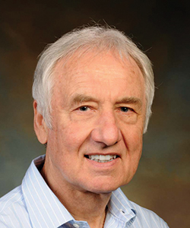

The SSRL Structural Biology Resource (SMB)
Accelerating the Pace of Industry and Drug Discovery
25+ Companies used The SMB Resource over the last 5 years
Research at SSRL has contributed discovery of FDA approved drugs (2010-2020):
Zelboraf® (Vemurafenib): treatment of late stage skin cancer (melanoma), FDA approved in 2011.
Venclexta® (Venetoclax): chronic lymphocytic leukemia (CLL) or small lymphocytic lymphoma (SLL), FDA approved in 2016.
Tarceva® (Erlotinib): treatment of non-small cell lung cancer. FDA approved in 2016.
Perjeta® (Pertuzumab): treatment of HER2-positive early breast cancer. FDA approved in 2017.
Rubraca® (Rucaparib): treatment of ovarian Cancer. FDA approved in 2018.
Scientists Discover a Potential Strategy to Treat Influenza A
NOBEL
Mice infected with a lethal dose of H1N1 influenza survived when given JNJ-4796
viral fusion
inhibitor
Frances Arnold, Caltech
2018 Nobel Prize for Chemistry
The Arnold lab has 50+ new structures (pdb entries)
and 20+ publications using data from SSRL BL12-2
Ian Wilson
Notes:
25+ Companies used The SMB Resource over the last 5 years (these are mainly MC and SAXS)
Drug list for last 10 years –Prior to 2010 we have these others:
Tamiflu®: antiviral for prevention and treatment of human influenza. FDA approved in 1999.
Retrovir® (Zidovudine): and related reverse transcriptase inhibitors: treatment of human HIV. First FDA approval in 1987.
Arnold numbers are since 2011 –
Frances Arnold uses BL12-2 (almost exclusively over the last 10+ years) and her research has spun off form new companies (that use microbes to produce pesticides, antibiotics, rocket fuel, etc.)
The structure of the complex between a cyclic peptide (yellow) and influenza hemagglutinin (blue with grey surface) that acts as a viral fusion inhibitor. - Wilson Group Scripps
https://www.scripps.edu/news-and-events/press-room/2019/20190311-wilson-influenza.html
Scientists discover a potential strategy to treat influenza A
when Mice given JNJ-4796 for seven days, 100% of mice infected with 25 times the normally-lethal dose of H1N1 influenza survived when given JNJ-4796 for 7 days., 100 percent of the mice survived.

Slide 9
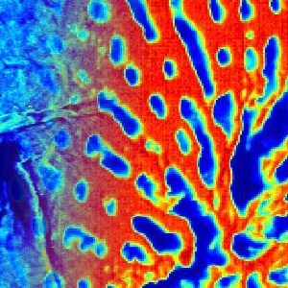
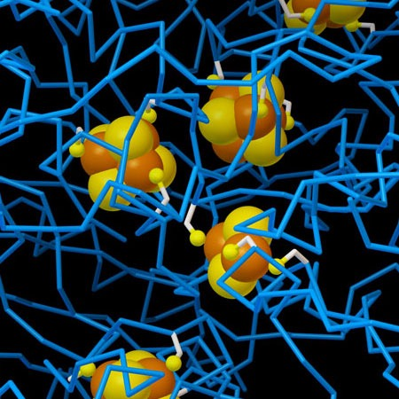
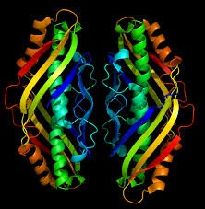
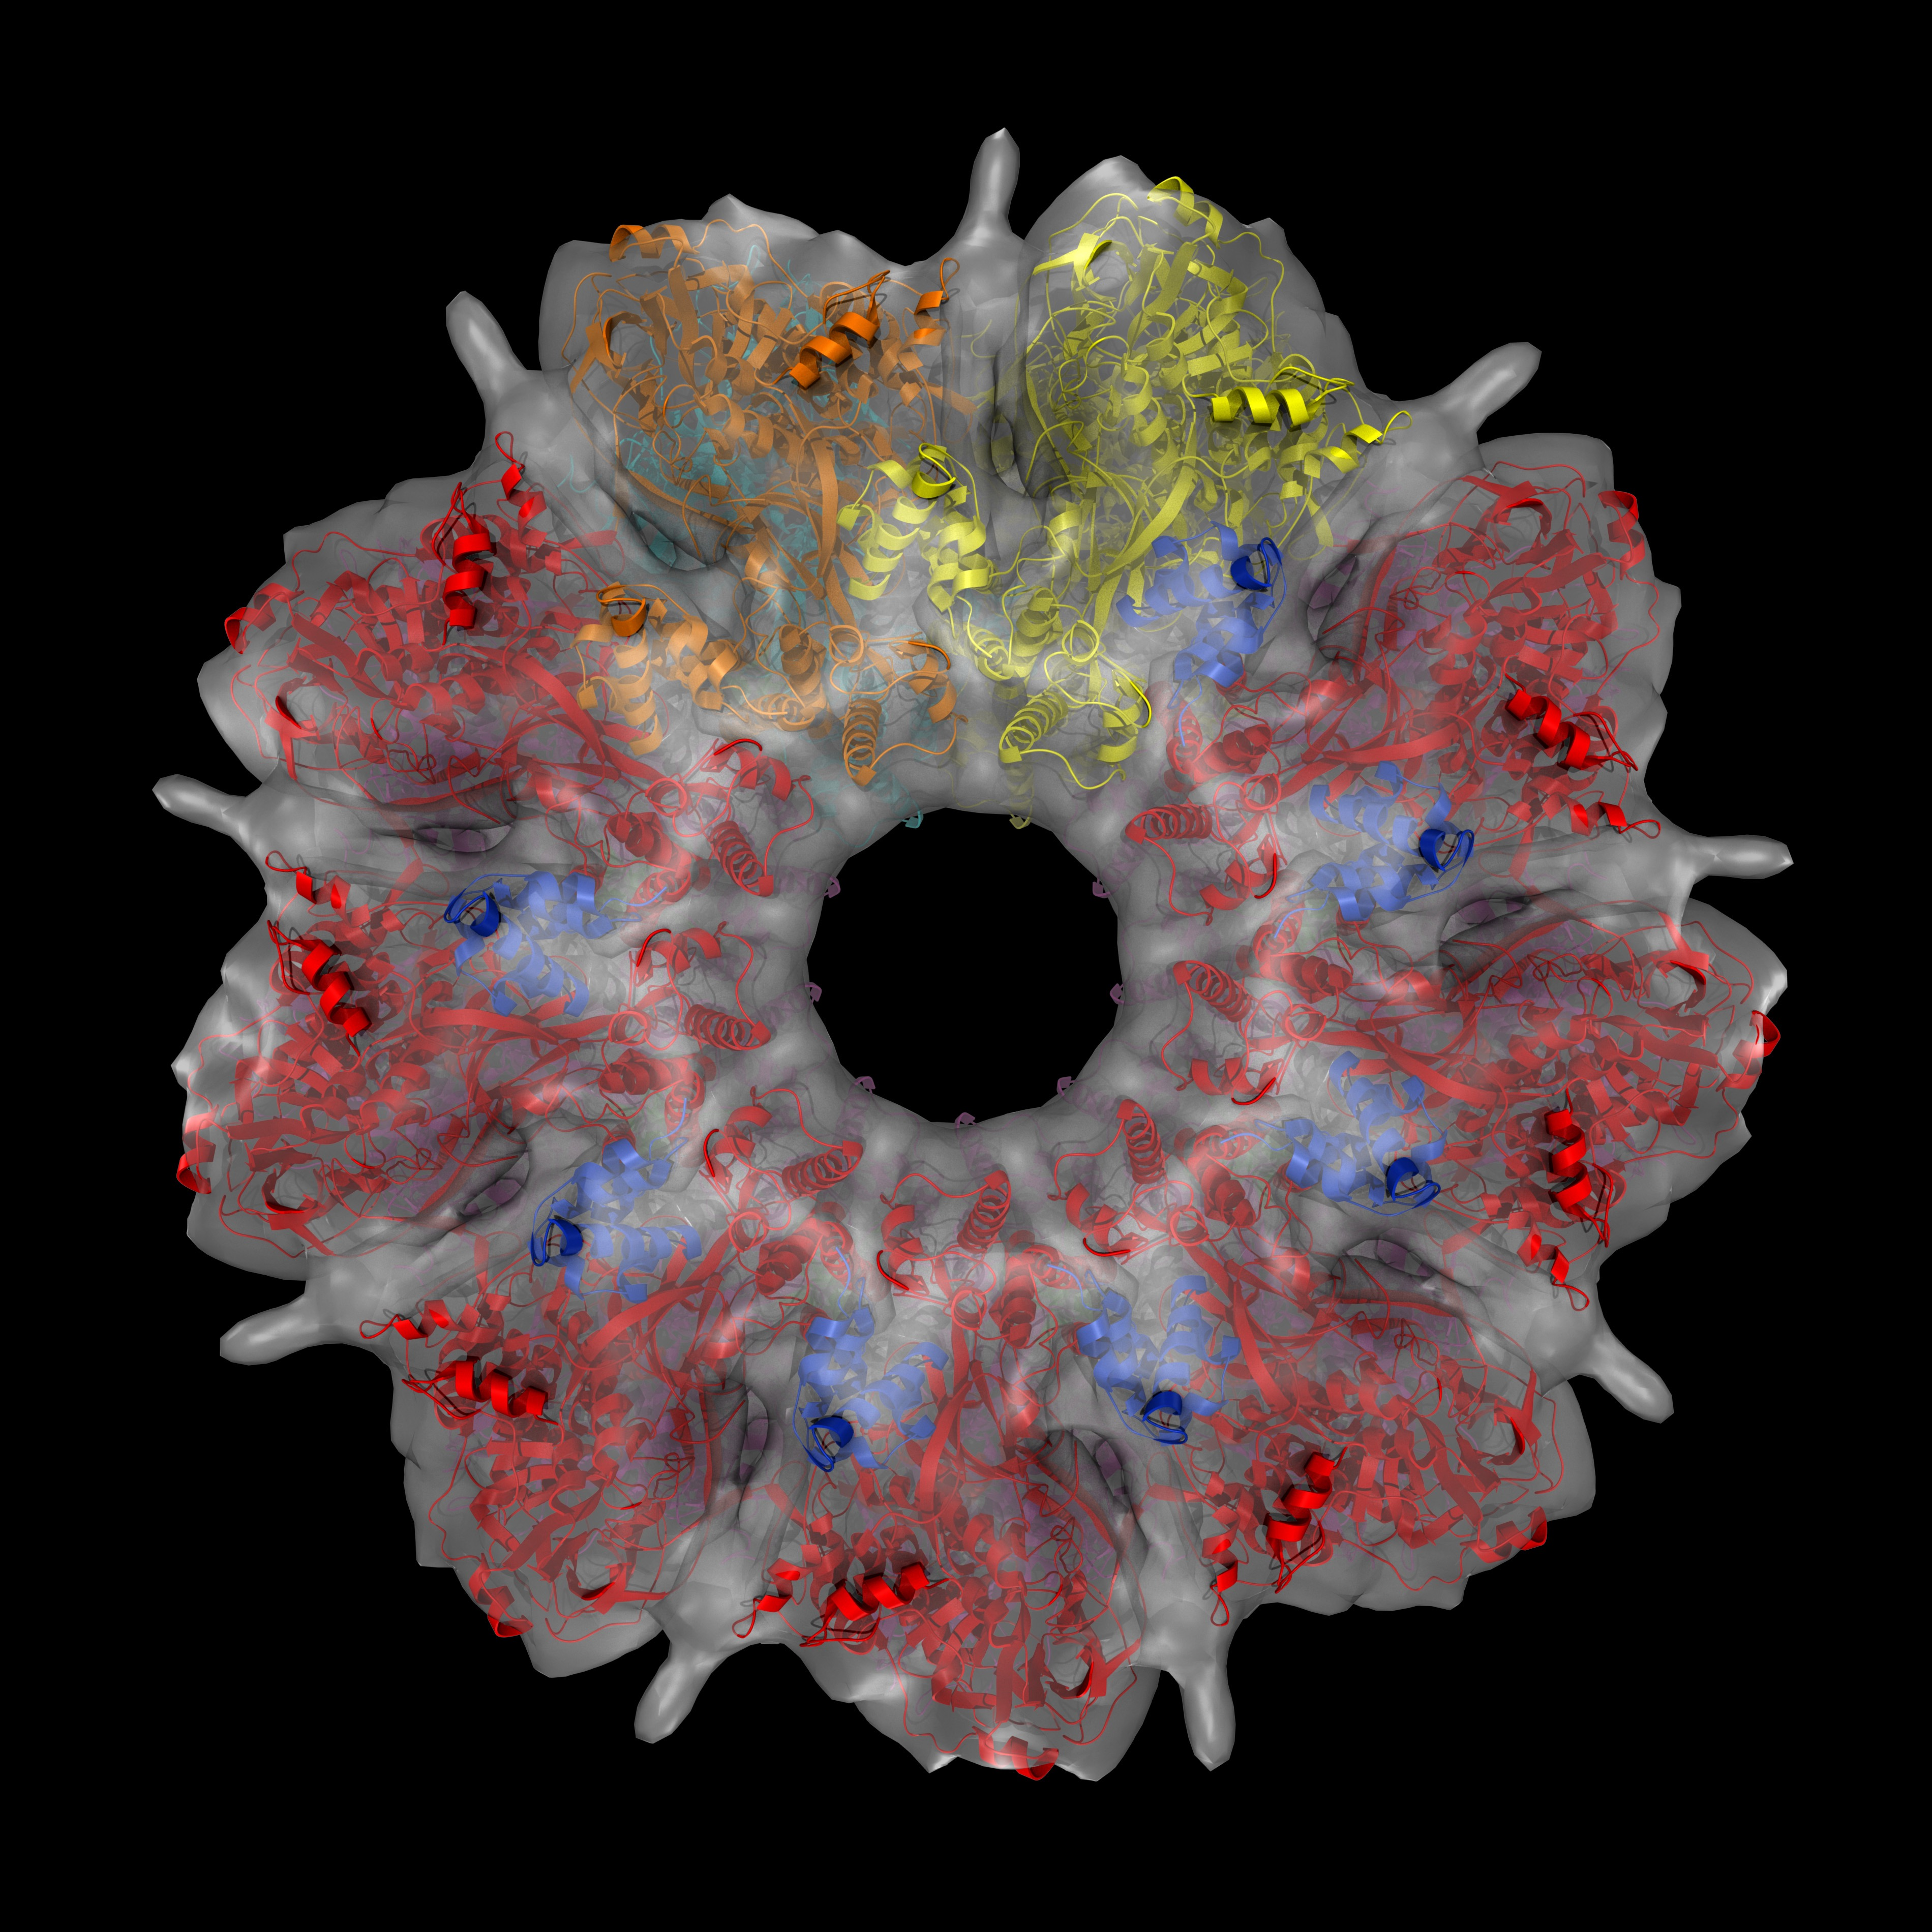
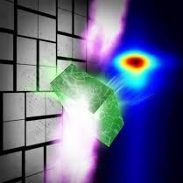
The SSRL Structural Biology Resource (SMB)
Illuminating Biological Structures at Molecular & Atomic Level
Integrated R&D and user support of structural biology beamlines
X-ray spectroscopies and Imaging (BioXAS) – contact Riti Sarangi - RitiS@slac.stanford.edu
Small angle X-ray scattering (SAXS) – contact Thomas Weiss - Weiss@slac.stanford.edu
Macromolecular crystallography (MC) – contact Aina Cohen - ACohen@slac.Stanford.edu
Synergistic user-operations with SLAC Cryo-EM Center and LCLS XFEL to address complex problems at various length and time scales
BioXAS - One of the largest dedicated and concentrated activities in the world
          Two beamlines dedicated to solution XAS at metal hard x-ray energies
          Low energy beamlines to studies ligands such as sulfur, chlorine and phosphorous
          Micro-spectroscopy, from µm to mm spatial resolution, over a wide range of metals
          XES spectroscopy facilities http://www-ssrl.slac.stanford.edu/smb/programs/xas/home.html

Slide 10
Summary
Science First approach to cost effective research and user support
SSRL is a key incubator for emerging DOE mission science efforts at SLAC
  Important connections to Stanford University
  World-class capabilities in cryo-EM and connections to LCLS
Strong emphasis on industry engagement in materials science, chemistry/catalysis and structural molecular biology

