Slide 1
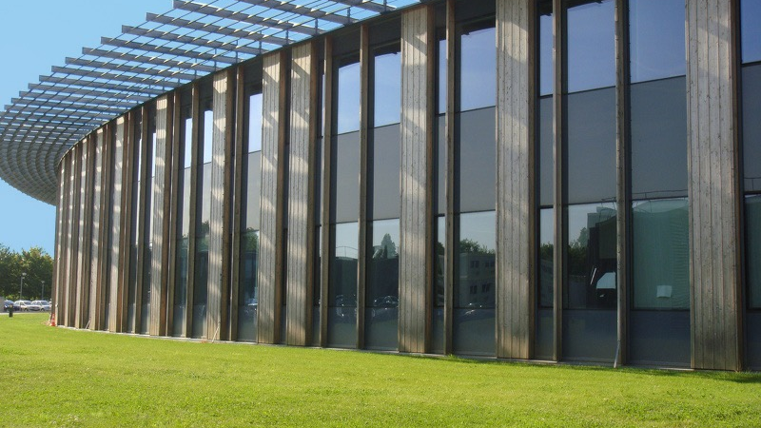
Hyperspectral Imaging with XRS Raman scattering
Application to Ancient Materials
Jean-Pascal Rueff
Synchrotron SOLEIL

Slide 2
Acknowledgments
J. Ablett, D. Céolin, D. Prieur, R. Georgiou (PhD, SOLEIL / IPANEMA)
L. Bertrand, P. Guériau
C. Sahle, A. Mirone
U. Bergmann
N. Brun
S. Bernard
R. Popelka-Filcoff

Slide 3
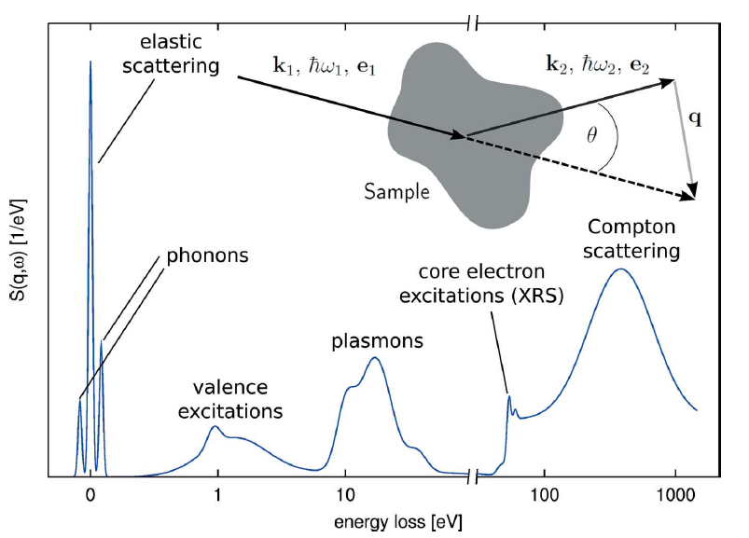
XRS
Dynamical structure factor S(q,w)
> Low-energy XAS
in the energy loss domain
magnons
C. Sahle et al., J. Synchrotron Rad. (2017)

Slide 4
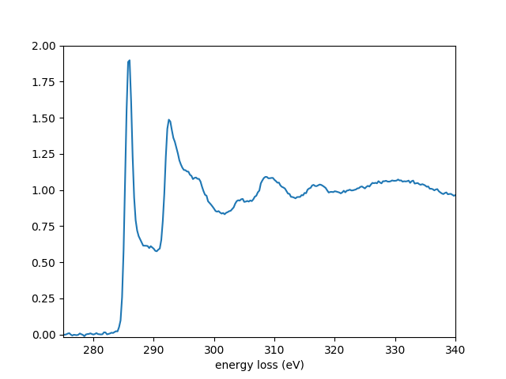
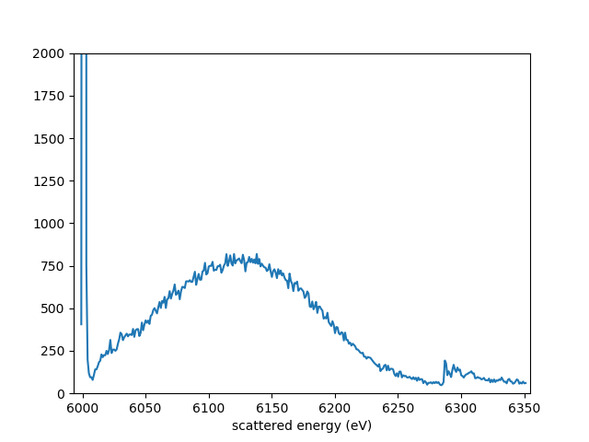
XRS at high Q
XRS
graphite, 6 keV, q= 5.6 A⁻¹
C K-edge
π*
σ*
Elastic
Compton
< 1min
bulk sensitivity
q² dependence
non-dipolar contrib.

Slide 5
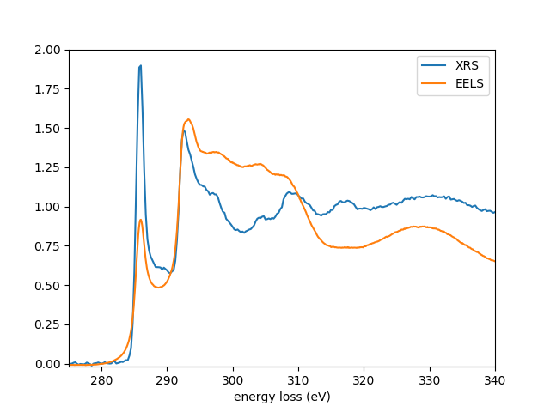
XRS at high Q
XRS
graphite, 6 keV, q= 5.6 A⁻¹
C K-edge
π*
σ*
Elastic
Compton
< 1min
bulk sensitivity
q² dependence
non-dipolar contrib.

Slide 6
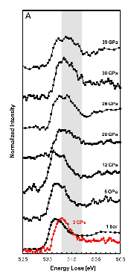
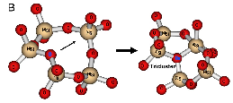
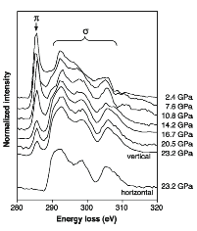
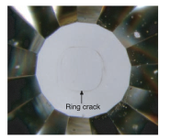
XRS at extreme conditions
O K-edge in MgSiO3 under high pressure
C K-edge in graphite under high pressure
Mao et al., Science (2003), 302 425
Lee et al., PNAS (2008) 105, 7925
Review in JPR and A. Shukla, Rev. Mod. Phys. (2010), 82 847

Slide 7
XRS in ancient materials

Slide 8
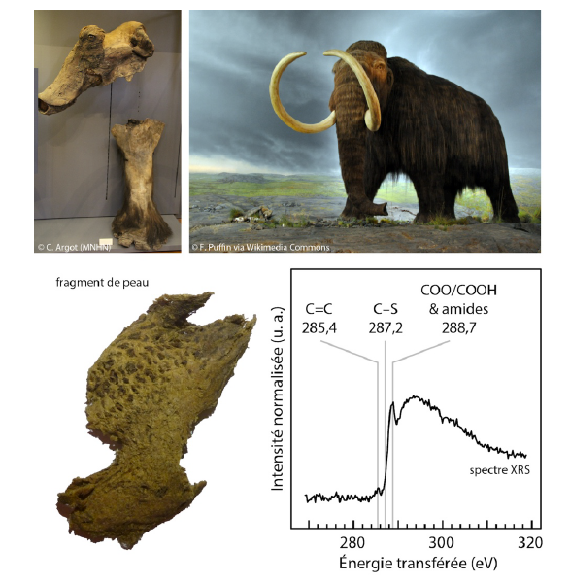
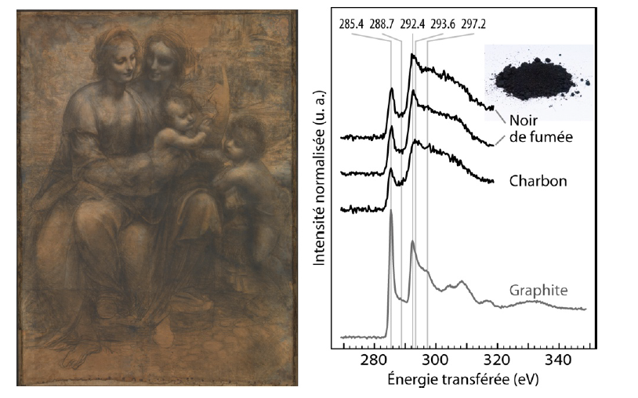
XRS in ancient materials
U. Bergmann, R. Georgiou, P. Gueriau, JPR, L. Bertrand, Reflet de la Physique (2019) in press
P. Gueriau, JPR, S. Bernard, J. A. Kaddissy, S. Goler, C. J. Sahle, D. Sokaras, R. A. Wogelius, P. L. Manning, U. Bergmann, and L. Bertrand, Analytical Chemistry (2017), 89, 10819.

Slide 9
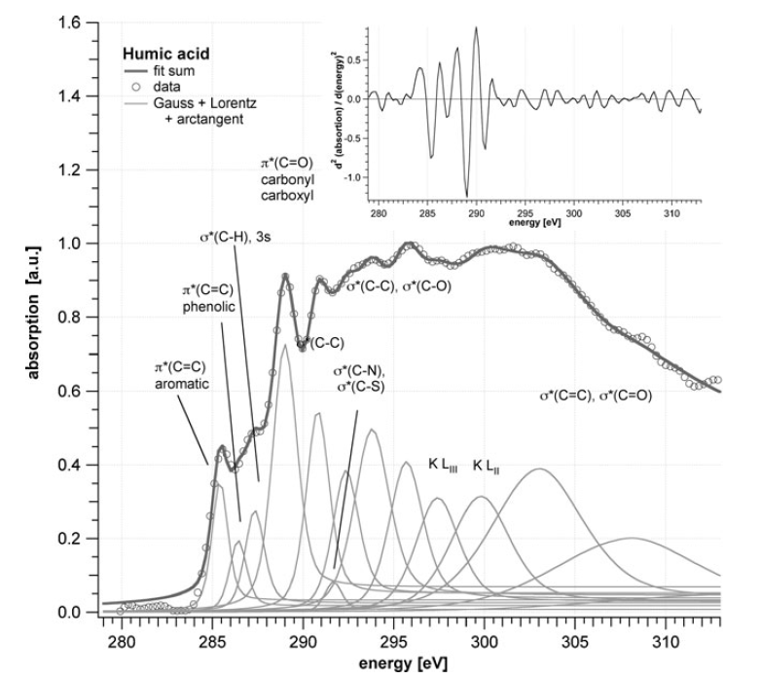
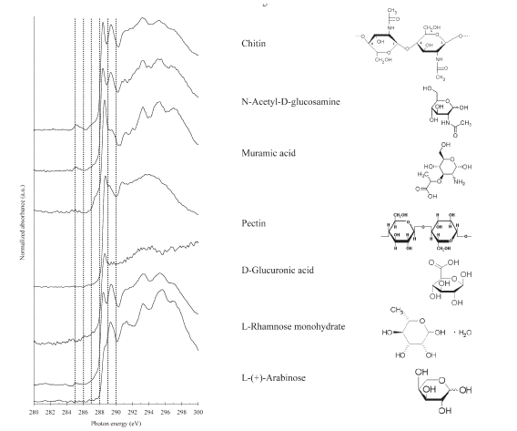
C-speciation by NEXAFS
J. Sedlmair et al., J Soils Sediments (2012) 12,24
D. Solomon et al., Soil Sci. Soc. Am. J. 73 (2009), 1817.

Slide 10
beamline
HAXPES and RIXS in the 2.3 - 12 keV energy range
focusing optics
U20 in-vacuum undulator
monochromators
DCM (Si 111) and HRM (dE = 100 meV - 1 eV)
HAXPES station
spot size : 30 x 80 µm²
RIXS station
spot size : 30 x 80 µm²
KB : 15 x 15µm²
JPR, J. M. Ablett, D. Céolin, D. Prieur, Th. Moreno, V. Balédent, B. Lassalle, J. E. Rault, M. Simon, and A. Shukla, J. Synchrotron Rad. (2015), 22, 175.

Slide 11
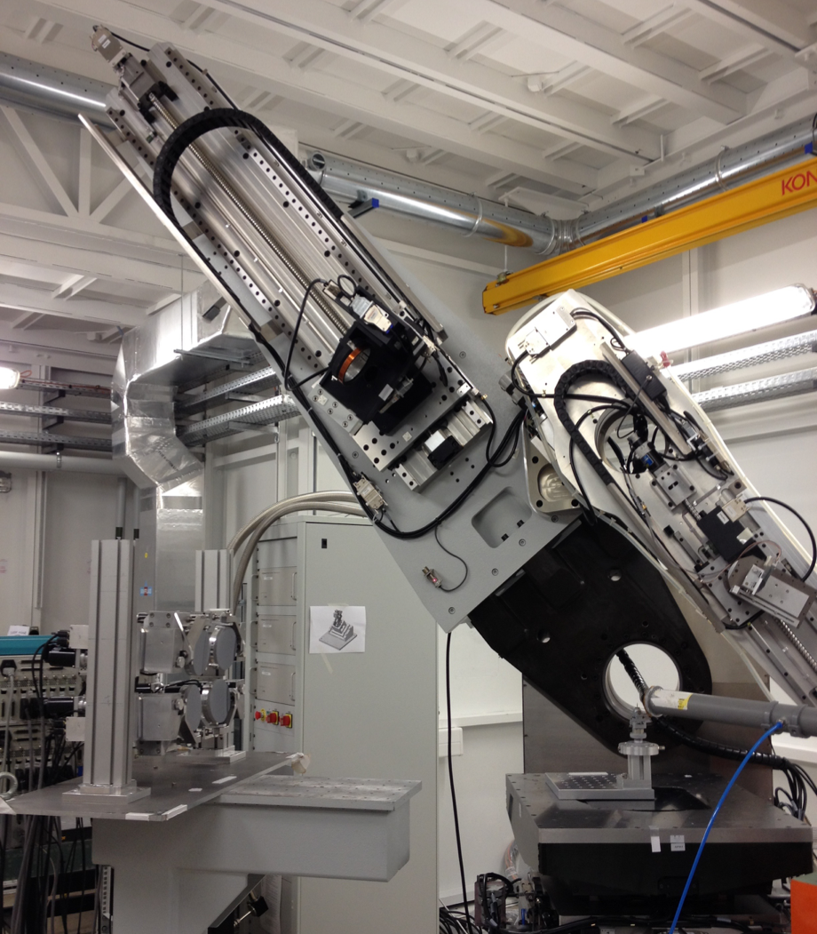
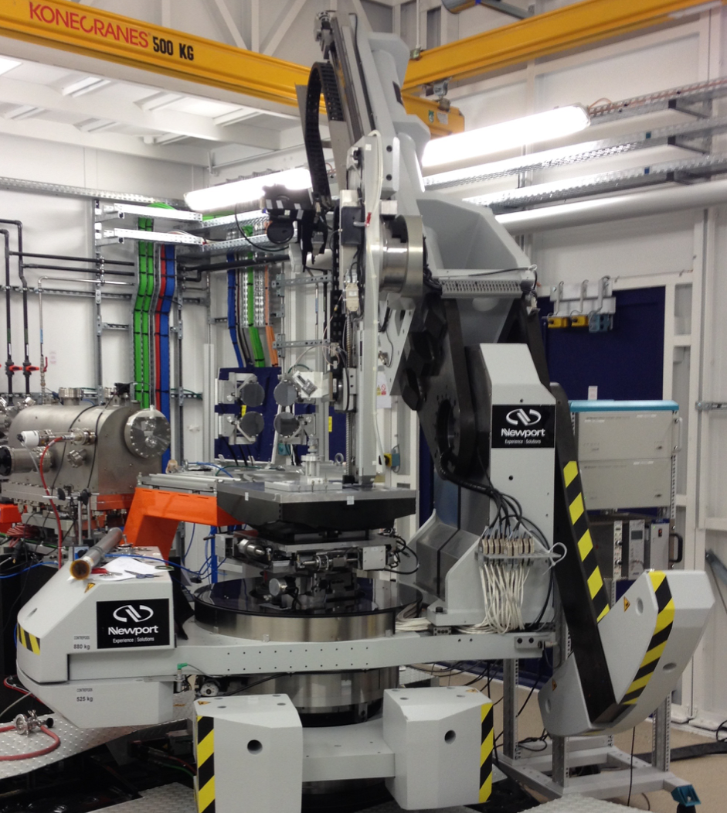
RIXS endstation
Long arm
(1 - 2m radius)
sample stage
Short arm for multianalyzers setup
(0.5 - 1m radius)

Slide 12
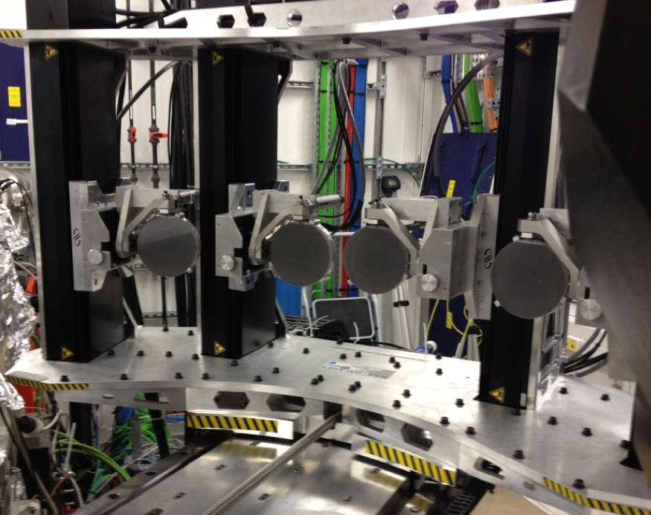
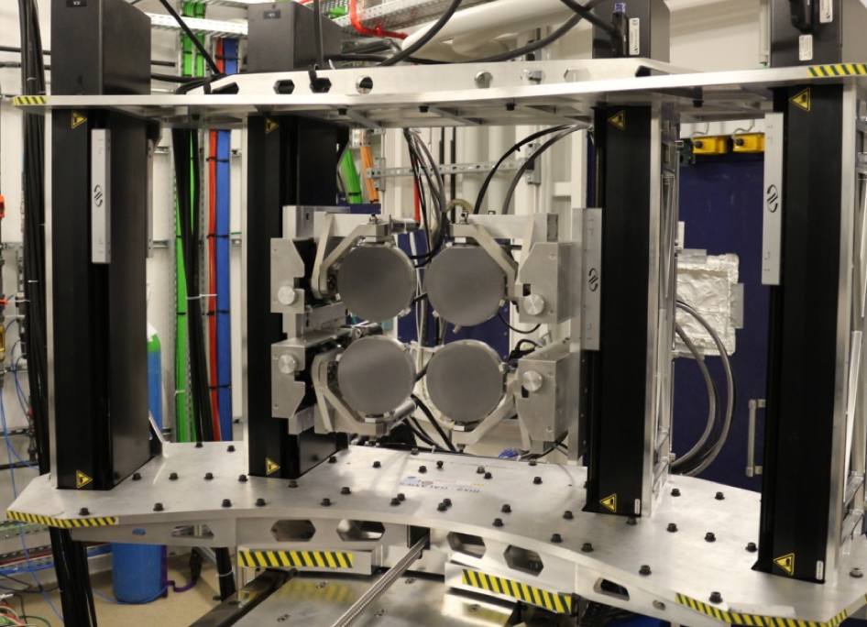
Multi-analyzers
4 x 1
RIXS - XES
2 x 2
XRS
J. M. Ablett, D. Prieur, D. Céolin, B. Lassalle-Kaiser, B. Lebert, M. Sauvage, Th. Moreno, S. Bac, V. Balédent, A. Ovono, M. Morand, F. Gélebart, A. Shukla, and JPR, J. Synchrotron Radiation (2019), 26

Slide 13
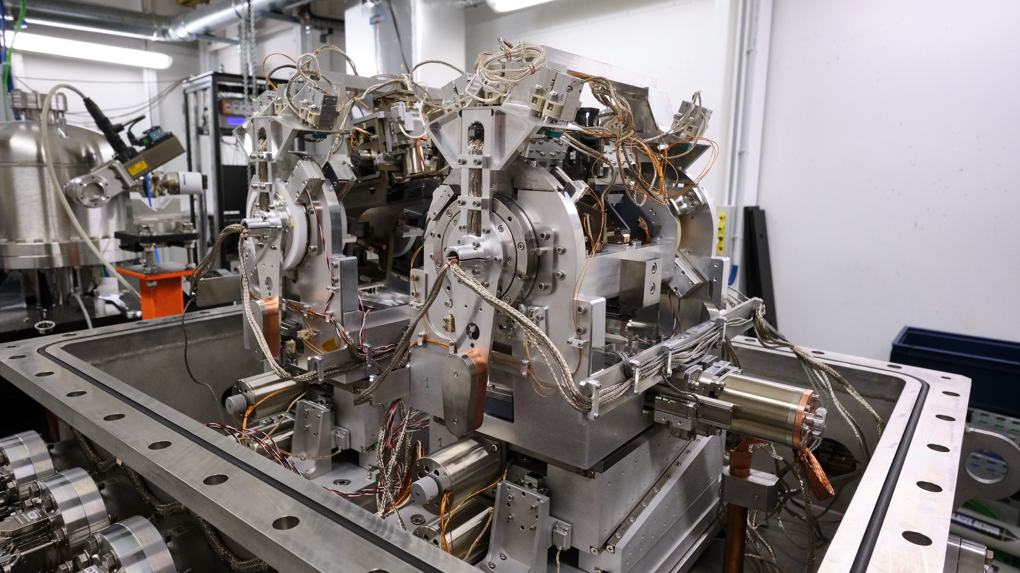
HRM
2 sets of crystals
4 x Si(110) sym
4 x Si(110) asym
0.1 eV < dE < 0.4 eV
@ 4 - 12 keV

Slide 14
XRS setup
analyzers
He bag
SDD
detector
2θ
sample
x-ray

Slide 15
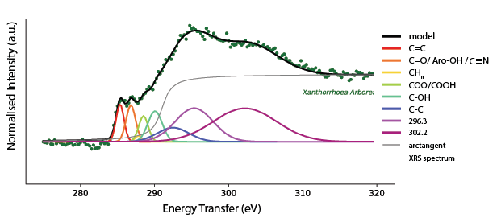
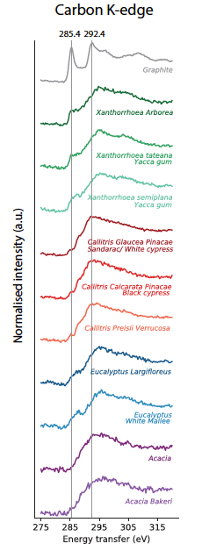
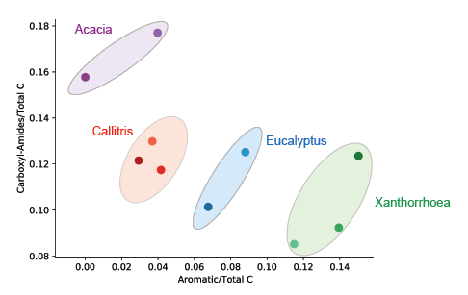
C speciation in resins
R. Georgiou, R. Popelka-Filcoff et al., in prep. (2019)

Slide 16
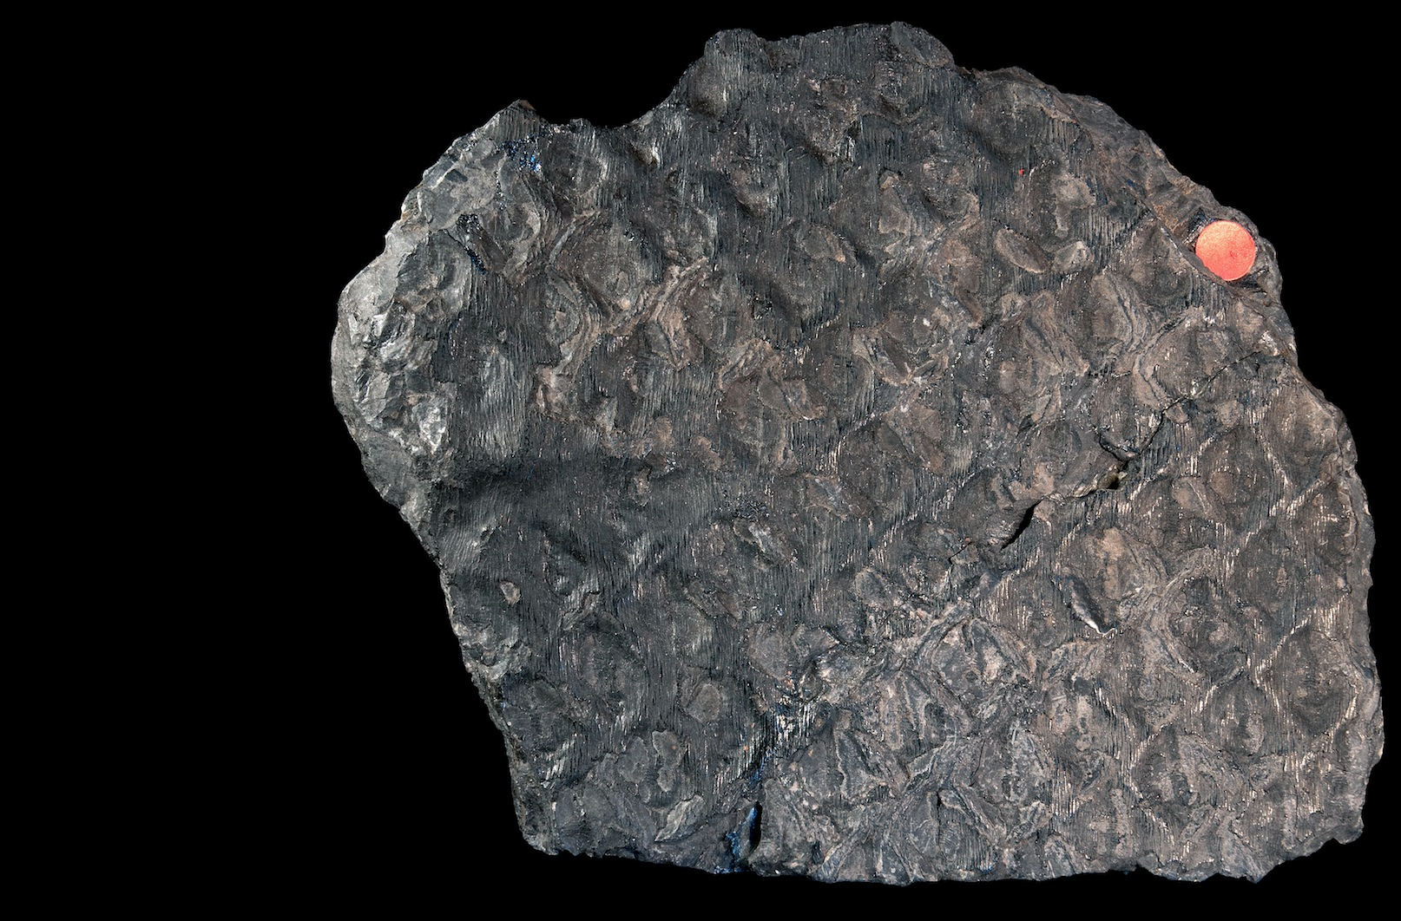
Towards XRS imaging
Lepidodendron fossil
(300 Mya)

Slide 17
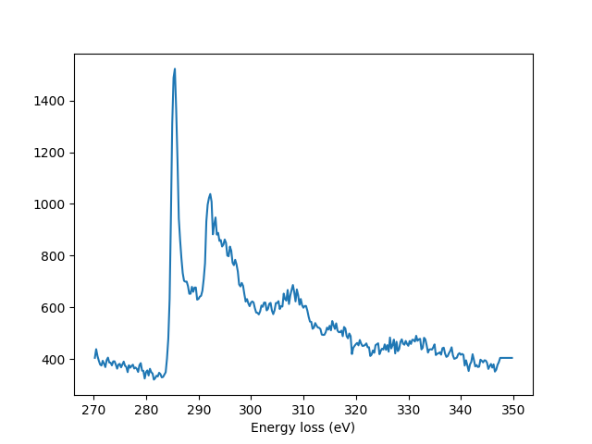
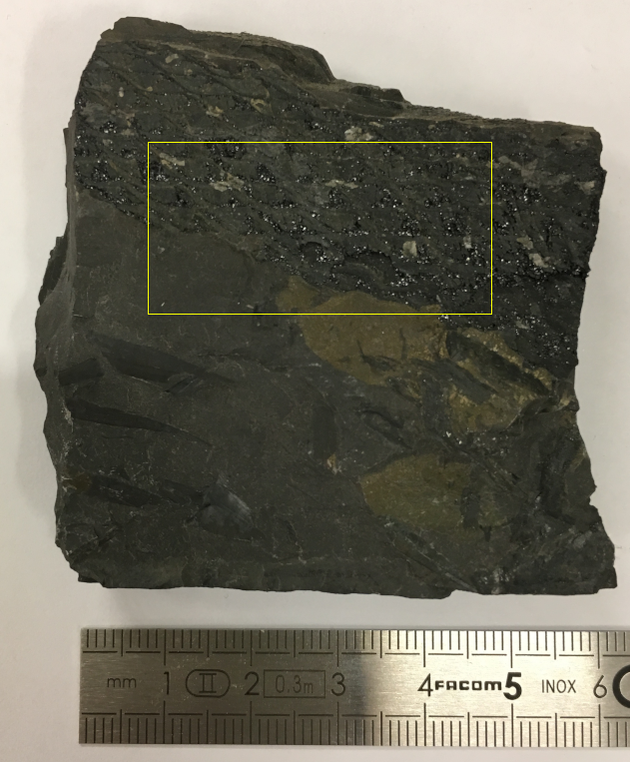
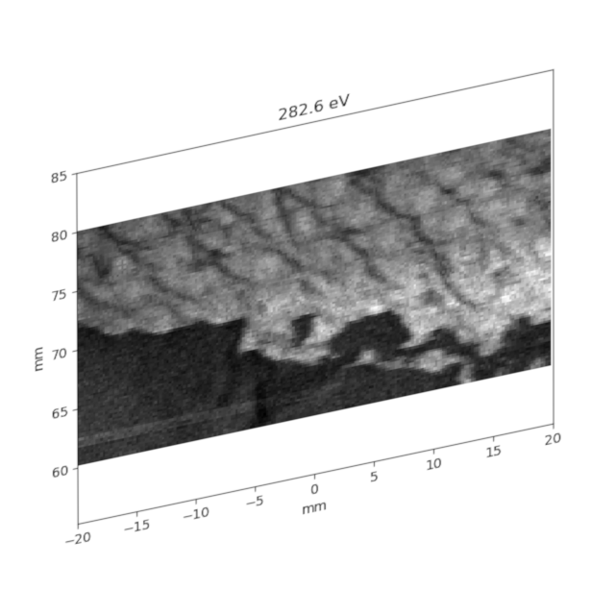
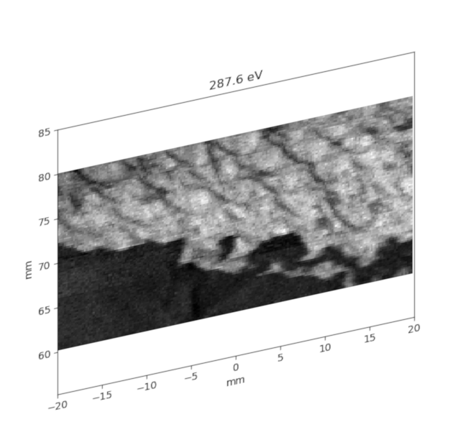
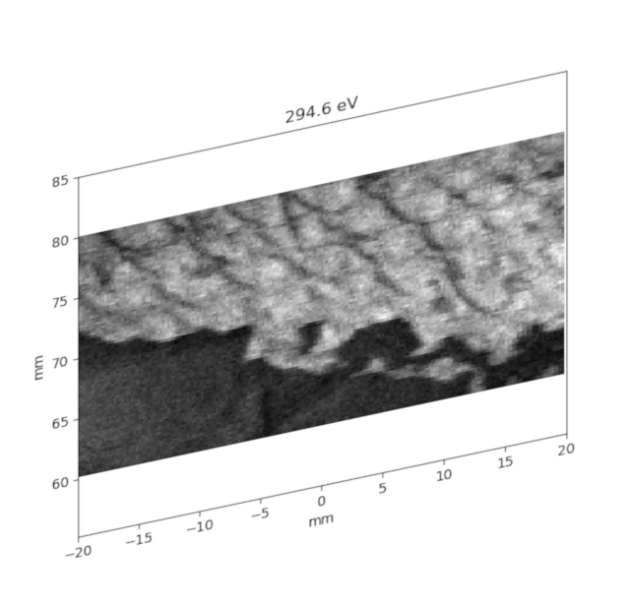
2D C-speciation in fossilized plant
C-speciation images
C K-edge
2D x-rays raster scan
R. Georgiou, P. Gueriau, C. Sahle, A. Mirone, S. Bernard, R. Garrouste, U. Bergmann, J.PR and L. Bertrand, Science Advances (2019), in press

Slide 18
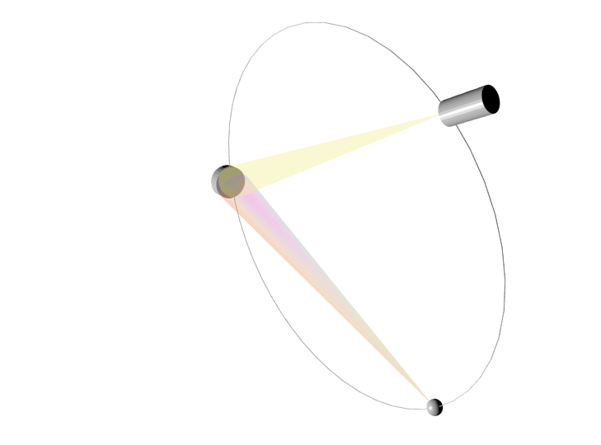
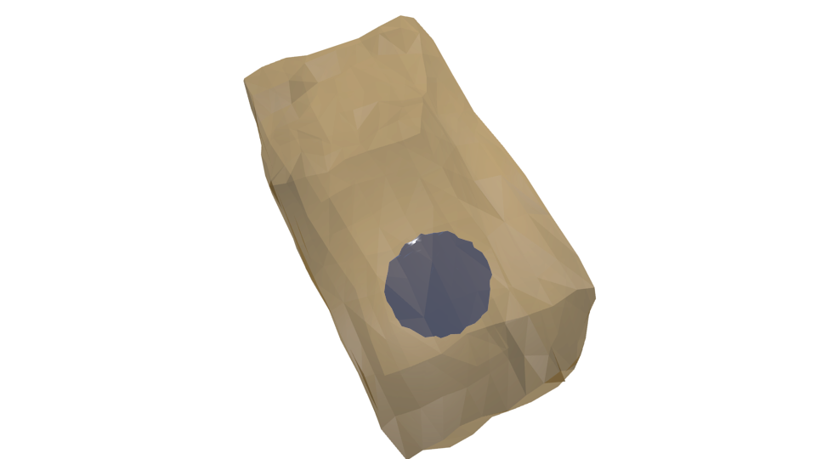
3D imaging
Direct tomography
Huotari et al., Nature Materials (2011)
detector
2D
analyzer
depth
2D x-rays raster scan
> 3D volume

Slide 19
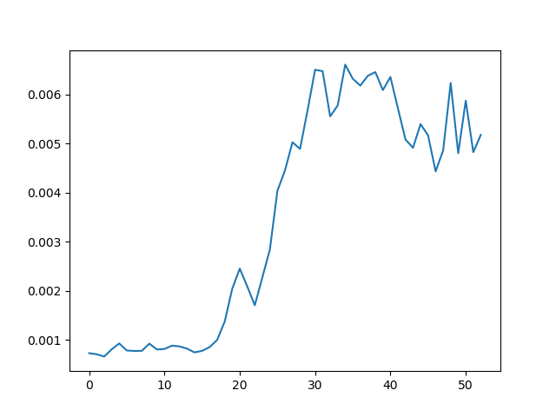
4D hyperspectral imaging
Direct tomography
Huotari et al., Nature Materials (2011)
detector
spectrum
2D
analyzer
depth
2D x-rays raster scan
> 3D volume

Slide 20
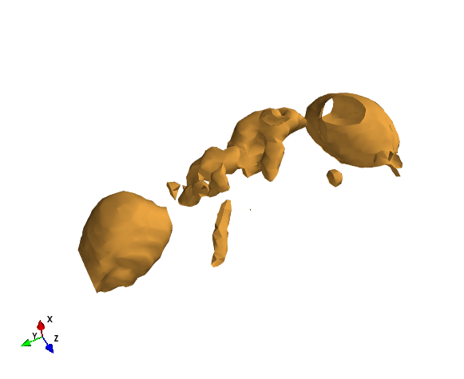
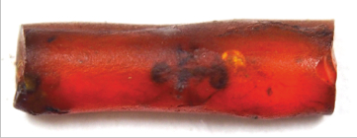
Case study (ID20, ESRF)
Coll. IPANEMA, ESRF
2D detector
(beam direction)
30 Mya (Oise, France)
isosurface energy integrated intensity
R. Georgiou, P. Gueriau, C. Sahle, A. Mirone, S. Bernard, R. Garrouste, U. Bergmann, J.PR and L. Bertrand, Science Advances (2019), in press

Slide 21
Case study (ID20, ESRF)
Coll. IPANEMA, ESRF
30 Mya (Oise, France)
isosurface energy integrated intensity
R. Georgiou, P. Gueriau, C. Sahle, A. Mirone, S. Bernard, R. Garrouste, U. Bergmann, J.PR and L. Bertrand, Science Advances (2019), in press

Slide 22
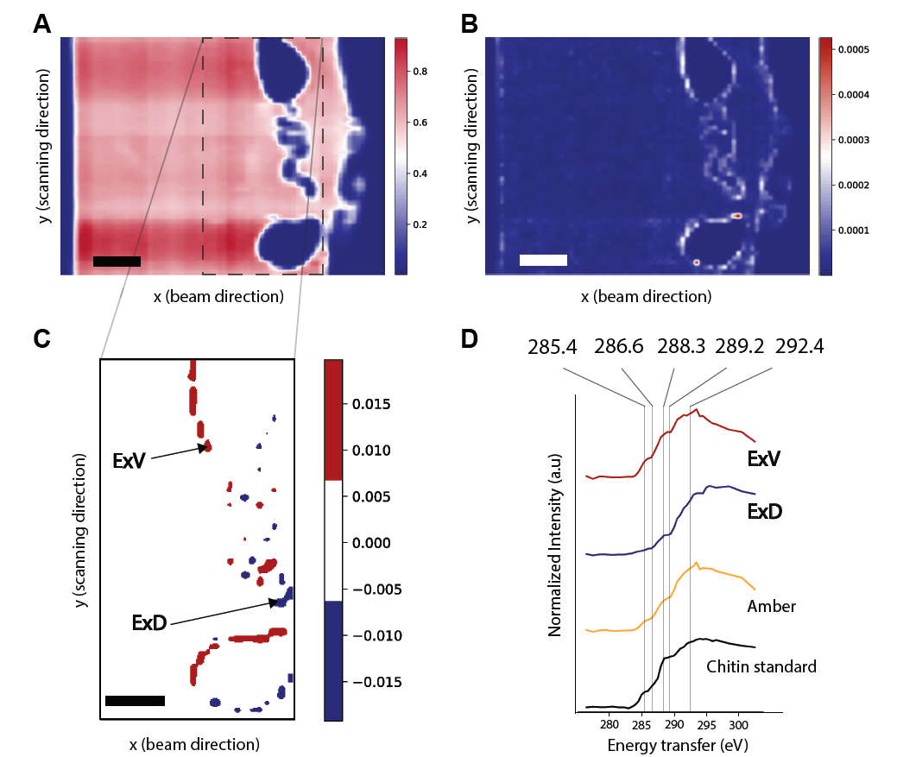
Case study (ID20, ESRF)
Coll. IPANEMA, ESRF
amber+chitin
amber
decomposition using model spectra
R. Georgiou, P. Gueriau, C. Sahle, A. Mirone, S. Bernard, R. Garrouste, U. Bergmann, J.PR and L. Bertrand, Science Advances (2019), in press

Slide 23
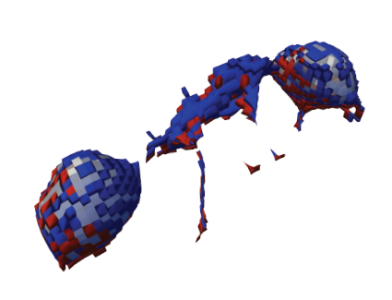
Case study (ID20, ESRF)
Coll. IPANEMA, ESRF
amber+chitin
amber
decomposition using model spectra
R. Georgiou, P. Gueriau, C. Sahle, A. Mirone, S. Bernard, R. Garrouste, U. Bergmann, J.PR and L. Bertrand, Science Advances (2019), in press

Slide 24
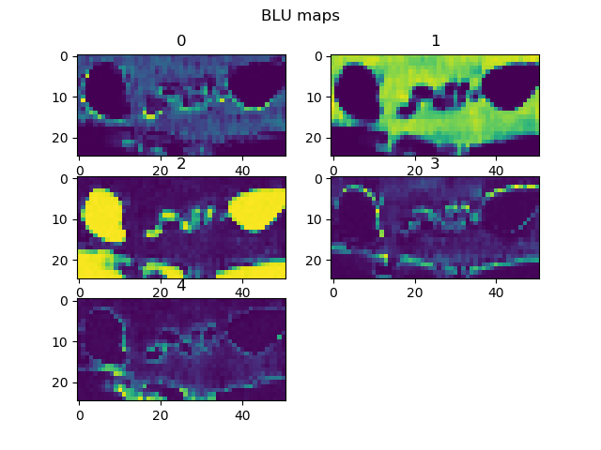
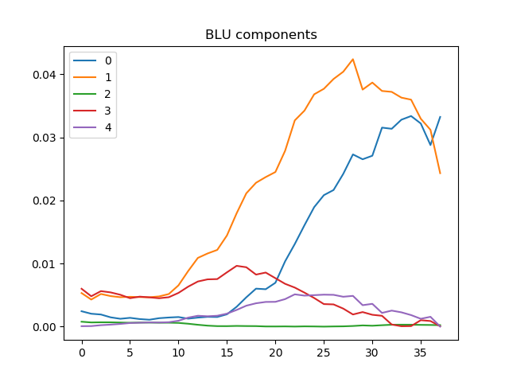
Model free spectral unmixing
Coll. LPS
Bayesian linear unmixing
N. Dobigeon et al., Ultramicroscopy (2012), 25–34.

Slide 25
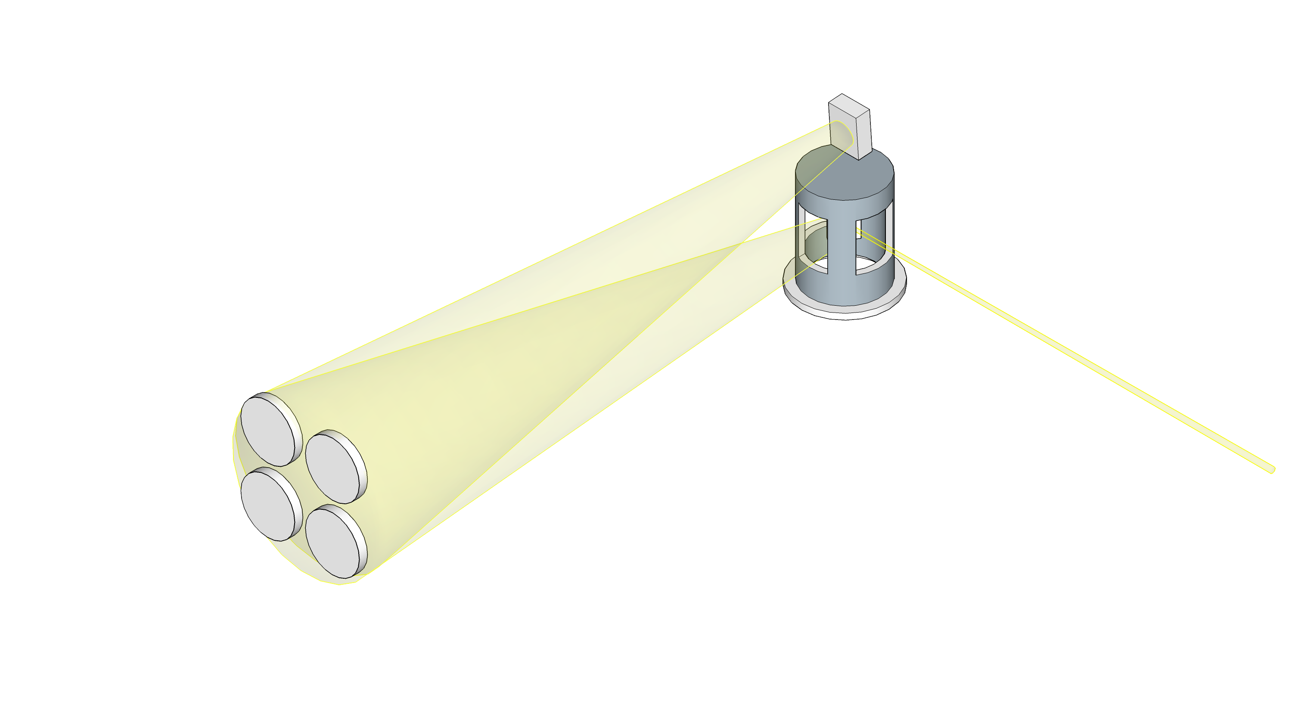
MATRIXS project
detector
sample chamber
4 analyzers
x-ray

Slide 26
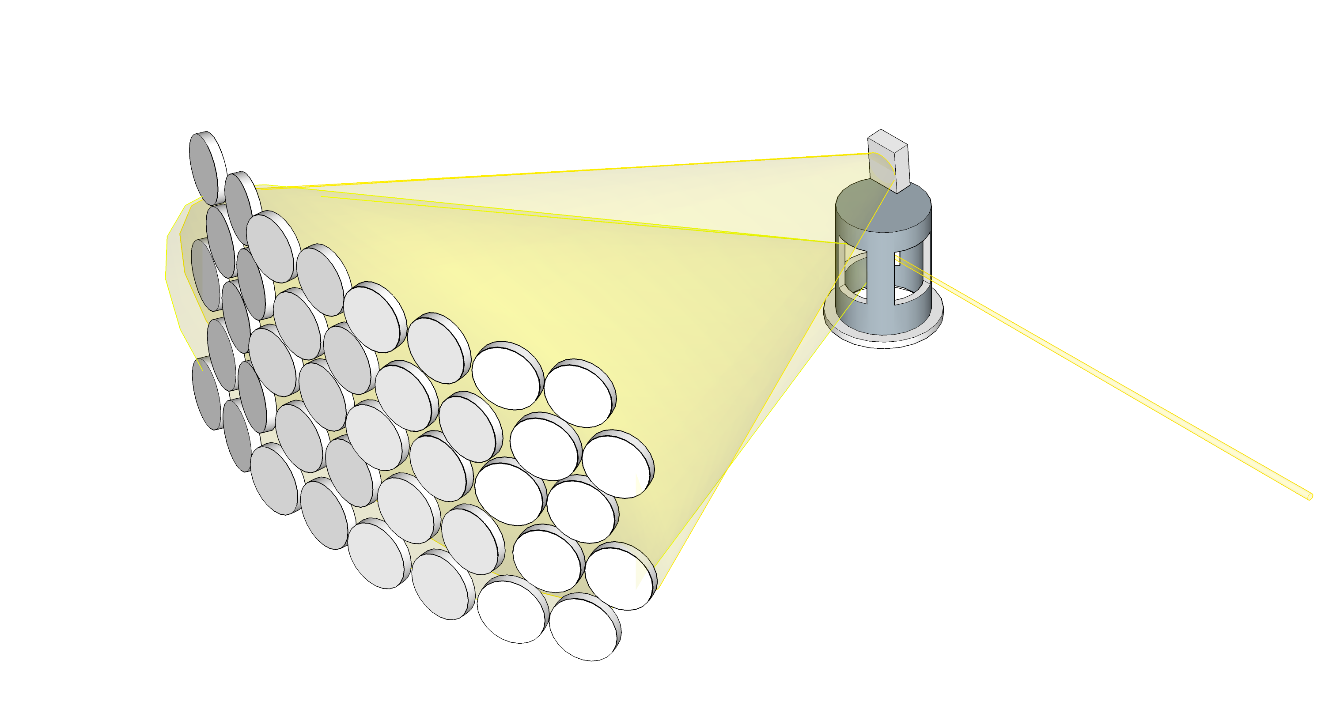
MATRIXS project
MAssive Tabular aRray for Inelastic X-ray Scattering
detector
40 analyzers
sample chamber
faster XRS
hyperspectral images
15 x 15 µm² resolution
tomography
SOLEIL Upgrade
x-ray

Slide 27
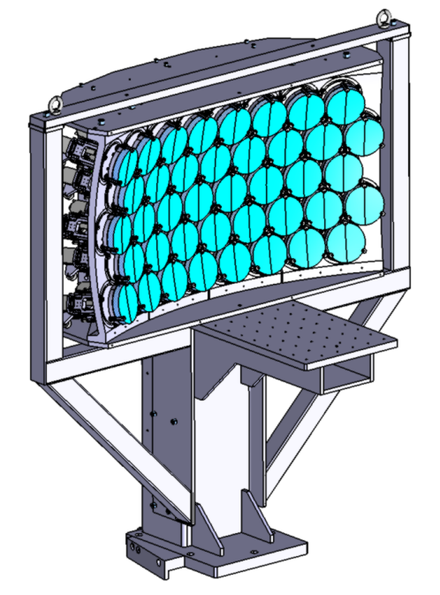
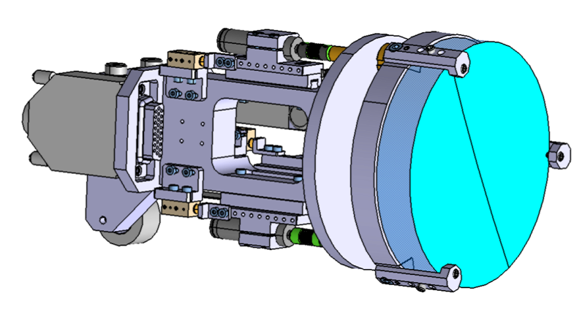
MATRIXS project
MAssive Tabular aRray for Inelastic X-ray Scattering
design
40 x analyzer modules
Si(110)
> available in 2020 at GALAXIES

Slide 28
Conclusions
Bulk sensitive low-energy XAS
avoid surface sensitivity
extreme conditions
Chemical Imaging / Tomography
Applications to energy / battery

Slide 29
Thank you for your attention !

Slide 30
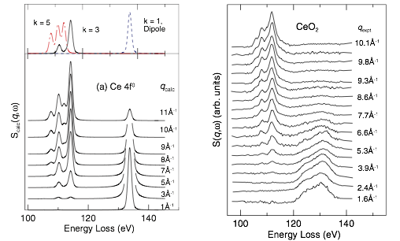
XRS equivalence to XAS
octupole
Triakonta-
dipole
q plays the role of ε in XAS
R.A. Gordon et al., EPL 81 (2008)

