Slide 1
Fly and trajectory scans
Tim Mooney
2/27/2015

Slide 2
Fly-scan choices
Software fly scan
Data acquired while positioners move at constant speed
Detectors triggered by software
Periodically, or at user-specified time intervals
Positions acquired by software along with detector data
Few-ms dead time between data points
No cabling required
Hardware fly scan
Data acquired while positioners move
Detectors triggered by pulses from positioner
Periodically
At user-specified positions
Positions implied or acquired by multichannel scaler
Arraycalc “cum” function reconstructs motor positions from scaler data
No dead time between points
Need cable from selected motor to selected detector(s)

Slide 3
Hardware fly choices
Constant speed (from now on, “Hardware fly scan”)
Positioner moves at constant speed
Positioner can be moved by motor record
Specify StartPos, EndPos, NPTS, and Speed
May be able to specify data-acquisition positions
Requires supported motor or external hardware
Trajectory (from now on, “Trajectory scan”)
Motor moves along specified trajectory
Use trajectory controls
Specify trajectory positions and times
Specify data-acquisition positions
Details depend on controller
Requires supported motor

Slide 4
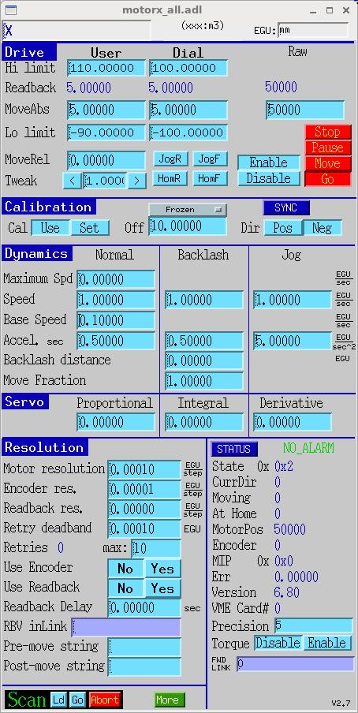
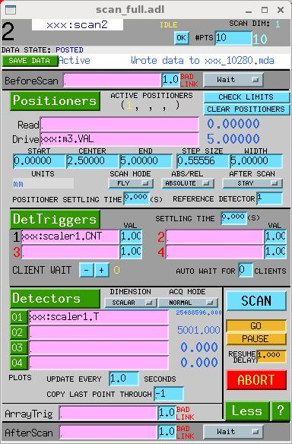
Software fly scan
Requirements:
positioner speed can be set
position updates periodically or on demand
scan manager (e.g., sscan record)
User interface:
Differences from step scan

Slide 5
Software fly scan
Remarks:
Positioner speed and detector-dwell time must be set
Imprecise synchronization between data and recorded positions
Limited to <~ 10 Hz
PVs: (values in green: user’s choice)
Same as for step scan:
$(scan).ACQT = SCALAR
$(scan).P1PV = $(motor).VAL
$(scan).R1PV = $(motor).RBV
$(scan).T1PV = $(scaler).CNT
$(scan).DnnPV = scaler.T
$(scan).P1SP = 0
$(scan).P1EP = 5
$(scan).NPTS = 10
$(scaler).TP = .5
Modified for software fly scan:
$(scan).P1SM = FLY
$(motor).VELO = 1.0

Slide 6
Hardware fly scan requirements
Positioner can output pulses during nontrajectory move
Any stepper motor (with external divide-by-N)
Aerotech Ensemble with EnsemblePSOFly database
Probably other servo motors can do this
softGlue can do this if you give it quadrature-encoder signals
Hardware-triggered detector can cache or stream scan data
MCS (Struck multichannel scaler)
XIA DXP
Cameras supported by areaDetector
Data-storage/management client
sscan record (saveData)
Spec, BlueSky
areaDetector plugin

Slide 7
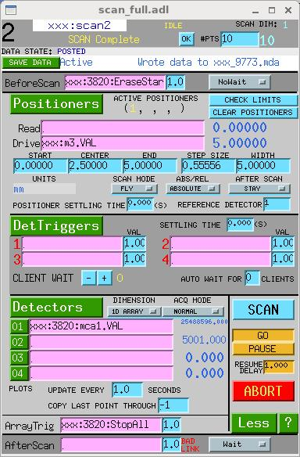
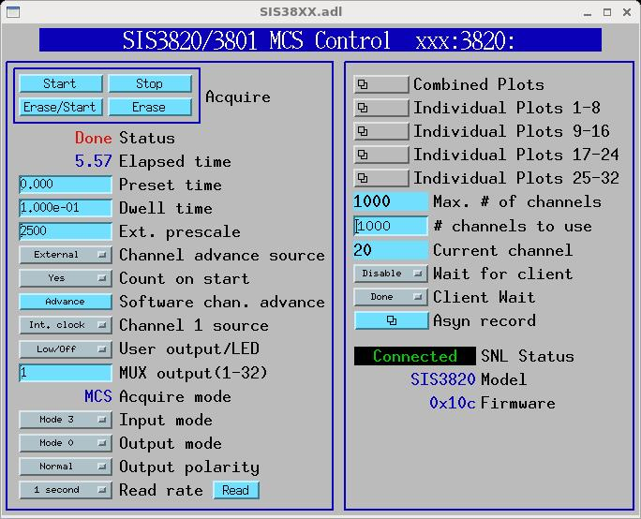
Hardware fly scan
User interface:
Differences from software fly scan:

Slide 8
Hardware fly scan
Remarks:
positioner speed must be set
detector must be prepared and started before motor moves
PVs:
Same as for software fly scan:
$(scan).P1PV = $(motor).VAL
$(scan).P1SM = FLY
$(scan).P1SP = 0
$(scan).P1EP = 5
$(scan).NPTS = 10
$(motor).VELO = 1.0
Modified for hardware fly scan:
$(scan).ACQT = 1D ARRAY
$(scan).BSPV = $(mcs):EraseStart
$(scan).BSWAIT = NoWait
$(scan).A1PV = $(mcs):StopAll
$(mcs):PresetReal = 0
$(mcs):ChannelAdvance = External
$(mcs):Channel1Source = Int. clock
$(scan).D01PV = $(mcs):mca1.VAL
$(mcs):Prescale = 2500
$(mcs):CountOnStart = Yes
$(mcs):NuseAll = 1000
$(scan).R1PV = not used
$(scan).T1PV = not used

Slide 9
Trajectory scan requirements
Controller can move motor along trajectory
Newport MM4005 or XPS
Aerotech Ensemble
Galil
Controller can generate position-synchronized pulses
Position-table generator
E.g., spec, arraycalc, python, etc.
Hardware-triggered detector can cache or stream scan data
Same as hardware fly scan
Data-storage client
Same as hardware fly scan

Slide 10
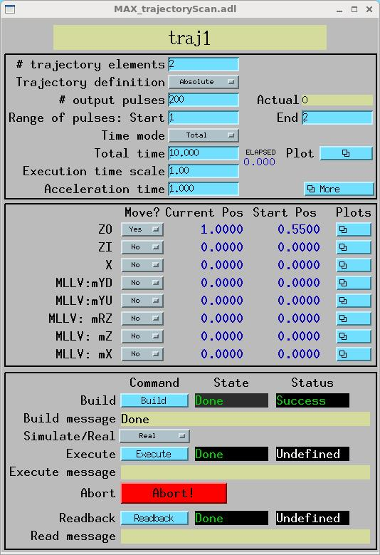
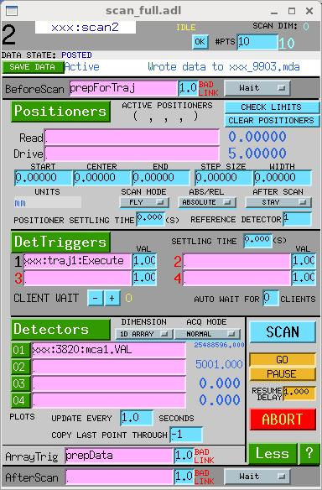
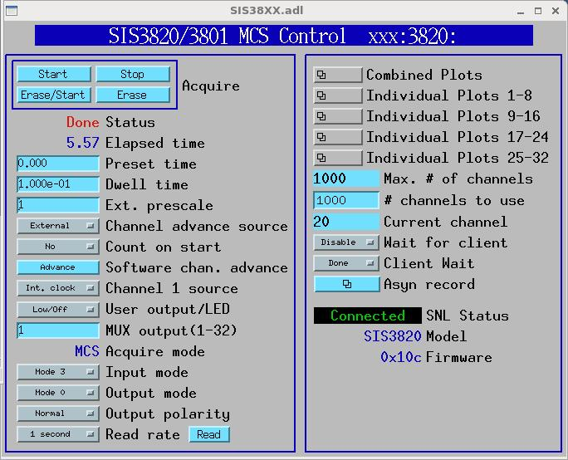
Trajectory scan
User interface:
Differences from hardware fly scan:

Slide 11
Trajectory scan
Remarks:
Trajectory must be loaded
Detector must be prepared and started before motor moves
PVs:
Same as for hardware fly scan:
$(scan).ACQT = 1D ARRAY
$(mcs):PresetReal = 0
$(mcs):ChannelAdvance = External
$(mcs):Channel1Source = Int. clock
$(scan).NPTS = 10
$(scan).D01PV = $(mcs):mca1.VAL
$(mcs):NuseAll = 1000
$(scan).R1PV = not used
Modified for trajectory scan:
$(scan).T1PV = $(traj):Execute
$(mcs):Prescale = 1
$(scan).BSWAIT = Wait
$(scan).BSPV = prepForTraj
$(scan).A1PV = prepData
$(mcs):CountOnStart = No
$(traj):* = many choices
$(scan).P1PV = not used
$(motor).VELO = not used
$(scan).P1SP = not used
$(scan).P1EP = not used
$(scan).P1SM = not used

Slide 12
Trajectory definition
Number of trajectory elements
Array of positions for each motor
Ensemble: only one motor
Array of times
Can be specified as total time
Number of output pulses, start/end element
MM4005: pulses evenly spaced in distance along trajectory
XPS: pulses evenly spaced in time
Ensemble: pulses evenly spaced in distance, or at trajectory points
Under development: at user-specified positions
For MAXv: pulses only at trajectory points
Absolute/Relative/Hybrid position mode
Currently, Ensemble and MAXv don’t support Hybrid mode
MAXv has timing problems in very slow motion

Slide 13
Detector-trigger options
motor/encoder
÷N
MCS
e.g., step-motor hardware fly
detector
motor/encoder
÷N(i)
÷1
MCS
e.g., trajectory, ensemblePSOFly
detector
softGlue
motor/encoder
÷N(i)
÷1
MCS
e.g., tableFly
detector

Slide 14
Examples
1ide hexFly (hard fly scan)
EnsemblePSOfly.db with evenly spaced data-gate signals
2bmb, 32idc tomography fly (hard fly scan)
EnsemblePSOfly.db with evenly spaced data-trigger signals
2bmb interlace fly (hard fly scan)
EnsemblePSOfly.db with user-specified data-trigger signals
tableFly.db uses softGlue to generate triggers from motor pulses
interlaceFly.db programs tableFly
Acquire at ~100 Hz for ~30 minutes
15idd USAXS fly (trajectory scan)
Ensemble trajectories with user-specified data-trigger signals
Rotation stage executes exponential trajectory
Translation stages execute commensurate trajectories
Gradient-multilayer-deposition system (trajectory motion)
Galil trajectory

