Slide 1
areaDetector Update:
EPICS V4 and More
Mark Rivers
GeoSoilEnviroCARS, Advanced Photon Source
University of Chicago

Slide 2
Outline
Last TWG areaDetector talk was April 2016
Releases since then: R2-5, R2-6 (very soon)
EPICS V4 driver and plugin
Other new and improved drivers
Other new and improved plugins
ImageJ plugins
Future plans

Slide 3
EPICS Version 4 in a Nutshell
Version 4 Additions to EPICS
New Protocol, “pvAccess”
Structured data
Introspection interface, “pvData”
Dynamic typing
Streaming
Standard Scientific Types
RPC and put/get
New smart database
Codec based transport
All APIs in C++ and Java
Python and Matlab
High Performance
High Reliability
$ eget -s XCOR:LI24:900:TWISS
non-normative type
structure
double energy 5.00512
double psix 37.7625
double alphax 13.6562
double betax -2.78671
double etax -0.00698294
double etaxp 0.00107115
double psiy 31.9488
double alphay 116.762
double betay 5.2592
double etay 0
double etayp 0
Figure: Example EPICS v4 pvAccess method “eget”, getting PV whose value is a structure giving the Courant-Snyder parameters at a corrector magnet.
This example is from the LCLS control system at SLAC.

Slide 4
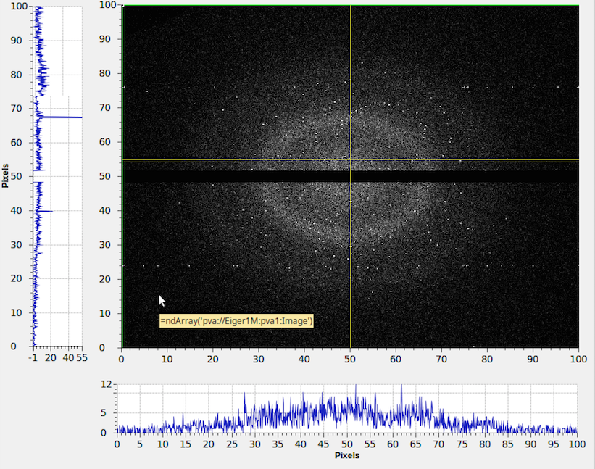
The EPICS V4 “Normative Types”
Version 4 Additions to EPICS
The Normative Types Spec defines a standard for commonly used data types, http://epics-pvdata.sourceforge.net/alpha/normativeTypes/normativeTypes.html
$ eget -s XCOR:LI24:900:RMAT
0.0727485 0.0289316 0 0 0.0652488 0.00125391
0.0578214 0.0391775 0 0 -0.027185 -0.000192344
0 0 0.00943029 1.14291 0 0
0 0 -0.0013367 -0.0348832 0 0
-0.000370971 -0.000283933 0 0 -0.0182387 -0.000198345
0.10031 0.018722 0 0 -10.5721 -0.179568
$ eget pva://mccas0.slac.stanford.edu:39633/QUAD:LTU1:880:RMAT?type=design
$ eget -s LCLS:ELEMENTS
ELEMENT ELEMENT_TYPE EPICS_DEVICE_NAME S_DISPLAY OBSTRUCTION
CATHODE MAD CATH:IN20:111 2014.7 N
SOL1BK MAD SOLN:IN20:111 2014.7 N
CQ01 MAD QUAD:IN20:121 2014.9 N
SOL1 MAD SOLN:IN20:121 2014.9 N
XC00 MAD XCOR:IN20:121 2014.9 N
…
Figure: An extract of the Table of Contents of the Normative Types Specification document, together with examples of 4 selected types
Notes:
The Normative Types Spec [1] defines a standard for data types commonly used in controls and science. So servers know what to package and generic clients know how to interpret and display.
This slide shows an extract from the Table of Contents of the Normative Types specification (on the left), and on the right some examples from LCLS of the types in use. The top one is the response matrix of a given horizontal corrector.
Note the URI. In epics v4, the command line tools can take a URI, including arguments in the case of RPC PVs.
A very well used Normative Type is NTNDArray, which Diamond pioneered and BNL and SNS have used to great effect for experimental beamline detector data acquisition and fanout. Let’s hae a look at it in more detail

Slide 5
What does an EPICS V4 PV for structured data look like?
Version 4 Additions to EPICS
The pvAccess PV name
EPICS V4 data type identifier “NTNDArray”
A lot of data snipped
The image raw data
The image meta data; giving how to interpret the data in the value field, and other information.
Figure: A screenshot of the output of the EPICS V4 “pvget” command, showing data of a PV which encapsulates all the data of an areaDetector NDArray in in Normative Type NTNDArray. Example from B. Martin’s AD work at BNL.
Notes:
Let’s take the opportunity of describing NSLS-II use of V4 for beamline experiment data distribution, to show what a V4 “structured pv” actually looks like in the wild.
The example is real data from an Eiger detector.
It shows a single PV, “Eiger1M:pva1:Image”, which is of EPICS V4 Normative Type “NTNDArray.”
An EPICS V4 NTNDArray is designed to encapsulate the data of the areaDetector type NDArray.
Note the type-id at the top. That indicates to clients what structure to expect in what follows, and is a clue to clients about how to display. C.f. the following slide of CS-Studio showing this PV.
The pvget option –r ‘field()’ means “show me all the fields” not just the (default) value field.

Slide 6
EPICS Version 3 basic block diagram
Version 4 Additions to EPICS
EPICS in the nominal usage: An EPICS client communicates over Channel Access (CA) protocol to an Input/Output Controller (IOC) Channel Access server (module rSrv in an IOC)
Channel Access Client
Channel Access (CA) protocol
Input / Output Controller (IOC)
CA Server (rSrv)
IOC database
Device I/O
Notes:
Let’s turn briefly to look at the most basic architectures of EPICS V4, before we look at examples of their use.
In the first case, just to situate ourselves – and show how basic we’re talking here – this is the basic architecture of “EPICS Version 3.”

Slide 7
EPICS Version 4 is an extension of V3
Version 4 Additions to EPICS
V4 IOC == V3 IOC + pvAccess Server
Channel Access Client
pvAccess Client
CA
pvAccess
Use Case: Network efficient acquisition
of archived meta data
Presently, only 1 PV per pvAccess channel.
But plan is to get/monitor a group of PVs
through one pvAccess channel.
IOC
rSrv
pvaSrv
IOC database
Device I/O
Notes:
The simplest thing you can do with EPICS V4 – add the pvAccess server to an IOC.
So the first thing we see is that in EPICS V4, at core, the IOC remains the same. An EPICS Version 4 IOC is just an EPICS Version 3 IOC with a pvAccess Server added.
To be honest, there is not much advantage in using just this configuration for EPICS installations which are already heavily invested in EPICS Channel Access, since all your existing clients will be using Channel Access. For such places, the advantages of EPICS V4 will stem more from the basic architectures in the following 2 or 3 slides, and for new work.
But for new institutions, just now building your EPICS installation, you may consider this architecture.
ESS for instance, is going to be all pvAccess.
[ADD: pvaSrv example]

Slide 8
EPICS Version 4 includes CA
Version 4 Additions to EPICS
The pvAccess API includes Channel Access support, so one client lib does both
Channel Access Client
pvAccess Client
CA
pvAccess
CA
IOC
rSrv
pvaSrv
IOC database
Device I/O
Notes:
Just to add, the client side library of EPICS V4 includes support for Channel Access.
In fact, more generally, the pvAccess API includes a plugable architecture for “channel providers”, of which the pvAccess protocol and the Channel Access protocol are two.
[ADD example of getting CA data with pvAccess API – pvget –p ca]

Slide 9
EPICS Version 4 new database
Version 4 Additions to EPICS
A new smart database, “pvDatabase” can be used for data assembly and processing
Channel Access Client
pvAccess Client
CA
pvAccess
CA
Examples; the SNS and NSLS-II beamline experiment high performance data acquisition and processing.
IOC
rSrv
pvaSrv
pvDatabase
IOC database
Device I/O
Device drivers etc stay
only under IOC database
Notes:
Now things get interesting for new kinds of work made easier by EPICS Version 4.
V4 adds a new kind of front end processing database, the “pvDatabase”.
The device I/O, particularly the device driver layer, remains under the IOC Database.
This slide illustrates the architecture in which a pvDatabase is used inside an IOC. But a pvDatabase can be used standalone, at the host level of an EPICS version 4 controls network. At that level it might be used to aggretage data from a number of Channel Access PVs in subordinate IOCs, like to gather data from a number of beam diagnostics and deliver it all as one package.

Slide 10
EPICS Version 4 middleware support
Version 4 Additions to EPICS
RPC and Service Oriented Architecture (SOA)
Channel Access Client
pvAccess Client
CA
pvAccess
CA
Examples; the SLAC/ESS model and infrastructure system; BNL/FRIB configurations; and NSLS-II experiment data support
pvAccess Server
BYO back-end datasource
IOC
rSrv
pvaSrv
pvDatabase
IOC database
Device I/O
Notes:
The last major architecture addition offered by EPICS Version 4, is to add the basis of service oriented architecture. The getRPC method of pvAccess allows a client to send arguments along with the PV. The arguments are then used for synchronous processing, and the results then returned.
Indeed, the same PV can be used both the monitor setup and in the RPC setup, allowing for one logical quantity to be acquired from either context – the result of a monitor of some system, or the result of a specific computation based on arguments. For instance, in an accelerator model, the PV for the beta function of a beampath may be continuously computed according to defaults – such as the default timing configuration, or it may be required to be computed from a specific timing configuration. The default case can be monitored, but the special case can be requested by RPC.
RPC is also very useful for connecting PVs to backend databases like MongoDB, mySql, Oracle etc. This is used at SLAC, ESS and NSLS-II.

Slide 11
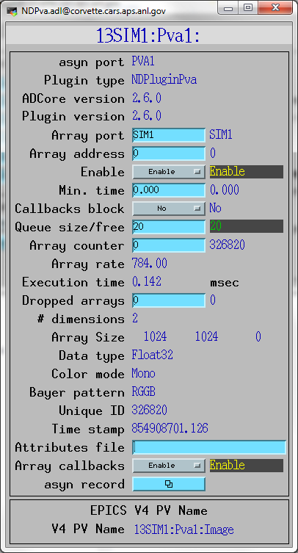
NDPluginPva
New plugin that converts NDArrays into the EPICSv4 normative type NTNDArray
An embedded EPICSv4 server serves the new NTNDArray structure as an EPICSv4 PV
High performance, ~3.2GB/s shown here
Can be received by any EPICSv4 client
Java, Python, C++ versions of pvAccess
CSS has a widget that can display NTNDArrays
caQtDM has a new camera widget to display NTNDArrays
Tim Madden is writing a version of the Java areaDetector ImageJ plugin based on pvAccess; will talk to this plugin
Can include an NTNDArray receiver in another IOC

Slide 12
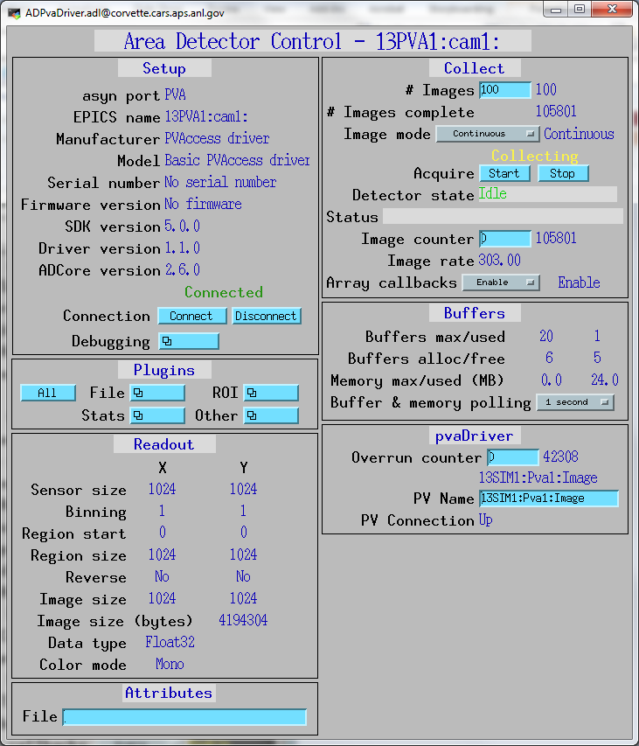
pvAccess Driver
New pvAccess driver receives NTNDArrays over the network, converts to NDArrays and calls plugins
Can be used to run areaDetector IOC and plugins on another machine or in another process
High performance:
~1.2 GB/s shown here with interprocess communication
Saturating 10 Gb Ethernet links has been demonstrated

Slide 13
pvAccess: Command Line Tools
>pvinfo 13SIM1:Pva1:Image
CHANNEL : 13SIM1:Pva1:Image
STATE : CONNECTED
ADDRESS : 164.54.160.82:5075
epics:nt/NTNDArray:1.0
union value
boolean[] booleanValue
byte[] byteValue
short[] shortValue
int[] intValue
…
uint[] uintValue
ulong[] ulongValue
float[] floatValue
double[] doubleValue
…
int uniqueId
time_t dataTimeStamp
long secondsPastEpoch
int nanoseconds
int userTag
…
>pvget 13SIM1:Pva1:Image -r 'field(uniqueId,dimension)'
13SIM1:Pva1:Image
structure
int uniqueId 886580
dimension_t[] dimension
dimension_t
int size 1024
int offset 0
int fullSize 1024
int binning 1
boolean reverse false
dimension_t
int size 1024
int offset 0
int fullSize 1024
int binning 1
boolean reverse false

Slide 14
NDPluginPVA and pvAccess Driver Demo

Slide 15
NDDriverStdArrays
Driver that allows any EPICS Channel Access client to create NDArrays in an areaDetector IOC.
Logical inverse of NDPluginStdArrays
That plugin converts NDArrays in an IOC into standard EPICS waveform records for use by Channel Access clients.
Also writes to additional records to describe the array structure. (SizeX, SizeY, ColorMode, etc.)
NDDriverStdArrays
This driver receives EPICS waveform records from CA clients
Converts them to an NDArray in the IOC.
Clients must also write to additional EPICS records to define the structure of the NDArray.
Similar in concept to pvaDriver
pvaDriver only works with EPICS V4 PVAccess clients
NDDriverStdArrays works with EPICS V3 Channel Access clients.

Slide 16
NDDriverStdArrays Use Case David Vine, LBNL
Display data from sscan record
Simple Python client reads data from sscan record, writes to NDDriverStdArrays
Allows real-time display of 2-D scans
Can write data in standard HDF5 file format
Any other AD plugins can be used on the scan data

Slide 17
NDDriverStdArrays
Driver receives 1-D arrays, normally from an EPICS waveform record.
NDimensions record controls actual number of dimensions to use when creating the NDArray.
Dimensions array record controls actual size of each of the NDimensions dimensions.
ColorMode record can be used to define the color mode (Mono, Bayer, RGB1, RGB2, or RGB3) of the NDArray.
Data type of the NDArray set by the DataType record.
Int8, UInt8, Int16, UInt16, Int32, UInt32, Float32, or Float64.
Datatype (FTVL) of the EPICS waveform record can be
CHAR, UCHAR, SHORT, USHORT, LONG, ULONG, FLOAT, or DOUBLE.
Driver does any required type conversion between the waveform record data and the NDArray data.

Slide 18
NDDriverStdArrays
2 modes of operation, AppendMode=Disable/Enable
Disable: each write to the waveform record generates a complete NDArray.
Enable: waveform record contains just part of the NDArray data; data appended by multiple writes to the waveform record to construct the complete NDArray. sscan record client would work in this mode
Records in Enable mode:
NewArray, NextElement, Stride, ArrayComplete
CallbackMode record controls when the driver does callbacks
OnUpdate, OnComplete, OnCommand

Slide 19
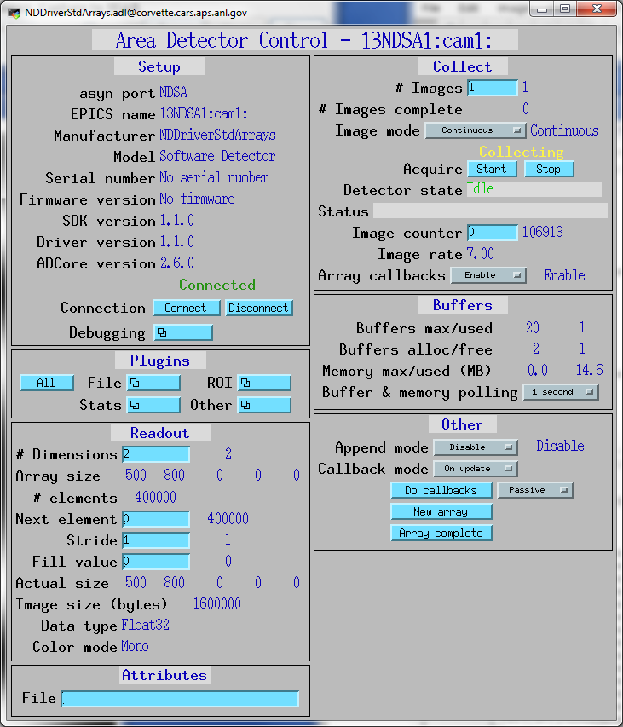

Slide 20
NDDriverStdArrays Demo
Runs Python Unit Tests
Complete NDArrays
Line scans (appends line at a time)
Point scans (appends pixel at a time)
4 detectors signals, sent to 4 ROIs

Slide 21
Pilatus Driver Update
Now supports Energy and ThresholdEnergy independently
ThresholdEnergy is used to set per-pixel discriminators
Energy is used to compute the correct flat-field normalization
Previously EPICS only exposed ThresholdEnergy
Camserver was supposed to set Energy=2*ThresholdEnergy
Bug in some versions of camserver, e.g. our new 1M CdTe detector. It was freezing Energy at 60 keV, and we collected an entire run of improperly normalized data
There are occasions when ThresholdEnergy = Energy/2 is not the optimum setting, i.e. to avoid strong fluorscence.

Slide 22
Pilatus Driver Update
If camserver is saving TIFF files then driver now reads the TIFFImageDescription tag from the TIFF file.
This is a long string that camserver writes to the file containing all of the detector settings, including threshold, energy, etc.
Driver adds this information to the NDArray using an NDAttribute called TIFFImageDescription.
The NDFileTIFF plugin in ADCore R2-6 was changed to write this complete attribute to the TIFFImageDescription tag in the new TIFF file.
It will also be written by the NDFileNetCDF, NDFileHDF5, and NDFileNexus plugins.
However these plugins are currently limited to 256 character string attributes, so some of the information will be lost because the string is longer than 256 characters.

Slide 23
ADAndor
Added support for Electron Multiplying (EM) Gain.
Added ability to set the BaselineClamp in the Andor SDK.
Enforce minimum values of ADShutterOpenDelay and ADShutterCloseDelay based on query of SDK.
Implemented ReverseX and ReverseY.
Fixed bug with AndorPreAmpGain; previously it was not actually calling SetPreAmpGain().
Added support for Full Vertical Binning (FVB) readout mode.
Added support for EPICS shutter control.

Slide 24
Pixirad driver update
CdTe pixel array detector available with multiple chips.
Detector pool has Pixirad-2, 402x1024. Now working at 1-ID.
Updated driver to work with new PIII chip.
Square 62 um pixels pixels, not hexagonal.
Single chip is 402x512 pixels.
Pixel mode (PM). Each pixel is independent.
Highest rate capability ( > 1MHz), no sharp color separation, multiple counts if threshold is low.
Neighbor Pixel Inhibit mode (NPI).
Only one counter per event allowed to count. The hit is allocated to the pixel receiving the highest fraction of the total charge. Highest position resolution and the lowest possible noise but sharpness of the color separation not completely solved yet
Pixel Summing mode (PSM).
The signals of 4 neighbor pixels are summed together in each pixel to correctly evaluate the total energy of any event involving up to 4 pixels.

Slide 25
Other detectors
New ADCameraLink, ADPCO drivers
Drivers for PCO cameras from Tim Madden
New ADLambda driver
Driver for Lamda pixel array detectors from John Hammonds
Many detectors (Pilatus, Prosilica, Point Grey, marCCD, mar345, Andor, etc.)
Added support for SerialNumber, FirmwareVersion, SDKVersion, DriverVersion, and ADCoreVersion which were added in ADCore R2-6.
ADSimDetector, ADCSimDetector, pvaDriver
Moved out of ADExample and into their own repositories
ADExample no longer used

Slide 26
ADSupport
New repository ADSupport
Source code for all 3rd party libraries used by ADCore.
hdf5, jpeg, netCDF, nexus, szip, tiff, xml2, zlib
ADBinaries no longer used.
Pre-built libraries for Windows too difficult to maintain, now all built from source using EPICS build system
ADSupport can be built for
Windows (Visual Studio or MinGW, 32/64 bit, static/dynamic),
Linux (currently Intel architectures only, 32/64 bit),
Darwin
vxWorks (currently big-endian 32-bit architectures only).
vxWorks previously supported only netCDF file plugin
All file saving plugins now supported on vxWorks 6.x (TIFF, JPEG, netCDF, HDF5, Nexus).
HDF5 and Nexus are not supported on vxWorks 5.x because the compiler is too old.
Could imagine migrating saveData to HDF5 since it now works on all platforms.

Slide 27
Optional Support
All 3rd party libraries now optional.
For each library XXX 4 Makefile variables control support for that library. XXX can be JPEG, TIFF, NEXUS, NETCDF, HDF5, XML2, SZIP, and ZLIB.
WITH_XXX YES then drivers or plugins that use this library will be built. NO then drivers and plugins that use this library will not be built.
XXX_EXTERNAL YES then the library is not built in ADSupport, but assumed to be found external to the EPICS build system. NO then the XXX library will be built in ADSupport.
XXX_DIR If defined and XXX_EXTERNAL=YES then the build system will search this directory for the XXX library.
XXX_INCLUDE If defined then the build system will search this directory for the include files for the XXX library.
All EPICS modules except base and asyn are now optional.

Slide 28
NDPluginOverlay
New Ellipse shape to draw elliptical or circular overlays.
Improved efficiency by only computing the coordinates of the overlay pixels when the overlay definition changes or the image format changes.
Important for ellipse because it uses trig functions
Added CenterX and CenterY parameter for each overlay.
Can now specify the overlay location either by PositionX and PositionY, (upper left corner), or by CenterX and CenterY,
If CenterX/Y is changed then PositionX/Y will automatically update, and vice-versa.
Changed the meaning of SizeX and SizeY for the Cross overlay shape.
Previously the total size of a Cross overlay was SizeX*2 and SizeY*2.
It is now SizeX and SizeY.
Now consistent with the Rectangle and Overlay shapes, i.e. drawing each of these shapes with the same PositionX and SizeX/Y will result in shapes that overlap in the expected manner.

Slide 29
Other Plugin Enhancements
All plugins: ElapsedTime PV for last execution.
This gives the execution time in ms the last time plugin ran.
Works both with BlockingCallbacks=Yes and No.
Convenient for measuring plugin performance without having to run detector at high frame rates.
NDPluginROI
Added CollapseDims to optionally collapse (remove) output array dimensions whose value is 1. For example an output array that would normally have dimensions [1, 256, 256] would be [256, 256] if CollapseDims=Enable
NDPluginStats
Added calcuations of 3rd and 4th order image moments, this provides skewness and kurtosis.
Added eccentricity and orientation calculations.
NDPluginFile
If the NDArray contains an attribute named FilePluginClose and the attribute value is non-zero then the current file will be closed.

Slide 30
Base Class Enhancements
asynNDArrayDriver, NDArrayBase.template, NDPluginBase.adl, ADSetup.adl, all plugin adl files
ADCoreVersion_RBV, DriverVersion_RBV.
Show the version of ADCore and of the driver or plugin that the IOC was built with.
ADDriver, ADBase.template, ADSetup.adl
SerialNumber_RBV, FirmwareVersion_RBV, and SDKVersion_RBV.
Show the serial number and firmware version of the detector, and the version of the vendor SDK library that the IOC was built with.
Because NDPluginBase.adl and ADSetup.adl grew larger all plugin and driver adl files have changed their layouts.

Slide 31
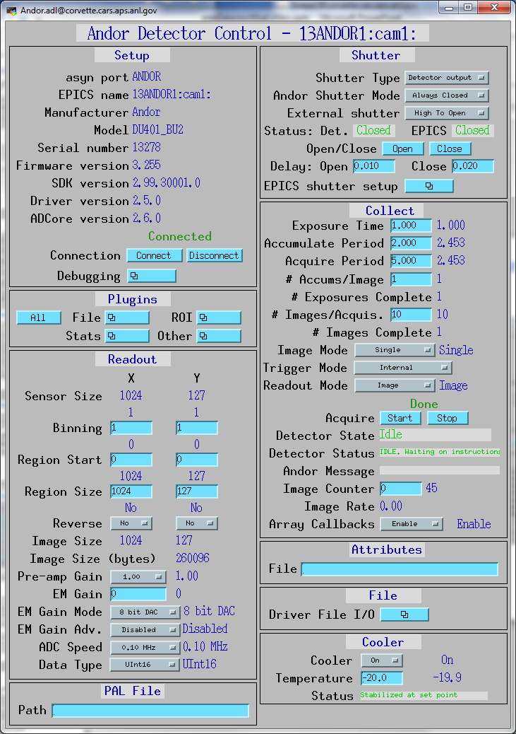
Base Class Enhancements

Slide 32
Viewers
EPICS_AD_Viewer enhancements
Automatically set the contrast when a new window is created.
Eliminates the need to manually set the contrast when changing image size, data type, and color mode in many cases.
When image window is automatically closed and reopened because the size, data type, or color mode changes the new window is now positioned in the same location as the window that was closed.
Gaussian Profiler
Like the normal ImageJ line profile in “live” mode, but with fitting of Gaussian and live display of fit parameters

Slide 33
Viewers
EPICS_AD_Controller. Allows using the ImageJ ROI tools (rectangle and oval) to graphically define the following:
The readout region of the detector/camera
The position and size of an ROI (NDPluginROI)
The position and size of an overlay (NDPluginOverlay)
The plugin chain can include an NDPluginTransform plugin which changes the image orientation and an NDPluginROI plugin that changes the binning, size, and X/Y axes directions. The plugin corrects for these transformations when defining the target object.
Chris Roehrig wrote an earlier version of this plugin.

Slide 34
Viewer Demo

Slide 35
Future Ideas: ADCore R3-0
Put more functionality into ADDriver base class
Currently it does not do much, all code is in each driver for:
Doing callbacks to plugins
Processing new exposure time with writeFloat64 function
writeFloat64 in ADDriver base class would call setExposure() in derived class
Derived class would call ADDriver::doPluginCallbacks(), which would handle setting attributes, getting timestamp, calling plugins, etc.
Model 3 motor driver and quadEM, which also use asynPortDriver, are written this way
Demultiplexor/multiplexor plugin
Allow multiple plugins to work on the same data stream when it saturates a single core
Simplify file saving modes (no more Single, Capture, Stream)

Slide 36
Future Ideas: ADCore R4-0
Change NDArray to NTNDArray for passing data to plugins
Utilize EPICS V4 infrastructure
Smart pointers automatically eliminate all unnecessary copying
V4 clients can immediately receive data with no need to convert to waveform records
Bruno Martins has demonstrated this working
Seems like a good path for the future

