Slide 1
Welcome to the
2017 New York Scientific Data Summit

Slide 2
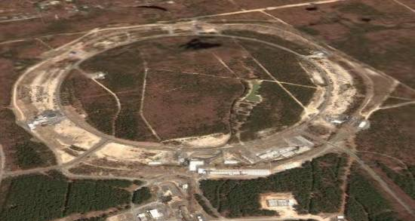
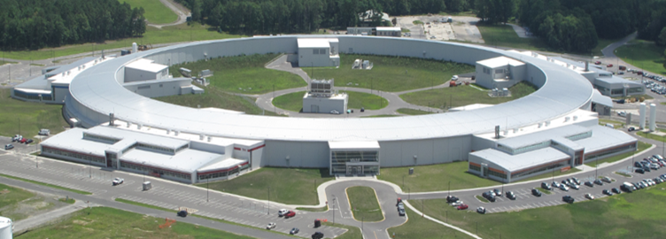
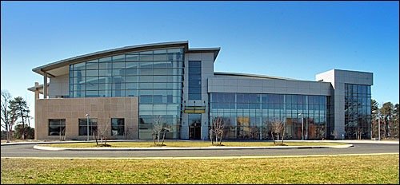
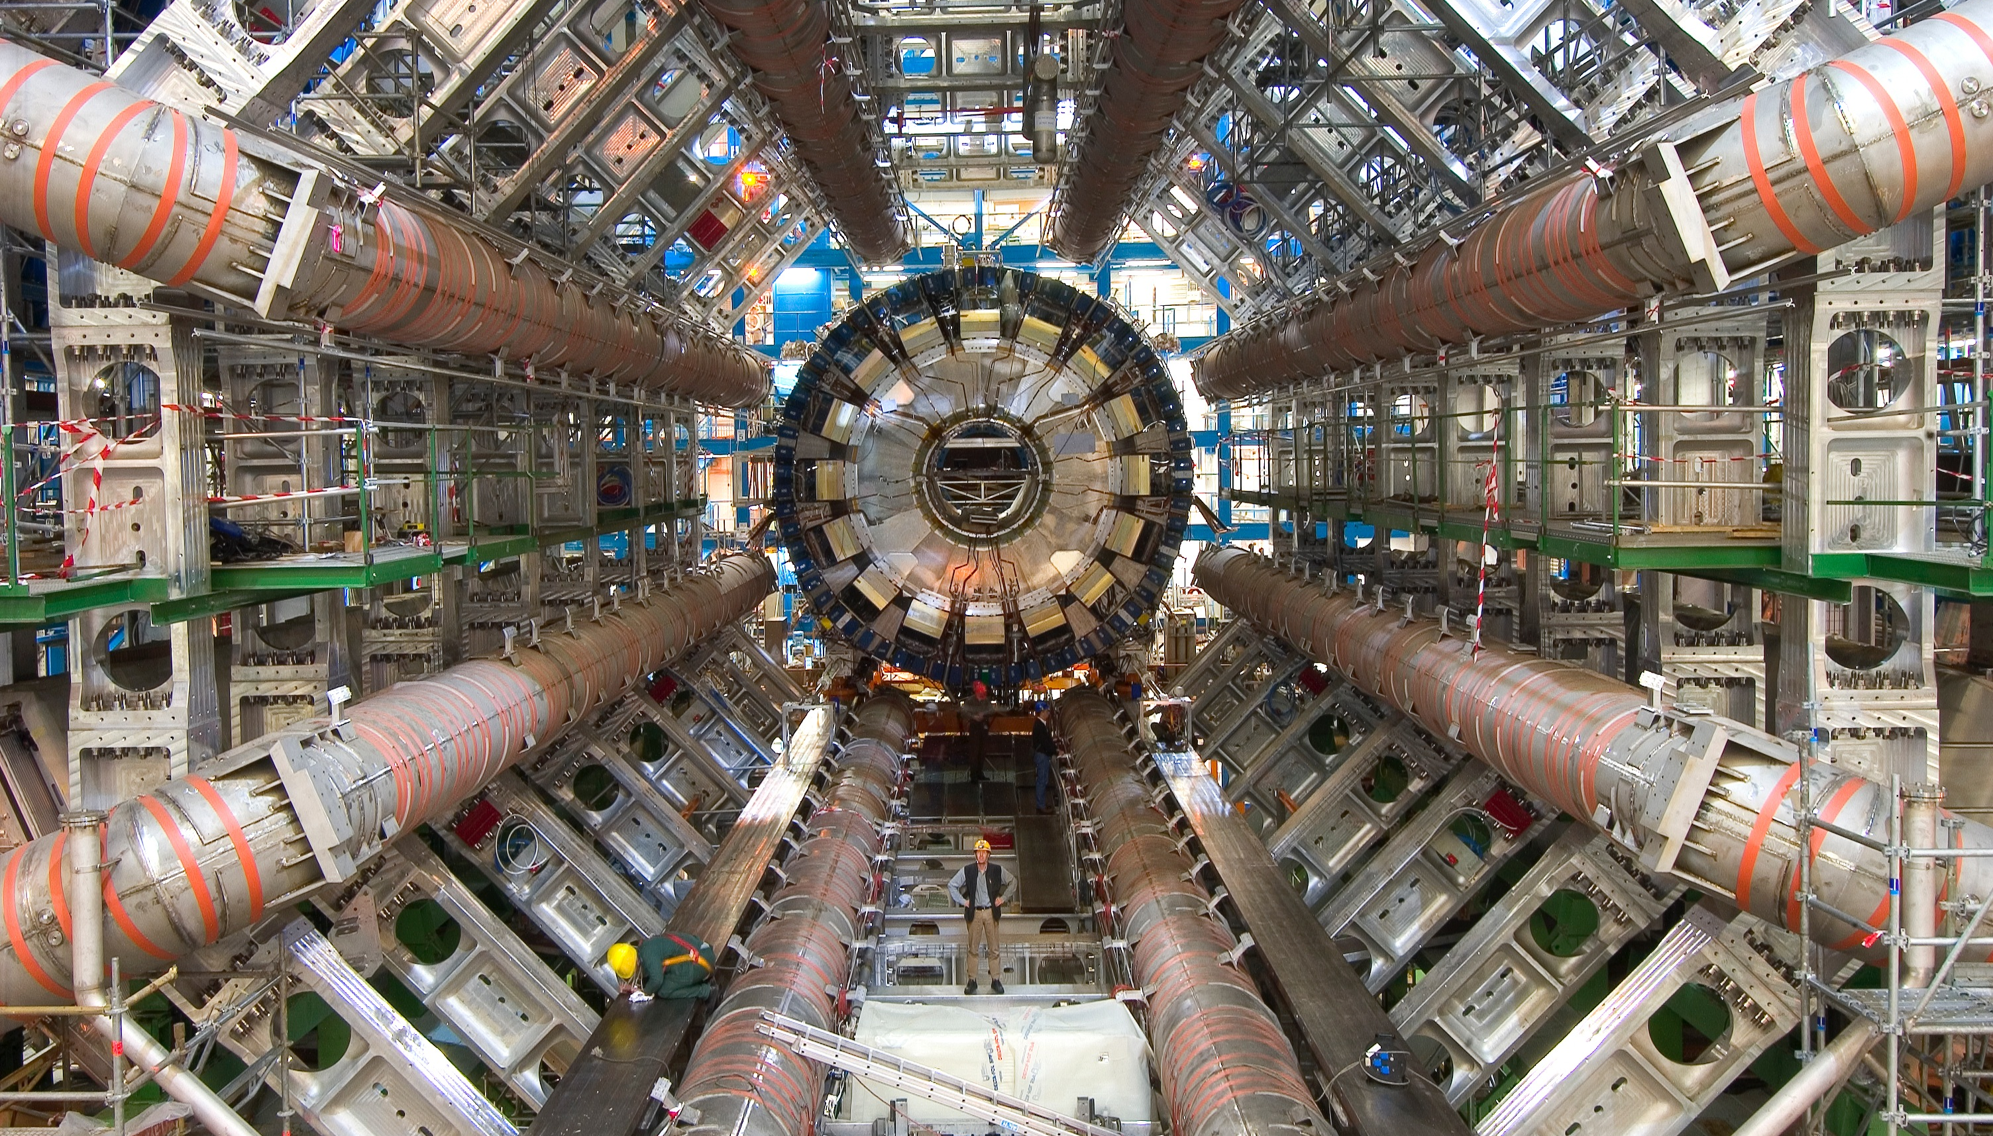
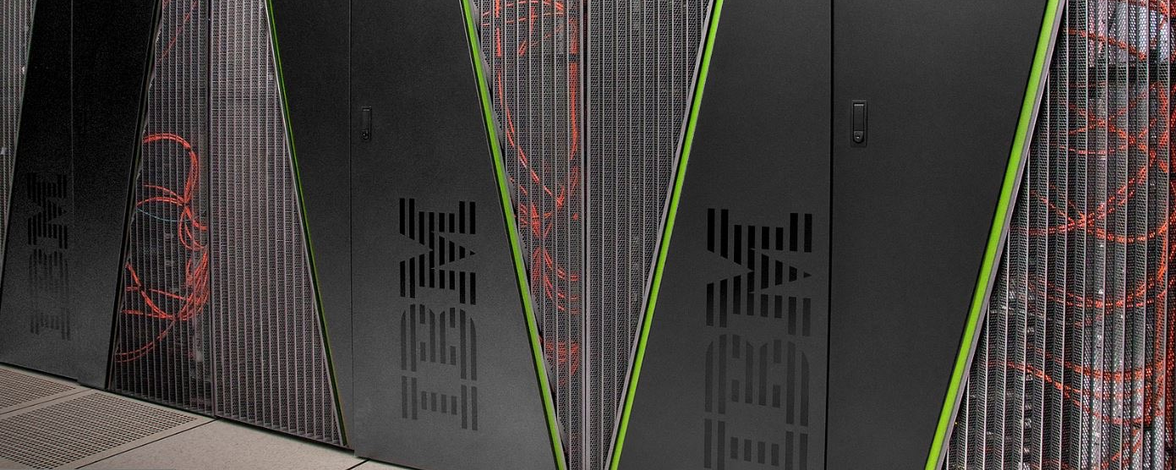
Why is BNL Interested in Big Data?
BNL provides Data-rich Experimental Facilities:
RHIC - Relativistic Heavy Ion Collider - supporting over 1000 scientists world wide
NSLS II - Newest and Brightest Synchrotron in the world opened in the world, supporting a multitude of scientific research in academia, industry and national security
CFN - Center for Functional Nanomaterials, combines theory and experiment to probe materials
BNL supports large scale Experimental Facilities:
STAR/PHENIX - the RHIC experiments
LHC ATLAS - Largest Tier 1 Center outside CERN
ARM - Atmospheric Radiation Measurement Program - Partner in multi-side facility, operating its external data Center
QCD - Facilities for BNL, RIKEN & US QCD communities
RHIC
NSLS II
CFN
ATLAS
QCD

Slide 3
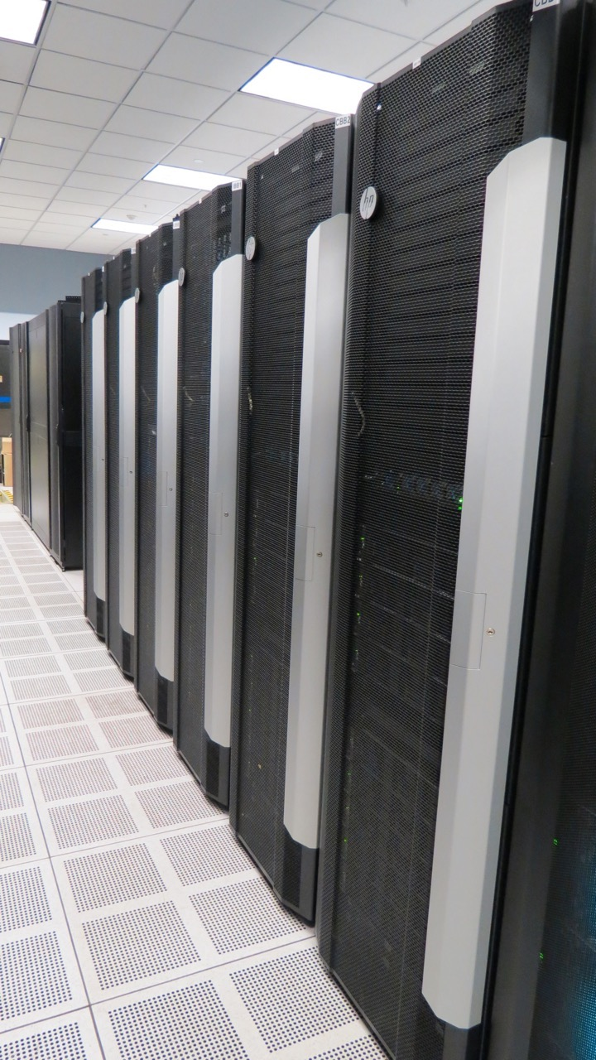
Extreme Scale Data is Key
World leading Data Archive and Analysis Facility
2nd largest archive in the US, 4th largest in the world (ECMWF, UKMO, NOAA)
Annual Data Statistics: 35 PB ingest, 37 PB export, 400 PB analyzed, up to 200TB/day transferred
~1.6 EXBytes of data processed through PanDA last year
70,000 High Throughput Computing Cores, HPC - IBM BG/Q, 2 new HPC Computer Systems
Current 200GB/s external network link will be upgraded to 300GB/s in 2017
17 Data Services, ~1700’s active users
http://www.hpss-collaboration.org/learn_who_petabyte_data.shtml

Slide 4
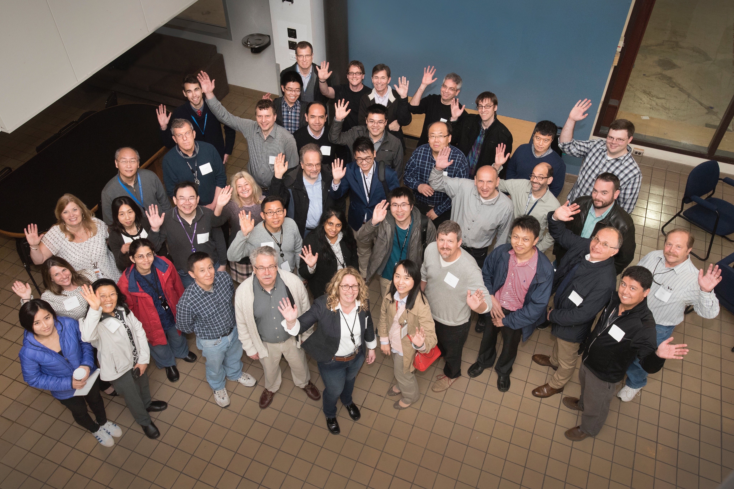
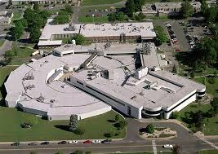
Computational Science Initiative (CSI)
Established December 2015
Vision - Translating Leading Computer Science and Applied Mathematics Research into Measurably Improved Scientific Discovery Processes
Focus - Data Analysis, Numerical Modeling Support for Experiments, Reusable Knowledge Repositories
Structure -
Scientific Data and Computing Center
Computer Science and Applied Math Research,
Computational Science Laboratory
Center for Data Driven Discovery
At present 90 staff and students
CSI’s New Home, incl. new Data Center (CFR)

Slide 5
Provides a Rich Data Analysis Environment
High Throughput Computing:
Since 2001 - RHIC and LHC ATLAS Computing - Largest Tier 1 Center in the world, ~250 Computer Racks
High Performance Computing:
3.5 Rack BlueGene/Q – 3584 nodes, 64512 cores, just received 2 more racks
2016 Institutional Cluster: 108 (upgrade to 200 in FY17) compute nodes of 2 Intel Xeon E5-2695V4 Broadwell CPU’s ,36 / 2.1 GHz, 2 Nvidia K80 GPUs, 256 GB of ECC RAM. EDR Infiniband. 1 PB disk - to be doubled in 2017
2016 Novel Data-Intensive Architecture Testbed Facility:
Initial system: 144 Intel Xeon Phi Processors 7230 (Knights Landing), 64 /1.3 GHz, 2 x 512 GB SSDs, 192 GB of ECC RAM, Intel Omni-Path 100 series network in a non-blocking configuration.
2016 BNL Cloud
2017 Coming - BNLBox

Slide 6
New Initiatives - Making Sense of Data at Exabyte-Scale and Beyond
Real-Time Analysis of Ultra-High Throughput Data Streams
Integrated, extreme-scale machine learning and visual analytics methods for real time analysis and interpretation of streaming data.
New in situ and in operando experiments at at large scale facilities (e.g., NSLS-II, CFN and RHIC)
Data intensive science workflows possible in the Exascale Computing Project
Analysis on the Wire
Autonomous Optimal Experimental Design
Goal-driven capability that optimally leverages theory, modeling/simulation and experiments for the autonomous design and execution of experiments
Complex Modeling Infrastructure
Interactive Exploration of Multi-Petabyte Scientific Data Sets
Common in nuclear physics, high energy physics, computational biology and climate science
Integrated research into the required novel hardware, system software, programming models, analysis and visual analytics paradigms

Slide 7
This Years Summit

Slide 8
Summit Themes
Day 1
Streaming Data Analysis
Autonomous Experimental Design and Optimization
Day 2
Performance for Big Data
After Dinner Speech on Big Theory for Big Data
Day 3
Interactive Exploration of Extreme Scale Data

Slide 9
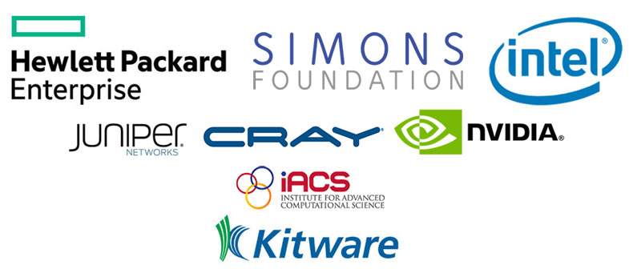
Big Thank you to our Workshop Sponsors!

Slide 10
WIFI Details
Guest ID: guest130
Password: boliengu

Slide 11
Have a great Summit!

