Slide 1

Building Near-Real-Time Processing Pipelines with the Spark-MPI Platform
Nikolay Malitsky, Aashish Chaudhary, Patrick O’Leary, Matt Cowan, Sebastien Joudain, Marcus Hanwell, and Kerstin Kleese Van Dam
New York Scientific Data Summit:
Data-Driven Discovery
August 7, 2017
Kitware

Slide 2
Outline
Rationale
Spark-MPI approach
Ptychographic application
Tomographic application
Future directions

Slide 3
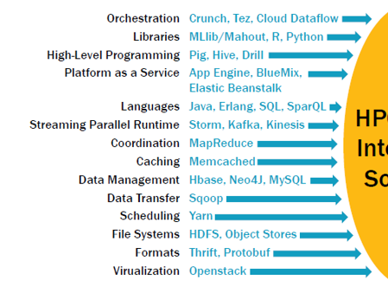
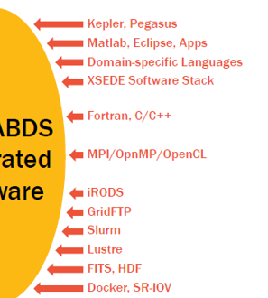
Closing a Gap between Big Data and HPC Computing
Ecosystems*:
Big Data
HPC Computing
New Frontiers
Leaders:
Spark
MPI
*Geoffrey Fox et al. HPC-ABDC High Performance Computing Enhanced Apache Big Data Stack, CCGrid, 2015

Slide 4
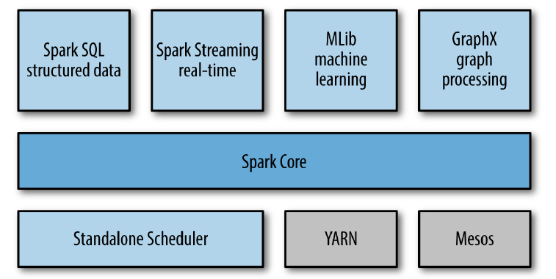
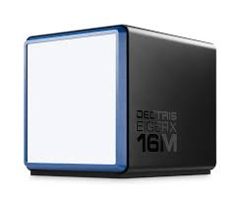

In Situ, Streaming, Data- and Compute-Intensive Platform for Experimental Data
Kitware and BNL, DOE ASCR SBIR’17 Phase I grant
Ptychography
Tomography
GISAXS
Deep Learning
…
Data-Information-Knowledge Discovery Path
Beamline Applications
Spark-MPI
topics of this talk
Resilient Distributed Dataset API
Composite Connector (s)
Receiver (s)
Heterogeneous Data Layer
X-Ray
Detector
Big Velocity
Big Volume + Variety

Slide 5
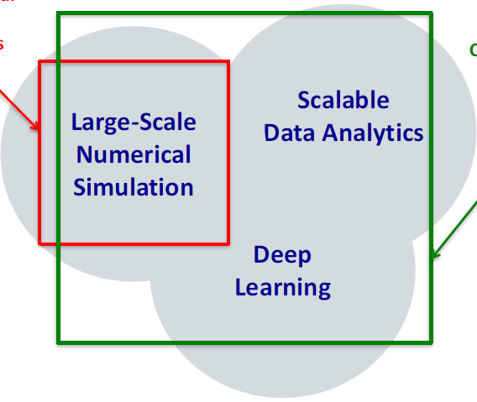
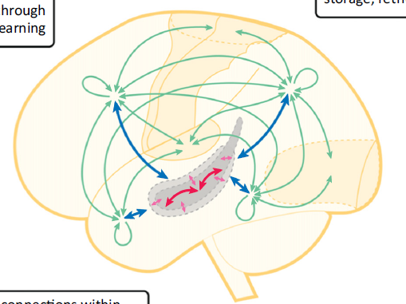
Approaching the Fifth Paradigm of Cognitive Applications
by consolidating Big Data frameworks on HPC clusters
CORAL Supercomputers
and Exascale Systems
5th Paradigm:
Cognitive Applications
The consolidation of the HPC and Big Data machine learning technologies represents the prerequisite for developing the next paradigm of cognitive applications
Traditional HPC Systems
DeepMind Deep Reinforcement Learning
IBM Watson
AI2 Aristo
4th Paradigm:
Data-Intensive Science
3rd Paradigm: Computational Science
Figure 2: Integration of Simulation, Data Analytics, and Machine Learning²
Figure 1: The Fifth Paradigm¹
Neocortex /
Heterogeneous Knowledge and Information Network
Hippocampus /
Streaming Pipeline
Figure 3: Complementary Learning Systems³
⁽¹⁾ Nikolay Malitsky, Approaching the Fifth Paradigm, Future Online Analysis Platform Workshop, 2017
⁽²⁾ Rick Stevens, Deep Learning in Cancer: Example for BDEC, BDEC, 2017
⁽³⁾ Dharshan Kumaran, Demis Hassabis, and James L. McClelland, What Learning Systems do Intelligent Agents Need ?
Complementary Learning Systems, Trends in Cognitive Sciences, 2016

Slide 6
Spark-MPI Approach

Slide 7
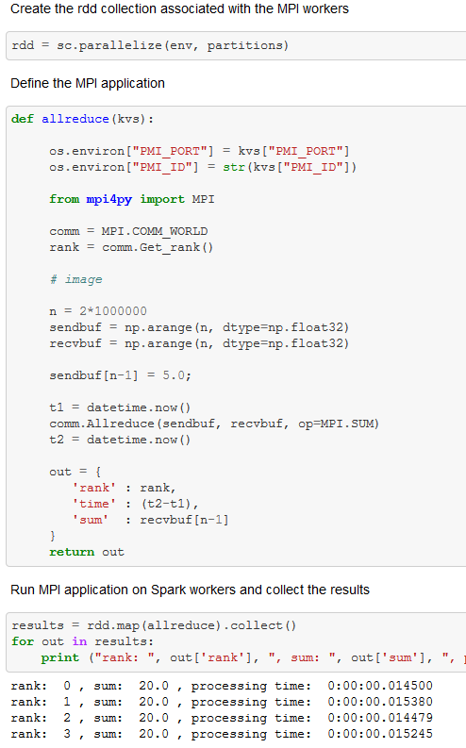
Spark-MPI AllReduce Demo
https://github.com/SciDriver/spark-mpi/tree/master/examples/spark/
PMI Server variables
PMI Server
Driver
Worker
Worker
MPI interface
Worker
Worker
Interfaces
Spark driver-worker
PMI server-worker
MPI inter-worker

Slide 8
Streaming Demo with the Kafka Streaming Platform and Spark-MPI
Kafka Producer
Kafka Cluster
Spark Pipeline
Kafka Receiver
RDD
Partition
Kafka Topics
Spark Workers
Kafka Receiver
RDD
Partition
Creating topic-specific RDDs
Spark Driver
Union
Operation
MPI Application
Topic-Init
init
clean
one micro-batch
PMI Server

Slide 9
Ptychographic Application

Slide 10
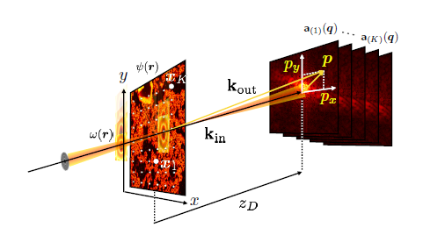


Ptychography
Ptychography is one of the essential image reconstruction techniques used in light source facilities. This method consists of measuring multiple diffraction patterns by scanning a finite illumination (also called the probe) on an extended specimen (the object).
Stefano Marchesini et al. SHARP: a distributed, GPU-based ptychographic solver, J. Appl. Cryst., 49, 2016

Slide 11
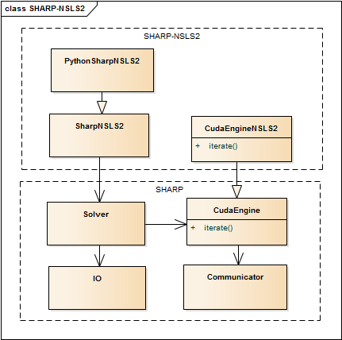
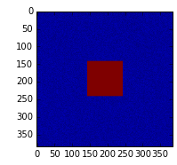
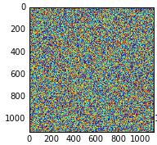
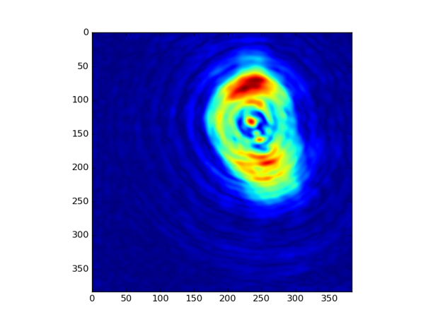
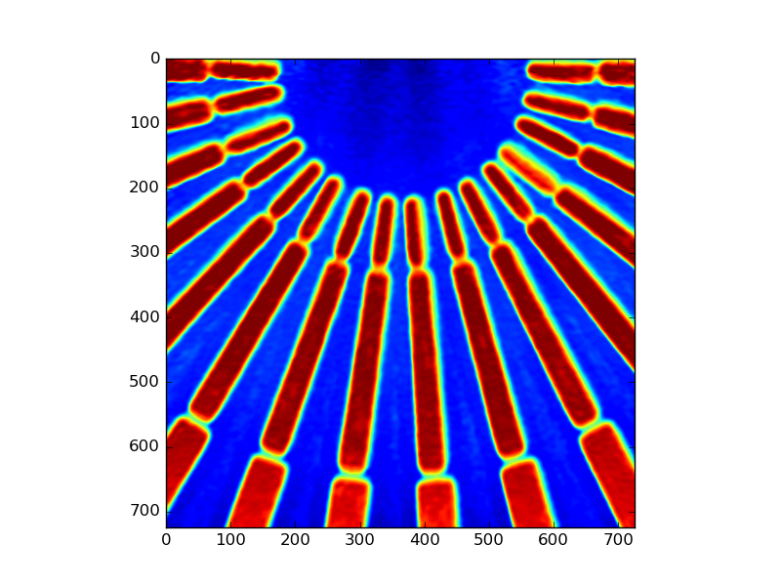
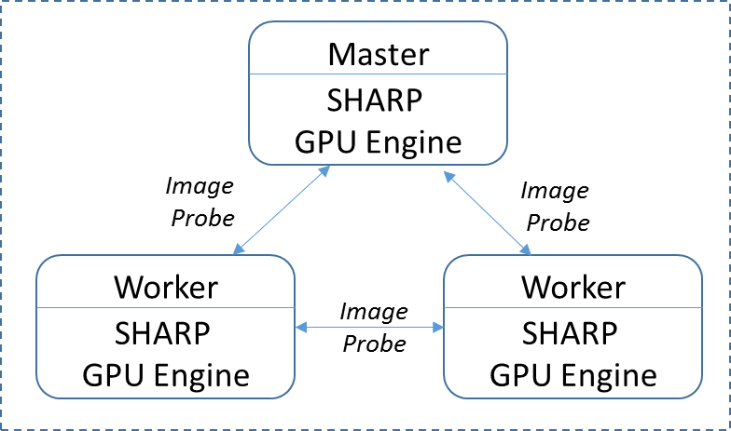
Near-Real-Time Ptychographic Pipeline
NYSDS’16
SHARP-NSLS2¹
Probe
Object
Xiaojing Huang, HXN Approach NSLS-II, BNL
Stefano Marchesini et al. SHARP GPU-based Framework,
Center for Advanced Mathematics for Energy Research, LBNL
NYSDS’17
Simulator
Kafka Producer
one micro-batch:
512 frames, 25 s
SHARP-NSLS2 MPI-GPU engine
25 s
1 Tesla K80: 23 s
2 Tesla K80: 14 s
4 Tesla K80: 9 s
ptychographic
projections
⁽¹⁾Nikolay Malitsky. Bringing the HPC Reconstruction Algorithms to Big Data Platforms, NYSDS, 2016

Slide 12
Tomographic application
Kitware

Slide 13
Transmission Electron Microscopy
Three-dimensional (3D) characterization of materials at the nano- and meso-scale has become possible with transmission and scanning transmission electron microscopes (S/TEM. We are using publicly accessible data from our collaborators referred to in a nature article (https://dx.doi.org/10.6084/m9.figshare.c.2185342). All of the files contained in the dataset are in 16 bit tiff image format.
Objective: Perform near real-time reconstruction leveraging existing serial and MPI-enabled parallel algorithms, image processing, and then visualization in parallel using parallel rendering

Slide 14
Tomographic Pipeline
Load a transmission electron microscopy (TEM) dataset into a Spark RDD
Repartition the data to ensure the neighboring pixel are in the same partition for reconstruction algorithm.
Apply Algebraic Reconstruction Technique (ART) implemented in TomViz on each partition in parallel using the Spark map-collect operations
Gather the resulting reconstruction 3D dataset and render it using ParaView
TEM dataset
Partitioning
SPARK
Reconstruction
TomViz ART
Visualization
SPARK-MPI
ParaView

Slide 15
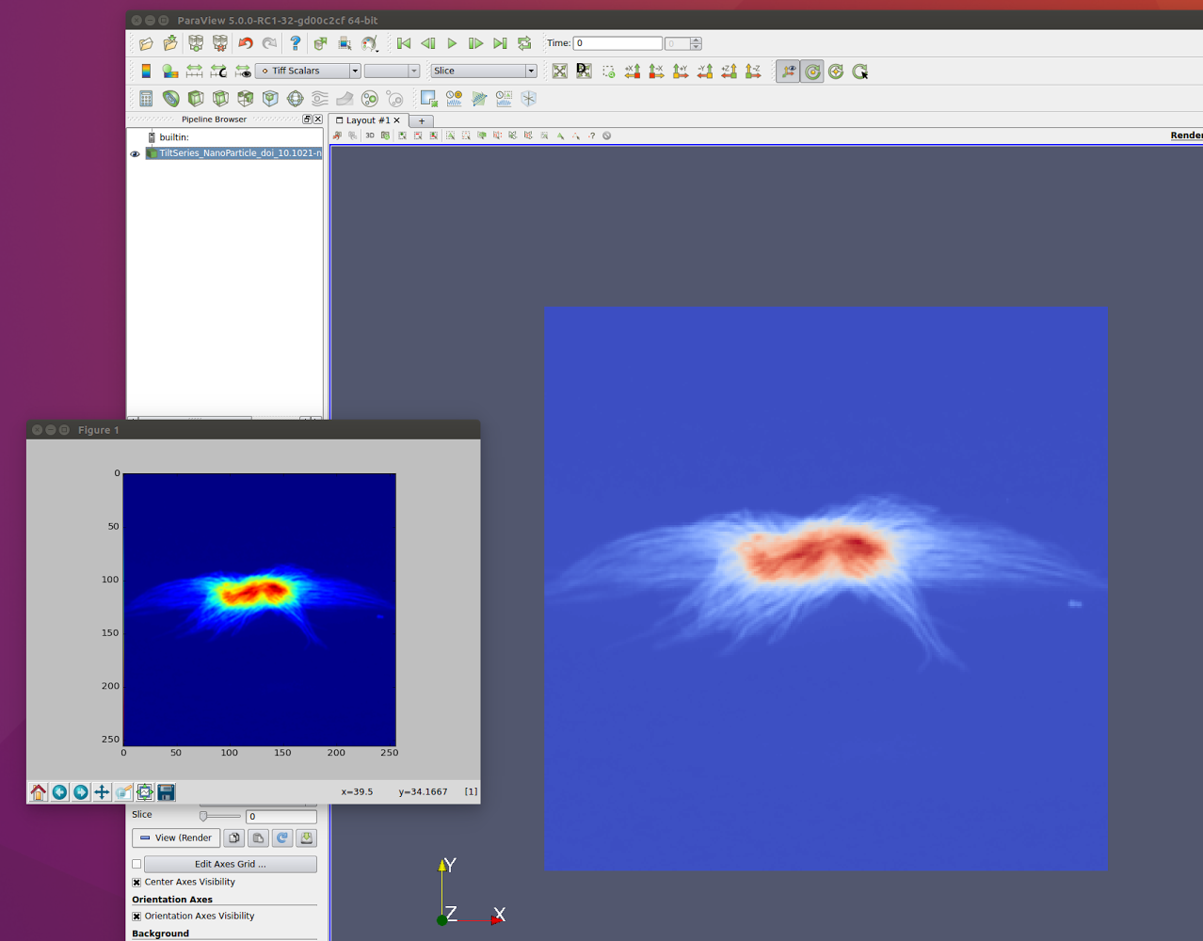
Scientific Data Ingestion – Column Storage
Goal: Ingest scientific data into Spark/Hadoop ecosystem
Input: TEM data
Approach: TEM data ingested into HDFS using Parquet (https://parquet.apache.org) format which provided both RDD and DataFrame.
Added following metadata to the parquet format:
  Tilt angles (data for each slice, hence this would be an array),
  Pixel size (dimensionality) (nanometers usually), and
  Shape of the array
Another approach is reading the data as NUMPY and using Spark parallelize to distribute it across nodes
Perform a conversion from the NumPy array to a VTK data structure before sending the dataset to the ParaView

Slide 16
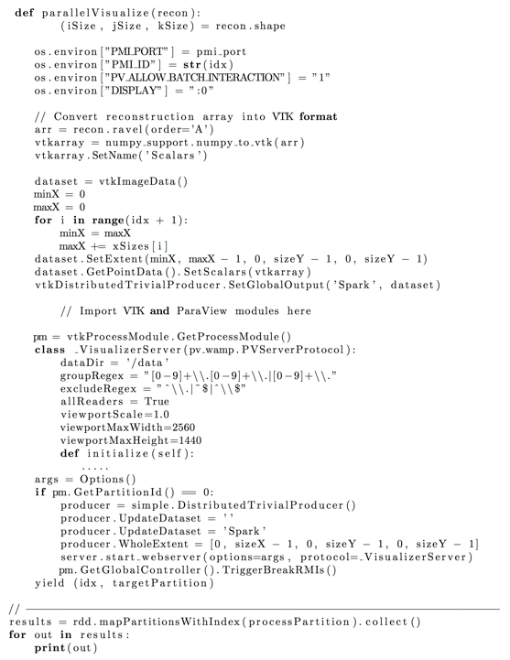
Parallel Visualization using ParaView and MPI
Perform the rendering and visualization utilizing ParaView that employs the MPI environment for parallelization

Slide 17
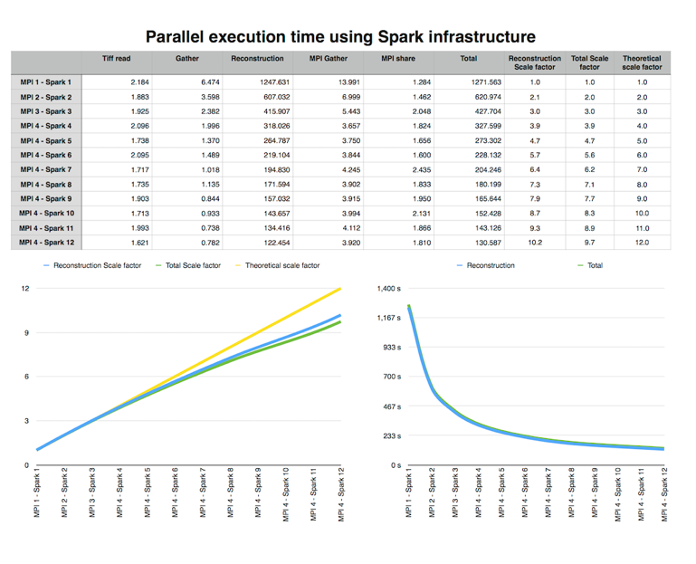
Performance
Metrics using 128 GB of memory, and 16 Intel(R) Xeon(R) CPU E5-2640 v3 @ 2.60GHz processors for the 256x256x74 TEM demonstration that produced a 256x256x256 reconstructed dataset.
Varied number of Spark workers (from 1 to 12), which performs the reconstruction, and the number of MPI ranks (from 1 to 4), which implements the visualization.
The total of ART went down to ~300 secs, an improvement of 6x over the implementation in TomViz

Slide 18
FUTURE DIRECTIONS

Slide 19
Climate Application
Problem Description: Perform insitu analysis and visualization in high resolution climate models
Sample data - The NASA Earth Exchange Globally Downscaled Projections (NEX-GDDP) dataset (https://cds.nccs.nasa.gov/nex-gddp) is comprised of downscaled climate scenarios for the globe that are derived from General Circulation Model (GCM) runs conducted under the Coupled Model Intercomparison Project Phase 5 (CMIP5) and across two of the four greenhouse gas emissions scenarios known as Representative Concentration Pathways (RCPs). The total size of the NEX-GDDP dataset is 12 TB with individual file size of 750MB.

Slide 20
Advancing Image Reconstruction Pipelines with Deep Learning Approaches
In collaboration with Shantenu Jha
DAQ
Streaming Pipeline
Pre-Processing
Development of deep learning approaches for analyzing reconstructed images
Development of streaming MPI-based deep learning applications
Development of machine learning approaches for steering pre-processing and reconstruction algorithms.
SPARK-MPI
Reconstruction
SPARK
DL Stack
Pre-Processing
Unsupervised
Learning
SPARK-MPI
Supervised
Learning
Reinforcement
Learning

