Slide 1
Statistical Data Reduction for Streaming Data
John Wu, Dongeun Lee, Alex Sim, Jaesik Choi
Scientific Data Management Group
Berkeley Lab

Slide 2
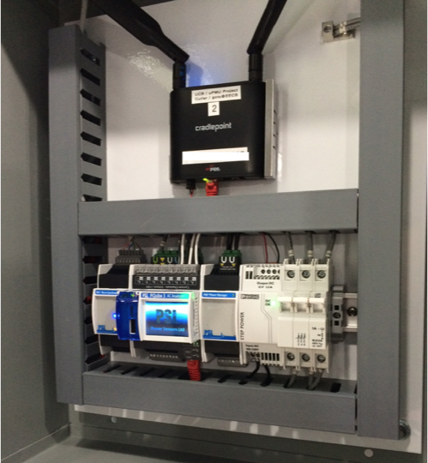
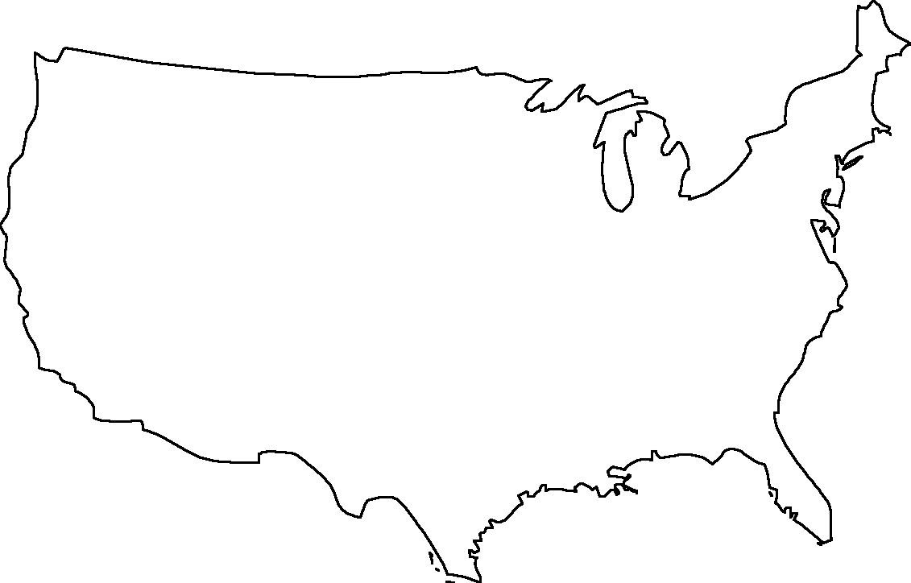
Streaming Sensor Data: μPMU for Electric Power Grid
Project μPMUs (present)
Additional μPMUs (present)
Additional μPMUs (prospective)
Berkeley LBNL
Alameda
PG&E
LBNL/CEC
LBNL/NSA
Navy Yard
DARPA
Pepco
Sandia
Tennessee
Riverside
SCE
Georgia
Alabama

Slide 3
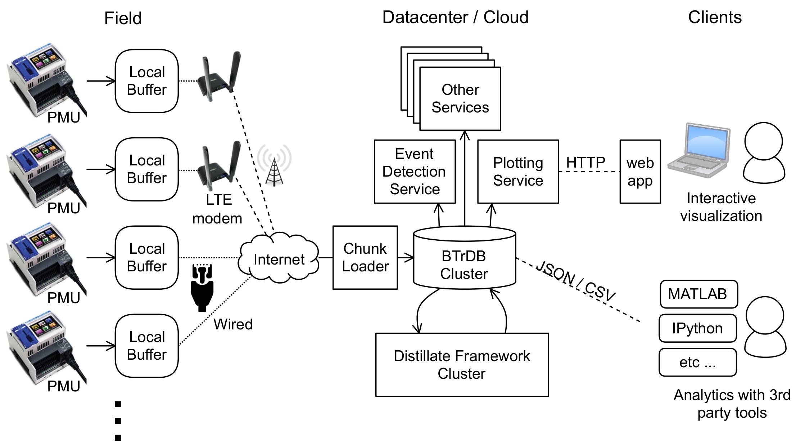
Example:μPMU Monitoring System
Archiver / Database
Stores (T, V) pairs
Nanosecond precision
Fault tolerant
Highly scalable
Unique abstraction
  query range (ver)
  insert values => ver
  delete range => ver
  query statistical (ver)
  compute diff(v1, v2)

Slide 4
Challenges in μPMU Data
Data management challenges: Immense time series data distributed around the US
  Grid monitoring: 1,700 PMUs in North America generate 2M insertions per second (ips)
  Grid usage data: 300M smart meters generate 0.33M ips
  Analytics: 120M queries per second
  Stream ALL the data to the cloud
Analytics challenges:
  Distillation infrastructure with extremely fast change set identification
  On-the-Fly statistical summaries over a multi-resolution store
  Multi-resolution search and process: e.g., find ‘needle’ events in immense haystacks instantly; drill down exponentially to analyze
Sensor data streams have similar data management and analysis challenges

Slide 5
What Compression Could Do?
Data compression is the science (and art) of representing information in a compact form.
  Widely used in Internet, digital TV, mobile communication
For μPMU data,
  Compression will reduce the data volume to be sent around the data network
  Compression will remove redundant information and make it easer to locate the interesting information

Slide 6
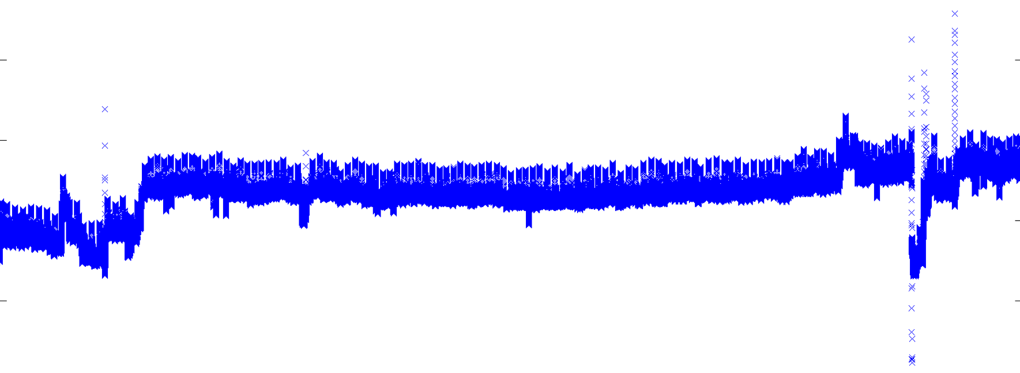
Characteristics of μPMU Measurements
Numerical values: voltage, current, phase angles for voltage and currents
Typically have a lot of “random” “small” fluctuations that are considered normal for the electric power grid system
Occasionally, has relatively “large” changes that require attention or intervention

Slide 7
Data Compression: Quick Review
Lossless compression
  gzip, 7-zip, PNG: work on repeated byte patterns
  Floating-point values compression
    FPC [Burtscher and Ratanaworabhan, 2009]: predictor+corrector
    Difficult to compress because the lower order bits typically change
Lossy compression
  Common techniques: JPEG, MP3
  Floating-point values compression techniques:
    ISABELA [Lakshminarasimhan, et al 2011]: sort + b-spline
    Scalar Quantization Encoding [Iverson, et al, 2012]; zfp [Lindstrom 2014]; sz [Capello 2016]
Challenges in compressing sensor data streams:
  Floating-point numbers: hard to compress
  “Random” fluctuations: hard to compress
Are there effective ways to compress random floating-point values?
  ZFP, SZ(EZ): effective for simulation data, which has natural continuity/smoothness
Notes:
Lossless compression is good because it keeps all the information in original data intact. But you do not expect enough data reduction.
On the other hand, lossy compression can reduce data size a lot, but at the expense of losing data quality.
To achieve this seemingly difficult goal, we designed a new data compression scheme. Then let’s see how IDEALEM works.

Slide 8
IDEALEM: New Perspective on Data Compression
IDEALEM (Implementation of Dynamic Extensible Adaptive Locally Exchangeable Measures)
Relaxing order of values opens up new horizons on data compression
  Information loss due to compression has been generally measured by Euclidean distance (L²-norm) between original data and reconstructed data with MSRE/SNR criteria
    Limitation: order of values not preserved
  Is the order of values really important?
    Devices such as sensors often measure random fluctuations
      Faithfully reproducing random fluctuations is not necessary!

Slide 9


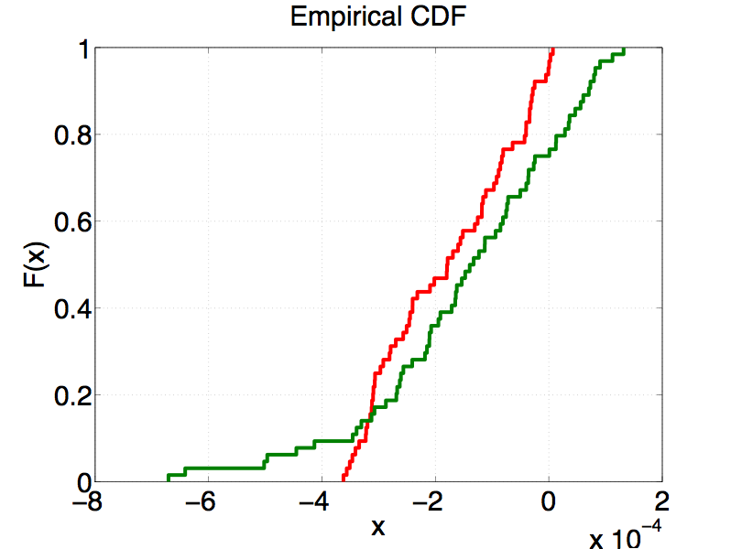
New Distance/Similarity Measure
original data
Euclidean distance
reconstructed data
statistical similarity
Define new statistical similarity measure
  based on Kolmogorov-Smirnov test (KS test)
  distributional distance/similarity of two random variables
    assuming each data block represents a random variable
distributional distance

Slide 10
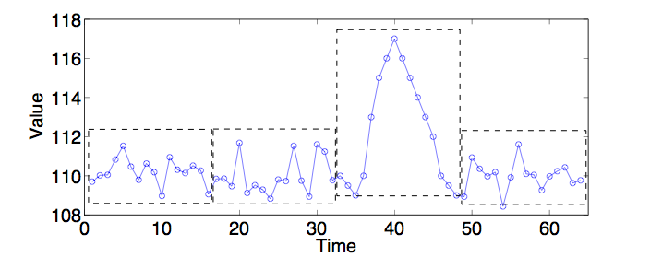
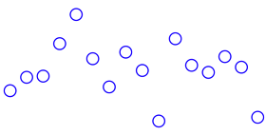

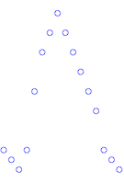
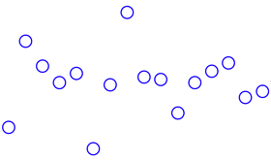
How IDEALEM Works
Breaks an incoming data stream into blocks of a fixed size
Represents similar blocks with the one that appears earlier in the sequence
Similarity here is based on statistical measure
  not on Euclidean distance
  Kolmogorov-Smirnov test (KS test)
1st block stored
2nd block similar
3rd block not similar
4th block similar
compressed stream
1st block
1
3rd block
1
Notes:
IDEALEM thinks a given signal can be represented by a few random number generators. If we only store these random number generators, then we can compress data.

Slide 11
Three Key Parameters in IDEALEM
block length
# of buffers
threshold for KS test
how many samples?
1st block stored
how many buffers?
2nd block similar
how similar is similar?
3rd block not similar
4th block similar
compressed stream
1st block
1
3rd block
1
Notes:
Currently, IDEALEM has three key parameters that affect compression performance.
Obviously many buffers give more chance to find a similar match. In general, we can compress more with more buffers.
Threshold is also directly related to the compression performance. If we lower the bar for passing KS-test, we can get more compression.

Slide 12
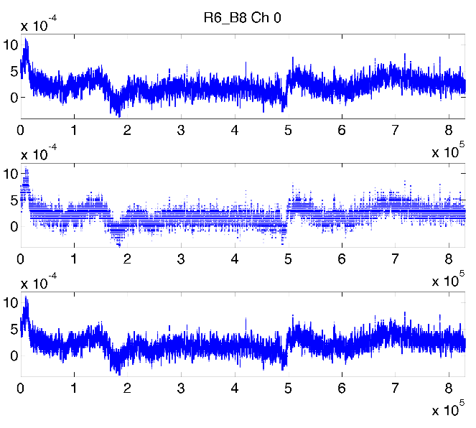
IDEALEM Achieves CR>100
Rat brain data (EEG)
original
state-of-the-art floating point compressor
zfp -a 0.0004
CR: 12.6
IDEALEM
CR: 106.6
compression ratio (CR): original size/compressed size
Notes:
We are given here time series data of brain signal (EEG signal).
compressed, later decompressed to produce reconstructed data
The goal of any compression algorithm is to reduce the size of data while minimizing the loss of information.
bands in between
a lot of gaps shown here indicate the loss of information
our scheme looks close to original (all the peaks and valleys of signal are kept)

Slide 13
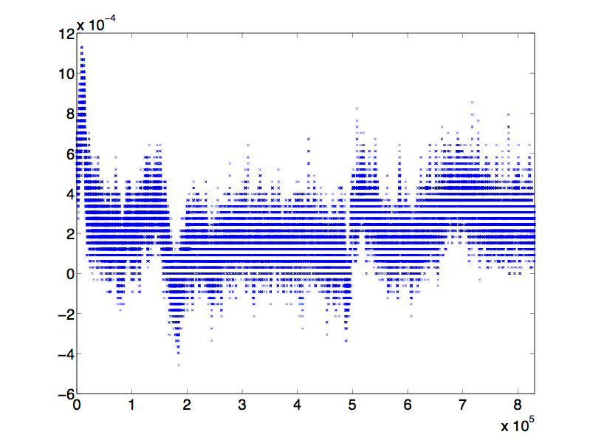
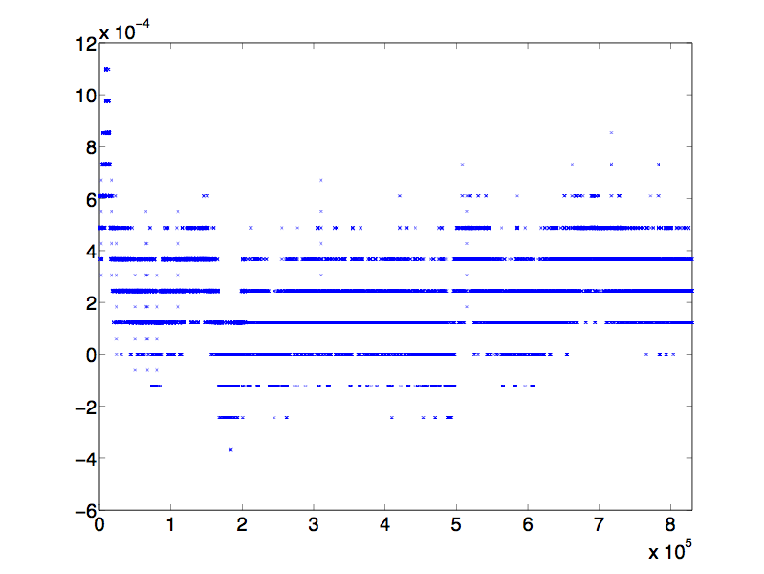
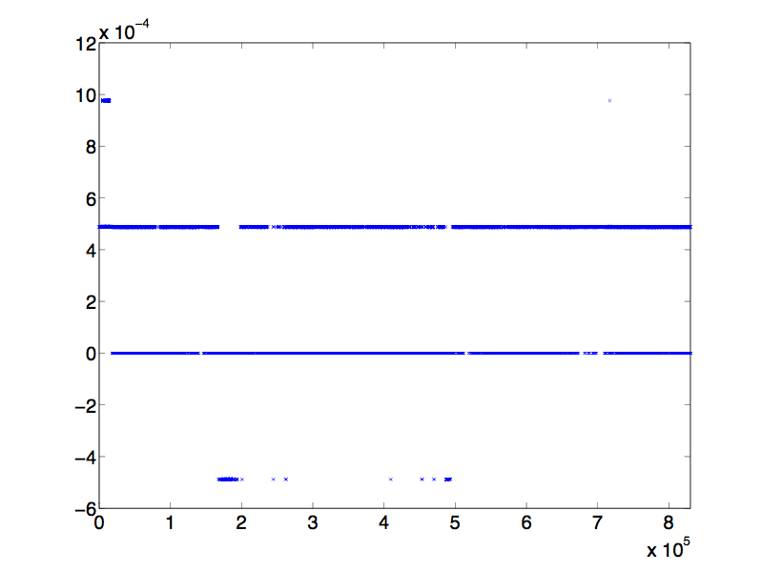
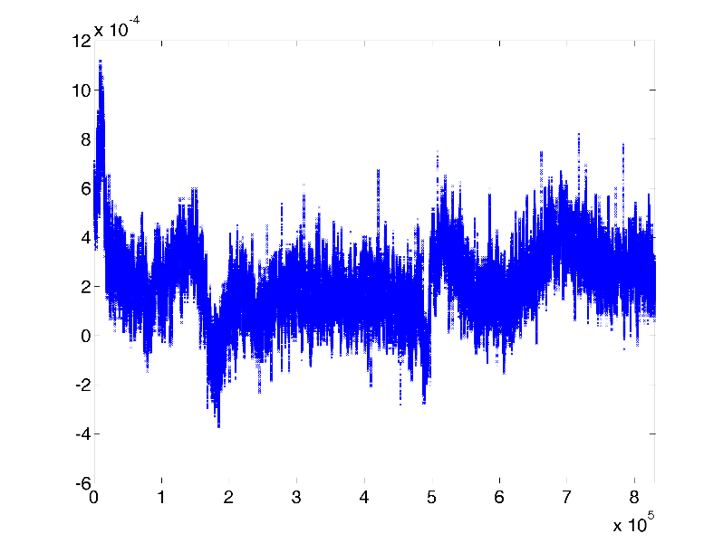
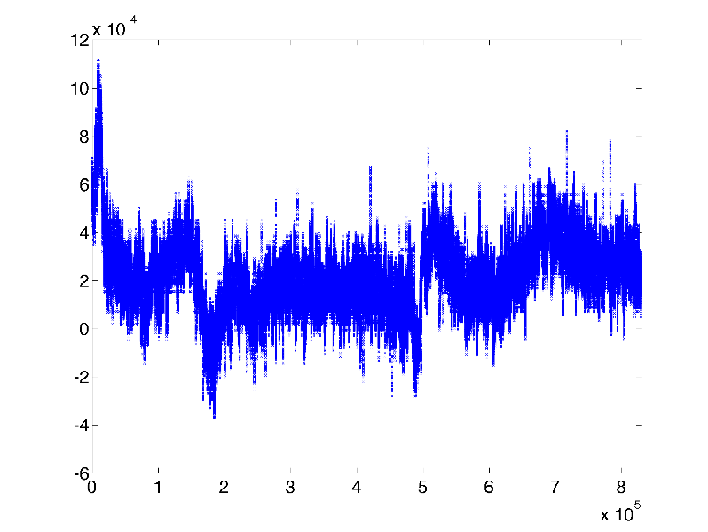

Compression ratio vs. Reconstruction Quality
zfp
CR: 12.6
CR: 14.1
CR: 21.0
IDEALEM
CR: 12.6
CR: 61.9
CR: 106.6
Notes:
With conventional lossy compression scheme, we lose interesting events as CR goes higher.
But IDEALEM captures all the important characteristics of signal even in high CR.

Slide 14
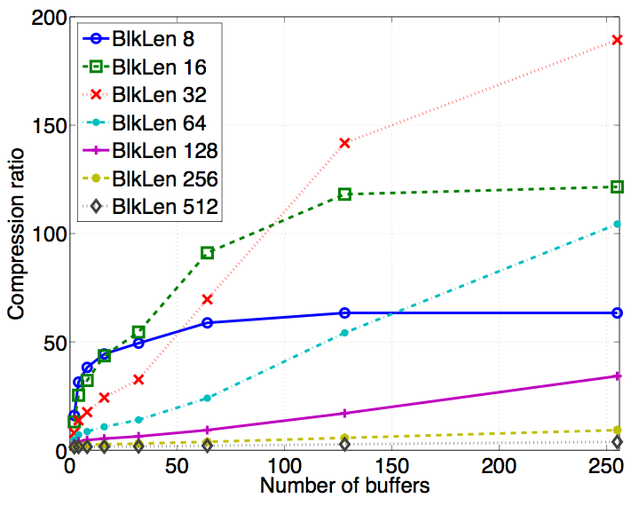
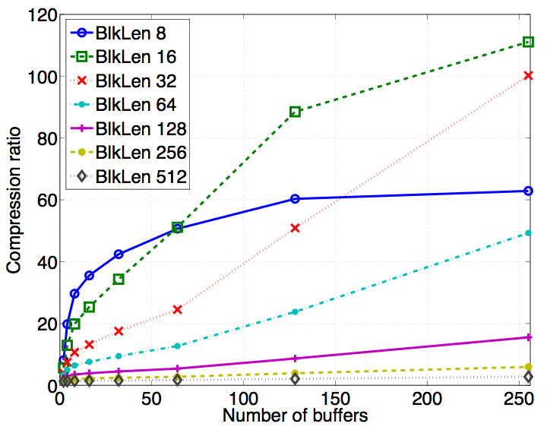
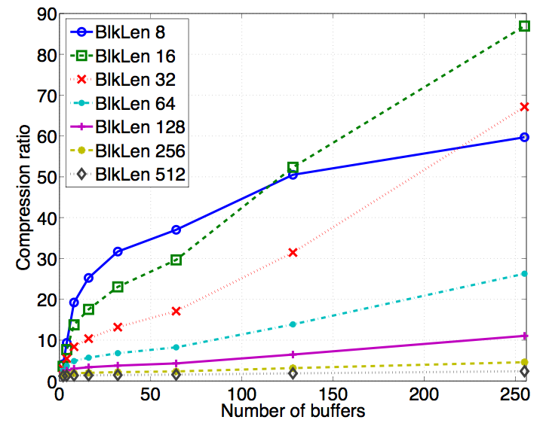
How Three Key Parameters Affect Compression Ratio
power grid monitoring data
threshold: 0.01
threshold: 0.05
threshold: 0.1
Small memory usage: 128KB for BlkLen=32 and 255 buffers
Two parameters have obvious influence on compression ratio (CR)
  threshold ↓, CR ↑
  # of buffers ↑, CR ↑
Effect of block length (BlkLen) is not immediately apparent

Slide 15
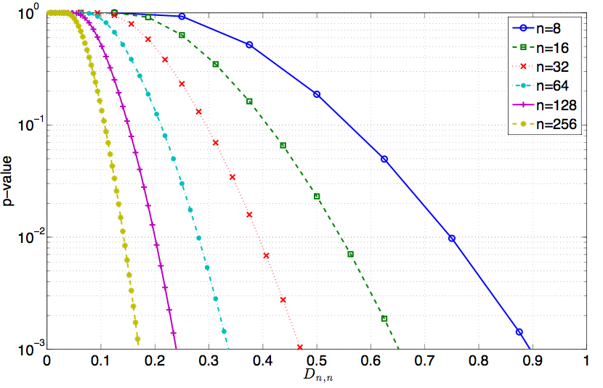
Limits on Achievable Compression Ratio
Proposition: Given a block length n, the maximum achievable CR of IDEALEM encoder with multiple buffers is 8⋅n
  assuming double precision floating-point format (8 bytes)
Large BlkLen n potentially increases CR, but it also increases difficulty of passing the KS test
large n makes it difficult to pass KS test for the same distributional distance
threshold
distributional distance

Slide 16
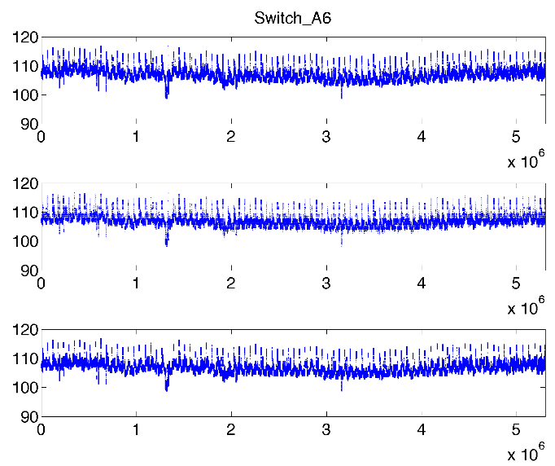
Another Example (power grid monitoring data)
original
12 hrs. of measurements in LBNL
zfp -a 2
CR: 8
IDEALEM
CR: 189.3
Notes:
Here’s another example of power grid monitoring data.
The signal shown here is relatively stable, so the compression ratio increases close to 200.

Slide 17
Fourier Spectra preserved through IDEALEM
Pictures below are Fourier component of EEG data
Lower frequency components (to the left of the orange line) are well preserved
Higher frequencies are modified due to the manipulation of the data values within blocks

Slide 18
IDEALEM for Non-Stationary Data
Previous IDEALEM was not so effective for non-stationary data such as phase angle of electricity data
New IDEALEM @ SSDBM 2017 offers two methods for transforming non-stationary data into locally stationary block to promote exchangeability/similarity: Residual transformation and Delta transformation
These methods allow local variations to be compared through KS test
phase angle
residual transformation
delta transformation

Slide 19
Summary
IDEALEM is a new class of compression methods
  that measures distance based on statistical similarity
  not traditional Euclidean distance (L²-norm)
IDEALEM can reduce data volume by more than 100-fold, while retaining key features from original data
IDEALEM preserves important features of the original data, e.g., outliers, Fourier spectrum
Fast enough execution time and small memory footprints to be used on resource limited devices for real time compression
Code is available at
  http://datagrid.lbl.gov/idealem
Notes:
We are actively working on IDEALEM to improve its performance.
In particular, along with KS-test, we want to add a simple detection scheme that can easily capture any application-dependent interesting events in the data stream.

Slide 20
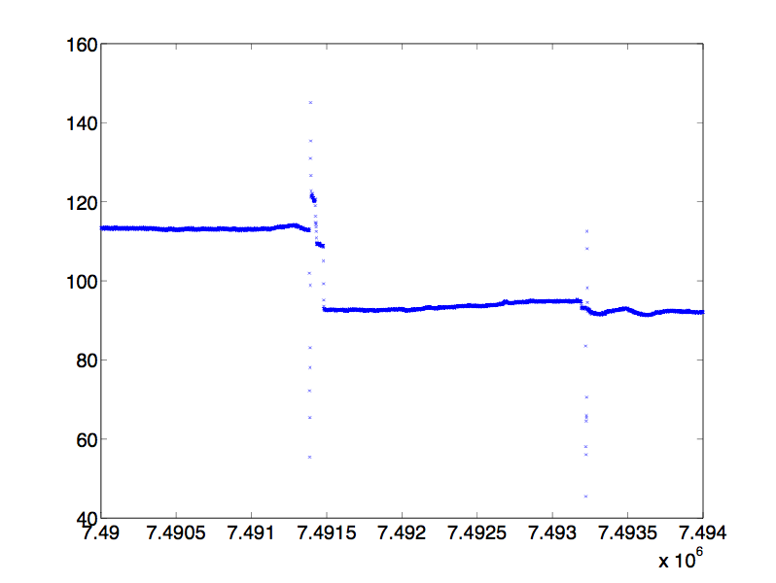
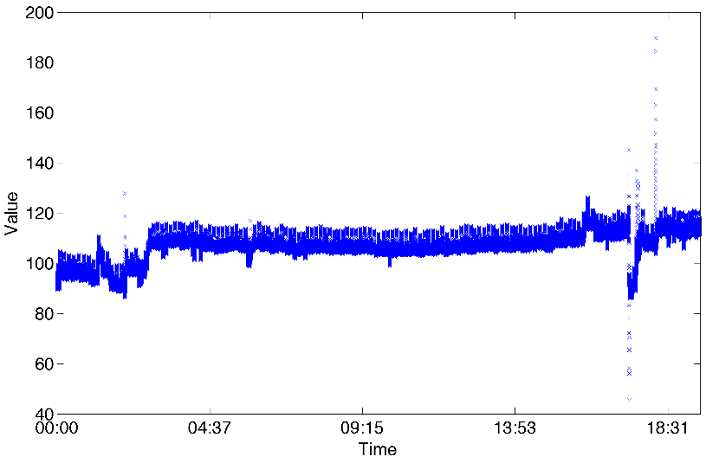
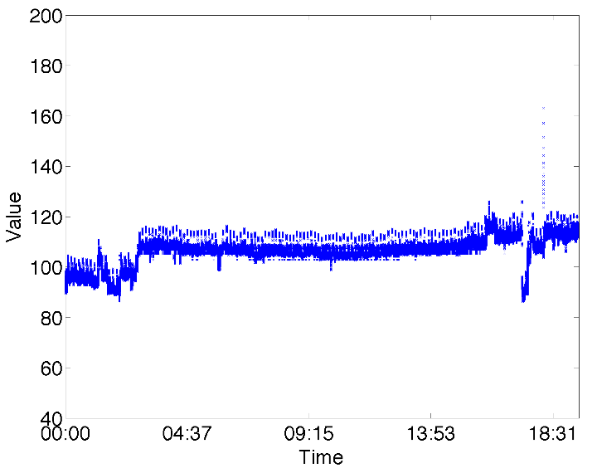
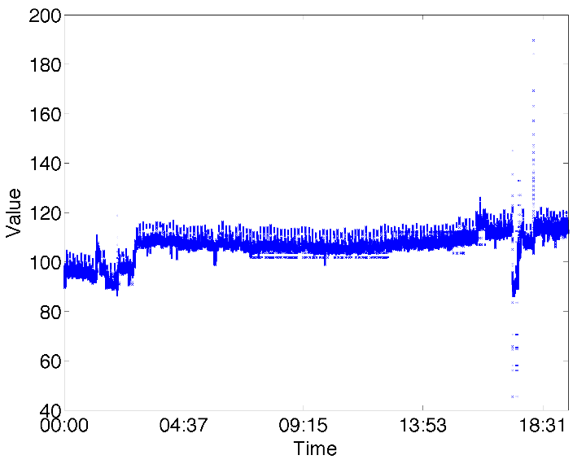
IDEALEM captures essential information
More work necessary
original
CR: 61.4
BlkLen 8, 255 Buffers, threshold 0.05
CR: 69.7
BlkLen 32, 255 Buffers, threshold 0.05
why?
why?
Notes:
So IDEALEM uses statistical test to determine similarity. And this new similarity measure can result in some unexpected results.
As you can see, some of points within the red circle are missing here. This is because IDEALEM captures only essential information in terms of statistical similarity. These missing points are outliers in statistical sense.
More research is needed to understand the full implication of using statistical similarity as distance measure for compression

Slide 21
Thanks!
Questions?
John Wu <John.Wu@nersc.gov>
http://crd.lbl.gov/wu
  IDEALEM code http://datagrid.lbl.gov/idealem
SDM group http://sdm.lbl.gov/
Berkeley Lab http://www.lbl.gov/

