Slide 1
Implementing a Distributed Volumetric Data Analytics Toolkit on Apache Spark
Chao Chen, Yuzhong Yan, Lei Huang, Lijun Qian
PVAMU
August 2017

Slide 2
Outline
Challenges
Main contributions
Methodology
Experiments and analysis
Conclusion & future work
References

Slide 3
The Normal Workflow
Volumetric Data
Data Scientists
Computer Scientists
Matlab Codes
OpenMP/MPI Codes
Product

Slide 4








The Big Challenge
Exponential growth in the volume of data
Increasing complexity and rapidly changing workflows
Handle different formats of unstructured streaming data
From computation-intensive to both data intensive and computation-intensive

Slide 5
Big Data in Oil&Gas Industry
Growing Volume Size
300 MB / km² early 90s
25 GB / km² in 2006
Growing to PBs /km²
Growing Variety of Data
Unstructured and semistructured well log and drilling reports
Growing Velocity of Data
Full 3D acquisition, 8GB/s - 20GB/s
http://www.slideshare.net/bjorna/big-data-in-oil-and-gas?related=3

Slide 6
The Workflow to Handle Big Data
Actual Data
Sample Data/ Synthetic Data
Data Scientists
Computer Scientists
Matlab Codes
MPI Codes
Product

Slide 7
Main Contributions
The paper attempts to address the performance of large distributed multi- dimensional array on a big data analytics platform by applying the HPC experiences and practices.
Scalability/Performance
Friendly User Interfaces

Slide 8
The Update Workflow
Actual Volumetric Data
Data Scientists
DMAT
Product

Slide 9
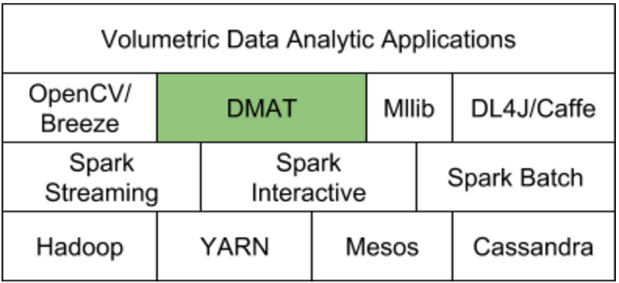
Software Stack of DMAT

Slide 10
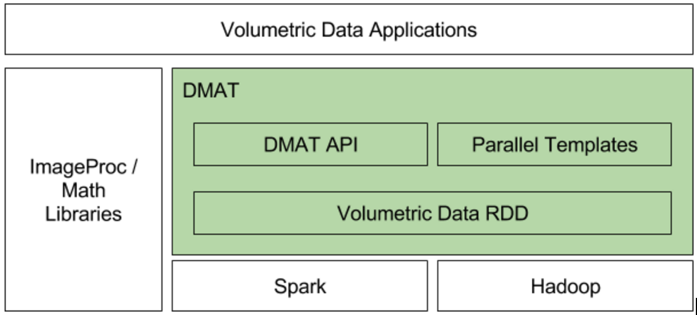
Architecture of DMAT

Slide 11
Main Components in DMAT
Data Distribution
Distributed Data Structure
Operations on Data Structure
High Level Interfaces

Slide 12
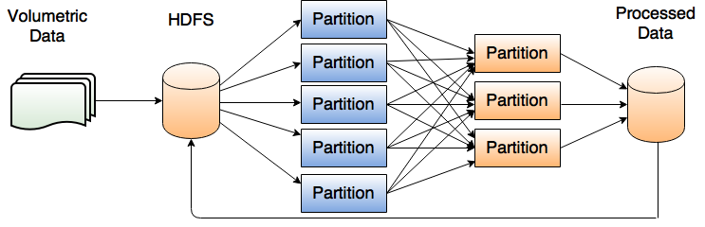
Data Distribution
SEGY or A3D

Slide 13
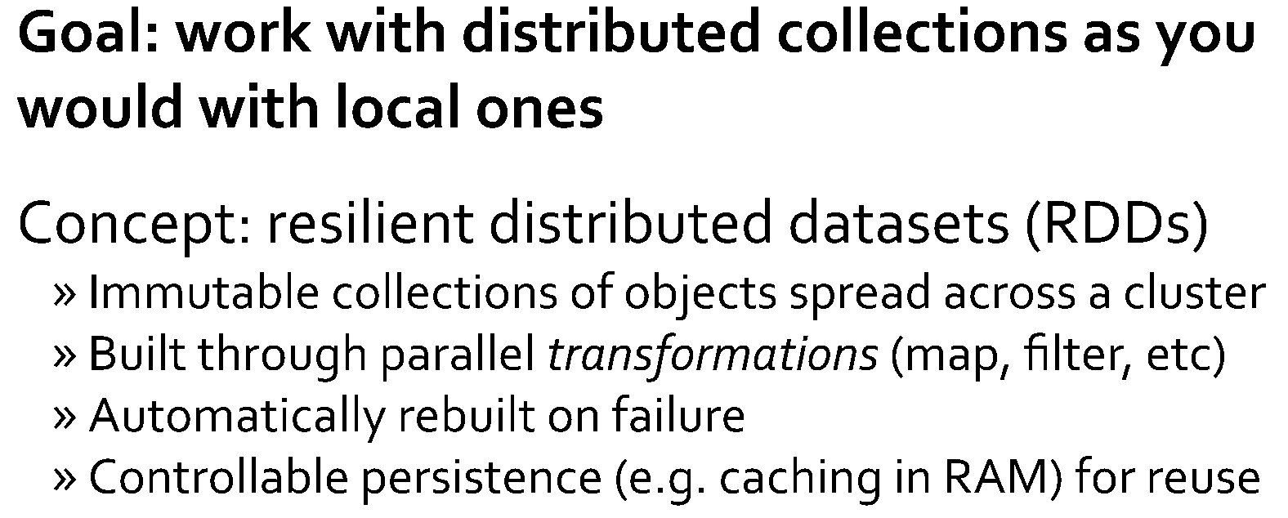
RDD in Spark

Slide 14
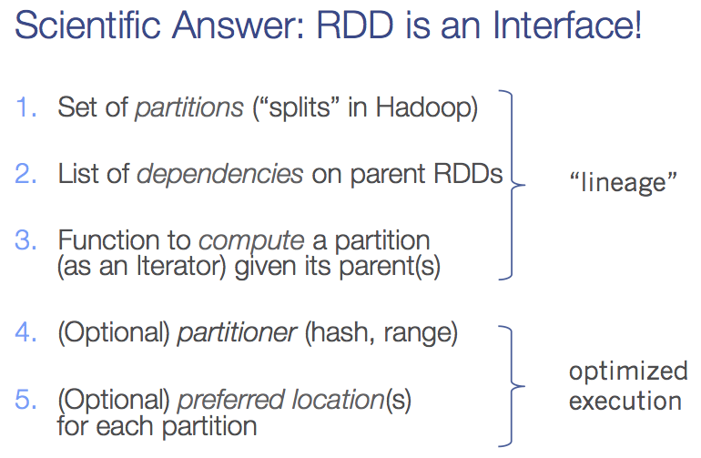
What is RDD?

Slide 15
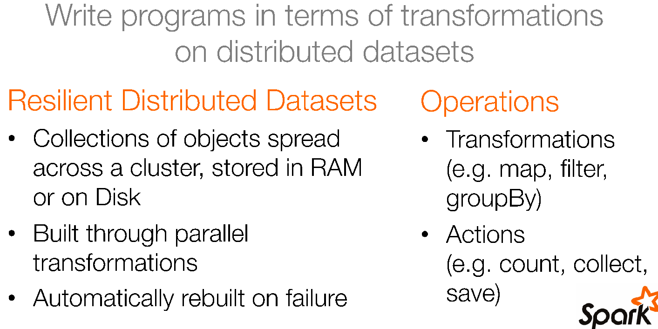
Key Concepts of RDD

Slide 16
Problems of RDD in Spark
Interfaces are still low level to domain specific experts
Each partition is independent, and all mappers run independently
The performance of accessing individual record is not good

Slide 17
VolumetricRDD
Abstract Class hide details of RDD
PlaneVolume/BrickVolume
Metadata Info
Load/Save Interface
Operations on distributed partitions
https://github.com/amplab/spark-indexedrdd

Slide 18
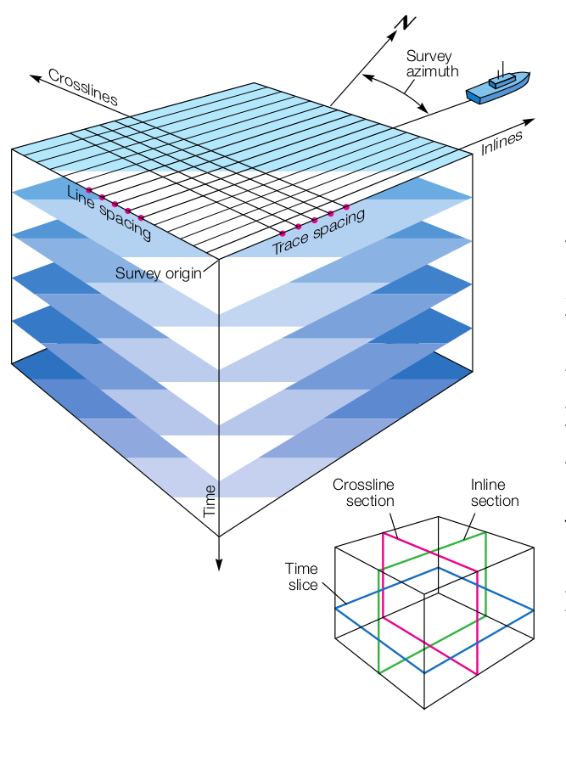
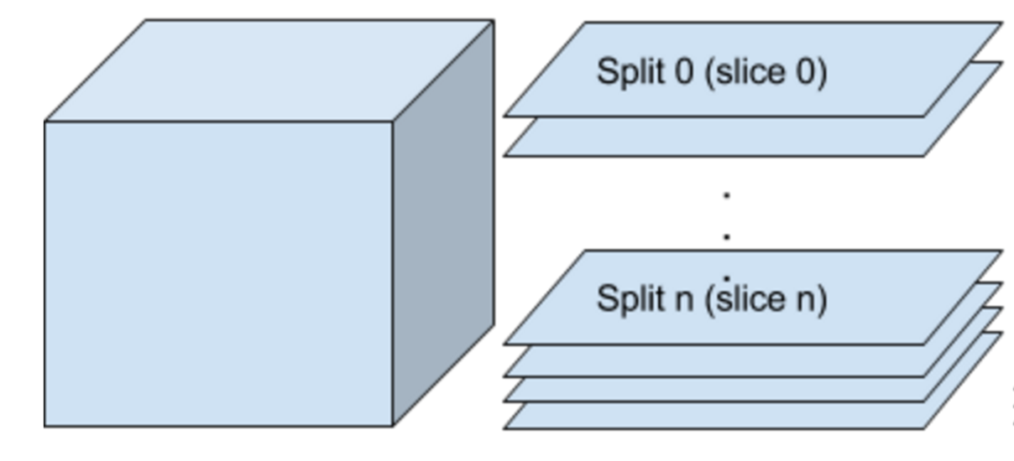
Seismic Data Example

Slide 19
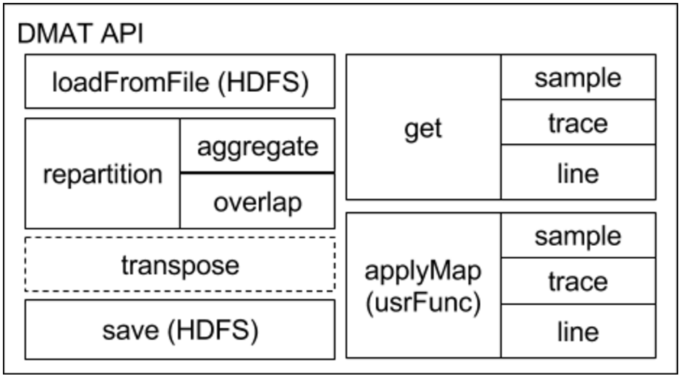
APIs

Slide 20
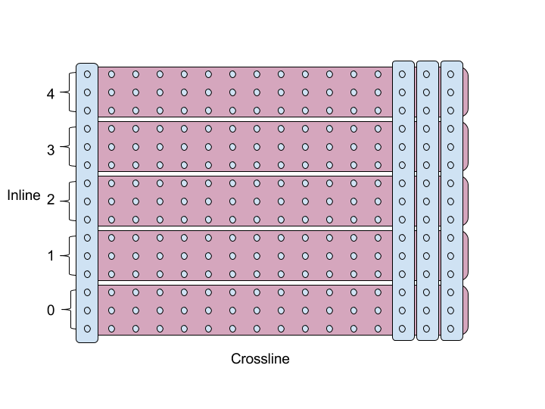
Transpose

Slide 21
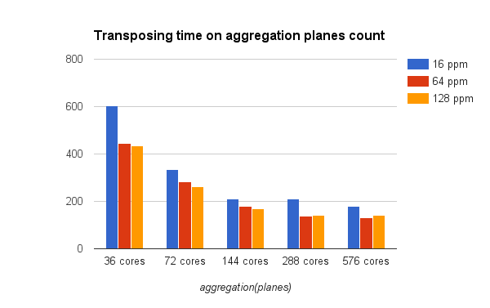
Performance of Transpose

Slide 22
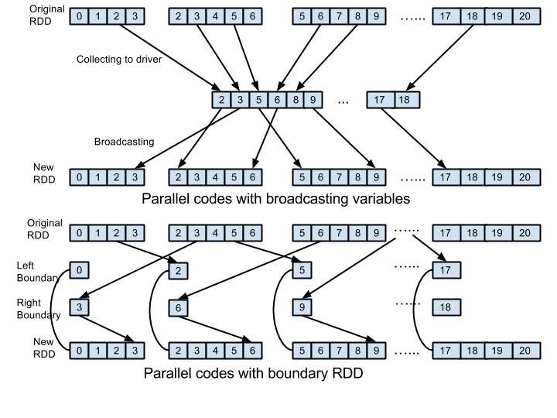
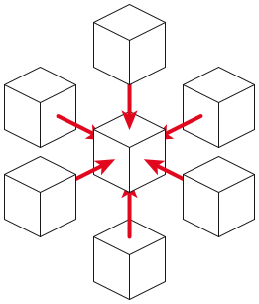
Stencil Computation: Jacobi
Notes:
https://en.wikipedia.org/wiki/Stencil_code

Slide 23
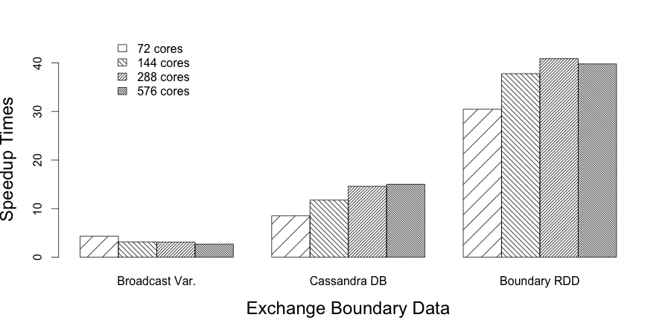
Running Results: Jacobi

Slide 24
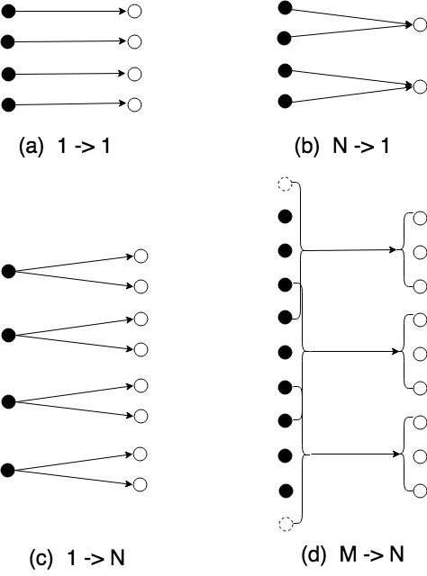
Templates in DMAT
Granularity
Sample
Trace
Plane
Volume

Slide 25
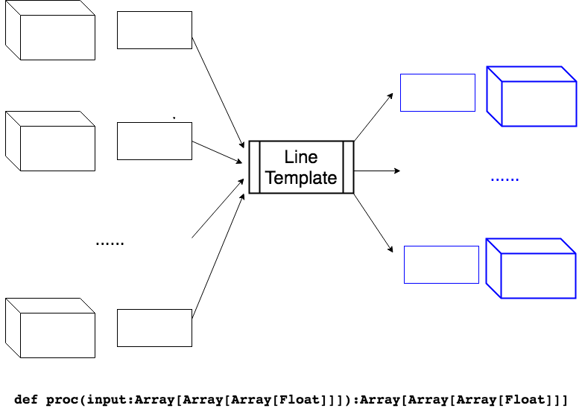
Plane Template

Slide 26
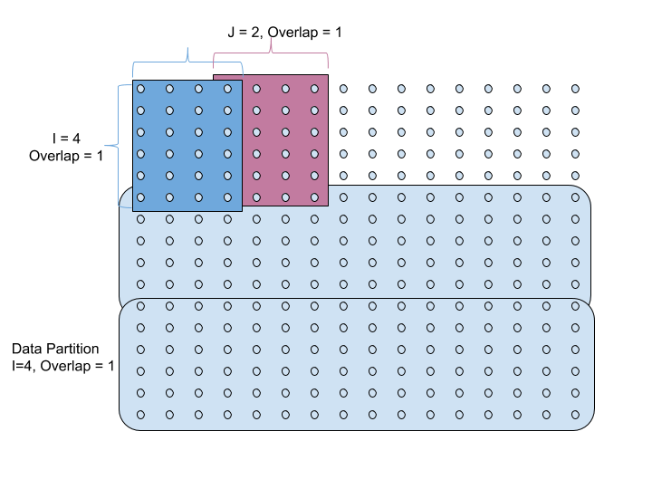
Overlap Template

Slide 27
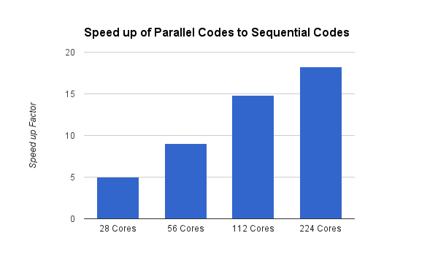
Performance of Stencil Computation

Slide 28
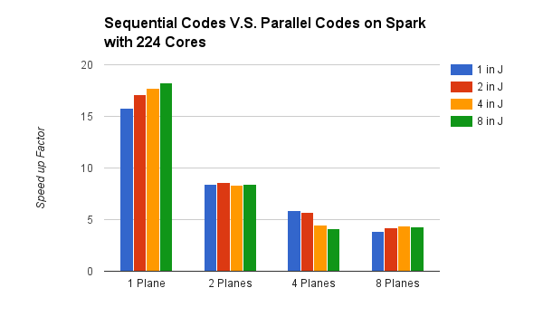
Performance of Stencil Computation

Slide 29
Conclusion
Spark provides good performance with in-memory RDD
DMAT provides a bridge of domain experts and parallel computing by hiding details of parallelism
RDD is simple, but performance differs greatly in different usages (Granularity and Memory)
Algorithms, data distributions, and configuration of resources will affect performance; Deep profiling is the most important one to boost performance
The overall performance of Spark is not as good as HPC, but productivity is better than HPC
Notes:
http://homepage.cs.latrobe.edu.au/zhe/ZhenHeSparkRDDAPIExamples.html

Slide 30
Future Work
More templates to handle other complex applications
Support streaming data
Integrate with other frameworks such as TensorFlow, DL4J, and Python support
Debug and profiling interface
GPU Support

Slide 31
Acknowledgements
This research work is supported in part by the US NSF award IIP-1543214, the U.S. Dept. of Navy under agreement number N00014-17-1-3062 and the U.S. Office of the Assistant Secretary of Defense for Research and Engineering (OASD(R&E)) under agreement number FA8750-15-2-0119.

Slide 32
References
http://www.open.edu/openlearnworks/mod/page/view.php?id=41010
http://csegrecorder.com/articles/view/advances-in-true-volume-interpretation-of-structure-and-stratigraphy-in-3d
http://www.slideshare.net/bjorna/big-data-in-oil-and-gas?related=3
http://www.winbold.com/upstream/using-big-data-technologies-to-optimize-operations-in-upstream-oil-and-gas/
https://databricks-training.s3.amazonaws.com/slides/advanced-spark-training.pdf
https://www.slb.com/~/media/Files/resources/oilfield_review/ors94/0794/p23_31.pdf

Slide 33

Thanks a lot!

