Slide 1










is automated materials design and discovery possible?
Mike McKerns
ExMatEx
Ex
ExMat
Extreme Materials at Extreme Scale
http://www.uqfoundation.org

Slide 2
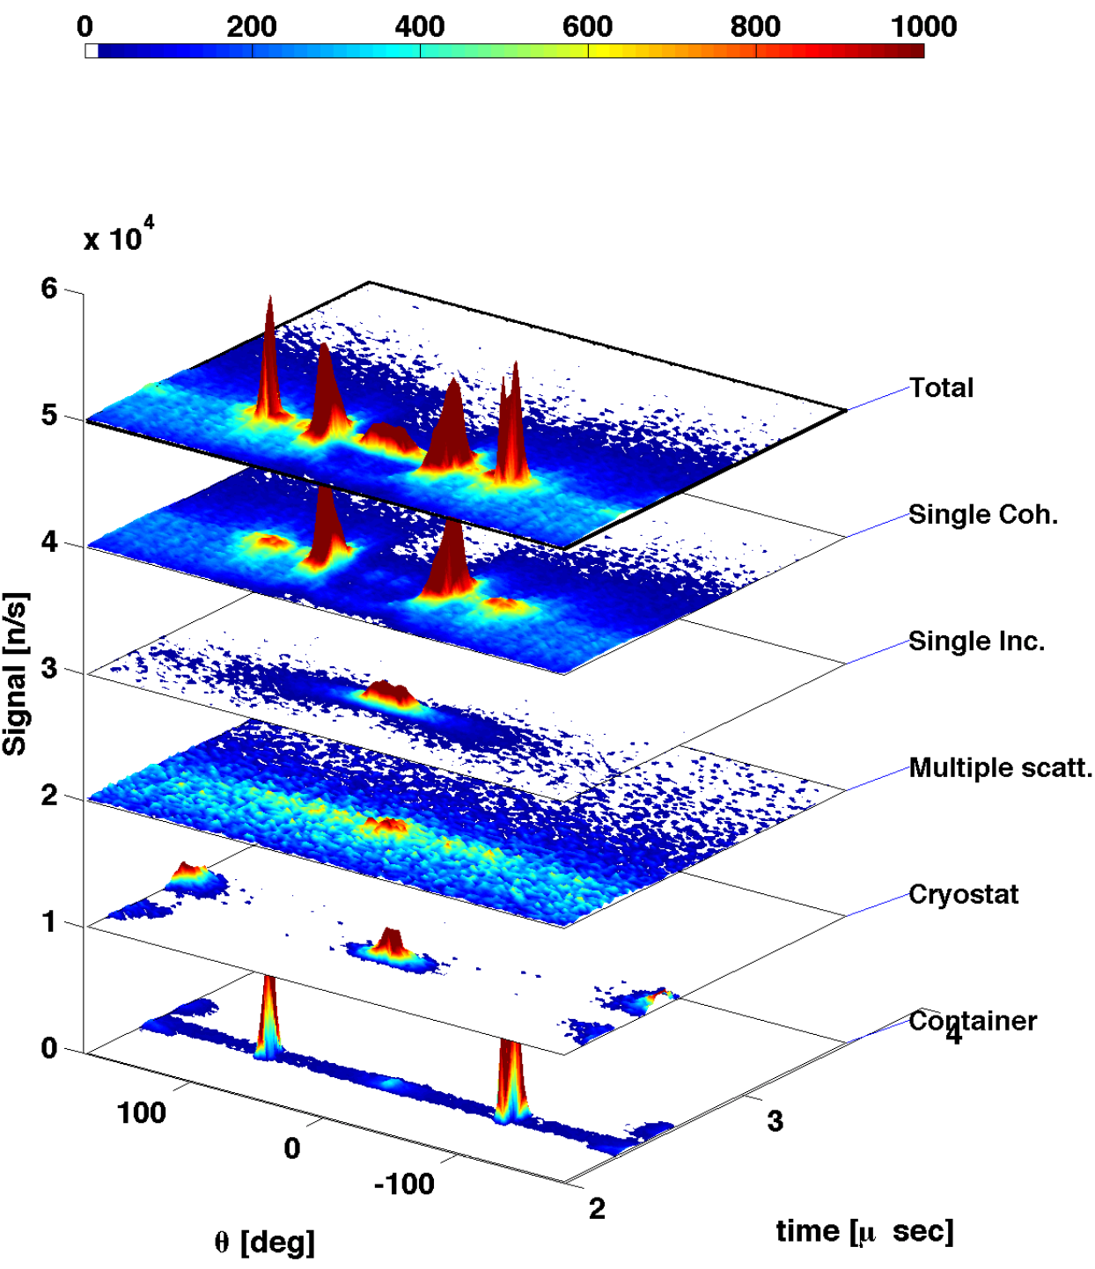
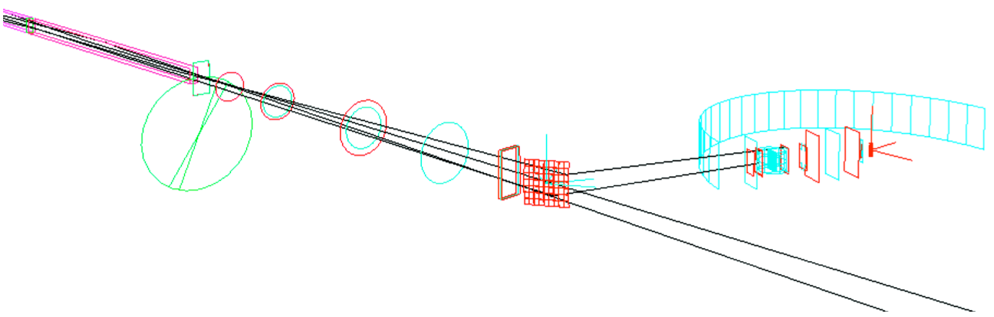
can optimal beamtime double scientific output?
beamtime allocation is estimated very conservatively
  insufficient beamtime causes inability to extract science
  absent ability to determine optimal beamtime, estimates must be conservative
  conservative estimates waste beamtime, and thus reduce scientific output
engineering design under uncertainty
    convex optimization with nonlinear constraints
the critical components for beamtime optimization are available
  instrument and materials simulation (using McStas/MANTID with GULP/etc)
  joint efforts of high-performance computing and data analysis/reduction
  parallel-scalable constrained nonlinear optimization (using mystic)
  engineering design under uncertainty with ML and OUQ
  ...

Slide 3
motivation: automated design of materials
what is the molecular structure that best produces the desired materials properties?
  can we optimize the probability that a structure will produce the desired properties within some tolerance?
what is the optimal reaction path between two molecular configurations?
  can we optimize the probability that a transition will occur between the initial and final states?
can we address these questions directly?
  can we formulate a quantity of interest (QOI) as a “goodness” metric, where we can use any and all information to constrain an automated search that considers only the space of viable solutions?

Slide 4
optimal / engineering design in a nutshell
find the global minimum that maximizes some property
  …how do we even formulate this question?
  requires “knowledge” of all states, or a good approximation of the energy surface
typically we also want a design measure for the system
  rigorous worst case bounds and the “most likely” model
  the bounds and the average provide a true system performance measure
  rigorously, this is at least one more higher-level minimization / maximization
tools are generally not sufficient to handle problems of this size and scope without strong approximations
poor approximations in statistical approaches can lead to increasing confidence in incorrect results

Slide 5

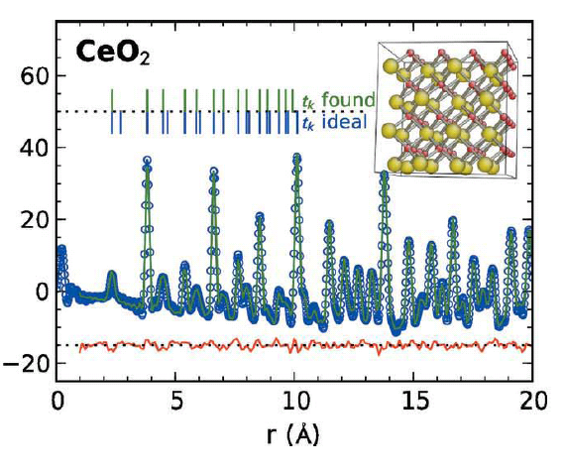
quantifying expert knowledge (may be hard)
ask an expert "is my crystal pure?":
  look at peak position, width, height, shape
  for both pair distribution and difference functions
  then make a judgment if crystal is pure or not
goal: quantify the knowledge ("how pure?"):
  what indicates imperfection versus noise?
  can we write equations for expected differences?
  can we write equations for the expected noise?
  if we quantify information… we can use it to predict!
we then can ask (and automate):
  what is the likelihood the crystal is pure (upper/lower bounds)?
  is the crystal pure within some tolerance?
  what is the structure that most likely produces the PDF given all available information?
optimal bounds on statistical error
uncertainty as model failure
optimal model

Slide 6
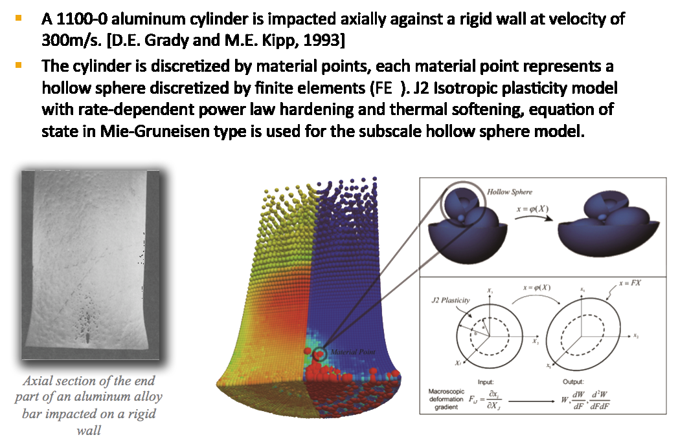
typical problem: model of impact plasticity
…
…
…

Slide 7
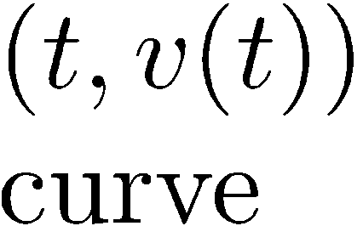
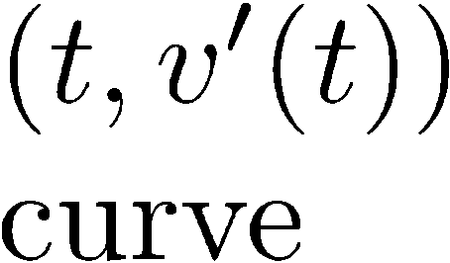
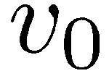
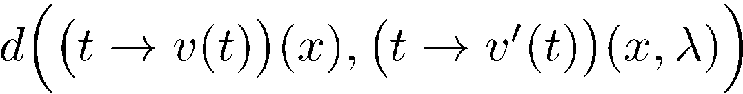
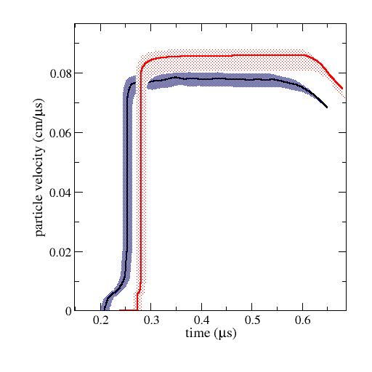
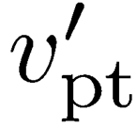

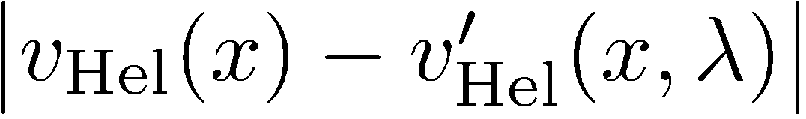

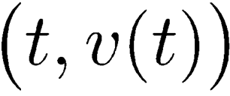
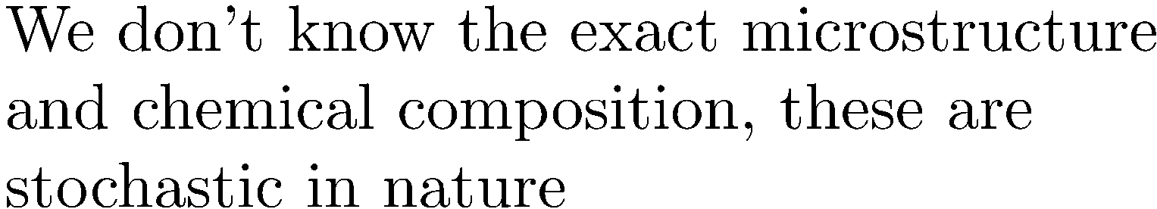

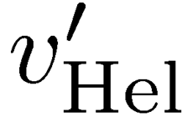
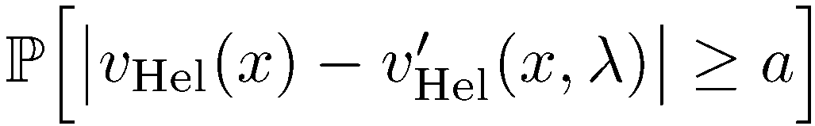
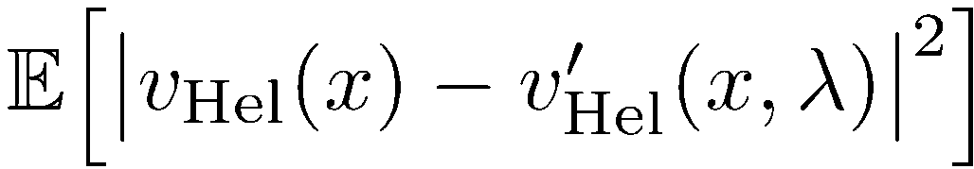
metrics for “how good is my model?”
model error (for the entire curve)
we want to estimate
we can compute
model error (for a scalar QOI)
Shock Simulation
Shock Experiment
model uncertainty
statistical error
likelihood of failure

Slide 8
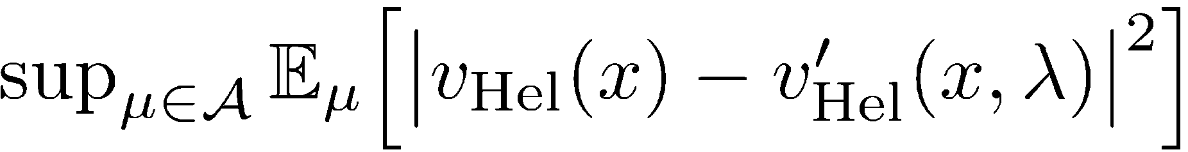
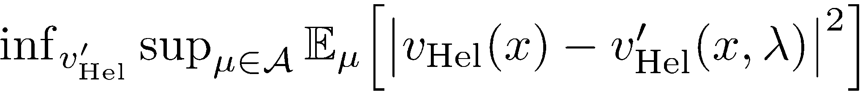
needle in an infinite-dimensional haystack
optimal bound on the statistical error
the optimal model is obtained by minimizing the optimal bound on the statistical error
min/max nested optimizations of all possible outcomes over all possible models of the material
  coordinate space provides a huge combinatorial problem
  with an optimization over all possible outcomes of the above
in terms of all possible states, the configurations that provide the desired properties are usually quite rare
…
  …
  …
a design measure requires two infinite-dimensional optimizations

Slide 9
how to solve it? simplify, simplify, simplify
optimal bound on the statistical error
the optimal model is obtained by minimizing the optimal bound on the statistical error
select the “most likely” distribution
  collapse optimization to the sub-manifold of coordinate space
select the form of the model
  collapse to a single parameterized model or class of models
solve a difficult finite-dimensional machine learning problem
then typically use monte-carlo estimation to obtain bounds

Slide 10
further simplifications due to limitations of tools
global optimization, convexity, dimensional reduction
  high dimensional and non-convex with nonlinear information constraints
  global optimization is slow and expensive
  reduce to convex and linear optimizations, less parameters
  use local optimizers for speed, ability to handle information constraints
  to handle large numbers of parameters, optimization is LP or QP at best
  LP / QP solvers accept linear / quadratic (in)equality constraints
constrained optimization and penalty functions
  information constraints handled by penalizing the objective
  penalty functions clash for 10’s of constraints
  only very simple kernel transformations are available
  constraining information is often only used post-optimization as validation
model validation and robustness
  subtle: approximations make the problem “solvable”, however are also biasing
  approximations often remove the ability to predict high-impact rare events
  by requiring locality of the optimum, we “look for lost keys only where we have light”

Slide 11
requires a rethinking of optimization
costFactory generates a cost function from a set of parameters and N models
constraintsFactory generates constraints from symbolic and/or functional constraints
monitorWrapper binds a monitor to an object
monitorWrapper
costFactory
constraintsFactory
functionWrapper
penaltyFactory
serviceFactory
functionWrapper binds a function to an object; useful for binding penalties to cost functions
penaltyFactory generates a penalty from symbolic and/or functional constraints
serviceFactory generates a compound service from a strategy and multiple copies of a service or services
“special” components:
  cost function = |model - model'|
  penalty = ΔE if condition is False
E
x
x
x
x
x
E
x
population generator
cost function
model
penalty
constraints
monitor
x'
E
E
E
x'
(E,x)

Slide 12



hierarchical constrained optimization
from mystic.math.measures import mean, spread
from mystic.constraints import with_penalty, with_mean
from mystic.constraints import quadratic_equality
# build a penalty function
@with_penalty(quadratic_equality, kwds={'target':5.0})
def penalty(x, target):
return mean(x) - target
# define an objective
def cost(x):
return abs(sum(x) - 5.0)
# solve using a penalty
from mystic.solvers import fmin
x = array([1,2,3,4,5])
y = fmin(cost, x, penalty=penalty)
# build a kernel transformation
@with_mean(5.0)
def constraint(x):
return x
# solve using constraints
y = fmin(cost, x, constraint=constraint)
Traditional constraints methods apply a penalty to the cost when the constraints are violated
penalty functions
fast, but implicit, inaccurate, and can add spurious features
box constraints
Decoupling constraints often produces a convex optimization for the QOI
explicit and can be parallelized,
can strongly reduce search space
data point & functional constraints
operators that commute can be spawned in parallel

Slide 13
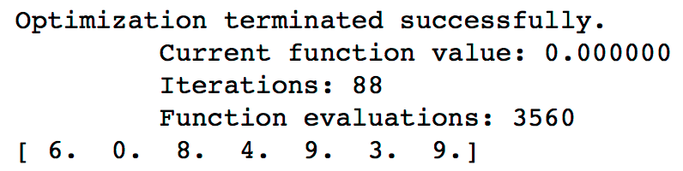
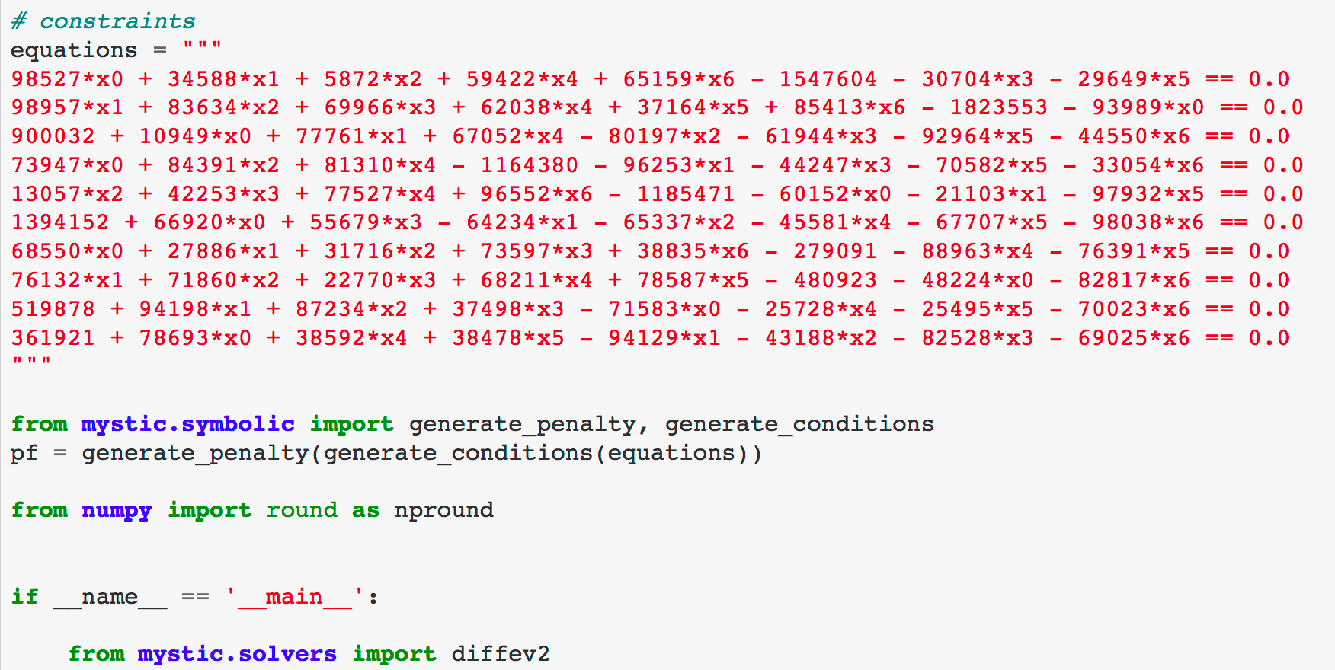
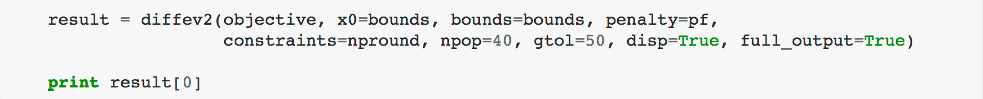
symbolic constraints and factory methods
…
  …
…
  …
…
  …

Slide 14
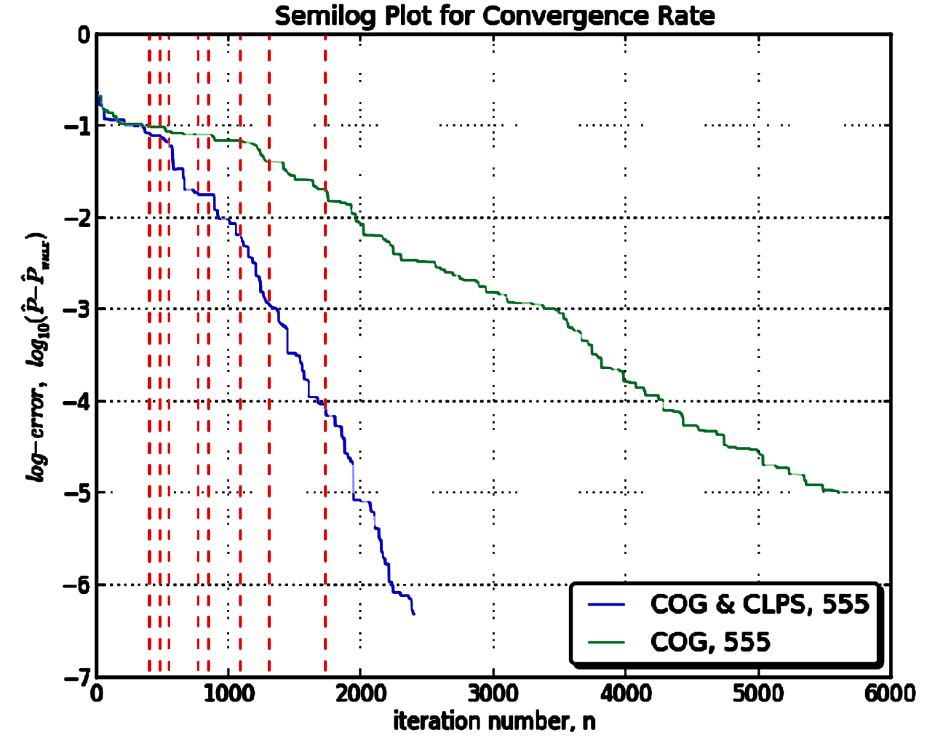
reduce search space with kernel transformations
box (range) constraints
nonlinear (functional) constraints
uniqueness and set-membership constraints
probabilistic and statistical constraints
constraints imposing sampling statistics
inputs from sampling distributions
constraints from legacy data (points and data sets)
constraints from models and distance metrics
constraints on (product) measures
support vector (weight, independence) collapse
collapse
dimensional collapse enables greater accuracy with less iterations
data point & model constraints
constraints may be solved by nested optimization

Slide 15
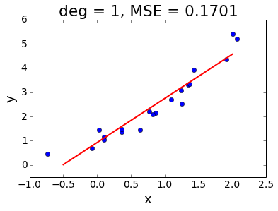
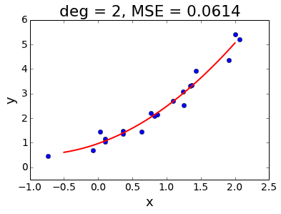
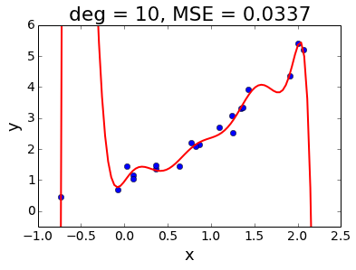
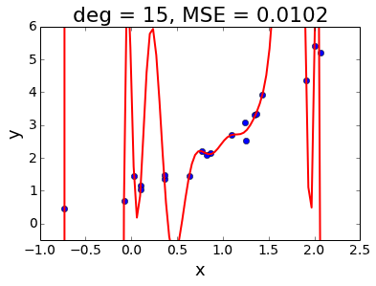
over-fitting can be avoided with better tools
over-fitting is a consequence of having missing information that fails to inform the optimizer
can come from:
  missing or approximate constraining information
  abstract convergence criteria (scoring function)
  poor objective function
no over-fitting if:
  all constraining information is explicitly applied (by kernel transformation)
  objective and scoring function are the QOI and our actual quality metric

Slide 16
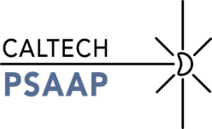
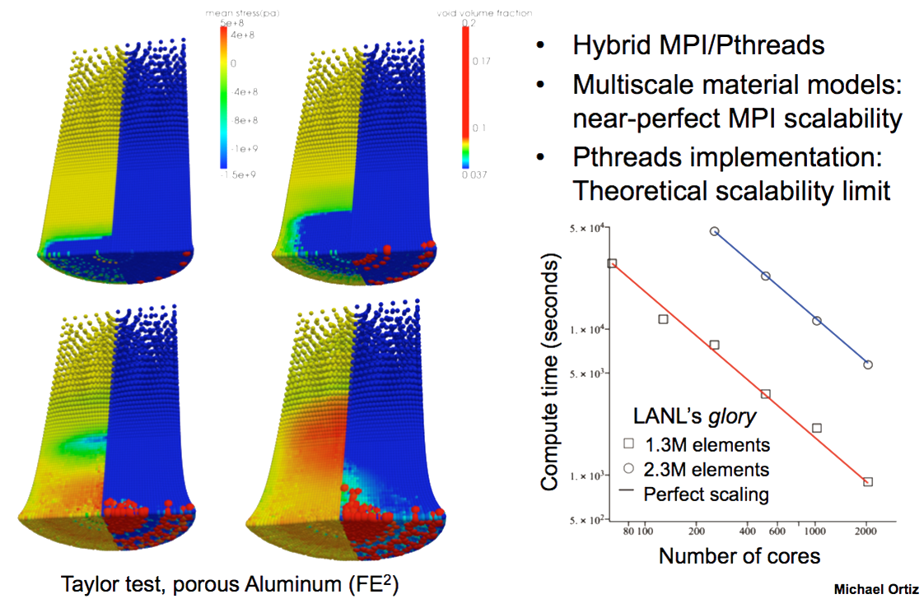
a realistic model can be very expensive

Slide 17
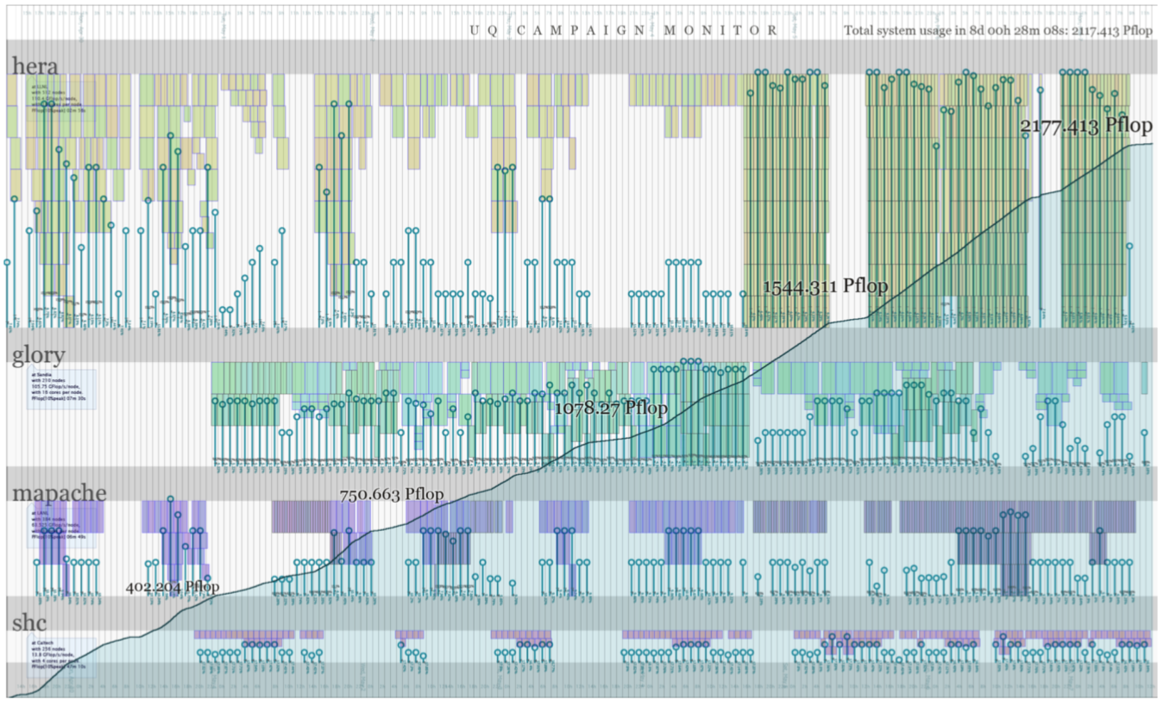
optimization can be very very expensive
sensitivity = - |F(x') - F(x)|²
…
…
  …
  …
…
…
…
…
…
…
…
UQ run over 8 days over distributed resources

Slide 18
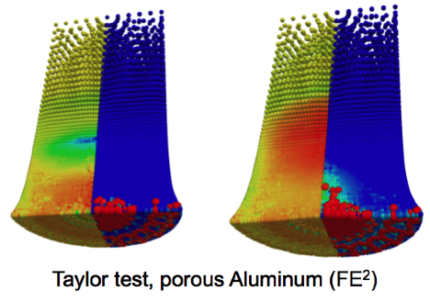
the need for optimizer-based parallelism
cluster-scale objective functions require:
  large-scale parallel and distributed computing
  asynchronous execution
  monitoring, caching, archiving, and job restarts
  dynamic decision making
  efficient batch execution of the model
optimizers, however, tend to be:
  notoriously serial (iterative process)
  (synchronously) bound to a model
  diagnostic-limited and stateless
  of fixed execution strategy
  efficient in solver algorithmic speed
…the opposite of what is required!
# the function to be minimized
# and initial values
import taylor as my_model
x0 = [0.8, 1.2, 0.7]
# obtain the solution
import diffev as solver
solution = solver(my_model, x0)
optimization tends to be blocking until a solution is found
Notes:
== Asynchronous Model Coupling
== Multi-scale Models
== Parallel & Nested Analysis Circuits

Slide 19
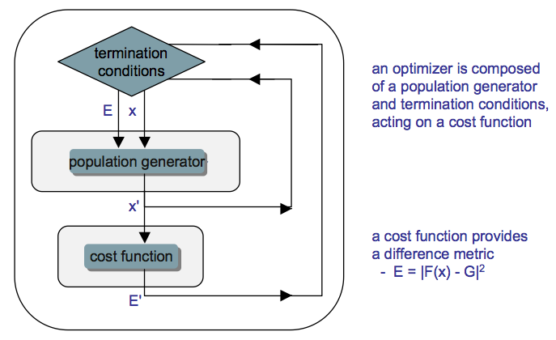
plug-and-play stateful optimization
# the function to be minimized and initial values
import taylor as my_model
x0 = [0.8, 1.2, 0.7]
# get monitor and termination condition objects
from mystic.monitors import Monitor, VerboseMonitor
stepmon = VerboseMonitor(5)
evalmon = Monitor()
from mystic.termination import ChangeOverGeneration
terminate = ChangeOverGeneration()
# instantiate and configure the solver
from mystic.solvers import DifferentialEvolutionSolver
solver = DifferentialEvolutionSolver(len(x0))
solver.SetSaveFrequency(100, 'solver.pkl')
solver.SetInitialPoints(x0)
solver.SetGenerationMonitor(stepmon)
solver.SetEvaluationMonitor(evalmon)
solver.Solve(my_model, terminate)
# obtain the solution
solution = solver.bestSolution
an optimizer has state
# obtain diagnostic information
function_evals = solver.evaluations
iterations = solver.generations
cost = solver.bestEnergy
# modify the solver configuration; restart
from mystic.termination import VTR, Or
COG = ChangeOverGeneration(tolerance=1e-8)
solver.Solve(my_model, Or(VTR(),COG))
# obtain the new solution
solution = solver.bestSolution
optimizer independent:
  monitoring, logging, caching
  penalties, constraints, stop conditions
Notes:
== Asynchronous Model Coupling
== Multi-scale Models
== Parallel & Nested Analysis Circuits

Slide 20
scalability with asynchronous parallelism
constraints operators enable scalable nonlinear optimization
  apply constraints as an "operator"
  almost embarrassingly parallel
  constraints solvers are dynamically launched by a governing optimizer
  has been used to solve problems with 1000's of nonlinear constraints
state enables asynchronous parallel computing in optimization
  optimizers have and can save state (to file or database archive), have streaming diagnostic monitors
  optimizers are serializable and asynchronous (thus are non-blocking parallel distributed)
  has slots for parallel maps on the objective, constraints, iteration, and the solver itself (for parallel ensemble and nested solvers)
  can utilize memory caching and transparent archiving
  dynamic optimization strategies, compound termination conditions, speed-up with automated dimensional collapse
  optimizers are event-based, can react to changing constraints & objective
operators that commute can be spawned in parallel
explicit and can be parallelized,
can strongly reduce search space

Slide 21
optimization workflow
initial
x,F
model
y = F(x)
constrained optimization
constraints
x’ = C(F,x)
optimizer
population
x’ = G(x,y)
All optimizers take a model and calculate the cost. All optimizers have a slot for the application of constraints.
Most optimizers are built so they can evaluate N copies of the cost function in parallel. More exotic optimizers can launch M optimizers in parallel.
Termination conditions are also modular.
cost
y = Q(F,x)
selector
x’ = S(x,y)
solved
x,y
terminate ?
initial
x,F
Constraints are first checked. If the constraints are not satisfied, then they are imposed on the optimization parameters.
Imposing any of the constraints is potentially a nested optimization that could leverage parallel computing.
The set of constraints can be dynamic. Constraints can be nested, coupled, etc.
impose constraints
constraints
bound
x’ = B(x)
constrain
x’ = Z(x)
valid
x
bounded ?
constrained ?
Notes:
== Asynchronous Model Coupling
== Multi-scale Models
== Parallel & Nested Analysis Circuits

Slide 22

pathos: framework for heterogeneous computing
abstraction on programming model:
  node, pipe, batch, map, fork, join
  scheduling/management strategies
  logging, caching, and archiving (database or file)
rapid exploration of system design:
  communication patterns
  parallelism hierarchies
  memory hierarchies
  synchronization and scheduling
  resilience strategies
  system efficiency
…
  …
  …
available launchers:
  multiprocessing, threading
  MPI-based (mpi4py)
  IPC-based (pp)
  SSH-based
  GPU-based (pyCUDA)
  cloud-based (mrjob)
available schedulers:
  torque, slurm, lsf
compound maps can be built with a coupling strategy
  workload balancing across different map technologies
  hierarchies of maps can be composed seamlessly

Slide 23
klepto: asynchronous sharing of state
klepto features:
  unified API for caching and archiving
  cache-to-archive interaction strategies
    lru, lfu, mru, random_replace, …
  backends: memory, file, directory, database, db table, hdf
  unified API for key encoding / serialization / hashing / encryption
    extensible: leverage pickle, json, dill, codecs, md5, … you pick
  ‘ignore’ selected arguments (partial arg caching)
  cache interpolation by rounding
  can leverage SQLAlchemy, numpy internals
planned and in-progress:
  leverage: redis, shared memory
  more interpolation algorithms
    kriging, etc…
  asynchronous cache-to-archive updates
local memory cache
F(x)
central archive
DB
F(x)
ExMatEx
Ex
ExMat
Extreme Materials at Extreme Scale

Slide 24
asynchronous map: speed and robustness
blocking map is fragile and prone to failure
…so decouple the launch and termination of parallel map
utilize a stop condition for when results are “good enough”
  simple case: 75% of the results have returned
  better case: use statistics to determine if “good enough”
note: we can still collect and archive all launched runs
  blocking time to the next iteration can be greatly reduced
  a “condition” removes requirement all runs complete
“statistics”
P[X ≤ a] ≥ e
75%
N
reduces time per iteration without loss in accuracy
t
ExMatEx
Ex
ExMat
Extreme Materials at Extreme Scale
Notes:
== Asynchronous Model Coupling
== Multi-scale Models
== Parallel & Nested Analysis Circuits

Slide 25
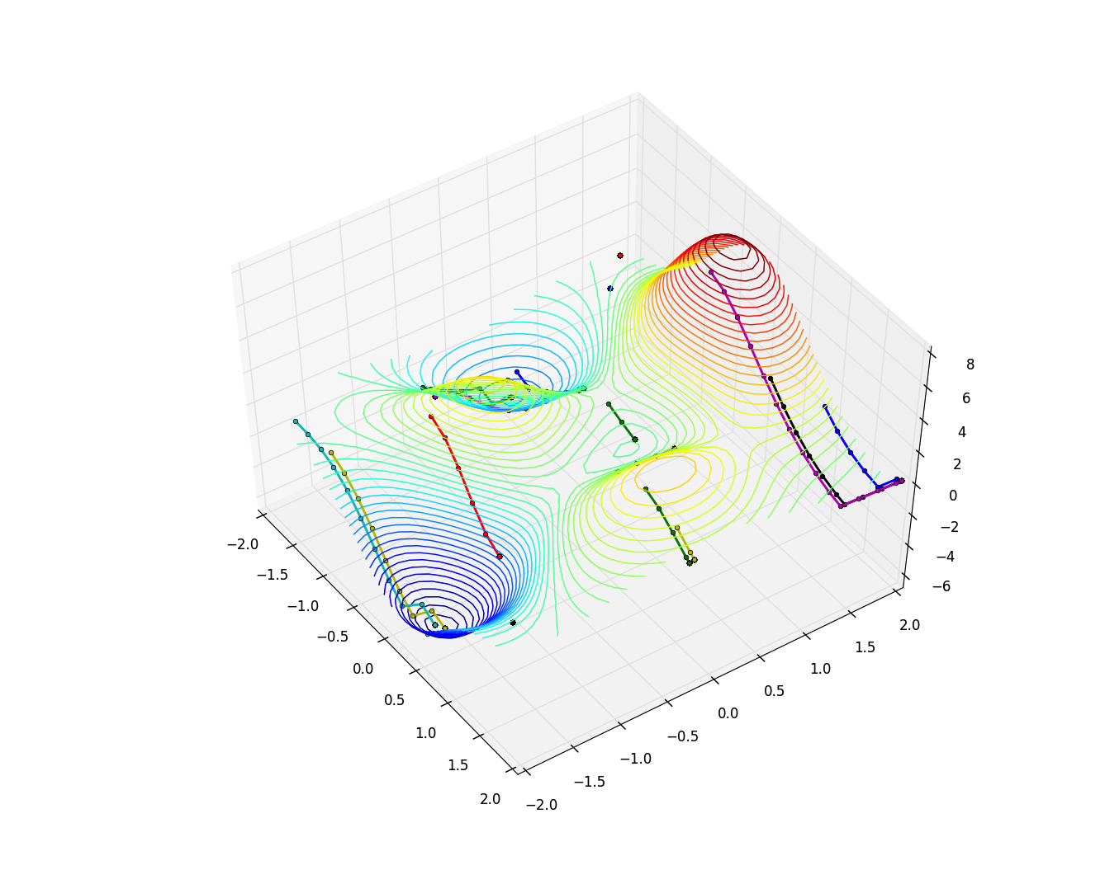
massively-parallel ensemble optimizers
# the function to be minimized and the bounds
from mystic.models import rosen as my_model
lb = [0.0, 0.0, 0.0]; ub = [2.0, 2.0, 2.0]
# get monitor and termination condition objects
from mystic.monitors import LoggingMonitor
stepmon = LoggingMonitor(1, 'log.txt')
from mystic.termination import ChangeOverGeneration
COG = ChangeOverGeneration()
# select the parallel launch configuration
from pyina.launchers import TorqueMpi
my_map = TorqueMpi('25:ppn=8').map
# instantiate and configure the nested solver
from mystic.solvers import PowellDirectionalSolver
my_solver = PowellDirectionalSolver(len(lb))
my_solver.SetStrictRanges(lb, ub)
my_solver.SetEvaluationLimits(1000)
# instantiate and configure the outer solver
from mystic.solvers import BuckshotSolver
solver = BuckshotSolver(len(lb), 200)
solver.SetRandomInitialPoints(lb, ub)
solver.SetGenerationMonitor(stepmon)
solver.SetNestedSolver(my_solver)
solver.SetSolverMap(my_map)
solver.Solve(my_model, COG)
# obtain the solution
solution = solver.bestSolution
optimizers can be set to search for minima, maxima, saddle, and other inflection points
with enough optimizers, we get a global map of the potential surface in a single shot
What happens when we use mystic to address questions in statistical science?
  statistics as global optimizations
  optimization over all possible scenarios (or priors), using statistical constraints
  represent probability distribution as a basis set
  apply constraints as “operators” that restrict space
  operators can spawn nested optimizations to solve constraints
Notes:
== Asynchronous Model Coupling
== Multi-scale Models
== Parallel & Nested Analysis Circuits

Slide 26
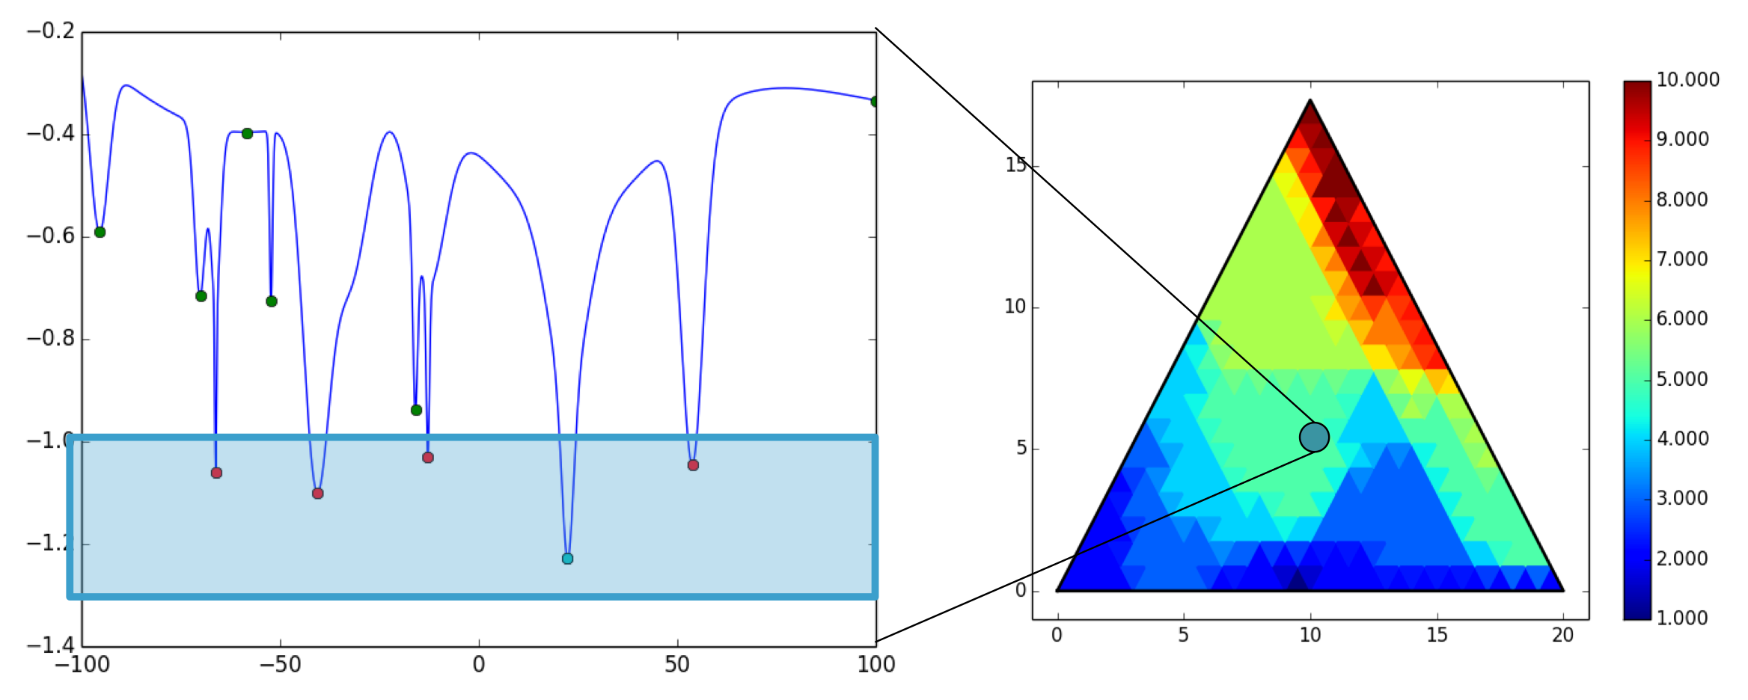
example: degeneracies in structure solution
…
• Solving a 1D proxy problem with multiple degenerate minima, finding the number of such minima.
• Constructed from 3 sets of Gaussians which may be mixed with different weights.
– Step 1: pick a point on the ternary source diagram
– Step 2: find the degeneracy for that version of the target function
– Step 3: use downhill method to choose a new point. Goal is to find point of lowest degeneracy
– Step 4: repeat many times, try different highly parallel searches
• Problem is hard for solvers because there are large flat regions of the surface.
…
…

Slide 27
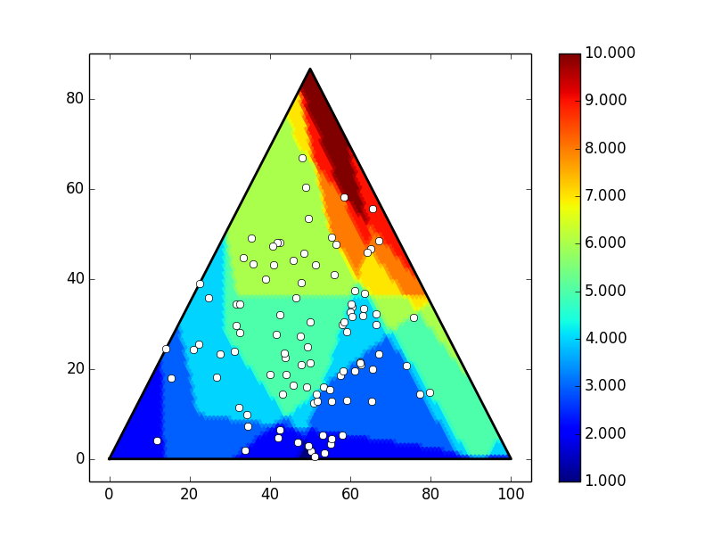
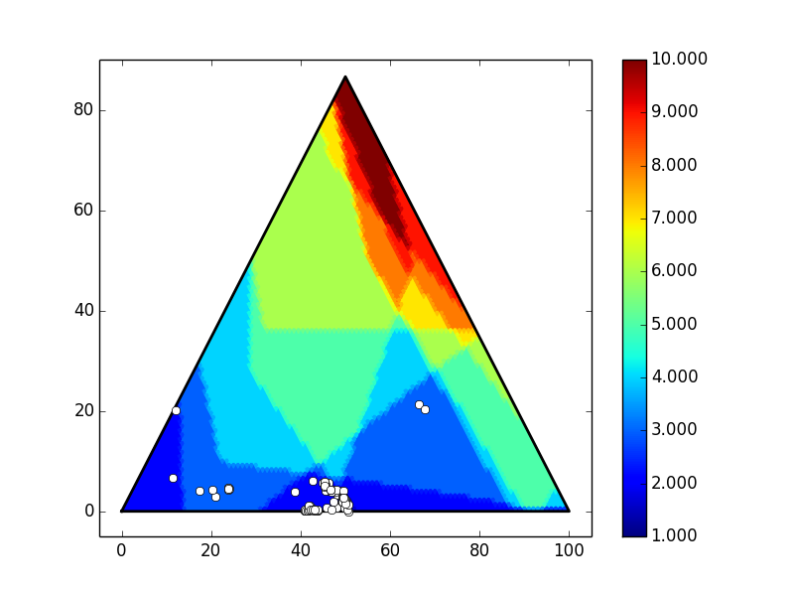
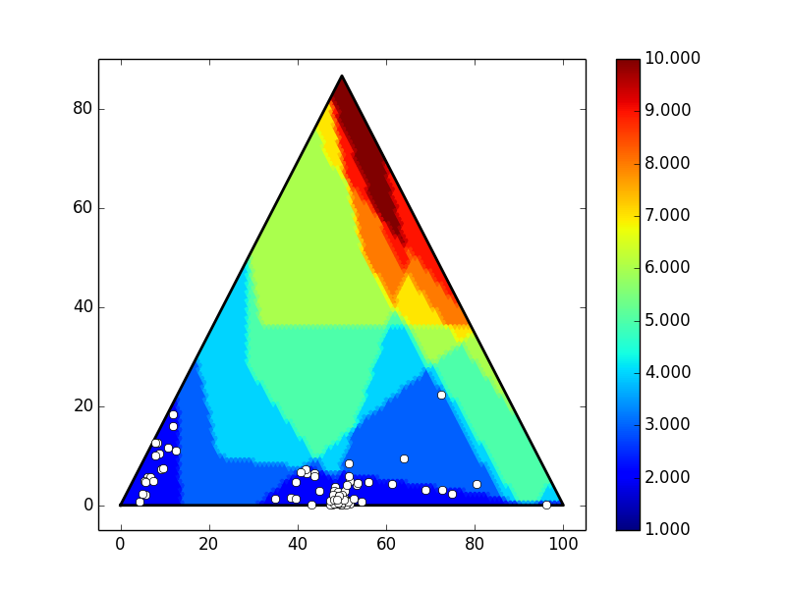
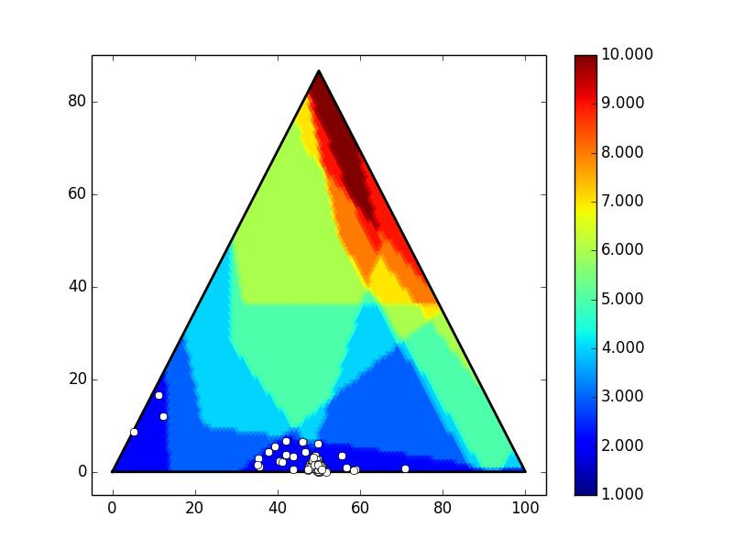

benchmark with ensemble optimizers
…
Simplex: 1000s (100 points at 10s /point)
Powell: 500s (100 points at 5s /point)
Diff Ev: 9500s (100 points at 95s /point) population of 40
Buckshot Simplex: 200s for batch of 100 solvers on 512 cores
Buckshot Powell: 68s for batch of 100 solvers on 512 cores

Slide 28
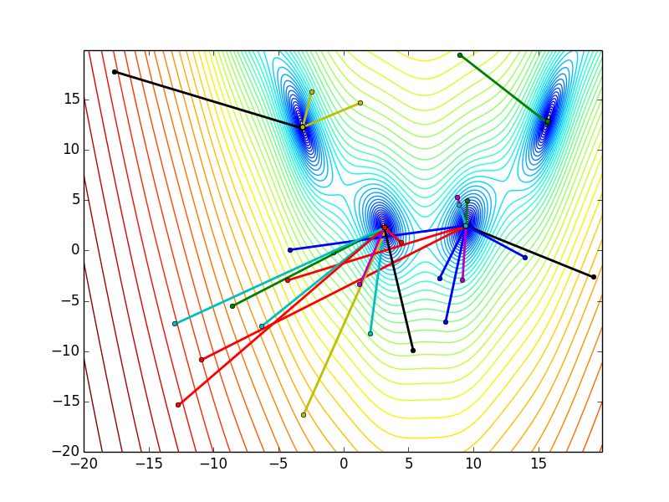
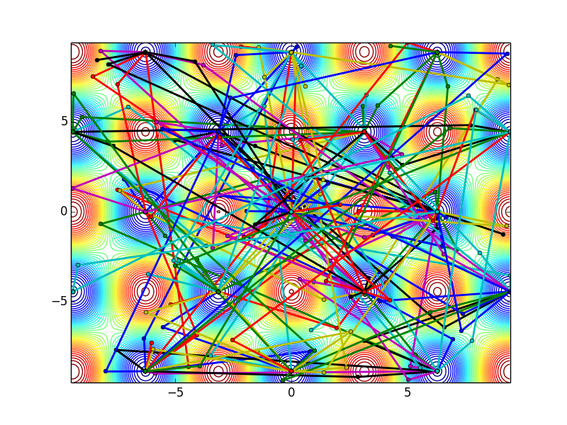
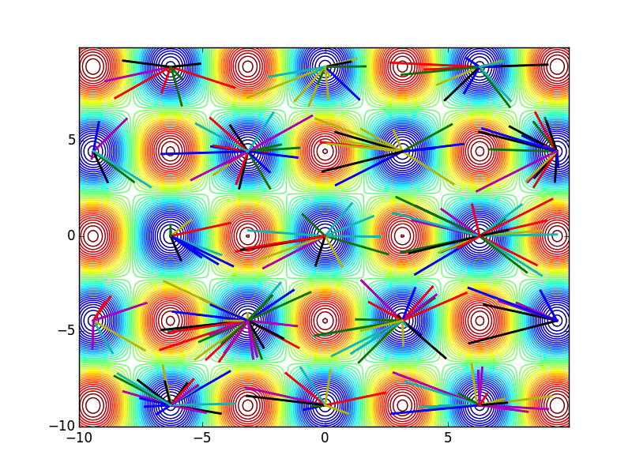
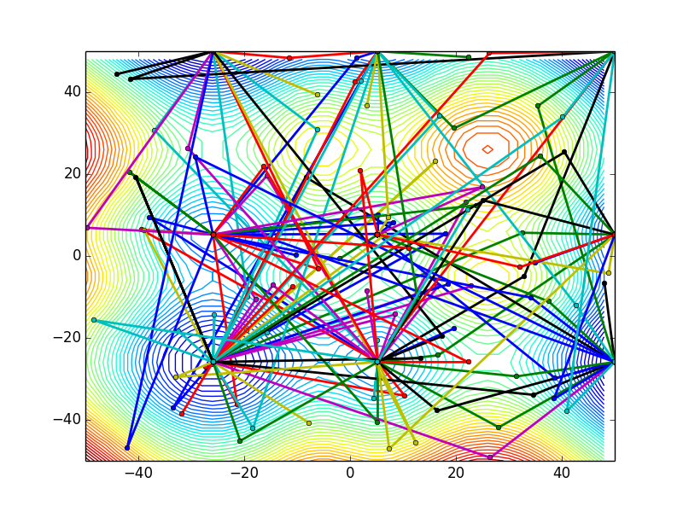
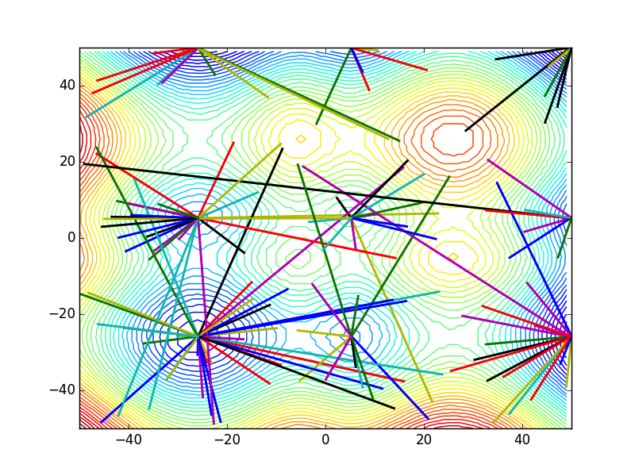
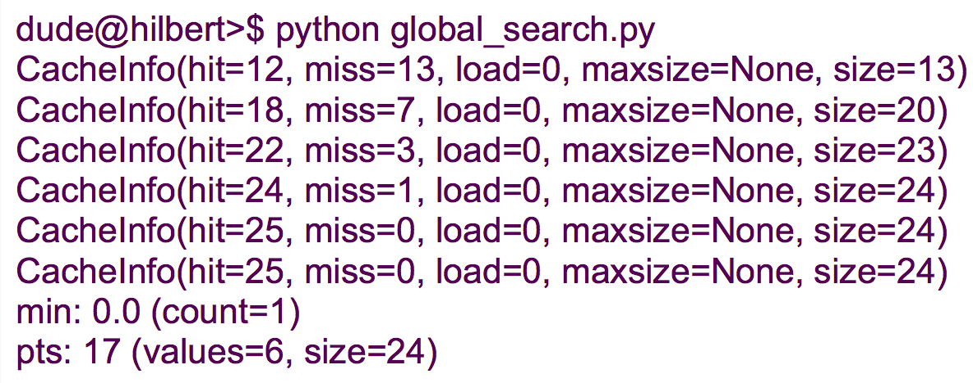
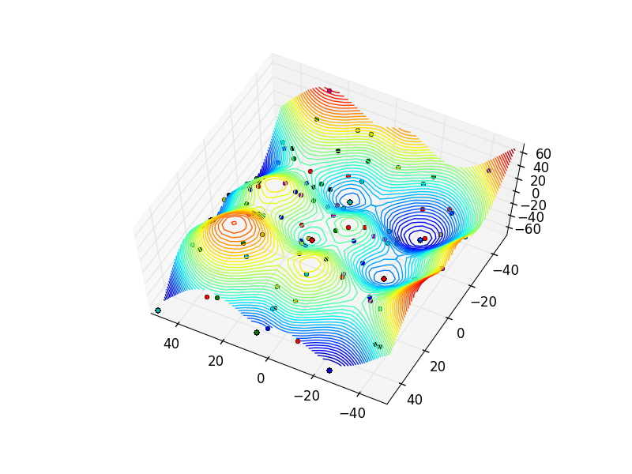
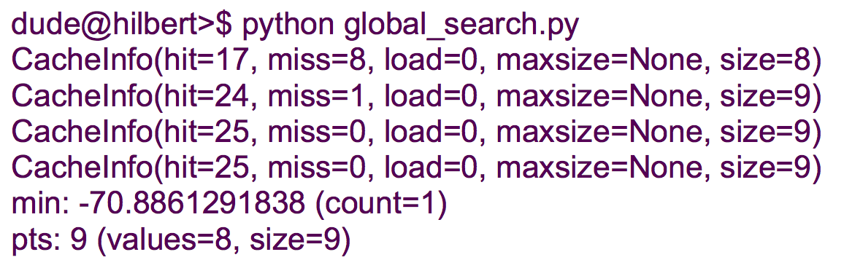
example: ensemble global search
…
Single Buckshot Powell search for all minima
Six-iteration Buckshot Powell search for all minima.
Two-iteration Buckshot Powell search for all minima.
Interpolate points to build a surrogate.
“cache” in this case is an abstraction on storage. “load” is local memory cache, while “hit” is an archive hit. “miss” is a new point. Results shown are for when configured for direct connectivity with archival database.

Slide 29
example: building the optimal surrogate
Can we build a surrogate for a n-dimensional surface, where we can optimally replicate the
original function’s behavior?
You can be smart about it, or use brute force. Let’s use brute force.
Notes:
== Asynchronous Model Coupling
== Multi-scale Models
== Parallel & Nested Analysis Circuits

Slide 30
example: building the optimal surrogate
Standard solution: pick a grid density, and drop points on the grid.
Then interpolate.
This approach does not scale well.
Can we do better?
Notes:
== Asynchronous Model Coupling
== Multi-scale Models
== Parallel & Nested Analysis Circuits

Slide 31
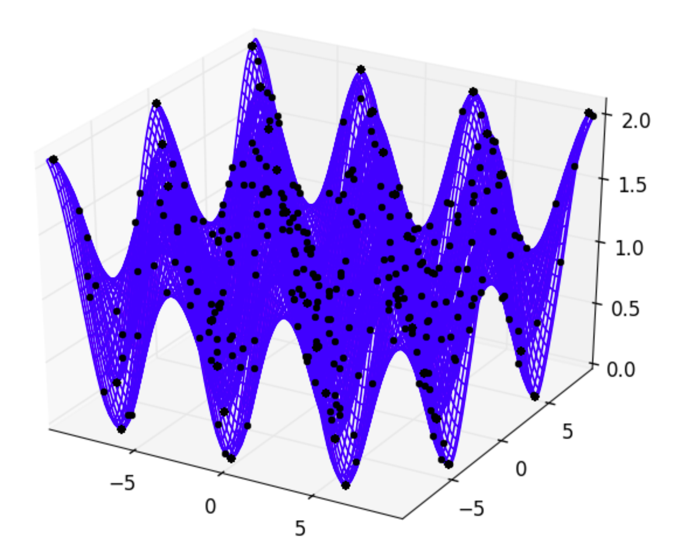
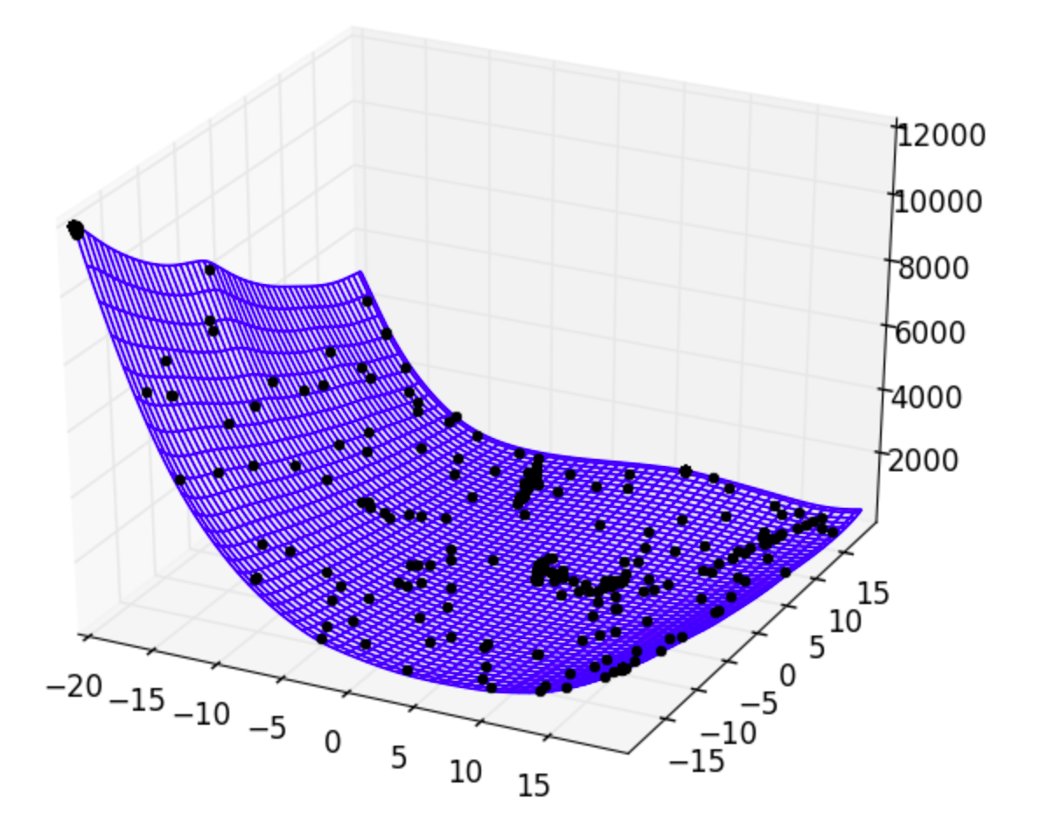
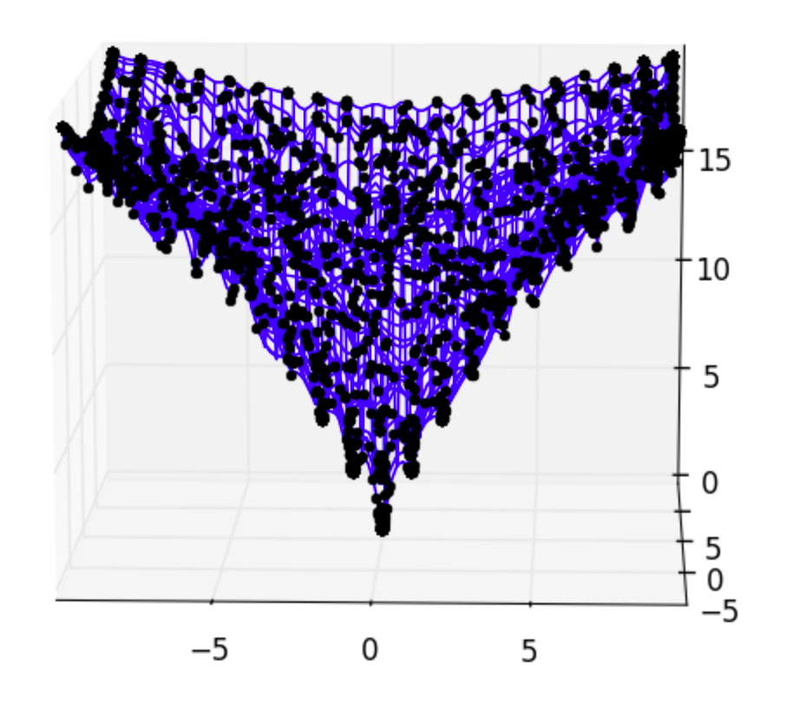
example: building the optimal surrogate
Better solution: pick points at all of the critical points for the unknown surface. Then interpolate.
Need to use an optimizer capable of reliably finding all critical points. Luckily, we have one.
Inflection points not shown.
As a “bonus” you also get the points from each function evaluation in the optimization.
Notes:
== Asynchronous Model Coupling
== Multi-scale Models
== Parallel & Nested Analysis Circuits

Slide 32
let’s revisit our initial simplifications…
selecting the “most likely” distribution
  ignore optimization in probability space (pick: weights, bias, prior, …)
  result: finds a structure, but in the manifold of the selected weights
  result: you get a best-fit structure, but not the likelihood of a structure
  results depend on how a selected distribution applies to all possible scenarios
selecting the model form
  hyper-parameter sampling and cross-validation are not optimization
  selecting a model class is not an automated process
  the majority of work is in trying to ensure the model is valid
other issues
  how to do model validation? (rigorous validation is lost w/ our simplifications)
  building and validating a surrogate needs to be done concurrently
  rigorous validation is model construction only guided by information constraints
  we are selecting the model and/or distribution by fitting to the given observations
  for rare-events, the past is not generally a good predictor of the future
  sampling a fixed distribution can only predict rare events that have been observed

Slide 33
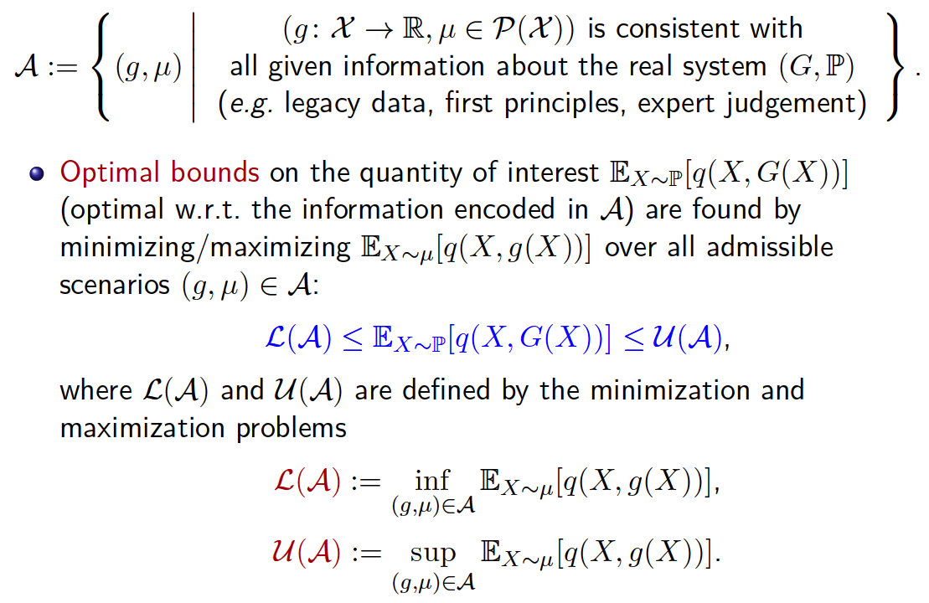
OUQ: a robust uncertainty theory
…
  …
…
  …
…
  …
extremes are bound by information in the form of constraints
formulated to handle UQ for catastrophic rare-events
Notes:
== Asynchronous Model Coupling
== Multi-scale Models
== Parallel & Nested Analysis Circuits

Slide 34
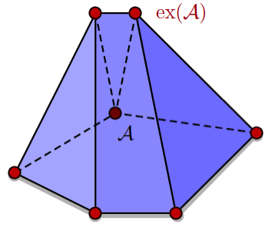

OUQ reduces infinite to finite dimensional
optimal bound on the statistical error
OUQ problems reduce to searches over finite dimensional families of extremal scenarios of
The dimension of the reduced problem is proportional to the number of probabilistic inequalities that describe
optimization is over product measures
  does not require selection of a probability distribution
  imposes constraining information on the possible distributions
valid only when solving for extrema
  this is what we want when solving for worst-case bounds
  much cheaper and more rigorous than monte carlo sampling
…
  …
  …

Slide 35









a simple problem with an unknown distribution
You are given one pound of playdoh.
How much mass can you put above a while
keeping the seesaw balanced around m?
this is an infinite-dimensional problem
we can make it finite-dimensional by using a two-mass basis set
the answer
the question
prior knowledge: constraints

Slide 36


UQ with unknown probability distributions
min/max on probability measure space (not input parameter space)
mean-constrained optimization balances weights and positions of Dirac masses around a critical point
OUQ is an optimization problem to find the rigorous bounds on system behavior
  all information is captured as constraints
  constraints restrict the set of all possible solutions (by directly constraining solution space)
  systems with minimal to no experimental data or unobserved rare events that govern system behavior
instead of selecting a "best" model or distribution or prior, we can optimize over all possible models, distributions, or priors.
  selecting a model or distribution is treated as an assumption or information (i.e. a constraint)
  our "prior" step becomes one of quantifying all the knowledge we have about the problem, and then encoding that knowledge as constraints
probability distribution
probability measure
(of Dirac masses)
critical point (mean constraint)
how many points are required? N+1 or less,
where N is the number or constraints.
Notes:
== Asynchronous Model Coupling
== Multi-scale Models
== Parallel & Nested Analysis Circuits

Slide 37

initial basis for a probability distribution…
Support Points at iteration 0

Slide 38

…solver looks for extremal cases……
Support Points at iteration 1000

Slide 39

…collapses candidate scenarios…
Support Points at iteration 3000

Slide 40

…and solves for probability of failure
optimal success scenarios
optimal success scenarios
Support Points at iteration 7100

Slide 41

rigorous model improvement and testing
We can hypothesize measurements of new information (say, a new constraint on the median of velocity, or on the angle of impact), and then optimize to see how that new information would alter the probability of the critical event.
We keep trying to design possible “experiments” to find the information
set that certifies the system as “safe” (not failing within the given tolerance)
Automate the search over models by defining a metric to compare models.

Slide 42


worst-case bounds on probability of failure
OUQ bounds are calculated with a mean constraint on δ, a mean constraint and a variance constraint on δ, a mean constraint on z, and a mean constraint on δ and a mean constraint on z.
The effect of having different information constraints can be seen on the calculated bounds. More specifically, the presence of additional information can be seen to generally tighten the bounds.
…
  …
…
  …
  …
probability that the shock wave reaches steady state
at x% of the mean distance z

Slide 43










used for model-parameter sensitivity
  …
  …
  …
  …
sensitivity in synaptic reaction networks
dynamic discovery of regions of criticality
left: schematic of major players in the synaptic reaction network
diameters help zero-in
on regions of parameter
space where parameters
have desired impact
large-scale calculations of risk
  …
  …
  …
  …
  …
  …
sensitivity of thermodynamic peak-broadening to bond anharmonicity
Crystal structure of monoclinic zirconia, with oxygen in red and zirconium in blue.
The partial density of states at 295 K calculated by GULP shows Zr dominates the lower energy modes.
A trading scenario generator creates and launches thousands of simulations on millions of trades.
sensitivity = - |F(x') - F(x)|²

Slide 44















used for probability of system failure
probability of elastoplastic failure under strain due to ground acceleration
UQ for solid mechanics of hypervelocity ballistic impact
  …
  …
  …
  …
  …
  …
typical scenarios for resulting ground acceleration
hypervelocity ballistics launcher and measurement system
value at risk
probability of failure as a function of maximum ground acceleration
when axial strain occurs near truss resonance modes, failure can occur
an impact simulation is used to quickly test materials response
a truss structure
validation of strength models for hypervelocity impact
the area of the above hole is determined by a laser probe
A Von Mises yield strength model with velocity = 100 m/s is shown 5 s after impact.
A feasible set defined by bounds
…and a mean constraint on area
Schematic of hypervelocity impact for a spherical steel projectile fired at a stainless steel plate.

Slide 45
outlook and opportunities
focused on applying mystic to advance machine learning
new high-level optimization workflows and strategies
new auto-dimensional reduction conditions
improving speed through multi-grid solvers
new releases of our software are available at:
  https://github.com/uqfoundation
I am interested in new opportunities for applications of these frameworks, and am always looking for contributors, collaborators, and partners, especially in materials science
  contact me at: mmckerns@uqfoundation.org

Slide 46
End Presentation

Slide 47



example: computing at exascale
DoE Exascale Co-Design Center for Materials in Extreme Environments
  DoE ASCR Center
  exascale system design
What is required for computing at exascale?
  predicted failure rates say that failure will be a part of normal operation
  therefore, an exascale computing system must be managed by statistics and a reliable uncertainty engine
  asynchronous and stochastic operation
  robustness against failure over the ability to restart
Team:
  7 Bell prize winners: CS and Materials Science
  primarily C++/Fortran and MPI
  driven by python for programming models (MPI+X) and statistics
ExMatEx
Ex
ExMat
Extreme Materials at Extreme Scale
DoE Extreme-Scale Technology Acceleration
FastForward $62.5M

Slide 48
the challenge: resilience at the exascale
It’s expected failure will occur as a part of normal operation.
  I’ll focus on “bad data”, but in many cases I’ll generalize to “failure”
What algorithmic changes can enable resilience at exascale?
  conjecture: an exascale system should be driven by statistics, and utilize redundancy where failure is expected to have a sizable impact
  robustness against failure over the need to restart
  programming models for dynamic flexibility in execution
  asynchronous parallel and stochastic operation
  integrated statistical forecasting and metric evaluation
How can statistics play a huge role in resiliency at exascale?
  identifying and filtering out errors (e.g. outliers that point to ‘bad data’)
  statistical sampling (for known distributions)
  statistical estimators/validators for system/algorithm behavior
  integrated driver for algorithmic robustness against failure

