Slide 1
Closed-loop
Autonomous Research Systems
( ARES )
Kristofer Reyes

Slide 2
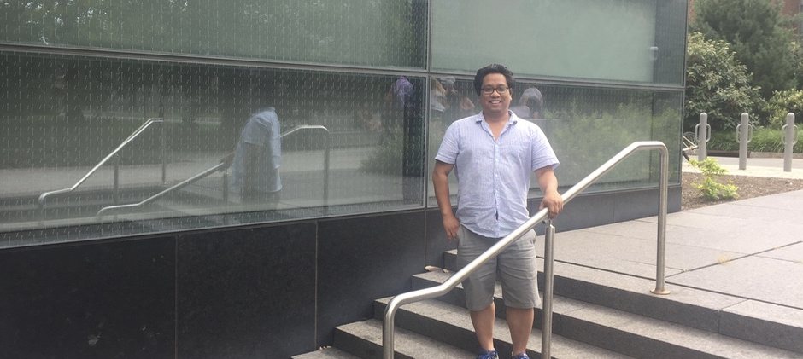
Acknowledgements
Dr. Benji Maruyama
Warren Powell (PI), Si Chen, Xinyu He, Yan Li, Yingfei Wang
Dr. Michael Krein

Slide 3
It takes an average of 20 years to go from discovery to widespread application.
1940
1950
1960
1970
1980
1990
2000
Teflon
Lithium-ion batteries
Velcro
Titanium production
Diamond-like thin films
Polycarbonate
GaAs
Amorphous soft magnets
After Gerbrand Ceder; Materials data from T. W. Eagar and M. King, Technology Review 98 (2), 42 (1995)

Slide 4
Efforts like MGI aim to accelerate materials design and discovery through data-driven techniques
Materials Genome Initiative (MGI)
Assemble data
Generate model
Virtual screening
Identify best materials design
Test with physical experiment

Slide 5
Data from experiments are the ultimate source of “ground truth"
New materials, synthesis method, characterization
Do we have enough data?
Do we have the right data?
If we need to perform experiments, which experiments do we need to perform?
Assemble data
Generate model
Virtual screening
Identify best materials design
Experiments as an information collection problem:
Collect the data that best helps achieve the stated design objective.
Test with physical experiment
Notes:
It behooves us to accelerate the process of experimental research. Not only in terms of bandwidth and high-throughput experiments, but more along the lines of “smart experiments.”
What do I mean by smart experiments?

Slide 6
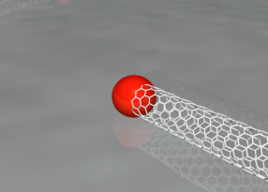
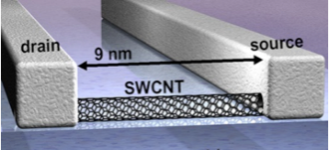
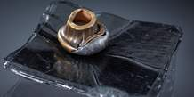

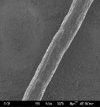



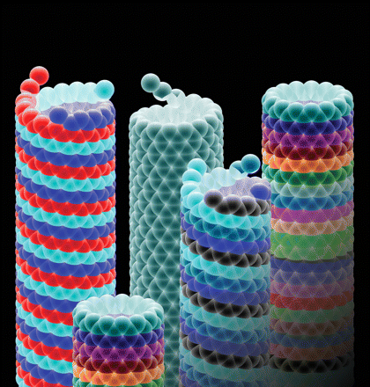
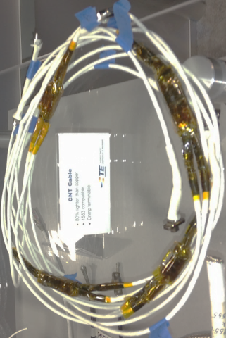

ARES: Autonomous Research System for the study of carbon nanotube synthesis
Catalyst
~1nm
Carbon nanotubes are one of the most promising & versatile nanomaterials
Broad application space: Electronic, Structural, Conductive & Sensing…
But key mechanisms during synthesis are not well understood
SWNT
(n,0)
(n,1)
(n,2)
Notes:
Unprecedented combination of mechanical, thermal and electrical properties
But carbon nanotube growth is still not sufficiently well understood
We don’t have precise control over key properties

Slide 7
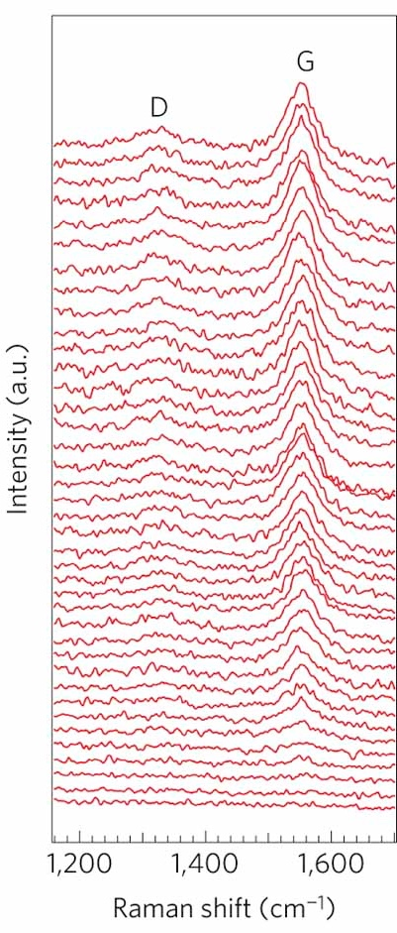
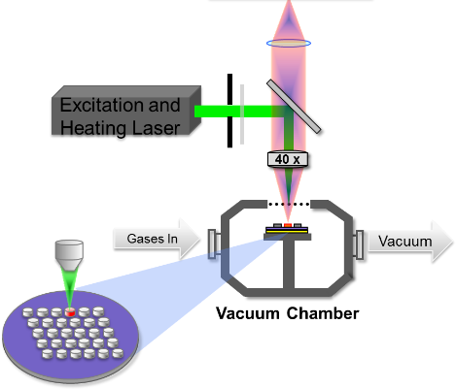
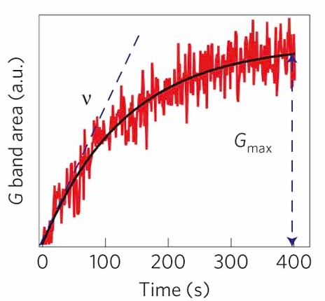
ARES autonomously executes, characterizes, analyzes and plans experiments.
Synthesis
Characterization
ARES Controller
Raman
Laser
Planner
Software
Gases In
Vacuum
Kinetics
Database
Silicon Wafer
Planning
P. Nikolaev, B. Maruyama, et al., npj Comp. Mat. (2016)

Slide 8
Planner: Sequential Bayesian Experimental Design

Slide 9
Planner uses Bayesian Experimental Design to select next experiments
Bayesian Experimental Design
Bayesian Optimization
Optimal Computing Budget Allocation (OCBA)
Active Learning
Optimal Learning
Prior Belief
Objective function
Experiment selection

Slide 10
Optimal Learning guides experiments to achieve an objective
Control variables
Objective functions
Flow rates
Temperature
Catalyst
Nanotube length
Defects
Polydispersity
We need to model and learn f(x).
”Evaluating” = running experiment
Experimental results are uncertain
Ground truth can be complicated
Notes:
Uncertainty in experimental results: Noise, Latent states and variables
Uncertainty in model: we don’t/can’t know everything. Complex phenomena: non-linear, non-convex, non-differentiable

Slide 11
Optimal Learning iteratively learns the objective function through a sequence of strategically selected experiments
Decision Policy
Experiment to perform
Experiment
Experiment outcome
Bayesian update
Current Belief
Prior formation
Model estimates and uncertainty
Temperature
Flow rates
Initial Data
Physical models
Domain expert
Materials database
CNT growth

Slide 12
Decision policies balance exploration vs. exploitation to deal with uncertainties
Upper Confidence Bounds
Interval Estimation
Expected Improvement
Knowledge Gradient
Monte Carlo Tree Search
Notes:
KG = scores a potential experiment based on its power to change our estimate of the maximum objective function value.
One-step look ahead = Calculate value of experiment by enumerating potential experimental results and averaging.

Slide 13
Estimation and uncertainties about the objective function are codified into Belief Models
Unknown quantities?
Non-parametric
Semi-parametric
Parametric models
Lookup table
Local parametric
Sampled beliefs
Linear models
Sparse additive
Belief Model =
Regression model + Uncertainty quantification

Slide 14
Sampled belief models considers a discrete distribution on a finite sample of parameters
Assumptions
Useful when using non-linear physical models
Simple calculations
Need to hill-climb (resample)
Susceptible to model misspecification
Model
Notes:
“Candidate models”

Slide 15
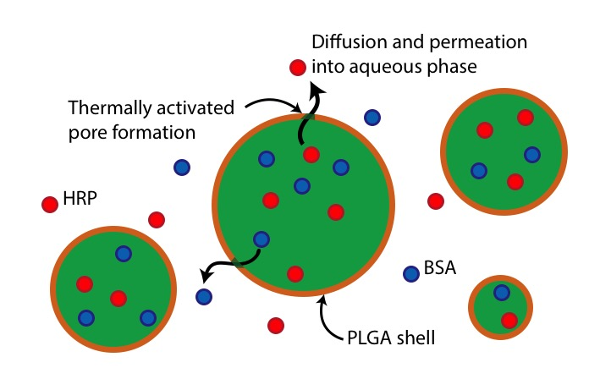
As more data is collected, the distribution on parameters becomes more refined
Prior belief
1 experiment
Maximize stability of an emulsion
Reaction-diffusion model of emulsion stability.
Three kinetic parameters
KG policy to select experiments
2 experiments
3 experiments
S. Chen, K. Reyes, et al. SIAM J. Uncertainty Quantification (2015).

Slide 16
Local parametric models avoid model misspecification
Global models
Pressure
Non-adaptive
Hard to get right
Local parametric models
“Stitch local models together”
Temperature
Notes:
Misspecification risk high when dealing with complex systems:
(ARES + CNT): Phase change phenomena, catalyst np activity, gas and surface reactions.
Idea with local models: Model dominant processes in a local region, assumption that local models are simpler than global.
Several local models l(x, theta), assigned to local regions in experiment space, and stitched together with Gaussian radial basis functions

Slide 17
Belief models and policies are evaluated using Optimal Learning simulations
Decision Policy
Experiment to perform
Noisy measurement from truth
Experiment outcome
Bayesian update
Current Belief
Generate ground truth
Model / policy performance

Slide 18
Average opportunity cost measures how far from optimal a policy achieves after a fixed number of steps.
How far from optimal?
Opportunity cost
Objective function
Truth
Estimate
Experiment space
Estimated best experiment
True best experiment
Number of experiments
Optimal Learning with Local Nonlinear Parametric Belief Models over Continuous Designs, X. He, K.Reyes, W.B. Powell

Slide 19
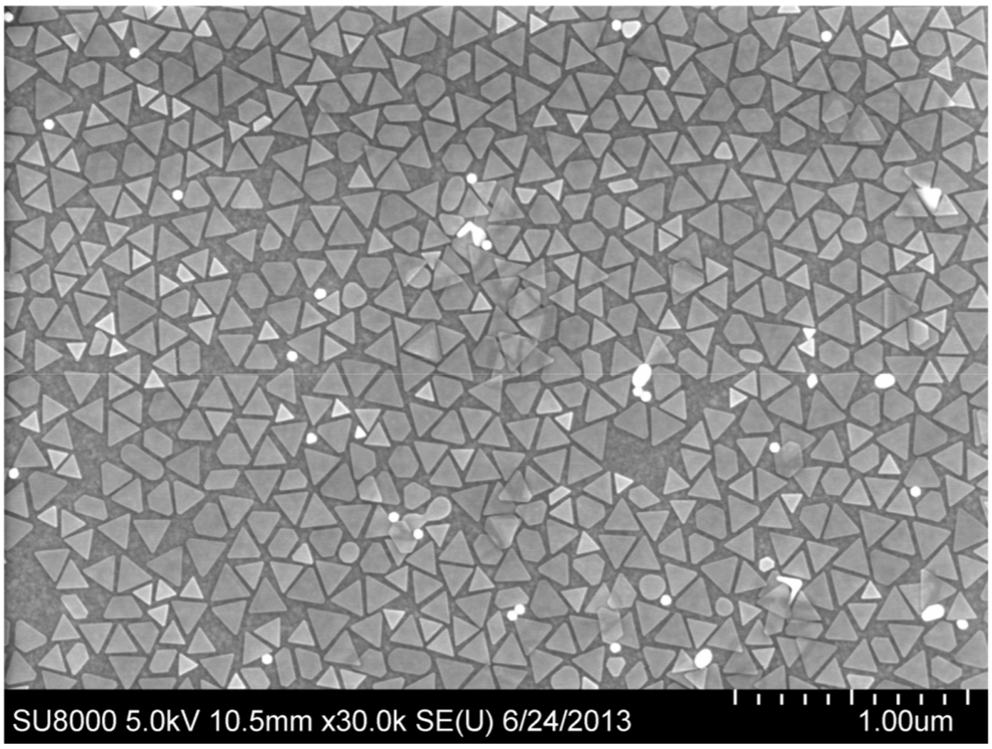
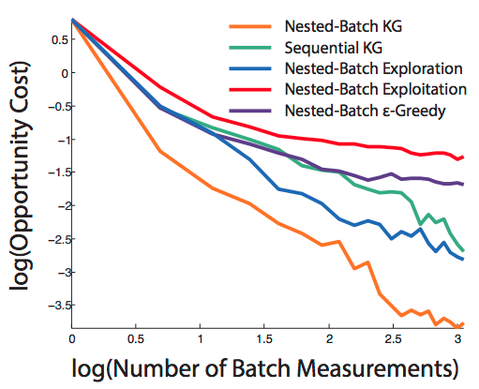
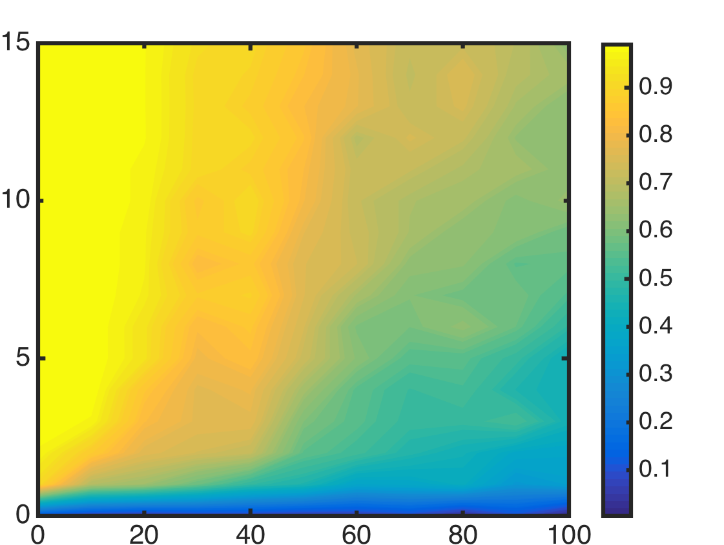
In addition to ARES, we’ve applied Optimal Learning to a diverse set of problems
Optimizing optoelectronics
Identifying information-rich regions in large RNA molecules
J. Vazquez-Anderson, M. K. Mihailovic, K. C. Baldridge, K. Reyes, K. Haning, S. H. Cho., P. Amador, W. B. Powell and L. M. Contreras. Nucleic Acids Research, 2017.
Analyzing risk in Optimal Learning campaigns
Probability of Success
Better performance
Measurements
Increasing measurement noise
Wang, K. Reyes, K. A. Brown, C. A. Mirkin, W. B. Powell, SIAM J. Scientific Computing, Vol. 37, 2015.
Measurement noise (%)
K. Reyes, S. Chen, Y. Li, W. B. Powell, Proc. of the TMS Annual Meeting, 2015

Slide 20
Key take-aways
ARES autonomously executes, characterizes, analyzes and plans experiments.
Planning is done by sequential Bayesian experimental design
Optimal Learning with the KG policy uses a one-step look-ahead to pick the experiment with highest marginal value of information.
Proper prior formation and uncertainty quantification is important for good decision making.

Slide 22
KG

Slide 23
The Knowledge Gradient policy scores potential experiments on their power to change the estimation of the maximum objective function value
: “future”
: “now”
: posterior estimate of
: prior estimate of
The experimental outcome if we choose “x” as the next experiment
The posterior estimate given experimental outcome
Weighted average over potential outcomes
Maximum value based on posterior belief
Maximum value based on current belief
Notes:
Useful pneumonic: KG = estimated posterior max minus the prior max.
One-step look-ahead policy: Approximate the value of a potential experiment by enumerating all possible outcomes and averaging.
Deceptively simple.

Slide 24
INSIGHTS

Slide 25
Insights for autonomous experimental design and optimization

Slide 26
Uncertainty quantification is important
Uncertainty in experimental results
  Noise
  Latent states and variables
  Experimental reproducibility
Uncertainty in belief models
  Unknown parameters
  Model specification
Notes:
Uncertainty in regression function: we don’t/can’t know everything

Slide 27
Many Optimal Learning calculations are embarrassingly parallelizable
Examples:
  KG values – Monte Carlo estimations
  Monte Carlo Tree Search policies
  Sampled belief model
Computational resources not onboard ARES
  Web-based API to compute servers
  https://hds.princeton.edu/demos

Slide 28
Scientific data comes equipped with useful prior knowledge
How do we incorporate physics knowledge as prior information?
Currently: Physical model with unknown parameters
  Model misspecification
  Research itself, not autonomous
Can we learn the model as we go?

Slide 29
AUTOMATED MODELS

Slide 30
Can we learn the model itself?
Semi-automated learning of chemical reaction networks
Notes:
Use models with variable but parametrical structure, and learn the structure.

Slide 31
Use chemical reaction networks instead of general machine-learning techniques.
Chemical Reaction Network
Neural Network
Parameters = network weights
Network structure is layered
Parameters = reaction rates
Network structure determined by reaction stoichiometry equations

Slide 32
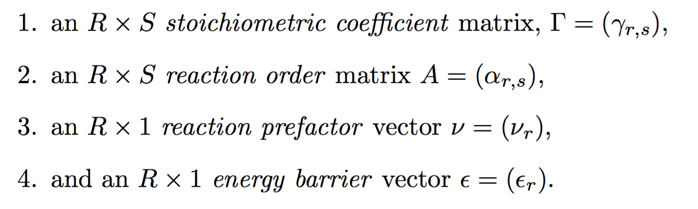
Chemical Reaction Networks
A CRN dictating the reaction rates between S species and R reactions is determined by:

Slide 33
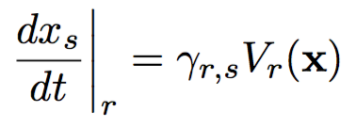
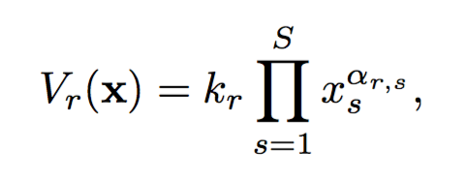
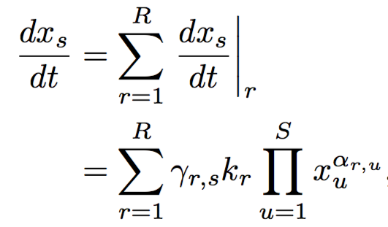
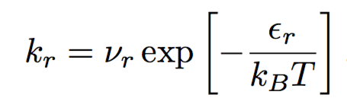
Kinetic equations
For each species, we let x_{s}(t ) represent the concentration of species s at time t.
Mass-action kinetics

Slide 34
Relevant species for the CNT problem
Precursor gases
Phase species
Other species?
C2H4
CO2
H2
H2O
CNT: “Carbon adsorbed onto CNT”
Cat: ”Catalyst NP Lattice sites”
Junk Carbon/Platelet that decrease Cat sites?
Gas phase products of pyrolysis?
Something else?
Problem: Can we learn the existence of other species and reactions to explain observations?

Slide 35
What is correct structure/parameters for CNT kinetics?
We attempt to fit structure/parameters to growth curves obtained experimentally.
Nested optimization problem:
Structural parameter
Continuous parameter
Experimentally observed growth curves

Slide 36
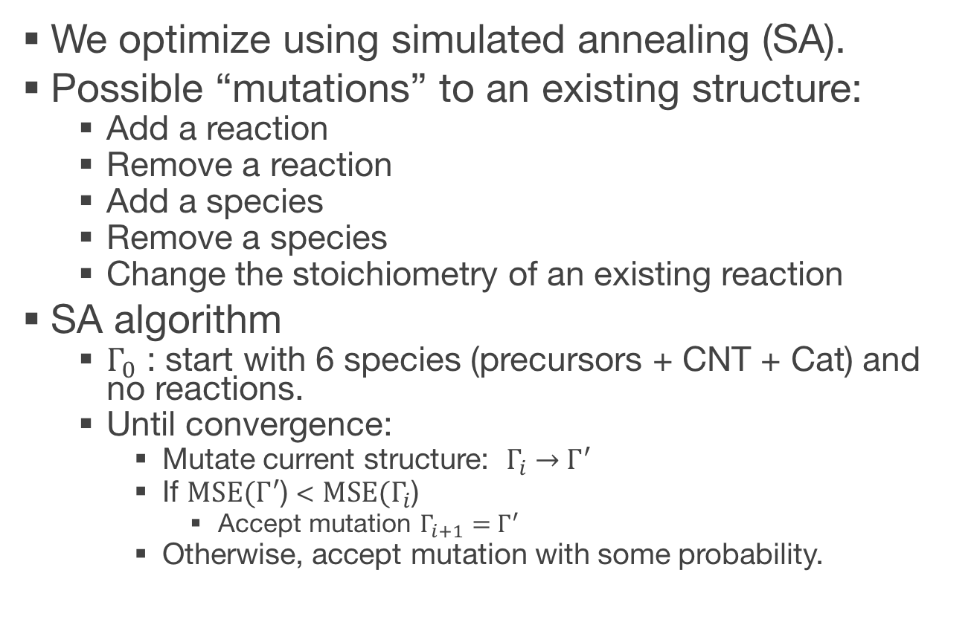
Outer optimization over CRN structure
We optimize using simulated annealing (SA).
Possible “mutations” to an existing structure:
  Add a reaction
  Remove a reaction
  Add a species
  Remove a species
  Change the stoichiometry of an existing reaction
SA algorithm
  $Γ_{0}$ : start with 6 species (precursors + CNT + Cat) and no reactions.
  Until convergence:
    Mutate current structure: $Γ_{i} \underset{→}{ }{ Γ}^{′}$
    If $\text{MSE}\text{(}Γ^{′}$) < $\text{MSE}\text{(}Γ_{i}$)
      Accept mutation $Γ_{i+1}={ Γ}^{′}$
    Otherwise, accept mutation with some probability.

Slide 37
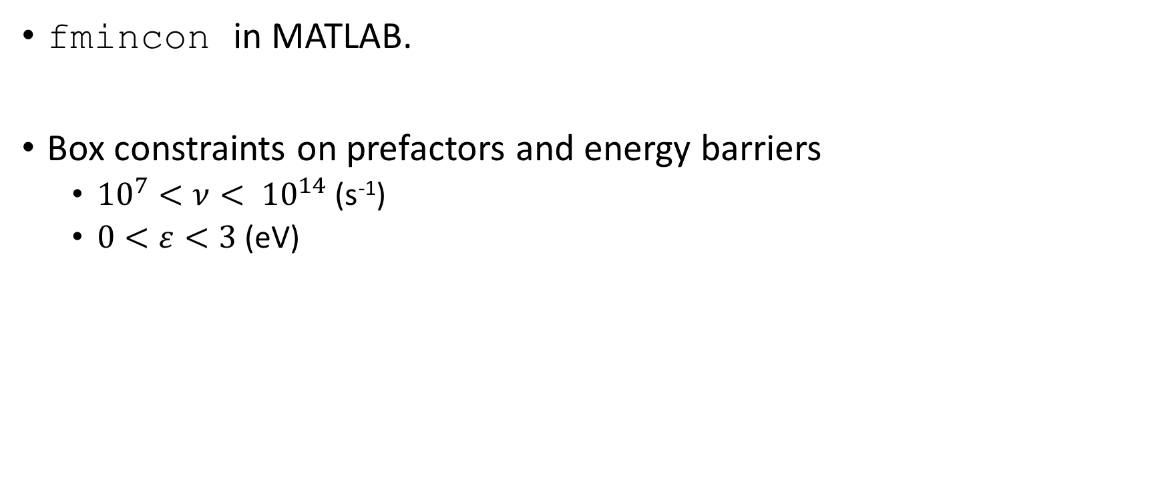
Inner optimization is classical constrained optimization
fmincon in MATLAB.
Box constraints on prefactors and energy barriers
  ${10}^{7}<ν< {10}^{14}$(s⁻¹)
  $0<ε<3$ (eV)

Slide 38
We can fit individual curves for various observed growth modes.
C2H4
H2
CO2
R1
H2O
CNT Growth
Cat
R2
CNT
Time (s)
X1

Slide 39
C2H4
H2
CO2
R1
H2O
CNT Growth
Cat
CNT
R2
R3(a,b)
Time (s)
X1
X2

Slide 40
C2H4
H2
CO2
R1
H2O
CNT Growth
Cat
CNT
R2
R3(a,b)
Time (s)
X1
X2

Slide 41
C2H4
R1
H2
CO2
F2
H2O
CNT Growth
Cat
CNT
R3
R4
Time (s)
X1
R5
X2

Slide 42
Searching over graph structures is hard
Optimization inner-loop requires integrating stiff dynamics.
  Current work: Can we optimize physical parameters during integration?
Simulated annealing outer-loop doesn’t explore graph structures effectively.
  Current work: Develop more continuous mutations (e.g. identifying and simplifying multistep reactions into several elementary ones).
  Current work: Need good “initial guess” – must come from this community.
Mass-action kinetics may be too simplistic.
  Future work: Instead of graph of species/reactions, consider a graph of potentially relevant physical mechanisms (nucleation, ripening, adsorption, etc.)
Notes:
Take advantage of problem-specific structure

