Slide 1
Parallelizing X-ray Photon Correlation Spectroscopy Software Tools using Python Multiprocessing
Sameera K. Abeykoon
Meifeng Lin
Kerstin Kleese van Dam

Slide 2
Talk outline
Scikit- beam
X-ray Photon correlation Spectroscopy (XPCS)
One-time correlation
Two-time correlation
Real time streaming data analysis
Python multiprocessing module
Multiprocessing Pool class
Multiprocessing Process class
Parallelizing XPCS software tools
Results
Conclusion and Summary

Slide 3
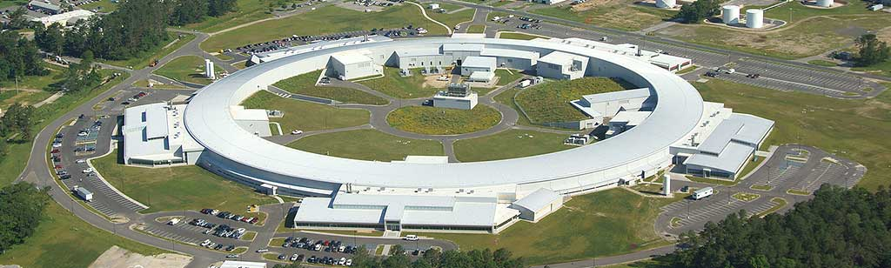
National Synchrotron Light Source-II
(NSLS-II)
Third generation synchrotron source
~17 beamlines
New X-ray techniques – in-situ measurements during evolution of materials
Need of “basic experimental toolkit” for data management and analysis.

Slide 4


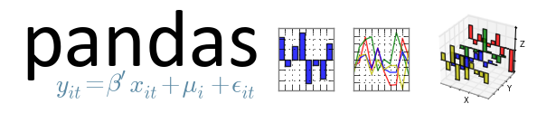



Scikit-beam – Python data analysis library
Analysis tools for X-ray, neutron and electron data.
Differential Phase Contrast
X-ray Speckle Visibility Spectroscopy
X-ray Fluorescence Techniques
Full-field Imaging
Powder Diffraction
X-ray Photon Correlation Spectroscopy
Analysis
Notes:
Primary Objective - Minimize technique-specificity and maximize code re-usability.
100% test coverage to all our analysis codes.
Full documentation for the users and developers.
All our functions are fully tested and validated by numerous domain experts.
Open source : https://github.com/scikit-beam/scikit-beam
Scikit-beam supports all levels of user expertise, from novice to developer.

Slide 5
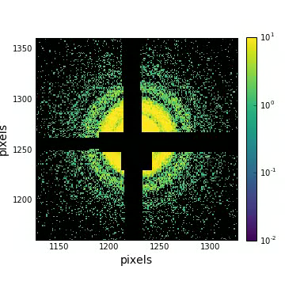
X-ray Photon Correlation Spectroscopy (XPCS)
Coherent X-ray scattering experiments are enabled at third generation synchrotron facilities.
When the coherent light scattered by a heterogeneous sample it produces a speckle pattern.
Speckle pattern is the characteristic of the specific arrangement of the scatters.
The resultant speckle intensity changes as the scatters fluctuate over time.
The time auto correlation functions of the speckle fluctuations reveal the scattering wave-vector dependent timescales associated with the motion of the scatterers.
A powerful experimental tool to
Study nano- and meso-scale dynamics of materials.
Study both, equilibrium and non-equilibrium dynamics.
XPCS access a unique combination of length- and time-scales
Notes:
Steady state, equilibrium
XPCS access a unique combination of length- and time-scales

Slide 6
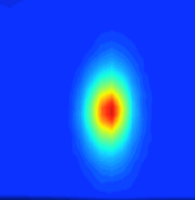
Scikit-beam, correlation module –
One-time correlation
Collect a speckle movie.
Long series of images with constant time lag between them.
I (q, t ) refers to the scattering intensity at the momentum transfer vector, q in reciprocal space at time, t.
Where; < > represents an ensemble average over nominally equivalent pixels and a time average over all the equivalent times t. t¹ is the time delay.

Slide 7
Scikit-beam, roi module
Ring “labels” (q rings)
Q rings marked on a silica colloidal average image (Average of 10000 images with 2 ms integration time)

Slide 8
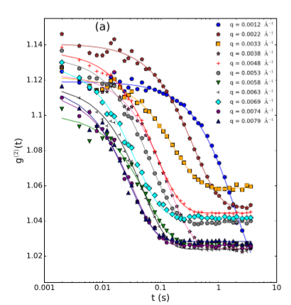
One-time correlation – Results from the Scikit-beam sequential algorithm
Silica colloidal sample,
10000 X-ray scattering images with 2 ms acquisition time.
One-time correlation functions, g⁽²⁾(q, t)’s calculated using the Scikit-beam XPCS analysis tools and plotted as a function of time delay, t.
The 11 correlation functions shown here correspond to q rings with width of
1.0x10⁻⁴A ^{̊-1}.
Solid lines represent the fitted curves using intermediate scattering function (Siegert relation).
S. K. Abeykoon et al., 2016 New York Scientific Data Summit (NYSDS), New York.
doi: 10.1109/NYSDS.2016.7747815

Slide 9
Scikit-beam, correlation module
Two-time correlation
Two-time correlation functions are useful for out-of-equilibrium systems - one-time correlation functions change with time,
I(q, t₁ ) refers to the scattering intensity at the momentum transfer vector, q in reciprocal space at time, t₁.
<…> - ensamble average over equivalent pixels of the detector.

Slide 10
Two-time correlation results –
Scikit-beam sequential algorithm
Represents the time along the t₁ = t₂ diagonal.
t = | t₁ – t₂ | measures the “distance” from t₁ = t₂ diagonal
Average time (age)
t_{a} = (t₁ + t₂)/2
When the system is in equilibrium, the two-time correlation functions depend only on the time difference, t, and not on the sample “age”, t_{a.}
S. K. Abeykoon et al., 2016 New York Scientific Data Summit (NYSDS), New York. doi: 10.1109/NYSDS.2016.7747815

Slide 11
Real time streaming data analysis pipelines
In a typical XPCS experiment, 20,000 speckle patterns are recorded at the maximum rate with an acquisition time of ~1ms/per pattern.
Presently one- and two-time correlation functions in the
Scikit-beam correlation module use a single processor
User beamtimes are short and awarded on competitive basis. Therefore, analysis and interpretation of a continuous stream of data is required to conduct experiments in an efficient manner.

Slide 12
Two-time correlation timings for the sequential code.
Number of images = 10000
Image xdim, ydim =
(1000, 1000)
When you increase the number of ROI’s sequential algorithm will take up to one hour to calculate the two-time correlation results.
Users will choose different ROI’s and may want to repeat the calculation.
They bring lot of samples. Therefore, they have to repeat the same calculation for all different samples. Time consuming
Need to speed up the data analysis process.

Slide 13
Parallelizing XPCS software tools
Real time data analysis will help users to make decisions regarding the data collection strategies during experiments to optimize the scientific outcome.
The goal of this project is to parallelize time-correlation function(s) to take advantage of all the CPU power available at beamline servers to analyze large amounts of data in real time.
Simple Python parallel programming techniques that does not require users a knowledge of parallel programming.
Investigate different Python parallel programing modules.

Slide 14
Parallelizing XPCS software tools using Python threading
Threads are the light-weight process to run parallel programs because multi-threading uses the shared memory parallelism model.
These threads share the same portion of memory assigned to their parent process; each thread can run in parallel if the computer has more than one CPU core.
However, Python global interpreter lock (GIL) mechanism will allow only one thread to execute python code once. This affects the performance of multi-threaded application for CPU bound tasks, and the execution time may be actually higher than serial execution.
Notes:
Parallelizing these software tools to use multiple processers available in the computer infrastructure of the NSLSII is the next step.

Slide 15
Python Multiprocessing to parallelize XPCS software tools
Multiprocessing is one way to execute tasks in parallel on a multi-core CPU, or across multiple computers in a computing cluster.
In multiprocessing, each task runs in its own process; each program running on a computer is represented by one or more processes
Python multiprocessing module has similar application programming interface(API) as the Python threading module to spawn the processes.
There are two options available to spawn the processes using multiprocessing module to distribute the work- load among multiple processes.
    1. A pool of worker processes created by the Pool class.
    2. Use of the Process class

Slide 16
Python Multiprocessing – Pool Class
Provides convenient approaches for a simple parallel processing tasks.
Approaches | Multi-args | Concurrence | Blocking | Ordered-list
Pool.map | no | yes | yes | yes
Pool.apply | yes | no | yes | yes
Pool.map_async | no | yes | no | no
Pool.apply_async | yes | yes | no | no
Pool.starmap | yes | yes | no | yes
Pool.stamap_async | yes | yes | no | no
Async methods submit all the processes at once and retrieve the results once they are finished. Use get method to obtain the results.
Pool.map(or Pool.apply)methods are very much similar to Python built-in map(or apply). They block the main process until all the processes complete and return the result.
Pool.imap and Pool.imap_async – lazier version of map and map_async.
Pool.starmap method, very much similar to map method besides it acceptance of multiple arguments.

Slide 17
Python Multiprocessing – Pool Class
# Import Pool class from multiprocessing module
from multiprocessing import Pool
# Get the number of processes
ncpus = no_rois
# Define pool of ncpus worker processes
p = Pool(ncpus)
# Start ncpus pool of worker processes in parallel
Results = p.starmap(multi_tau_auto_corr, zip(repeat(num_levels),
repeat(num_bufs), label_array, repeat(images))
# Close the ncpus worker processes.
p.close( )
# Join ncpus worker processes. Stop and wait for all of the results to be finished
# and collected before proceeding with the rest of the program
p.join( )

Slide 18
Python Multiprocessing – Process Class with a Queue
The Pool approaches are best suitable for one argument as an input parameter to the calling function.
Other approach is to use the multiprocessing, Process class with a queue.
Process class follow the API of threading class. (Equivalent to all the methods in threading.Thread.)

Slide 19
Python Multiprocessing – Process Class with Queue
# Import Process, Queue classes from multiprocessing module
from multiprocessing import Queue, Process
# Create receive queue (To retrieve final results)
results_q = Queue()
# Define multiple processes or jobs
jobs = [ ]
# Send the arguments to separate processes in parallel
for i in range(no_rois):
p = Process(target=multi_tau_auto_corr,
args= (num_levels, num_bufs, label_array[i],images, (i, results_q))
jobs.append()
# The process daemon flag, a Boolean value
p.daemon = True
# Start worker processes in parallel
p.start()

Slide 20
Python Multiprocessing to parallelize XPCS software tools
We have investigated two options for this purpose:
A pool of worker processes created by the Pool class. Pool.starmap
Use of the Process class with FIFO(First in First Out) queue to receive the data.
We used Coherent Soft X-ray -1 (CSX-1) beamline server at NSLS-II and the Scientific Data and and Computing center(SDCC) cluster at CSI to test the acceleration performance of the new parallelized algorithms.
The SDCC cluster is an Intel Xeon CPU E5-2695 v4, 2.10GHz processor consists of 36 CPU cores.
The CSX-1 server is an Intel Xeon CPU E5-2667 v2, 3.30GHz processor consists of 16 CPU cores that is dedicated for user data processing and analysis.

Slide 21
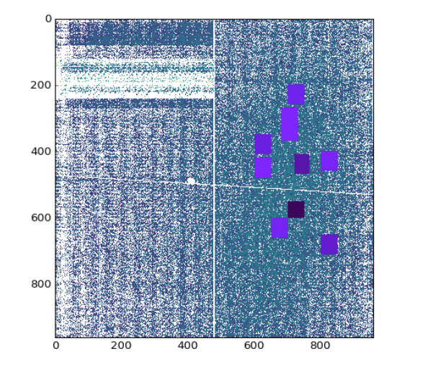
Parallelized XPCS software tools using multiprocessing module
We have used multiprocessing module to parallelize both one- and two-time correlation functions.
In the time correlation analysis, users choose desired region of interests (ROI’s), in the image to perform time correlations.
In our parallelization scheme, the calculations of the time correlation functions for different ROI’s are distributed to different CPU process.

Slide 22
Parallelized XPCS software tools using multiprocessing - Results
The performance acceleration of the parallelized one-time(or two-time) correlation functions was compared with the run time of the sequential code (original Scikit-beam one-time(or two-time) correlation function) running in a single process.
Same arguments (eg: number of images, number of roi’s, etc..) used for both parallelized function and the serial code for the comparison of the performance.

Slide 23
Parallelized XPCS software tools using multiprocessing Pool class - Results
Pool.starmap method
1000 images (xdim,ydim) = (1000, 1000)
We have to extremely increase the Number of ROI’s and increase thickness of a ROI ring to achieve a Speed_up.
Maximum Speed_up 1.8 with 8 processes. Large overhead
Overhead needed to create the worker pool and dispatch a single task to a worker.
Not a good option to parallelize the XPCS tools
Used CSX-1 server

Slide 24
Parallelized XPCS software tools using multiprocessing - Process/ Queue Results
Number of images = 1000
Image xdim, ydim =
(1000, 1000)
Number of process = Number of ROI’S.
Time(one-time and two-time) correlation Speed_up was calculated while increasing the Number of ROI’s.
Reasonable Speed_up up to factor of 4.
Used CSX-1 server.

Slide 25
Parallelized XPCS software tools using multiprocessing - Process/ Queue Results
Repeated the two-time correlation calculations using SDCC cluster.
Number of process = Number of ROI’S.
Number of images = 1000
Image xdim, ydim =
(1000, 1000)
Two-time correlation Speed_up was calculated while increasing the Number of ROI’s.
Even more Speed_up and inline results.
Couldn’t achieve the ideal Speed_up

Slide 26
Parallelized XPCS software tools using multiprocessing – Process/ Queue Results
Number of process = Number of ROI’S = 9. Image xdim, ydim = (960, 960). Number of images 800
The IO part of the calculations is not parallelized.
Two-time correlation Speed_up was calculated while increasing the Number of images.
Number of images small – IO cost makes up a large portion of the total computing cost.
When the number of images increase the IO cost becomes negligible.
Used CSX-1 server.

Slide 27
Processing time breakdown for two-time correlation for 16 ROI’s
Number of images = 10000. Image (xdim, ydim) = (1000, 1000). The inset shows the ROI’s.
Compare the processing time taken for each ROI with serial algorithm processing time and the parallel algorithm processing time.
Each ROI is different in sizes and pixels. Therefore, the parallel work is not evenly distribute among different processes.
Parallel process time dominated by the largest ROI ‘s process time.
Factor of 4
Used SDCC server.

Slide 28
Parallelized XPCS software tools – same size ROI’s two-time correlation Results
Number of images = 2000. The inset shows the ROI’s.
We were able to achieve better Speed_up for two-time correlation calculation when we distributed the same size of work to all the processes.
Using same size ROI’s and increasing the size of computation will produce reasonable Speed_up.
XPCS software tools contain multiple input arguments therefore inter-process communication can add considerable overhead to the parallel task.
Used SDCC server

Slide 29
Conclusion and Summary
New beamlines at NSLS-II generate large volumes of experimental data. Therefore, it is essential to have efficient data analysis tools to process, analyze, and interpret continuous streams of structured and unstructured data.
Python multiprocessing module introduced easy ways to achieve true parallelism to Python codes.
Pool.starmap
Insignificant performance Speed_up after extremely increasing the Number of ROI’s and the thickness of A ROI ring.
Parallel version runtime was longer than the serial version runtime due to overhead needed to create the worker pool and dispatch a single task to a worker.
Process with a queue to receive output results
This approach produced reasonable Speed_up when parallelizing Scikit-beam XPCS software tools.
The Speed_up was continued to increase while proliferating the Number of processors in both parallelized one-time and two-time correlation calculations.
Multiprocessing Process class with a queue to distribute CPU-intensive tasks into parallel processes is a better option to parallelize the Scikit-beam software tools.

Slide 30
Acknowledgments
Funding Source : BNL, Laboratory Directed Research and Development (LDRD) program.
Stuart Campbell, Nikolay Maltisky,Thomas Caswell, Daniel Allan, Li Li and Arman Akilic (NSLS-II, DAMA Group)
Andrei Flerasu and Yugang Zhang (NSLS-II, CHX beamline)
Stuart Wilkins, Claudio Mazzoli and Andi Barber (NSLS-II, CSX-1 beamline)
NSLS-II scientific staff
NSLS-II controls group

Slide 31
THANK YOU

Slide 33
Scikit-beam
Primary Objective - Minimize technique-specificity and maximize code re-usability.
100% test coverage to all our analysis codes.
Full documentation for the users and developers.
All our functions are fully tested and validated by numerous domain experts.
Open source : https://github.com/scikit-beam/scikit-beam
Scikit-beam supports all levels of user expertise, from novice to developer.

Slide 34
Scikit-beam
XPCS fitting tool
Intermediate scattering function (ISF) or dynamic structure factor g⁽¹⁾(q,t) is calculated in theoretical simulations.
β₂ is the correlation function contrast factor, and g∞ is the baseline.
ISF describes all dynamics information about a system. Therefore, XPCS method provides a direct measurement of the nano- and micro-scale dynamics of the scatterers.

Slide 35
Python Multiprocessing – Process Class with Queue
Queues are thread and process safe.
Two FIFO(First In, First Out) queues can be created to send input data elements and receive output data respectively.
Pipe returns a pair of connection objects connected by a pipe. Each connection object has send() and recv() methods. Two processors(or threads) try to read from or write to the same end of the pipe at the same time data can be corrupted. Using different ends at of the pipe at same time is risk free.
Even though it is possible to use a Process without queues or pipes, it is recommended to use them to avoid synchronization locks.

Slide 36
Python Multiprocessing – Communication between processes
When using multiple processes to run parallel computation it needs some communication between these processes.
Python use pickle module for these conversations
When sending an object from one process to another, Python convert it to a stream of bytes “pickling” and the assemble the object back at the receiving end “unpickling”
Pickling and unpickling can add considerable overhead to the multiprocessing. Therefore, having few arguments to send/receive as possible will increase the performance.

Slide 37
Future Work
Python numba module to accelerate the performance of the Scikit-beam XPCS software tools.
Using numba, array oriented and math-heavy Python programs can be just-in-time(jit) complied to native machine instructions using few annotations
Other advantage is numba accelerate codes can be run on either CPU or GPU hardware.
Therefore, we are planning on use the numba's CUDA support exposes facilities in time correlation function.
Compare performance acceleration of many-core and multi-core approaches using Python. Benchmark different Python parallelize options.
Notes:
These facilities are very much similar to those exposed by NVidia's CUDA C
Language. It is mentioned in the numba documentation pure
Python codes can be gain similar performance as
C, C++ and Fortan codes using numba.
These
data will be very much important of parallelizing other functions in
scikit-beam data analysis library.

