Slide 1
Big Theory for Big Data
Peter V Coveney
Centre for Computational Science, University College London, UK
p.v.coveney@ucl.ac.uk

Slide 2






Acknowledgements
Ed Dougherty (Texas A&M)
Roger Highfield (Science Museum, London)
Dave Wright (UCL)
Ruth Eccleston (UCL)
Neil Dalchau (Microsoft)
Tim Elliott (Southampton)
Rick Stevens (Argonne/U Chicago)
John Chodera (MSKCC)
Shantenu Jha (Rutgers)
Frank Alexander (BNL)
P. V. Coveney, E. R. Dougherty and R. R. Highfield, "Big Data Need Big Theory Too”, Phil Trans R Soc London A 374, 20160153 (2016), DOI: 10.1098/rsta.2016.0153
R. C. Eccleston, S. Wan, N. Dalchau, P. V. Coveney, "The role of multiscale protein dynamics in antigen presentation and T lymphocyte recognition", Frontiers in Immunology, 8, 875 (2017) DOI: 10.3389/fimmu.2017.00797
R. C. Eccleston, S. Wan, N. Dalchau, P. V. Coveney, Host genotype and time dependent antigen presentation of viral peptides: predictions from theory, submitted (2017)
R. C. Eccleston, S. Wan, N. Dalchau, P. V. Coveney, A mechanistic model for predicting cell surface presentation of competing peptides by MHC class I molecules, submitted (2017)

Slide 3
This is the era of big data
Big data "size" is a constantly moving target
"Big data is high volume, high velocity, and/or high variety information assets that require new forms of processing to enable enhanced decision making, insight discovery and process optimization."
Gartner’s definition (2012)
Notes:
Big data usually includes data sets with sizes beyond the ability of commonly used software tools to capture, curate, manage, and process data within a tolerable elapsed time
Big data "size" is a constantly moving target, as of 2012 ranging from a few dozen terabytes to many petabytes of data.
In a 2001 research report and related lectures, META Group (now Gartner) analyst Doug Laney defined data growth challenges and opportunities as being three-dimensional (i.e. increasing volume (amount of data), velocity (speed of data in and out), and variety (range of data types and sources). )
In 2012, Gartner updated its definition as follows: "Big data is high volume, high velocity, and/or high variety information assets that require new forms of processing to enable enhanced decision making, insight discovery and process optimization."

Slide 4
This is the era of big data
It has become increasingly easy to acquire large datasets.
Does this mean, as popular commentators have speculated, the end of theory and the scientific method [1]? Unlikely.
Do more data at least mean that we can more easily fathom nature’s mysteries? Not necessarily.
[1] Anderson, C. 2008 The end of theory: The data deluge makes the scientific method obsolete. See http://www.wired.com/2008/06/pb-theory/
Notes:
Big data usually includes data sets with sizes beyond the ability of commonly used software tools to capture, curate, manage, and process data within a tolerable elapsed time
Big data "size" is a constantly moving target, as of 2012 ranging from a few dozen terabytes to many petabytes of data.
In a 2001 research report and related lectures, META Group (now Gartner) analyst Doug Laney defined data growth challenges and opportunities as being three-dimensional (i.e. increasing volume (amount of data), velocity (speed of data in and out), and variety (range of data types and sources). )
In 2012, Gartner updated its definition as follows: "Big data is high volume, high velocity, and/or high variety information assets that require new forms of processing to enable enhanced decision making, insight discovery and process optimization."

Slide 5
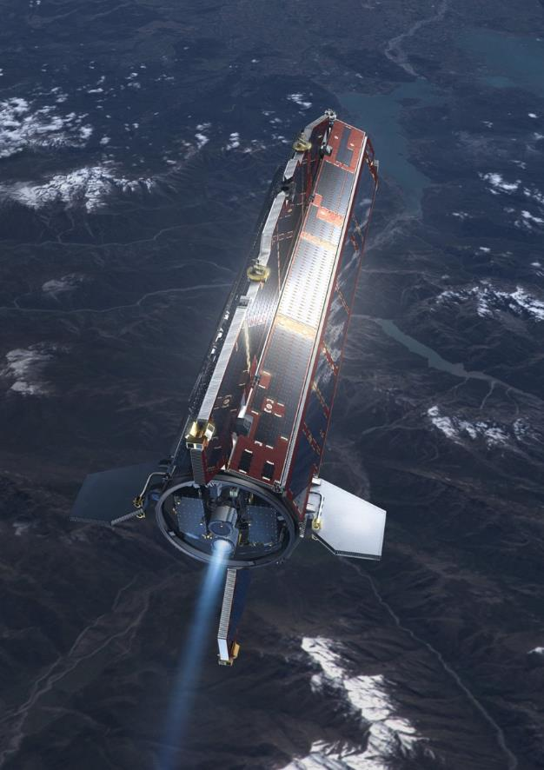
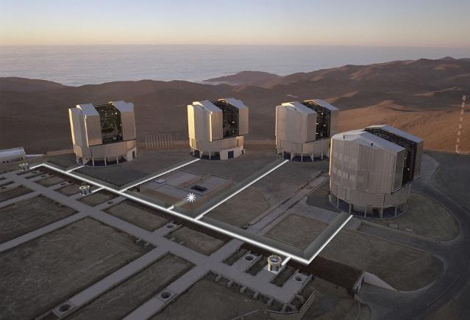
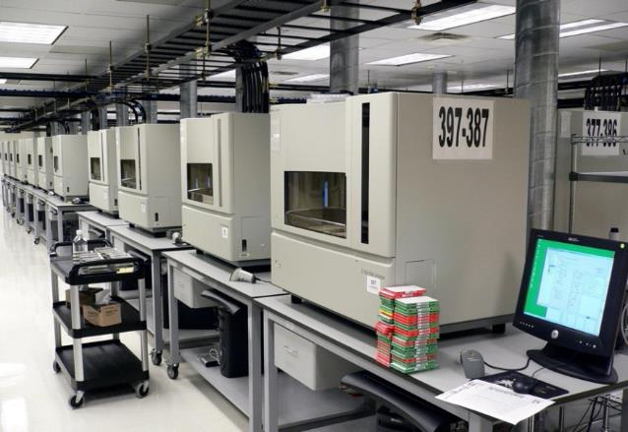
How Science is Done/Data Gathering
Notes:
SLIDES OF SATELLITES, EG Goce http://www.esa.int/spaceinimages/Images/2008/03/GOCE_in_orbit3
SEQUENCERS
https://en.wikipedia.org/wiki/DNA_sequencer#/media/File:DNA-Sequencers_from_Flickr_57080968.jpg
TELESCOPES
https://en.wikipedia.org/wiki/Very_Large_Telescope#/media/File:Aerial_View_of_the_VLTI_with_Tunnels_Superimposed.jpg

Slide 6
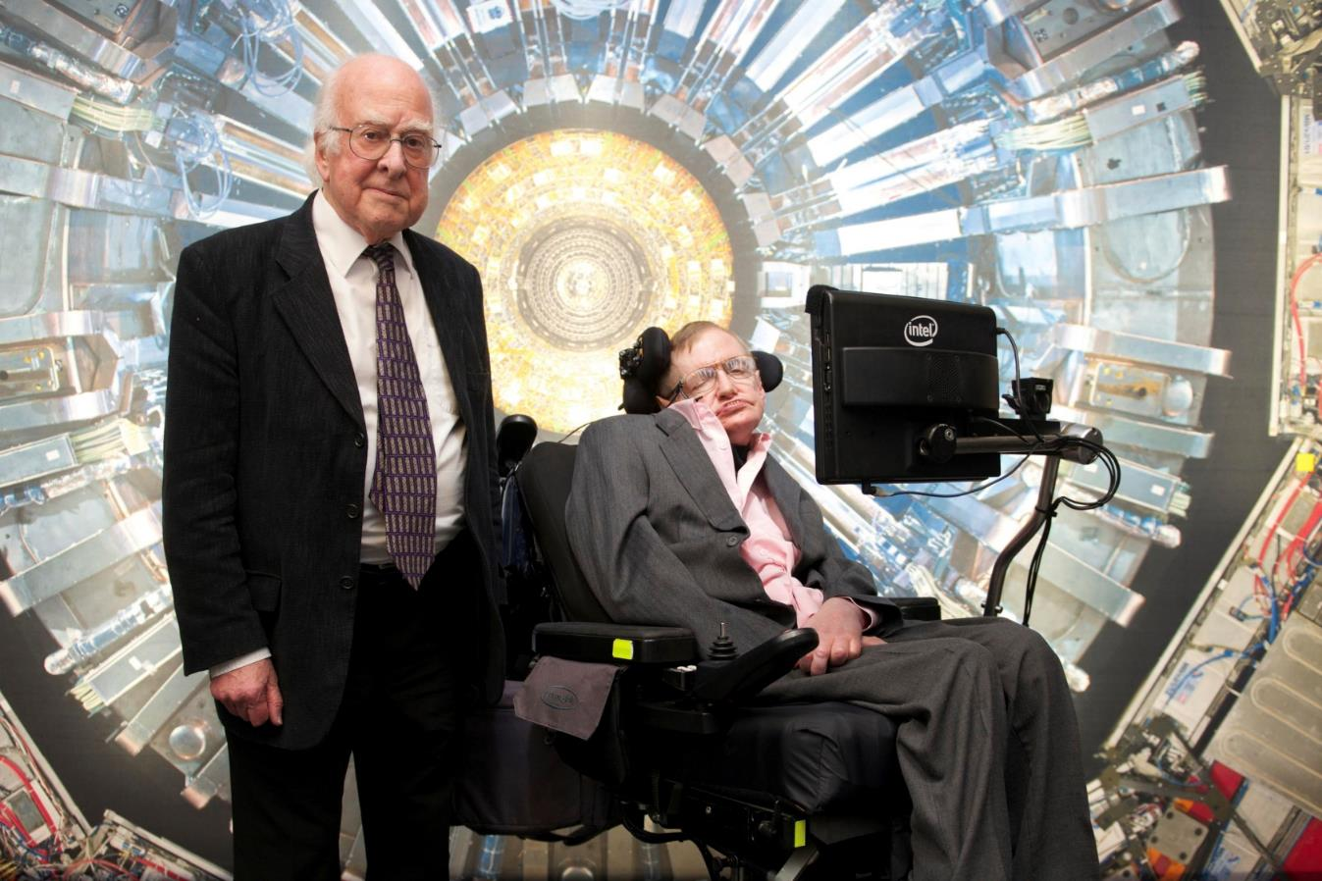
Theory and big data/particle physics
Professor Peter Higgs and Professor Stephen Hawking - Collider Exhibition Launch Event at the Science Museum, London.

Slide 7
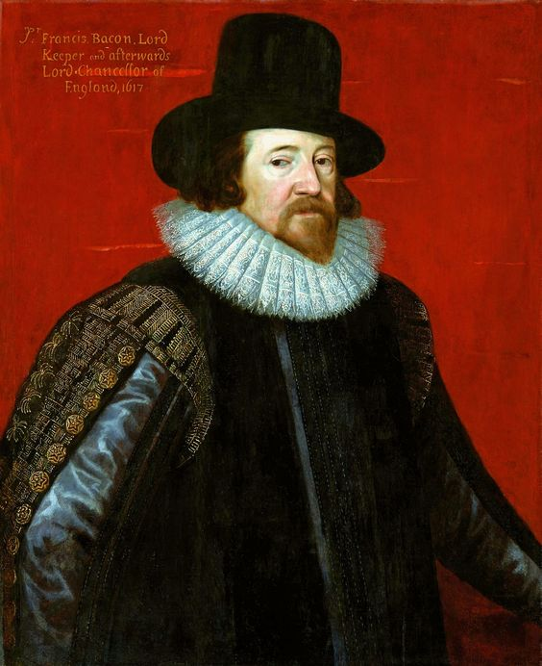
The father of empiricism: Francis Bacon

Slide 8
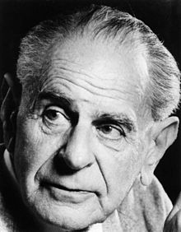
Karl Popper
“The objectivity of scientific statements lies in the fact that they can be inter-subjectively tested.”

Slide 9
Newton’s Principia
Philosophiæ Naturalis Principia Mathematica (1687), Sir Isaac Newton:
‘For I here design only to give a mathematical notion of these forces, without considering their physical causes and seats…. Hitherto I have not been able to discover the cause of those properties of gravity from the phenomena, and I frame no hypothesis; for whatever is not deduced from the phenomena is to be called an hypothesis; and hypotheses, whether metaphysical or physical, whether of occult qualities or mechanical, have no place in experimental philosophy.’

Slide 10
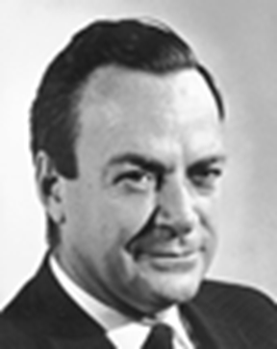
Prediction: Foundation of Scientific Knowledge
Richard Feynman: “It is whether or not the theory gives predictions that agree with experiment. It is not a question of whether a theory is philosophically delightful, or easy to understand, or perfectly reasonable from the point of view of common sense.
The theory of quantum electrodynamics
describes Nature as absurd from the point of view of common sense. And it agrees fully with experiment. So I hope you can accept Nature as She is – absurd.”
http://gsp.tamu.edu
http://gsp.tamu.edu

Slide 11
Scientific Theory
Mathematical model consisting of variables and relations between the variables.
Operational definitions relating the variables to observable (and measurable) phenomena.
Experimental design to test predictions made by the model.
A scientific theory is validated to the extent that predictions derived from it agree with future experimental observations.
  Criteria of agreement precisely specified.
  Rigorous statistical theory characterizing agreement.
http://gsp.tamu.edu

Slide 12
“Does anyone really believe that data mining could produce the general theory of relativity?”
Edward R Dougherty

Slide 13
Data Mining
Data mining is a return to pre-Baconian groping, albeit at a much faster groping rate than was then possible.
It suffers from three debilitating properties:
  It does not ask precise questions.
  There is no statistical characterization of the procedure.
  As opposed to pattern recognition, it lacks a characterization of prediction in the context of a distribution.
http://gsp.tamu.edu

Slide 14
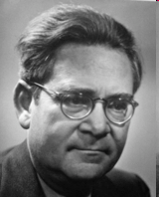
Radical Empiricism Denies Knowledge
Hans Reichenbach (Rise of Scientific Philosophy):
“A mere report of relations observed in the past cannot be called knowledge. If knowledge is to reveal objective relations of physical objects, it must include reliable predictions. A radical empiricism, therefore, denies the possibility of knowledge.”
  A collection of measurements, together with statements about the measurements, is not scientific knowledge.
http://gsp.tamu.edu

Slide 15
The problems with big data
Not all data sets are reliable.
We need models and theoretical insights to help guide the collection, curation and interpretation of data.
Extrapolation beyond the range of existing data. The overestimate of peak influenza levels by Google Flu Trends reminds us that past success in describing epidemics is no guarantee of future performance.
Correlations observed in sets of data are not necessarily evidence of dependency.
Sensitivity of complex systems to tiny errors in data and the effects of chaos make predictions hard.

Slide 16
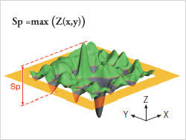
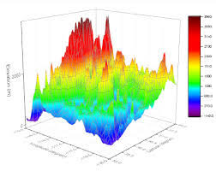
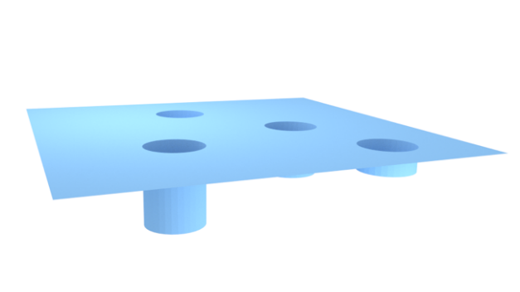
Pitfalls of a pure big data approach
All machine learning algorithms depend on assumptions of continuity in the data. These fail in many cases.

Slide 17
Theorems in machine learning
There are a lot of theorems in distribution-free machine learning but they often take the form of:
(i) bounds that are of little use because they are so loose or so large as to impose unrealistic data requirements
(ii) positing random sampling assumptions which are not valid with the kind of data sets that people are using

Slide 18
Important theorems in machine learning
Xiao-Li Meng (Harvard) has demonstrated that one can only make reliable predictions from big data if they represent a (very) large fraction of the actual population of interest.
“As far as statistical inference goes, what makes a ‘Big Data’ set big is typically not its absolute size, but its relative size to its population”.
Xiao-Li Meng, “A trio of inference problems that could win you a Nobel Prize in statistics (if you help fund it)”, 2014. In Past, Present, and Future of Statistical Science, ed. Xihong Lin, Christian Genest, David L. Banks, Geert Molenberghs, David W. Scott, and Jane-Ling Wang, 537-562. Boca Raton, FL: CRC Press.

Slide 19


Is data science the end of science?
Correlations may have potential predictive power: use the value of one variable to predict or modify the value of another.
“With enough data, the numbers speak for themselves”.
BUT
With “big data”, you are bound to find lots of “spurious correlations” and hence false positives. These correlations are only due to the size, not the nature, of the data.
C. S. Calude, G. Longo, “The Deluge of Spurious Correlations in Big Data”, Found Sci (2016). doi:10.1007/s10699-016-9489-4

Slide 20
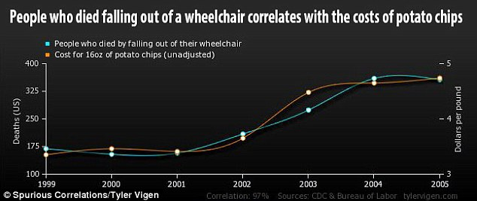
Spurious correlations are inevitable
“… the more [data] we have, the more difficult it is to extract meaning from it. Too much [data] tends to behave like very little information.”
More examples can be found at:
http://www.tylervigen.com/spurious-correlations

Slide 21
Prediction in science
The ultimate challenge. How are we doing?
Earthquake prediction
Weather forecasting
Climate prediction
Economics
…
Nate Silver, The Signal and the Noise: Why So Many Predictions Fail –But Some Don’t (2012)

Slide 22
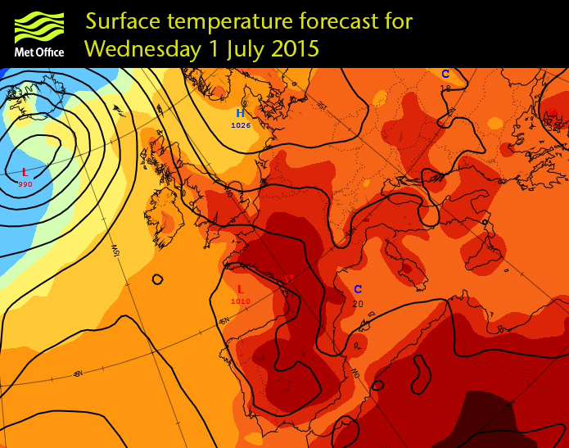
Theory and big data/weather forecasting
“Climatology” is the “science” of predicting weather based on past history of weather patterns in the area of interest.

Slide 23
IBM Watson – Cognitive Computing
Personal weather station
IBM Watson is perhaps the most well-known example of artificial intelligence (“cognitive computing”) in use today.
Weather Forecaster, Healthcare, Finance, Legal, Retail, Fantasy Football
Watson “combines the best models”; apparently it uses the “best” of the current weather forecasting models to make predictions.
http://www.zdnet.com/article/ibm-watson-what-are-companies-using-it-for/

Slide 24
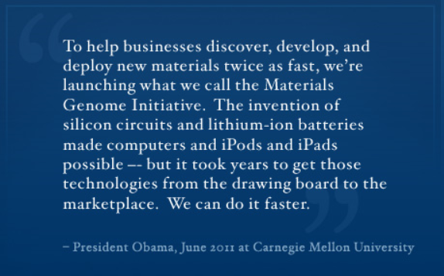
Materials Genome Initiative
Notes:
Beneath this slide, some slides are on cement setting things.
Ask RH. Peter will help populate this slide to.

Slide 25
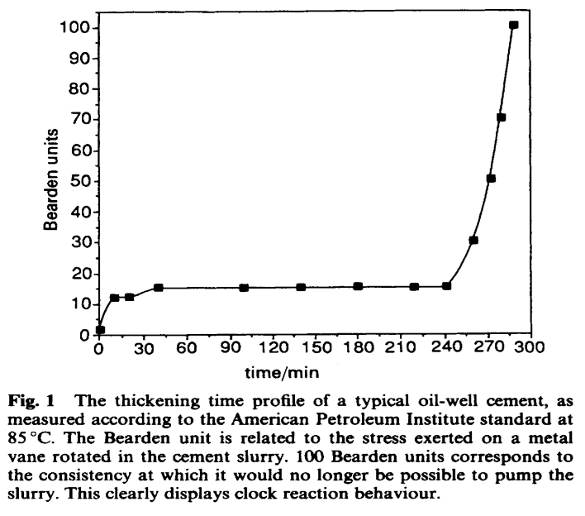
Cement, big data analytics and machine learning
Using big data analytics methods based on artificial neural networks we showed that the rapidly performed diffuse reflectance Fourier Transform Infra-Red (FTIR) spectrum of a cement powder can be used to predict the thickening time of the slurry made up from the powder.
Notes:
Beneath this slide, some slides are on cement setting things.
Ask RH. Peter will help populate this slide to.

Slide 26
Cement, big data analytics and machine learning
This remarkable result has been exploited by the oil industry and could be applied to many other problems from retail and financial services, through smart cities to biomedical informatics.
BUT
It has not advanced our understanding of cement, a highly complex material, and how it thickens.
SO
There’s no foundation for the development of new kinds of cement
Notes:
Beneath this slide, some slides are on cement setting things.
Ask RH. Peter will help populate this slide to.

Slide 27
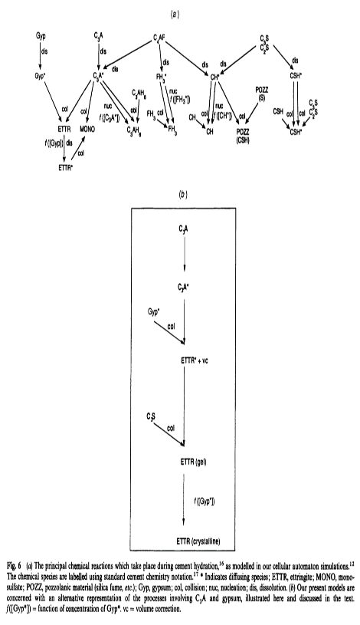
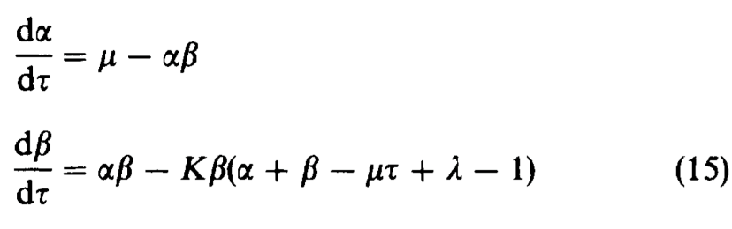
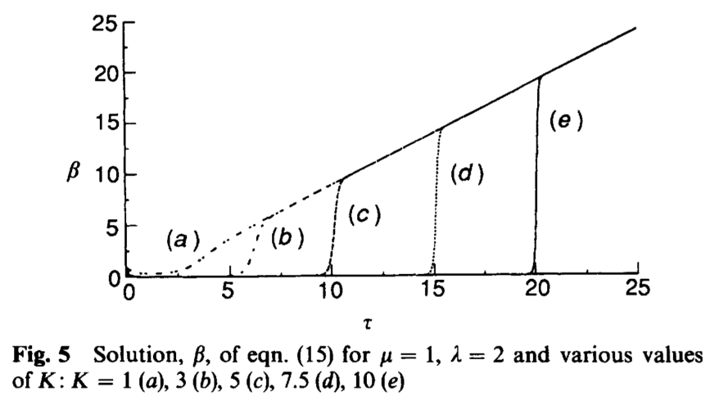
Understanding cement setting needs theory
Notes:
Beneath this slide, some slides are on cement setting things.
Ask RH. Peter will help populate this slide to.

Slide 28
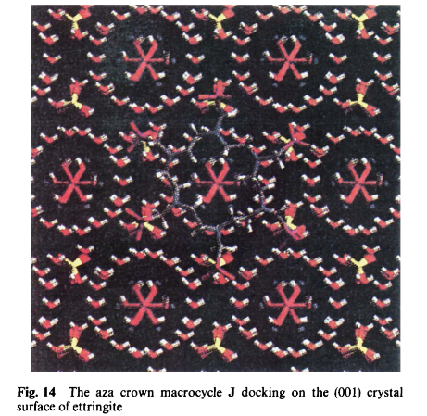
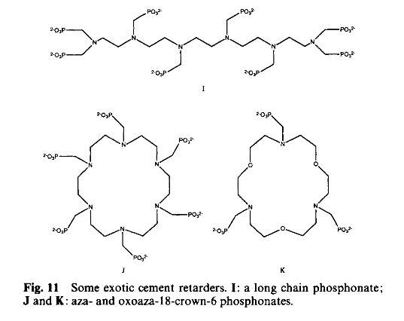
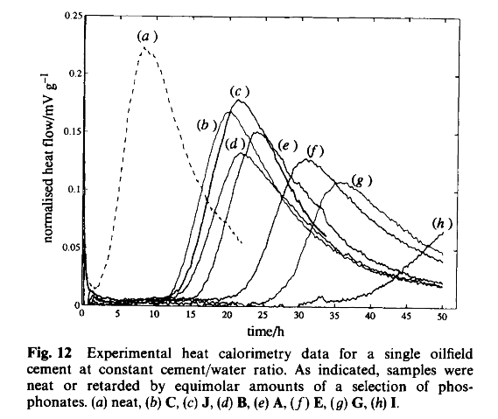
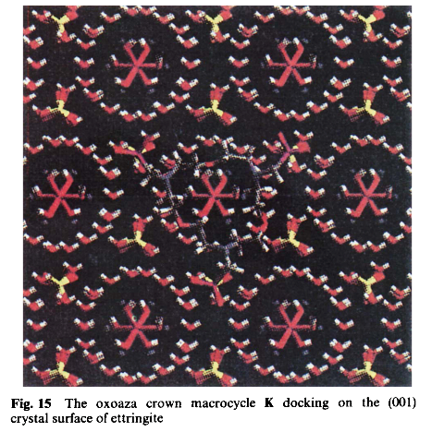
Understanding cement setting needs theory
Notes:
Beneath this slide, some slides are on cement setting things.
Ask RH. Peter will help populate this slide to.

Slide 29
Patient-specific medicine
Personalised medicine
“One Size Does Not Fit All”
“The power in tailored therapeutics is for us to say more clearly to payers, providers, and patients, — ‘this drug is not for everyone, but it is for you’ — that is exceedingly powerful.”
John C. Lechleiter, Ph.D., President and Chief Executive Officer, Eli Lilly and Company

Slide 30
Personalised Medicine
Downward causation
Complexity of the feature space/vastness of the datasets required to achieve statistical significance.
Relative lack of information about the dynamical processes of disease
Mechanistic models/descriptions are required by regulatory agencies (FDA, EMA) in order to satisfy them about how a drug/treatment acts. Mere statistics will never be deemed acceptable here.

Slide 31
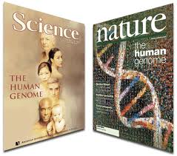
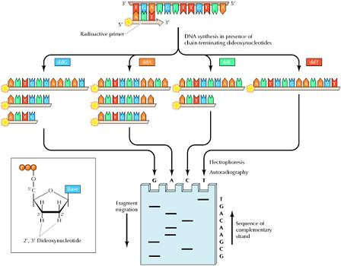
Genome Sequencing
In 2001, the Human Genome Project consortium published its working draft in Nature and Science. It cost £1.9bn and took 12 years.
Its fruits have been meagre. Among the genetic findings for common illnesses, only a handful are of genuine significance for human health. Routine DNA sequencing in hospitals is still years away but it will need big theory to make sense of it.

Slide 32
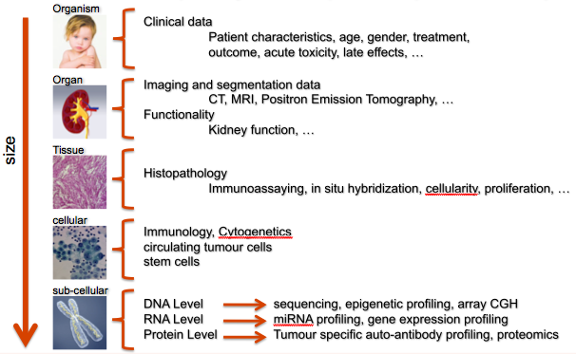
Large scale data & computing
Big data in medical science
Models are built for use in clinical decision support
  results are needed in a timely fashion.
It is necessary to have the possibility of seamlessly “plugging in” resources for parallel and large scale computing “here and now”
  petascale computing is needed to perform e.g.:
    activities like drug binding affinity determination
    bBlood flow through tumours
Seamless access and integration of distributed, heterogeneous data in a data warehouse repeatedly over time (≈ 200 GB / patient and time point)

Slide 33
Why has it now become precision medicine?
Personal Medicine
Precision Medicine
(stratified populations)
Poorly characterised patient populations

Slide 34
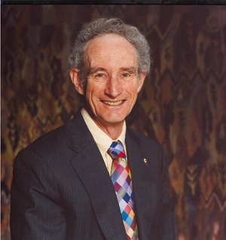
Bob May: ‘Mathematics does not have the long-standing relation to the life sciences that it does to the physical sciences’
Image Credit: Royal Society

Slide 35
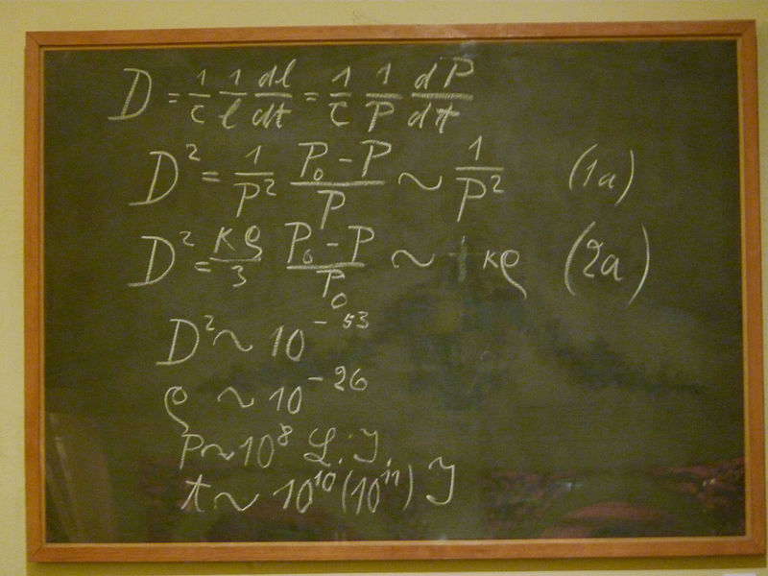
A rare sight in biology laboratories
tbc
Einstein's Blackboard at the Museum of the History of Science in Oxford.

Slide 36
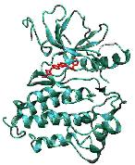
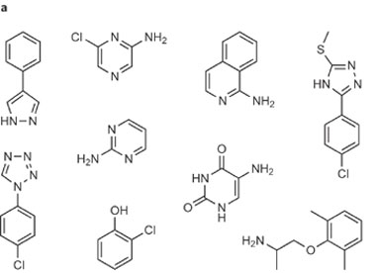
Patient specific drug design & selection
Binding affinity calculator (BAC)
We need a binding affinity predictor for compounds with target proteins.
It could be used as a drug ranking tool in clinical decision making and as a virtual screening tool in pharmaceutical lead discovery.
Ranking of binding affinities
Blackbox-like BAC
Big data versus theory based approach?
36

Slide 37
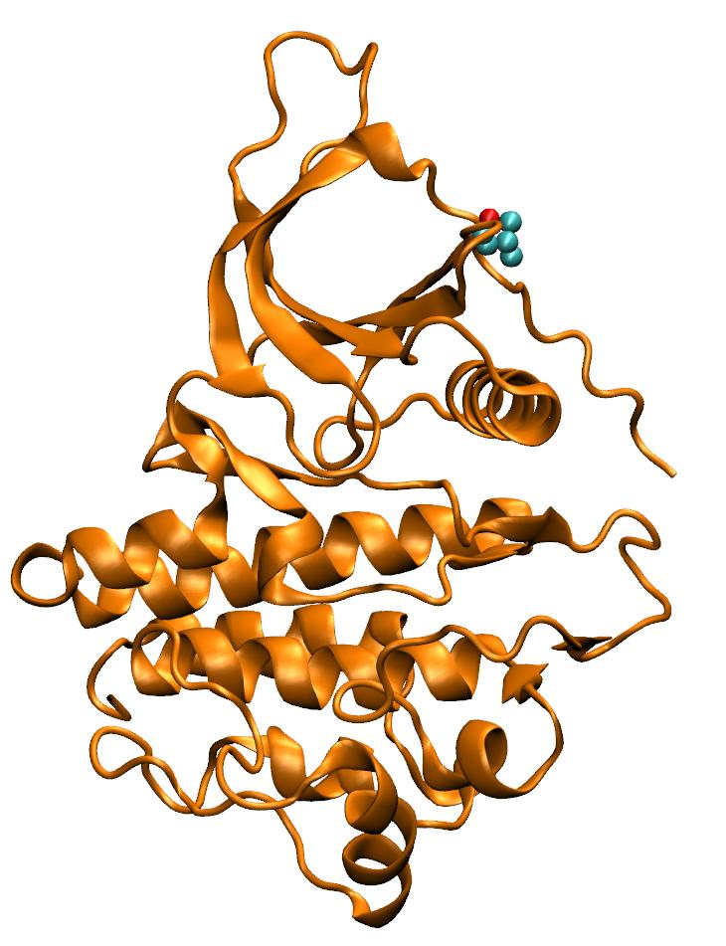
Forecasting Clinical Treatment:
Ensemble Molecular Dynamics
Run 50 ‘replica’ simulations
Vary only initial velocities
Each produces 4 ns of production trajectory
More efficient sampling compared to single long simulation
Allows us to examine reproducibility of results
Most studies in the literature use at most one or two simulations
Not reproducible, unscientific!
Sadiq, S.K, Wright, D.W., Kenway, O.A. and Coveney, P.V. “Accurate Ensemble Molecular Dynamics Binding Free Energy Ranking of Multidrug-Resistant HIV-1 Proteases.” Journal of Chemical Information and Modeling 2010 50 (5), 890-905.

Slide 38
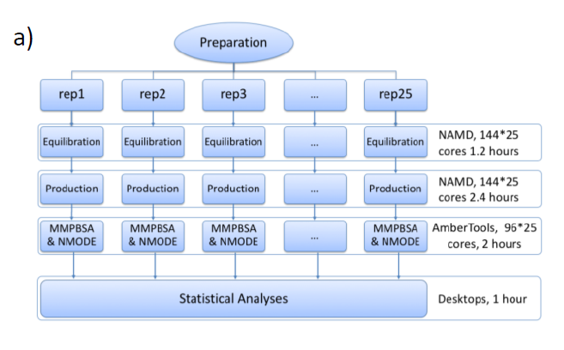
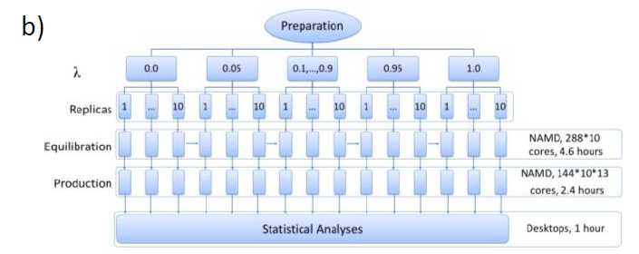
Drug Design and Selection
Workflows employed in BAC for (a) ESMACS and (b) TIES simulations.
ESMACS - Enhanced sampling of molecular dynamics with approximation of continuum solvent
TIES - Thermodynamic integration with enhanced sampling

Slide 39
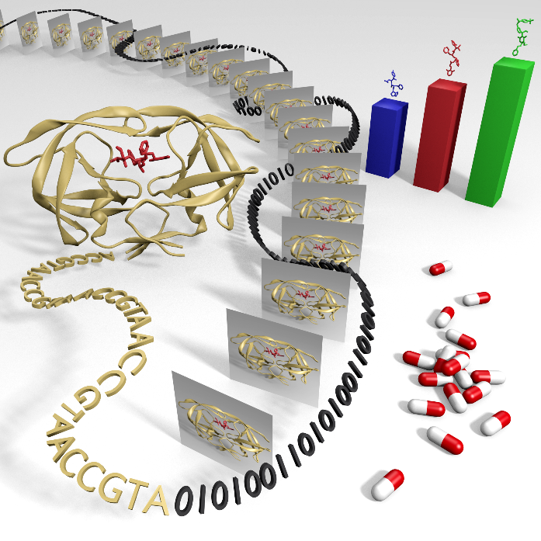
Calculating Clinically Relevant Binding Affinities
This work required a combination of several of the most powerful supercomputers in the USA, UK, and EU!
Wright, D.W., Hall, B.A.,Kenway, O.A., Jha, S. and Coveney, P.V. "Computing Clinically Relevant Binding Free Energies of HIV-1 Protease Inhibitors.” Journal of Chemical Theory and Computation, 2014, 10, 1228−1241. DOI: 10.1021/ct4007037

Slide 40
Treating patients with cancer
The challenge we face is that many cancer patients become resistant to drugs administered to cure them. How can we figure out which drugs to prescribe in these situations?
Most observed mutations are rare!
Use the physicochemical modelling methods just described. These approaches are computationally expensive but applicable to all mutations including those that are rare.
Can we combine them with the “broader brush” of machine learning, in the hope that ML can then reliably predict the response of cancer patients to kinase drugs?
INSPIRE: Rick Stevens, John Chodera, Shantenu Jha & Peter Coveney

Slide 41
Combining Machine Learning with Predictive Mechanistic Modelling
These approaches are complementary in that the more expensive physical modelling approach can be used to generate additional targeted data for the machine learning approach to improve its predictive accuracy at the expense of up-front computational effort.
ML methods need “lots of data” and the simulations will serve to generate some of this, filling in gaps in the cancer data bases available to us today.
We hope to develop an interactive process whereby sequence based ML predictions are used to inform simulations to perform and in turn fed back to improve accuracy of the ML model(s).

Slide 42
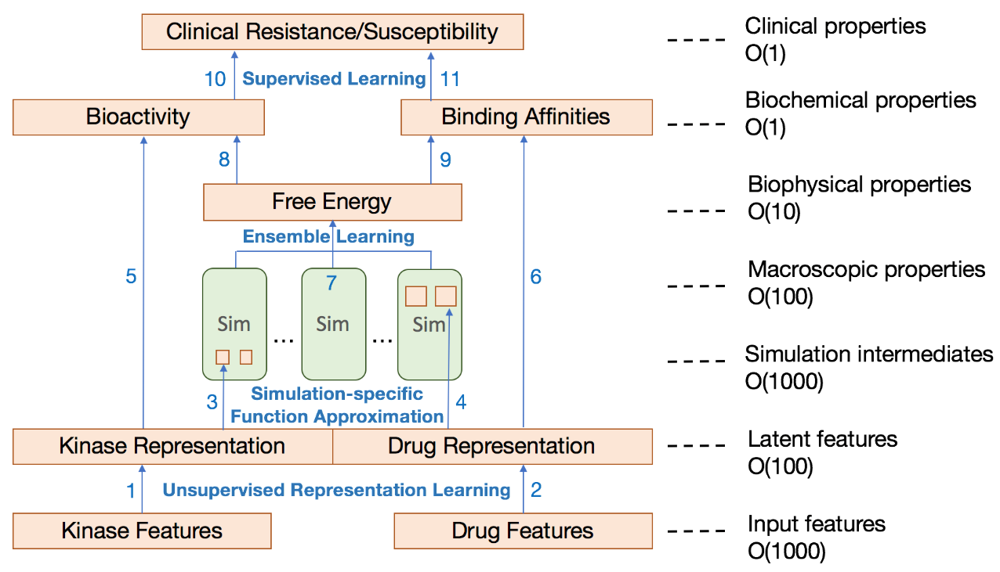
Combining Machine Learning with Predictive Mechanistic Modelling: INSPIRE
Datasets: Clinical data, Biochemical data; Biophysical data; Bioactivity data
Data from physicochemical modelling
Machine learning can be used as a unifying framework to integrate all the experimental and simulated data that quantify relationships between proteins (kinases) and compounds.

Slide 43
Immunology and immunotherapy
Predicting the immune response to infection
Recognition is not just by a single molecule, but a large collection of them..
Learn not through a single agent, but multiple ones

Slide 44
Antigen presentation on infected cell surface
Foreign proteins enter the cell of host organism
Like host proteins, they are broken down in the proteasome
The peptide fragments bind to MHC proteins and get taken to the cell surface
At the cell surface they get recognised by T-cells and may trigger an immune response
One would like to predict the spectrum of such antigens presented
.

Slide 45
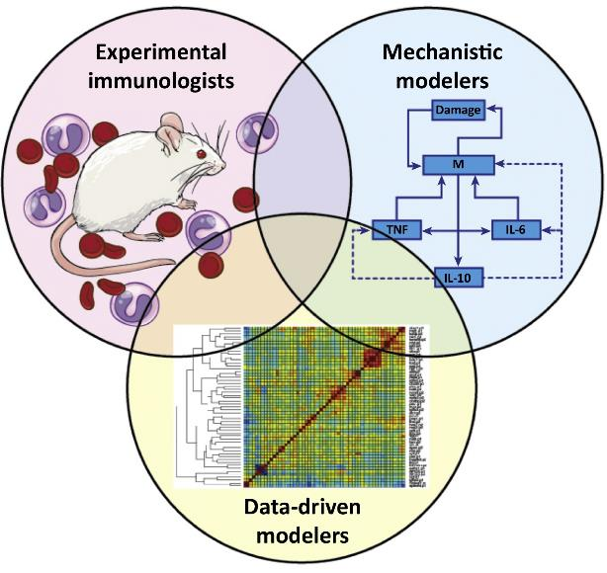
Integrative Approaches to Predict the Immune Response
Predictive mechanistic modelling
Integrative approaches
Vodovotz, Y. et al. (2017) “Solving Immunology?” Trends Immunol., 38(2), 116–127.
Eccleston RC, Wan S, Dalchau N and Coveney PV (2017) “The Role of Multiscale Protein Dynamics in Antigen Presentation and T Lymphocyte Recognition”. Front. Immunol. 8:797. doi: 10.3389/fimmu.2017.00797T

Slide 46
Machine Learning & Predictive Mechanistic Modelling
Machine learning efforts have been made to describe this.
They work for static data, as an “immuno-informatics” tool
ML methods can predict “epitope” sequences based on input proteins. This approach works well in limited conditions, i.e. for the space of sequences trained upon. It cannot predict reliably outside its very limited “domain of validity”. Worse, it cannot handle temporal variations in epitope concentrations due to local cell conditions.
In short, there is no hope at all for ML to predict the immune response of cells to infection simply by aggregating data. The amount of data required would be truly astronomical and such a research programme an absurdity.
Predictive mechanistic modelling
However, we know there is a mechanism by means of which antigens get transported to cell surfaces. We can build mechanistic models which describe this process in a temporal manner.
Eccleston, R.C., Coveney, P.V. and Dalchau, N. “Host genotype and time dependent antigen presentation of viral peptides: predictions from theory” preprint, 2017

Slide 47
What such approaches imply for biologists & medics
Experimental “wet lab” research must pay more attention to theory and models of biological processes
If this is done, it will lead to the efficient and effective acquisition of appropriate data which is suitable for incorporation in models – not just blind data gathering in so-called “data-driven” science. This way, an effective symbiosis between modelling and experiment will develop in biology and medicine, which is largely absent today.
It will come to mirror that which is commonplace in the physical sciences.
A challenge to the life and medical science mind set
Achieving this will not be easy, as it requires a progressive shift in the education and training of biologists and medics.
Collaborations can be fraught when such understanding is lacking. Several biomodellers have created their own wet labs in order to get the data they need for their models.

Slide 48
What such approaches imply for biologists & medics
Experimental “wet lab” research must pay more attention to theory and models of biological processes
If this is done, it will lead to the efficient and effective acquisition of appropriate data which is suitable for incorporation in models – not just blind data gathering in so-called “data-driven” science. This way, an effective symbiosis between modelling and experiment will develop in biology and medicine, which is largely absent today.
It will come to mirror that which is commonplace in the physical sciences.
A challenge to the life and medical science mind set
Achieving this will not be easy, as it requires a progressive shift in the education and training of biologists and medics.
Collaborations can be fraught when such understanding is lacking. Several biomodellers have created their own wet labs in order to get the data they need for their models.

Slide 49
The immune response: predicting cell surface presentation of competing peptides by MHC class I molecules
Due to the diversity in T-cell receptor molecules together with both the peptides and MHC proteins they bind to, it has been difficult to design vaccines and treatments based on these interactions.
Machine learning has made some progress in trying to predict the immunogenicity of peptide sequences in the context of specific MHC class I alleles but, as such approaches cannot integrate temporal information and lack explanatory power, their scope will always be limited.
We advocate a mechanistic description of antigen presentation and T-cell receptor activation which is explanatory, predictive and quantitative, being capable of furnishing reliable biological descriptions that are difficult for experimentalists to provide.
Eccleston RC, Wan S, Dalchau N and Coveney PV (2017) “The Role of Multiscale Protein Dynamics in Antigen Presentation and T Lymphocyte Recognition”. Front. Immunol. 8:797. doi: 10.3389/fimmu.2017.00797T

Slide 50
Predicting cell surface presentation of competing peptides by MHC class I molecules: a mechanism
bc

Slide 51
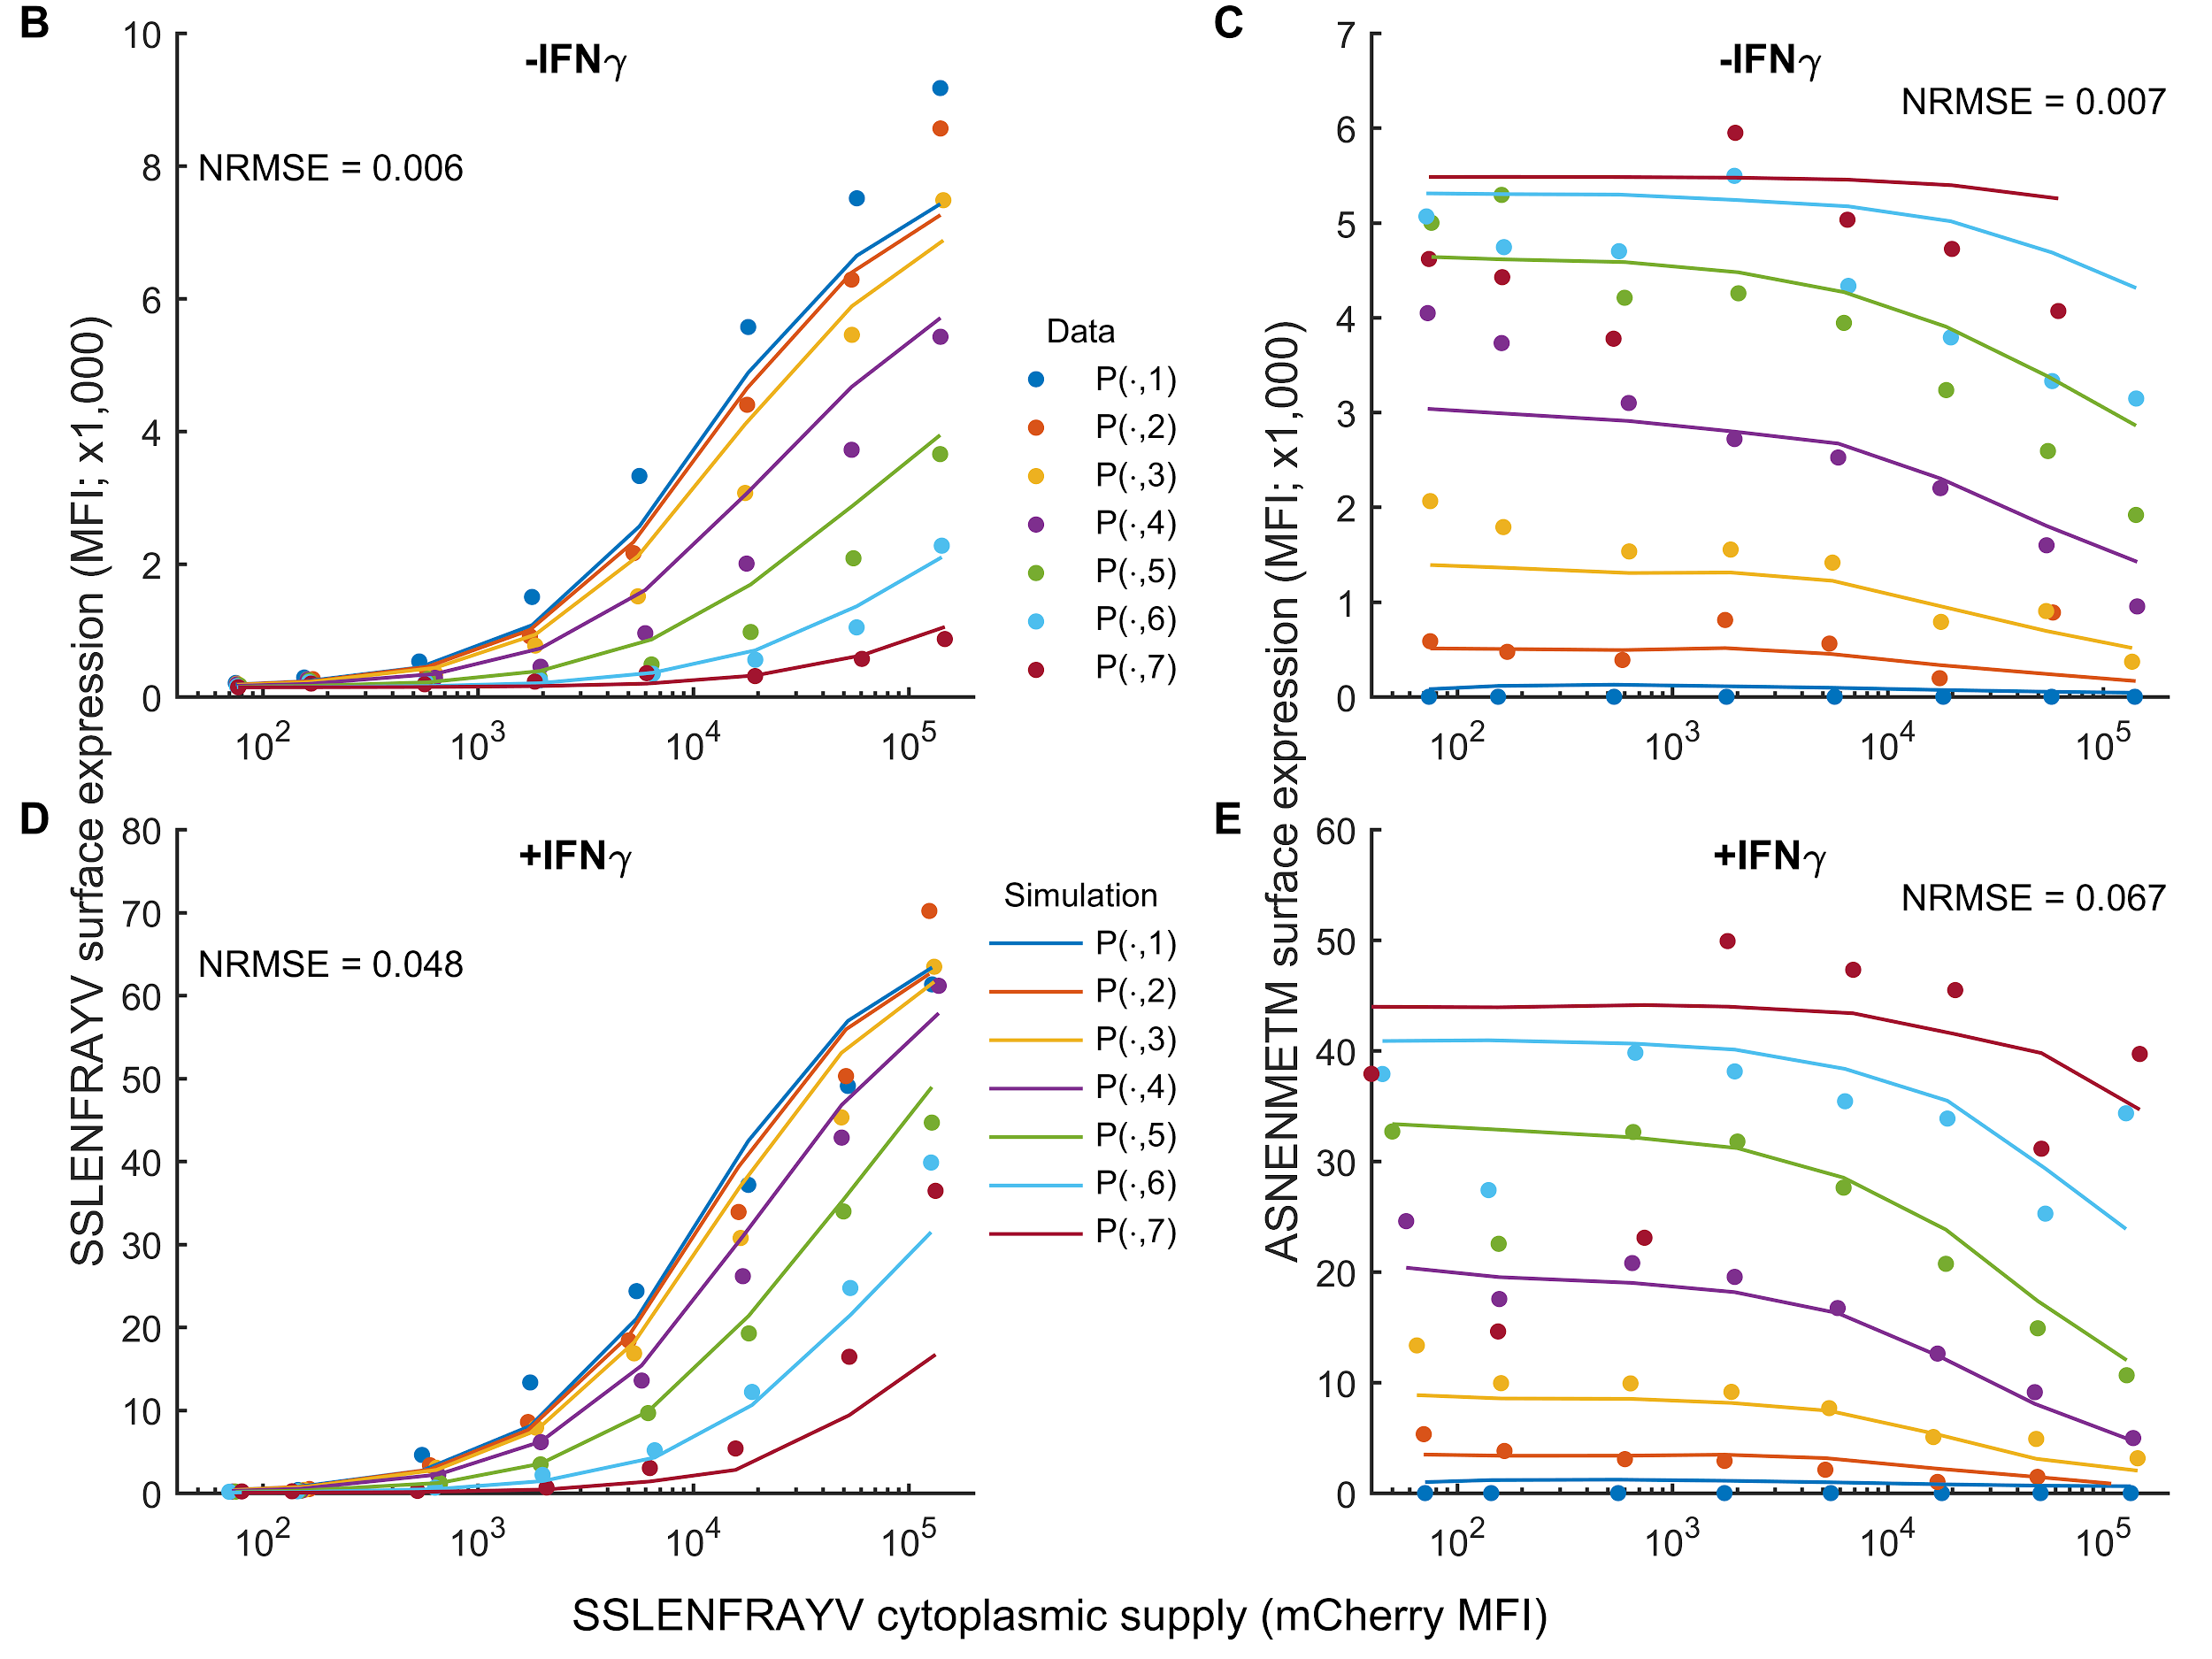
We’ve found a willing team of experimentalists …
Comparison of the model (solid lines) evaluated at the maximum likelihood parameter values against experimental fluorescence measurements (circles) for a single experiment measuring SSLENFRAYV/ASNENMETM epitope competition.
D. Boulanger, R. C. Eccleston, A. Phillips, P.V. Coveney, T. J. Elliott, N. Dalchau, submitted (2017)

Slide 52
The challenge for biologists & medics
Reviewer’s comment in accepting the manuscript:
“I do feel very strongly that the approach is the way forward, but I am also conscious that it is very challenging to change the mindframe of most biologists.”
Our full scale modelling plus experiment manuscripts are now submitted to major journals.
STOP PRESS: One immediately rejected by editor on day of submission:
“The intracellular events are not well enough understood … making the modeling of this process of dubious significance.”

Slide 53
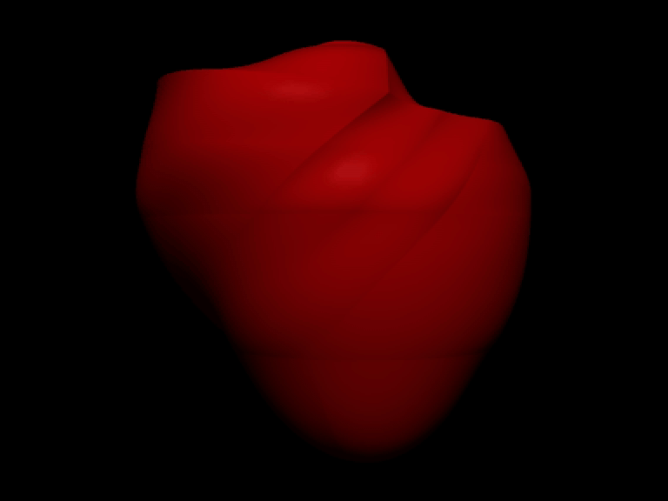
Virtual Physiological Human
€207M initiative in EU-FP7
Aims
  Enable collaborative investigation of the human body across all relevant scales.
  Introduce multiscale methodologies into medical and clinical research
The framework is:
  Descriptive
  Integrative
  Predictive
F. Nolte, E.R. Hyde, C. Rolandi, J. Lee, P. van Horssen, K. Asrress, J.P.H.M. van den Wijngaard, et al. “Myocardial perfusion distribution and
coronary arterial pressure and flow signals: clinical relevance in relation to multiscale modeling, a review.” Med Biol Eng Comput, 2013.
Image compliments of Prof Nic Smith, King’s College London
P. V. Coveney, V. Diaz-Zuccarini, , P. Hunter, and M. Viceconti, Computational Biomedicine. Oxford University Press, 2014
http://vph-conference.org/: VPH2016 “Translating VPH to the Clinic”, Amsterdam, 26-28 September

Slide 54
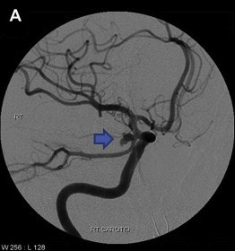
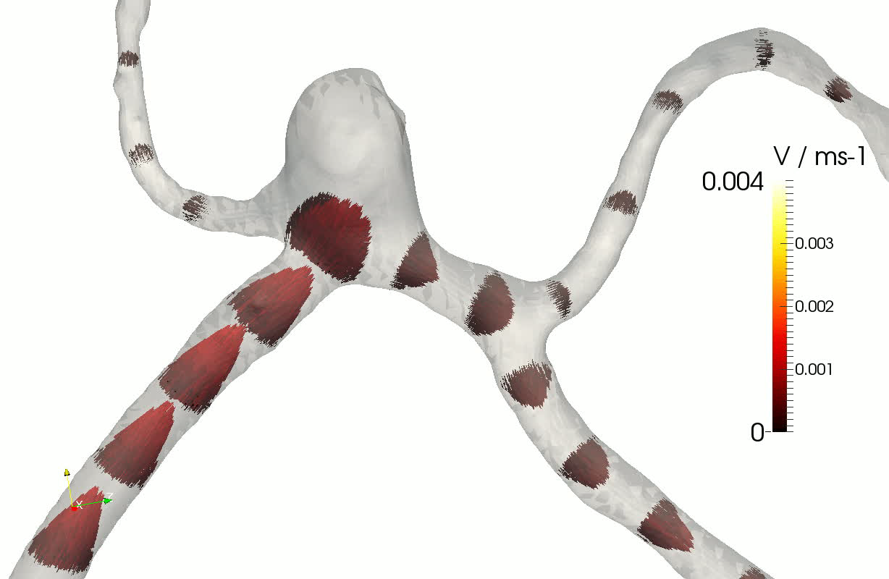
Cerebrovascular Bloodflow
Hemodynamics plays a role in the process of many diseases
Example: aneurysmal subarachnoid haemorrhage; costs UK National Health Service £168 million GBP per annum
About 1-5% of the population will have a brain aneurysm sometime in their life (only a small fraction of those will rupture).
Aneurysmal subarachnoid haemorrhage causes 10% of all deaths in the UK ¹
Costing society over £0.5 billion annually ²
¹http://www.who.int/healthinfo/global burden disease/estimates country/en/index.html
²Arias et al., Cost Effectiveness and Resource Allocation 8(6), 2010.
Notes:
Our key goal is to give clinicians insight in to blood flow anomalies, which can’t be got in any other way

Slide 55
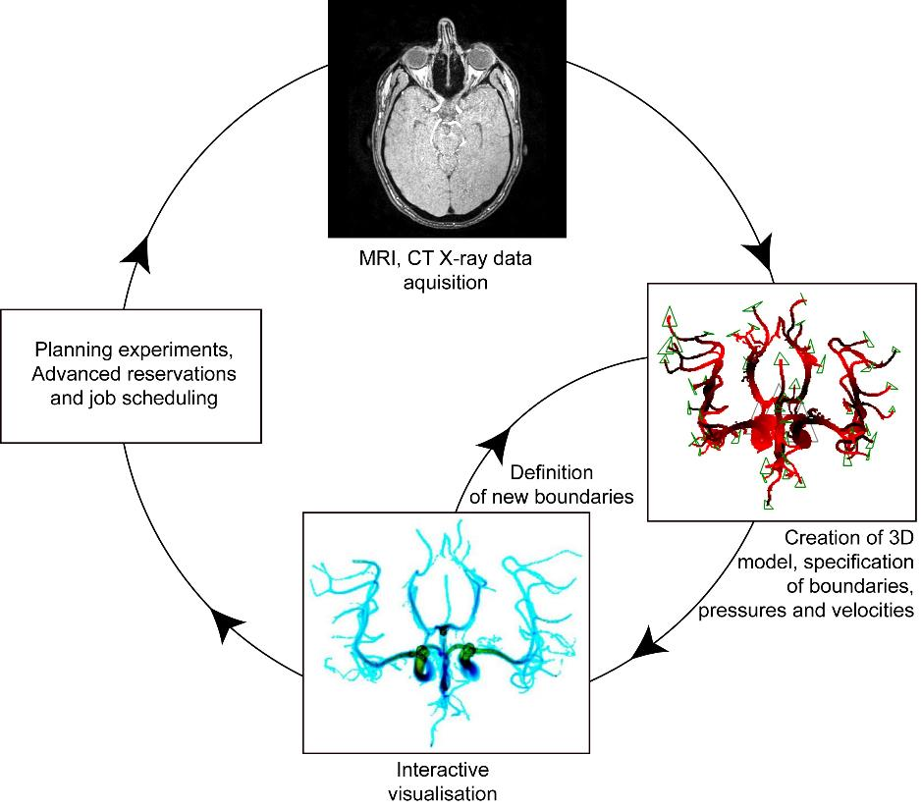
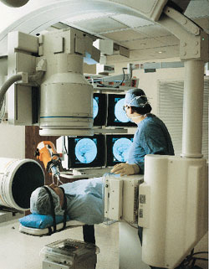
Clinical Work Flow
Reserve computing resources in advance or have a system by which simulations can be run urgently
Shift imaging data around quickly over high-bandwidth low-latency dedicated links
Interactive simulations and real-time visualisation for immediate feedback
15-20 minute
turnaround

Slide 56
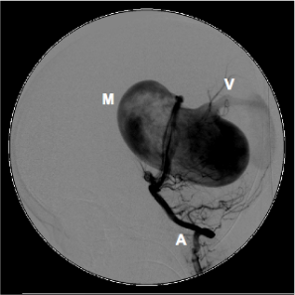
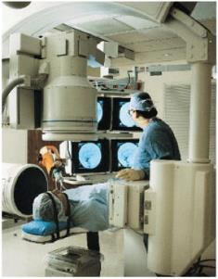
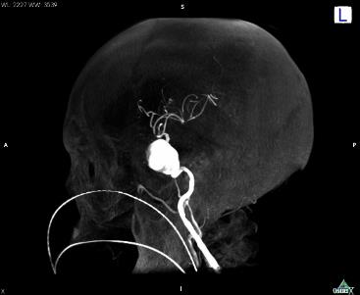
HemeLB Decision Support
HemeLB is a simulation environment for modelling blood flow in sparse geometries.
Goals
To assist clinicians in predicting the effects of brain surgery.
Provide simulation support from within the operating theatre for neuroradiologists
Provide new information to surgeons for patient management and therapy:
Provide patient-specific information which can help plan embolisation of arterio-venous malformations, coiling of aneurysms, etc.
M. D. Mazzeo and P. V. Coveney, "HemeLB: A high performance parallel lattice-Boltzmann code for large scale fluid flow in complex geometries", Computer Physics Communications, 178, (12), 894-914, (2008). DOI: 10.1016/j.cpc.2008.02.013.
Notes:
New - unavaiable information, pressure,s stress etc.

Slide 57
What should be done?
More attention needs to be given to theory if the many attempts at integrating computation, big data, and experiment are to provide useful knowledge.
A substantial portion of funding used to gather and process data should be diverted towards efforts to discern the laws of biology.
The field of big data is important but its impact will be diminished without big theory.

Slide 58
What is being done?
Most national funding agencies are beholden to their pre-determined peer review groups.
In life and medical science, these are heavily empirical and big data / machine learning is the easy option.
EU and DoE fund more innovative approaches which allows modelling to be supported.
We are seeking the convergence of HPC with HPDA (high performance data analytics) in order to make optimal scientific progress.

Slide 59

Computational Biomedicine
An EU H2020 Centre of Excellence in
High Performance Computing 2016-19 http://www.compbiomed.eu/
Peter Coveney
UCL
  This project has received funding from the European Union’s Horizon 2020 research and innovation programme.

Slide 60
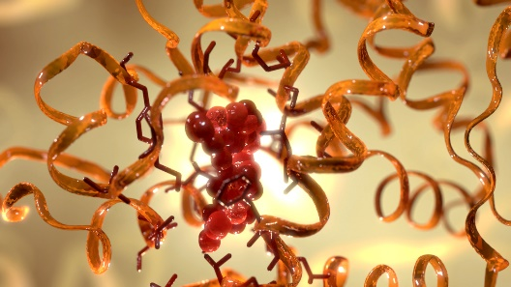
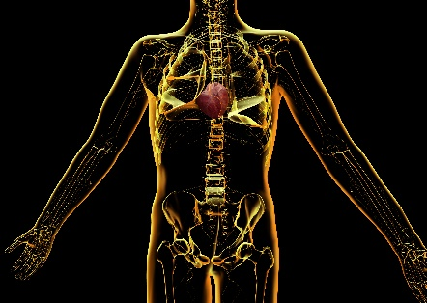
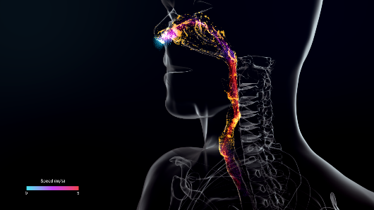
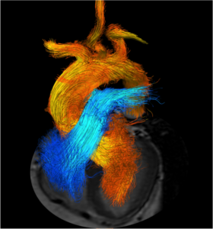
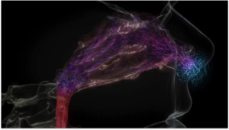
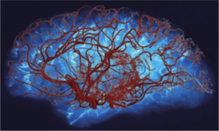

Computational Biomedicine
User-driven biomedical modeling and simulation
  Biomedical science across all scales
  Targeting new and emerging biomedical research areas
Molecular Systems
Organisms (The virtual human)
Organs
Cardiovascular medicine
Molecularly-based modelling
Neuro-muscoskeletal medicine
  This project has received funding from the European Union’s Horizon 2020 research and innovation programme.

Slide 61

The Virtual Human: IMAX Event, London 09-27-17

