Slide 1

A Tale of Two Convergences: Applications and Computing Platforms
2017 New York Scientific Data Summit (NYSDS)
Data-Driven Discovery in Science and Industry
Geoffrey Fox, Shantenu Jha, August 8, 2017
gcf@indiana.edu, http://www.dsc.soic.indiana.edu/, http://spidal.org/
Digital Science Center
Department of Intelligent Systems Engineering
`

Slide 2
Abstract
There are two important types of convergence that will shape the near-term future of computing sciences.
The first is the convergence between HPC, Cloud, and Edge platforms for science.
The second is the integration between Simulations and Big Data applications.
We believe understanding these trends is not just a matter of ideal speculation but is important in particular to conceptualize and design future computing platforms for Science.
This paper presents our analysis of the convergence between simulations and big-data applications as well as selected research about managing the convergence between HPC, Cloud, and Edge platforms.

Slide 3
Important Trends I
Data gaining in importance compared to simulations
  Data analysis techniques changing with old and new applications
All forms of IT increasing in importance; both data and simulations increasing
Internet of Things and Edge Computing growing in importance
Exascale initiative driving large supercomputers
Use of public clouds increasing rapidly
  Clouds becoming diverse with subsystems containing GPU’s, FPGA’s, high performance networks, storage, memory …
  They have economies of scale; hard to compete with
Serverless (server hidden) computing attractive to user:
“No server is easier to manage than no server”
Notes:
Barga Edge and Serverless driving AWS

Slide 4
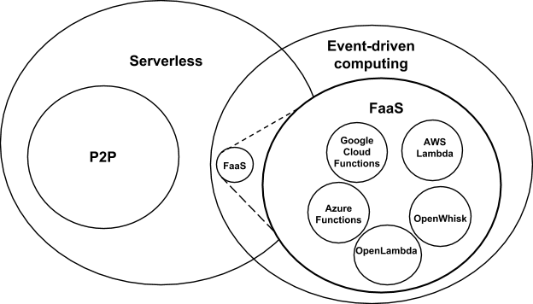
Event-Driven and Serverless Computing
Cloud-owner Provided Cloud-native platform for
Short-running, Stateless computation and
Event-driven applications which
Scale up and down instantly and automatically and
Charges for actual usage at a millisecond granularity
Remember GridSolve as FaaS
Notes:
Short-running, Stateless computation may go away

Slide 5
Important Trends II
Rich software stacks:
  HPC for Parallel Computing
  Apache for Big Data Software Stack ABDS including some edge computing (streaming data)
On general principles parallel and distributed computing have different requirements even if sometimes similar functionalities
  Apache stack ABDS typically uses distributed computing concepts
  For example, Reduce operation is different in MPI (Harp) and Spark
Big Data requirements are not clear but there are a few key use types
  Pleasingly parallel processing (including local machine learning LML) as of different tweets from different users with perhaps MapReduce style of statistics and visualizations; possibly Streaming
  Database model with queries again supported by MapReduce for horizontal scaling
  Global Machine Learning GML with single job using multiple nodes as classic parallel computing
  Deep Learning certainly needs HPC – possibly only multiple small systems
Current workloads stress 1) and 2) and are suited to current clouds and to ABDS (no HPC)
  This explains why Spark with poor GML performance is so successful

Slide 6
Predictions/Assumptions
Supercomputers will be essential for large simulations and will run other applications
HPC Clouds or Next-Generation Commodity Systems will be a dominant force
  Merge Cloud HPC and (support of) Edge computing
  Clouds running in multiple giant datacenters offering all types of computing
  Distributed data sources associated with device and Fog processing resources
  Server-hidden computing for user pleasure
  Support a distributed event-driven serverless dataflow computing model covering batch and streaming data
  Needing parallel and distributed (Grid) computing ideas
  Span Pleasingly Parallel to Data management to Global Machine Learning

Slide 7
Convergence Points (Nexus) for
HPC-Cloud-Edge- Big Data-Simulation
Nexus 1: Applications – Divide use cases into Data and Model and compare characteristics separately in these two components with 64 Convergence Diamonds (features)
Nexus 2: Software – High Performance Computing (HPC) Enhanced Big Data Stack HPC-ABDS. 21 Layers adding high performance runtime to Apache systems (Hadoop is fast!). Establish principles to get good performance from Java or C programming languages
Nexus 3: Hardware – Use Serverless Infrastructure as a Service IaaS and DevOps (HPCCloud 2.0) to automate deployment of event-driven software defined systems on hardware designed for functionality and performance e.g. appropriate disks, interconnect, memory
Deliver Solutions (wisdom) as a Service HPCCloud 3.0

Slide 8
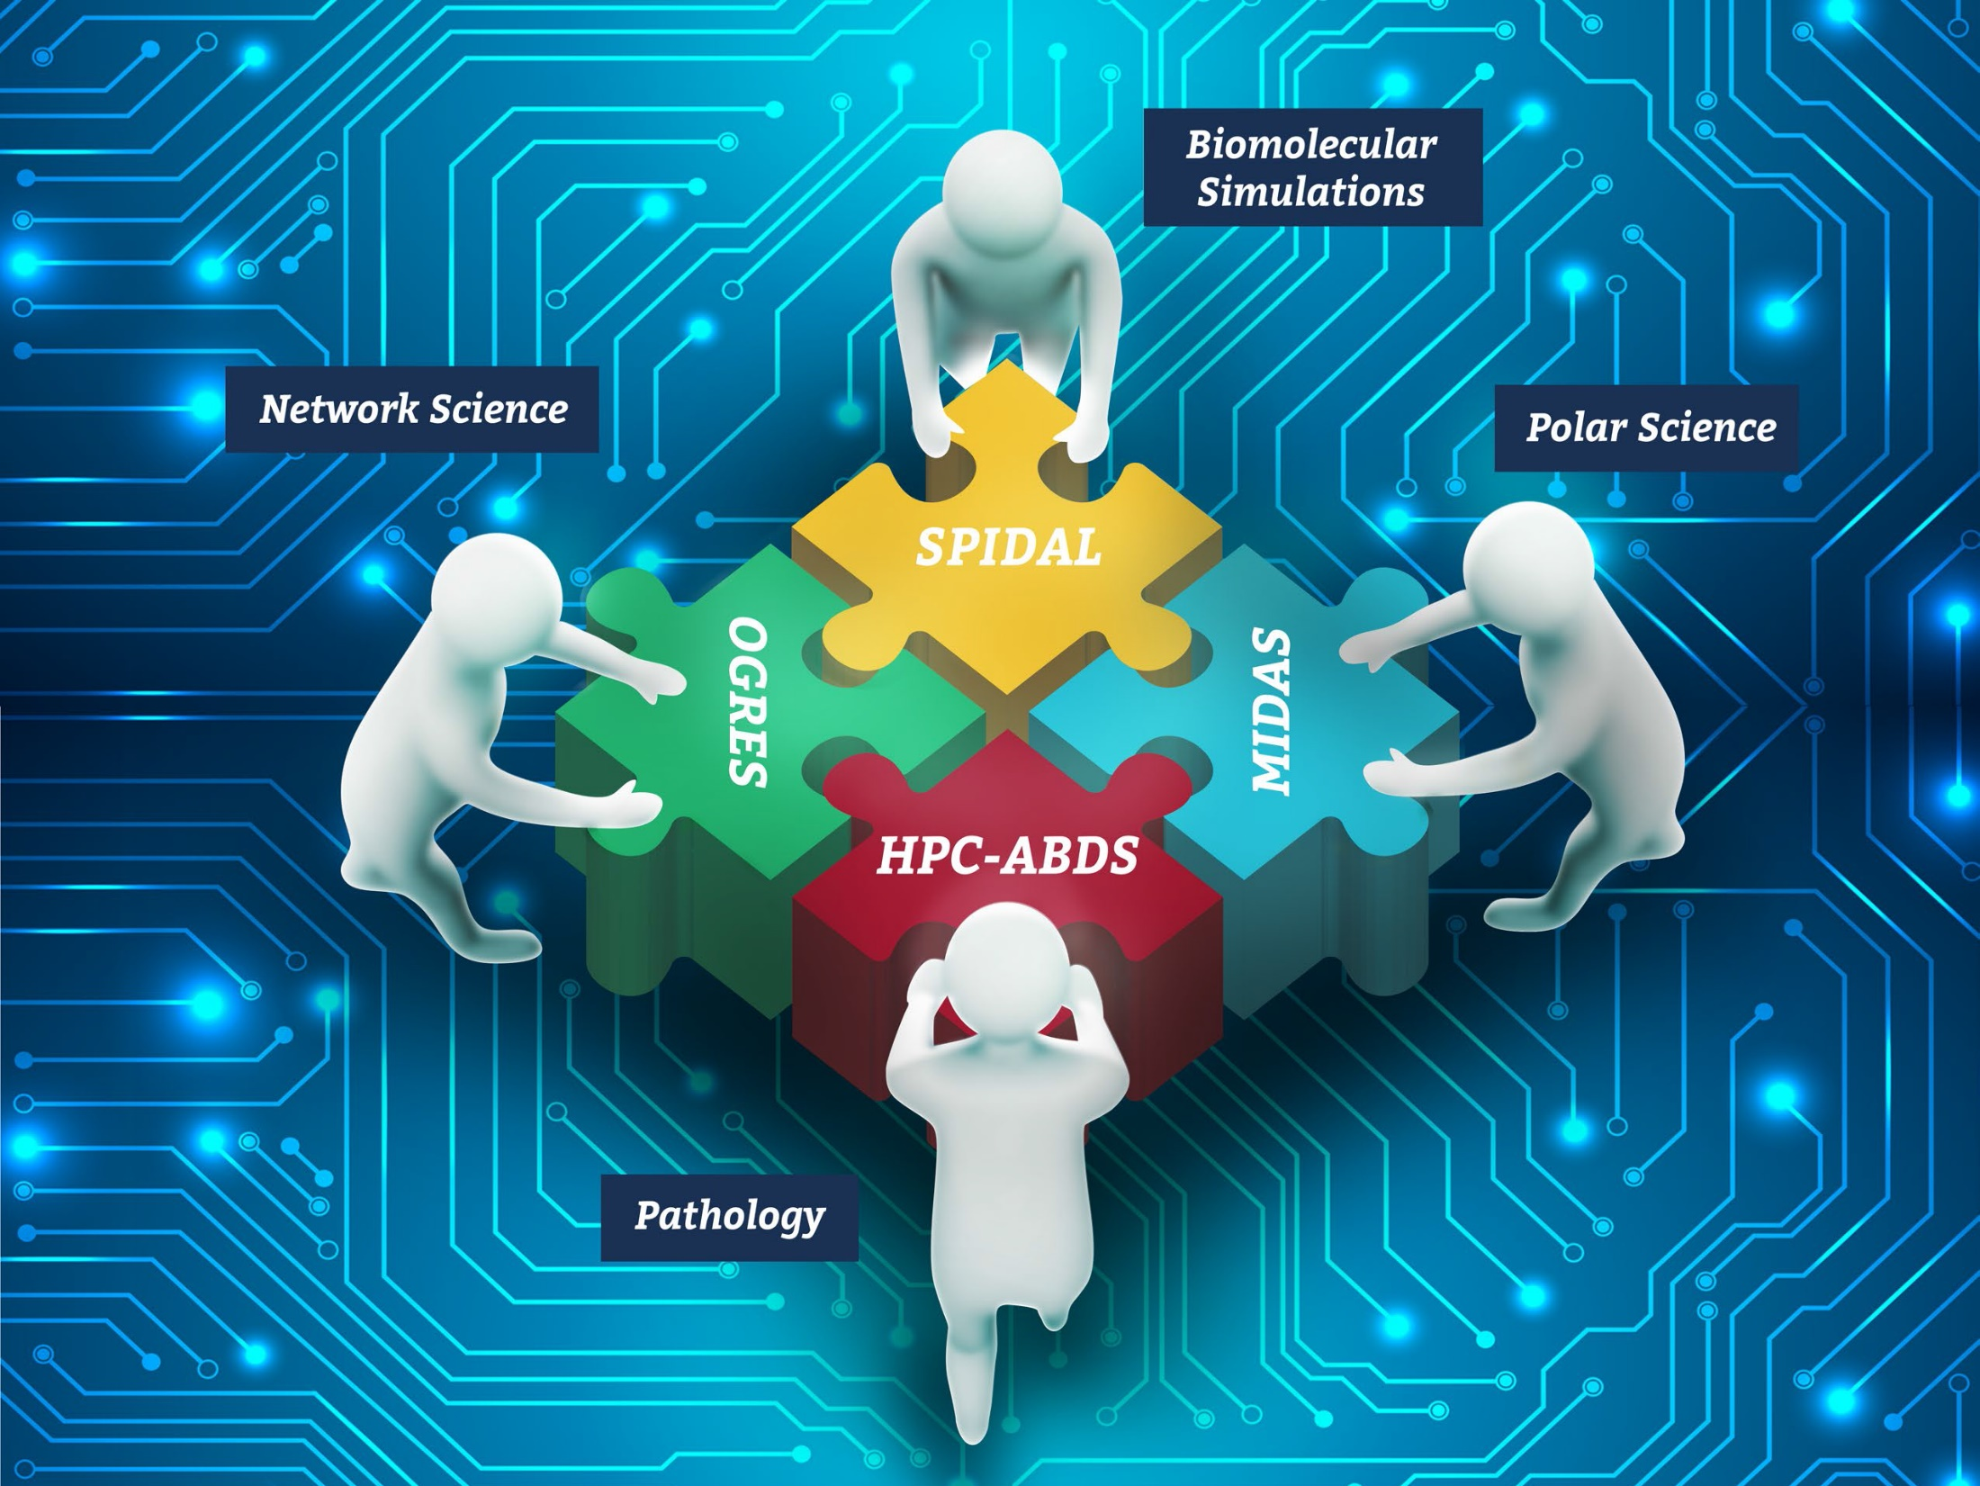




NSF 1443054: CIF21 DIBBs: Middleware and High Performance Analytics Libraries for Scalable Data Science
Ogres Application Analysis
HPC-ABDS Software
Harp and Twister2 Building Blocks
SPIDAL Data Analytics Library
Software: MIDAS
HPC-ABDS

Slide 9
Components of Big Data Stack
Google likes to show a timeline; we can build on (Apache version of) this
2002 Google File System GFS ~HDFS
2004 MapReduce Apache Hadoop
2006 Big Table Apache Hbase
2008 Dremel Apache Drill
2009 Pregel Apache Giraph
2010 FlumeJava Apache Crunch
2010 Colossus better GFS
2012 Spanner horizontally scalable NewSQL database ~CockroachDB
2013 F1 horizontally scalable SQL database
2013 MillWheel ~Apache Storm, Twitter Heron (Google not first!)
2015 Cloud Dataflow Apache Beam with Spark or Flink (dataflow) engine
Functionalities not identified: Security, Data Transfer, Scheduling, DevOps, serverless computing (assume OpenWhisk will improve to handle robustly lots of large functions)

Slide 10
HPC-ABDS
Integrated wide range of HPC and Big Data technologies.
I gave up updating!

Slide 11
64 Features in 4 views for Unified Classification of Big Data and Simulation Applications
41/51 Streaming
26/51 Pleasingly Parallel
25/51 Mapreduce

Slide 12
Global Machine Learning
Classic Cloud Workload
These 3 are focus of Twister2 but we need to preserve capability on first 2 paradigms

Slide 13
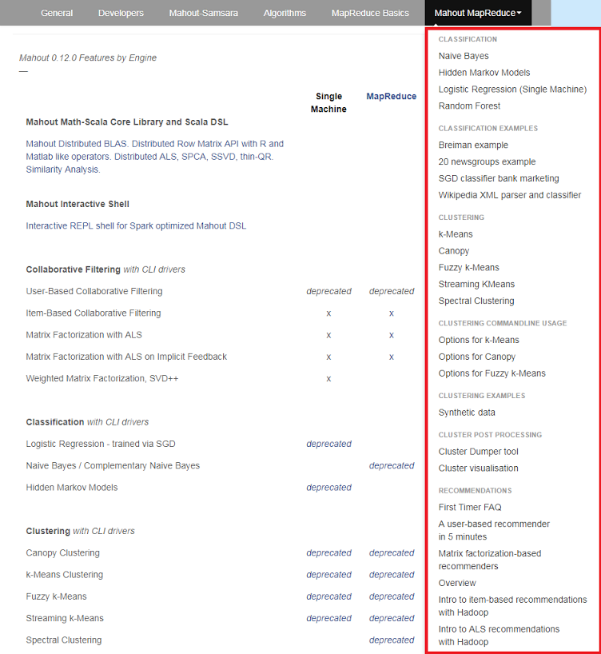
Mahout and SPIDAL
Mahout was Hadoop machine learning library but largely abandoned as Spark outperformed Hadoop
SPIDAL outperforms Spark Mllib and Flink due to better communication and in-place dataflow.
SPIDAL also has community algorithms
  Biomolecular Simulation
  Graphs for Network Science
  Image processing for pathology and polar science

Slide 14
Core SPIDAL Parallel HPC Library with Collective Used
DA-MDS Rotate, AllReduce, Broadcast
Directed Force Dimension Reduction AllGather, Allreduce
Irregular DAVS Clustering Partial Rotate, AllReduce, Broadcast
DA Semimetric Clustering Rotate, AllReduce, Broadcast
K-means AllReduce, Broadcast, AllGather DAAL
SVM AllReduce, AllGather
SubGraph Mining AllGather, AllReduce
Latent Dirichlet Allocation Rotate, AllReduce
Matrix Factorization (SGD) Rotate DAAL
Recommender System (ALS) Rotate DAAL
Singular Value Decomposition (SVD) AllGather DAAL
QR Decomposition (QR) Reduce, Broadcast DAAL
Neural Network AllReduce DAAL
Covariance AllReduce DAAL
Low Order Moments Reduce DAAL
Naive Bayes Reduce DAAL
Linear Regression Reduce DAAL
Ridge Regression Reduce DAAL
Multi-class Logistic Regression Regroup, Rotate, AllGather
Random Forest AllReduce
Principal Component Analysis (PCA) AllReduce DAAL
DAAL implies integrated with Intel DAAL Optimized Data Analytics Library (Runs on KNL!)

Slide 15
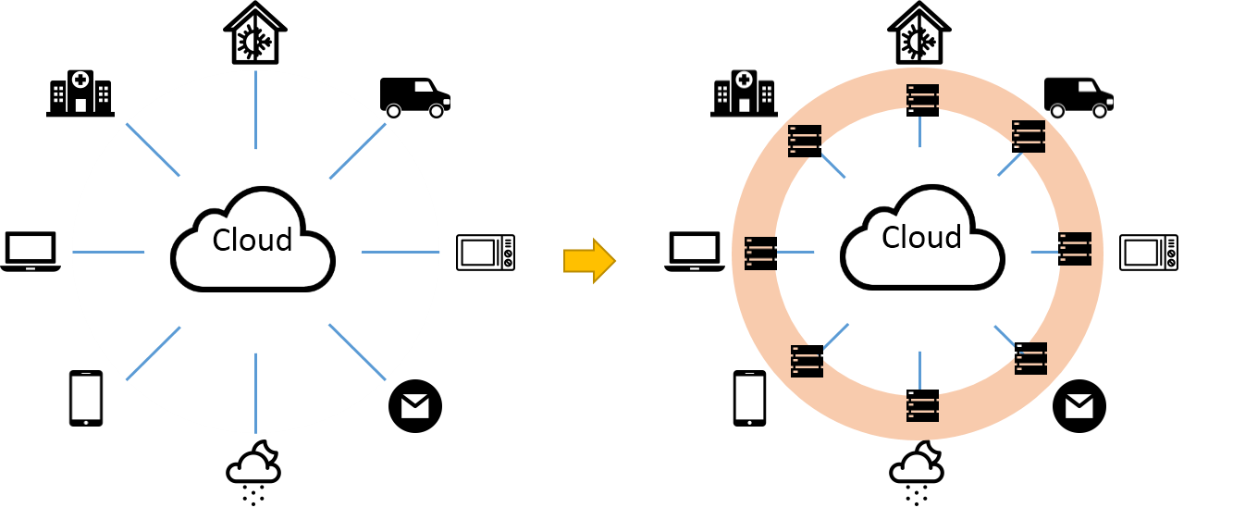


Implementing Twister2 at a high level
Cloud
HPC
Cloud
HPC
Fog
Cloud
HPC
Centralized HPC Cloud + IoT Devices
Centralized HPC Cloud + Edge = Fog + IoT Devices

Slide 16
Twister2: “Next Generation Grid - Edge – HPC Cloud”
Original 2010 Twister paper has 878 citations; it was a particular approach to MapCollective iterative processing for machine learning
Re-engineer current Apache Big Data and HPC software systems as a toolkit
Support a serverless (cloud-native) dataflow event-driven FaaS (microservice) framework running across application and geographic domains.
  Support all types of Data analysis from GML to Edge computing
Build on Cloud best practice but use HPC wherever possible to get high performance
Smoothly support current paradigms Hadoop, Spark, Flink, Heron, MPI, DARMA …
Use interoperable common abstractions but multiple polymorphic implementations.
  i.e. do not require a single runtime
Focus on Runtime but this implicitly suggests programming and execution model
This defines a next generation Grid based on data and edge devices – not computing as in old Grid
See long paper http://dsc.soic.indiana.edu/publications/Twister2.pdf

Slide 17

Proposed Approach
Unit of Processing is an Event driven Function (a microservice) replacing libraries
  Can have state that may need to be preserved in place (Iterative MapReduce)
  Functions can be single or 1 of 100,000 maps in large parallel code
Processing units run in HPC clouds, fogs or devices but these all have similar architecture (see AWS Greengrass)
  Fog (e.g. car) looks like a cloud to a device (radar sensor) while public cloud looks like a cloud to the fog (car)
Analyze the runtime of existing systems (More study needed)
  Hadoop, Spark, Flink, Naiad (best logo) Big Data Processing
  Storm, Heron Streaming Dataflow
  Kepler, Pegasus, NiFi workflow systems
  Harp Map-Collective, MPI and HPC AMT runtime like DARMA
  And approaches such as GridFTP and CORBA/HLA (!) for wide area data links

Slide 18
Comparing Spark Flink and MPI
On Global Machine Learning.
Note this is not why Spark and Flink are successful

Slide 19
Machine Learning with MPI, Spark and Flink
Three algorithms implemented in three runtimes
  Multidimensional Scaling (MDS)
  Terasort
  K-Means
Implementation in Java
  MDS is the most complex algorithm - three nested parallel loops
  K-Means - one parallel loop
  Terasort - no iterations

Slide 20
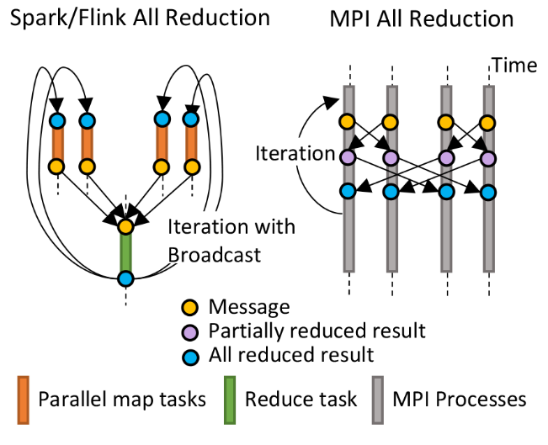
HPC Runtime versus ABDS distributed Computing Model on Data Analytics
Hadoop writes to disk and is slowest; Spark and Flink spawn many processes and do not support AllReduce directly;
MPI does in-place combined reduce/broadcast and is fastest
Need Polymorphic Reduction capability choosing best implementation
Use HPC architecture with
  Mutable model
  Immutable data

Slide 21
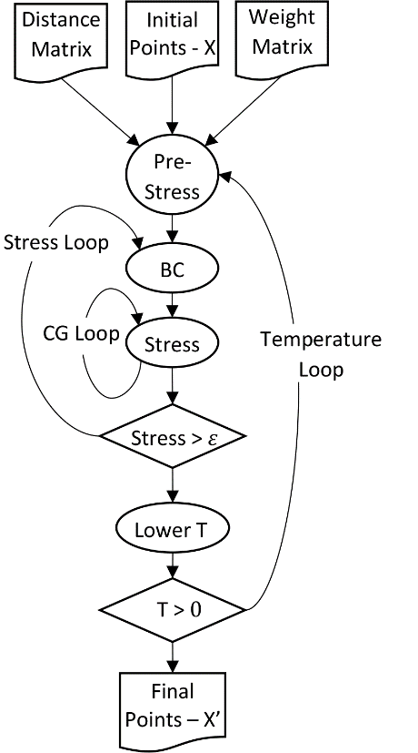
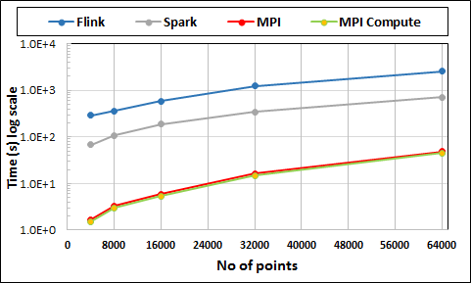
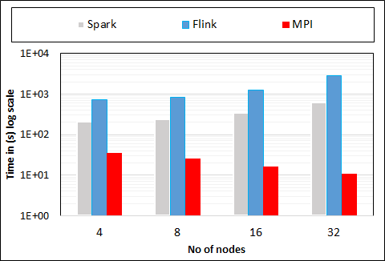
Multidimensional Scaling: 3 Nested Parallel Sections
MDS execution time on 16 nodes with 20 processes in each node with varying number of points
MDS execution time with 32000 points on varying number of nodes. Each node runs 20 parallel tasks

Slide 22
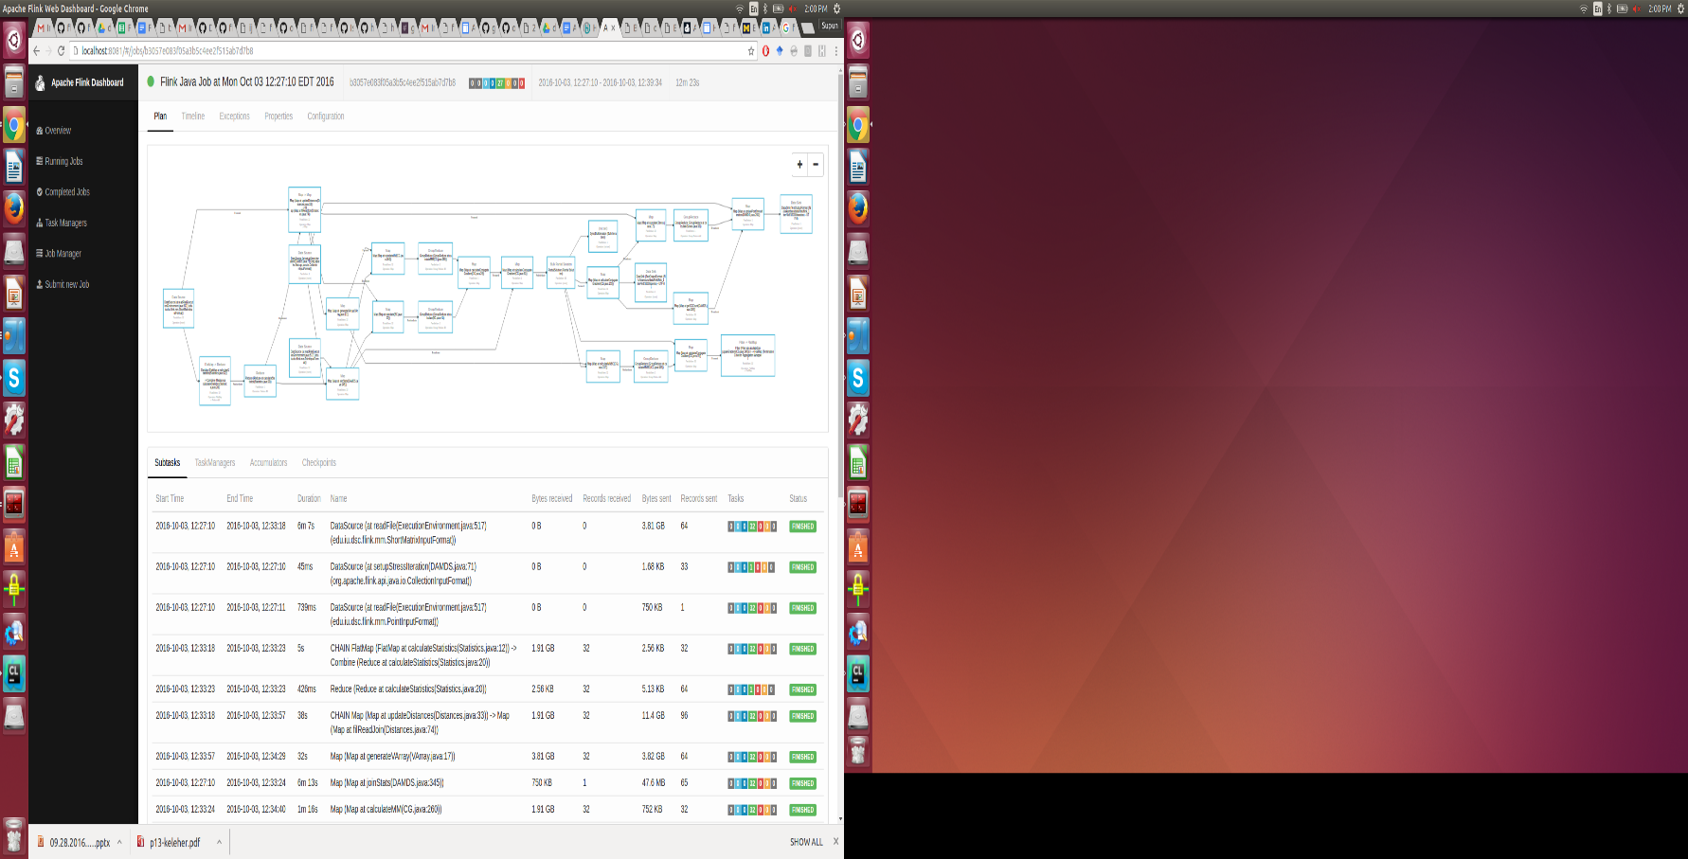
Flink MDS Dataflow Graph

Slide 23
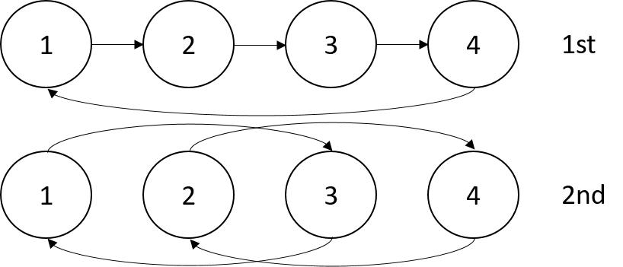
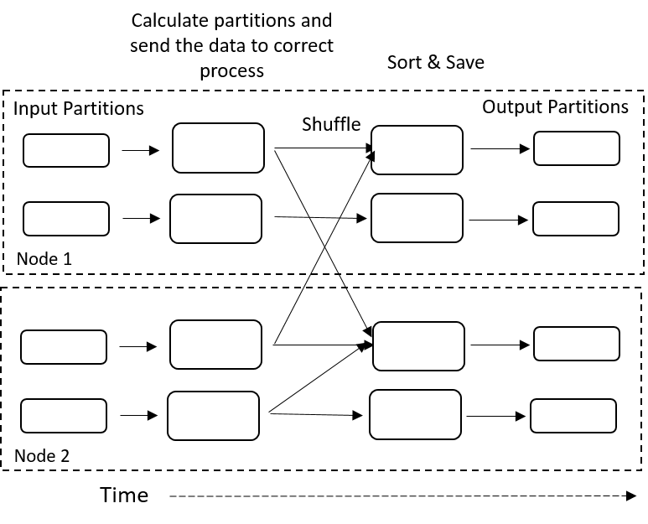
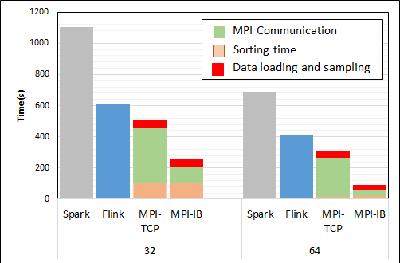
Terasort
Transfer data using MPI
Sorting 1TB of data records
Terasort execution time in 64 and 32 nodes. Only MPI shows the sorting time and communication time as other two frameworks doesn't provide a viable method to accurately measure them. Sorting time includes data save time. MPI-IB - MPI with Infiniband
Partition the data using a sample and regroup

Slide 24
Implementing Twister2 in detail

Slide 25
What do we need in runtime for distributed HPC FaaS
Finish examination of all the current tools
Handle Events
Handle State
Handle Scheduling and Invocation of Function
Define and build infrastructure for data-flow graph that needs to be analyzed including data access API for different applications
Handle data flow execution graph with internal event-driven model
Handle geographic distribution of Functions and Events
Design and build dataflow collective and P2P communication model (build on Harp)
Decide which streaming approach to adopt and integrate
Design and build in-memory dataset model (RDD improved) for backup and exchange of data in data flow (fault tolerance)
Support DevOps and server-hidden (serverless) cloud models
Support elasticity for FaaS (connected to server-hidden)
Green is initial (current) work

Slide 26
Communication Support
MPI Characteristics: Tightly synchronized applications
  Efficient communications (µs latency) with use of advanced hardware
  In place communications and computations (Process scope for state)
Basic dataflow: Model a computation as a graph
  Nodes do computations with Task as computations and
  edges are asynchronous communications
  A computation is activated when its input data dependencies
  are satisfied
Streaming dataflow: with data partitioned into streams
  Streams are unbounded, ordered data tuples
  Order of events important and group data into time windows
Machine Learning dataflow: Iterative computations and keep track of state
  There is both Model and Data, but only communicate the model
  Collective communication operations such as AllReduce AllGather
  Can use in-place MPI style communication
W
S
W
G
S
Dataflow
W

Slide 27
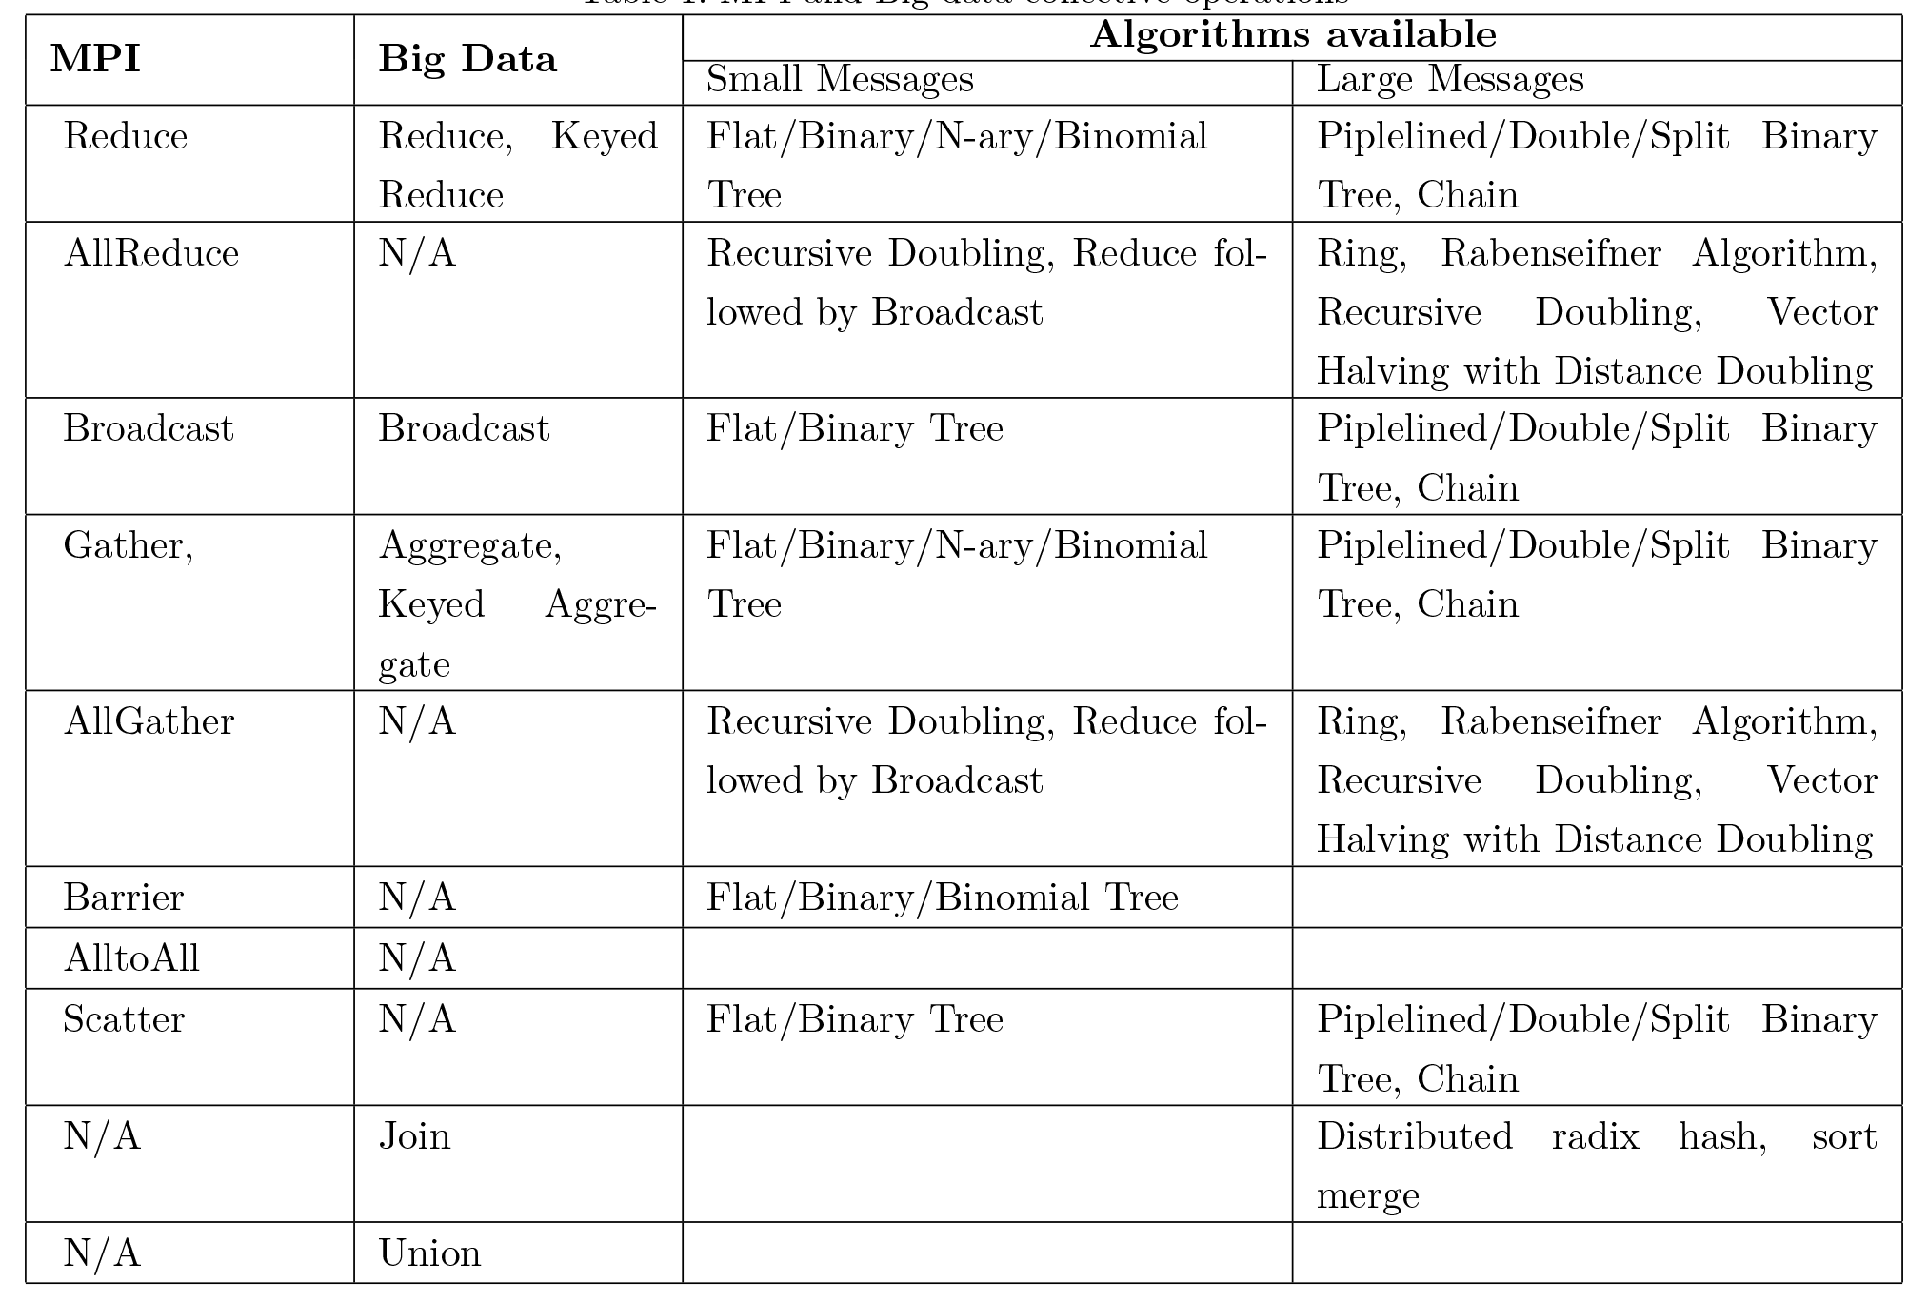
Communication Primitives
Need Collectives and Point to point
Real Dataflow and in-place
Big data systems do not implement optimized communications
It is interesting to see no Big data AllReduce implementations
  AllReduce has to be done with Reduce + Broadcast
Should consider RDMA

Slide 29
Dataflow Graph State and Scheduling
State is a key issue and handled differently in systems
  CORBA, AMT, MPI and Storm/Heron have long running tasks that preserve state
  Spark and Flink preserve datasets across dataflow node using in-memory databases
  All systems agree on coarse grain dataflow; only keep state by exchanging data.
Scheduling is one key area where dataflow systems differ
  Dynamic Scheduling (Spark)
    Fine grain control of dataflow graph
    Graph cannot be optimized
  Static Scheduling (Flink)
    Less control of the dataflow graph
    Graph can be optimized

Slide 30
Fault Tolerance and State
Similar form of check-pointing mechanism is used already in HPC and Big Data
  although HPC informal as doesn’t typically specify as a dataflow graph
  Flink and Spark do better than MPI due to use of database technologies; MPI is a bit harder due to richer state but there is an obvious integrated model using RDD type snapshots of MPI style jobs
Checkpoint after each stage of the dataflow graph
  Natural synchronization point
  Let’s allows user to choose when to checkpoint (not every stage)
  Save state as user specifies; Spark just saves Model state which is insufficient for complex algorithms

Slide 31
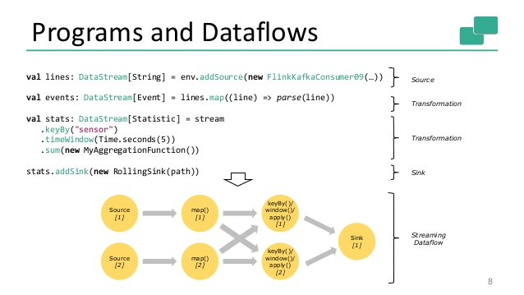
Spark Kmeans Flink Streaming Dataflow
P = loadPoints()
C = loadInitCenters()
for (int i = 0; i < 10; i++) {
T = P.map().withBroadcast(C)
C = T.reduce() }
Store C in RDD

Slide 32
Summary of Twister2:
Next Generation HPC Cloud + Edge + Grid
We suggest an event driven computing model built around Cloud and HPC and spanning batch, streaming, and edge applications
  Highly parallel on cloud; possibly sequential at the edge
Expand current technology of FaaS (Function as a Service) and server-hidden (serverless) computing
We have built a high performance data analysis library SPIDAL
We have integrated HPC into many Apache systems with HPC-ABDS
We have done a very preliminary analysis of the different runtimes of Hadoop, Spark, Flink, Storm, Heron, Naiad, DARMA (HPC Asynchronous Many Task)
  There are different technologies for different circumstances but can be unified by high level abstractions such as communication collectives
  Need to be careful about treatment of state – more research needed
See long paper http://dsc.soic.indiana.edu/publications/Twister2.pdf

