Slide 1
Improving Large Scale Visual Data Analysis using Software Defined Visualization Solutions
August 8, 2017
Performance For Big Data Session, NYSDS
Jim Jeffers, Principal Engineer, Director, SW Defined Visualization (SDVis)
Intel Corporation
Notes:
- Hi, I’m an applications engineer with the scalable visualization group at Intel
- OSPRay: Open, Scalable, Portable, Ray tracing library

Slide 2





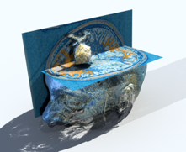
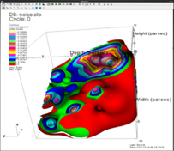
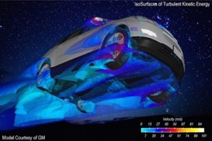
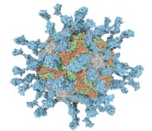


SDVis Quick OVERVIEW
Intel supported community effort for high performance, high fidelity, in-situ CPU-only based rendering
High, interactive performance for even very large (TB+) datasets
Fully Open Source with liberal Apache 2 and MIT License
Single Node and Cluster-wide Scalability in 1) Render Time; 2) Render Quality; 3) 3D Model Data Size
OpenGL and Ray Tracing Support with shadows, ambient occlusion, up to photorealistic quality; Enhanced Visual Cues
Now broadly Integrated and tested with both general and targeted domain applications
Brayns
VL3
Polio Virus
Data courtesy Kitware.
Visualization, Carson Brownlee, Intel
Courtesy John Stone, Beckman Institute, Univ. Illinois at Urbana-Champaign
Data and Visualization courtesy Cyrille Favreau, EPFL
Data: Salman Habib, Katrin Heitmann, and the HACC team.
Visualization: Joe Insley, Slivio Rizzi, ANL
Courtesy Hank Childs, U Oregon, Jian Huang and Alok Hota, UTenn
Courtesy Sean Ahern, CEI and General Motors

Slide 3
A ”little” ANECDOTE about “Big Data”….
ONE DAY A COUPLE YEARS AGO SOMEONE SAID TO ME (CASUALLY) …....
ROBERT HARRISON – BNL DIRECTOR IACS, then DIRECTOR, JICS, UTENN
“HEY I JUST REALIZED THAT THERE’S REALLY QUITE A LOT OF DATA BEING GENERATED IN CHEMISTRY, COSMOLOGY, NUCLEAR ‘STUFF’, LARGE HADRON COLLIDERS, - THAT SORT OF THING…..COME TO THINK OF IT, EVEN FACEBOOK!”

Slide 4

A ”little” ANECDOTE about “Big Data”….
HMMM, INTERESTING THOUGHT, SOUNDS LIKE WE”RE ON THE WAY TO ’HUGE DATA’, MAYBE WE SHOULD COIN THAT PHASE.

Slide 5
A ”little” ANECDOTE about “Big Data”….
“WELL, JIM, THAT’S NOT TOO BAD BUT SEEMS A LITTLE PRETENTIOUS, I THINK ’LARGE DATA’ SOUNDS MORE REALISTIC…”

Slide 6
A ”little” ANECDOTE about “Big Data”….
COME ON ROBERT, THAT’S NOT BOLD ENOUGH! I SAY WE GO WITH ‘BIG DATA’ AND CALL IT A DAY… BTW, WHEN ARE YOU GONNA COME EAST AND REALLY ENJOY LIFE!”

Slide 7
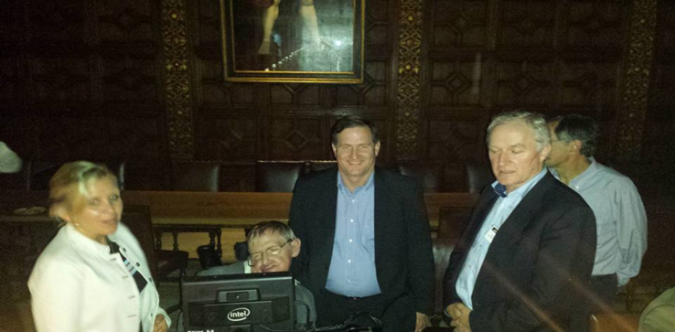
A ”little” ANECDOTE about “Big Data”….
NOTE TO SELF: HIT WITH HEAVY NAME DROPPING (AT LEAST FOR GEEKY HPC CIRCLES!] (DELETE BEFORE PRESENTING]
”Hey Stevie, my friend, I heard Cosmology needs big data “true ’dat?!”
You know who, Hawking Centre for Theoretical Cosmology, U Cambridge
“Hi Jim, Yes, we need ‘big’ data. Our mini-apps for benchmarking generate only 10 TB of data, real cosmology needs lots more.... “BTW, I need help simulating and visualizing colliding black holes around 36TB for 0.2 secs real time data, something big (aka LIGO) is about to happen and I want in!.”

Slide 8
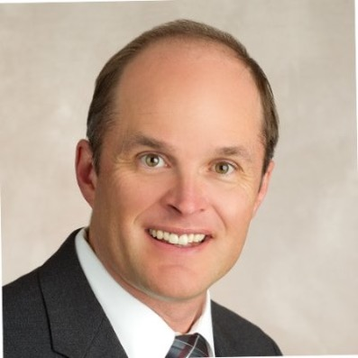
A ”little” ANECDOTE about “Big Data”….
Hi Jim A, heard your making some noise about Vis, Exascale data, In-Situ etc, etc. What’s up with that?
Jim Ahrens, Los Alamos National Lab, Data Science at Scale Lead
“Well Jim, where the heck have you been? We already know Trinity’s gonna be a big machine for ‘large data science’ plus Vis. We don’t have any GPU’s spec’d to do the Vis. Whatcha gonna do ‘bout that’?!

Slide 9
A ”little” ANECDOTE about “Big Data”….
HMMM, I’LL GET BACK TO YOU SOON, JIM!
ALSO, I’M CALLING IT ‘BIG DATA’ NOT ‘LARGE’ DATA… CUTE, HUH?

Slide 10
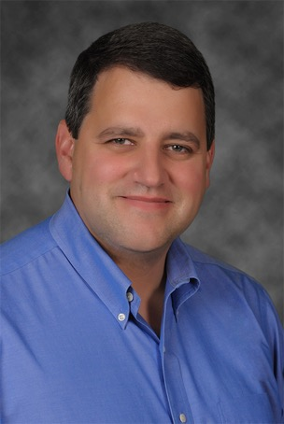
A ”little” ANECDOTE about “Big Data”….
Hi Dan, heard through the grapevine that Data is getting bigger. Mean anything to US’s largest supercomputer @TACC?
DAN STANZIONE, EXECUTIVE DIRECTOR, TEXAS ADVANCE COMPUTING CENTER
“Hey Jim, NSF says “Data Science” is critical to the future of all kinds of analysis done by our 7,000 – 10,000 users of Stampede I (10 PF) and II (18 PF). You got a plan for success, right?”. Heard you know something about Vis, how are we going to make THAT work ‘at scale” and with TBs and PBs of data, not to mention Exascale?!

Slide 11
A ”little” ANECDOTE about “Big Data”….
INTERESTING, I HEAR YOU DAN! BTW, Robert H. and I have decided to call it “BIG DATA” for short. I’ve got some ideas and know some world class Intel engineers with graphics and vis software technology. LET ME GIVE A HEADS UP TO MANAGEMENT AND GET BACK TO YOU.”
‘BIG DATA”…. YOUR GONNA BE TOAST!”

Slide 12
A ”little” ANECDOTE about “Big Data”….
HEY RAJ, THE ‘WHOLE’ HPC INDUSTRY IS IN AN UPROAR ABOUT ‘BIG DATA’ AND REALIZES THAT VISUAL ANALYSIS TO UNDERSTAND IT IS GETTING MORE IMPORTANT THAN EVER. HOW ‘BOUT WE START A MINI GROUP TO LOOK AT THAT….. I PROMISE IT WON’T COST MUCH AT ALL!”

Slide 13
A ”little” ANECDOTE about “Big Data”….
HEY JIM, (THAT’S YOUR NAME RIGHT?). SOUNDS INTERESTING, MINI GROUP SOUNDS REALLY INEXPENSIVE, IN THAT CASE, GO FOR IT!”. REPORT BACK IN 3-4 YEARS AND LET ME KNOW HOW IT’S GOING!”
Corporate Vice President, General Manager, Enterprise and Gov’t Group, Intel

Slide 14
A ”little” ANECDOTE about “Big Data”….
YOU GOT IT, RAJ! I’VE GOT YOUR BACK, DON’T GIVE THIS CPU VIS STUFF A SECOND THOUGHT, EVERYONE WILL GET IT RIGHT AWAY…. GO AHEAD, START COUNTING YOUR ‘CHICKENS’!”

Slide 15
Growing Challenges in HPC
System Bottlenecks
“The Walls”
Divergent Workloads
Barriers to
Extending Usage
Machine Learning
Big
Data
Optimizing
For Cloud
HPC
Visualization
Memory | I/O | Storage
Energy Efficient Performance
Space | Resiliency |
Unoptimized Software
Resources Split Among Modeling and Simulation | Big Data Analytics | Machine Learning | Visualization
Democratization at Every Scale | Cloud Access | Exploration of New Parallel Programming Models
Notes:
Key Message:
But HPC could do so much more if we could overcome these barriers
‘The Walls’ represent the base technical barriers the industry is facing in compute, memory, I/O, storage and power
This is compounded with different workloads hitting these walls differently, driving separate systems with specialized hardware and softer for each workload – increasing acquisition and management costs and reducing efficiencies (load balancing)
Both of these have driven the complexity of acquiring, managing and programming for an HPC system, and we need new methods and tools to reduce this complexity to extend HPC’s reach (Cloud, holistic software stacks, new programming models)
Background: However, HPC could do so much more than is currently possible, if we can overcome several growing challenges facing HPC. (A growing challenge is not necessarily a new challenge, simply one that is becoming more of a problem over time)
On the left, are the main technical barriers that we’re used to hearing about. “The Walls” (memory, I/O, storage and power walls). Areas where we’ve been relying on new technologies to push these walls back. However, as we run into multiple walls, I.E. faster compute, memory and I/O but at lower total power, new technologies alone cannot overcome all of the walls. These issues compound as you attempt to scale both your application and the system you’re running it on.
We see this effect in the middle column. Due to divergent workloads, shown here as traditional modeling and simulation on the left, visualization on the top (key to HPC, as visualization is how we derive insight from our data), Big Data and data analytics on the right, and Machine Learning on the bottom. Because of fundamental nature of these workloads stresses different parts of a machine (compute, memory, I/O), we’ve often created dedicated systems running specialized hardware and software for specific workloads. This increases the cost of acquiring and managing a system while reducing the efficiency of that system (unable to load balance between workloads on different systems).
These are only adding to the complexity already involved in acquiring and running an HPC system, which is limiting the number and types of end users that can utilize HPC. Reducing this complexity is a crucial step in enabling more people to take advantage of the aforementioned benefits HPC offers (previous slide). This democratization could take many forms; cloud resources to reduce the complexity of acquiring and managing an HPC system, holistic system software stacks to reduce the complexity of utilizing the hardware, or new programming models to reduce the complexity of creating HPC applications.

Slide 16
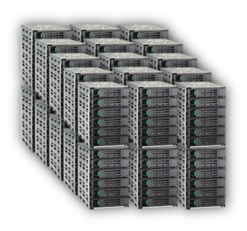

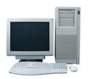

The Challenge with ‘Traditional’ Visualization
Circa 2010 - 2015
Using Dedicated hardware and specialized software
Bottlenecks…
I/O, Scheduling, Memory Size, Power,…
HW Visualization
HPC cluster performs
modeling and simulations
Dedicated Visualization
HW (GPUs) and SW
Client devices view
the final images
Workaround Bottlenecks by Fitting Problem To Available Vis Resource!
Notes:
Were we’ve come to in large scale Vis and Graphics over the past decade plus..

Slide 17
An HPC Product Comparison GPU v. CPU
Feature | NVidia Tesla P100 | Intel® Xeon Phi™ 72xx Processors | Intel® Xeon® Scalable Processors
Max Memory | 16 GB | 384GB | 1.5TB
xPU Access to Data | PCIe->GDDR | Direct Sys. Mem | Direct Sys Mem
Typ. # xPU per node | 1 x 2x CPU | 1 | 2
Typ. Platform Cost(192GB DDR4)* | $~14K+ | ~$6K+ | ~$8K+
*Prices are very rough from quick internet search and not a quote. Mileage may vary

Slide 18
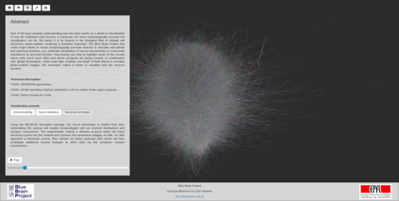
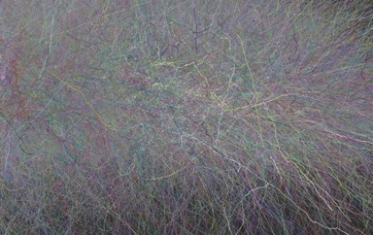
Example: EPFL Blue Brain Project
“Brayns” + OSPRay
Brain Neuron Growth 3D Visualization
Web-Based GUI
Large Display or Display Wall Output
Real-time Simulation of Brain Neuron Formation and Electrical Impulses
~70 GB of Input Data @ 15-20fps; Shown using 4 Knights Landing Processors @ ISC’16 Intel Booth
IMPOSSIBLE FOR A TETHERED GPU WITH LIMITED MEMORY AND Bandwidth!

Slide 19
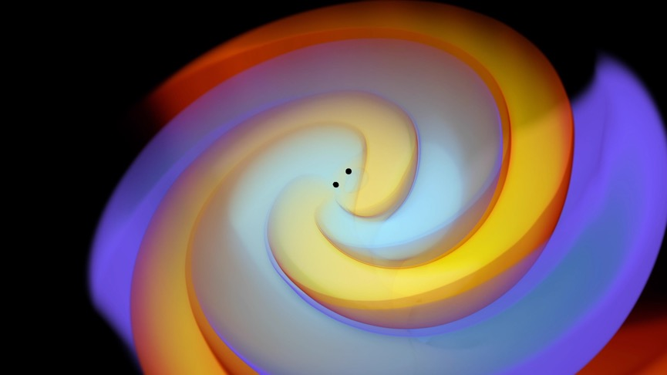
Example:GR-Chombo Black Hole Collision
Stephen Hawking CTC
LIGO Black Hole Collision simulation and resulting Gravitational Waves
1200 Timesteps over 0.2s – Collide @ ‘Speed of Light’
3.6 TB Postprocessed (from 36 TB) Dataset
IMPOSSIBLE FOR A TETHERED GPU WITH LIMITED MEMORY AND Bandwidth!

Slide 20
Software Defined Visualization

Slide 21

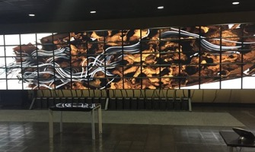






Our Vision: Scalable, Flexible Vis Rendering that Runs Anywhere!
Cloud or
Network
Standalone Laptops or Workstations
Large Compute+Vis clusters with
Local or Remote Clients
Big Memory Nodes or Rendering Focused Clusters
Notes:
Get on any platform – can visualize on laptops and workstations too - biggest data challenges may need a full cluster not just a specialty ‘vis’ cluster… Target for YOUR use cases….

Slide 22
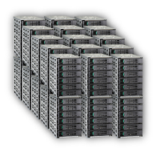
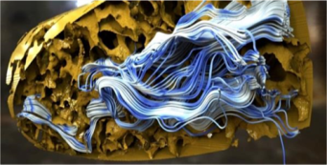

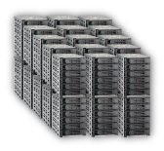
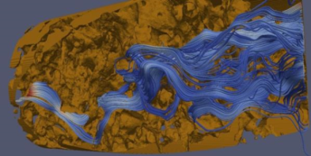


How?
Intel-Supported Software Defined Visualization (SDVis)! http://software.intel.com/sdvis www.sdvis.org
Image Rendered by OSPRay
Software Defined Visualization
Embree
CPU Optimized Ray Tracing Algorithms
‘Tool kit’ for Building Ray Tracings Apps
Broadly Adopted by 3rd Party ISVs
More at http://embree.github.io
OSPRay
Rendering Engine Based on Embree
API Designed to Ease Creation of Visualization Software
More at http://ospray.org
OpenSWR
High Performance CPU Vis Rasterization
Fully Integrated into MESA v12.0+
Supports ParaView, Visit, VTK, EnSight, VL3
More at http://mesa3d.org ; www.openswr.org
HW Visualization
Standard OpenGL Image

Slide 23
Addressing Large-scale, High Performance, and High Fidelity Visualization with SDVis
Gain deeper understanding of data impacting science & discovery
High fidelity, more realistic images even as data sets become increasingly larger,
and more complex; no need to compromise data resolution
Solve computing + modeling problem together (in-situ vis)
Essential SW development suite that makes concurrent simulation and
visualization efficient – users can work interactively and get results quicker
One system
Use same system for both simulation and visualization, avoid data transfer
delays and memory size constraints – faster insights for solving toughest problems
No Discrete GPU Needed!

Slide 24
Software-Defined Visualization – Why?
File Size | 100 Gbps | 10 Gbps | 1 Gbps | 300 Mbps | 54 Mbps
1 GB | < 1 sec | 1 sec | 10 sec | 35 sec | 2.5 min
1 TB | ~100 sec | ~17 min | ~3 hours | ~10 hours | ~43 hours
1 PB | ~1 day | ~12 days | ~121 days | >1 year | ~5 years
Increasingly Difficult to Move Data from Simulation Machine

Slide 25

Traditional/Post Hoc Analysis
Simulation
Visualization
Simulation runs in a loop, infrequently saving out large files to slow disk.
Sometime later, user manually loads files into an analysis package to inspect the data.

Slide 26
In Situ Analysis
Simulation
Visualization
Embed analysis library into the simulation code. Simulation periodically makes calls to generate on the fly results.
Largely avoids I/O, therefore increases achievable temporal granularity.
As long as Vis is faster and more scalable than disk, in situ is a viable route to exascale problem sizes.
Notes:
Mention that slow disk reduces simulation rate
Mention that you don’t want post process to do same

Slide 27
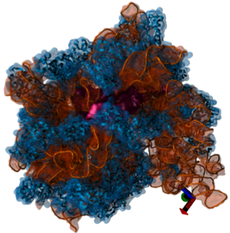
Benefits of SDVis
Open-sourced technology delivering vivid visualization of complex, enormous data sets
Innovative software libraries for visualizing results with high performance by unlocking the parallelism already in your system
High-fidelity images for gaining deeper insights in science and industry, faster
Software Only solution lowers costs – no card cost, no card maintenance, lower power bills
Gravational Waves : GR-Chombo AMR Data, Stephen Hawking CTC, UCambridge; Queens College, London; visualization, Carson Brownlee, Intel, ParaView)
Your Work. No Compromises.
Magnetic Reconnection Model, Courtesy Bill Duaghton(LANL) and Berc Geveci(Kitware)
Ribosome: Data: Max-Planck Institute for Biophysical Chemistry
Notes:
Audience: SW developers in research (including academics)

Slide 28



Hi-Fidelity Visualization with…
  … scalable image quality
  … scalable model size
  … scalable in rendering cost
Data set provided by Florida International University

Slide 29

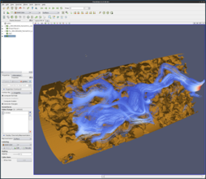
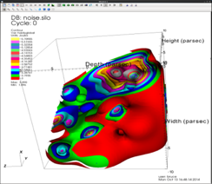

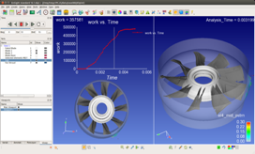
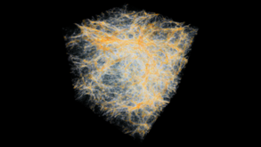
OpenSWR Software Rasterizer (www.mesa3d.org www.openswr.org)
High performance open source software implementation of OpenGL* rasterizer
  Fully multi-threaded and vectorized for Intel® processors
  Can access full system memory - highest resolution data
  Leverages community development effort (MESA)
Drop in replacement for OpenGL library
Available since July’16 in Mesa v12.0+ targeting features and performance for leading ScIVis Apps
VL3
Notes:
Focus on performance
Drop in replacement: turns compute nodes into vis nodes!
Growing subset of OpenGL features

Slide 30
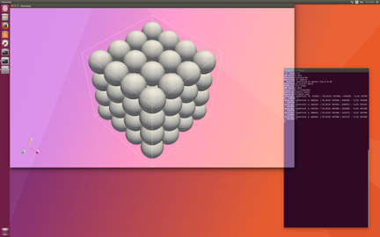
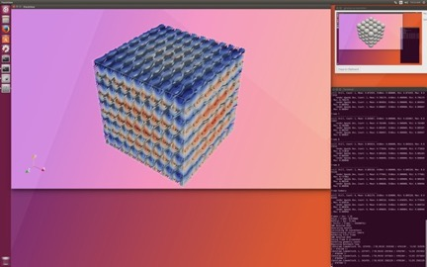
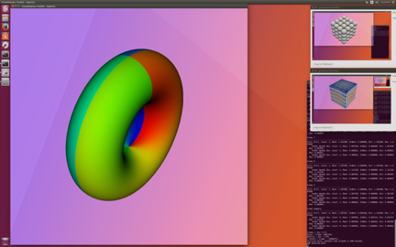
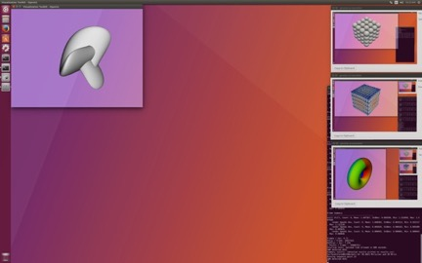
OPENGL (OpenSWR) benchmarks
manyspheres.py
67 MiPolys
wavelets.py
11 MiPolys
TimingTests
30 MiTris
GLBenchmarking
30MiTris

Slide 31
INTEL® Xeon® E5 v4 OPENSWR/LLVMPIPE PERFORMANCE RATIO
Software and workloads used in performance tests may have been optimized for performance only on Intel microprocessors. Performance tests, such as SYSmark* and MobileMark*, are measured using specific computer systems, components, software, operations and functions. Any change to any of those factors may cause the results to vary. You should consult other information and performance tests to assist you in fully evaluating your contemplated purchases, including the performance of that product when combined with other products. For more information go to http://www.intel.com/performance.

Slide 32
INTEL® Xeon Phi™ 7250 OPENSWR/LLVMPIPE PERFORMANCE RATIO
Software and workloads used in performance tests may have been optimized for performance only on Intel microprocessors. Performance tests, such as SYSmark* and MobileMark*, are measured using specific computer systems, components, software, operations and functions. Any change to any of those factors may cause the results to vary. You should consult other information and performance tests to assist you in fully evaluating your contemplated purchases, including the performance of that product when combined with other products. For more information go to http://www.intel.com/performance.

Slide 33
PERFORMANCE TEST PLATFORMS
Two machines:
KNL: Intel® Xeon Phi™ CPU 7210 @ 1.30GHz, Ubuntu 17.10, 4.10.0-20-generic, gcc 6.3.0
BDW: Intel® Xeon 2699v4 x 2 (44 cores) @ 2.20GHz, Ubuntu 17.10, 4.10.0-19-generic, gcc 6.3.0
Four tests:
manyspheres.py (-s 64 -r 726 -v 1920,1080) – paraview benchmark script
waveletcontour.py (-d 256 -v 1920,1080) – paraview benchmark script
TimingTests (-width 1536 -height 1536 -regex SurfaceColoredWithNormals -nochart -ss 14 -se 14) – vtk benchmarking app
GLBenchmarking (--start 14 --end 14) – vtk benchmarking app

Slide 34
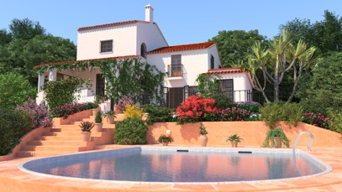
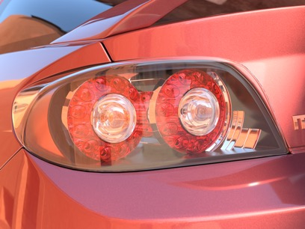

Ray Tracing Foundation:
Embree Ray Tracing Kernel Library
Provides highly optimized and scalable ray tracing kernels
  Acceleration structure build and ray traversal
  Single Ray, Ray Packets(4,8,16), Ray Streams(N)
Targets up to photorealistic professional and scientific rendering applications
Highest ray tracing performance on CPUs
  1.5–6× speedup reported by users
Support for latest CPUs / ISAs
  Intel® Xeon Phi™ Processor (codenamed Knights Landing) – AVX-512
API for easy integration into applications
Free and open source under Apache 2.0 license
  http://embree.github.com
34

Slide 35
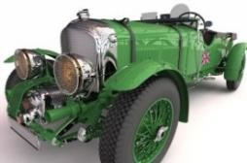


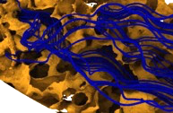
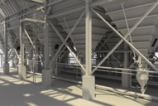
Performance: Embree vs. NVIDIA* OptiX*
Frames Per Second (Higher is Better), 1024x1024 image resolution
Embree 2.16.1, Intel® C++ Compiler 17.0.2, Intel® SPMD Program Compiler (Intel® ISPC) 1.9.1
NVIDIA* OptiX* 4.0.2, CUDA* 8.0.44
Source: Intel
Software and workloads used in performance tests may have been optimized for performance only on Intel microprocessors. Performance tests, such as SYSmark* and MobileMark*, are measured using specific computer systems, components, software, operations and functions. Any change to any of those factors may cause the results to vary. You should consult other information and performance tests to assist you in fully evaluating your contemplated purchases, including the performance of that product when combined with other products. For more information go to http://www.intel.com/performance.
Intel ® Confidential – NDA Required

Slide 36
Broadwell Configuration
Node count | 1
Platform
CPU | 2 x Intel® Xeon® E5-2699 v4 Processor (Dual socket, 2.2GHz, 2 x 22 cores)
RAM | 256 GB total
BIOS | Vendor: Intel Corporation Version: Release Date: BIOS Configuration: default, turbo on, hyper-threading on
OS / Kernel | CentOS release 7.2.1511 / 3.10.0-327.36.2.el7.x86_64
* Other names and brands may be claimed as the property of others.

Slide 37
Knights Landing Configuration
Node count | 1
Platform
CPU | Intel® Xeon Phi™ 7250 Processor (16GB MCDRAM, 1.40 GHz, 68 cores)
RAM | 64 GB DDR4 total, 16 GB MCDRAM in quad/cache mode
BIOS | Vendor: Intel Corporation Version: S72C610.86B.01.01.0147.060220162105 06/02/2016 BIOS Configuration: default, turbo on, hyper-threading on
OS / Kernel | Fedora Core 23 Server / 4.8.13-100.fc23.x86_64 Linux Power Scheme: performance governor 8 GB of pre-allocated 2MB pages
* Other names and brands may be claimed as the property of others.

Slide 38
NVIDIA Pascal Configuration
Node count | 1
Platform
CPU | 2 x Intel® Xeon® E5-2697 v4 Processor (Dual socket, 2.3GHz, 2 x 18 cores)
RAM | 256 GB total
BIOS | Vendor: Intel Corporation Version: Release Date: BIOS Configuration: default, turbo on, hyper-threading on
NVIDIA Co-Processor | Tesla P100-PCIE-16GB (GP100) 3584 CUDA Cores 16GB HBM2 memory Software Details: Driver Version: 375.20 CUDA Version 8.0.44 OptiX Version 4.0.2
OS / Kernel | Red Hat Enterprise Linux Server 7.2 / 3.10.0-327.el7.x86_64
* Other names and brands may be claimed as the property of others.

Slide 39




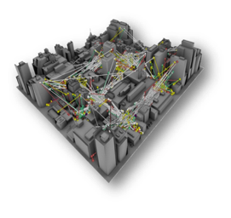
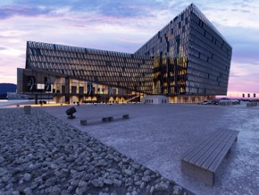






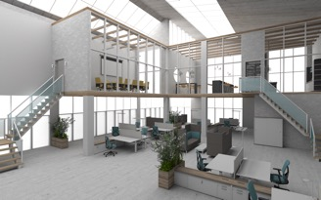
Embree Adoption*
Courtesy of Jeff Patton, Rendered with Corona Renderer
Rendered with StingRay,
SURVICE Engineering
Image rendered with FluidRay RT
*Many other announced users incl.: Pixar, Illumination, Weta Digital, Activision, Chaos V-Ray, Ready At Dawn, FrostBite, EpicGames UnReal, High Moon, Blue Sky, UBISoft MP, Framestore,….
pCon.planner rendered courtesty EasternGraphics
Notes:
JJ 7/2 - *** REMOVED SOLID ANGLE AS WE BELIEVE THEY JUST REVIEWED BUT DID NOT DEPLOY EMBREE
List of known Embree Users
Last updated 08/28/2014
Abstract
This list is to keep track of current users of Embree; what they use it for, and what for, contacts, etc. Please keep updated. As there already are a lot of users by the time this document was even created this list will be incomplete.
List of Users
Pixar
Company:
Pixar Animation Studios
Renderer:
Renderman
Webpage:
Renderman.pixar.com
Contact:
Charlie Kilpatrick (ck@pixar.com) (part (tech lead?) of the renderman team; not part of katana team)
Embree Version:
Using hand-modified version, engaging to move back to trunk.
Usage:
Accelerating PRMan (Photorealistic Renderman)’s ray tracing
CPU:
Xeon
Platforms:
Unknown
License:
Pixar License; Free for non-commercial use (08/14);
Speedup:
Unknown
Other:
Told us at Siggraph 2014 that (pixar-modified version of) Embree is now used in PRMan, and ships with every install of PRMan.
Dana Batali: “. I'm aware of at least two independent Embree users at Pixar right now. In R&D, Tom Duff has been using embree to explore some interesting LOD challenges. And as Charlie indicated, we're currently using a subset of the codebase in a few of our raytracing codepaths within RenderMan.
”
Autodesk Sweden (former “OptiCore” team, now “RapidRT” team)
Company:
Autodesk AB
Renderer:
RapidRT (according to Peter, soon to be used in “virtually all” ADSK rendering products)
Webpage:
www.autodesk.com
Contact:
Peter Rundberg (peter.rundberg@autodesk.com)
Embree Version:
v2.3.1 (switching to v2.3.2 as comfirmed by Nolan Goodnight)
Usage:
Most autodesk products, specific TBD, they do not modify Embree (confirmed by Nolan.goodnight@autodesk.com)
CPU:
Primarily Xeon (have had Embree2-based Xeon Phi version in the past)
Platforms:
Unknown
License:
Autodesk License;
Speedup:
4.8x
Other:
Autodesk 360 team (Hutchison & Arbee; autodesk cloud rendering software) still uses different renderer, but said at Sig14 that they’ll switch to Embree as well (but haven’t don’t so yet).
Autodesk VRED Team: Not currently using Embree but Embree team engaging to help with AVX2 and to consult on possible move to Embree. VW/Audi are key users interested in Embree capabilities.
Nolan Goodnight (Nolan.goodnight@autodesk.com) is one of the developers porting their ray tracer to use Embree.
Autodesk VRED team (formerly PI-VR)
Company:
Autodesk
Renderer:
Webpage:
www.autodesk.com
Contact:
Michael Nikelsky (michael.nikelsky@autodesk.com)
Embree Version:
Usage:
Not yet using Embree, but integrated some Embree algorithms into their code.
CPU:
Xeon CPUs
Platforms:
Windows / Linux
License:
Speedup:
Other:
High Moon Studios
Company:
High Moon Studios
Renderer:
Unknown
Webpage:
www.highmoonstudios.com
Contact:
Ecker, Martin mecker@highmoonstudios.com
Embree Version:
v2.1
Usage:
Extended single-ray intersector with callback functionality
CPU:
Xeon
Platforms:
Unknown
License:
Internal tool
Speedup:
6x compared to their octree implementation
Other:
Pre-baking light maps: “We’re not shooting AO rays. We’re actually baking lightmaps and per-vertex lighting, so we’re doing a full GI solution using Monte Carlo integration”
Works like a charm for our needs and got rid of all the numerical issues we were seeing with re-shooting rays with a slight push-off (it also yields better performance).
Fluid Interactive
Company:
Fluid Interactive
Renderer:
Fluid Ray RT
Webpage:
www.fluidray.com
Contact:
Embree Version:
Unknown
Usage:
Unknown
CPU:
Xeon
Platforms:
Win32, Win64, OSX64
License:
Commercial
Speedup:
Unknown
Other:
July 26, 2013: "For intersection, we use Intel Embree raytracing kernels, which is CPU only and doesn’t suffer from the memory limitation problem, while still providing an excellent real-time performance."
Corona
Company:
None
Renderer:
Corona
Webpage:
www.corona-renderer.com
Contact:
Ondrej Karlik (Founding Partner), ondra@corona-renderer.com
Embree Version:
v1.0 or v1.1
Usage:
Unknown
CPU:
Xeon
Platforms:
Win 64 (Vista or newer)
License:
currently free but plans to make it commercial
Speedup:
2x - 5x speedup
Other:
2012-01-21, https://corona-renderer.com/forum/index.php?topic=6.0:
It may be possible to run Corona with my old ray casting structure (which is 2x-5x slower). Try setting "BVH full SAH" as the acceleration structure in Corona settings.
SimLab Composer 2014
Company:
Simlab Soft
Renderer:
SimLab Composer 2014
Webpage:
www.simlab-soft.com
Contact:
Embree Version:
v1.0, will update to v2.2 September 2014
Usage:
adopted traversal and builder code
CPU:
Xeon, Xeon Phi soon
Platforms:
Win32, Win64, OSX64
License:
Commercial
Speedup:
2x - 5x speedup
Other:
06/23/2013, https://software.intel.com/en-us/forums/topic/394096?language=en: "At SimLab Soft we utilized the power of embree in the new SimLab Composer 2014, and the result is a real time rendering capability that makes user happy."
Cinema4D R15
Company:
Maxon
Renderer:
Cinema4D R15
Webpage:
www.maxon.net
Contact:
Embree Version:
Pre 2.0 (1.2, with slight modifications). Asking for double-precisoin before they want to switch to 2.x.
Usage:
adopted traversal and builder code
CPU:
Xeon
Platforms:
Win32, Win64 (XP, Vista, Win7), OSX64
License:
Commercial
Speedup:
1.25x to 3x speedup
Other:
http://www.maxon.net/products/new-in-cinema-4d-r15/rendering.html: The Physical Renderer in CINEMA 4D R15 uses Intel’s Embree raytracing engine whose highly optimized algorithms increase render power by up to 300% without any reduction in image quality! The more complex a scene is, the more you get out of this increased power, regardless of which processor you’re using!
http://www.youtube.com/watch?v=rJd-WEtkg-Q&noredirect=1
Strongly asking for “double-precision” version of embree
Chaos Group - VRay 3.0
Company:
Chaos Group
Renderer:
VRay 3.0
Webpage:
www.v-ray.com
Contact:
Embree Version:
Unknown
Usage:
Unknown
CPU:
Xeon
Platforms:
Win32, Win64, OSX64
License:
Commercial
Speedup:
1.5x to 5x speedup
Other:
http://www.cgchannel.com/2013/11/v-ray-3-0-for-3ds-max-now-available-in-beta/: Brute force raytracing speed has been improved from 1.5 to 5 times via support for Intel’s Embree kernel.
http://www.v-ray.com/features/faster-ray-tracing/: V-Ray 3.0 introduces significant optimizations to the ray tracing core. This speeds up calculations for Brute Force GI, Progressive Path Tracing, Reflections, Refractions, and more. Beta testers have reported speed increases of up to 5X.
http://www.v-ray.com/technical-overview/: In V-Ray 3.0 a new check box "Use Embree" can be found in the System rollout. This option enables the Intel Embree ray caster which uses single precision instead of the default double precision. Currently in V-Ray, Embree accelerates only static geometry (as opposed to dynamic, or render-time geometry). To get the maximum performance, it is recommended to set the Default geometry parameter to Static - this will use more memory (any instances will be replicated), but the rendering will be much faster. You can also use Embree to accelerate 3D displacement and subdivision surfaces if you enable the Static geometry option in VRayDisplacementMod. Please note that this option can increase dramatically the memory requirements for the scene. Speed optimizations are also noticeable in scenes where Brute Force GI is used.
According to people at Siggraph 2014, VRay switches Embree for final frame rendering evne when using GPU for interactive mode.
Ready at Dawn
Company:
Ready at Dawn
Renderer:
used in game engine
Webpage:
www.readyatdawn.com
Contact:
Embree Version:
Unknown
Usage:
Unknown
CPU:
Xeon
Platforms:
Unknown
License:
Commercial Games
Speedup:
Unknown
Other:
Cite: "We’ve been using Embree in our game as our ray cast solution against static geo (gun shots, foot placements, etc..) for a few years now and it’s been working out wonderfully."
Animal Logic
Company:
Animal Logic
Renderer:
Unknown
Webpage:
www.animallogic.com
Contact:
Embree Version:
v1.0
Usage:
using modified Embree traversers and builders
CPU:
Xeon
Platforms:
Unknown
License:
Internal
Speedup:
Unknown
Other:
Dassault (former RTT)
Company:
3DXcite (Realtime Technologies)
Renderer:
Stella
Webpage:
www.rtt.ag
Contact:
Embree Version:
Unknown
Usage:
Unknown
CPU:
Xeon
Platforms:
Unknown
License:
Internal but soon commercial
Speedup:
Unknown
Other:
Thea Presto
Company:
Solid Iris
Renderer:
Thea Presto
Webpage:
www.thearender.com
Contact:
Embree Version:
Unknown
Usage:
Unknown
CPU:
Unknown
Platforms:
Unknown
License:
Commercial
Speedup:
Unknown
Other:
http://www.thearender.com/cms/index.php/news/edition-13.html: Presto is now running on both GPU and CPU simultaneously, harvesting all your computer raw power. For coding Presto on the CPU, we didn't want just a "port" of the code from Nvidia CUDA architecture to x86/CPU architecture. We wanted to squeeze the CPUs to the max and see a real performance comparison between GPUs and CPUs. For this, we decided to adapt Intel's Embree library. What does this mean? with every GPU and CPU core running Presto, it means fast, very fast, rendering. And this fast rendering is coupled with Thea's material/light system. All in all, pure quality in the shortest render times!
http://www.thearender.com/cms/images/edition13/TheaPrestoGPUCPUBenchmark.pdf: Benchmark that compares their CPU to GPU render performance
OpenCL based shading system
Dreamworks (Torch)
Company:
Dreamworks Animation
Renderer:
Torch – a real-time lighting tool for animators.
Webpage:
www.dreamworksanimation.com
Contact:
Eric Tabellion
Embree Version:
v2.2 (on trunk)
Usage:
use through API, using Embree Renderer
CPU:
Xeon, Xeon Phi
Platforms:
Unknown
License:
Internal
Speedup:
2x (according to Charles Congdon)
significantly faster than lib/vt raytracer (according to Eric Tabellion)
Other:
Anton Kaplanyan
Company:
Spinoff of Anton Kaplanyan
Renderer:
Unknown
Webpage:
Unknown
Contact:
Anton Kaplanyan
Embree Version:
v2.3
Usage:
adopting ideas from Embree traversal and using Embree BVH builder
CPU:
Xeon
Platforms:
Unknown
License:
In development
Speedup:
Unknown
Other:
Small Spin Off from KIT (http://cg.ivd.kit.edu/kaplanyan/)
Cite: "I was recently improving BVH traversal robustness in our product. The traversal is very similar to the one you have in embree and we use embree for BVH builing."
Geomerics
Company:
Geomerics
Renderer:
Geomerics Enlighten
Webpage:
www.geomerics.com
Contact:
Embree Version:
v1.0
Usage:
Unknown
CPU:
Xeon
Platforms:
Unknown
License:
Internal tool
Speedup:
2x – 3x
Other:
Lighting prebacking for games
Arnold
Company:
Solid Angle
Renderer:
Arnold
Webpage:
www.solidangle.com
Contact:
Embree Version:
v1.0
Usage:
using only some parts of Embree BVH builder
CPU:
Xeon
Platforms:
Unknown
License:
Commercial
Speedup:
2x faster but also 2x memory
Other:
UBISoft Motion Pictures
Company:
UBISoft Motion Pictures (a division of Ubisoft, but making animated movies, not games)
Renderer:
Their own
Webpage:
Contact:
Farchad Bidgolirad <farchad.bidgolirad@ubisoft.com>
Embree Version:
V2.x
Usage:
Used in production renderer that is all open-source based; used to render movies for TV.
CPU:
Xeon, interested in Phi
Platforms:
Unknown
License:
Unknown
Speedup:
Unknown
Other:
Located in Paris
“We are really happy with the global performances, robustness of Embree and also the documentations. So thank you for the good job J”
“Our renderer is running on production now, so the next thing is to take care of the optimization and hardware acceleration.”
XRT Renderer
Company:
None
Renderer:
XRT Renderer
Webpage:
http://xrt.wikidot.com/
Contact:
Embree Version:
V1.1
Usage:
Using modified version of Embree BVH builder and traverse.
CPU:
Xeon, interested in Phi
Platforms:
Unknown
License:
Unknown
Speedup:
Unknown
Other:
Activision
Company:
Activision
Renderer:
Internal Tool
Webpage:
http://www.activision.com/
Contact:
Sloan, Peter-Pike [Peter-Pike.Sloan@activision.com]
Ko, Manny [Manny.Ko@activision.com]
Iwanicki, Michal [Michal.Iwanicki@activision.com]
Embree Version:
v2.0, v2.1, v2.3.1 (on trunk, regular contacts)
Usage:
Light Pre-Baking for Games (http://www.ppsloan.org/publications/BungieBake.pdf)
Not shipping with final game, not used on actual end-users hardware; but used by artists and developers for pre-baking content during game development in (according to PP) all Activision locations.
CPU:
Xeon
Platforms:
Unknown
License:
Unknown
Speedup:
Unknown
Other:
They use Microsoft Compiler
They always trace entire batches of rays; interested in streaming or large-packet techniques if those give higher speedup.
Poser
Company:
SmithMicro Software
Renderer:
Webpage:
http://poser.smithmicro.com/
Contact:
Embree Version:
v1.X
Usage:
Character Animation Tool
CPU:
Xeon
Platforms:
MacOSX 64Bit, Windows 64Bit
License:
Commercial Tool
Speedup:
Unknown
Other:
Visual Graphics Framework
Company:
Open Source project
Renderer:
Webpage:
https://www.visualgraphics.tv
Contact:
Markus Mönig [markusm@visualgraphics.tv]
Embree Version:
v3.5
Usage:
CPU:
Xeon
Platforms:
License:
LGPL v3
Speedup:
Other:

Slide 40






OSPRay: A Ray-Tracing based Rendering Engine for High-Fidelity Visualization
  Build on top of Embree; Launched June 2016
  Scalable Visualization targeted features
    Surfaces (both polygonal and non-polygonal)
    Volumes, and volume rendering
    High-Fidelity rendering/shading methods
    Scalable Cluster Wide Rendering
  Packed it up in an ‘easy-to-use’ rendering library for visualization
    Same "spirit" as OpenGL, but different API
Brayns
PowerCT
NASA
VL3
Notes:
OSPray has very Impactful Early adopters

Slide 41

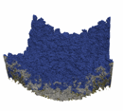

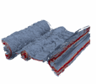
Performance: OSPRay vs. GPU (OpenGL)
Frames Per Second (higher is better), 1024x1024 image resolution
Intel® Xeon® Processor E5-2699 v3
2 x 18 cores, 2.3 GHz
ParaView 5.2.0 RC2 w/ OSPRay 1.1.0
NVIDIA* Driver 370.28, default configuration
Source: Intel
Software and workloads used in performance tests may have been optimized for performance only on Intel microprocessors. Performance tests, such as SYSmark* and MobileMark*, are measured using specific computer systems, components, software, operations and functions. Any change to any of those factors may cause the results to vary. You should consult other information and performance tests to assist you in fully evaluating your contemplated purchases, including the performance of that product when combined with other products. For more information go to http://www.intel.com/performance.
Notes:
Key things to note here is
This is Ray traced (ie. higher fidelity up to photorealistic rendering via real-time modeling of “light”) vs. standard GPU “OpenGL” rasterization (ie. approximations, pre-baked lighting, less flexible)
Yes, for tiny/small amounts of data a GPU using OpenGL can outperform (in framerate) but falls over as sizes grow.
Note that Ray traced rending maintains framerate at interactive levels even as the size of the data increases
Eventually as the data approaches the GPU memory limit, it simply fails/crashes while OSPRay can scale up to the CPU DDR memory and then beyond with OPA/MPI

Slide 42
Intel® Xeon Processor Configuration
Node count | 1
Platform
CPU | 2 x Intel® Xeon® E5-2699 v3 Processor (Dual socket, 2.3GHz, 2 x 18 cores)
RAM | 256 GB total
BIOS | Vendor: Intel Corporation Version: Release Date: BIOS Configuration: default, turbo on, hyper-threading on
NVIDIA Co-Processor | NVIDIA* TITAN X (GP102) 3584 CUDA Cores 12GB GDDR5X memory Software Details: Driver Version 370.28 default config
OS / Kernel | CentOS release 7.2.1511 / 3.10.0-327.36.2.el7.x86_64
* Other names and brands may be claimed as the property of others.

Slide 43
SDVIS SOUNDS GREAT….BUT....
HOW DO I GET STARTED?

Slide 44
A TURNKEY SDVIS APPLIANCE SOLUTION
For:
In Situ Compute+Vis!; Vis Walls up to 6 UHD Displays; HPC Compute, Vis+HPC SW Development and EVEN Post-Processing Vis

Slide 45
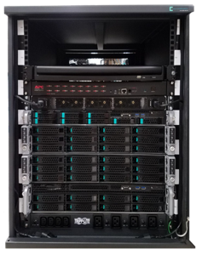
Announcing the Turnkey SDVis Appliance!
Improving Data Visualization with Intel® Solutions
Optimizing for Visualization
Optimized for parallel processing and latest instruction sets
OpenSWR, Embree, & OSPRay all available
Used by ParaView, VisIt, VMD, CEI EnSight, and more…
Reducing Cost for Visualization
Lower cost of host vs cost of host + card for GPUs
Single host can address up to 384GB memory
Additional use as general purpose compute platform
Pre-Configured Appliance Solution Available Now
1.58x to 1.91x better performance than GPUs¹
Supports data sets up to 1.5TB
Standard configuration price $79,000²
More Info: http://sdvis.xeonphi.com/
  For in-situ, post-processing, and professional rendering visualization needs
*Other names and brands may be claimed as the property of others.
²Pricing as of June 15, 2017. Pricing is subject to change without notice
¹Software and workloads used in performance tests may have been optimized for performance only on Intel microprocessors. Performance tests, such as SYSmark and MobileMark, are measured using specific computer systems, components, software, operations and functions. Any change to any of those factors may cause the results to vary. You should consult other information and performance tests to assist you in fully evaluating your contemplated purchases, including the performance of that product when combined with other products. For more complete information visit www.intel.com/benchmarks. Source: Intel measured or estimated as of May 2017. See slide 7 for performance measurements. Configuration Details: See slide 5.
Notes:
The SDVis Appliance offers a pre-configured solution for in-situ, post-processing, and professional rendering visualization tasks. It does this with higher performance and a lower cost than competing GPU-based solutions. It can support visualization of data sets up to 1.5TB in size. To find out more use the above information to get pricing, availability, and more details.

Slide 46
SDVis Appliance Solution
Appliance Configuration
Installed Software Intel® HPC Orchestrator, SDVis Software (ParaView, VTK, VisIt, VMD), Intel® Parallel Studio Cluster Edition, SW Dev. Tools
Nodes 8x Intel® Xeon Phi™ 7250 compute nodes, Intel® Xeon® E5-v4 head node, Intel® Xeon® E5-v4 storage node
Storage 32TB Raid
Network 24 port Omni-Path & Ethernet switches
SDVis Appliance
Master
Head Node
Node + Display Management
Software: CentOS 7.3, HPC Orchestrator
Hardware: 1 CX-87723 Intel® Xeon® Node
Intel® Xeon ® E5-v4 36 cores, 256GB DDR4, OPA HFI, Up to 6 4K Monitors Display Card, SSD 480GB
Compute Nodes
Compute +
Render
Software: CentOS 7.3, SDVis Software (ParaView, VTK, VisIt, VMD), Intel Parallel Studio Cluster Edition, SW Dev. Tools
Availability & Pricing
Available 4 weeks after ordering
Price $79,000 (1 year SW subscriptions)¹
Hardware: 8 CX-87719 Intel® Xeon Phi™ Nodes
Intel® Xeon Phi™ 7250 68 cores, 192GB DDR4, Intel® OPA HFI, SSD 150GB
Storage System
Software: CentOS 7.3
Hardware: 1 CX-87794 Intel® Xeon® Node
Intel® Xeon ® E5-v4 16 cores, 64GB DDR4, Intel® OPA HFI, 32TB RAID
Ordering & More Info
sales@colfax-intl.com
http://sdvis.xeonphi.com/
Networking
OPA/100G Ethernet
Hardware: 24 Port OPA Edge Switch, 16 Port Ethernet Switch
  Pre-configured solution for visualization needs
*Other names and brands may be claimed as the property of others.
¹Pricing as of June 15, 2017. Pricing is subject to change without notice
Notes:
The SDVis Appliance (Software Defined Visualization Appliance) includes all the necessary software for visualization including SDVis Software (ParaView, VTK, VisIt, VMD), Intel® Parallel Studio Cluster Edition, and software SW Development Tools. It also includes the Intel® HPC Orchestrator management software. It has 1 Intel® Xeon® management node, 1 Intel® Xeon® storage node, and 8 Intel® Xeon Phi™ compute nodes. It has 32TB RAID for storage and includes a 24 port Intel® Omni-Path switch and a 24 port Ethernet switch. Use the contact information to get availability, pricing, and more details.

Slide 47

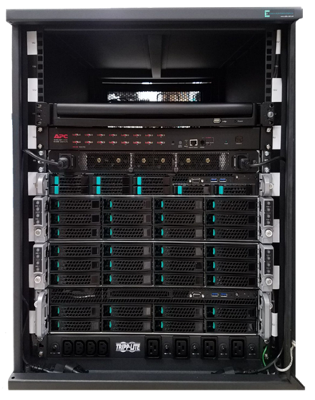
SDVis Appliance
Available Now!
Includes all the necessary software for visualization and rendering, node management, and software development
Address up to 1.5TB data sets using 8 Intel® Xeon Phi™ 7250 68 core compute nodes
Intel® Xeon® E5-v4 36 core management node
Intel® Xeon® E5-v4 16 core storage node with 32TB RAID storage
Features Intel® Omni-Path interconnect fabric
The SDVis Appliance is more than just a good idea, it is available now from Colfax International. For more information use the links below.
Product Webpage:
http://sdvis.xeonphi.com/
Sales Contact:
sales@colfax-intl.com
14U Rack
Software: SDVis Software (ParaView, VTK, VisIt, VMD), Intel® Parallel Studio XE Cluster Edition, Intel® HPC Orchestrator, SW Dev. Tools
24 port Ethernet Switch
24 port Intel® Omni-Path Switch
Intel® Xeon® Management Node
4x Intel® Xeon Phi™ Compute Nodes
4x Intel® Xeon Phi™ Compute Nodes
Intel® Xeon® Storage Node (32TB RAID)
Power Distribution Unit

Slide 48
Some SDVis Examples

Slide 49
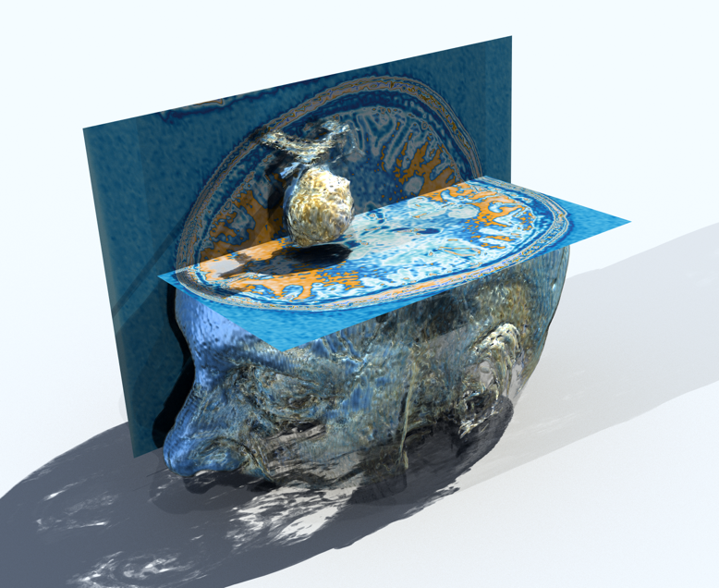
ParaView v5.x with integrated OSPRay and OpenSWR
Brain Tumor monitoring and treatment
3D interactive @ 10-20fps
Intel® Xeon Phi™ processor cluster
Ambient occlusion plus shadows
Shown Live at Intel SC’16 booth
Data courtesy Kitware. Visualization, Carson Brownlee, Intel

Slide 50
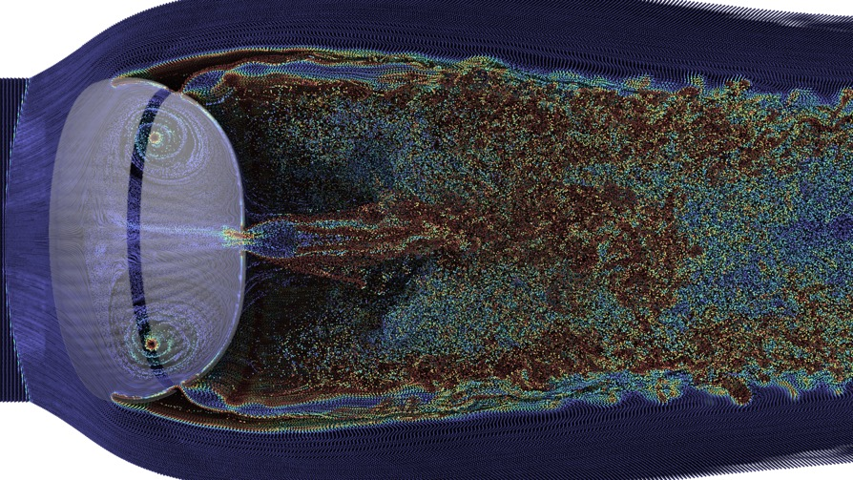
NASA – Custom OSPRay App
Rendered on Pleiades supercomputer attached Vis wall cluster
dataset: parachute; simulation: Dr M. Barad, NASA Ames; visualization: Tim Sandstrom, NASA Ames

Slide 51
Stephen Hawking Centre for Theoretical Cosmology –
ParaView / VTK with OSPRay
600 GB Memory Footprint
36 TB Simulation Data Set
4 Intel® Xeon Phi™ 7230 Processors
1 Intel® Xeon® E5 v4 Dual Socket node
Intel® Omni-Path Fabric
~10 fps
Gravational Waves : GR-Chombo AMR Data, Stephen Hawking CTC, UCambridge; Queens College, London; visualization, Carson Brownlee, Intel)

Slide 52
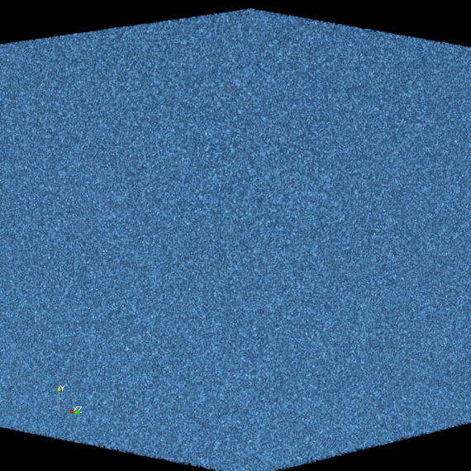
Stephen Hawking Centre for Theoretical Cosmology –
‘Walls’ in situ with OSPRay Rendering
10 TB Memory Footprint
SGI UV-300 16TB SMP
>1000 Shared memory Intel® Xeon® E5 v3 processors
~15 fps
Domain Wall formation in the universe from Big Bang to today (13.8 billion years)
Simulation code by Shellard et al, Visualizaiton by Johannes Gunther (Intel)

Slide 53
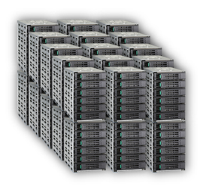




Summary:
Software Defined Visualization Is For
Big Data’ Vis Analysis software.intel.com/sdvis ; www.sdvis.org
Addresses ever-growing HPC challenges for data size, flexibility, reliability and maintainability
OpenSWR, OSPRay and Embree rendering libraries optimize use of CPUs and main memory
Integrated into prominent Vis tools, ParaView*, VisIt, EnSight*, VMD, Brayns, VL3, and more …
In-Situ Analysis will be required for Exascale, SDVis is ready now to enable it!
SDVis = Performance, Fidelity and Lower Cost!!

Slide 54
More info?
https://software.intel.com/sdvis
https://www.ixpug.org/
http://sdvis.xeonphi.com
james.l.jeffers@intel.com

Slide 57
Legal Notices and Disclaimers
Intel technologies’ features and benefits depend on system configuration and may require enabled hardware, software or service activation. Performance varies depending on system configuration. No computer system can be absolutely secure. Software and workloads used in performance tests may have been optimized for performance only on Intel microprocessors.
Performance tests, are measured using specific computer systems, components, software, operations and functions. Any change to any of those factors may cause the results to vary. You should consult other information and performance tests to assist you in fully evaluating your contemplated purchases, including the performance of that product when combined with other products.
Copyright © 2017 Intel Corporation. All rights reserved. Intel, Intel Inside, the Intel logo, Intel Xeon and Intel Xeon Phi are trademarks of Intel Corporation in the United States and other countries. *Other names and brands may be claimed as the property of others.
Copyright © 2017 Intel Corporation, All Rights Reserved

