Slide 1
Provenance as a diagnostic tool for workflow performance evaluation
Line Pouchard, Abid Malik, Huub Van Dam, Cong Xie, Wei Xu, Kerstin Kleese Van Dam
Notes:
The purpose of this effort and the main point I want to demonstrate is that provenance can be a very useful diagnostic tool to evaluate and improve the performance of workflows in scientific codes and facilitate code optimization during development in extreme-scale environments, such as the Department of Energy Leadership computing facilities.
This work is part of the DOE Extreme Scale Program CODAR: Center for Online Data Analysis and Reduction, and ECP Co-design center.
The goal is … but in fact the research challenge is ….
Feedback from Kerstin:
Motivation, clear example, no one done before
Heat equation
End a team slide as to who does what?
Examples
Perf capture
Scripts
Visualition who does what?
Where people contribute in the process
She and Robert can talk about it afterwards

Slide 2
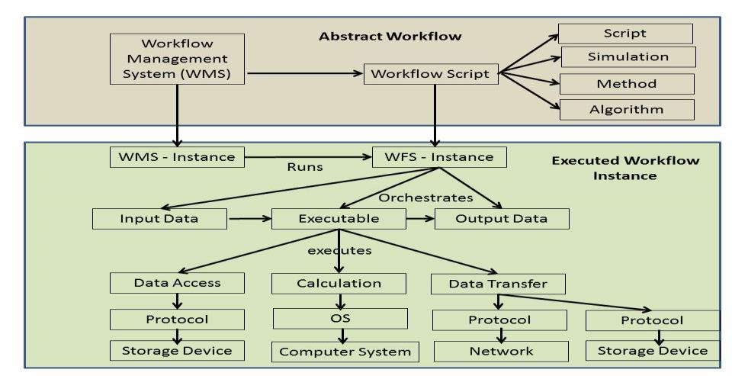
Workflow complexity and ecosystem
Workflows are complex, utilize shared resources, and mix programming models
Usage of shared resources can introduce further complexities
Reference: Kleese van Dam, K., et al., Enabling Structured Exploration of Workflow Performance Variability in Extreme-Scale Environments, Proc. 8th Workshop in Many-Task Computing on Clouds, Grids, and Supercomputers (MTAGS) collocated with SC 2015. DOI: 10.13140/RG.2.1.3311.9127
Notes:
We define workflows as the set of computational tasks and dependencies needed to carry out in silico experiments, so a large inclusive definition
Scientific workflows play an important role in helping scientists coordinate complex tasks and take better advantage of their computing resources by decoupling the composition of tasks from workflow instance executions and their actual environment. Popular scientific workflows managements systems such as Kepler and Pegasus do this.
Workflows are complex and can have 1000s of components. They utilize shared resources, and can mix programming models. As a result, the performance of each individual component can affect overall performance of a workflow. Usage of shared resources can introduce further complexities
(Taylor, Deelman, Gannon, & Shields, 2006).

Slide 3
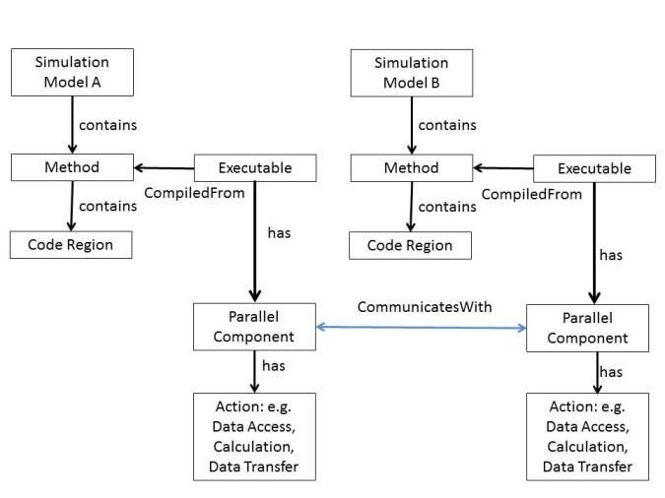
Interdependencies between parallel components at runtime
Performance of each individual component can affect overall performance of a workflow
Performance metrics are measurements from workflow and system resources
Notes:
Interdependencies between parallel components at runtime render the study of workflows and of workflow performance even more complex.
So we take a provenance-based approach that allows us to collect performance metrics for workflows in their execution context and runtime environment. This approach allows us to relate the performance metrics obtained for individual workflow components to provenance characteristics.
And we saw yesterday in Shantenu’s talk the runtime fluctuations that can be obtained in ensemble simulations in distributed execution contexts. In adaptive execution, changes are made to the task graph during run-time on the base of results generated during executed sections of the task-graph.
Adaptive execution motivates the need to extract and store provenance for future querying

Slide 4
Challenges for studying workflows
Real-time monitoring of scientific workflow processes
to validate performance and support reproducibility
Defining the appropriate level of abstraction for monitoring workflows given:
the number of components
the complexity of the connections
the rate of execution for each component
Performance tools extract metrics for single applications, not workflows
Notes:
Some high-level challenges when studying the performance of workflows include:

Slide 5
Basic workflow example: heat transfer equation
Notes:
In our pilot, the heat transfer equation for fusion is implemented as a 2-component workflow running on n processors: one component calculates the equation, and the second one implements a staged write function – the first component includes the performance metrics and I/O data reduction through ADIOS. This equation was developed at Oak Ridge.

Slide 6
Provenance of workflow performance
The provenance that captures and correlates traditional provenance characteristics and performance metrics data.

Slide 7
Provenance of performance in complex workflow examples
In-situ data reduction and analysis at exascale
Questions - what analytics can I do, where to place the analytics, what are the trade-offs, are there performance tipping points?
Streaming data analysis and steering for experiments
Questions - what workflow can I complete in time, how many resources do I need, what resources do I need, what decisions did I make and how did this impact performance?
Evolving Workflows
Questions - Is my workflow getting better, which trade offs do I see, why do I see changes in performance, what are the sources of performance variability?
Notes:
Here are some questions that we can ask to the provenance of performance in complex workflow examples. For instance,
In response to the challenges outlined earlier and in order to bring elements of response to exploring the performance of workflows, we designed an experiment that includes
1) a Use Case from NWChemEx, a set of scientific codes for simulating the dynamics of large scale molecular structures and material systems on large atomistic omplexes
2)the Workflow Performance Provenance Ontology WFPP
3) performance monitoring tools
and 4) an integrated provenance framework with performance visualization

Slide 8
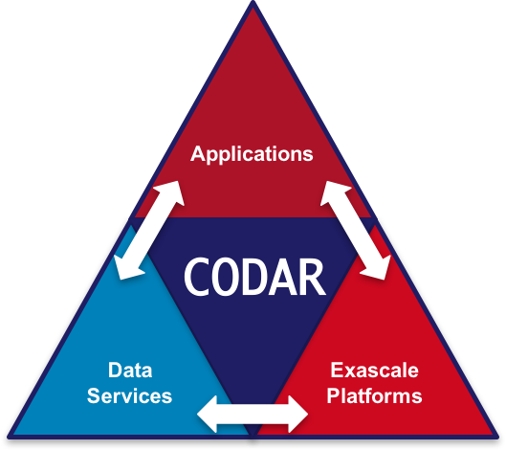
A new use case for NWChem using workflows
1) NWChemEX runs MD in parallel and produces a trajectory
2) Another component analyses the trajectory concurrently
3) This is important during development phase to trace code and system evolution together with performance changes
4) Also important to evaluate performance portability
5) We added code instrumentation to enable performance metric capture for the communication between workflow components
MD
Analysis
Notes:
An important component of the NWChemEx project is to demonstrate scalability on the future exa-scale platforms as well as performance portability and of course efficient use of resources. These characteristics will be captured in, so called Key Performance Parameters (KPP). The parameters will be measured on the current code and on the new NWChemEx code and set levels of improvement must be met for the project to be successful. Obviously this requires tracking which codes are being compared, for which information on the SVN branches and revision numbers, time compiled, and time started are important.
As problems can originate in any of these components it is important to capture information not only about the code itself but also information that can be correlated with the state of the computing platform. In addition to measure the impact of the code development work the time taken by different code regions or workflow components is crucial as changes there will be related to changes in the algorithms or their implementations. Even in cases where the total volume of compute does not change significantly improvements may be obtained by better distributions of the workload hence imbalance in the workload is important to track.
Communication, whether by message passing, through files, or yet some other mechanism are always critical to the parallel performance of a code. In all these cases it is essential to record these performance characteristics in such a way that improvements in a code’s performance can be attributed to particular coding efforts. This is required to ensure that modifications that successfully improve the performance are selected and kept on the basis of solid empirical evidence for improved performance.

Slide 9
Workflow Performance Provenance ontology (WFPP)
Specifies provenance indicators
Specifies performance metrics
Specifies relationships between the two
Is used to instantiate metrics of interest
Translate the information coming out of various tools and data files into common names
Contains annotations of what some variables may mean
Notes:
Output map to the metrics we want to capture: this is what we would get and show how it relates to what we want to capture:
So we can show the results of several runs over time: how coders have developed, system info, and perf has developed

Slide 10
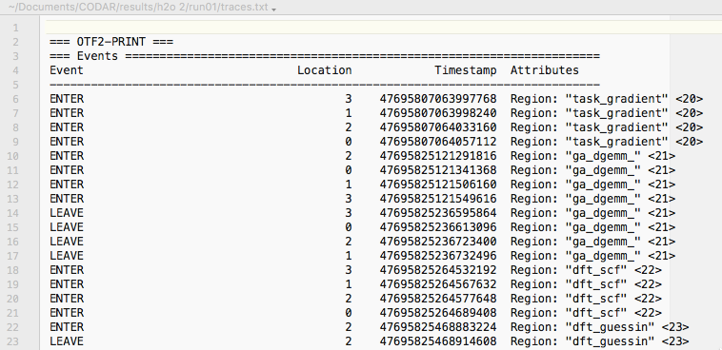
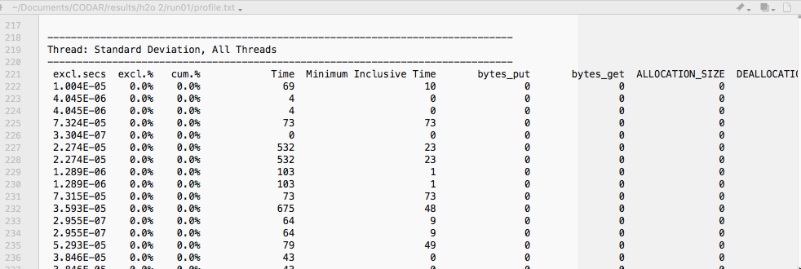
Performance tools need to be extended to extract metrics for workflows
Notes:
Text files are Trace and profiles for nwchem runs

Slide 11
Job information missing from performance tools
Application Name
Northwest Computational Chemistry Package (NWChem) 6.6
hostname = hpc1.csc.bnl.gov
program = ../../../../bin/LINUX64/nwchem
date = Fri Feb 3 10:56:28 2017
compiled = Wed_Feb_01_22:15:51_2017
source = /home/hvandam/scorep/nwchem-dev
nwchem branch = Development
nwchem revision = 28991
ga revision = 10147
input = ../h2o.nw
prefix = h2o-dat.
data base = ./h2o-dat.db
status = startup
nproc = 4
time left = 2390 s
StartTime
Version
Time Allocated
Notes:
All of it is needed but it’s not granular enough

Slide 12
Provenance relates changes in performance to changes in software and system
Performance Metrics
Provenance characteristics
Start/End Time
Number of Calls
I/O Read and Write
Memory usage
Communication Time
Interconnect Performance
Application names, versions
Input data
Use Cases, Job configuration
Host names, architectures
System software stack
Decisions
Notes:
Start end time for entire workflow, workflow component, subroutines
Instrumentation in the code
System information
Job information
In/output files
Depends on the application and/or workflow

Slide 13
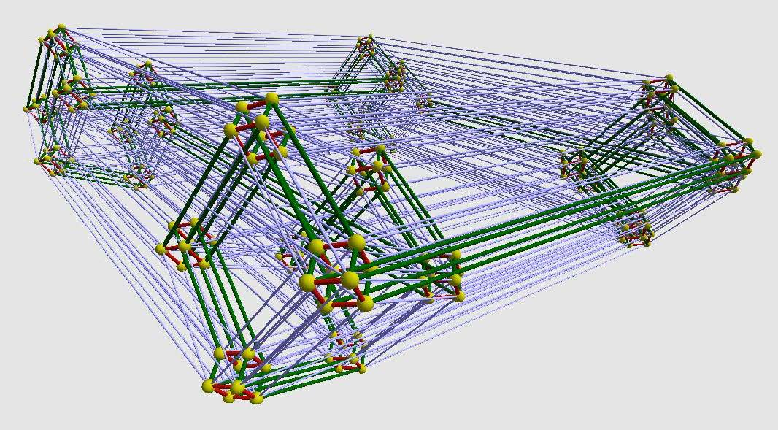
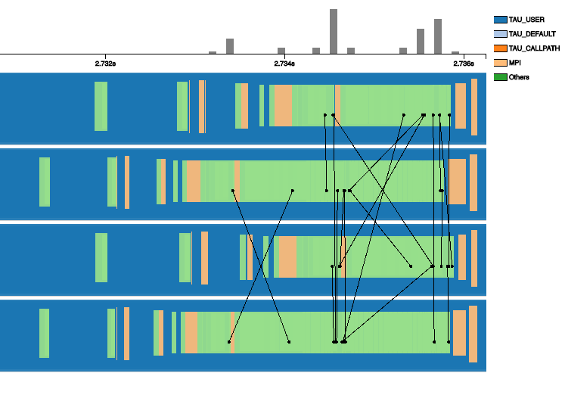
Chimbuko provenance framework
A unique capability to capture, analyze and visualize workflow performance evolution over time
Systematically captures, stores and correlates provenance and performance metrics of workflows and systems
Ability to plug in various performance tools incl. ECP Tuning and Analysis Utilities
Instantiates the WFPP Workflow Performance Provenance ontology to describe metrics
LQCD
Performance Analysis
Information Extraction and Wrapping
Hybrid data stores
Analysis
Notes:
Performance metrics are made explicit and usable across several applications and architectures
Visual Analytics interface to query and display workflow performance
New information system wrappers are developed to instrument code and extract meaningful metrics
ProvEn system: Harvester + hybrid data store consisting of a triple store and a times series database
Chimbuko framework includes:
(1) ability to plug in different performance collection tools (incl. TAU),
(2) capability to label collected metrics to attribute them correctly to different workflow components or critical code regions of specific components,
(3) ability to collect provenance information to trace changes in the application or system environment,
(4) capability to correlate performance information collected for different workflow components,
(5) Ability to store performance metrics and provenance in support of larger performance studies,
(6) Ability to visualize and visually query performance information;
(7) Initial set of performance analysis algorithms developed that can identify event of interest in large volumes of performance data

Slide 14
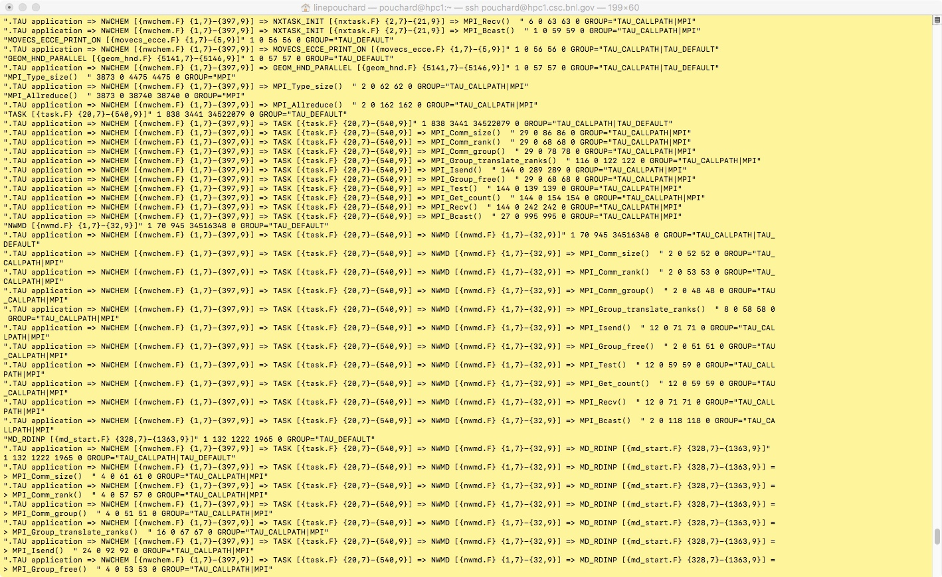
Profile of NWChem workflow example
Notes:
These metrics were obtained by executing the dynamics and analysis concurrently for an NWChem MD calculation in an attempt to simulate a concurrent workflow situation. The MD calculation loops until a trajectory file appears. At that point the analysis workflow is started.
This is the output for the reduced trace:
# MD time steps: 220 (not 320) on 4 cores
MD wall clock time: 38.0 seconds
# Analysis time steps: 100 on 1 core
Size of binary trace file: 224 MB
Size of text trace file 777 MB
Also the instrumentation was reduced to include only the main MD and analysis routines. Thereby making the trace file much smaller.
A trace file was obtained; the size of this Trace file is 224MB in binary format, 812MB in text format, and represents a classical MD run of 320 timesteps on 4 cores as well as the corresponding analysis of 100 timesteps on 1 core. From start to finish the MD run took 38.0 seconds wall clock time. In addition the program was compiled to suppress the instrumentation of all subroutines apart from the main MD and analysis routines.

Slide 15
Chimbuko information management system
Workflow starts
Workflow ends
Information summary
C5
TAU wrappers coalesce independent component information in JSON format
C4
C3
C2
C1
Information dumping using TAU Infrastructure
Chimbuko Extract and Wrap Layer
Notes:
In terms of the progress that we have done so far:
It is now possible to save Profiles/Traces for each component in separate directories
Performance metrics are defined and extracted for each component and associated to their provenance
Single Application: An application that doesn’t have any stream of computation
Workflow application: An application that have at least one stream of computation
Swift + ADIOS: Using SWIFT + ADIOS (Workflow application)

Slide 16
Information summary for the heat transfer equation
Total Execution Time
mpi communication
idle time as mpi barriers
Notes:
execution times are in seconds?
Idle time is time spent in mpi barriers, also in seconds?
what is the unit of communication volumes?
Again, is it only mpi communication here?
The gain for a scientific user is the usability of the information, as more details of the performance metrics are extracted and presented in dynamic multi-level visualization.

Slide 17
The video presentation illustrates the visualization component of the Chimbuko framework characterizing the provenance of workflow performance at scale. Chimbuko provides a multi level-of-detail visualization for trace events and message generated by the TAU performance analysis tools
Notes:
The total volume of trace data visualized here is 16 TB.
The zoomed-in area contains about 20,000 trace events and 96 messages.
node 4 only have 12 events that start happening around time 6.13 seconds -
very sparse on node 4
the tracing between node 4 and the other nodes is not implemented yet
# MD time steps: 2200 on 4 cores
# Analysis time steps: 1000 on 1 core
Everything fully instrumented
Size of binary trace file 2410 MB
Size of text trace file 15975 MB
Wall clock time of MD: 309.3 second

Slide 18
Notes:
nodes 0-3 has 247816 trace events
zoomed-in area: about 20,000 trace events - 96 messages -
node 4 only have 12 events that happen around time 6.13 seconds -
very sparse on node 4
the tracing between node 4 and the other nodes is not implemented yet
# MD time steps: 2200 on 4 cores
# Analysis time steps: 1000 on 1 core
Everything fully instrumented
Size of binary trace file 2410 MB
Size of text trace file 15975 MB
Wall clock time of MD: 309.3 second

Slide 19
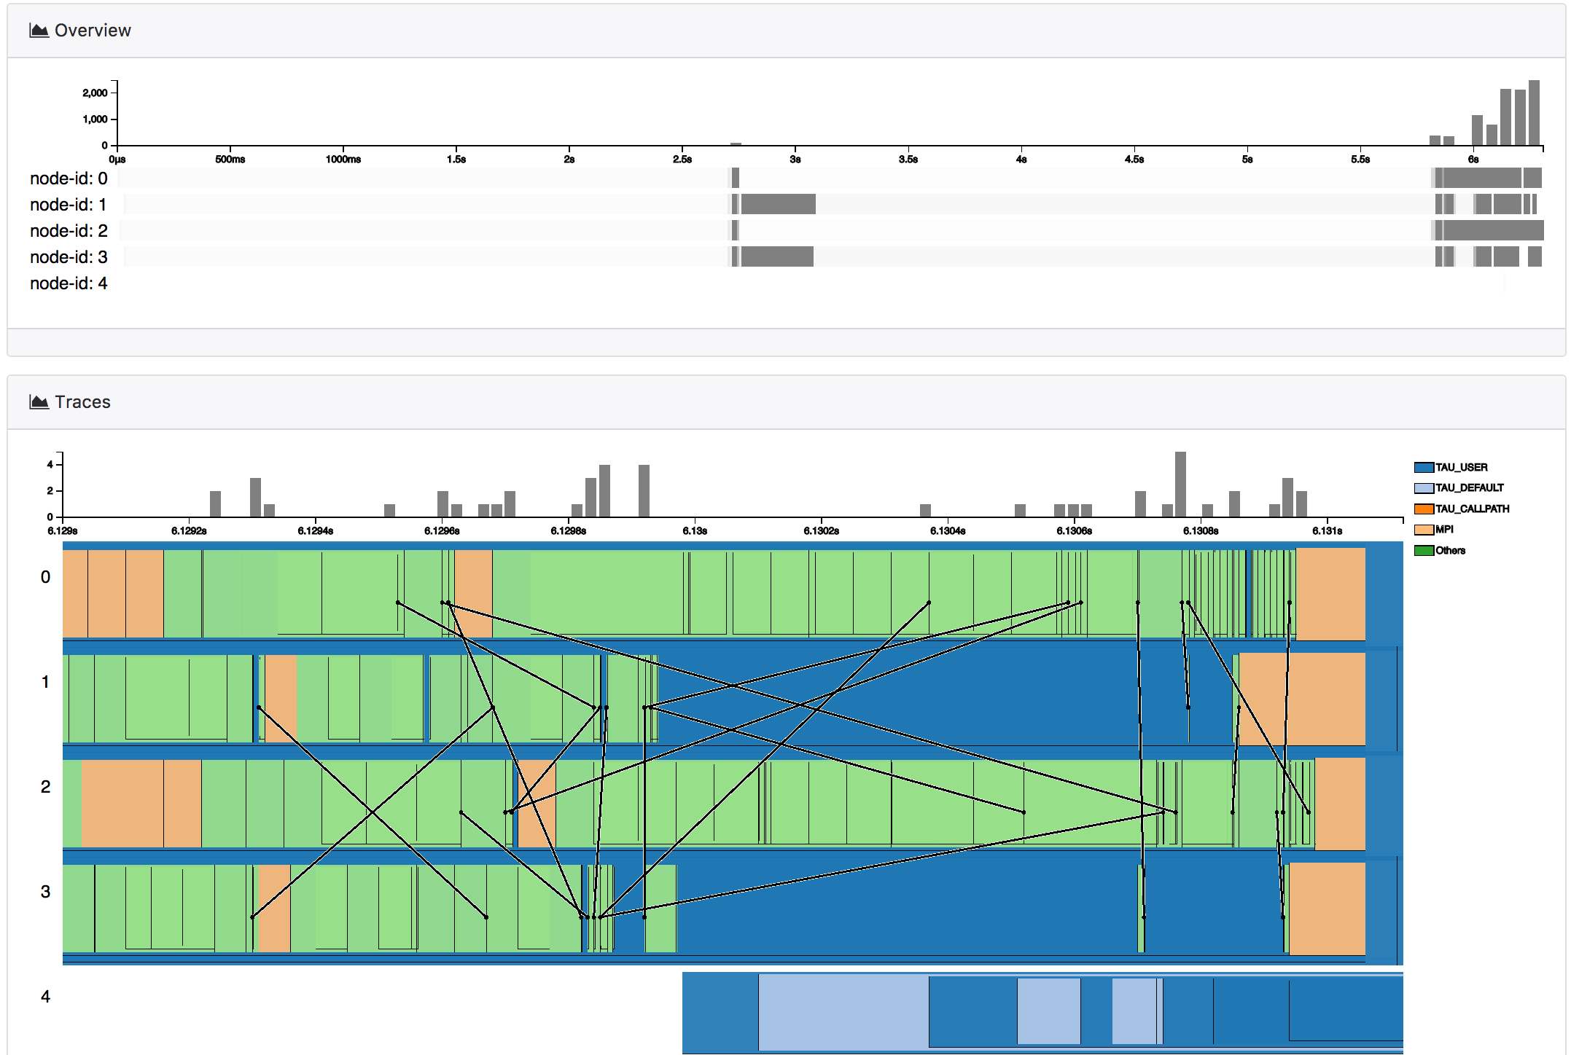
Detailed traces at time 6.12 s

Slide 20
Applications of performance provenance in scientific workflows
Detect and diagnose performance bottlenecks at scale
Detect and diagnose contention for resources within your own workflow
Compare code versions and code regions w.r.t. performance
Improve code design by profiling new code versions
Detect patterns in performance
Combine with data reduction to profile application composition
Notes:
Provenance is increasingly important for in silico experiments seeking reproducibility of results and portability of code with performance

Slide 21
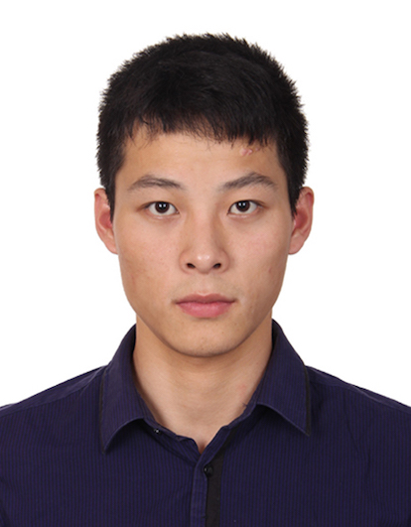
Provenance takes a team approach
Line Pouchard
Provenance
Computational
Scientists
Application
Scientists
Abid Malik
Infrastructure
Data
Scientists
Wei Xu and Cong Xie
Visualization
Kerstin Kleese Van Dam
Provenance
Huub Van Dam
NWChemEx

Slide 22
Thank you
This manuscript has been authored in part by employees of Brookhaven Science Associates, LLC under Contract No. DESC0012704 with the U.S. Department of Energy. The publisher by accepting the manuscript for publication acknowledges that the United States Government retains a non-exclusive, paid-up, irrevocable, world-wide license to publish or reproduce the published form of this manuscript, or allow others to do so, for United States Government purposes.
This research was supported by the Exascale Computing Project (ECP), a collaborative effort of two DOE organizations – the Office of Science and the National Nuclear Security Administration. The Project Number for the Co-design center for Online Data Analysis and Reduction (CODAR) that supported this research is 17-SC-20-SC.

Slide 23
Additional slides

Slide 24
Trace overview
Y axis: count of message events: sending and receiving
Node 4 has no data for this time segment
Notes:
How it was produced: 16 GB trace file from NWChem
start time and end tine of anay function call
a classical MD run of 320 timesteps on 4 cores as well as the corresponding analysis of 100 timesteps on 1 core. From start to finish the MD run took 38.0 seconds wall clock time. In addition the program was compiled to suppress the instrumentation of all subroutines apart from the main MD and analysis routines.

Slide 25
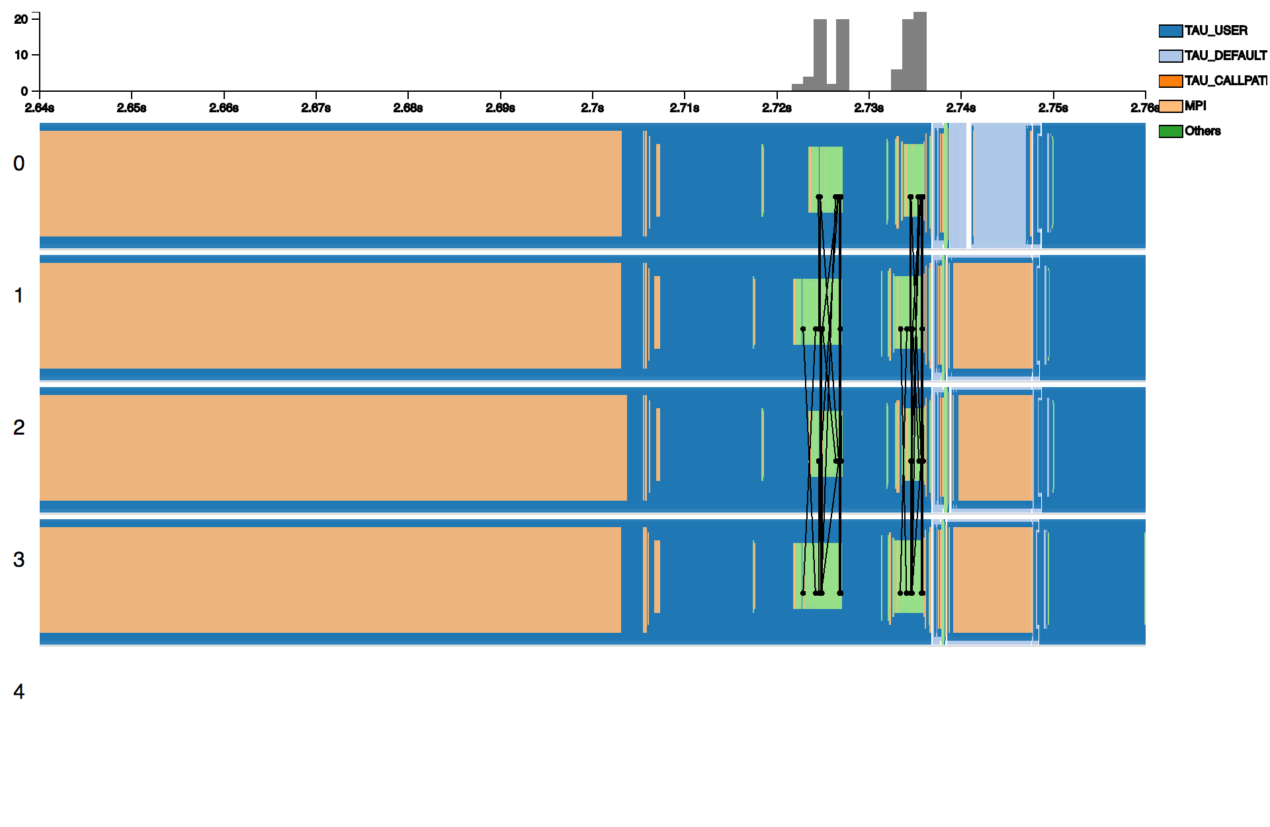
Traces
Notes:
why is other the interesting area? these are the fucntions in the trajectory calculation
mpi_init

Slide 26
Trace details
Notes:
Detailed view shows the function calls and the messages in the selected time range. The functions are visualized with nested rectangles that indicate their depths in the call path. We use different transparency for overlapped functions. They are colored according to different call groups. Additionally, we visualized the message passing (send and receive) between functions.
The user can further zoom in in this view to obtain a zoom-in effect. In this mode, we add the stroke of the rectangle to enhance the separation of different functions.

Slide 27
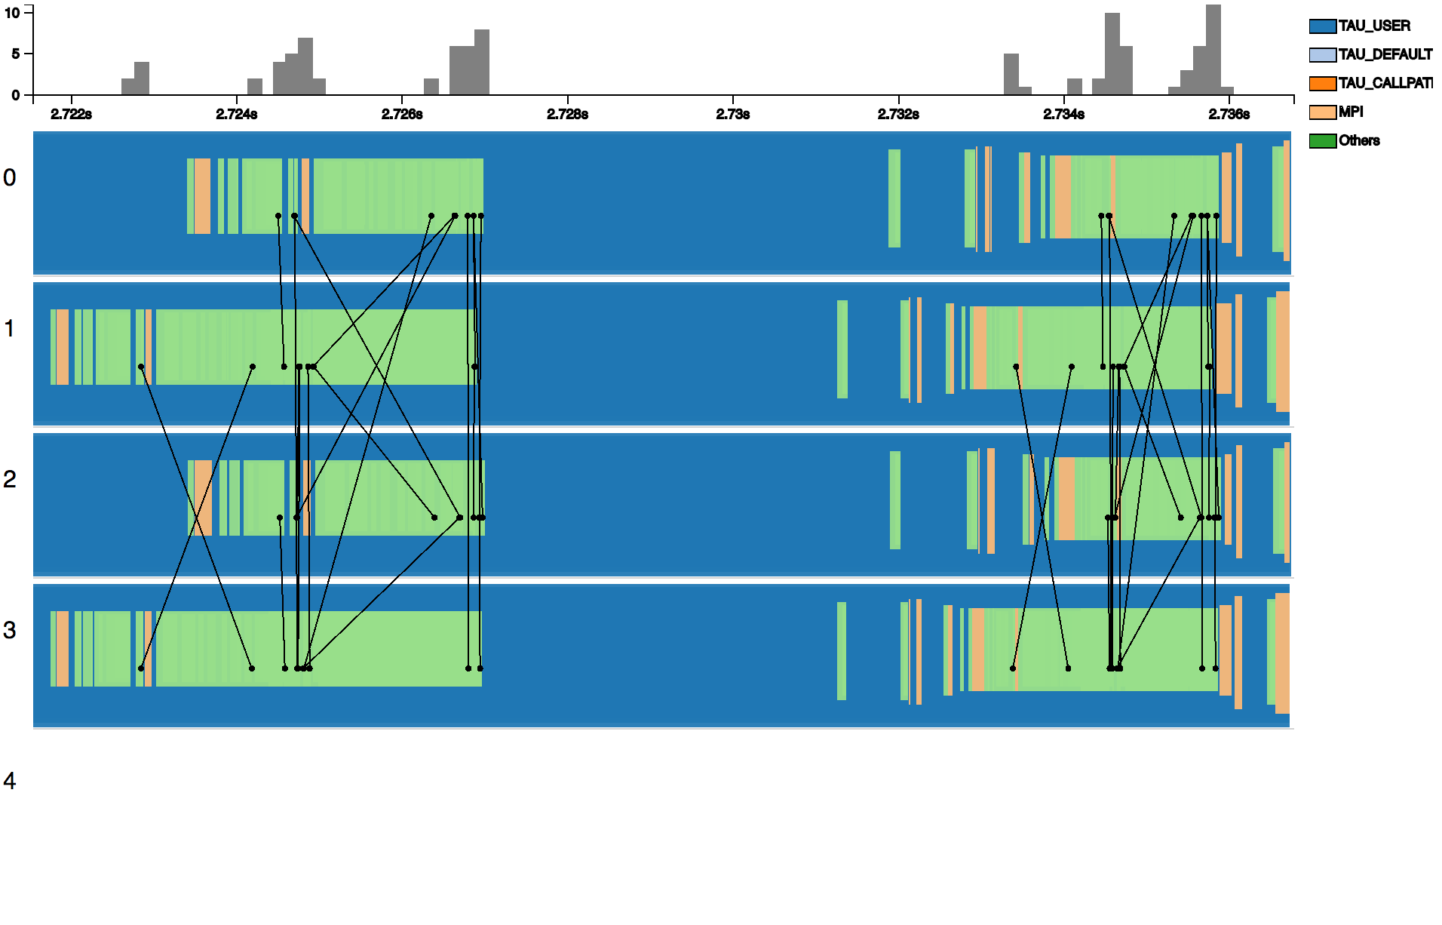
Zooming 1

Slide 28
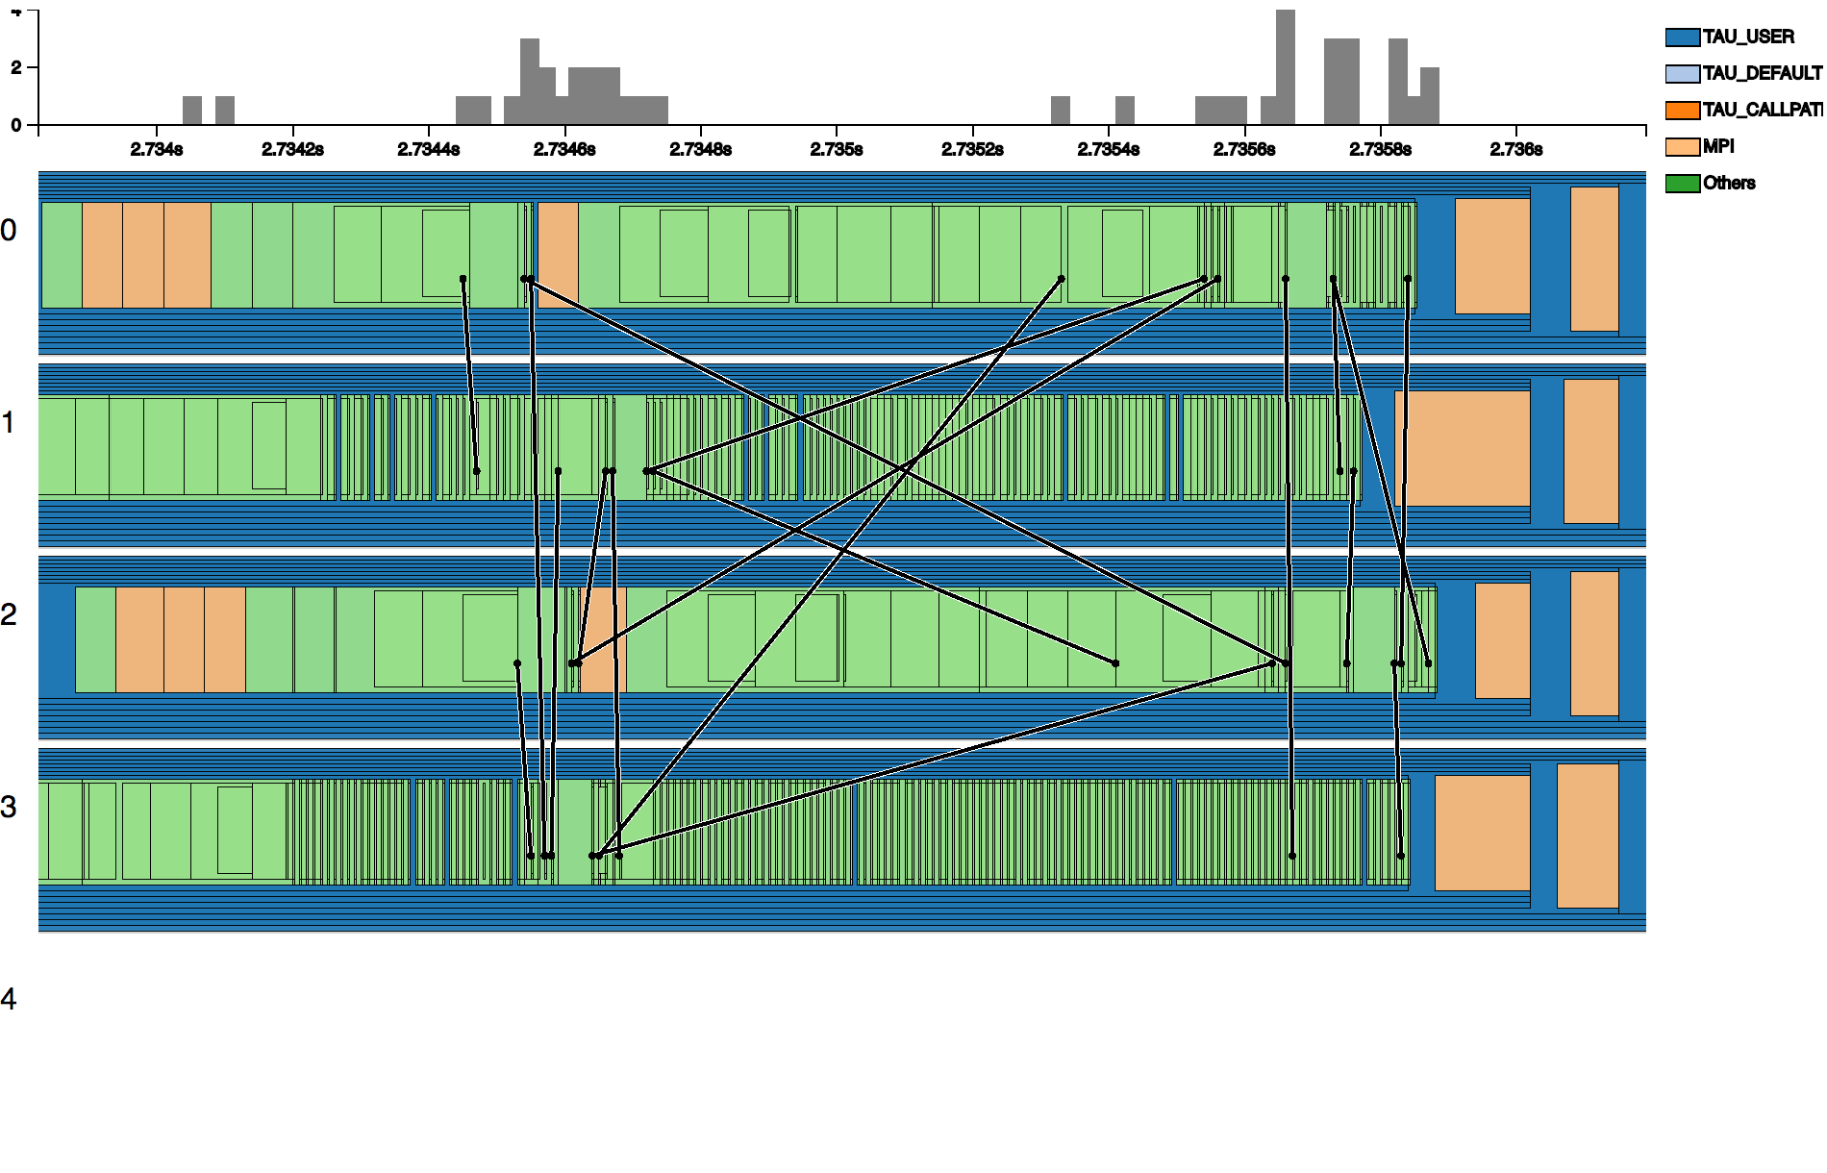
Zooming 2
Notes:
each black border is a function call
others: detailed functions with diff names

Slide 29
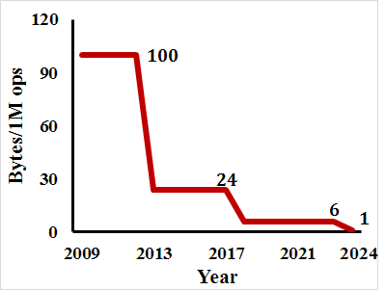
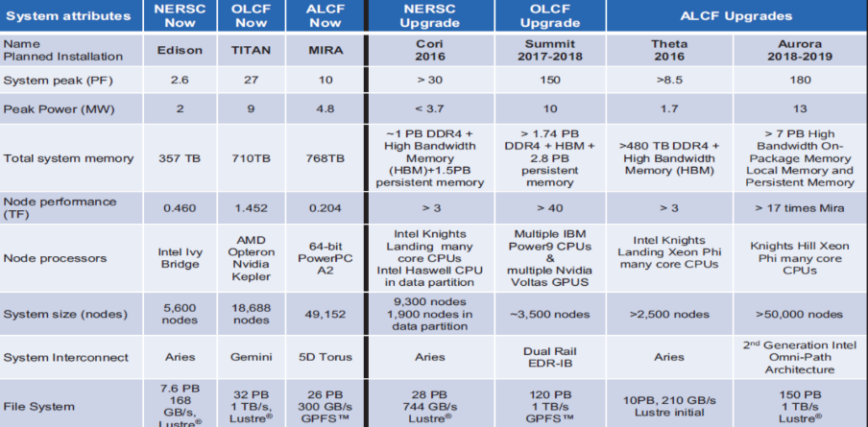
The compute-data gap is a major challenge for exascale
Filesystem/network bandwidth falls behind CPU/memory: Fewer bytes/operation
Swap I/O for CPU cycles:
Data (de)compression
Online data analysis
Right bytes in right place at right time!
Applications are already demanding 100 PBs of data for ‘medium-term’ (12 months)

Slide 30
Workflows as directed acyclic graphs
Wf
Component
1
Wf
Component
1.1
Wf
Component
1.n
Wf
Component
2
Wf
Component
2.1
Wf
Component
2.2
Wf
Launch
ID
Trace
File
ID
Wf
Component
n
Wf
Component
n.1
Profile
The set of computational tasks and dependencies needed to carry out in silico experiments
Notes:
We define workflows as the set of computational tasks and dependencies needed to carry out in silico experiments. Scientific wfs play an important role in helping scientists coordinate complex tasks and take better advantage of their computing resources by decoupling the composition of tasks from wf instance executions and their actual environment. Popular scient wfs managements systems such as Kepler and Pegasus do this.
In mathematics and computer science, a directed acyclic graph (DAG /ˈdæɡ/ ( listen)), is a finite directed graph with no directed cycles. That is, it consists of finitely many vertices and edges, with each edge directed from one vertex to another, such that there is no way to start at any vertex v and follow a consistently-directed sequence of edges that eventually loops back to v again.
definition of wfs:
(Taylor, Deelman, Gannon, & Shields, 2006).
(AI Buzzwords explained: Scientific Workflows. D Garijo, AI Matters, 3:1, 2017)

