Slide 1
A Scientific Data Provenance Harvester for Distributed Applications
Eric Stephanª, Todd Elsethagen^{a,},Carlos Gamboa^{B}, LINE POUCHARD^{B} ,BIBI RAJUª
^{A} Pacific Northwest National Laboratory
^{B} Brookhaven National Laboratory

Slide 2
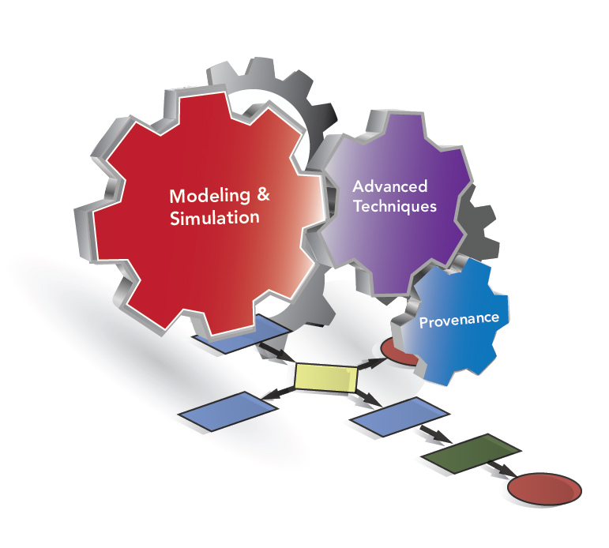






IPPD: Integrated Performance Prediction & Diagnosis
Aim to provide an integrated approach to the modeling and analysis of extreme scale scientific workflows
Brings together researchers working on modeling / simulation / empirical analysis, workflows and domain scientists
Builds upon existing research much of which has focused to date on large-scale HPC systems and applications
  Explore in advance – Design-space exploration & Sensitivity Analyses
  Optimize at run-time – Guide execution based on dynamic behavior

Slide 3
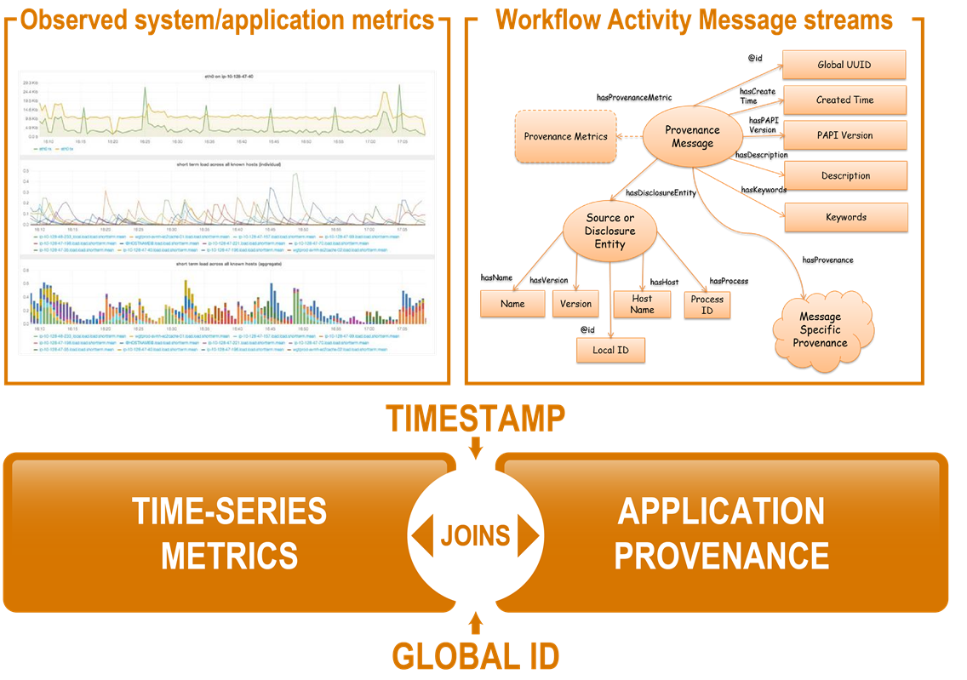
IPPD’s ProvEN supports large-scale workflows
The Provenance Environment (ProvEn) extends classical provenance concepts to incorporate metrics, handle scalability, and undertake analytics to support large scale science workflows.
ProvEn is capable of capturing metrics and provenance in multiple forms.
Information on
  Workflow components
  System resources
  Time-series data
Federation of Provenance
and metrics using
timestamps or identifiers.
Wang et al., “Big Data Provenance: Challenges, State of the Art and Opportunities” ASH ’15
Elsethagen, Stephan, et al. “Data Provenance Hybridization Supporting Extreme-Scale Scientific Workflow Applications” NYSDS ’16

Slide 4
Provenance Architecture
ProvEn is a provenance management platform consisting of loosely coupled components supporting the disclosure, storage, and access to provenance information.
Describe Anything Provenance Interface API (DAPI)
  ProvEn’s provenance disclosure library. Scientific workflow applications instrumented with DAPI can produced and disclose their provenance data.
Provenance Cluster
  ProvEn’s scalable approach for collecting concurrent provenance data streams from DAPI sources.
Hybrid Store
  ProvEn combines system level metrics (Metric Store) with the traditional disclosed provenance (Semantic Store) to create an extended provenance view.

Slide 5
Accomplishments to date
ProvEN Server: Completed initial single node build-out for provenance and metrics disclosure, collection and federation.
  By default handles up to 50B triples and 100M metrics.
  Open Source licensing will be available in 4th quarter of FY17.
  Initial design of multi-node architecture to support real-time distributed provenance & analytics to assist with scaling.
Standards: standards-based data model to support streaming provenance and metrics
Client API: record and stream provenance messages asynchronously.
  DAPI-based harvester & language support provenance collection and integration from logs.
  Supports techniques for predefining and dynamically defining provenance message structures
Interfaces: Developed alpha release portal tied together with Jupyter notebook, Swagger, and REST API and SPARQL endpoint offering a wide range of client side access to provenance.
  Initial Deployments: LLNL, BNL, Belle II and internal experimental cluster.

Slide 6
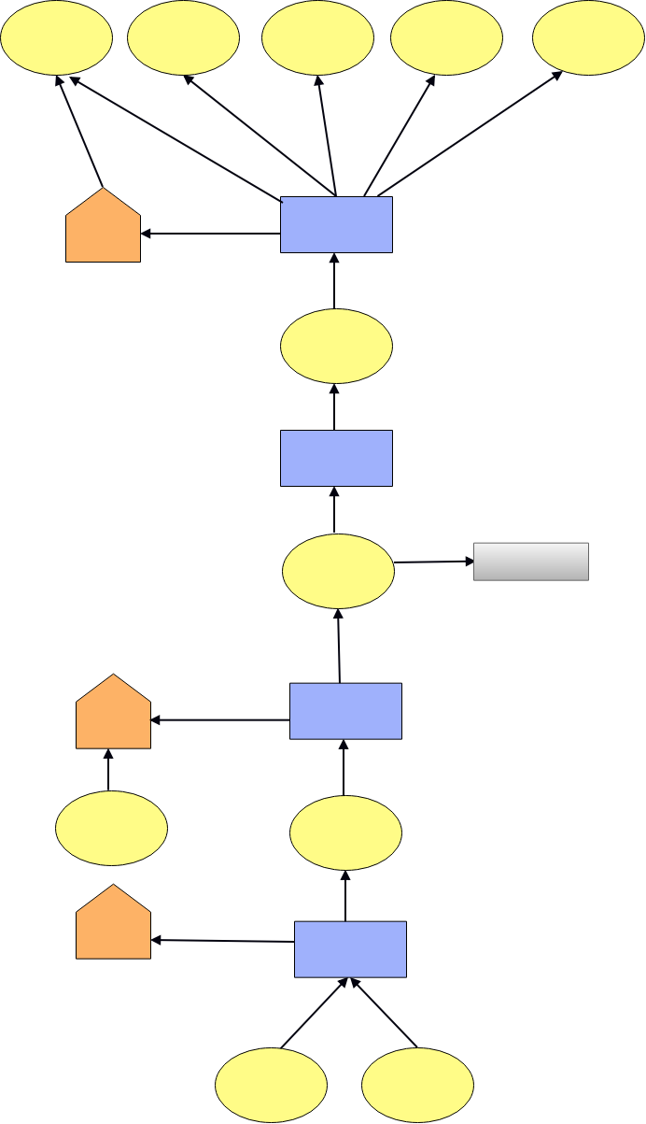
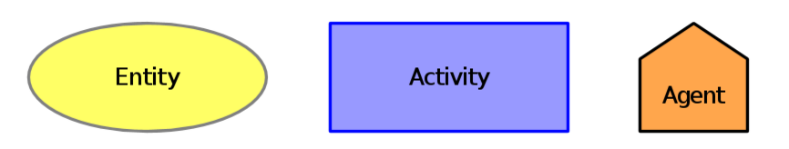
Provenance Definitions
  The origin or source of something
  A detailed historical explanation of influential factors, process flows, data flows used to accomplish work.
  The chronology of the ownership, custody or location of a historical object
  Provenance is information about entities, activities, and people involved in producing a piece of data or thing, which can be used to form assessments about its quality, reliability or trustworthiness [W3C PROV].
  Scruffy provenance – provenance in a simplified form.
Provenance Graph
Tracing Data Origin
Notes:
Provenance perspectives
Data flow
Process flow
Responsibility (who can be attributed to the data or process)
Prospective
Retrospective

Slide 7


Provenance Disclosure Challenges
“Field of dreams” philosophy on client API didn’t materialize- if you build it they will disclose…
  Provenance collection is not automatic
  Inertia from model developers
  Need of native language bindings to support applications written in different programming languages
Not all science communities were using a workflow engines to run their science application
Some science communities were collecting auditing records and logs that were referred to as provenance.
The EUREKA moment occurred when we realized the most benefit could be provided by enriching the existing scientist provenance capabilities!

Slide 8
Making Provenance More Precise Through Enrichment
Data enrichment in general refers to a set of processes that can be used to enhance, refine or otherwise improve raw or previously processed data.
W3C Data on the Web Best Practices Recommendation, 2017
Examine the existing provenance drivers used by scientists
Identify relatable mental models used by the scientists to convey provenance:
  Terminology
  Data formats
Determine missing areas where enrichment can occur:
  Organizing structures
  Identification schemes for connectivity between concepts.
  Referential material to provide better context including alignment to community models.
Develop simple syntax that preserves and enriches mental model
Harvest enriched provenance
Rigorously test value proposition of added provenance precision.

Slide 9

Expected Impact: ESGF and ACME
ProvEn is needed in ESGF to maintain:
  detailed history information about the steps followed to access and derived data during analysis tasks.
  provenance of data products and of the workflows that derive these products and their executions.
Interest in several topics
  use cases focusing on Vulnerability, Impacts and Adaptation (VIA) communities.
  Provenance aspects involved in the publication of data on large volumes of regional climate change projection data sets.
  Defining and publication of provenance metadata
  in the ESGF scientific gateways.
  Retaining provenance information regarding the
  Accelerated Climate Modeling for Energy (ACME)
  simulation logs, configuration files, software descriptions,
  and compile settings.
Notes:
Dean N. Williams,
Executive Committee Chair of the Earth System Grid Federation

Slide 10
ACME Example Ensemble Provenance
Ensemble contains 3072 ACME simulations
Ensemble contains 126,484 files distributed across 3072 ACME simulation directory trees.
Each ACME simulation consisting of 5 model runs
Each model run tracks performance for up to 12 levels of code regions
Efficiencies in simulation production creating single simulation in days.
Credit: http://randommization.com/2011/08/10/walking-on-the-edge-of-torontos-cn-tower/
Source | Purpose | Mental Model | Value
ACME | Code Region | Timing file, tabular | Code Calling Stack
ACME | Performance | Timing file, tabular | Timers
CIME, User generated | Workflow | Directory path | Workflow Calling stack
ACME | Input | Namelist Parameter files | Simulation/Model Input
CIME Setup | Configuration | Python Variables in runscript | Run settings
Is there a general way we can import native ACME provenance into ProvEn?
Once ingested what approaches can be used to access and analyze the results?

Slide 11
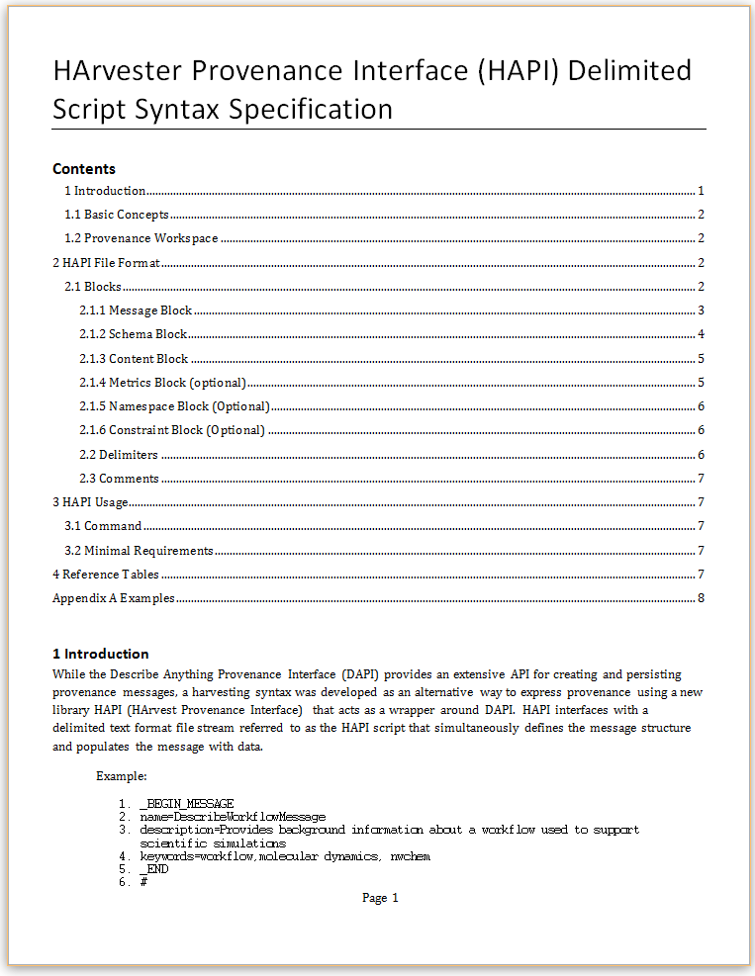
Harvester Provenance Interface (HAPI)
HAPI uses scruffy provenance content as basis for messages:
  Tabular data
  Parameter list
  Large objects
Uses schemas, identifiers, and references to other content to support enrichment.
Supports alignment to community vocabularies.
HAPI Message File
Message Block
1
O,1
Metrics Block
Schema Block
1,m
O,1
Namespace Block
Content Block
1,m
O,1
Constraint Block

Slide 12
Enriching Provenance with HAPI
Contains:
  Basic keys and metadata
  Entities, Activities, Agents
  Timing measurements
Lacks
  Traceability
  Aggregation
  Portability

Slide 13
Enrichment Goals
Provide unique identifier to timing records to support cross-comparison.
Add bi-directional trace linkages from ensemble to code_regions.
Support data reduction queries to support spreadsheet analysis across the ensemble.
Original file acme_0000.timing in directory v1_ppe_set2_kab_INI0002-01-01_BD1_0001
code_region,On,Called,Recurse,Wallclock,max,min,UTR_Overhead
CPL:ICE_RUN,,240,,10.101504,0.190648,0.003369,0.000055
CPL:LND_RUN,,240,,17.696318,0.553784,0.057170,0.000055
CPL:ROF_RUN,,40,,0.676368,0.068045,0.010950,0.000009
CPL:ATM_RUN,,240,,7378.128418,151.226151,22.292257,0.000055
CPL:OCNT_RUN,,239,,0.411395,0.014874,0.001344,0.000055

Slide 14
Putting code region in context of a simulation
_BEGIN_CONTENT
node=wfpp:Simulation
name,code_region,On,Called,Recurse,Wallclock,max,min,UTR_Overhead
/v1_ppe_set2_kab_INI0002-01-01_BD1_0001/CPL:RUN_LOOP/CPL:ICE_RUN,CPL:ICE_RUN,,240,,10.101504,0.190648,0.003369,0.000055
/v1_ppe_set2_kab_INI0002-01-01_BD1_0001/CPL:RUN_LOOP/CPL:LND_RUN,CPL:LND_RUN,,240,,17.696318,0.553784,0.057170,0.000055
/v1_ppe_set2_kab_INI0002-01-01_BD1_0001/CPL:RUN_LOOP/CPL:ROF_RUN,CPL:ROF_RUN,,40,,0.676368,0.068045,0.010950,0.000009
/v1_ppe_set2_kab_INI0002-01-01_BD1_0001/CPL:RUN_LOOP/CPL:ATM_RUN,CPL:ATM_RUN,,240,,7378.128418,151.226151,22.292257,0.000055
/v1_ppe_set2_kab_INI0002-01-01_BD1_0001/CPL:RUN_LOOP/CPL:OCNT_RUN,CPL:OCNT_RUN,,239,,0.411395,0.014874,0.001344,0.000055
_END

Slide 15
Adding Schema
DAPI uses declared keys to generate object identifiers using SHA256 hash algorithm.
  Inspired from the CSV on the Web data driven approach to schemas
  Similar to data definition language (DDL)
  Supports XSD data types
_BEGIN_SCHEMA
node=wfpp:Simulation
format=TABLE_
field,datatype,keyConstraint
name,,primaryKey
code_region,,
On,,
Called,,
Recurse,,
Wallclock,,
max,,
min,,
UTR_Overhead,,
_END
#
_BEGIN_CONTENT
node=wfpp:Simulation
name,code_region,On,Called,Recurse,Wallclock,max,min,UTR_Overhead
/v1_ppe_set2_kab_INI0002-01-01_BD1_0001/CPL:RUN_LOOP/CPL:ICE_RUN,CPL:ICE_RUN,,240,,10.101504,0.190648,0.003369,0.000055
/v1_ppe_set2_kab_INI0002-01-01_BD1_0001/CPL:RUN_LOOP/CPL:LND_RUN,CPL:LND_RUN,,240,,17.696318,0.553784,0.057170,0.000055
/v1_ppe_set2_kab_INI0002-01-01_BD1_0001/CPL:RUN_LOOP/CPL:ROF_RUN,CPL:ROF_RUN,,40,,0.676368,0.068045,0.010950,0.000009
/v1_ppe_set2_kab_INI0002-01-01_BD1_0001/CPL:RUN_LOOP/CPL:ATM_RUN,CPL:ATM_RUN,,240,,7378.128418,151.226151,22.292257,0.000055
/v1_ppe_set2_kab_INI0002-01-01_BD1_0001/CPL:RUN_LOOP/CPL:OCNT_RUN,CPL:OCNT_RUN,,239,,0.411395,0.014874,0.001344,0.000055
_END

Slide 16
Referencing Nodes Across Graph
DAPI generates object identifiers for references using SHA256 hash algorithm.
  Target reference doesn’t have to exist
_BEGIN_SCHEMA
node=prov:Agent
format=_PARAMETERS
field,dataType,constraint
name,,primaryKey
mbox,,
_END
#
_BEGIN_SCHEMA
node=wfpp:Simulation
format=_TABLE
field,datatype,keyConstraint
name,,primaryKey
code_region,,
On,,
Called,,
Recurse,,
Wallclock,,
max,,
min,,
UTR_Overhead,,
prov:wasStartedBy,,referenceNode
_END
#
_BEGIN_CONTENT
node=wfpp:Simulation
name,code_region,On,Called,Recurse,Wallclock,max,min,UTR_Overhead,prov:wasStartedBy
/v1_ppe_set2_kab_INI0002-01-01_BD1_0001/CPL:RUN_LOOP/CPL:ICE_RUN,CPL:ICE_RUN,,240,,10.101504,0.190648,0.003369,0.000055,prov:Agent?name=Jun Li
_END
#
_BEGIN_CONTENT
node=prov:Agent
prov:name=Jun Li
foaf:mbox=<mailto:junli@example.org>
_END

Slide 17
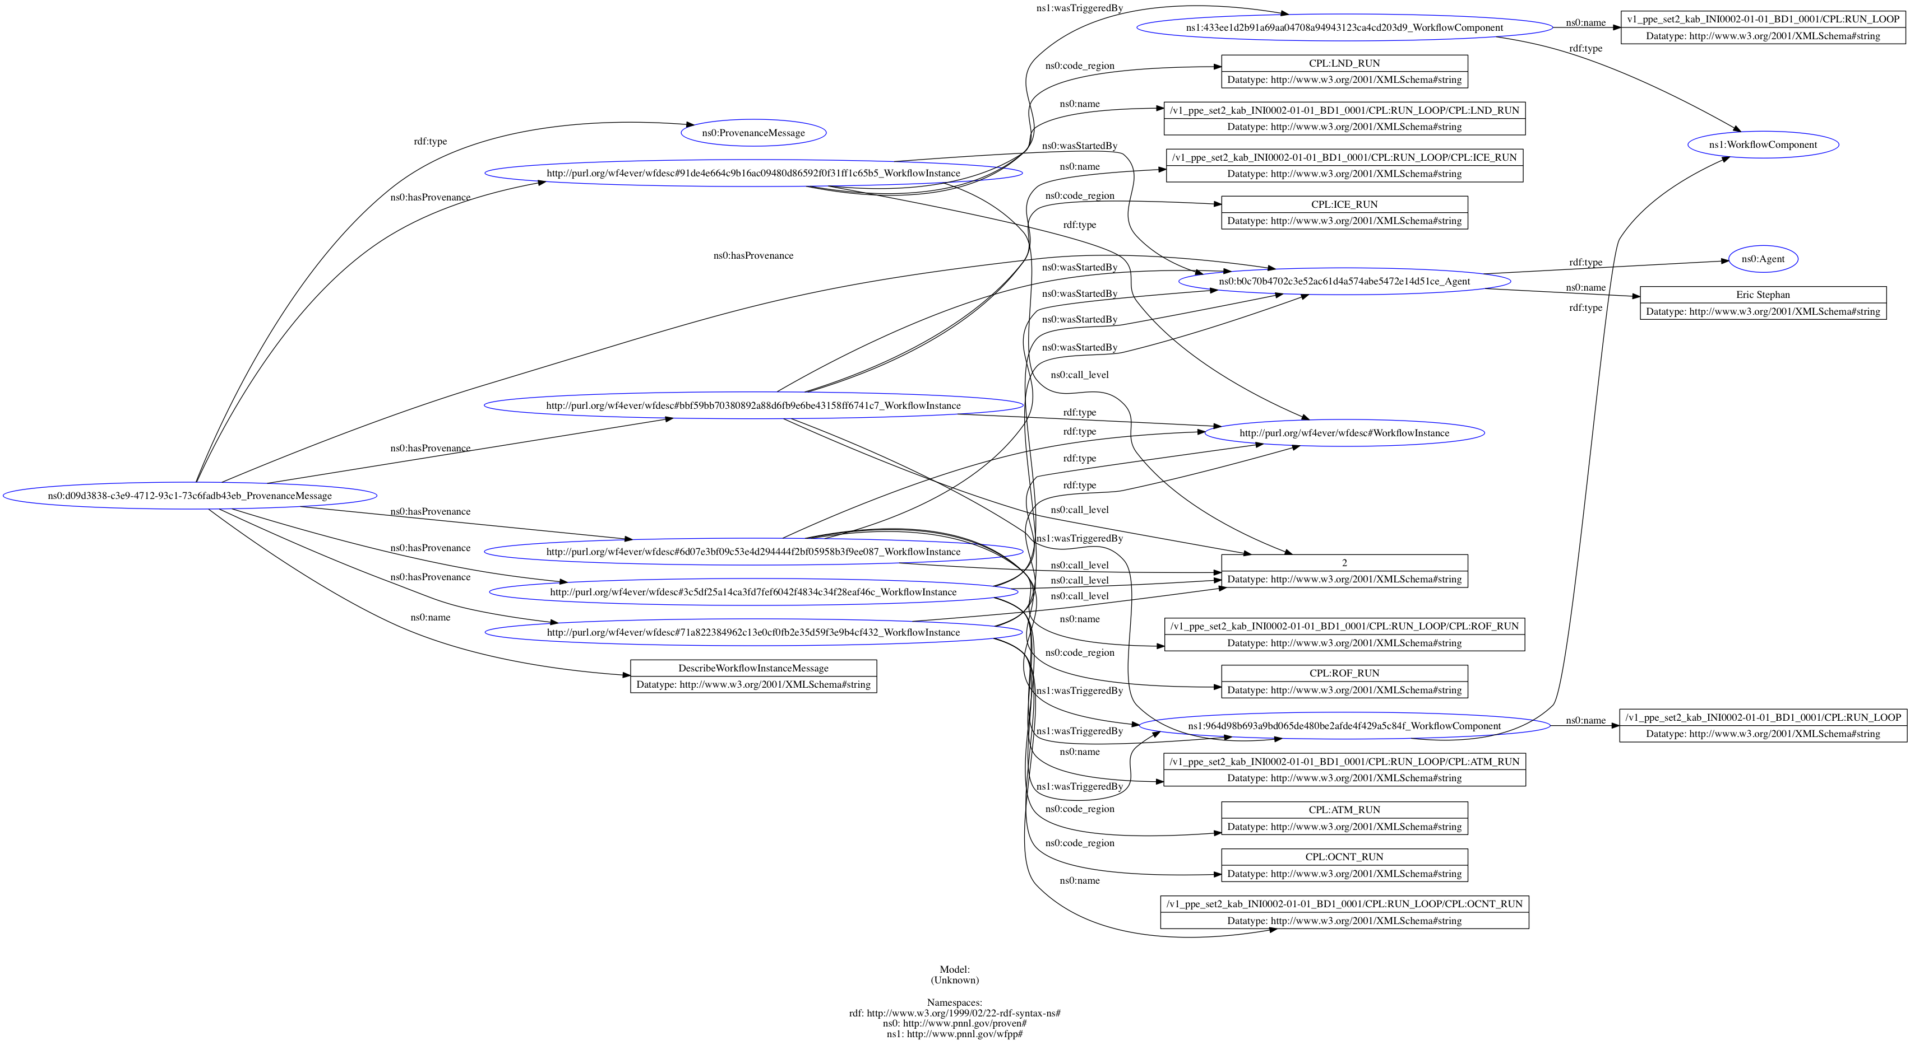
Describing Message Header
Provenance
Fragment
_BEGIN_MESSAGE
name=describeModelSimulationTiming
description=A CESM workflow runs a simulation that is composed of multiple models
keywords=CAM,CLM,Ocean,Atmosphere,Land,Ice,simulation,ACME,climate
domain=acme
producer=harvester
producer_version=v1.0
_END#
Named
Graph

Slide 18
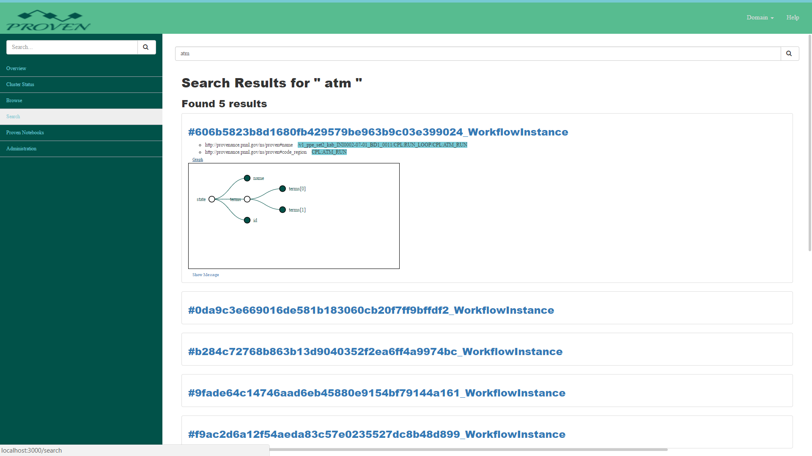
ACME: Analyzing Simulation Trends with Harvested Ensemble Provenance
Solution: Harvest provenance from native results to dynamically build code location hierarchy with associated wall clock runtime to isolate and report performance anomalies.
  Provenance allowed users to examine code region performance at desired level of granularity over 3000 simulation runs.
  ProvEn through data reduction, provided portable trending database with small footprint.
  Jupyter notebook interfaced with ProvEn Portal to support desktop analysis
  REST interfaces allow any HTTP enabled client to access time series or semantic information .
HAPI Message Harvested,
Tranformed to JSON-LD
Provenance Fragment saved in named subgraph
Jupyter notebook can be used to query provenance and metrics
_BEGIN_MESSAGE
name=describeModelSimulationTiming
description=A CESM workflow runs a simulation that is composed of multiple models
keywords=CAM,CLM,Ocean,Atmosphere,Land,Ice,simulation,ACME,climate
domain=acme
producer=harvester
producer_version=v1.0
_END
#
_BEGIN_SCHEMA
node=wfpp:Simulation
format=TABLE_
field,datatype,keyConstraint
name,,primaryKey
code_region,,
On,,
Called,,
Recurse,,
Wallclock,,
max,,
min,,
UTR_Overhead,,
_END
#
_BEGIN_CONTENT
node=wfpp:Simulation
name,code_region,On,Called,Recurse,Wallclock,max,min,UTR_Overhead
/v1_ppe_set2_kab_INI0002-01-01_BD1_0001/CPL:RUN_LOOP/CPL:ICE_RUN,CPL:ICE_RUN,,240,,10.101504,0.190648,0.003369,0.000055
/v1_ppe_set2_kab_INI0002-01-01_BD1_0001/CPL:RUN_LOOP/CPL:LND_RUN,CPL:LND_RUN,,240,,17.696318,0.553784,0.057170,0.000055
/v1_ppe_set2_kab_INI0002-01-01_BD1_0001/CPL:RUN_LOOP/CPL:ROF_RUN,CPL:ROF_RUN,,40,,0.676368,0.068045,0.010950,0.000009
/v1_ppe_set2_kab_INI0002-01-01_BD1_0001/CPL:RUN_LOOP/CPL:ATM_RUN,CPL:ATM_RUN,,240,,7378.128418,151.226151,22.292257,0.000055
/v1_ppe_set2_kab_INI0002-01-01_BD1_0001/CPL:RUN_LOOP/CPL:OCNT_RUN,CPL:OCNT_RUN,,239,,0.411395,0.014874,0.001344,0.000055
_END

Slide 19

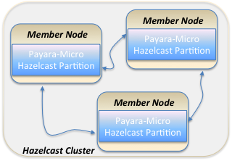

Next Steps: Provenance Cluster
What’s a Member Node?
Payara-Micro
  Open source Java EE application container
  Embedded server
  Hazelcast Integration
  Payara-Micro API
  Microservices development approach
Hazelcast
  Open source in-memory data grid (IMDG) library
  Auto-clustering provided by Hazelcast
  Distributed data structures to provide provenance in real-time
  Distributed compute to perform data distribution
Member Node = Payara-Micro + Hazelcast
  Elasticity
  High Availability
  Provenance processing via microservices
Notes:
Same technology stack being used on another project I support -> Belle2 Conditions Database
Using Payara/Hazelcast to scale the Conditions Database application
Orchestration (scaling and load balancing ) using Kubernetes & Docker

Slide 20
Provenance Cluster
Provenance Message Distribution
Provenance message is stored in-memory in an IMap distributed Key/Val data structure where it can be queried.
Provenance message is stored in-memory in an IQueue staged for persistence to registered stores (Producer – Consumer buffer)
Provenance message is saved to Semantic Store in their domain context
If provenance message contains Provenance Metrics, they are serialized to Metric Store
Hazelcast Cluster
<<system>>
Semantic Store
Member Node
3
1
Java Heap
2
<<system>>
Metric
Store
Microservices
4
Notes:
IMap is partitioned & distributed – provennace message volume should be ~equal on each member node
IQueue is distributed NOT partitioned
Expiration policies and memory constraints

Slide 21
Extending ProvEn for Distributed, Hierarchical, and Real-time Observations
Investigating use in reproducible ACME workflows
Extend ProvEn architecture and deploy to multiple cluster-nodes
Fault-tolerant: cluster-nodes form P2P network that can survive site failure
Real-time observations will be fed back to analysis services and can be persisted using cluster stores or cold storage
Can gather data related to distributed data motion as well as intra-cluster data motion
Explore a hierarchical provenance capture architecture, including time-series data collection at fine granularity through ProvEn extensions and other tools (e.g. TAU)

Slide 22
Observations and Conclusions
Data driven approach and language agnostic
HAPI encourages local terminology as a first citizen in provenance.
Easier to have conversations about provenance (baby steps).
Each HAPI message acts as an envelope encapsulating scruffy provenance
Most effective when application developers deliver consistent scruffy provenance that can be extracted by scripts
Works just as well with auditing records in databases.
Investigating its use as cold storage (offline) provenance.
  Provenance doesn’t have to be online
  Users can still perform regular expression searches on HAPI

Slide 23
Publications
CLUSTER ’17: R. D. Friese, N. R. Tallent, K. J. Barker, J. Yin, M. Schram, V. Bansal, M. Halappanavar, E. Stephan, and D. J. Kerbyson, “Optimizing distributed data-intensive workflows,” 2018. Under submission.
IPDPS ’17: R. D. Friese, N. R. Tallent, A. Vishnu, D. J. Kerbyson, and A. Hoisie, “Generating performance models for irregular applications,” in 31st IEEE International Parallel and Distributed Processing Symposium, May, 2017.
CHEP ’16: M. Schram, V. Bansal, R. D. Friese, N. R. Tallent, J. Yin, K. J. Barker, E. Stephan, M. Halappanavar, and D. J. Kerbyson, “Integrating prediction, provenance, and optimization into high energy workflows,” Proc. of the 22nd Intl. Conf. on Computing in High Energy and Nuclear Physics (CHEP 2016), 2017. To appear..
NYSDS ’16: Elsethagen, T., E. Stephan, B. Raju, M. Schram, M. MacDuff, D. Kerbyson, K. K. van Dam, A. Singh, and I. Altintas. 2016. “Data Provenance Hybridization Supporting Extreme-Scale Scientific Workflow Applications.” In 2016 New York Scientific Data Summit.
BIGDATA-W ’16: Singh, A., Stephan, E., Elsethagen, T., MacDuff, M., Raju, B., Schram, M., Kleese van Dam, K., J Kerbyson, D., Altintas I., Leveraging Large Sensor Streams for Robust Cloud Control, In Proc. of the Big Data for Cloud Operations Management: Problems, Approaches, Tools, and Best Practices Workshop.
Kerstin Kleese van Dam, Eric Stephan, Bibi Raju, Ilkay Altintas, Todd Elsethagen , Sriram Krishnamoorthy. “Enabling Structured Exploration of Workflow Performance Variability in Extreme-scale Environments“, 8th Workshop on Many-Task Computing on Clouds, Grids, and Supercomputers (MTAGS), November 5, 2015 Ausin, Texas.
Thomas M, J Laskin, B Raju, EG Stephan, TO Elsethagen, and SN Nguyen. "Enabling Re-executable Workflows with Near-real-time Visualization, Prove-nance Capture and Advanced Querying for Mass Spectrometry Data." NYSDS 2016, New York City, NY. August 14-17, 2016.

Slide 24
Acknowledgements
Todd Elsethagen, Bibi Raju, Malachi Schram - Pacific Northwest National Laboratory
Kerstin Kleese van Dam, Line Pouchard, Carlos Gamboa - Brookhaven National Laboratory
Ilkay Altintas, Alok Singh - San Diego Supercomputer Center & University of California, San Diego
Project Acknowledgements
  Integrated End-to-end Performance Prediction and Diagnosis for Extreme Scientific Workflows (IPPD) Project. IPPD is funded by the U. S. Department of Energy Awards FWP-66406 and DEC0012630
  Accelerated Climate Modeling for Energy (ACME) project funded by the Office of Biological and Environmental Research (BER) in the U.S. Department of Energy (DOE) Office of Science.

