Slide 1
Jialin Liu Data Analytics & Service Group
Debbie Bard, Quincey Koziol, Stephen Bailey, Prabhat
Searching for Millions of Objects in the BOSS Spectroscopic Survey Data with H5Boss
New York Scientific Data Summit
Aug 9 2017

Slide 2
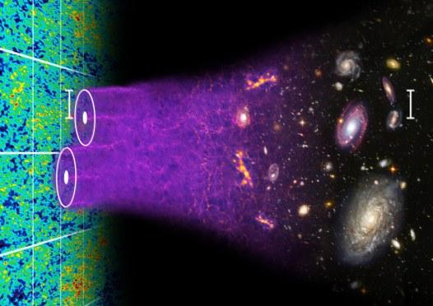
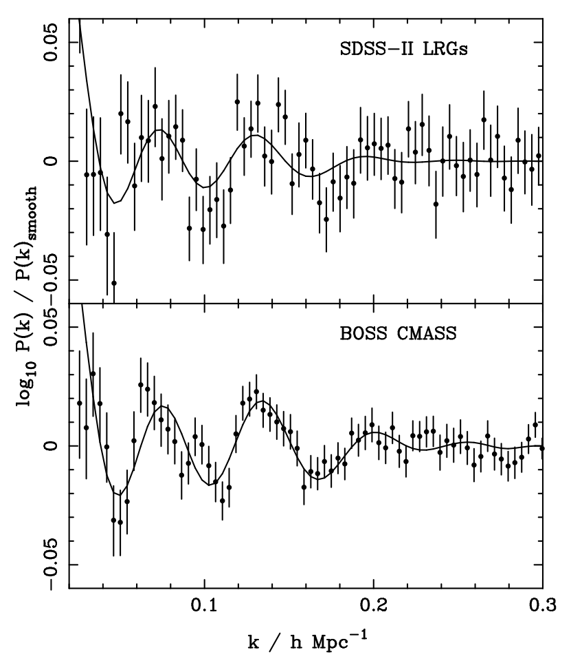
Boss Data and Analysis: Background
BOSS: Baryon Oscillation Spectroscopic Survey – from SDSS III
Perform typical randomly generated query to extract small amount of stars/galaxies from millions
Better fit to the cosmological model than SDSS II
Dark energy and the origin of cosmic acceleration
Baryon acoustic oscillations in early universe, still can be seen in survey like BOSS, (courtesy of Chris Blake and Sam Moorfield)
Comparison of the power spectrum of SDSS-II LRGs and BOSS DR9 CMASS galaxies. Solid lines show the best-fit models. From Anderson et al. 2012.
Notes:
https://www.darkenergysurvey.org/the-des-project/science/four-probes/baryon-acoustic-oscillations/: Baryon acoustic oscillations (BAO) are a key measurement relating the physics of the early Universe to its history of expansion since. For roughly the first 380,000 years after the Big Bang

Slide 3
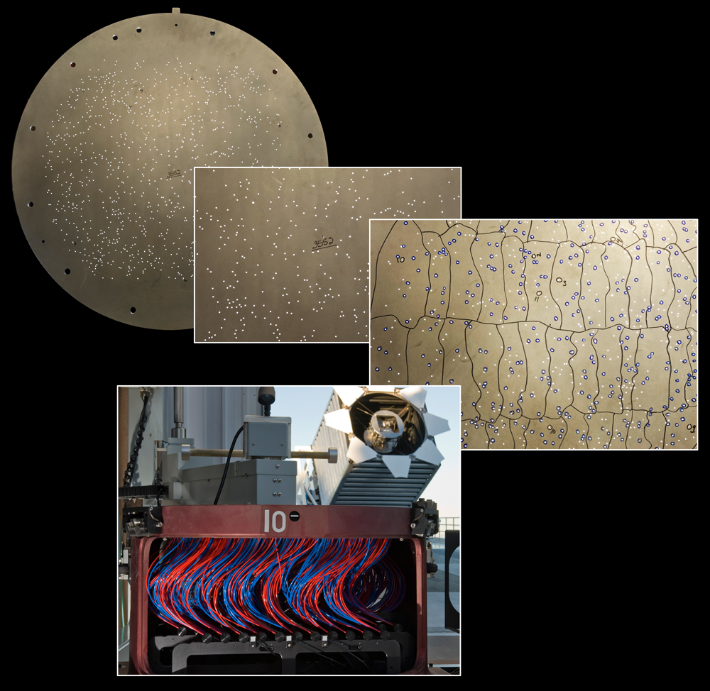
Boss Data and Analysis: Collection
Plate: Each plate contains 1000 objects, observed over full wavelength range 3600-10,000 Angstroms
MJD (Modified Julian Date): The date of observation
Fiber: Optical fibers plugged into the hole of the Plate
http://newscenter.lbl.gov/2012/08/08/boss-sdss-dr9/
Notes:
The SDSS has used thousands of plug plates in its fourteen year history. These are large aluminium plates into which tiny holes are drilled. Each hole has an optical fibre plugged into it (by hand by our plate pluggers). Each hole corresponds to the sky location where there is an object (a star or a galaxy) which SDSS wants to measure a spectrum for.

Slide 4
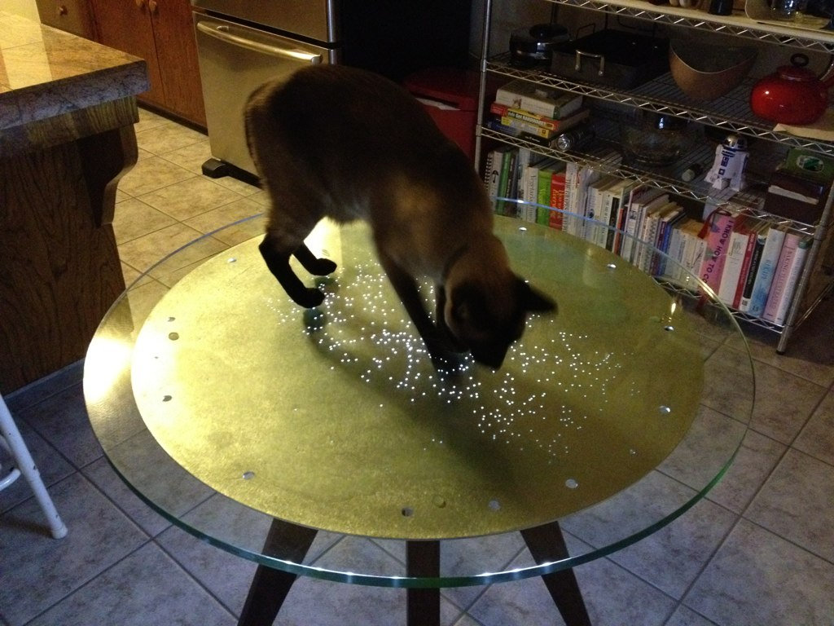
Boss Data and Analysis: Problems
Plate + MJD + Fiber uniquely determines a single observation of a single object
Once FITS, Always FITS, formats has restriction
Finding an object is not scalable
No parallel I/O library
Figure courtesy of Brian Lee

Slide 5
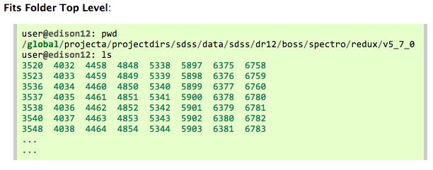
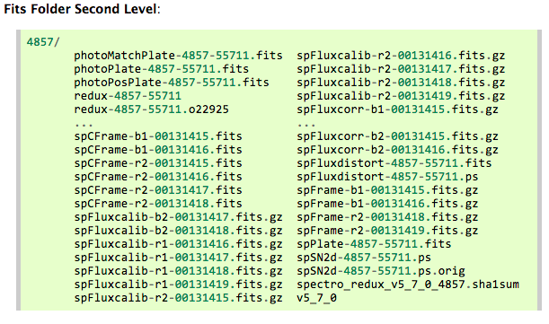
Boss Data and Analysis: Files
Within each PLATE folder, hundreds of FITS Files
First Level Folder
Second Level Folder

Slide 6
Boss Data and Analysis: Files
 | H5BOSS Selected |  |  | SDSSIII Released
Folders | Files | Inodes | Size(TB) | Files | Inodes | Size(TB)
4,888 | 89,816 | 94,704 | 6.4 | 276,575 | 281,463 | 11
Files/Inodes Statistics
Hundreds thousands of Files
Hundreds thousands of Inodes Required
TBs -> PBs

Slide 7
Boss Data and Analysis: Formats
Each FITS File has several HDUs;
Each HDU has Header Units and Data Units (optional)
Header unit contains a sequence of fixed-length 80-character keyword records which have the general form:
KEYNAME = value / comment string
Data unit is a multiple of 2880 bytes long, immediately follows the last 2880-byte block in the header unit
Image, Ascii, Binary

Slide 8
Boss Data and Analysis: Analytics
Step 1:
  Specify Plate, Mjd, Fiber
  e.g., 4857 55711 332
Step 2:
  Read HDUs
  e.g., HDUs: Wave, Flux
Step 3:
  Perform Analytics
HDUs: WAVE and FLUX
HDUs: WAVE, FLUX, IVAR, and MASK
All HDUs
Example Query Patterns
Typical Analytics Steps

Slide 9
From Fits to HDF5, Why?
Format Matters:
  File management
  IO
Whether HDF5 can be a better alternative for Fits ?
  Related Work: Fits2HDF5 project has designed a 1-to-1 conversion between FITS and HDF5
In H5Boss, we explored
  Customized formats/structure based on HDF5
  Parallel H5py

Slide 10
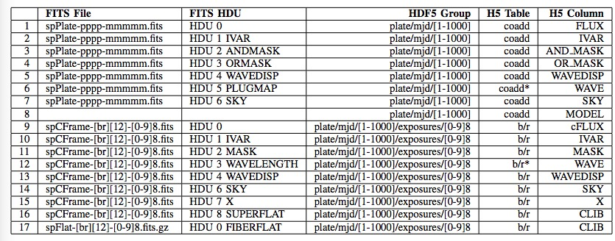
File Structure is Simpler
Leverage HDF5 hierarchy, e.g., subgroups
Group data by objects, i.e., FiberID
Union variables into table records

Slide 11

File System is Happier
 |  | H5BOSS Selected |  |  | SDSSIII Released
 | Folders | Files | Inodes | Size(TB) | Files | Inodes | Size(TB)
FITS | 4,888 | 89,816 | 94,704 | 6.4 | 276,575 | 281,463 | 11
HDF5 | 1 | 2,444 | 2,445 | 3.2 | 2,444 | 2,445 | NA
Before
After

Slide 12


How About Programming and I/O?
HDUs: WAVE and FLUX
HDUs: WAVE, FLUX, IVAR, and MASK
All HDUs
Analytics Patterns Matters
I/O Patterns?
Random
Read/Write
Small IO
Millions Datasets
…
Other factors?
Python
Mpi4py
H5py
Lustre
…

Slide 13
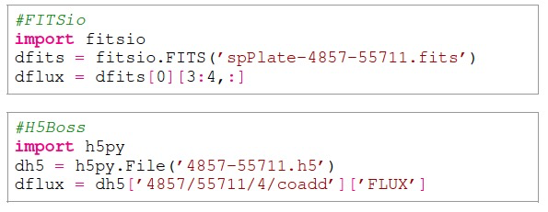
Reading ‘Flux’ HDU (Single Variable) in FITS and HDF5
Programming interface is similar, FITS users can quickly pick it up
Query/Reading Plate: 4857, Mjd: 55711, Fiber: 4, FLUX
Read with FITSio
Read with H5py

Slide 14
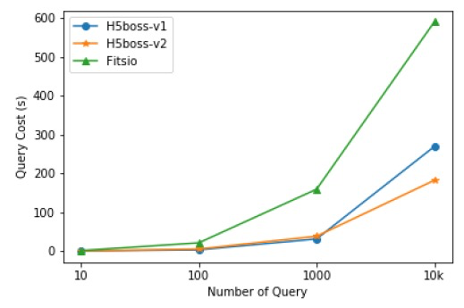
Reading ‘Flux’ HDU (Single Variable) in FITS and HDF5
Read 10/100/1000/10000 FLUX, Serial IO Performance
Using Pre-selected Files
Run sub-selection first,
Then read from this single file
2X-3.2X speedup

Slide 15
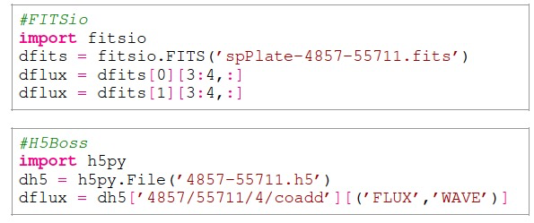
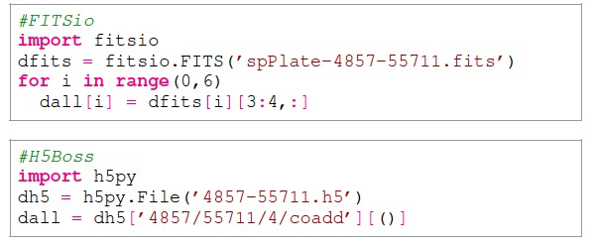
Reading Multiple HDUs (Variables) in FITS and HDF5
Programming interface is similar, FITS users can quickly pick it up
Query/Reading Plate: 4857, Mjd: 55711, Fiber: 4, FLUX, IVAR
Two HUDs Query
All HDUs Query

Slide 16
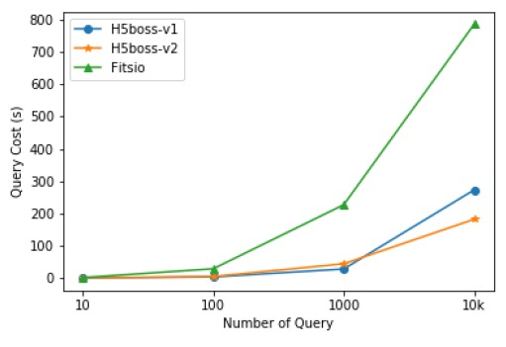
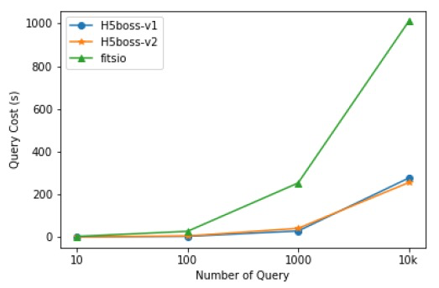
Reading Multiple HDUs in FITS and HDF5
Read Flux and Wave
Read All HDUs
2.8-4.3X
3.6-3.9X

Slide 17
H5Boss Workflow, Scalability?
Read
Data Analysis
(no write needed)
Query
Meta Query
Meta Reduce
2
Converted FITS Files in HDF5
or
1
Read
Write
3
Data Analysis
(no write needed
if pre-selected file exists)
plate | mjd | fiber
4322 | 55532 | 32
5892 | 55598 | 25
Pre-selected File
Query Conditions

Slide 18
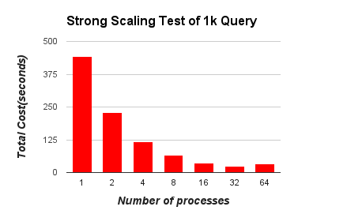
H5Boss Scaling and Lessons Learned
Before optimization, with 1k query, strong scaling:
Scalable on single node
Not scalable on multiple nodes

Slide 19
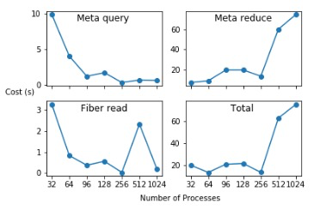
H5Boss Scaling
1
1
Query
2
Read
2
3
Write
3

Slide 20
H5Boss Scaling
Each Process: Meta Query
  Step 1: Files open
  Step 2: Plate/mjd/fiber searching
Each Process: Meta Reduce
  Step 3: Key-value construction
All Processes: Meta Reduce
  Step 4: All to all reduction to form a global shared k-v list
1
1
Query
2
Read
2
3
Write
3
Checklist:
  The (key, value) structure
  The python overhead in MPI_allreduce
  The balance of the workload

Slide 21
H5Boss Scaling
Why mpi4py’s allreduce could be an issue?
1
1
Query
1. allreduce vs Allreduce
Lowercase: generic Python objects, send(), recv(), etc
Upper-case: buffer like object, Send(), Recv(), etc
2
Read
2
2. pickling & unpickling
3
Write
3
sender
receiver
direct
pickling
unpickling
dispatching
allocation
packing
allocation
translation
unpacking
C mpi

Slide 22
H5Boss Scaling
Simplify the key, value structure
1
1
Query
Key: Path to HDF5 dataset
Value: (type, shape, path to file)
2
Read
2
K:
b[‘3666/55159/599/coadd’]
V:
(([((WAVE, ‘<f4’), (FLUX, ‘<f4’), (IVAR, ‘<f4’), (AND_MAKS, ‘<i4’),(OR_MASK, ‘<i4’), (‘WAVEDISP’, ‘<f4’), (SKY, ‘<f4’), (MODEL,‘<f4’)]),
(4619,)
‘/global/cscratch1/sd/jialin/h5boss/3666-55159.hdf5’)
3
Write
3
Before
Key: Path to HDF5 dataset
Value: shape
After
K: (str) “3666/55159/599/coadd”
V: (int) “4619”

Slide 23
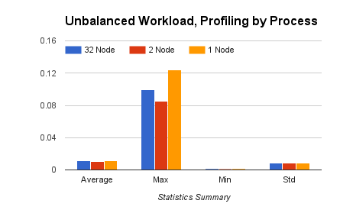
H5Boss Scaling
1
1
Query
2
Read
Imbalance
2
3
Write
3
Dynamic rebalance the workload
Balancing Factors:
Number of processes
Number of files
Number of fibers
Number of k,v pairs

Slide 24
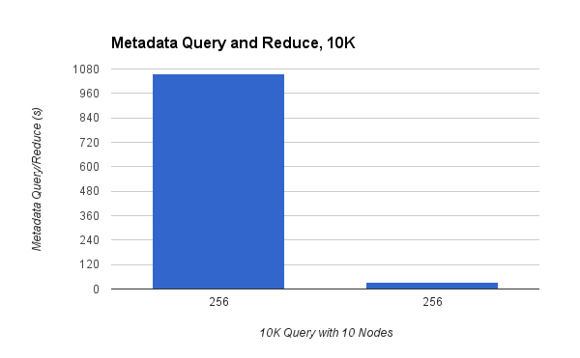
H5Boss Scaling
With workload finer rebalancing, 30X
1
1
Query
2
Read
2
3
Write
3

Slide 25
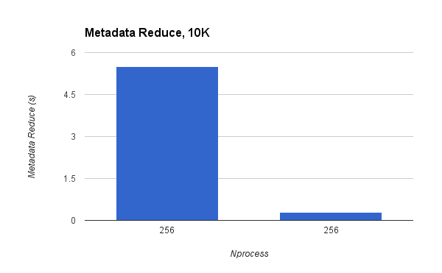
H5Boss Scaling
With optimized (k,v) structure, 19X further
1
1
Query
2
Read
2
3
Write
3

Slide 26
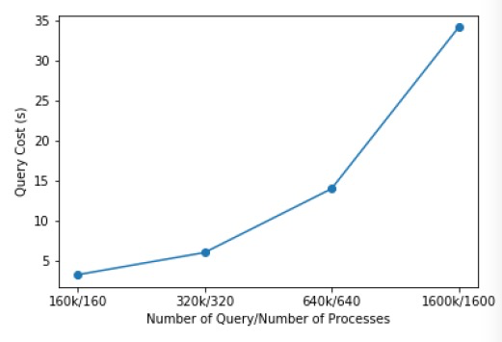
H5Boss Scaling
After optimization:
Weak scaling to 1.6 million fiber query and 1600 processes on Cori
1
1
Query
2
Read
2
BOSS has 2.5 million unique objects
DESI will have O (100M)
3
Write
3
Notes:
10 billions light years

Slide 27
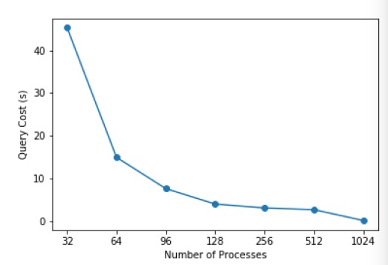
H5Boss Scaling
Read is scalable
1
1
Query
2
Read
2
3
Write
3

Slide 28
H5Boss Scaling
Write is not scalable: Small I/O, < 1MB
1
1
Query
2
Read
2
I/O Requests
3
Write
3
Time
Lock
1MB
1MB
Lustre Stripe

Slide 29
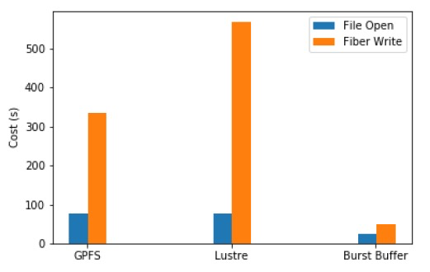
H5Boss Scaling
Speedup write on Burst buffer
1
1
Query
2
Read
2
Stage in
Stage out
3
Write
3
5.5X

Slide 30
Conclusion
Explored the HDF5 format for replacing the FITS format
Designed two structures based on access patterns
  2X-4X speedup
  Dramatic reduction in the the number of inodes or files
H5Boss supports file manipulation and data query
  Scalable query and read performance on millions of fiber
  Identified bottleneck in write, resolved with Burst Buffer, 5.5X
A comprehensive study meaningful for data management and analysis in future sky survey, DESI, O (100 million) objects, O(500M) spectras

Slide 31
Thanks and Questions?
https://github.com/valiantljk/h5boss

Slide 32
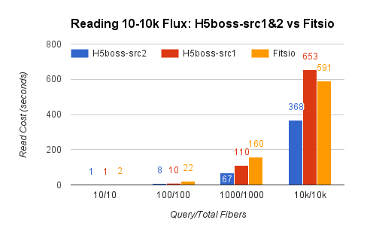
Reading ‘Flux’ HDU in FITS and HDF5
Serial IO Performance
  Read 10/100/1000/10000 flux
Using Source Files
Read directly from
~2000 converted HDF5 files

Slide 33
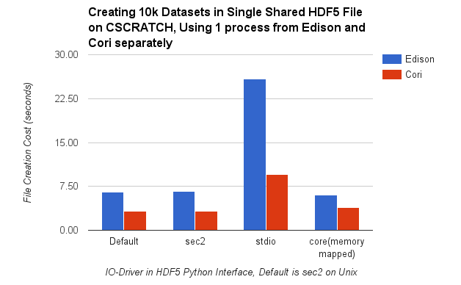
H5Boss Scaling
Write: File Creation
  Libversion: Use ‘latest’ version format, not default
  IO driver: Use default IO driver
1
1
Query
2
Read
2
3
Write
3

Slide 34


Scalability?
h5py
mpi4py
numpy

