Slide 1
Streaming MD Trajectories Sampling
Shinjae Yoo
Hubertus van Dam (BNL), Li Tang (BNL), Jong Yol Choi (ORNL), Line Pouchard (BNL), Tashin Kurc (SBU)

Slide 2
Outline
Motivation
Challenges
Analysis
Case Study

Slide 3
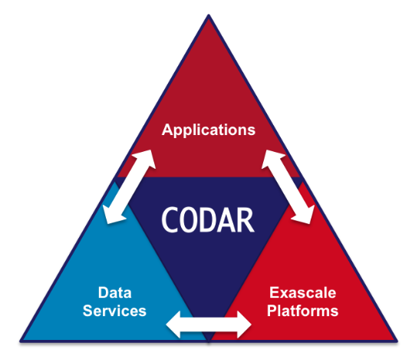
Background
CODAR: Co-design Center for Online Data Analysis and Reduction (Exascale Computing Project)
Argonne National Laboratory
Brookhaven National Laboratory
Oak Ridge National Laboratory
Brown University
Chicago University
Rutgers University
Stony Brook University

Slide 4
Real-time decisions
Goal: Enable collaborative, real-time decisions
Workflows including both experiments and simulations
Reduce cost, improve efficiency of expensive scientific instruments
Research challenges
Optimization of single, long-running massively parallel workflows
Prioritization of critical work
Optimization of multiple, collaborative workflows
Metric of Success
Reduction of time to make a “good” decision, across the entire scientific process

Slide 5
NWChem – Parallel Open Source Computational Chemistry
NWChem started in the early 1990s [1,2].
It supports a wide range of functionality:
Density Functional Theory (most popular)
For molecules
For materials
Coupled Cluster (very accurate, but expensive)
Molecular Dynamics for Biomolecules
And other methods and many properties
NWChemEx is the successor under development as part of the exascale computing project
NWChem availability:
Installed on all major DOE facilities (Oak Ridge, Argonne, NERSC)
Binary versions through Debian, and Ubuntu Linux distributions
Source code available from GitHub at https://github.com/nwchemgit/nwchem
[1] High Performance Computational Chemistry Group, Pacific Northwest Laboratory. Richland, Washington 99352. USA, NWChem. a computational chemistry package for parallel computers, version 1.0, 1994.
[2] http://www.nwchem-sw.org, [07/05/2018]

Slide 6
NWChem - Molecular Dynamics for Biomolecules
Molecular Dynamics treats molecules as:
Masses connected with springs for bonded interactions
Electrostatics for non-bonded interactions
Not as accurate as quantum mechanical methods but much faster
Biomolecules are an important special class of molecules
Structures highly standardized (see e.g. PDB files)
Facilitates setting up calculations
Not so good if you want to do other than biological systems
Exascale science challenge:
Conformational changes in proteins
About 1 million atoms
Time scale of a microsecond (time steps of a femtosecond means a billion time steps)

Slide 7
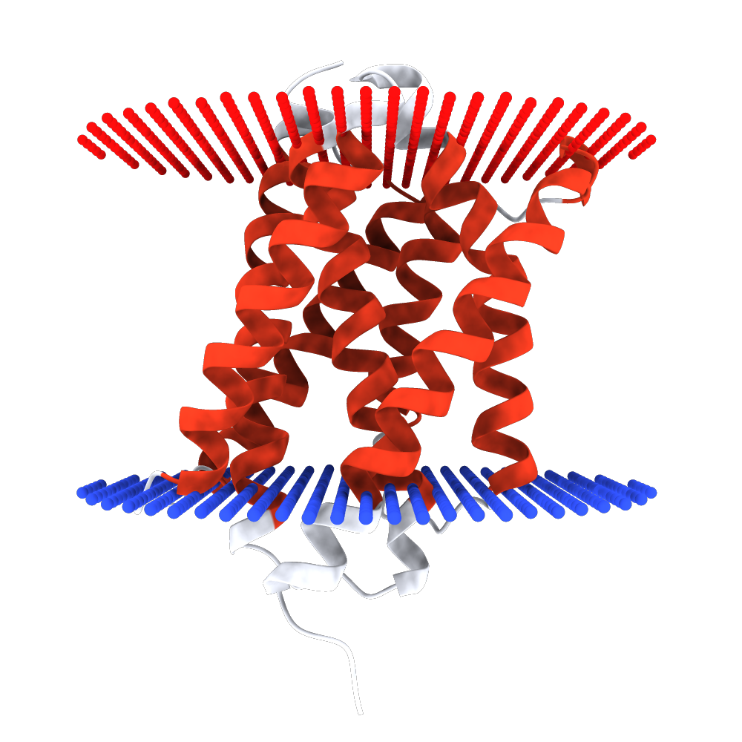
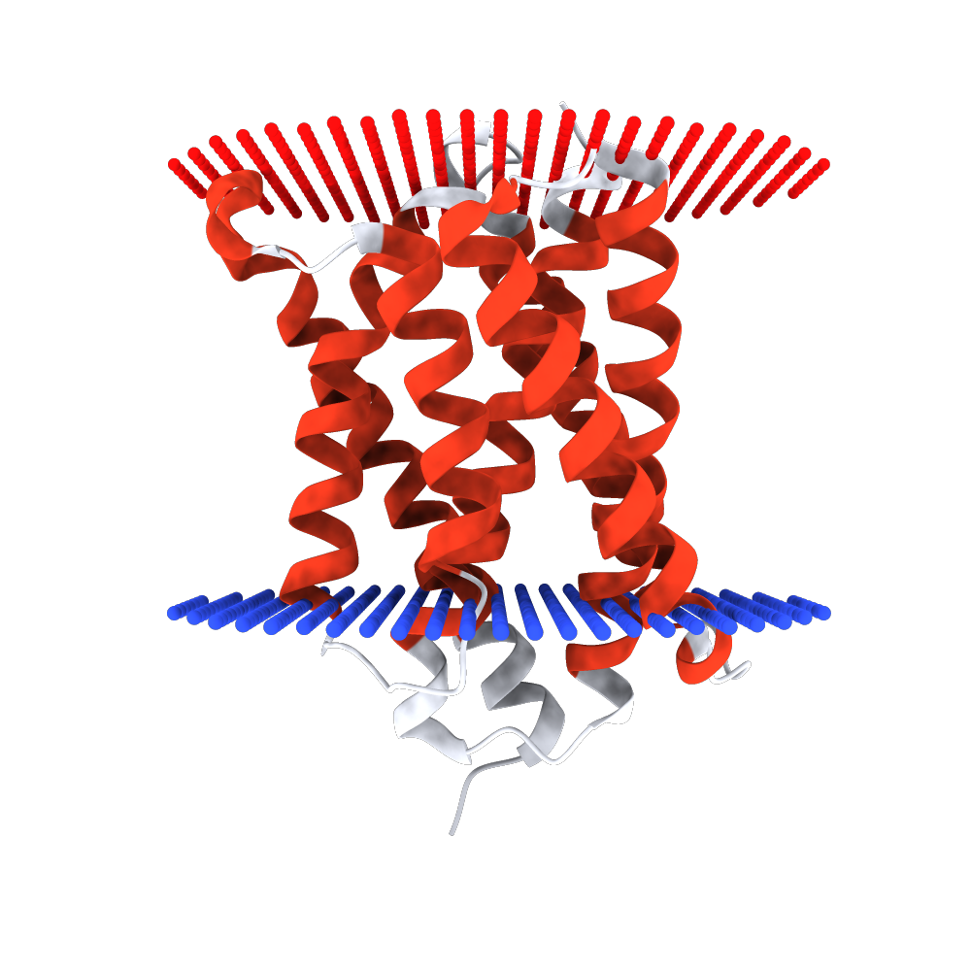
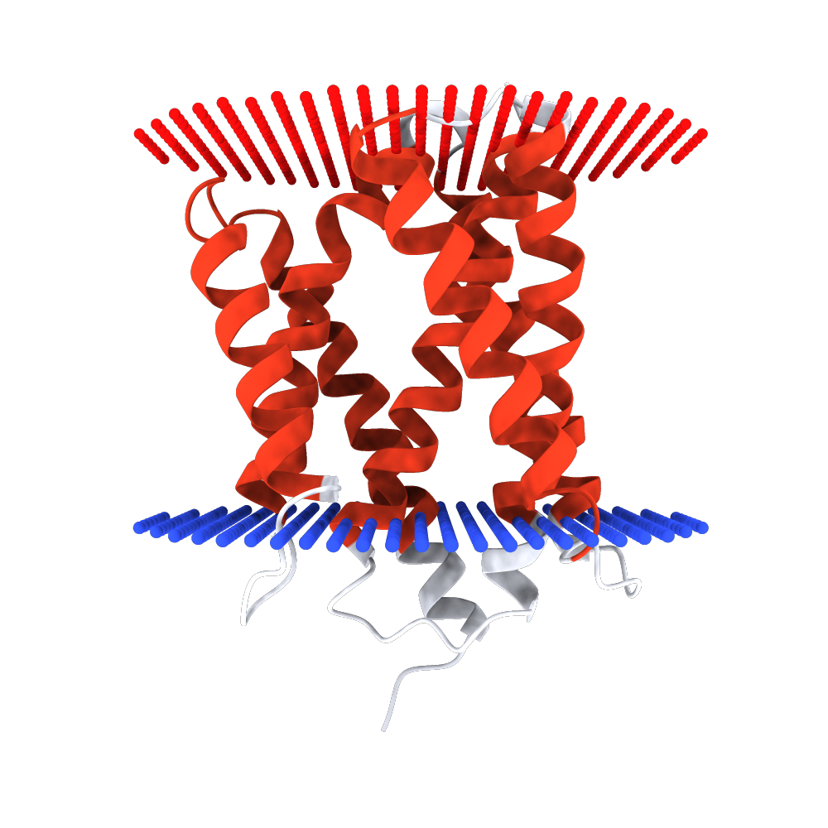
NWChem - MD Challenges
pH 8
1 Million atom simulations
Conformational changes take about a microsecond (1e⁻⁶)
Time resolution of the simulation is a femtosecond (1e⁻¹⁵)
Storing everything 8*4*1e⁶*(1e⁻⁶/1e⁻¹⁵)=32 PB (1 PB = 1000 GB)
Typical approach: uniform sampling Store 1 out of 1000 structures
Not very intelligent
pH 6
Y. Chang, R. Bruni, B. Kloss, Z. Assur, E. Kloppmann, B. Rost, W. A. Hendrickson, Q. Liu. Structural basis for a pH-sensitive calcium leak across membranes. Science 344, pp. 1131-1135.

Slide 8
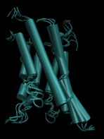
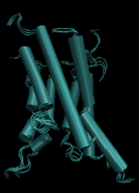
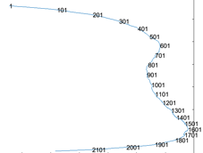
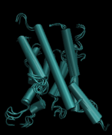
Motivation / Challenges
Motivation
Not all the trajectories are interesting
Only interested in significant phase change event
Challenges
The atoms vibrate significantly
Difficult to compress
Low dimensional manifold projection of different state of MD trajectories

Slide 9
Batch Approach
Manifold Learning for MD trajectories
Learn the intrinsic relations between time points
Less vibrational noise than original space
Effectively compress high dimensional coordinates
Important / Interesting event detection
L2 normalized gradient changes
Not focus on how fast atoms moves
But focus on docking or conformational changes
Mean filter for smoothed trajectories
Gradient based changes can be sensitive local fluctuations
Smoothed manifold helps to stabilize trajectories

Slide 10
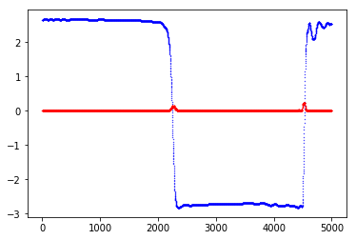
A Case Study

Slide 11
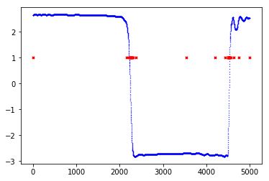
A Case Study – 32 Samples

Slide 12
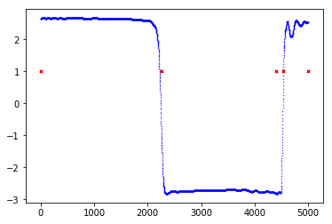
A Case Study – 5 Samples

Slide 13
Online Adaptive Approach
Manifold Learning for MD trajectories
Matrix Sketch of MD trajectories
Important / Interesting event detection
Weighted Reservoir Sampling of gradient changes

Slide 14
Streaming SVD
Frequent Items
Capture top k frequent items from the item stream

Slide 15
Streaming SVD
Frequent Items
Capture top k frequent items from the item stream
By setting

Slide 16
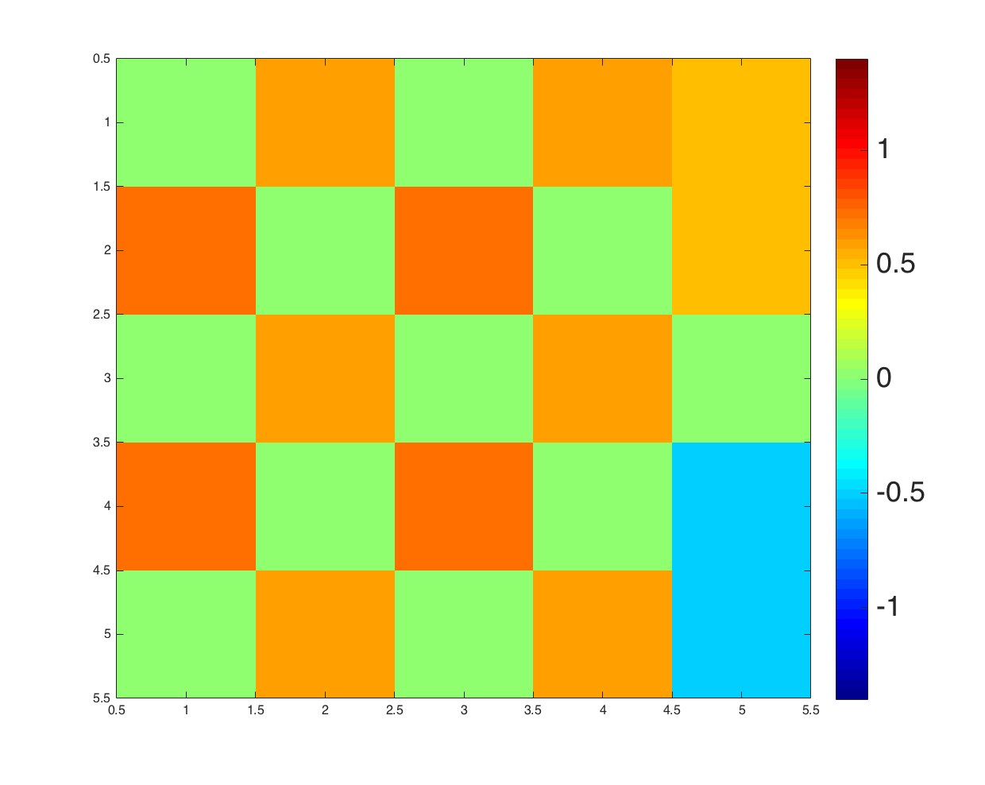
Streaming SVD
Frequent Directions
Capture top k frequent directions from data stream

Slide 17
Streaming SVD
Frequent Directions
Capture top k frequent directions from data stream

Slide 18
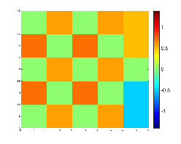
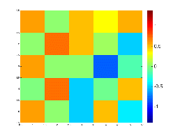
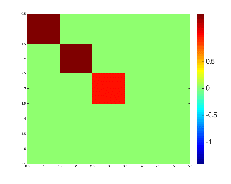
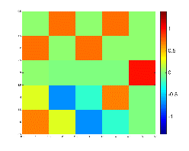
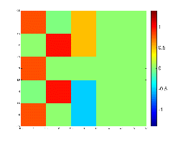
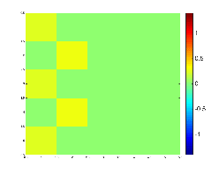
Streaming SVD
Frequent Directions
Capture top k frequent directions from data stream

Slide 19
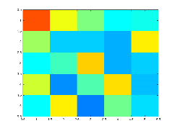
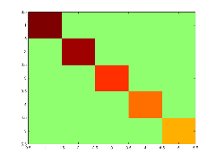
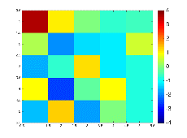
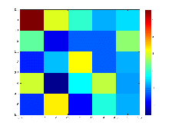
Streaming SVD
Our extension
Why one at a time?

Slide 20
A Case Study – 32 Samples

Slide 21
A Case Study – 5 Samples

Slide 22
Backup

