Slide 1
streaming classical multidimensional scaling
Xi Zhang, hAO huang, Klaus mueller, shinjae yoo
Brookhaven National Laboratory
Stony Brook University

Slide 2

contents
Streaming classical multidimensional scaling
Introduction
    Multidimensional Scaling (MDS)
    Classical Multidimensional Scaling (cMDS)
    Adapting for streaming
Algorithm
Experiments

Slide 3
contents
Streaming classical multidimensional scaling
Introduction
    Multidimensional Scaling (MDS)
    Classical Multidimensional Scaling (cMDS)
    Adapting for streaming
Algorithm
Experiments

Slide 4
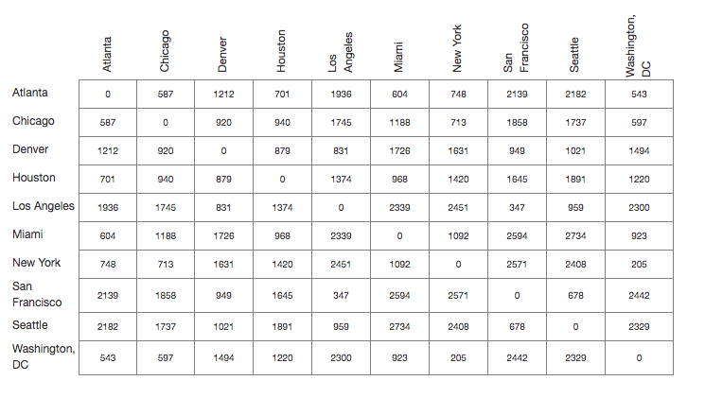
What’s Multidimensional scaling (MDS)?
scmds - introduction
Matrix of distances between cities
https://www.benfrederickson.com/multidimensional-scaling/

Slide 5


What’s Multidimensional scaling (MDS)?
scmds - introduction
Multidimensional scaling (MDS) is a widely used dimensionality reduction method that preserves similarity/dissimilarity among data in a lower dimensional space.
Goal: minimizing the objective function:
    where is the “distance” in high dimensional space and is the “distance” in a lower dimensional space.
Joseph B Kruskal and Myron Wish. Multidimensional scaling, volume 11. Sage, 1978.

Slide 6
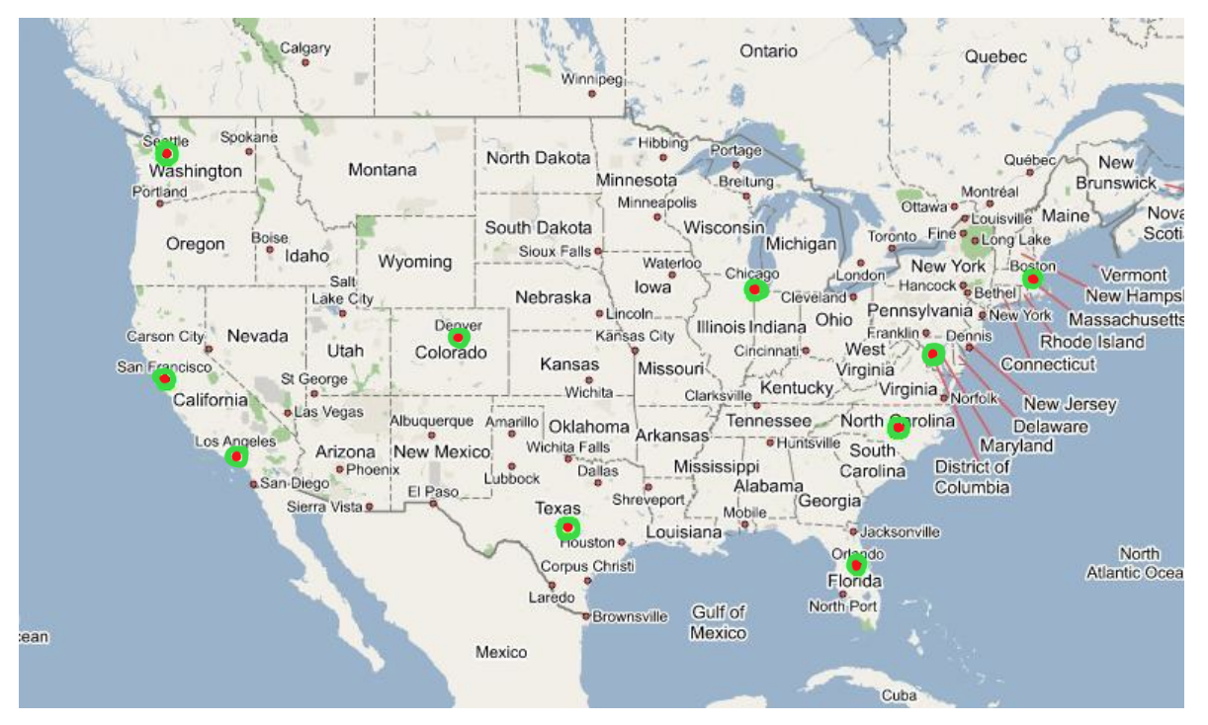
What’s Multidimensional scaling (MDS)?
scmds - introduction
Scatter plot by MDS
Compare with real map
https://www.benfrederickson.com/multidimensional-scaling/

Slide 7
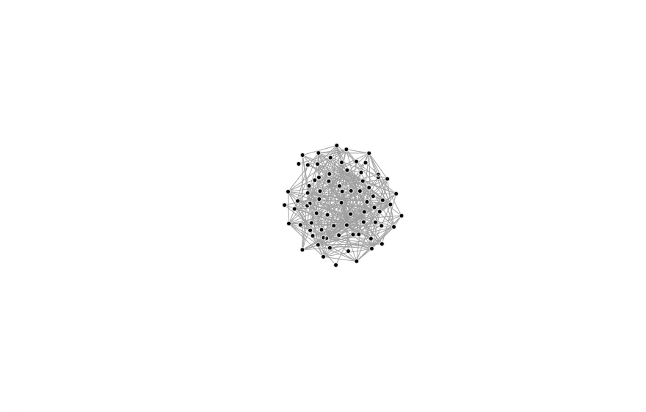
What’s Multidimensional scaling (MDS)?
scmds - introduction
It is a spring-like system

Slide 8
contents
Streaming classical multidimensional scaling
Introduction
    Multidimensional Scaling (MDS)
    Classical Multidimensional Scaling (cMDS)
    Adapting for streaming
Algorithm
Experiments

Slide 9

different mds methods
scmds - introduction
Based on different similarity/dissimilarity measurements, different MDS methods are introduced:
    Classical MDS
    Metric MDS
    Non-metric MDS
This work focuses on classical MDS (cMDS), which preserves the Euclidian distance in lower dimensional space.

Slide 10
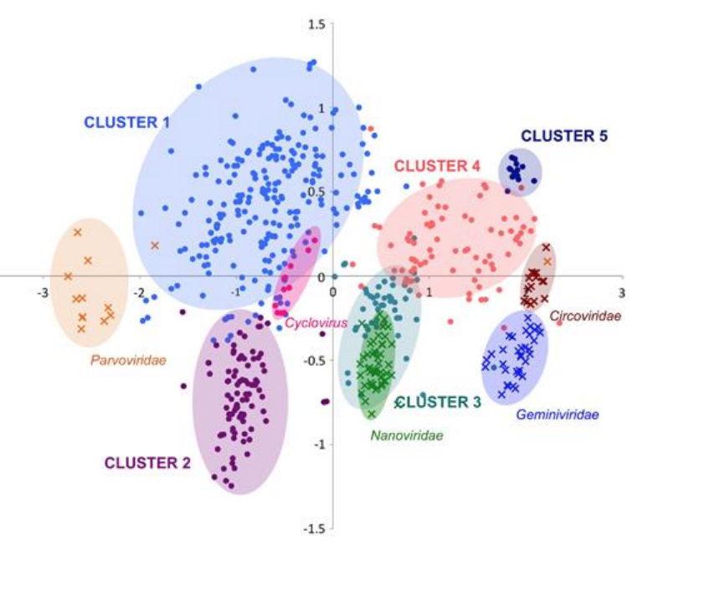
cLASSICAL MULTIDIMENSIONAL SCALING (CMDS)
scmds - introduction
Application 1: Dimensionality reduction
http://www3.cs.stonybrook.edu/~mueller/teaching/cse564/dimensionreduction.pdf

Slide 11
cLASSICAL MULTIDIMENSIONAL SCALING (CMDS)
scmds - introduction
Application 2: Data context map
Shenghui Cheng and Klaus Mueller. 2016. The data context map: Fusing data and attributes into a unified display. IEEE transactions on visualization and computer graphics 22, 1 (2016), 121–130.

Slide 12
contents
Streaming classical multidimensional scaling
Introduction
    Multidimensional Scaling (MDS)
    Classical Multidimensional Scaling (cMDS)
    Adapting for streaming
Algorithm
Experiments

Slide 13
Streaming data
scmds - introduction
Many applications are generating data all the time
NSLS-II : Newest and brightness synchrotron in the world
LHC ATLAS: Largest tier 1 center outside CERN
CFN-TEM: A widely used research tool
We need real time analyzing tool
Adapt classical MDS into streaming fashion

Slide 14
contents
Streaming classical multidimensional scaling
Introduction
    Multidimensional Scaling (MDS)
    Classical Multidimensional Scaling (cMDS)
    Adapting for streaming
Algorithm
Experiments

Slide 15
Challenges
SCmds - ALGORITHM
Distance matrix for data stream?
  Don’t need to compute the distance explicitly!
  We proved that, by using the normalized data with a feature side centering operation, one can get the same cMDS results as using the distance matrix.
Limited memory?
  We extended the Matrix Sketch [1] approach and used a much smaller dataset to approximate all the arrived data.
Concept Drift?
  We introduced realignment methods to overcome the feature shifting over time.
[1] Edo Liberty. Simple and deterministic matrix sketching. In Proceedings of the 19th ACM SIGKDD international conference on Knowledge discovery and data mining, pages 581–588. ACM, 2013.

Slide 16
Limited memory requirement
SCmds - ALGORITHM
We can’t store all the arrived data during streaming
In the streaming cMDS algorithm, a fix data batch is used as the data sketch of all the observed data.
The program is scalable and could run in near-real time.
Edo Liberty. Simple and deterministic matrix sketching. In Proceedings of the 19th ACM SIGKDD international conference on Knowledge discovery and data mining, pages 581–588. ACM, 2013.

Slide 17
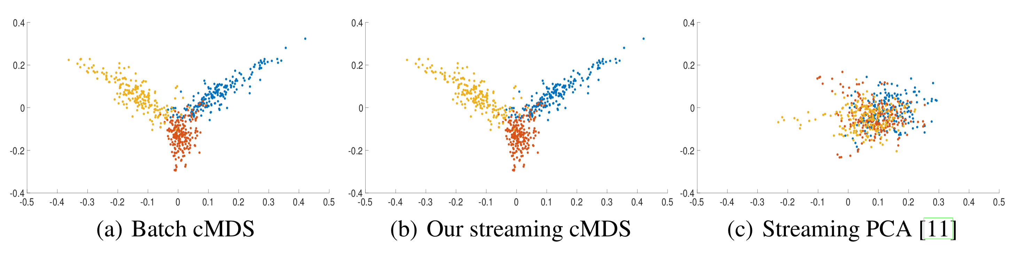
embedding REALIGNMENT
SCmds - ALGORITHM
Feature basis changed during streaming!
Figure: 2D coordinates generated with different methods using a 1700×600 synthetic data. Due to the concept-drift within data stream, streaming PCA (sPCA) fails to embed the data properly while our streaming algorithm performs close to batch cMDS.
[11] Ioannis Mitliagkas, Constantine Caramanis, and Prateek Jain. Memory limited, streaming pca. In Advances in Neural Information Processing Systems, pages 2886–2894, 2013.

Slide 18
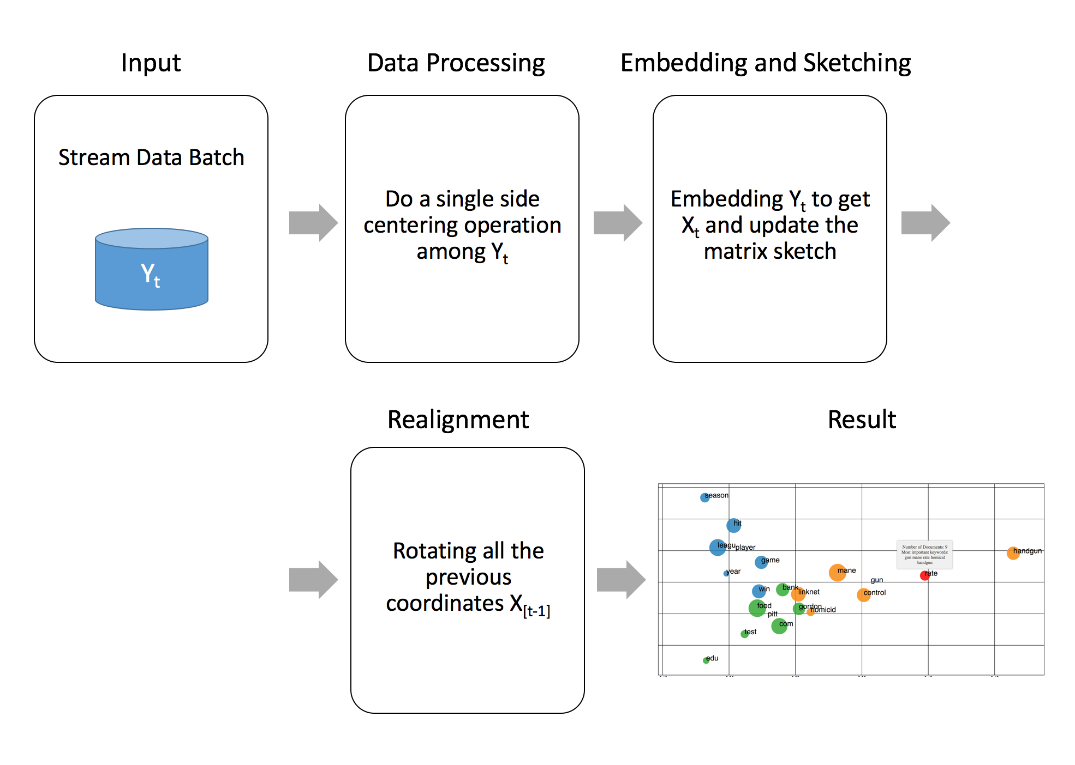
workflow
SCmds - ALGORITHM

Slide 19
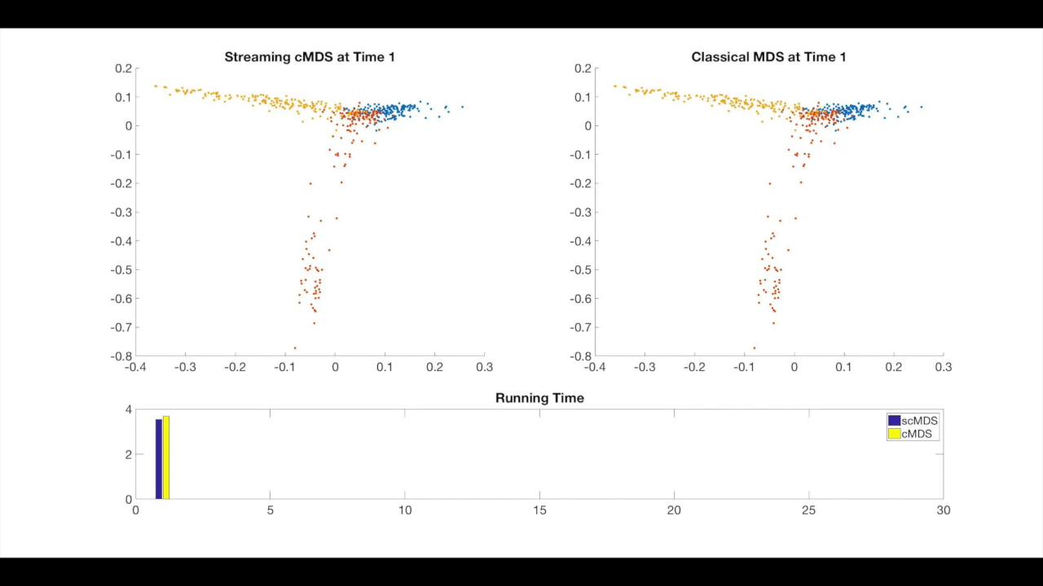
scmds
SCmds - algorithm

Slide 20
Contributions
SCmds - ALGORITHM
scMDS, our streaming, one-pass cMDS algorithm
  High-quality approximation
  Limited memory requirement
  Operates in near-real time
  Scalable on large datasets
  Stable on various situation

Slide 21
contents
Streaming classical multidimensional scaling
Introduction
    Multidimensional Scaling (MDS)
    Classical Multidimensional Scaling (cMDS)
    Adapting for streaming
Algorithm
Experiments

Slide 22
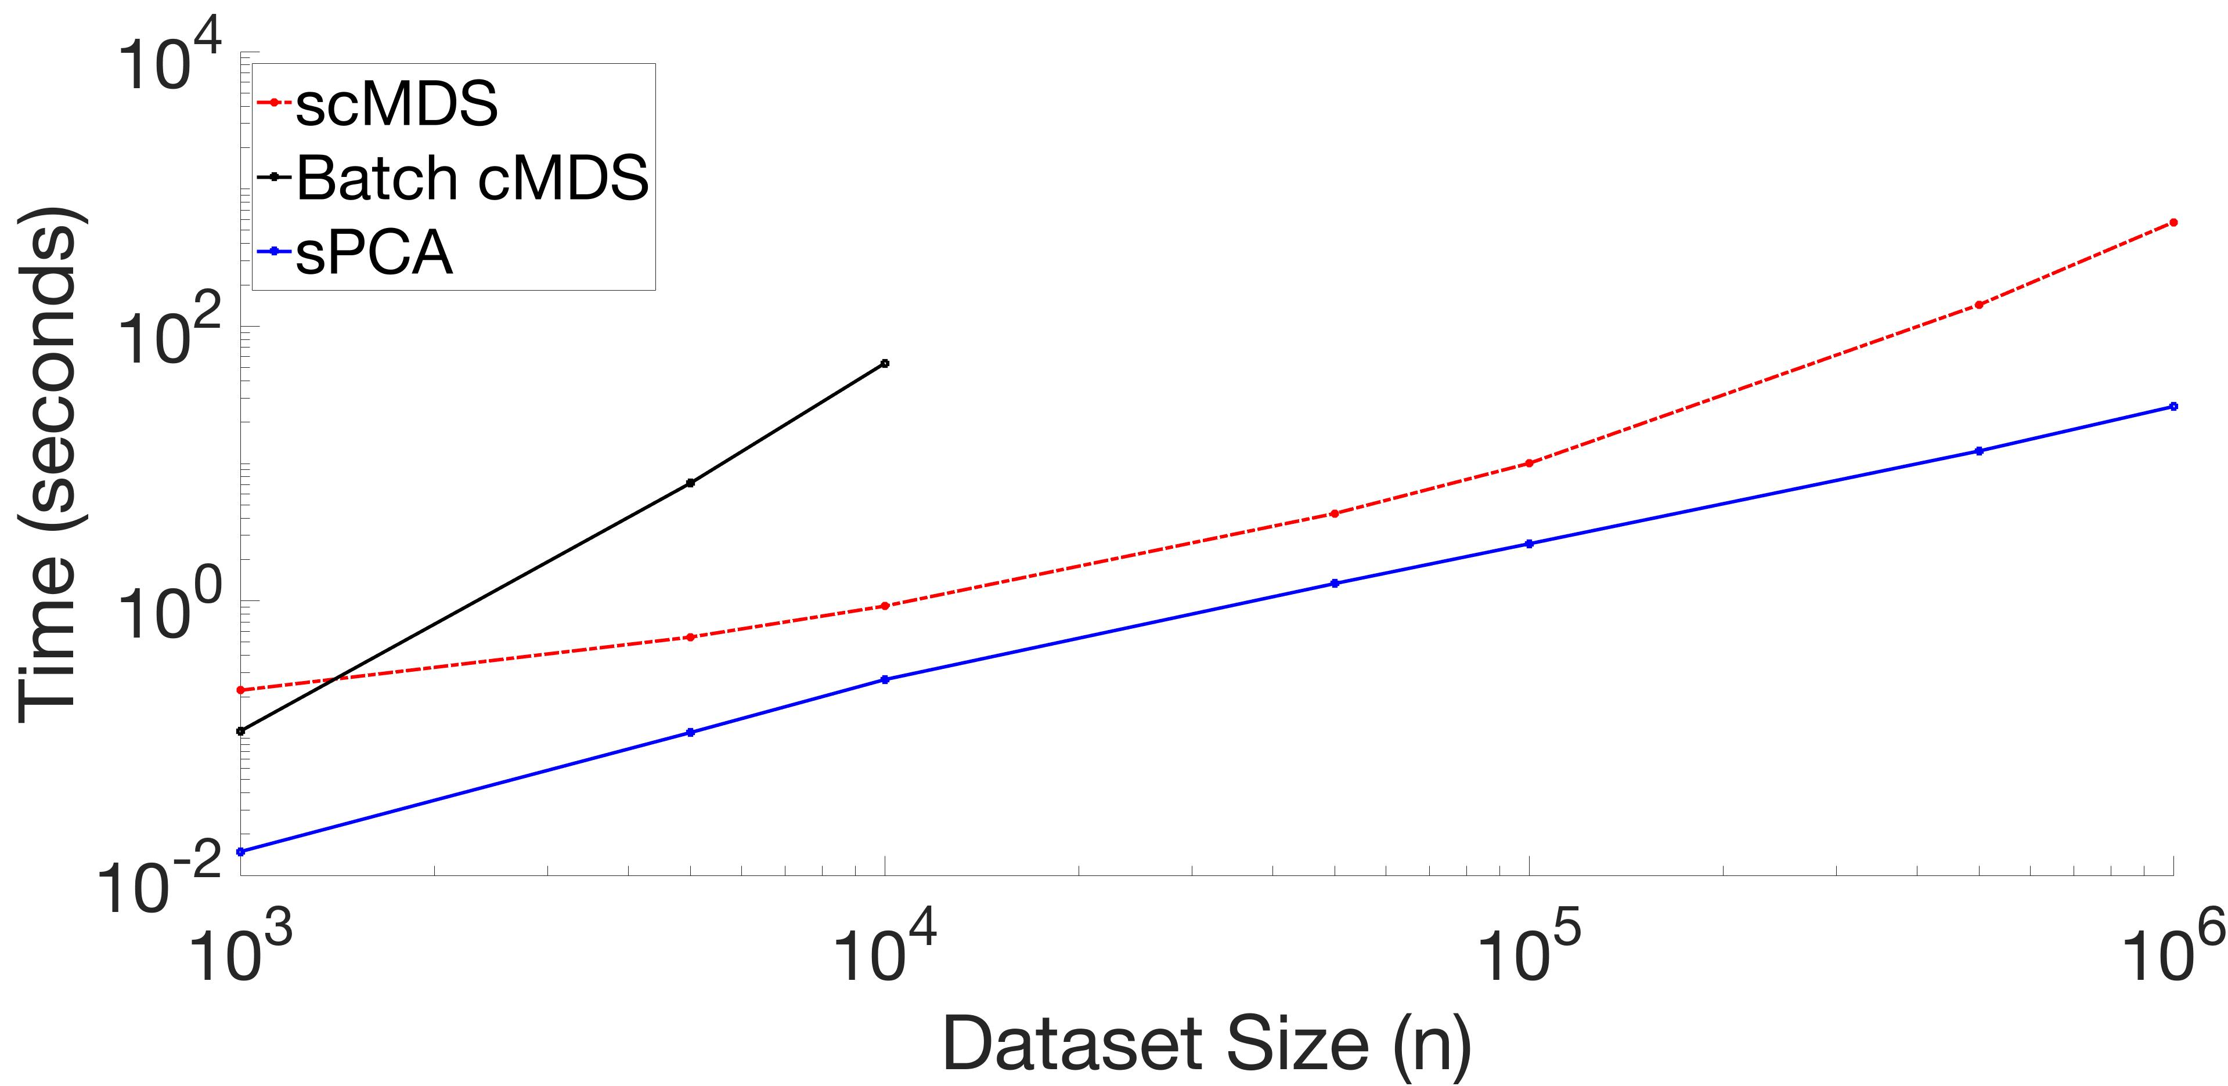
running time
SCmds - experiments
Figure: The batch cMDS does not scale (out of memory beyond 10^4) while the scMDS and sPCA approaches scale well.

Slide 23
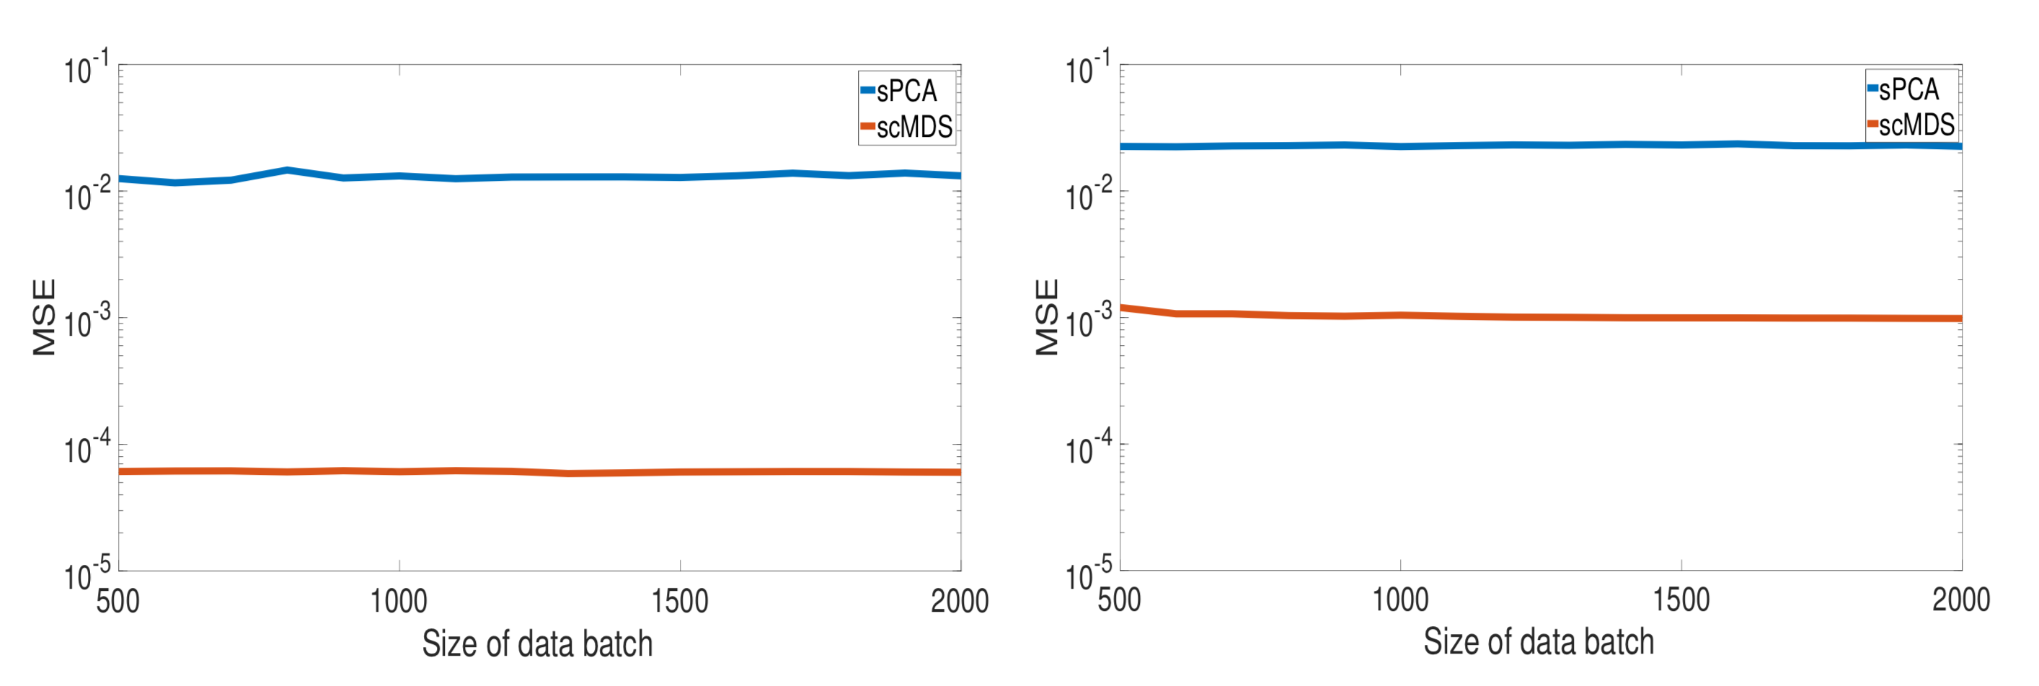
quality study
SCmds - experiments
Reuters Corpus Volume I (RCV1): an archive of over 800,000 manually categorized newswire stories
Figure: Performance comparison between sPCA and scMDS among RCV1 with different sizes of streaming data batch. Our scMDS algorithm provides competitive accuracy.

Slide 24
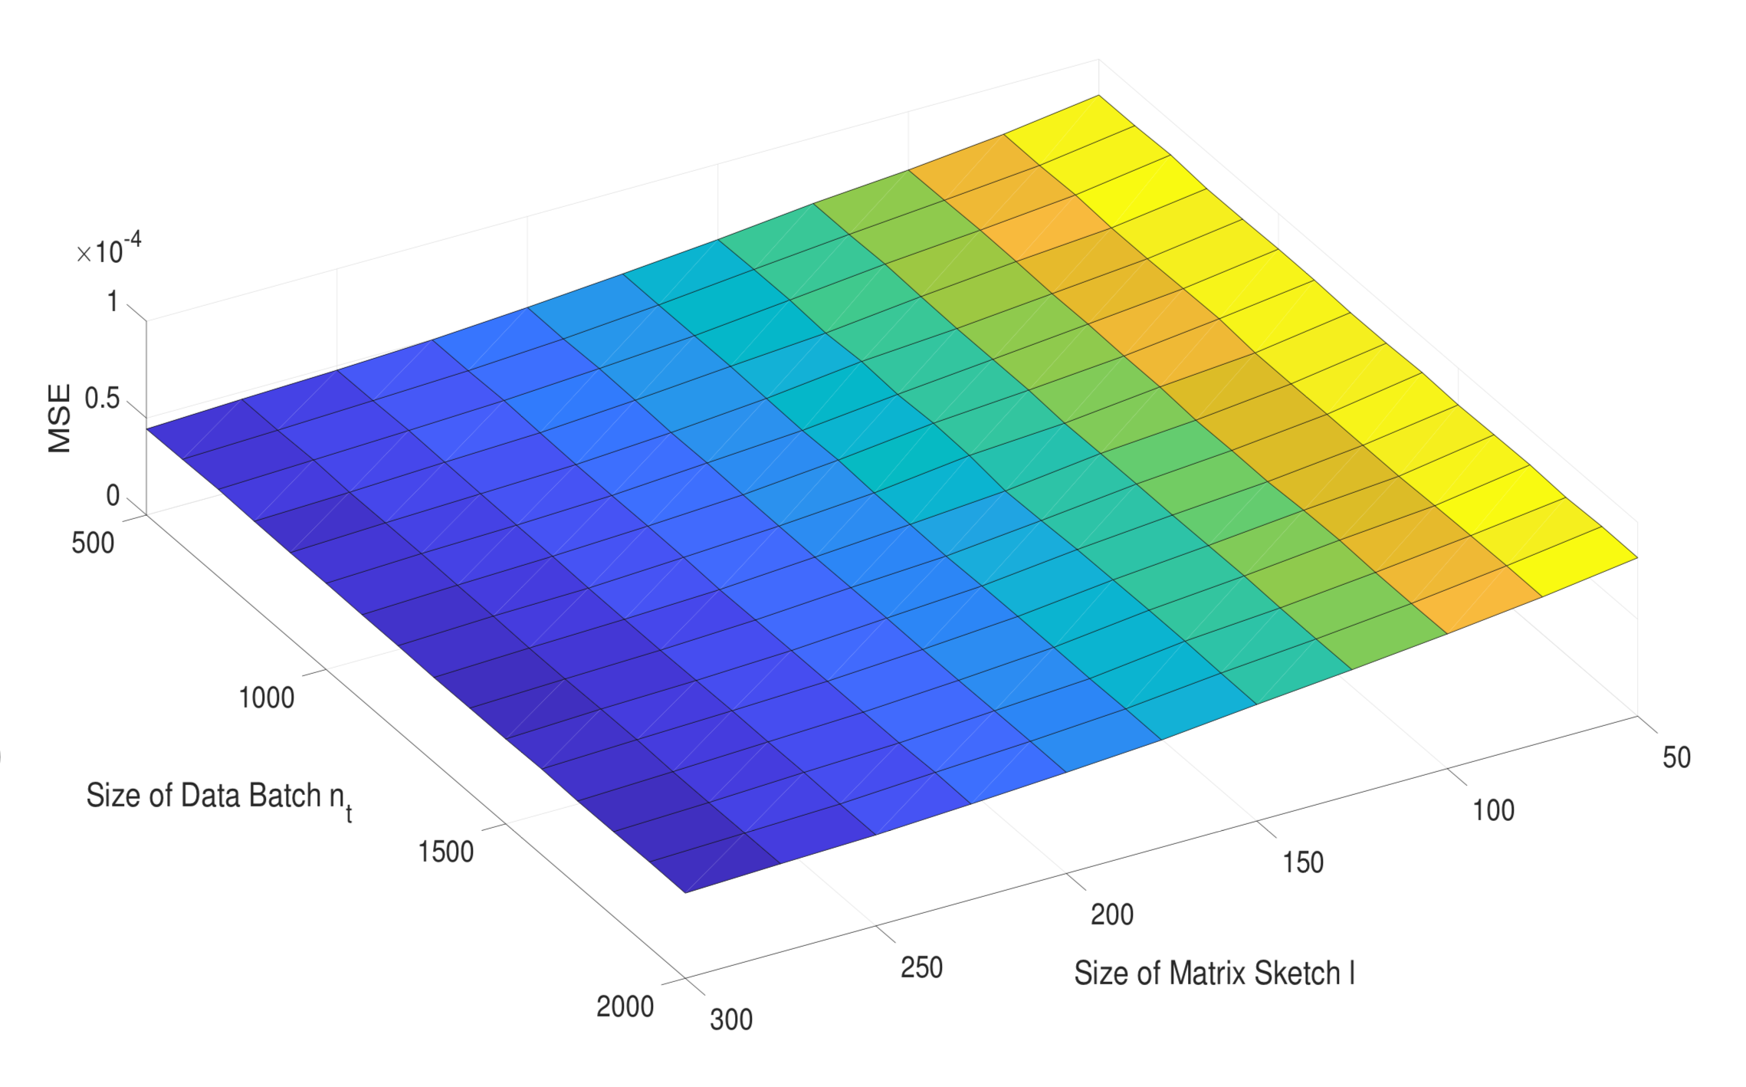
stability study
SCmds - experiments
Figure: Sensitivity check among RCV1. Our scMDS algorithm is stable among different parameter settings.

Slide 25
Streaming classical multidimensional scaling
Thank you!

Slide 26
Streaming classical multidimensional scaling
[BACKUP SLIDES]

Slide 27

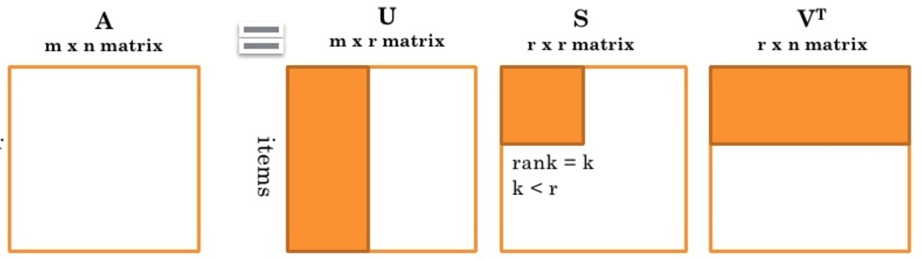
Singular Value Decomposition (svd)
Streaming classical multidimensional scaling
SVD gives us a way to treat the multivariate time series
Database with m time series, each of length n, can be represented by a m × n matrix A. A can always be written in the form
[1] https://rstudio-pubs-static.s3.amazonaws.com/287384_361b4e0daf5648fcafb404cade2e2bc1.html

