Slide 1
The BNL Computational Science Initiative welcomes you to NYSDS 2018
Kerstin Kleese van Dam
Director
Computational Science Initiative

Slide 2
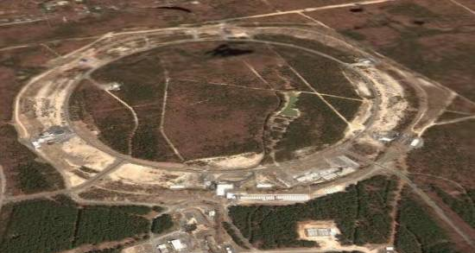
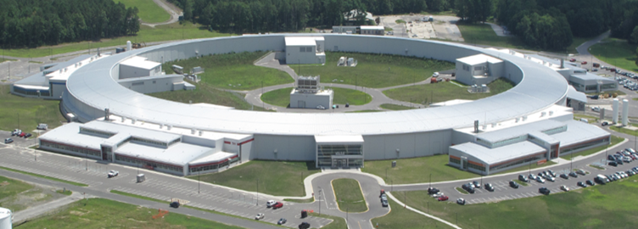
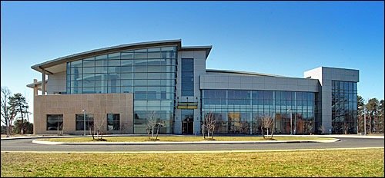
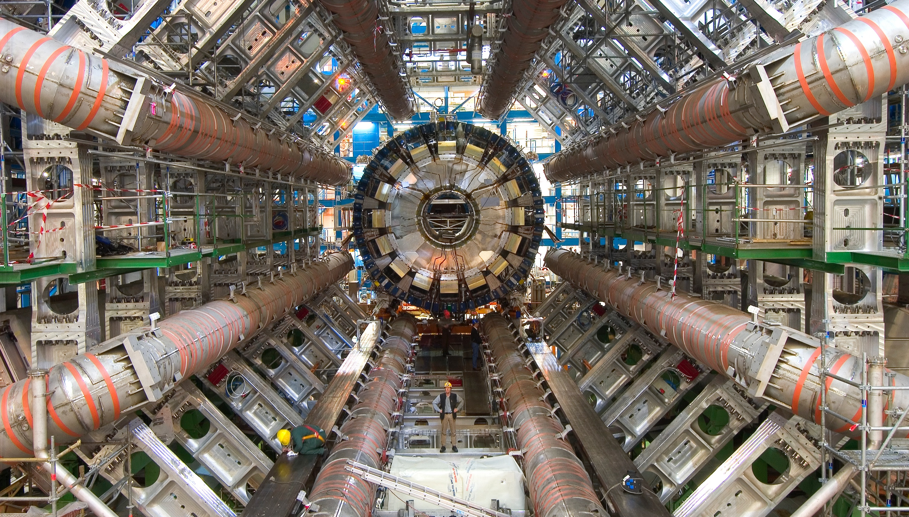
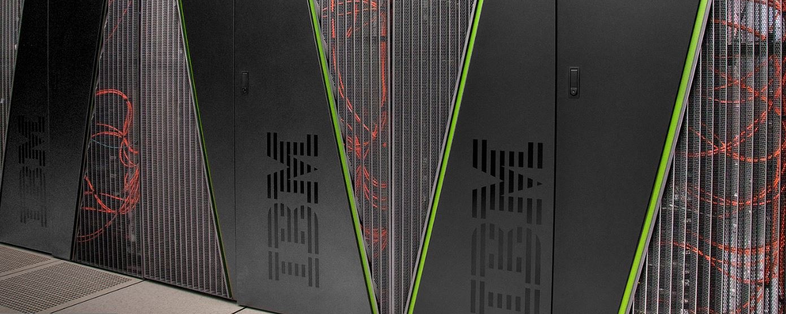
BNL is a Data-Driven Science Laboratory
BNL supports data-rich experimental facilities:
Relativistic Heavy Ion Collider (RHIC
National Synchrotron Light Source II (NSLS-II):
Center for Functional Nanomaterials (CFN):
Accelerator Test Facility (ATF)
Large Hadron Collider (LHC) ATLAS: largest Tier 1 Center outside CERN
Atmospheric Radiation Measurement (ARM) program
Belle II: computing for neutrino experiment
Quantum chromodynamics (QCD) computing facilities for BNL, RIKEN, & US QCD communities
RHIC
NSLS II
CFN
ATLAS
QCD

Slide 3
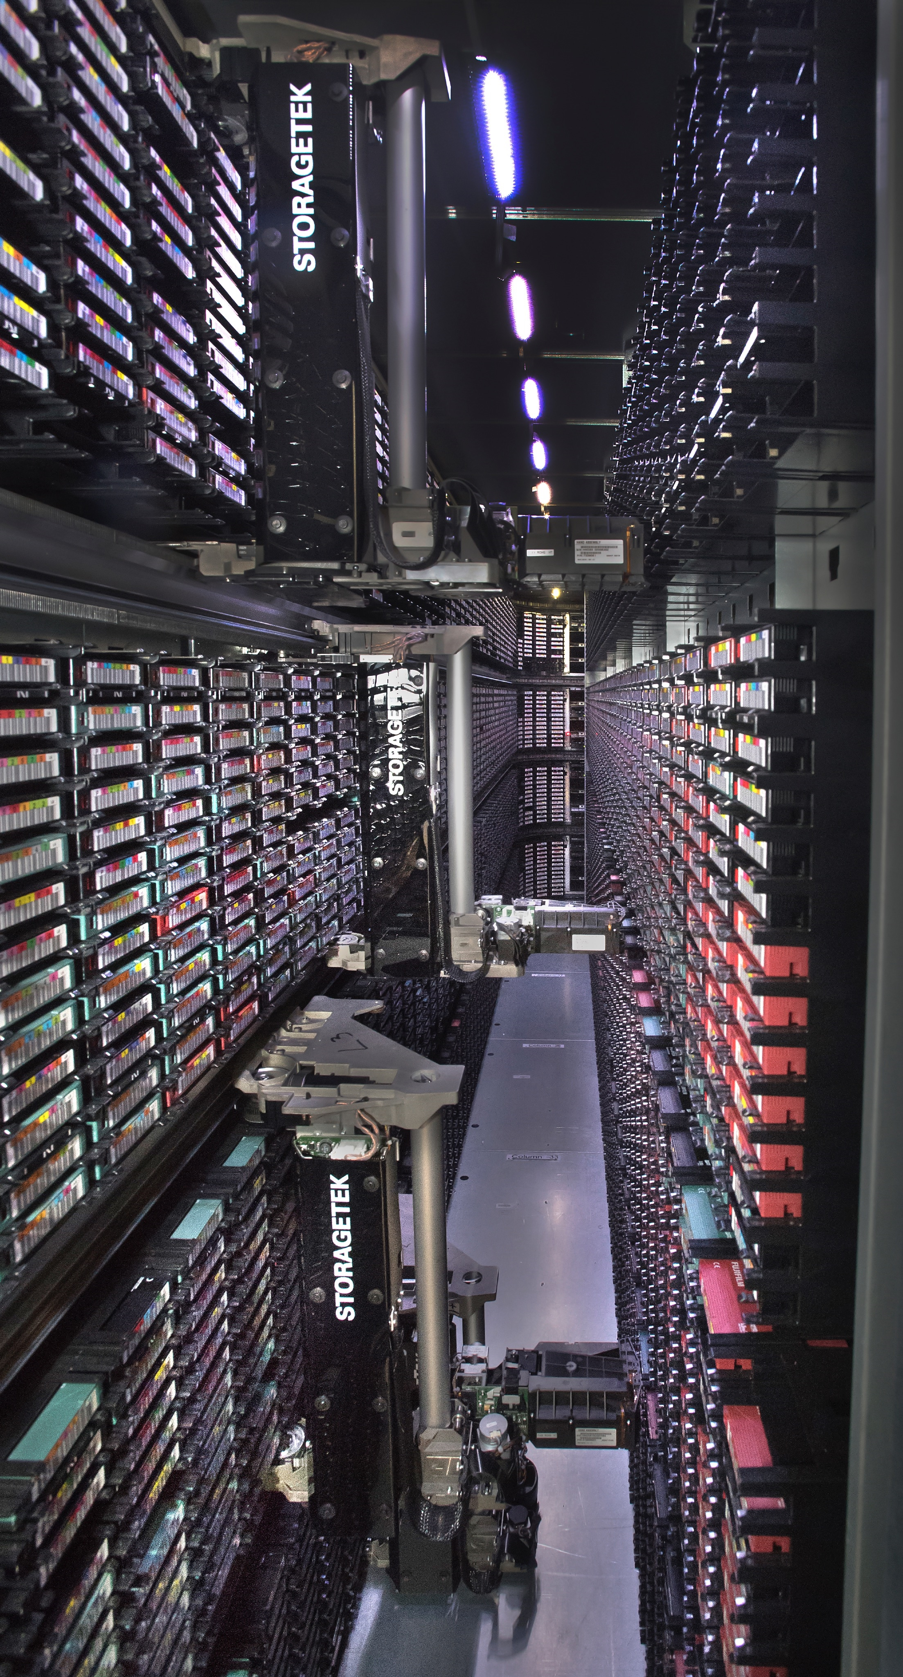
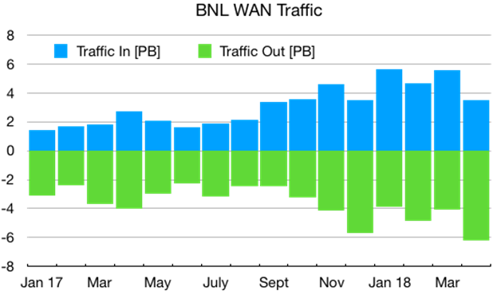
BNL Data and Computing Statistics
Largest scientific archive in the U.S., 3rd largest in the world (ECMWF, UKMO)*
99.5% service availability guaranteed
2017:
>130 PB of catalogued data archived for long-term, frequent reuse (+30 PB in 2017)
500 PB of data analyzed (2016, 400 PB)
~4 PF HTC and HPC computing – Broadwell/P100, KNL, Skylake
2018 expected: 9 PB/month,110 PB/year
Tape library
*http://www.hpss-collaboration.org/customersT.shtml

Slide 4
Making Sense of Data at Exabyte Scale and Beyond
Real-time analysis of ultra-high-throughput data streams
Required by: new in situ and in operando experiments at large-scale facilities (e.g., NSLS-II, CF, and RHIC); data-intensive science workflows possible in the Exascale Computing Project
Research: integrated, extreme-scale machine learning and visual analytics methods for the real-time analysis and interpretation of streaming data
Autonomous optimal experimental design
Required by: high-throughput experiments, complex multi-modal experimental studies, combinatorial or ensemble numerical modeling studies
Research: goal-driven capability that optimally leverages theory, modeling/simulation, and experiments for the autonomous design and execution of experiments
Interactive exploration of multi-petabyte scientific data sets
Required by: nuclear and high-energy physics, computational biology, and climate science communities with multi-petabyte data collections
Research: integrated research into the required novel hardware, system software, programming models, analysis and visual analytics paradigms

Slide 5
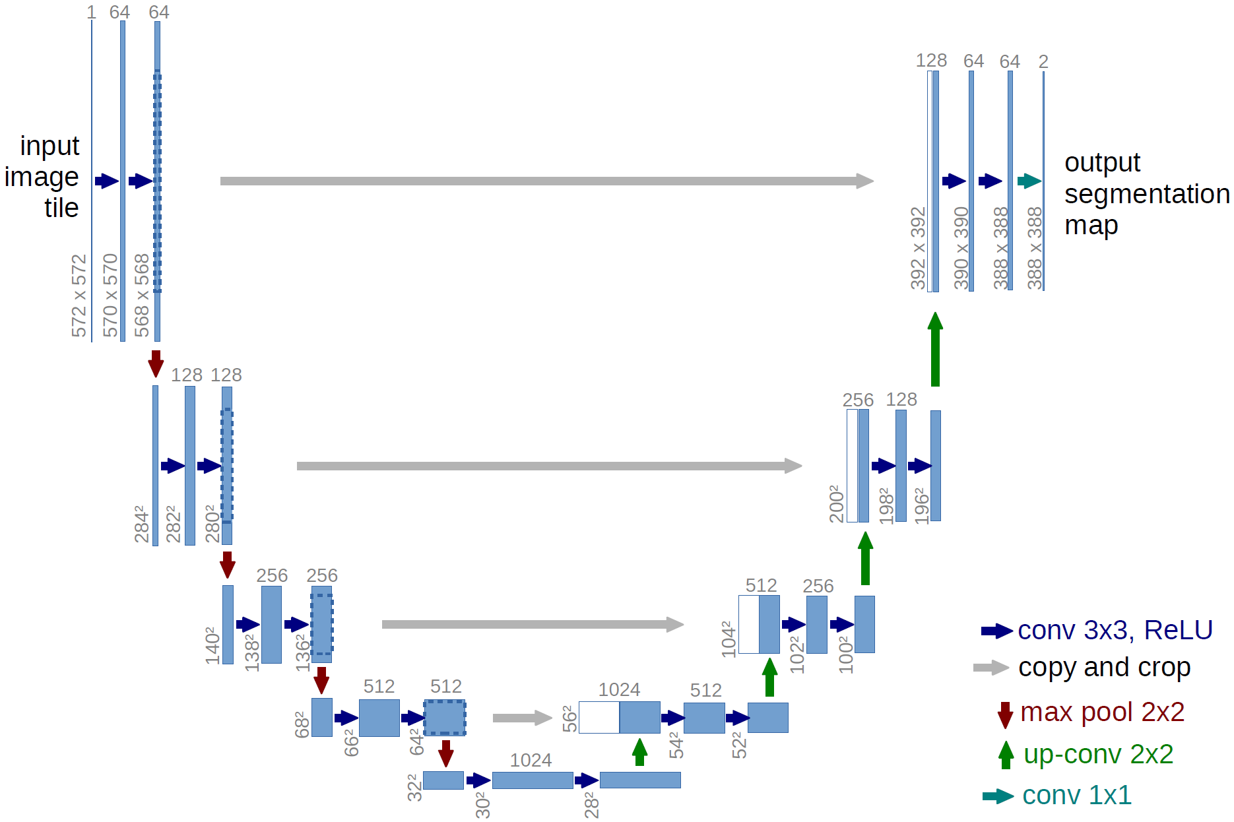
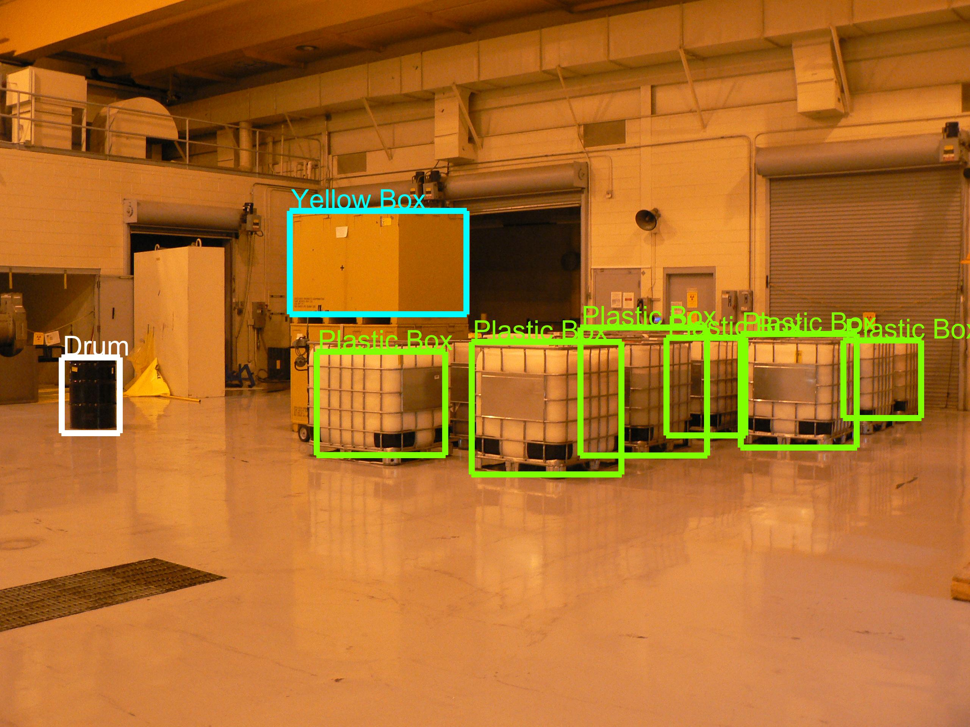
Impactful Machine Learning
Research Leaders in extreme scale, science specific new Machine Learning Methods
Joint Research Center for Machine Learning @ Scale with Carnegie Mellon University
Advanced analysis deployed at several NSLS-II beamlines (HXN, ISS, XPD, CMS) and CFN instruments. Similar techniques now also applied to national security challenges.
Extreme-Scale Multi-Modal Learning Methods for Spatio-Temporal Data were also successfully applied to Alzheimer’s detection and prognosis.
Leading new Exascale Machine Learning project.
CFN – Real Time Particle Detection and Analysis
Original ETEM image
U-Net
Detection result
Object detection in images of simulated nuclear facility
100% Alzheimer’s detection accuracy and 83% prediction accuracy for early-stage Alzheimer’s. The algorithms were trained on magnetic resonance imaging and brain phenotyping clinical data.

Slide 6
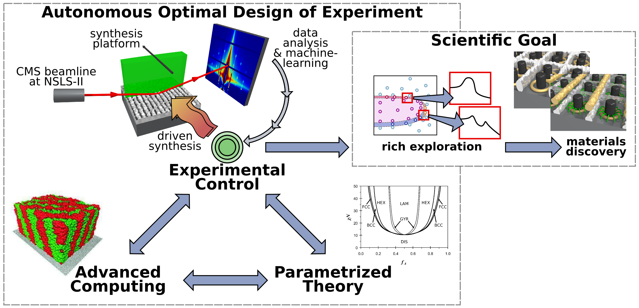
AI driven Optimal Experimental Design
Which experiment(s) should be carried out next in order to achieve a specified goal?
How best to use limited DOE resources for autonomous decision making under uncertainty and with finite resources?
Physics-informed autonomous synthesis for self-assembling materials:
Generate parameterized predictions of equilibrium structure formation
Explicit HPC modeling of time-evolution of polymer molecules assembling into morphologies
Machine Learning to predict future configurations
Markov decision methods for experimental control under uncertainty
Notes:
CFN, NSLS II, CSI Collaboration
We will advance beyond existing work (by ourselves and other groups) by coupling the known physics of
the material under study deeply into the autonomous experimental loop; in particular by using
analytic field equations to capture equilibrium behavior, machine-learning approximants to
estimate the role of non-equilibrium effects, and HPC modeling to capture the pathway dependence
of assembly.
Decision-making will be treated as solving a constrained optimization problem under uncertainty, where stochastic Markov decision methods can be
applied using experimental data and input from theory/simulation to predict system response and uncertainty. We will take advantage of cost formalisms, which will allow us to impose costs for the autonomous engine to trigger measurements (small costs computed based on measurement
complexity), to trigger computations on a high-performance cluster (intermediate costs associated with computational burden), or to direct the human scientist to synthesize new
samples (high cost). Algorithms that can fairly weight data uncertainties against experimental costs will allow optimal use of finite resources (beamtime, cluster time, experimenter effort) while delivering predictive models with associated uncertainty estimates.

Slide 7
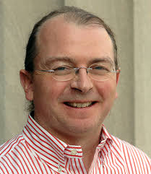
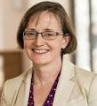
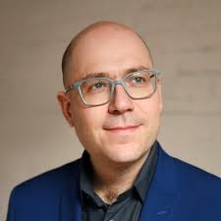
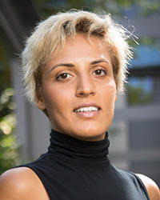
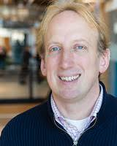
Enabling Scalable Quantum Computing
Setting up NEQsys – North East Quantum Systems Center, with initial partners: Harvard, MIT, Princeton, Columbia, Tufts
Partners: Seth Lloyd (MIT), Alan Aspuru-Guzik (Toronto), Peter Love (Tufts), Margaret Martonosi (Princeton), Prineha Narang (Harvard)
Building teams that leverage BNL and NEQsys strengths
QIS Programming Models
QIS Machine Learning
Quantum Chemistry
Lattice QCD and High Energy Physics
Seth Lloyd
Margaret Martonosi
Alan Aspuru-Guzik
Prineha Narang
Peter Love

Slide 8
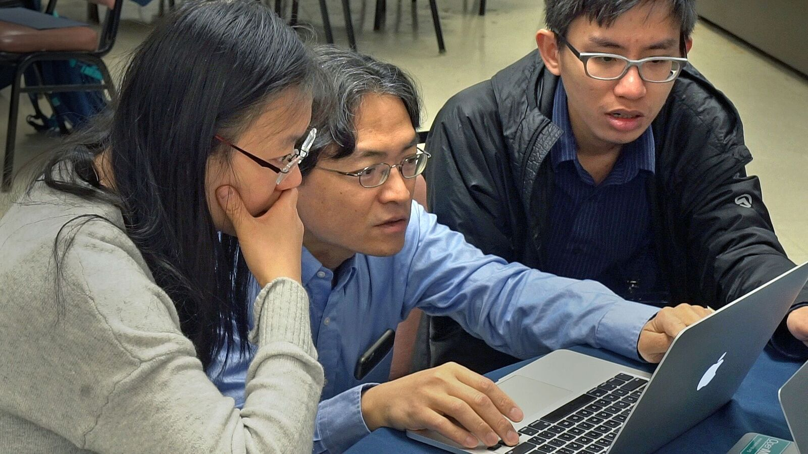
BNL is providing HPC training
Training for Novel Architecture Usage, Programming Models and Performance Analysis and Modeling
In 2017/2018:
GPU Hackathon
IWOMP
OpenMPCon
cOMPunity
PAM
KNL Hackathon
Many courses held in collaboration with the ASCR Exascale Computing Project and the HEP Center for Computational Excellence.

Slide 9
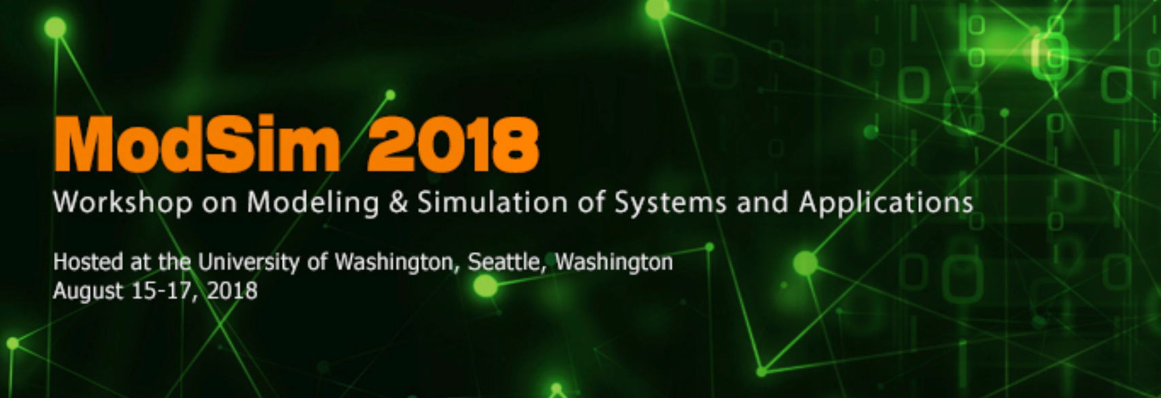
BNL organizes international workshops and conferences

Slide 10
Exciting Program this Week
Monday
Streaming Data Analysis
Big Theory for Big Data
Tuesday
Performance for Big Data
AI Driven Optimal Experimental Design
Wednesday
Quantum Computing and Big Data

Slide 11
Keynote Speakers:
Zohar Karnin (Amazon AWS AI) – Algorithms in Amazon SageMaker
Edward Dougherty Jr. (Texas A&M) – The Knowledge-Data Design Loop
Henry Gabb (Intel) – The Convergence of HPC, Big Data Analytics, and AI in Future Workflows
Payal Das (IBM TJ Watson) – Towards Creative and Interpretable AI for Real-World Applications
Prineha Narang (Harvard University) – Excited States and Quantum Electrodynamical Interactions on NISQ Devices

Slide 12
Conference Co-hosts
Brookhaven National Laboratory (BNL)
Stony Brook University (SBU)
NYU Center for Data Science (NYU)
Institute for Advanced Computational Science at Stony Brook (IACS)
The Moore-Sloan Data Science Environment
IEEE New York Computer Society
Rutgers University (DIMACS)
Columbia University (Data Science Institute)

Slide 13
Big Thank you to our Sponsors:
HPE – sponsors of Monday’s + Tuesday’s Breakfast
NVIDIA – sponsors of Monday’s + Tuesday’s Lunch
RAID – sponsors of Monday’s Poster Session and Wednesday’s Breakfast
IACS – sponsors of Tuesday’s Conference Dinner

Slide 14
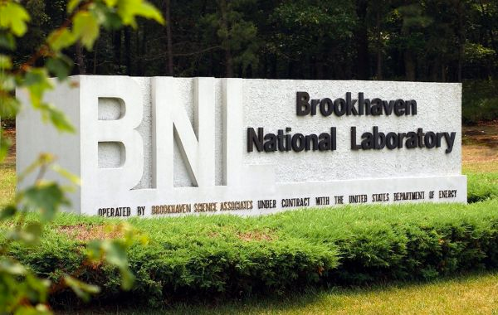
Welcome!

