Slide 1
Structure Determination of Metallic Nanoparticles: A Machine Learning Benchmark
Yuewei Lin, Mehmet Topsakal, Janis Timoshenko, Deyu Lu, Shinjae Yoo, Anatoly I. Frenkel.

Slide 2
Outline
The scientific story of metallic nanoparticles structure determination.
Regression models
Gradient boosted decision tree (GBDT)
Multiple layer perceptron (MLP)
One-dimensional convolutional neural network (1D-CNN)
Transfer learning
Conclusions

Slide 3
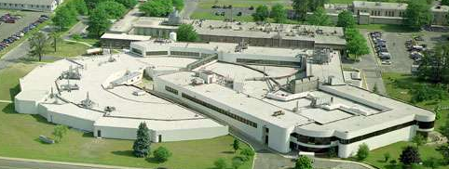
Computational Science Initiative
(Previously: National Synchrotron Light Source)
You are here !!!

Slide 4
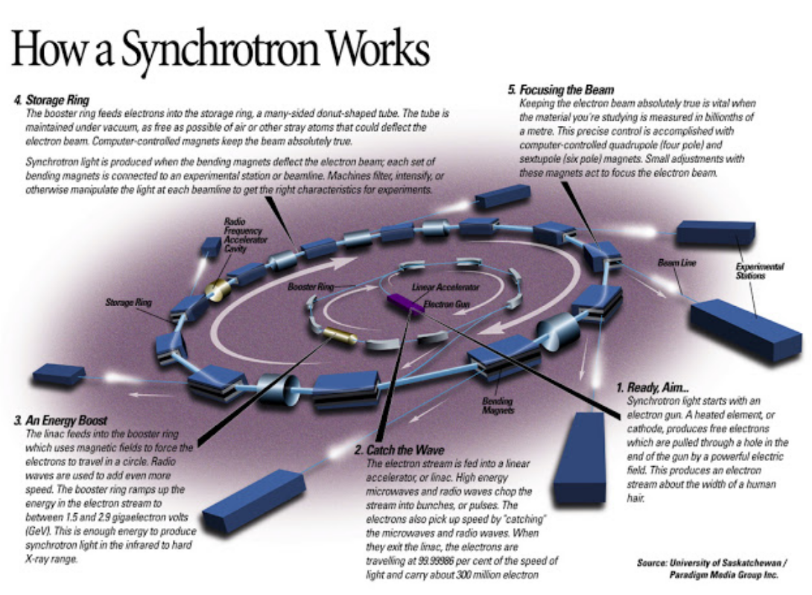
What is a synchrotron ?

Slide 5
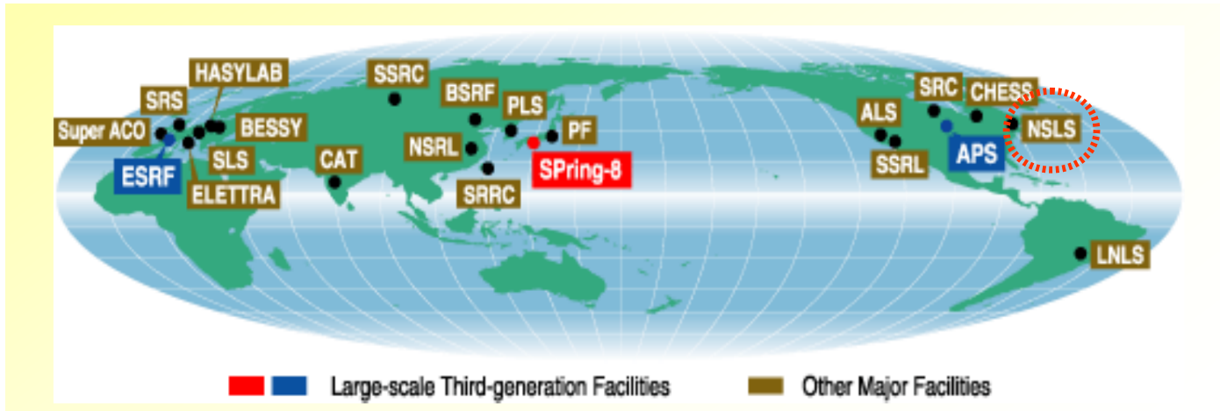
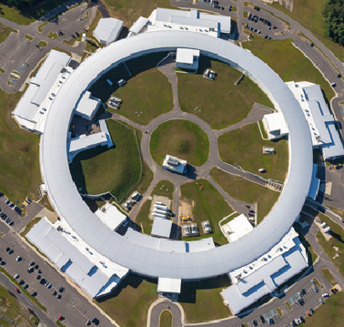
Light sources around the world
NSLS (retired)
NSLS-II
($1B project cost)

Slide 6
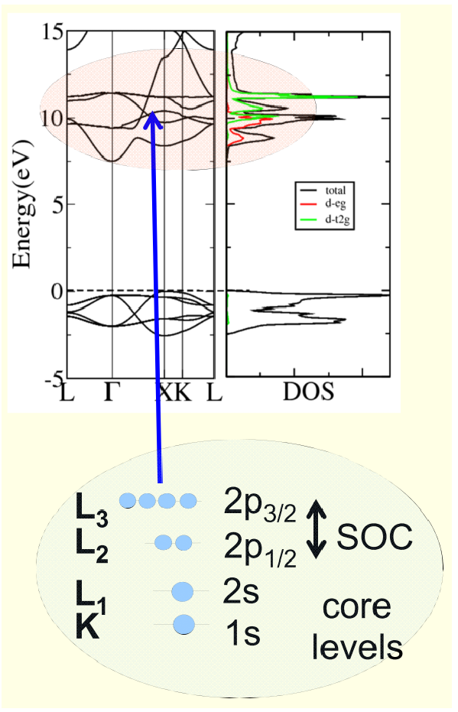
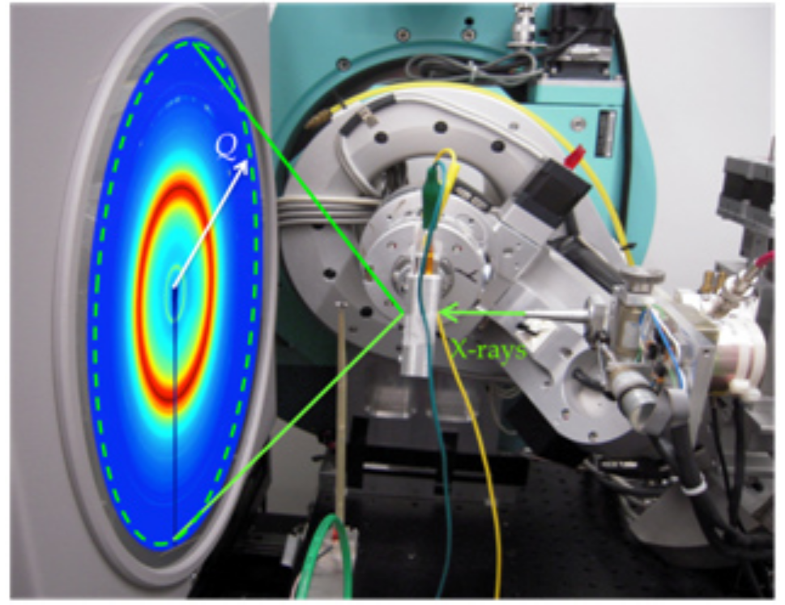
What is light source used for ?
https://www-ssrl.slac.stanford.edu

Slide 7
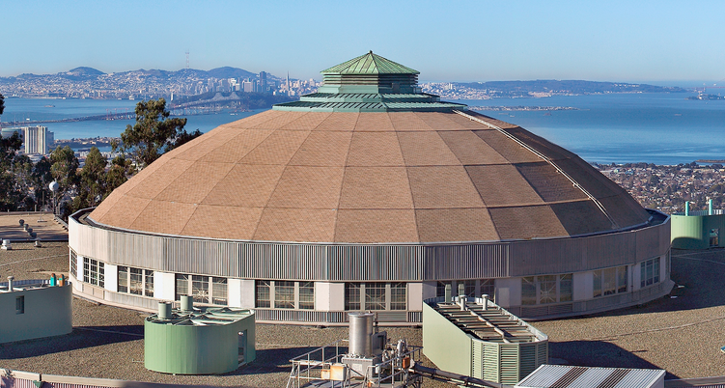
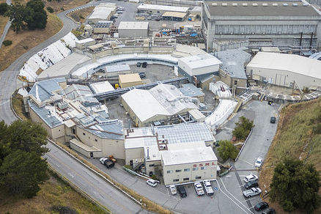
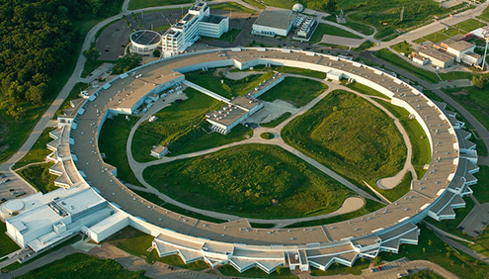
Light sources in US
ALS
NSLS-II
SSRL
APS

Slide 8
Light sources in US
ALS
NSLS-II
SSRL
APS
In 2017, NSLS-II served over 1,000 researchers ("users") from academic, industrial, and government laboratories worldwide.

Slide 9
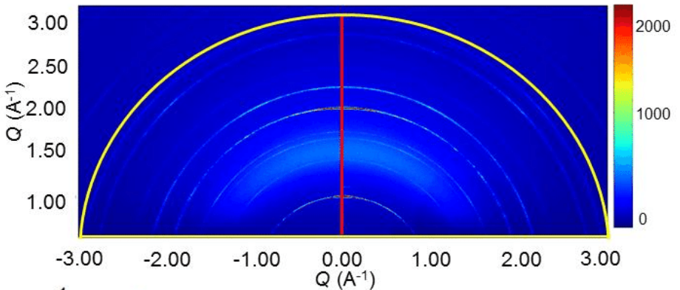
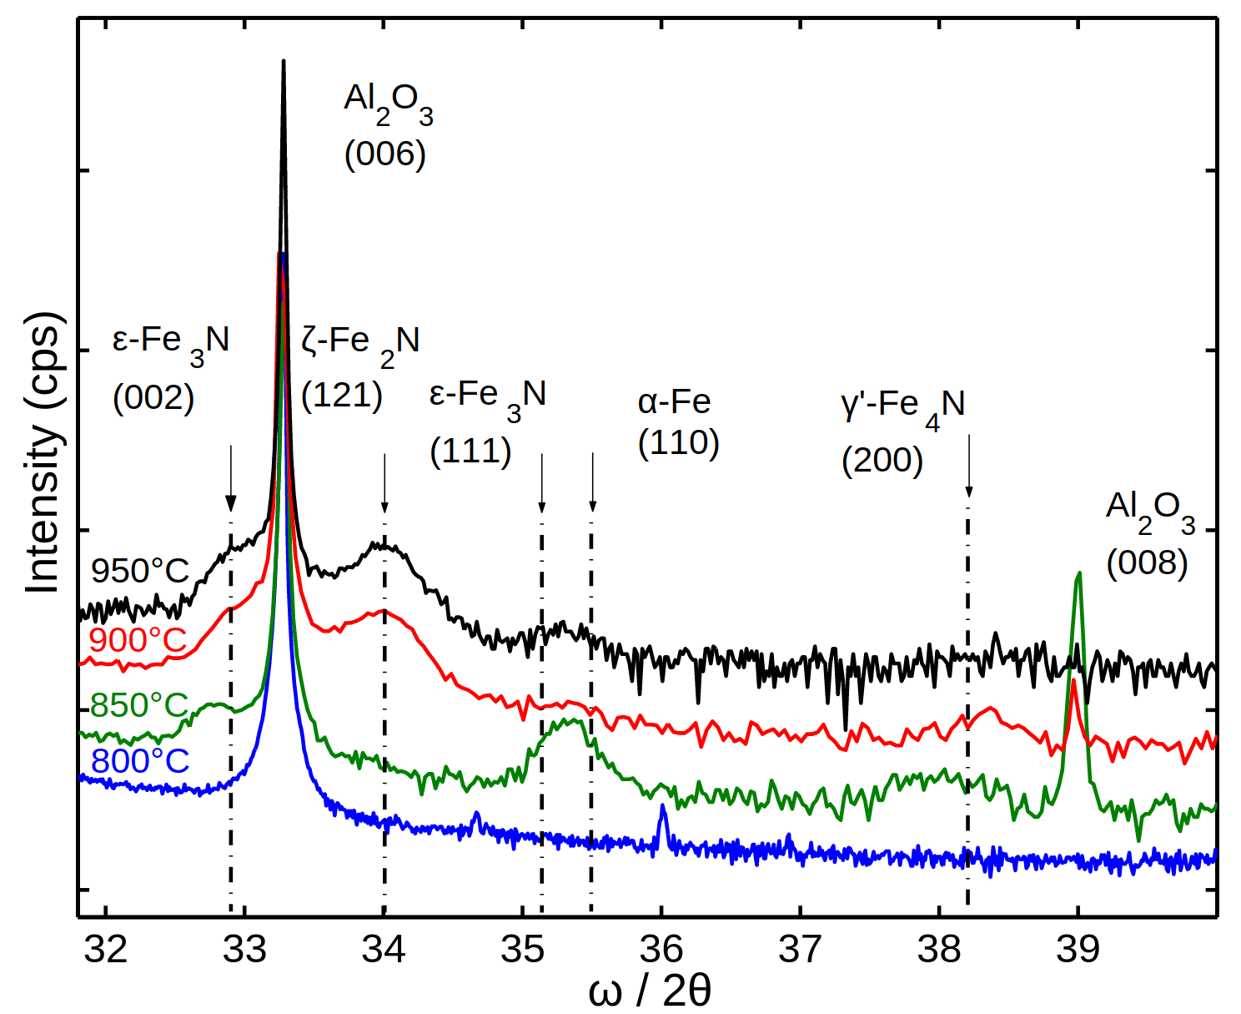
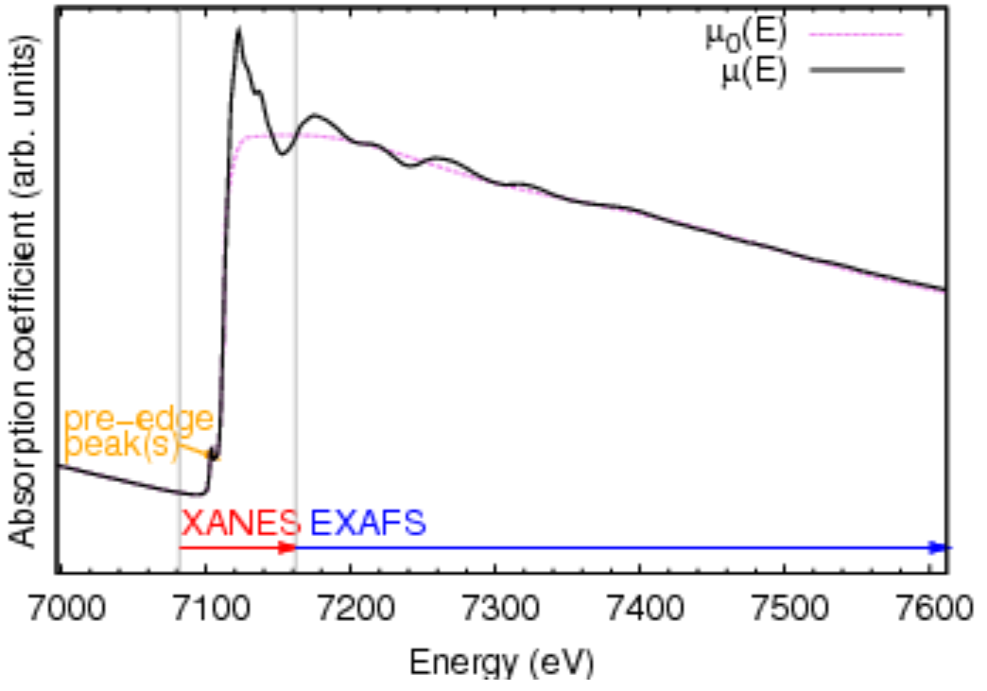
Why do scientists go to light sources ?
???

Slide 10
X-ray absorption near-edge spectroscopy (XANES) is a powerful tool in many scientific fields

Slide 11
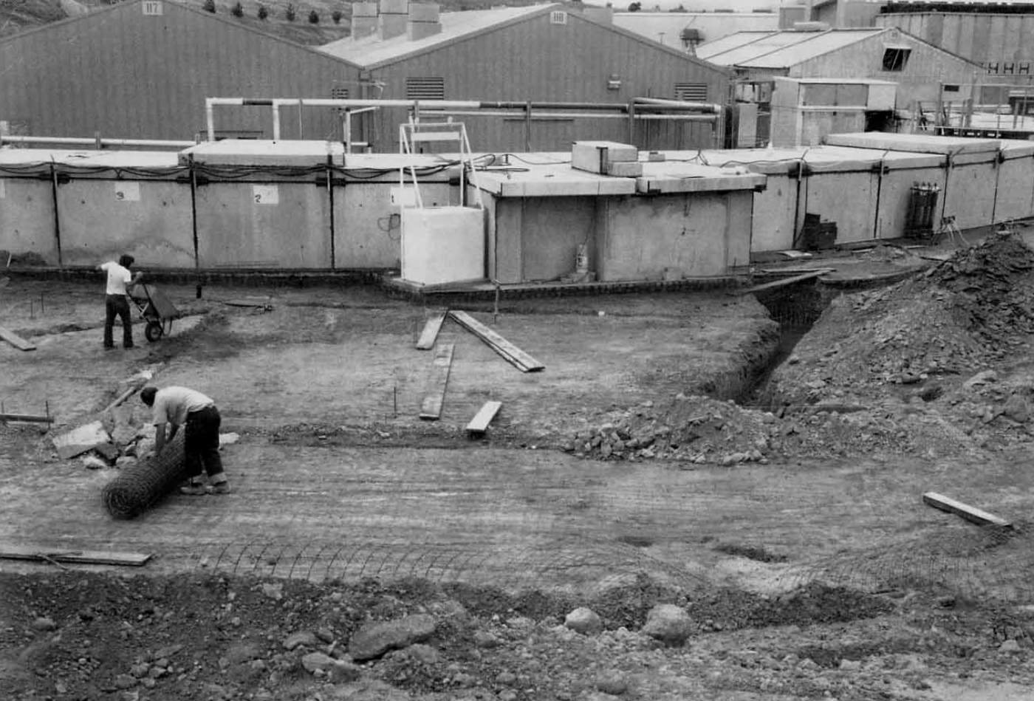
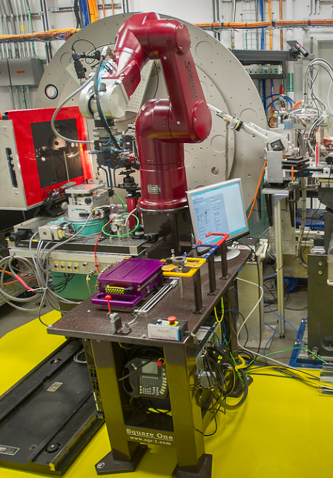
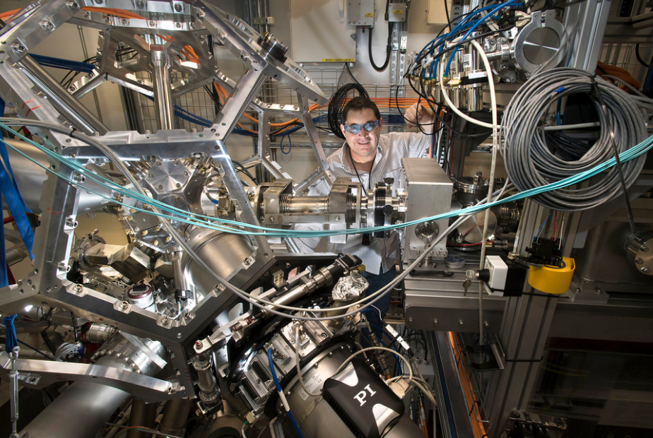
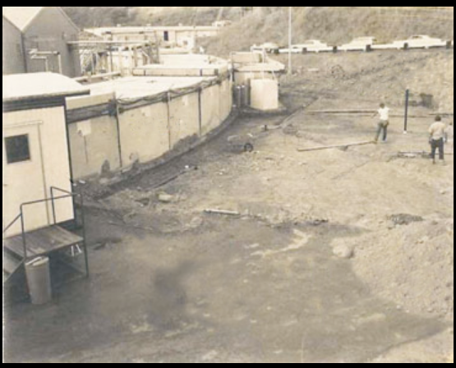
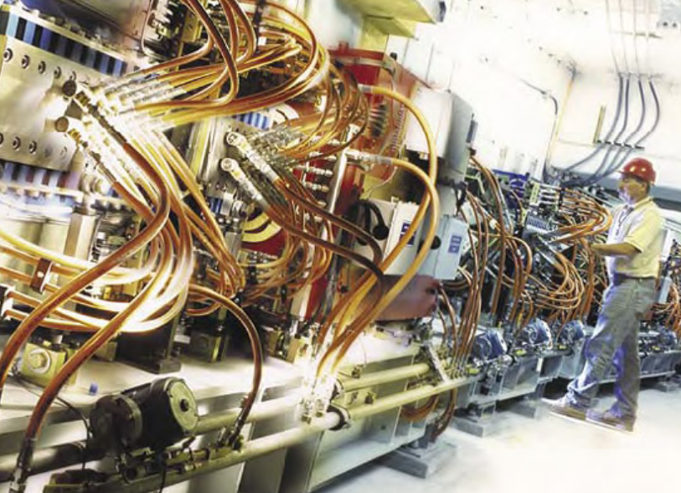
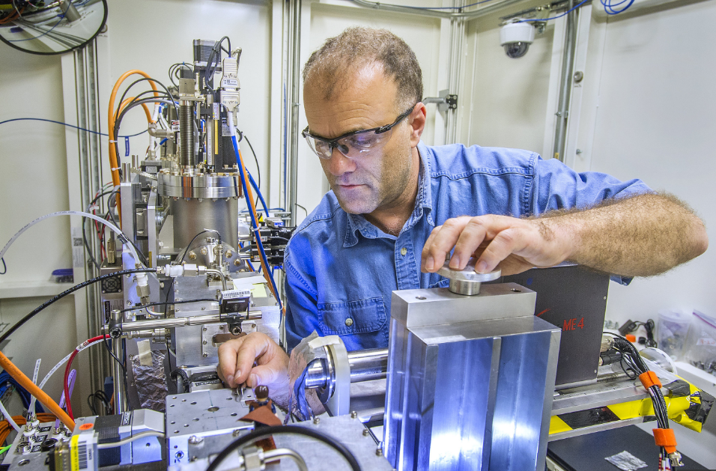
Advances in light source development
NSLS 2015. Latest light source.
SSRL 1972. First x-ray beamline.
Robot @ XPD
ISS
BMM beamline (2018)

Slide 12
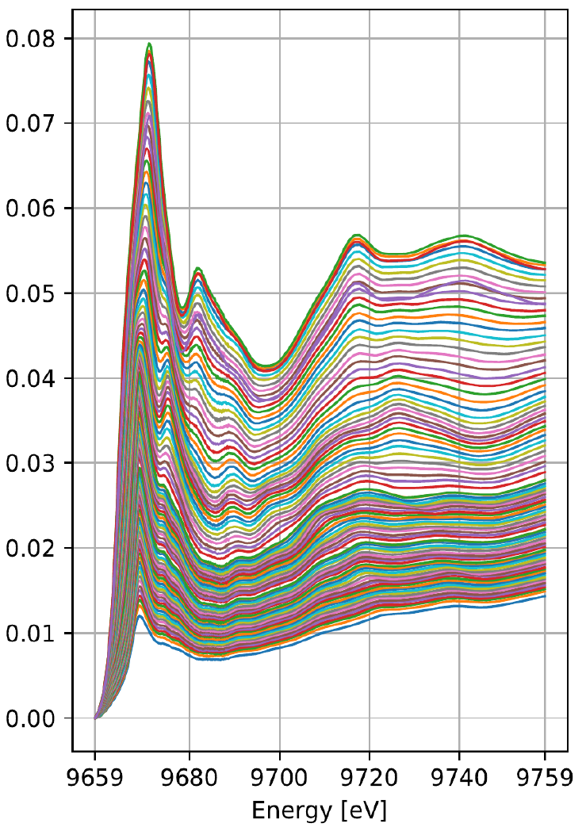
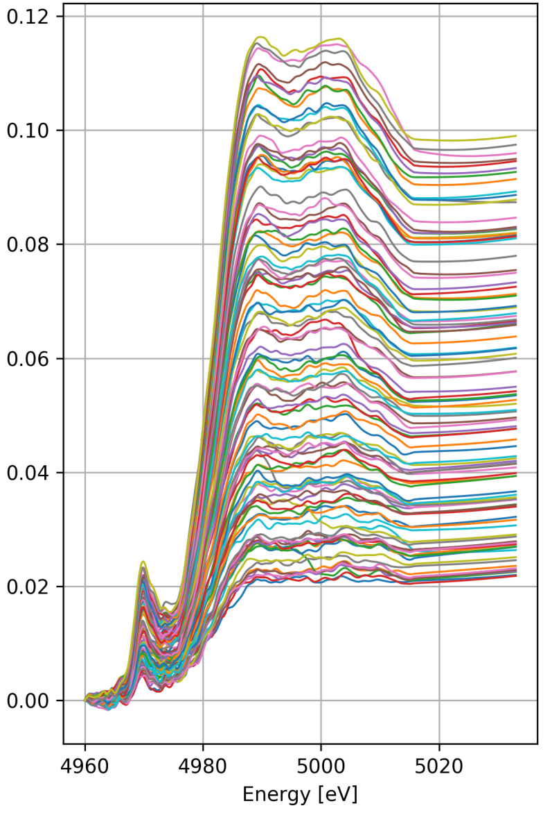
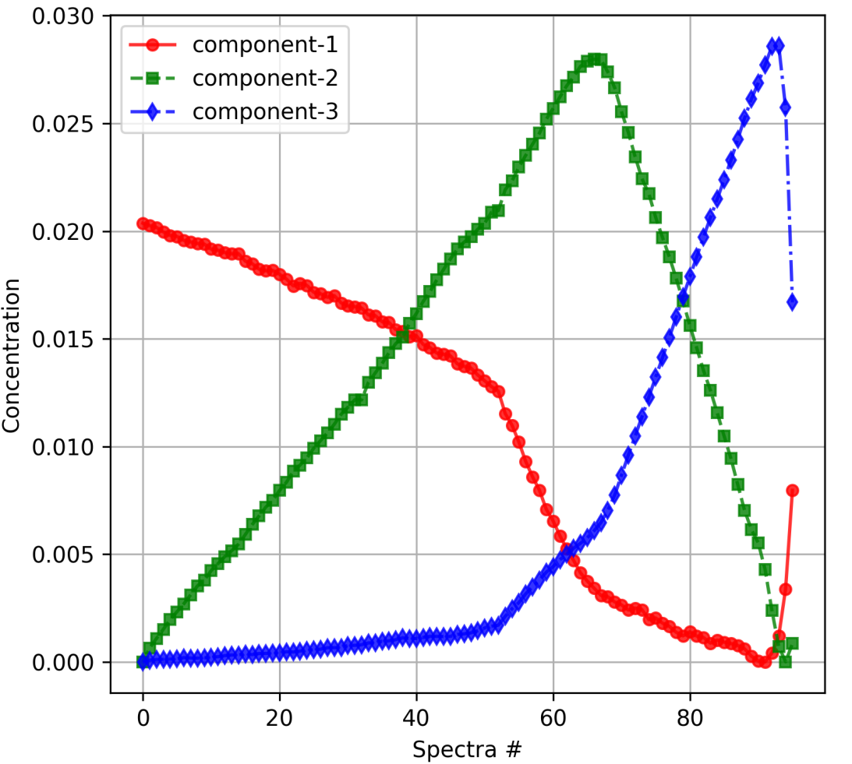
Advanced facility >>>>> too many data!!
NSLS 2015. Latest light source.
Robot @ XPD
ISS
BMM beamline (2018)
Too many data can be obtained very quickly !!

Slide 13
Advanced facility >>>>> too many data!!
???
???
Too many data can be obtained very quickly !!

Slide 14
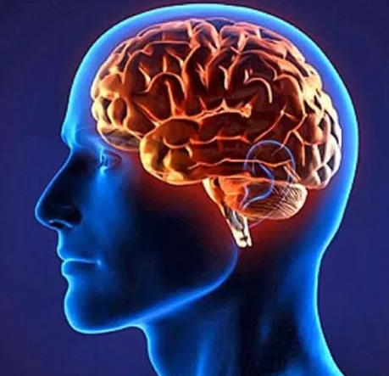
Advanced facility >>>>> too many data!!
Human brain
AI
Lazy
Slow
May forget
Accurate
Source:http://knowledgelotus.info
Fast
Doesn’t forget
May fail (for now)
Too many data can be obtained very quickly !!
Source:https://evolutionnews.org

Slide 15
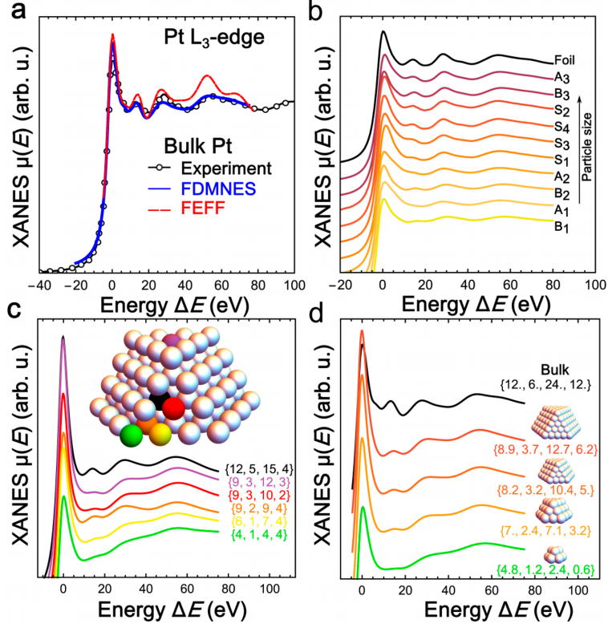
XANES of a Pt nanoparticle depends on its size

Slide 16
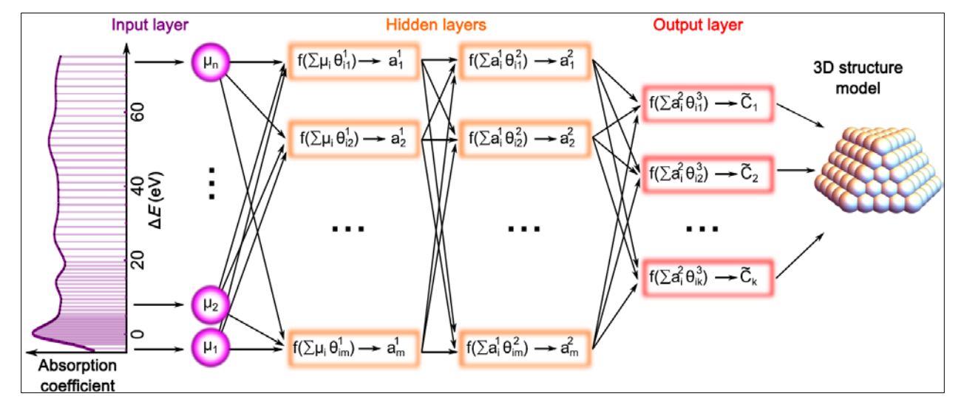
Predicting by Machine Learning models

Slide 17
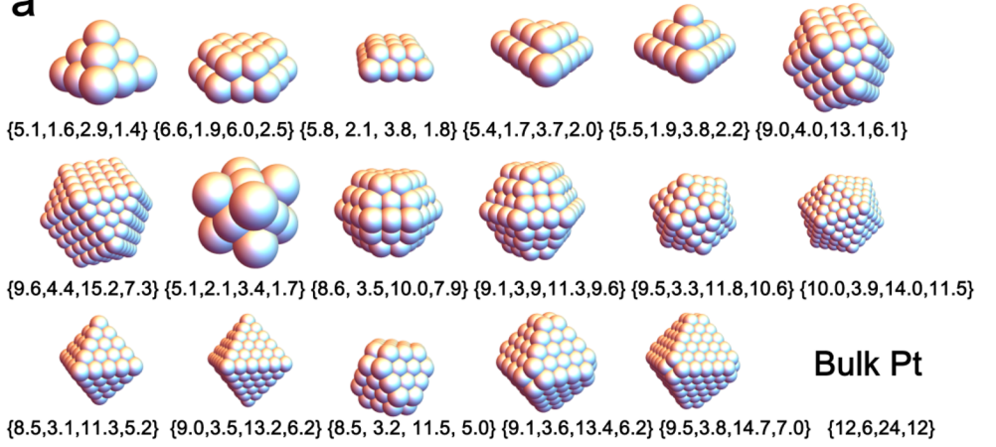
Data preparation
Artificial Pt nanoparticles were generated for training
Randomly choose 3 sites
And average CN and XANES
to get artificial NP.
When we do this 200,000 times, we
will get XANES and CN of 200,000
artificial nanoparticles for model training.

Slide 18
Data
Training dataset:
200,000 data samples
129 dimensions for each sample
4 coordination numbers ground truth
Testing dataset:
73 data samples
129 dimensions for each sample
4 coordination numbers to be predicted

Slide 19
Regression models
In machine learning, regression is used to predict the outcome (with continuous values) based on the relationship between variables obtained from the dataset.
Regression models (F) are trained on training dataset $D_{train}=\text{\{(}{X_{i},y}_{i}\text{)}\}_{i=1}^{N}$
Three regression models are evaluated: gradient boosted decision tree (GBDT), multiple layer perceptron (MLP) with deep and shallow structures, and one-dimensional convolutional neural network (1D-CNN).
$$Obj\left(F\right)=\sum_{i=1}^{N}{L(y_{i},F(X_{i}))\text{ + }Ω(F) }$$
Training Loss measures how well model fit on the training data
Regularization measures complexity of model

Slide 20
Gradient Boosted Decision Trees (GBDT)
Ensemble of multiple decision trees.
Computes a sequence of trees, where each successive tree is trained for the prediction residuals of the preceding trees, i.e., train a new tree to fit the negative gradient of the loss:
$$F_{K}(X)=\sum_{k=1}^{K}{f_{k}\left(X\right),{ f}_{k} is a decision tree}$$
$$F_{K}\left(X\right)=F_{K−1}\left(X\right)+f_{K}\left(X\right)$$
$$−{\left[\frac{∂L(y,F\left(x\right))}{∂(F\left(x\right))}\right]}_{{F\left(x\right)=F}_{\left(m−1\right)}(x)}$$

Slide 21
Multi-layer Perceptron (MLP)
$$f_{j}^{\left(1\right)}(X)=act\left(\sum_{i=1}^{n}{w_{ij}^{\left(1\right)}x_{i}}+b_{j}^{(1)}\right)=act(W_{j}^{\left(1\right)}X+b_{j}^{(1)})$$
First Layer:
Second Layer:
$f_{j}^{\left(2\right)}(X)=act\left(W_{j}^{\left(2\right)}(act\left(W^{\left(1\right)}X+b^{\left(1\right)}\right))+b_{j}^{(2)}\right)$=$act\left(W_{j}^{\left(2\right)}f^{\left(1\right)}(X)+b_{j}^{(2)}\right)$
…
$$F(X)=act\left(W^{\left(m\right)}f^{\left(m−1\right)}(… act\left(W^{\left(2\right)}f^{\left(1\right)}(X)+b^{(2)}\right))+b^{(m)}\right)$$

Slide 22
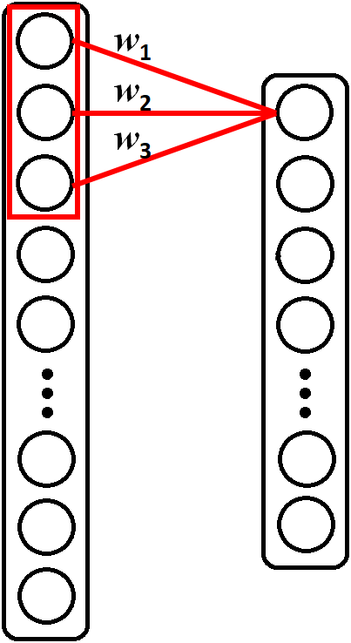
One-dimensional CNN (1D-CNN)
Could be treated as a special MLP with:
Sparse connectivity (local feature)
Shared Weights (small number of weights)
Could have multiple kernels (different feature extraction)

Slide 23
Configuration of the models
GBDT:
Four models, one for each coordination number.
100 simple trees with the depth of three for each model.
MLP:
Shallow structure: two layers with 400 nodes, tanh function as the activation function.
Deep structure: five layers with 400, 400, 200, 200, 100 nodes, tanh function as the activation function.
1D-CNN:
two convolution layers with 32 and 64 kernels, two fully connected layers.
Filter size 30.
The rectified linear unit (ReLU) as the activation function.
No pooling layers.

Slide 24
Results
The scatter plots results show the comparison of the prediction values obtained from four different regression models and the ground truth.

Slide 25
Transfer Learning
Machine learning methods often assume that the training and testing data follow similar distributions.
In many real applications, the training data is obtained from one domain (aka. source domain), while the testing data come from a different domain (aka. target domain).
The data samples show different distributions.
Examples of distribution difference between source and target domains.

Slide 26
Transfer Learning
Fine-tuning based transfer learning:
1) Pre-train, training a model on a source domain, which is usually large scale.
2) Fine-tuning, treating the pre-trained model as the initialized model, and training on labeled data from target domain.
In this work:
1) Pre-train on source (training) dataset using deep MLP.
2) Utilize limit number of samples in target (testing) dataset for fine-tuning, with freezing the first two layers and only updating the weights in last three layers.
This way, we can also reduce the overfitting, considering the amount of target training data is pretty limited.

Slide 27
Results for transfer learning
The scatter plots results show different settings of transfer learning

Slide 28
Quantitative Result
Models |  | CN₁ | CN₂ | CN₃ | CN₄ | Ave.
w/o TL | GBDT | 0.2457 | 0.2289 | 0.8599 | 0.6087 | 0.4858
 | 1D-CNN | 0.1029 | 0.1326 | 0.3849 | 0.2809 | 0.2253
 | MLP (shallow) | 0.0907 | 0.1494 | 0.6838 | 0.3623 | 0.3215
 | MLP (deep) | 0.1163 | 0.1541 | 0.3747 | 0.2512 | 0.2241
MLP w/ TL | 20% labeled | 0.1182 | 0.2052 | 0.3152 | 0.1994 | 0.2095
 | 30% labeled | 0.1475 | 0.1654 | 0.2827 | 0.2036 | 0.1998
 | 40% labeled | 0.1066 | 0.1346 | 0.3029 | 0.1720 | 0.1790
 | 50% labeled | 0.0949 | 0.1100 | 0.1956 | 0.2329 | 0.1584

Slide 29
Conclusions
With the large number of training samples available
Neural network based models show better results.
The deeper models show better results.
Transfer learning helps, even though only limited number of labeled samples are available in target domain, if there is domain shift between training and testing datasets.

Slide 30
Thanks!
Q & A

