Slide 1
Performance Evaluation for Tape Storage Data Recall with T10KD Drive
NYSDS2018
Guangwei Che
Scientific Data and Computing Center
Brookhaven National Lab

Slide 2
Agenda (1)
Purpose of the Performance Evaluation
SDCC Tape Storage Overview
HPSS Community Data Size Ranking
What is RAO and TOR
Test Environment and Setup
Test Cases and Configuration
Test Results and Analysis
Summary and Conclusion
Q & A

Slide 3
Purpose of the Evaluation (2)
Tape storage is the best solution for archiving big data due to high capacity, low cost and long retention.
As the nature of sequential media, the main drawback versus disk storage is the slow performance for data recall in random access order
With emerging of the modern technology, new solutions from both hardware and software are developed to improve the data recall performance.
Finding the best solution for SDCC mass storage becomes more challenging and imperative

Slide 4
SDCC Tape Storage Overview (3)
Serves a worldwide scientific community since 1998
Facilitate and store more than 100 (142) PBs data for RHIC and LHC and many other scientific org.
Managed by High Performance Storage System (HPSS), a software which is developed in 1990s by IBM in collaboration with various DOE National Labs
Ranked 2nd largest HPSS site in the US, 4th in the world

Slide 5
HPSS Community Data Size Ranking (4)
Sites | Data PBs | Last update date | HPSS in prod. since
ECMWF (European Centre for Medium-Range Weather Forecasts) | 363.25 | 7/17/2018 | Nov 2002
UKMO (United Kingdom Met Office) | 253.06 | 7/10/2018 | Jun 2009
NOAA-RD (National Oceanic and Atmospheric Administration Research & Development) | 144.09 | 7/11/2018 | Nov 2002
BNL (Brookhaven National Laboratory) | 142.39 | 7/03/2018 | Sep 1998
LBNL-User (Lawrence Berkeley National Laboratory – User) | 136.54 | 7/05/2018 | Mar 1998

Slide 6
What is RAO and TOR (5)
Tape recall: restore data from Tape to disk buffer for user’s access
Linear Tape Open (LTO) tape drives support file offset ordered recalls. However, sequential media nature result in long seek times between file reads.
The example below illustrates a 316 seconds of file seeking time:

Slide 7
What is RAO and TOR (6)
Enterprise tape drives now support Recommended Access Ordering (RAO).
Multiple tape recalls are properly ordered by the tape drive to reduce recall time.
This same example illustrates now only 126 seconds file seeking time in RAO drives, overall file access performance increased by 151%

Slide 8
What is RAO and TOR (7)
A new feature named Tape Ordered Recall (TOR) introduced in HPSS7.5.1 release.
It supports both RAO and non-RAO drives
TOR will use RAO feature if available. Otherwise, it makes a linear offset ordering to recall the data.

Slide 9
Test Environment and Setup (8)
HPSS core and gateway server: RHEL6.9, HPSS7.5.1p2u1, DB2v10.5p8
HPSS mover and pftp client server: RHEL6.9, HPSS7.5.1p2u1
Tape Library: Oracle StorageTek SL8500 Modular Library System
Oracle Automated Cartridge System Library Software (ACSLS): 8.4.0
Tapes and drives: Oracle T10KD, firmware: 4.13
All tests performed as stage only, no network data transfer was involved

Slide 10
Test Cases and Configuration (9)
Big file test
800 big files of 10 GB, total 7.81 TB data migrated to a T10KD tape
Small file test
4000 small file of 1 GB, total 3.91 TB data migrated to a T10KD tape
Aggregated small file test
2000 small file of 1 GB, total 1.96 TB data migrated to a T10KD tape

Slide 11
Test Cases and Configuration (10)
HPSS setting
TOR: by default TOR is enabled
Noschedule: TOR is disabled
Nodrive: RAO is disabled
Recall coverage
The percentage data recalled out of the whole tape: 10%, 50% and 100%
Recall tools and settings
HPSS scrub (stagebatch), HPSS quaid, ERADAT (= Efficient Retrieval and Access to Data Archived on Tape)

Slide 12
Test Results and Analysis (11)
Big file staging test result

Slide 13
Test Results and Analysis (12)
Big file (10GB) non-aggregated recall
ERADAT has the best performance. In 100% recall, ERADAT performs the best: 253 - 254 MB/s.drv
Quaid ranks second: 247.53 MB/s.drv,
RAO ranks third: 224.46 MB/s.drv
Noschedule and nodrive rank last: 133.94 MB/s.drv and 133.84 MB/s.drv respectively.
ERADAT TOR mode for partial recall performs better than nonTOR mode. For 10% and 50% staging test, TOR mode performs 68% and 27% better than nonTOR mode.

Slide 14
Test Results and Analysis (13)
Small file non-aggregated staging test result

Slide 15
Test Results and Analysis (14)
Small file (1GB) non-aggregated recall
ERADAT has the best performance: 249 – 252 MB/s.drv
Quaid is the second: 184.97 MB/s.drv
RAO is the third: 105.67 MB/s.drv
Nodrive is the fourth: 32.48 MB/s.drv
Noschedule is the last: 27.21MB/s.drv
Nodrive performs 19% higher than noschedule mode.

Slide 16
Test Results and Analysis (15)
Small file aggregated staging test result

Slide 17
Test Results and Analysis (16)
Small file (1GB) aggregated recall
ERADAT still has the best performance: 224.49 – 253.75 MB/s.drv
Quaid ranks second: 74.86 MB/s.drv,
However, nodrive ranks third now instead of RAO: 68.61 MB/s.drv
RAO has the same performance as noschedule mode and ranks the last: 20.45 MB/s.drv and 20.35MB/s.drv respectively. As RAO is unable to recognize the file offset, not working anymore.
ERADAT nonTOR mode performs also better than TOR mode.

Slide 18
Summary and Conclusion (17)
100% recall performance ranking

Slide 19
Summary and Conclusion (18)
In summary
Tape Ordered Recall (TOR) is a great feature to enhance the random access recall’s performance. It works effectively for both enterprise drives with RAO support and non-enterprise (LTO) drives.
RAO will not work with aggregated tape recall. As it can not recognize the file offset within the aggregate.
Quaid has even better performance than TOR in all cases tested. However, as it is a command line tool, customization script is needed for advanced usage and implementation.
ERADAT is proven to be the best performer among all recall tools tested, especially for aggregated small file recall.
Given SDCC’s data characteristics, ERADAT definitely is the best solution to handle both large amount of aggregated and non-aggregated data.

Slide 20
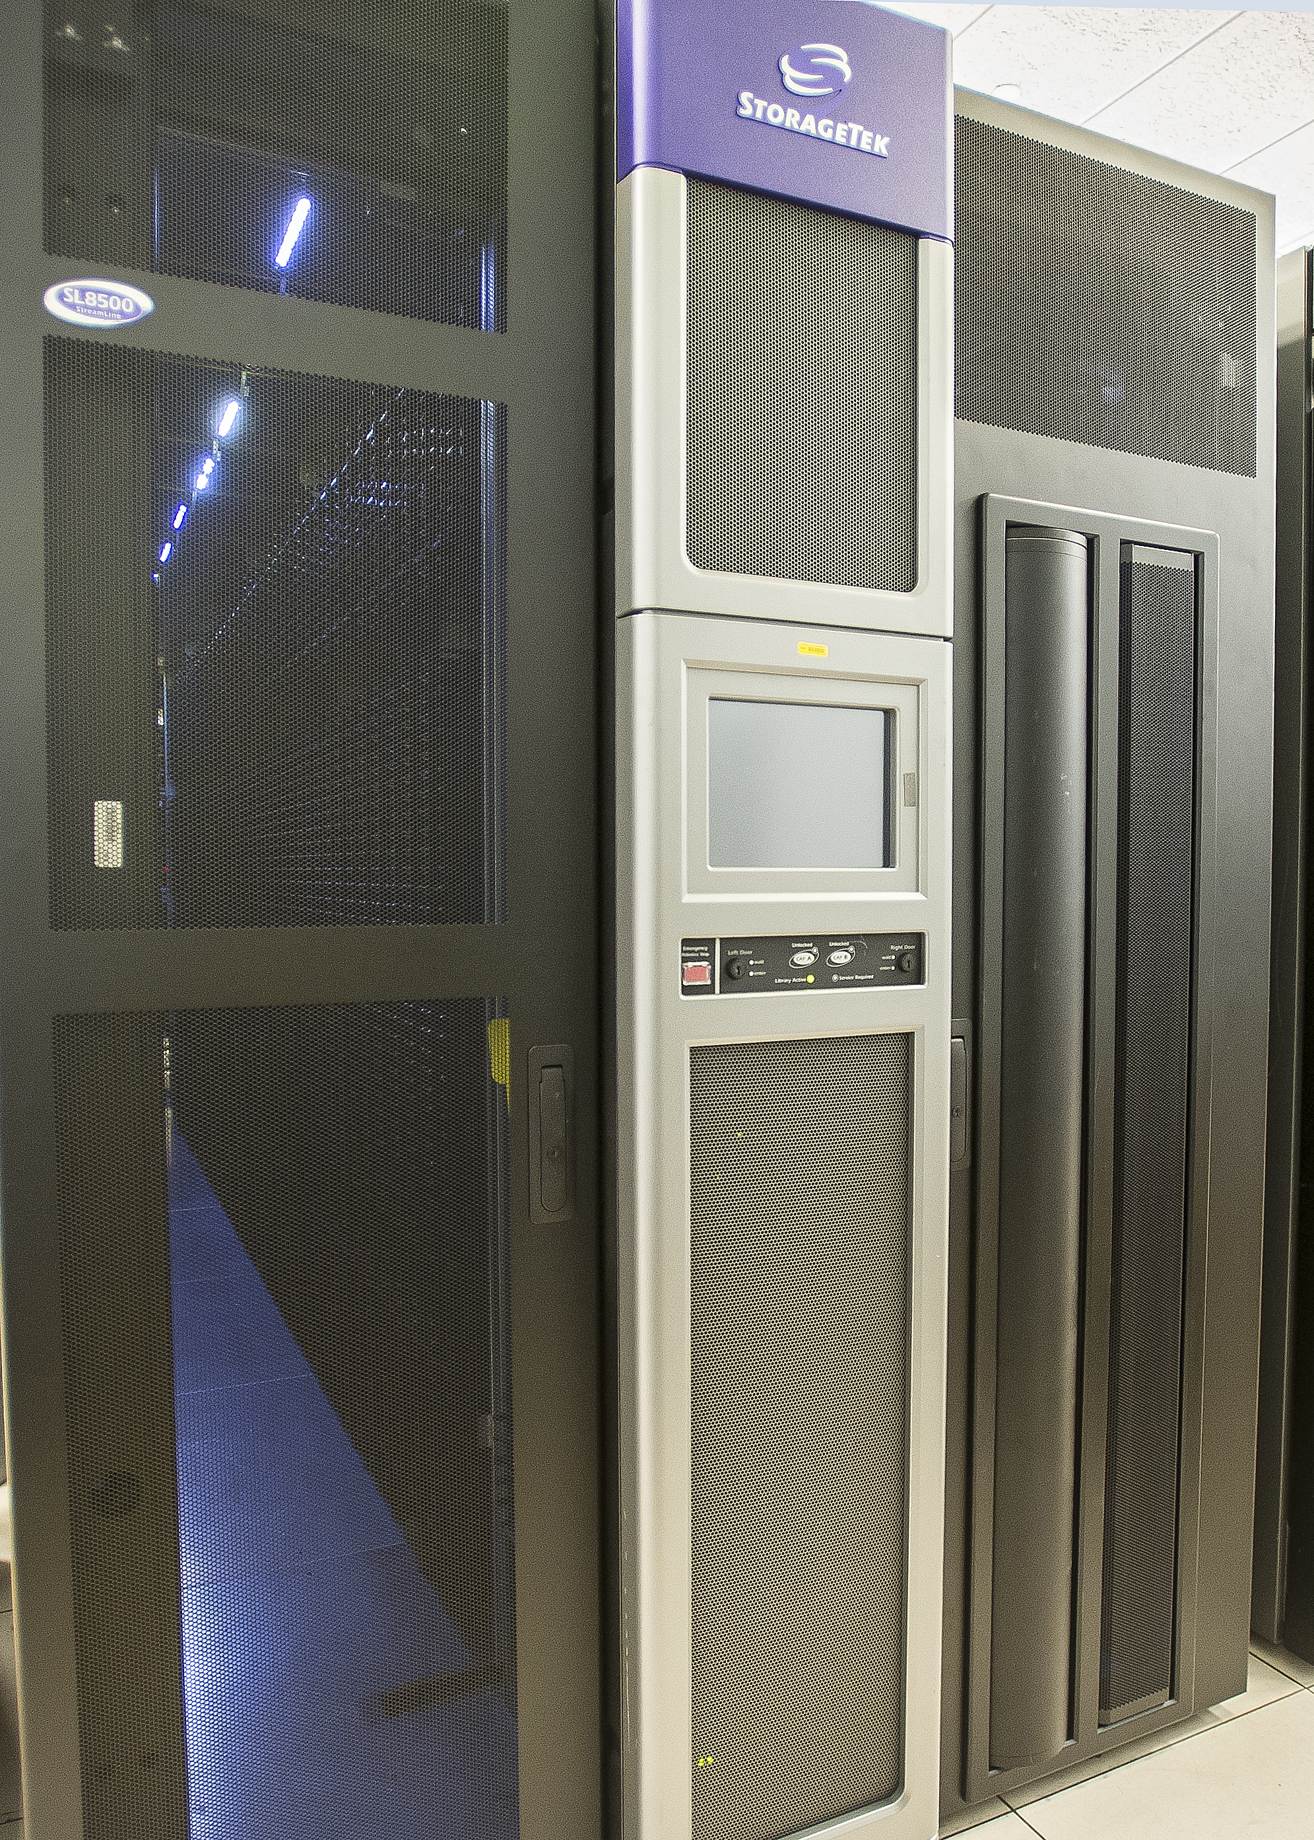
SDCC Tape Library Pictures (19-1)

Slide 21
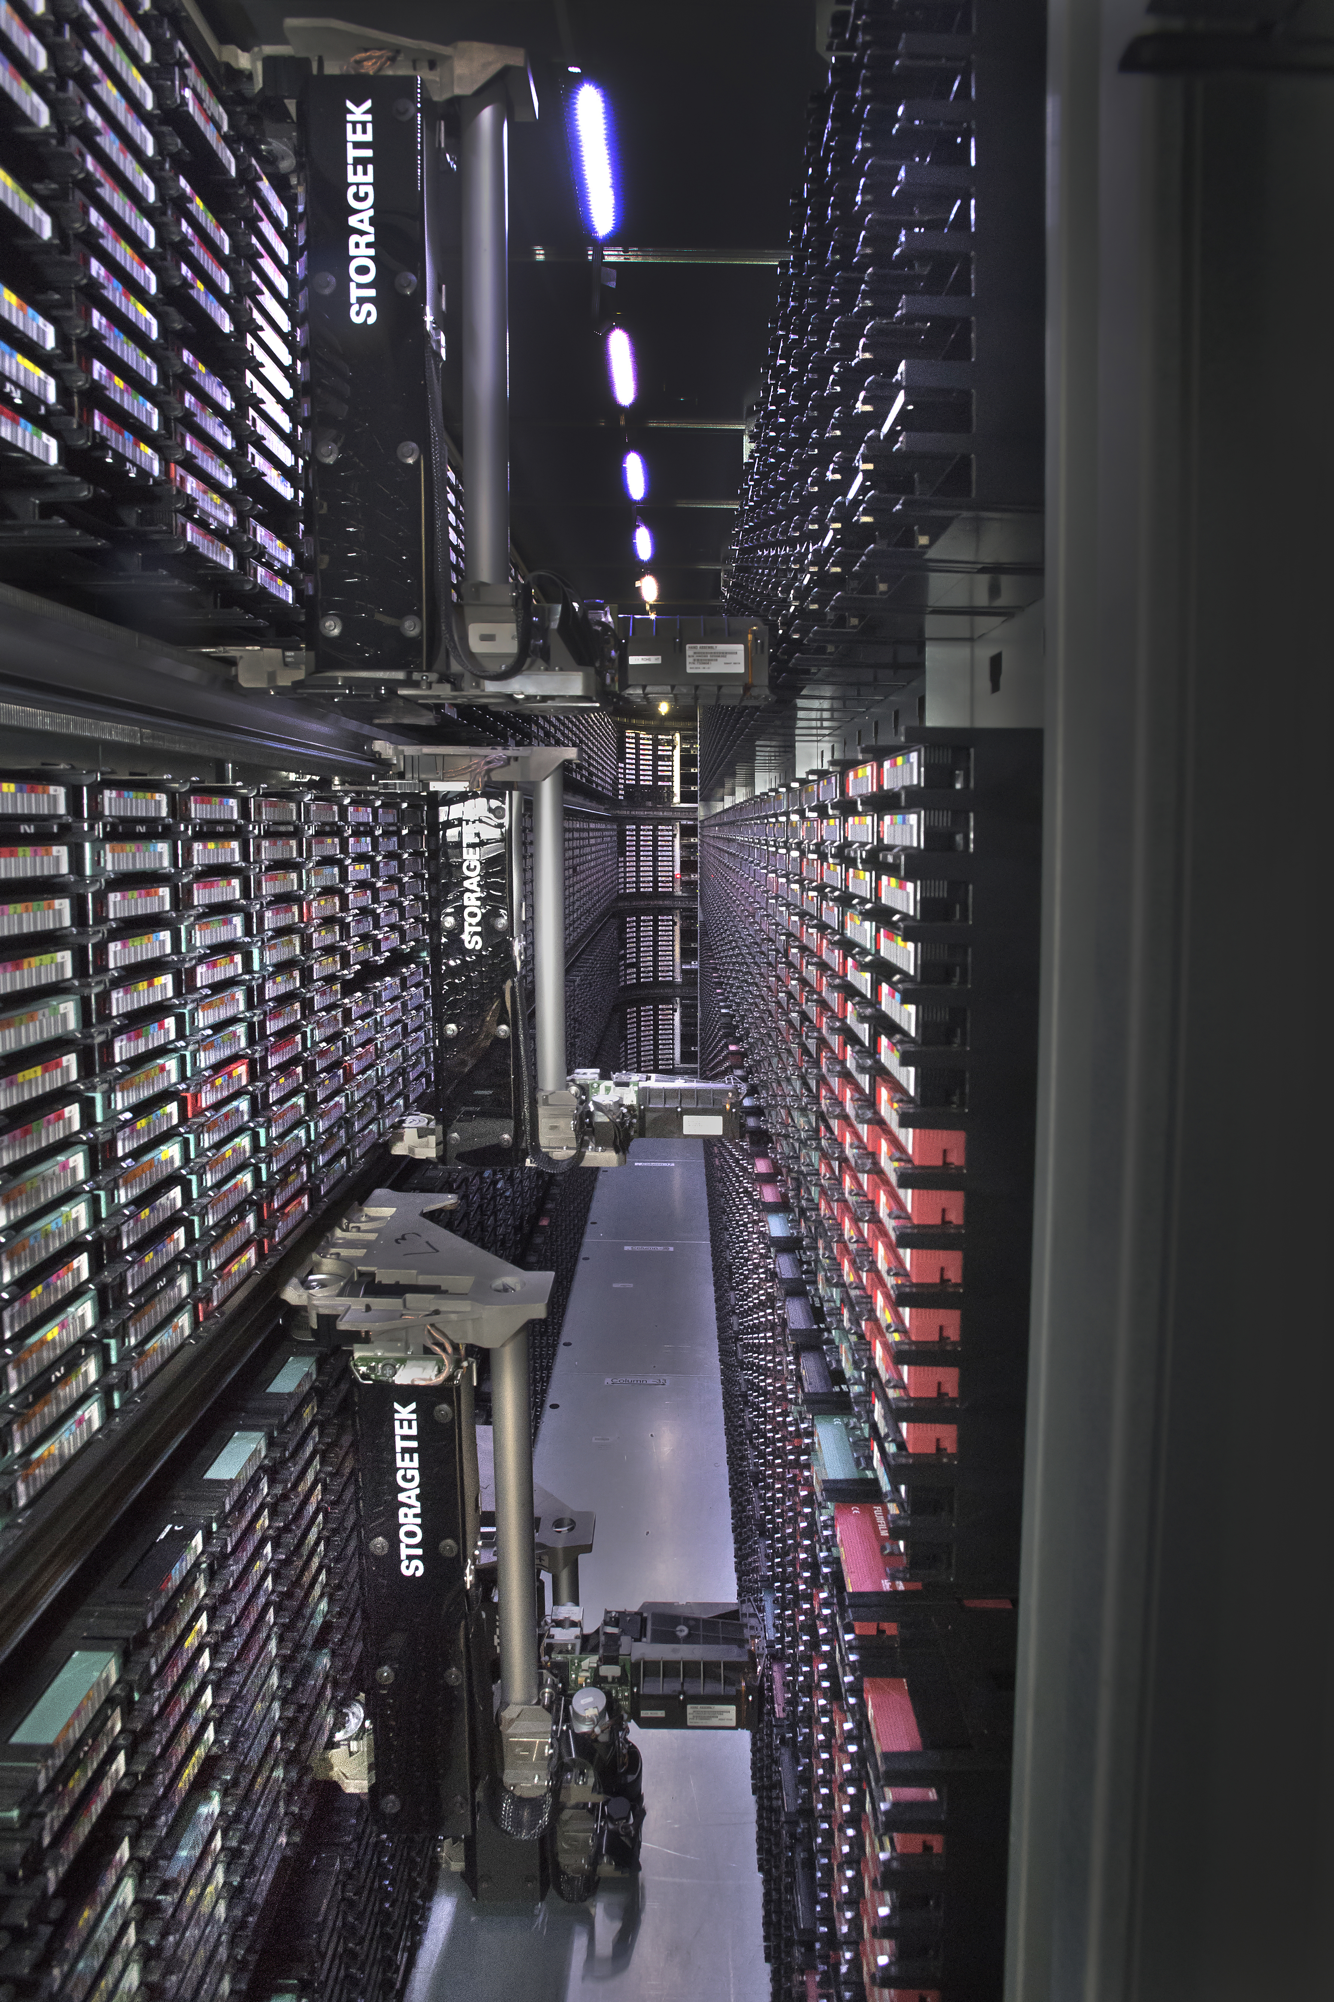
SDCC Tape Library Pictures (19-2)

Slide 22
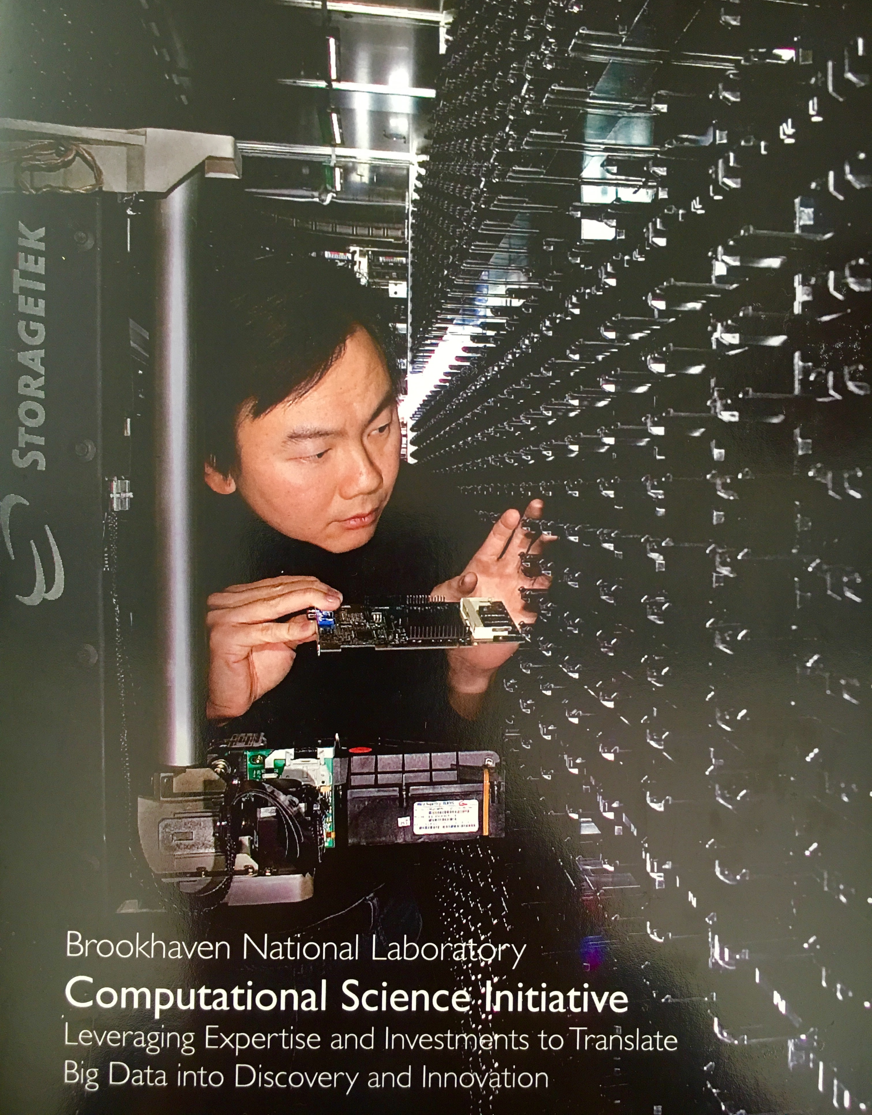
SDCC Tape Library Pictures (19-3a)

Slide 23
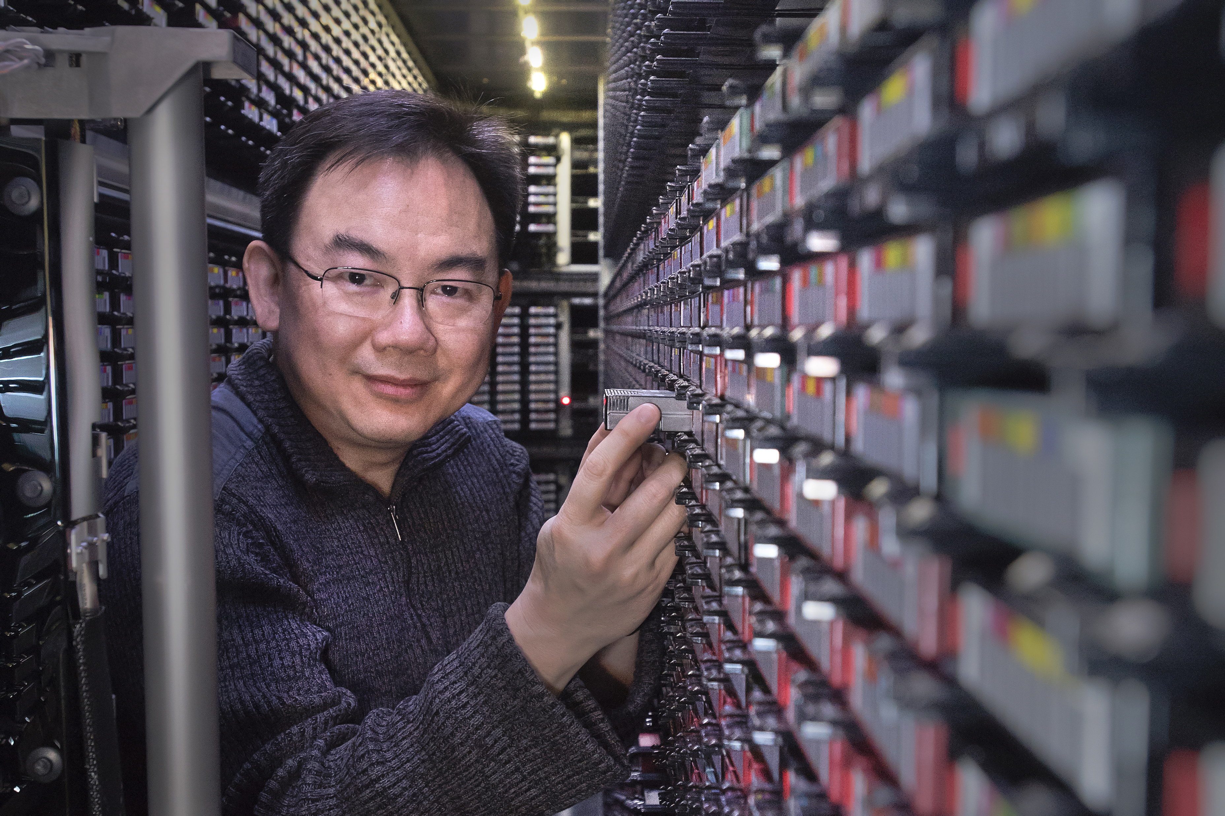
SDCC Tape Library Pictures (19-3b)

Slide 24
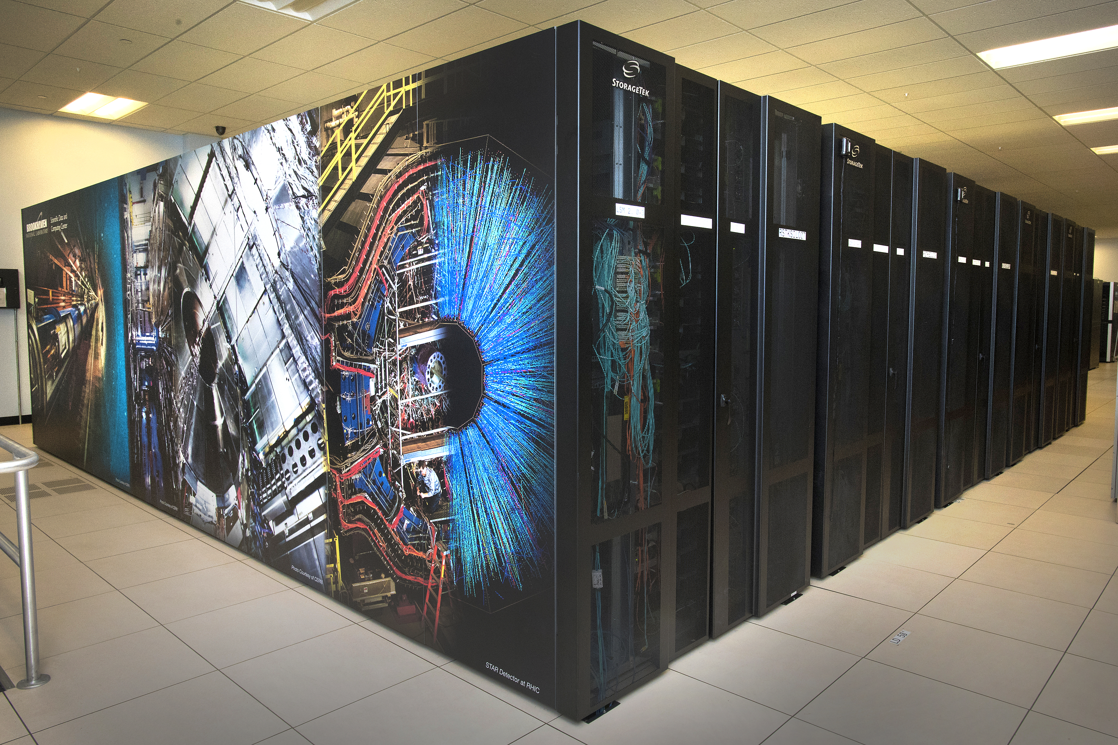
SDCC Tape Library Pictures (19-4)

Slide 25
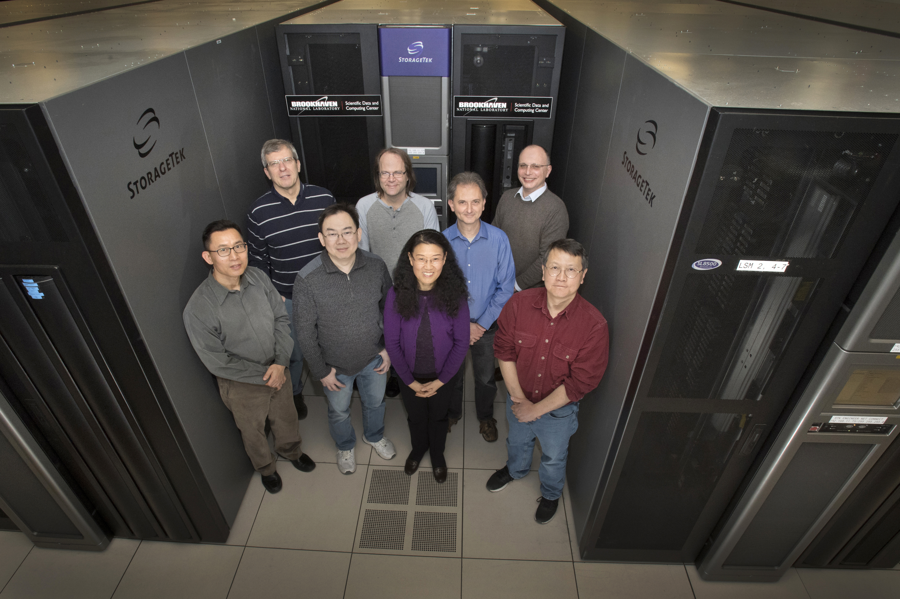
SDCC Tape Library Pictures (19-5)

Slide 26
Q & A (20)
Questions ????

