Slide 1
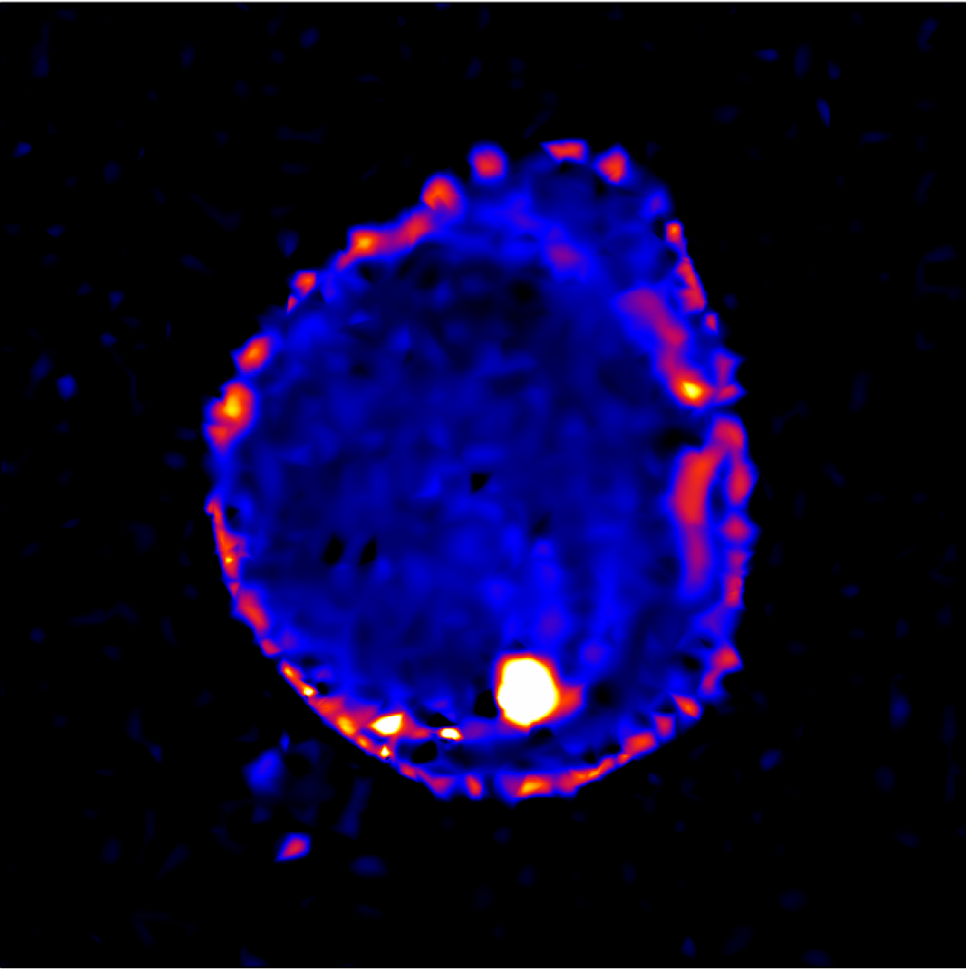
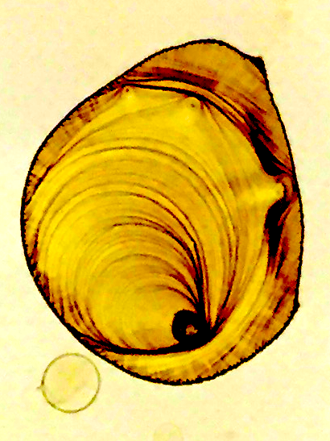
Autonomous
X-Ray Scattering Experiments
through
Surrogate Models and Optimization
Marcus M Noack, James A Sethian
Masafumi Fukuto, Kevin Yager
Notes:
Name, I am an applied Mathematician with CAMERA (Center for Applied Mathematics Energy Research Applications) at Lawrence Berkeley National Laboratory.
I am closely collaborating closely with scientists from the NSLS2 and the CFN here at Brookhaven National Laboratory. We are working on Autonomous [title]. When I started my position one year ago the problem to be solved was the following.

Slide 2
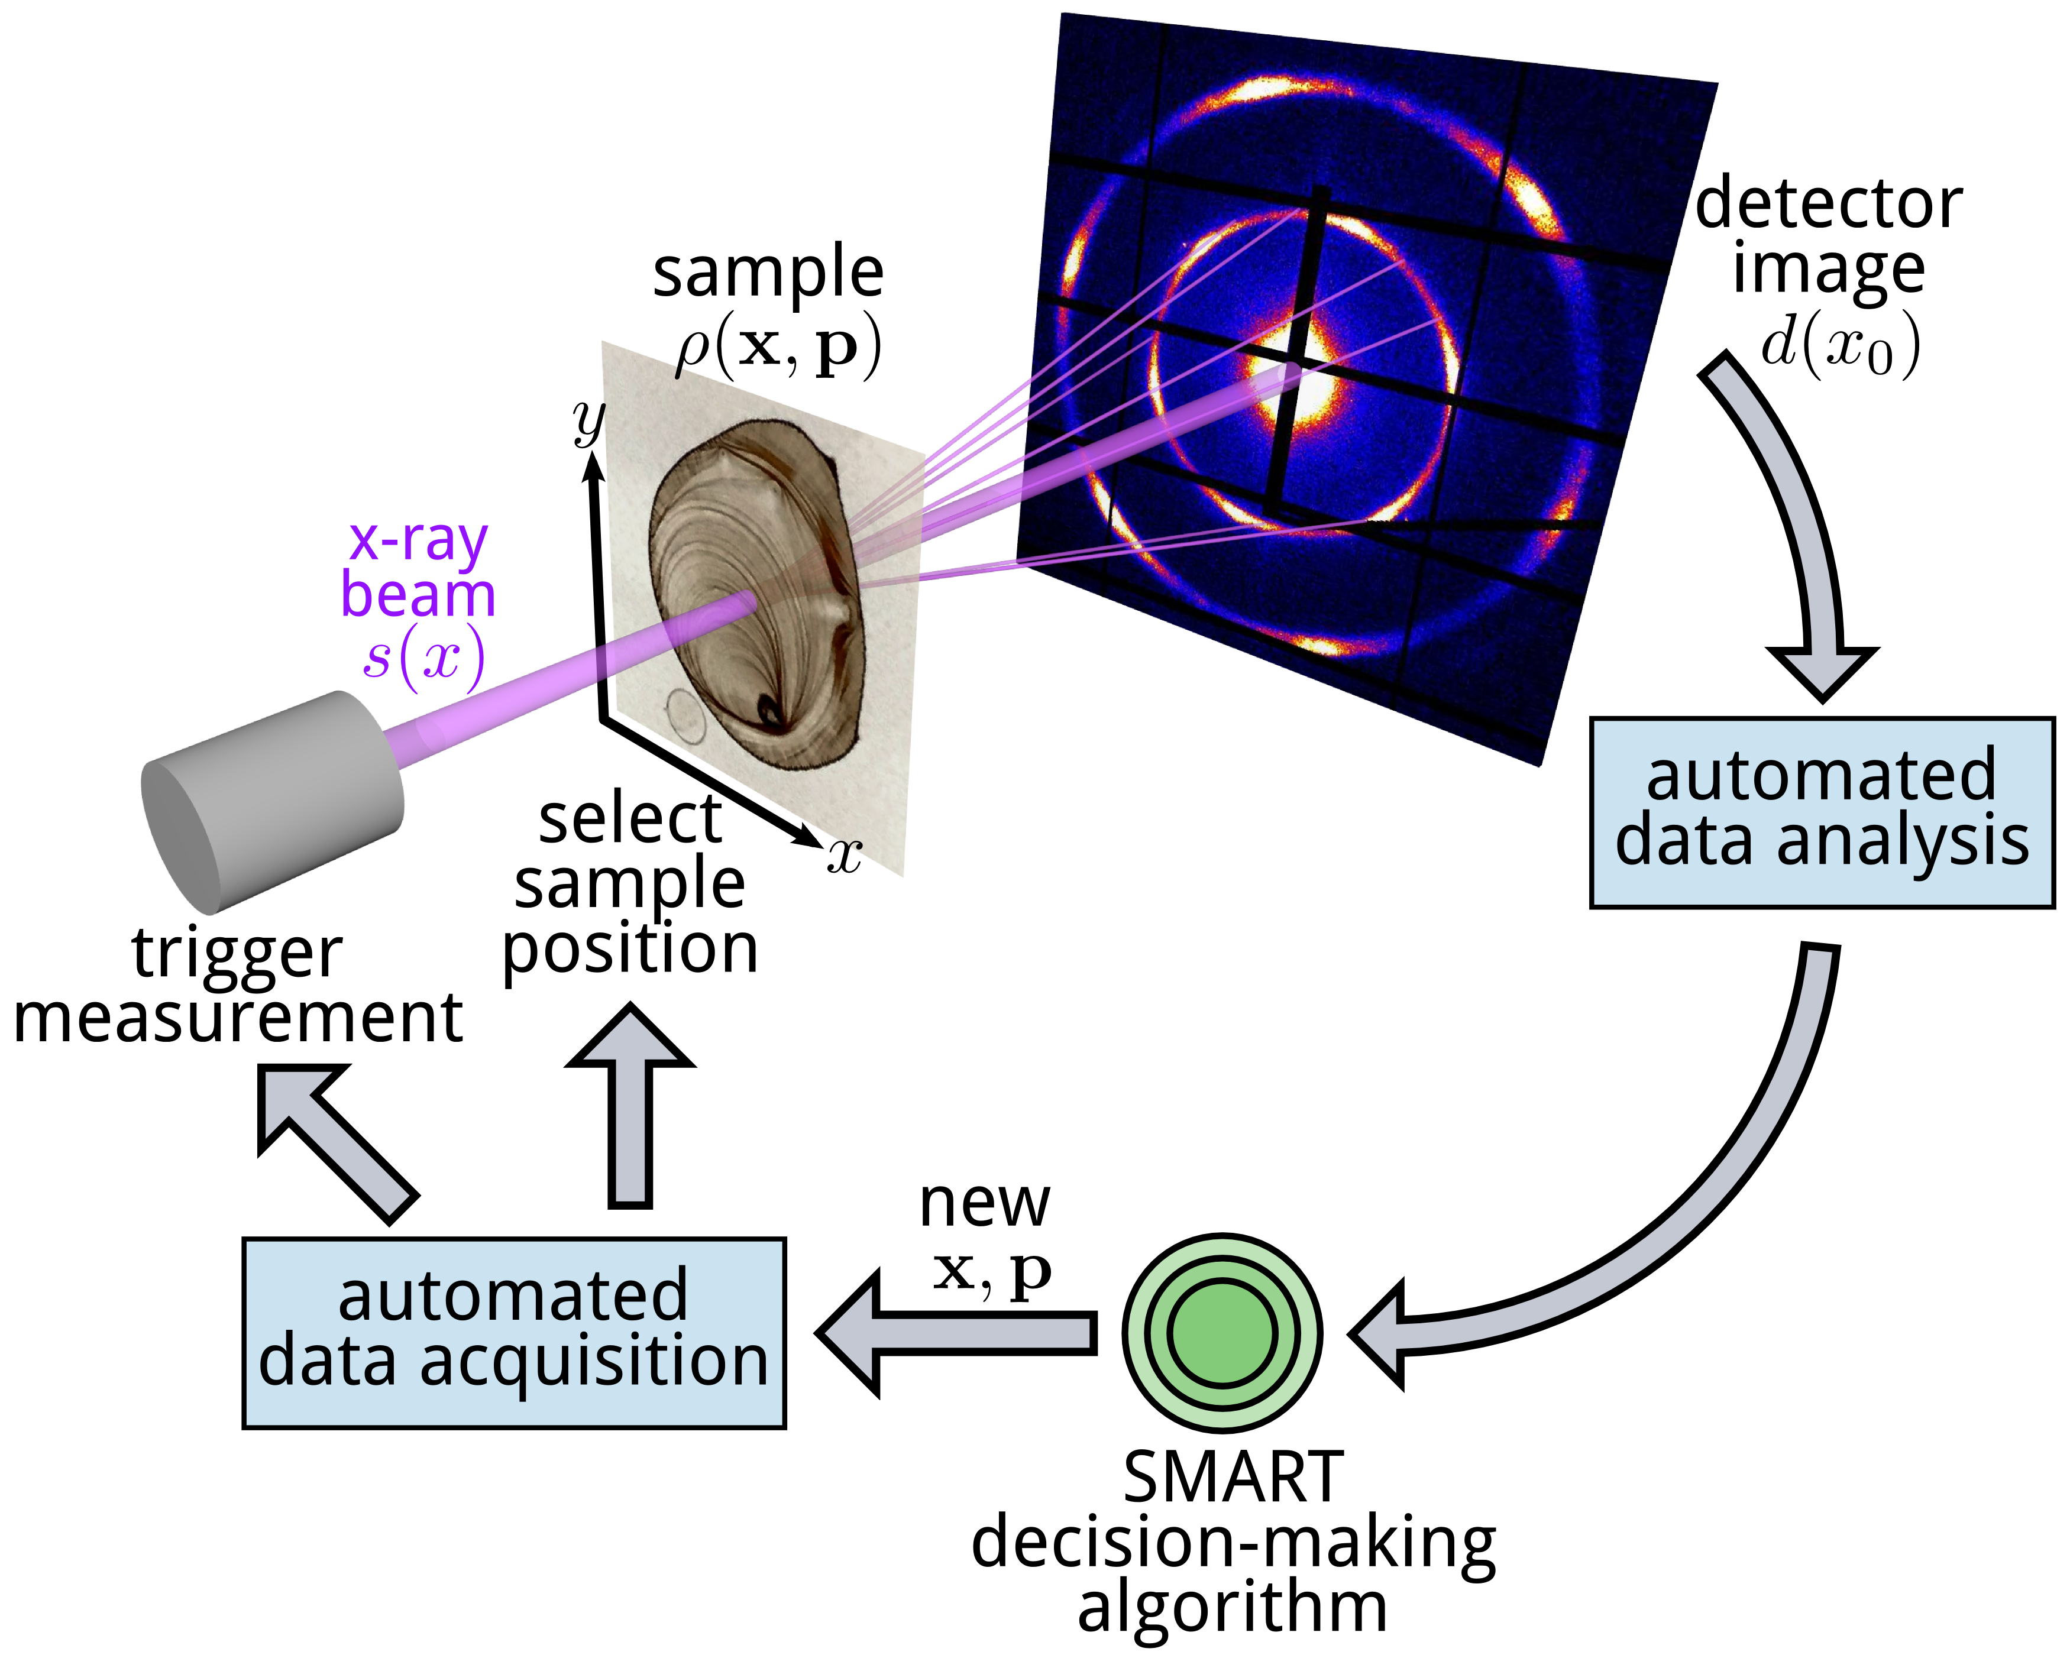
Image Processing
Inversions
Notes:
Given an experimental sample just like the one on the slide, and an experimental setup [explain: source, reflecting or penetrating sample, p,x,rho, detector image] how can we find a numerical reconstruction of the sample most efficiently. In other words, how can a computer decide where (x,y,p) to perform the next experiment, versatile, simple, non-physics based. Lets have a closer look at this specific example.

Slide 3
Notes:
The human eye clearly recognizes the resemblance of the sample on the left and the numerical reconstruction on the right and where experiments should be performed (examples). But how can a computer make these decisions in the most efficient way.

Slide 4
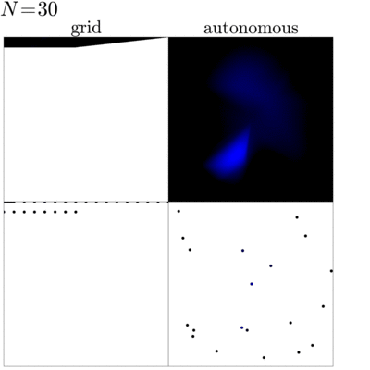
SMART
Notes:
On the left side, points for experiments are chosen based on a uniform grid. This is the method chosen by most experimentalists aloud me.
One dot in these pictures at the bottom represents one experiment.
On the top, we see the resulting model of the sample.
On the right, we can see the choice of measurement point in an intelligent way. Something is happening here allowing the past experiments steering future experiments.
This is our algorithm we have been developing called SMART for Surrogate Model Autonomous expeRimenT. SMART uses all
previously acquired data to decide the next point for measurement. The algorithms seems to have learned that there are interfaces and where they are, since experiments are chosen close to those
features. I want to explain in this talk how this is done.

Slide 5
Intuition
Random Choice
position
parameters:
temperature
pressure …
Each experiment is an evaluation of a function defined over a high dimensional space.
A large number of experiments is required to characterize a material.
Notes:
Abstractly thinking/speaking, an experiment is a function evaluation of a function defined over a high-dimensional space. x is … p… is (explain)
A fully characterized sample therefore means that we can define a function over the set of all
parameters sufficiently well. Experimentalists currently are choosing the experiment points mainly by intuition, which needs the person standing by at all times, which is time consuming and biased. A possible autonomous choice is (click) random points. Clearly not the most efficient method…

Slide 6
LUR
position
parameters:
temperature
pressure …
Each experiment is an evaluation of a function defined over a high dimensional space.
A large number of experiments is required to characterize a material.
Notes:
Abstractly thinking/speaking, an experiment is a function evaluation of a function defined over a high-dimensional space. x is … p… is (explain)
A fully characterized sample therefore means that we can define a function over the set of all
parameters sufficiently well. Experimentalists currently are choosing the experiment points mainly by intuition, which needs the person standing by at all times, which is time consuming and biased. A possible autonomous choice is (click) random points. Clearly not the most efficient method…

Slide 7
UG
Random, intuition, LUR and uniform grid-based approaches are
inefficient, uninformative and/or biased
Notes:
They can be chosen in grid manner. We have actually done that at the beam line and the result is presented here. The random choice and the grid-based approach are inefficient in the sense that they don’t give a measure of quality of the model.
Method of points in largest unexplored region better, but, none of them take advantage of previously acquired data and what the data tells us about the function we are trying to estimate.

Slide 8
Random
Intuition
LUR
UG
prev. data not used
no info on quality
not autonomous
no info on quality
past experience for new science
prev. data not used
no info on quality
prev. data not used
no info on quality
inefficient
uninformative
biased

Slide 9
Problem Summary
Commonly used methods are inefficient, biased and deliver no measure of model quality, wasting beam and personnel time
The key: Using past data to select future experiments autonomously
There is demand for an underlying mathematical structure that describes the need for an experiment at a point, based on past experiments

Slide 10
The error function is a measure of uncertainty and its
maxima dictate the next experiment.
Notes:
The mathematical structure is an error surface, like we see it here, to guide the
guide the next choice of parameters. Clearly, where experiments have happened, the error = 0,
and other regions show a high error. This error is a measure how certain we are about the model
at a certain point in space. Maxima of this surface represent adequate choices for the next experiment parameters.

Slide 11
Autonomous
X-Ray Scattering Experiments
through
Surrogate Models and Optimization
Computing an error surface
Finding the Maximum of the
Error Surface
Current and Future Projects
Notes:
So far we have seen that the autonomous steering of experiments reduces to two main
steps, building the error surface and finding its maximum. This is what I will present next.
Afterwards I will show the results of a recent x-ray imaging experiment, on the sample we have seen in the beginning. And I will talk about the future. this project is very young and the future certainly bright and exciting.

Slide 12
Autonomous
X-Ray Scattering Experiments
through
Surrogate Models and Optimization
Computing an error surface
Finding the Maximum of the
Error Surface
Current and Future Projects

Slide 13
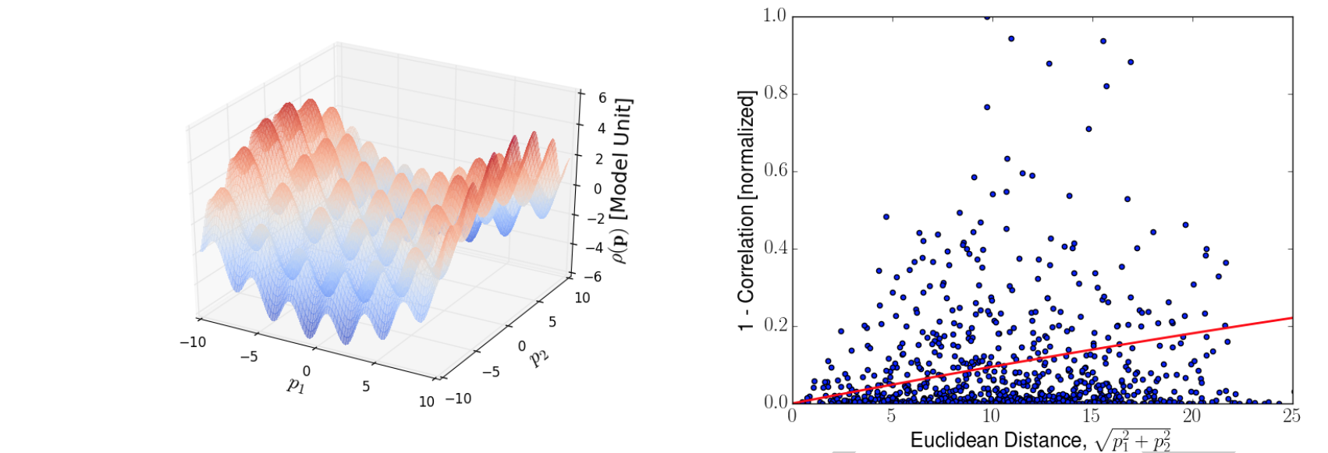
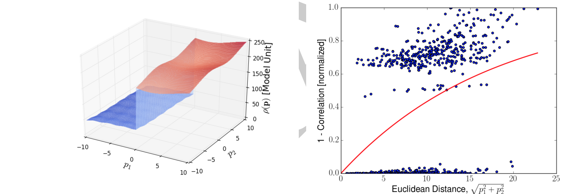
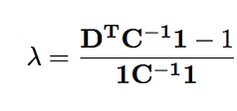
Building the Error Surface: Kriging
1
2
3
4
5
6
7
8
9
Notes:
A good method to build the error surface is called Kriging, it originated in the geosciences when
scientists were interested in estimating the most likely gold deposits in the subsurface in south Africa based on a few drilled wells. It is based on a linear combination of the data points (1). The weights are found by minimizing the error variance (2), Simply rewritten as (3). New, C and D are functions of what is in the heart of Kriging, the variogram, which itself is a function of
all acquired data. Nothing else than a function fitted to the data in a least-squares-manner. C and D are measures of covariances between a pair of points. C, between existing points and D between an existing point p and the new point, the point we are eventually looking for. Given the variogram and a point, C, D and therefore the weights and the lagrangian mustiplier lambda is defined and can be used to evaluate the error surface at the point p. Then, the point can be weighted by certain features of interest of the model we are looking for, e.g. the gradient as shown.

Slide 14
Autonomous
X-Ray Scattering Experiments
through
Surrogate Models and Optimization
Computing an error surface
Finding the Maximum of the
Error Surface
Current and Future Projects

Slide 15
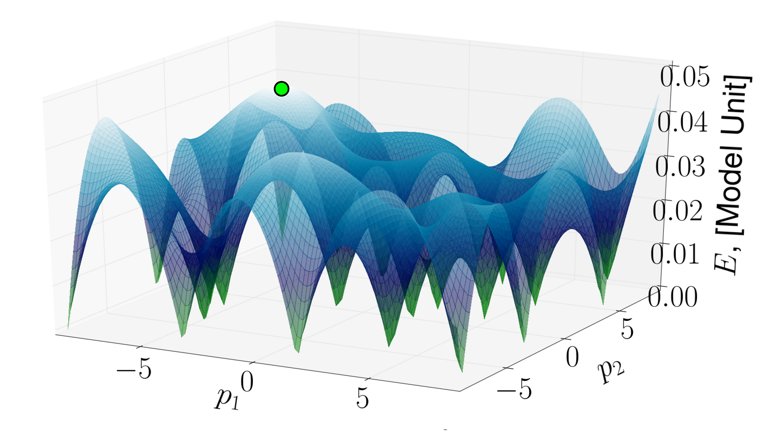
Optimizing the Error Surface
Low Dimensionality
Local optima acceptable
Cheap function evaluations
Optima are often not satisfying first optimality condition
Population
Recombination
Notes:
To find a suitable optimization method we have to look at the characteristics of the space and the function over the space, [see slide].
These characteristics make global optimization methods ideal candidates to find the maximum of our error surface. And we chose an evolutionary algorithm the job.
On a very basic level, it works the following way …[slide]
The procedure results in the global of local optimum.

Slide 16
Image Processing
Inversion
Notes:
Given an experimental sample just like the one on the slide, and an experimental setup [explain] how can we find a numerical reconstruction of the sample most efficiently. In other words, how can a computer decide where (x,y) to perform the next experiment. Lets have a closer look.

Slide 17
Random
Intuition
LUR
UG
prev. data not used
no info on quality
not autonomous
no info on quality
past experience for new science
prev. data not used
no info on quality
prev. data not used
no info on quality
inefficient
uninformative
biased

Slide 18
SMART
autonomous
previous data used
info on quality
no knowledge of past, unrelated experiments
efficient
informative
unbiased

Slide 19
Autonomous
X-Ray Scattering Experiments
through
Surrogate Models and Optimization
Computing an error surface
Finding the Maximum of the
Error Surface
Current and Future Projects

Slide 20
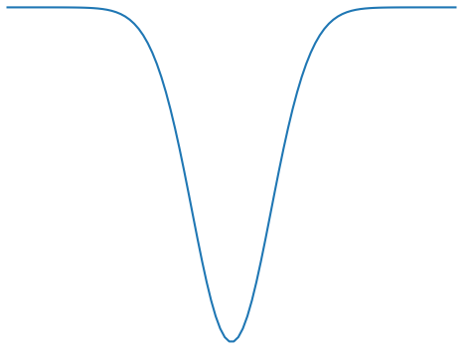
Building the Error Surface using Radial Basis Functions
1
0
Notes:
Radial Basis Function for error surface
Width of gaussian is defined by correlation of data
Advantage, local correlation and depending on direction by xis. Therefore much
better emphasis on local characteristics
“Versatile”

Slide 21
Near Future: Non-Holonomic System
Notes:
A problem in experimental sciences are non-holonomic systems. Fo far we have only dealt with
holonomic systems, the means, two experiments at the same (x,T) have the same outcome,
independent of when I measure them. (x1,T1) —> (x2,T2) —> (x1,T1), the results at (x1,T1) will be the same. In non-holonimic systems, the result will not be the same but depends on the entire
curve how I reached a point in P. We cannot anymore define a function oder the parameter space,
that we call a model. We have to define a new space [explain, 18 dim]. In this space, we can perform Kriging or the radial basis function approach to define an error surface. The maximum will define an entire new curve to measure. The problem here is that only few beam lines are equipped with the machinery to exchange samples autonomously. So even though the math is ready, the gear may not be. But hopefully in the next 2-5 years.

Slide 22
The Grand Plan: The Merger of Data Science and Physics
Improving the physics operator by using data operators
to make autonomous experiments
more robust and accurate:
The Expert-Enhanced Machine
Notes:
Merger of data science and physics. In sub-domains of our space P physical theories will
be available. In others the uncertainty of those physical theories will be high or they won't be available at all. Experiment should be chosen strategically based on the known physics.
I call this the expert-enhanced machine. This will lead a whole new level of minimizing the number of experiments to fully characterize a sample and possibly to new physics too.

Slide 23
Take-Home Messages from this Talk
Autonomous experimentation based on surrogate model optimization called SMART
SMART is running at the CMS beamline at BNL, the ALS and is offered to users; in use also at the University of Bayreuth in Germany
Simple, versatile, stable, fast
For more information: MarcusNoack@lbl.gov
Notes:
will run on many beam line computers in Brookhaven, Berkeley, all over the country and hopefully the globe.

Slide 24
Thank you for your attention
Marcus M Noack, James Sethian
Masafumi Fukuto, Kevin Yager
Notes:
Name, I am an applied Mathematician collaborating closely with the NSLS2 and the CFN at Brookhaven National Laboratory. We are working on Autonomous [title]. The title obviously has a lot of content, but I hope by the end of the talk that it will make perfect sense. Some time ago CAMERA was contacted by … with the following challenge.

