Slide 1
Decision-Making Modalities in Automated and Autonomous Experimental Science
Kristofer Reyes
Materials Design and Innovation Department
University at Buffalo

Slide 2
Sequential Bayesian Experimental Design and Optimization
Ground truth
Kriging
Active Learning
Optimal Learning
Bayesian Optimization
Reinforcement Learning
Optimal Control
Experimental inputs
Bayesian beliefs
Noisy measurements
Decision-making policy

Slide 3
Decisions are made in a closed-loop fashion using beliefs and policies.
Decision policy
Experiment
Bayesian update
Belief model
Estimates and uncertainty of response function
Uses current belief to strategically select experiments

Slide 4
Common choices of belief models and decision policies
Belief Models
Decision Policies
Gaussian processes
Linear Models
Expected Improvement
Lookahead policies:
KL-Divergence
Knowledge Gradient
Goal of good models/policies
Discover extrema of response function as efficiently as possible.
Notes:
GPs:
Easy to apply to most (low-dimensional) problems
GPs, along with Gaussian noise have nice properties, conjugacy
Many of the expectations have closed form solutions or algorithms to compute exactly.

Slide 5
In practice, other types of decision-making and modeling are important
Commonly used assumptions in Bayesian Optimization
Optimization of an a priori unknown scalar function through (Gaussian) noisy observations
Use of Gaussian Processes to model beliefs
  Simple covariance function
No constraints/costs for exploring experiment space
Seen in practice:
Multi-dimensional observations
Optimization of non-linear transformations of observations
The desire to learn the entire function or some other features (besides extrema)
Incorporating and learning physics-based knowledge
Multi-stage decision making
Constrained optimization
How do we build-in problem-specific structure?
Notes:
GPs
-- Easy to apply, but it’s hard to impose problem specific structure or prior information (other than mean and covariance functions).
Multi-stage decision making:
-- Make decisions cognizant of previous or future experiments, and their outcomes
-- In extreme case, real-time decision making
Constrained optimization:
-- subset of above, where time and costs of each experiment is significant
-- instead of minimizing number of experiments, minimize costs or time while learning about extrema of response function

Slide 6
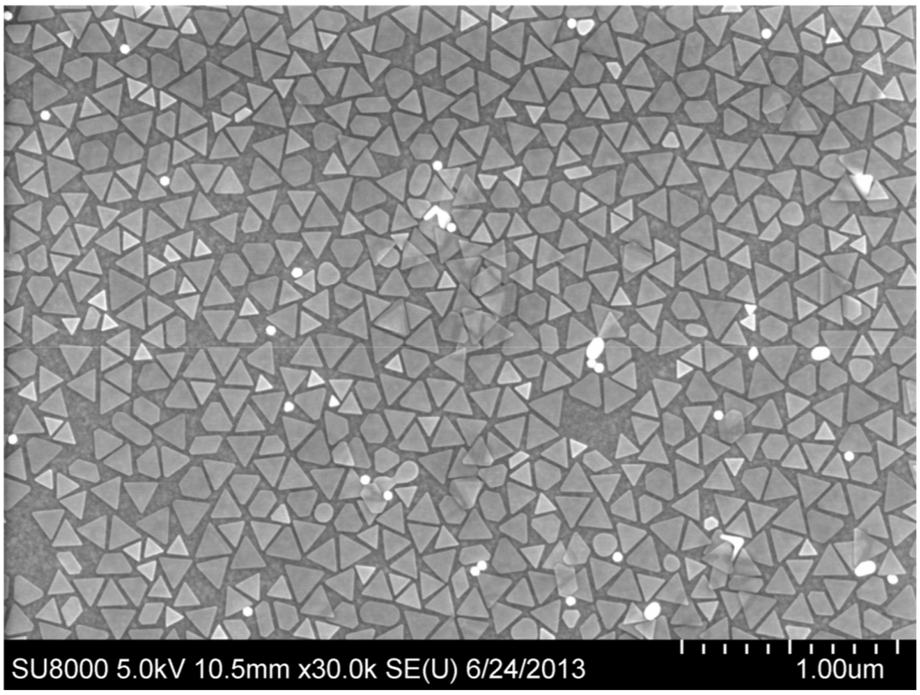
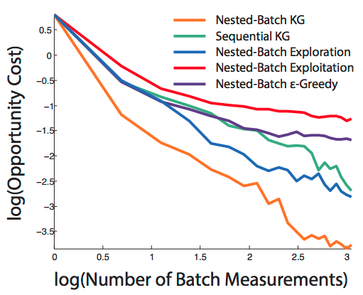
Multi-stage decision making for optimizing optoelectronics
Goal: Maximize output current in optoelectronic device
Design variables:
Shape
Size
Composition
Density
Hard to vary
Easy to vary, done in batches
Two-stage decision policy:
Better performance
Select slow variables
Select batches of fast variables
Notes:
2-stage decision policy:
-- Try to score selections of slow variables.
For each choice of slow variable:
Select batches of fast variable via Thompson sampling.
Each element in batch is a fully described experiment, score using utility function
Back propogate
Aggregate scores for a batch
Aggregate scores from batches to a score for slow variable.

Slide 7
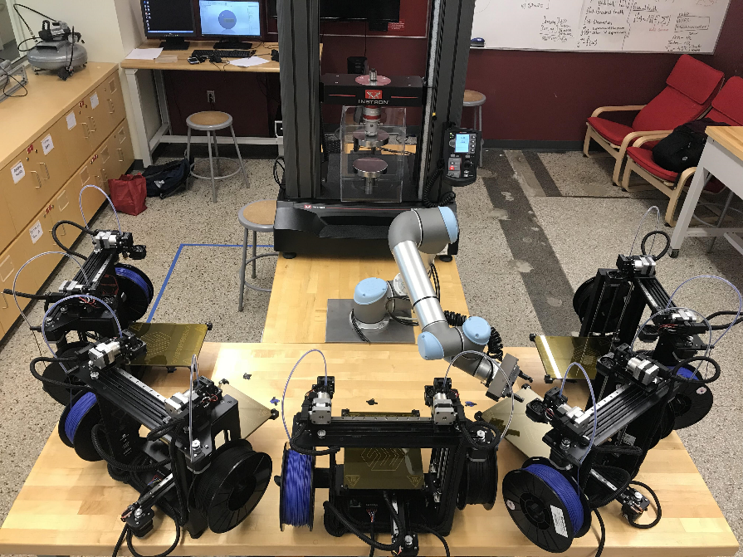
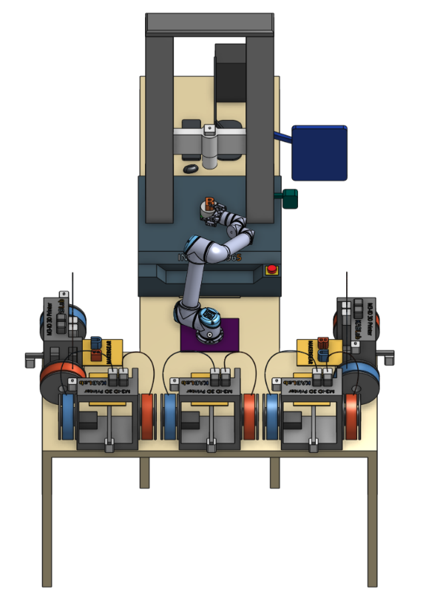
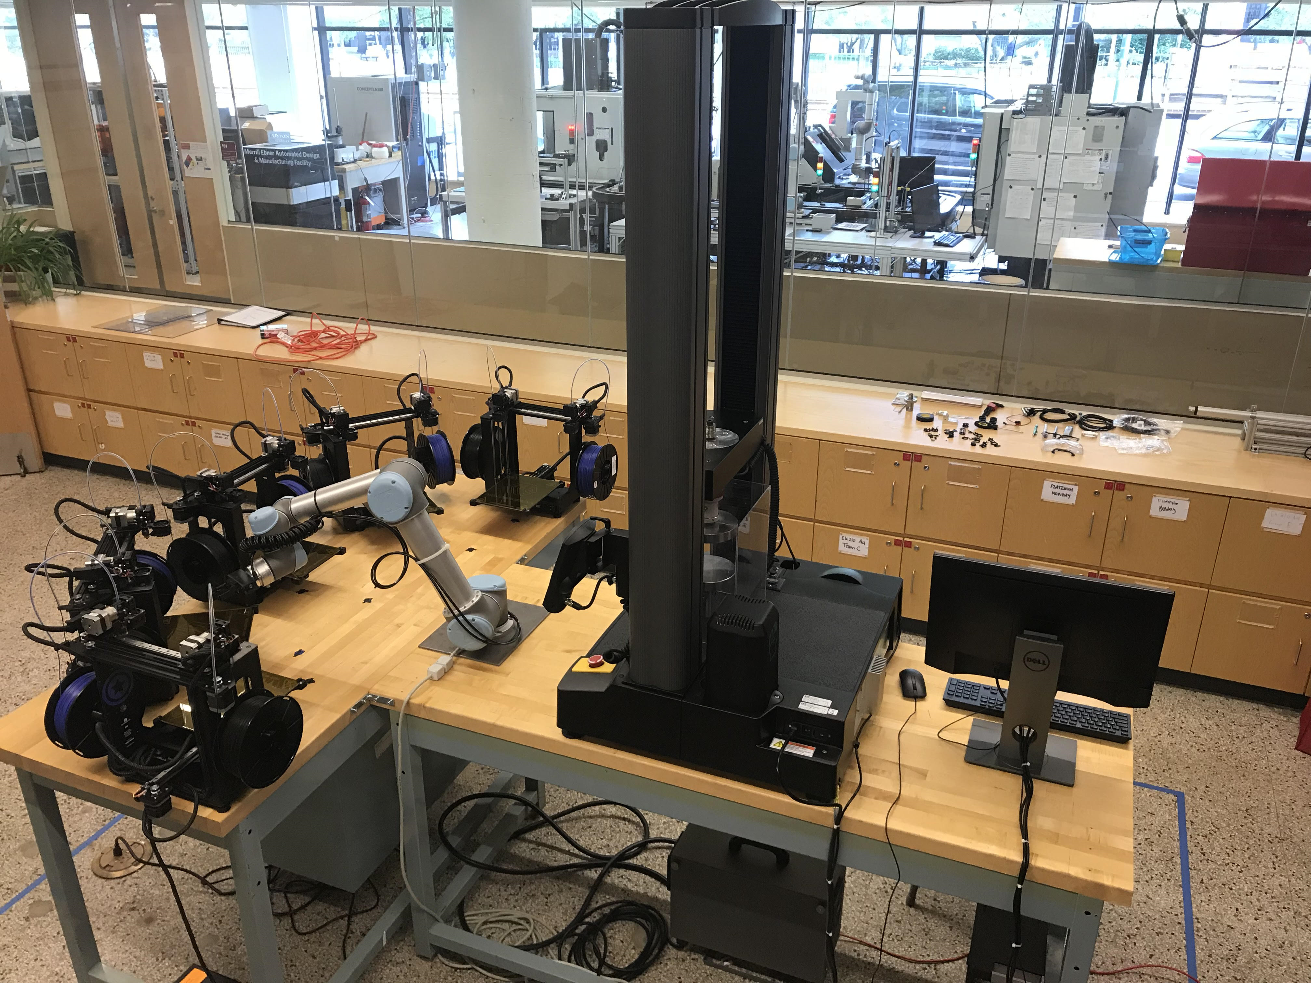

Asynchronous decision making for simultaneous autonomous experiments
Optimize mechanical properties of 3D printed structures.
Can run 5 simultaneous experiments
When 1 experiment is done, what next?
  Should be informed by other 4 experiments currently running.
Calculate expected utility, and marginalize out the results of 4 other experiments.
Instron
5965
UR5 robotic arm
Five MakerGear dual extruder printers
KABLab.org

Slide 8
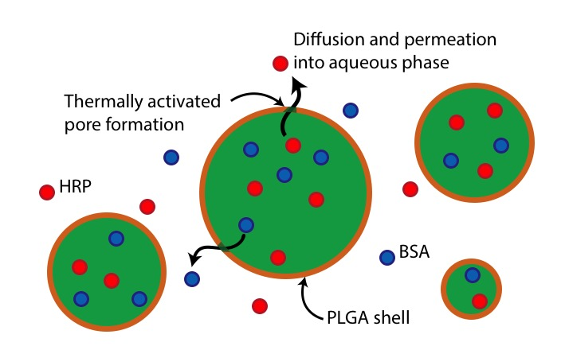
Using physics-based models instead of Gaussian Processes
Prior belief
1 experiment
2 experiments
3 experiments
Maximize stability of an emulsion
Reaction-diffusion model of emulsion stability.
Three kinetic parameters

Slide 9
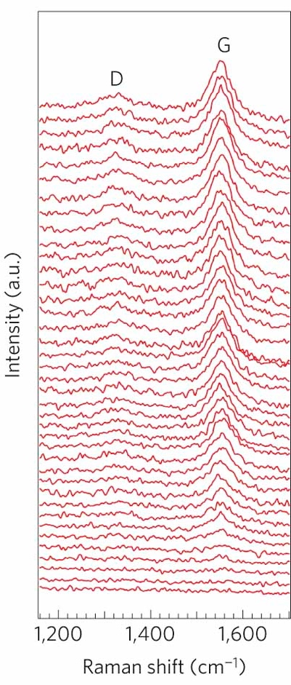
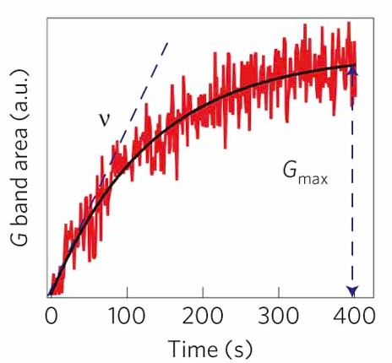
ARES: AFRL’s robot scientist that autonomously grows carbon nanotubes
Synthesis
Characterization
In-situ
Raman spectra
Feedstock Gas
Laser
Raman
Controller
Carbon Nanotube
Catalyst NP
Next
experiment
Si pillars
Growth curve
Planner
(Sequential BED)
Kinetics
Database
Planning
P. Nikolaev, B. Maruyama, et al., npj Comp. Mat. (2016)

Slide 10
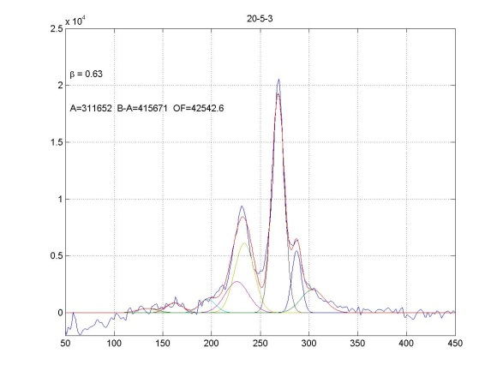
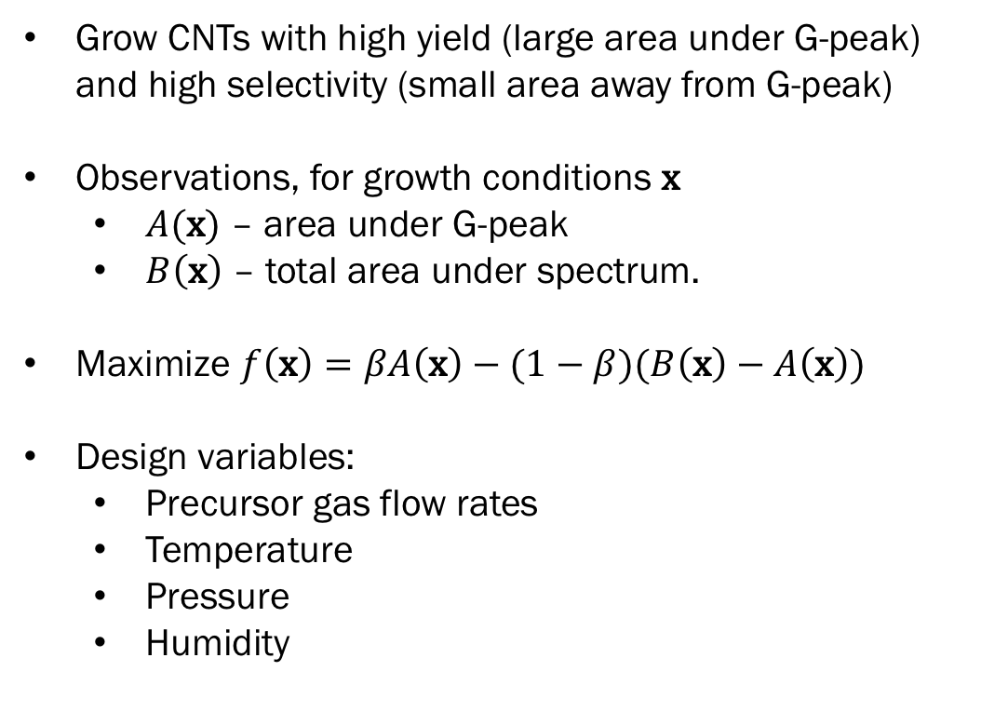
ARES Objective: grow high selectivity, high yield CNTs
Grow CNTs with high yield (large area under G-peak) and high selectivity (small area away from G-peak)
Observations, for growth conditions $\text{x}$
  $A(\text{x})$ – area under G-peak
  $B\left(\text{x}\right)$ – total area under spectrum.
Maximize $f\left(\text{x}\right)=βA\left(\text{x}\right)−(1−β)(B\left(\text{x}\right)−A\left(\text{x}\right))$
Design variables:
  Precursor gas flow rates
  Temperature
  Pressure
  Humidity
Raman Spectra
G peak
Counts
Raman Shift (cm⁻¹)

Slide 11
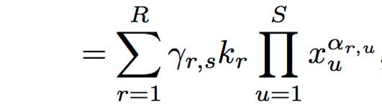
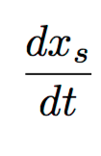
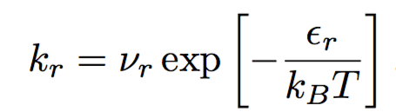
In ARES: we use local parametric models for beliefs
Local models in ARES
Model the growth of phases in CNT growth using mass action kinetics.
Allows us to take advantage of in situ Raman data.
Global models
Pressure
Non-adaptive
Hard to get right
Local parametric models
“Stitch local models together”
Temperature

Slide 12
We’ve ran an initial set of Sequential BED experiments using the KG policy
Sequential BED
Initial data
Initial data
Exploitation mode
Objective Function (a.u.)
Learning mode (KG)
Experiment Index

Slide 13
Problem specific structure should inform modeling and decision making
Typical assumptions in Bayesian Optimization do not capture many types of decision making modalities that occur in practice
We have designed techniques to incorporate:
  Multi-stage decision making
  Physics-based models
  Global /feature learning
We’re applying these techniques to autonomous experimentation.

Slide 14
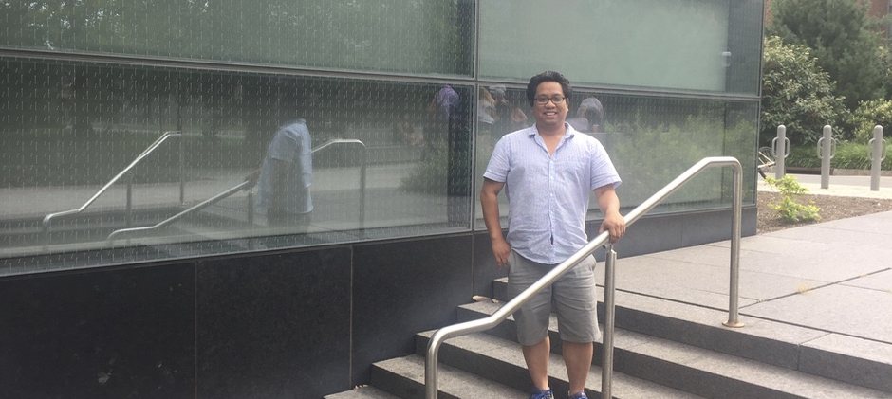
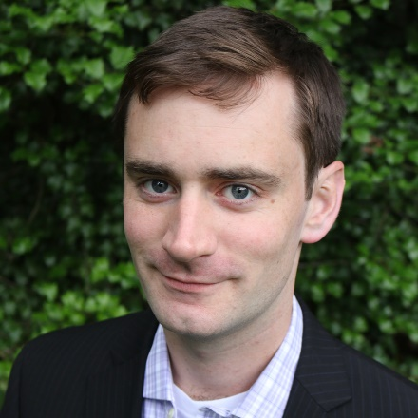
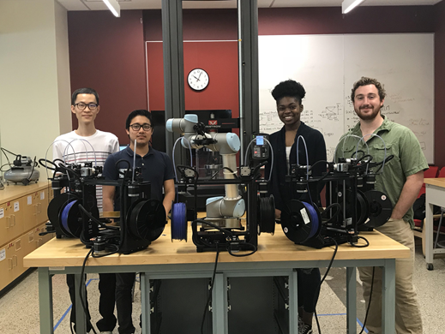

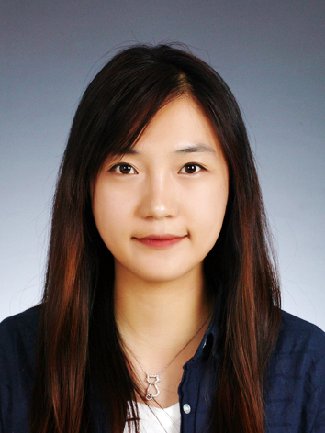
Acknowledgements
KABLab.org
Prof. Keith A. Brown
Mechanical Engineering
Boston University
Bowen
Chika
Wyatt
Dr. Benji Maruyama
Aldair
Aditi Sonal
Soojung Baek

Slide 16
Global and feature learning
Often, scientists are interested in learning the entire response function or some feature of it.
Global learning: learn a phase diagram efficiently
Features: level-set learning
Global learning: learn the phase diagram of an Ising model
4x speedup
We can design policies to efficiently learn phase diagrams.

Slide 17
Truth generation
To test decision making policies, we use learning simulations, for which we must generate ground truth.
To do this, we uniformly sample:
We then solve for intersection
If we accept sample parameters. Otherwise, we reject and resample.

Slide 18
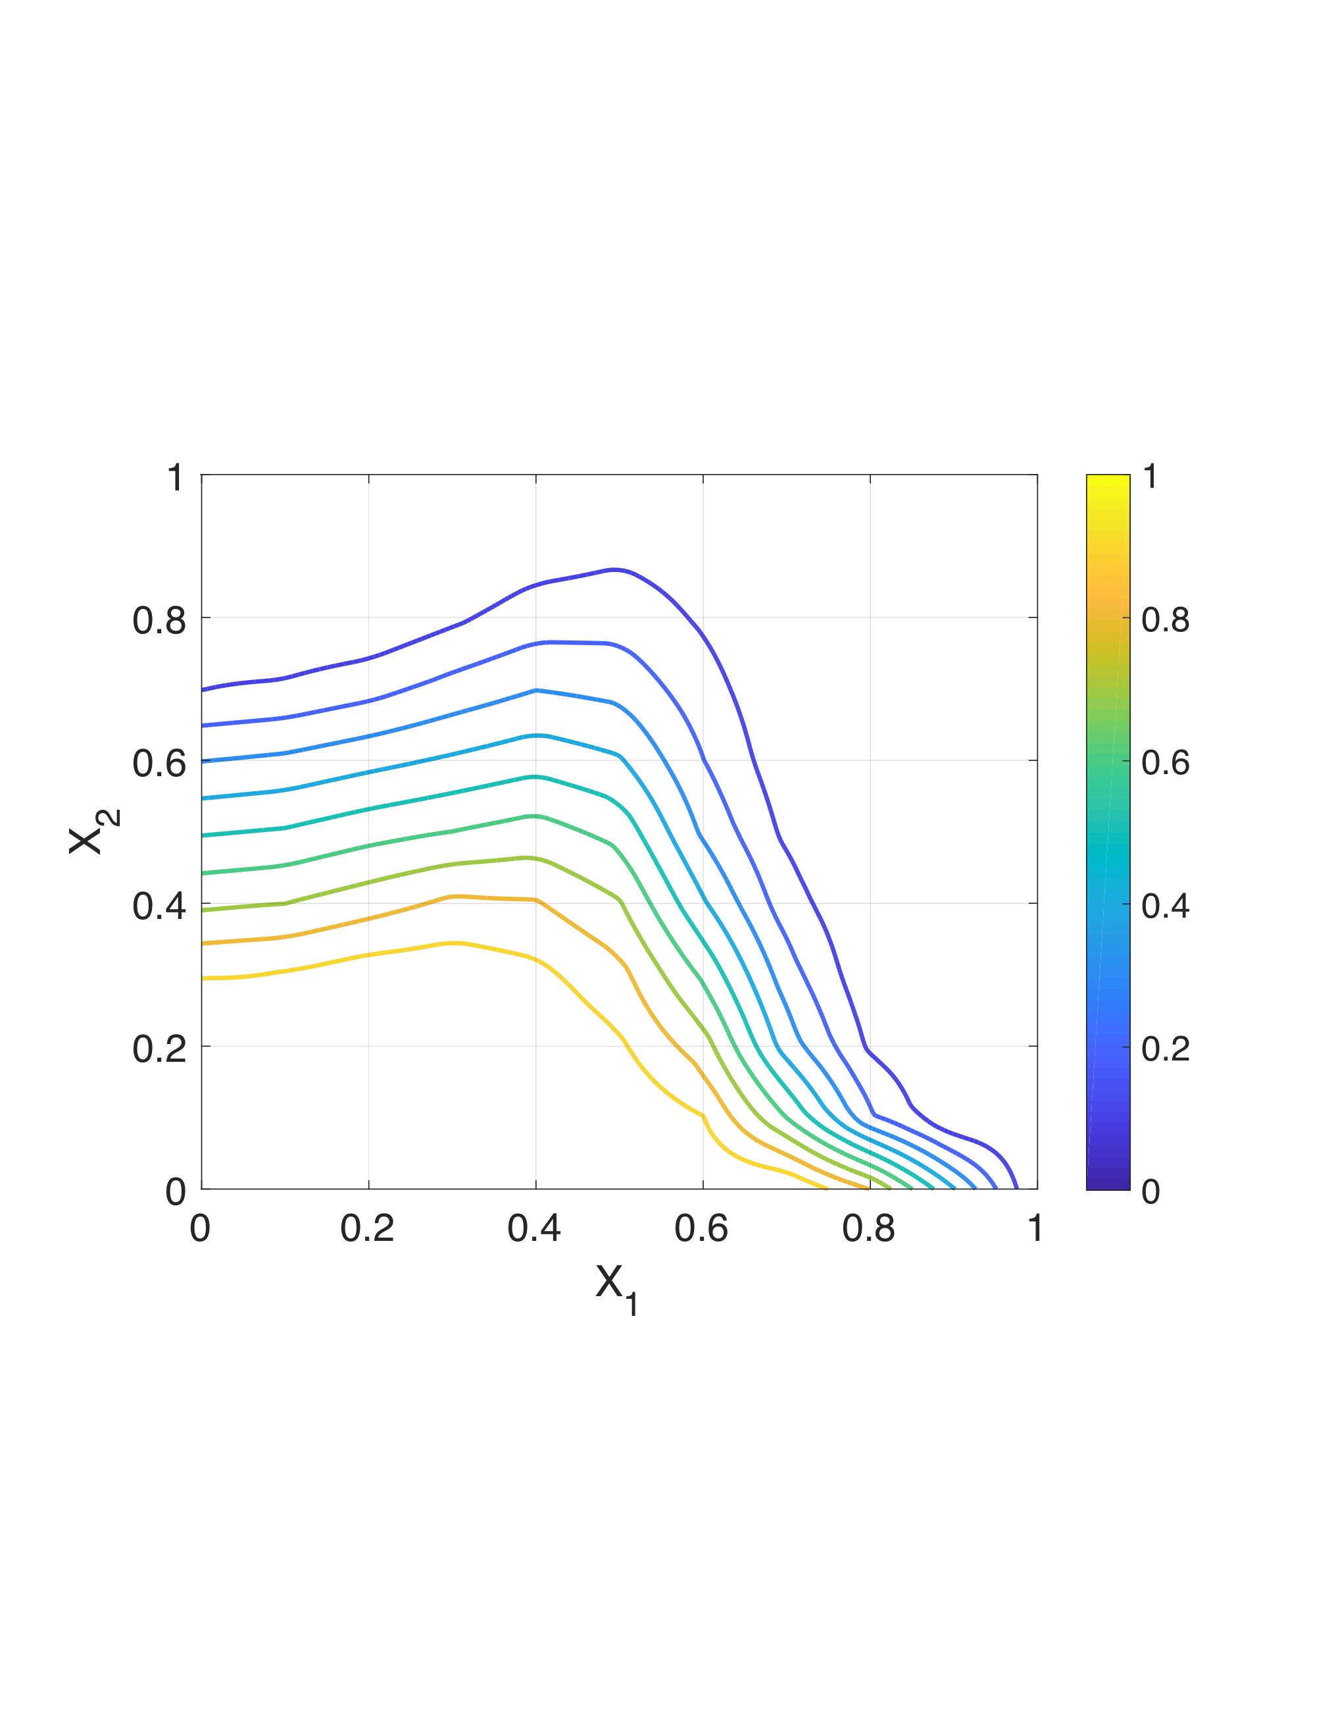
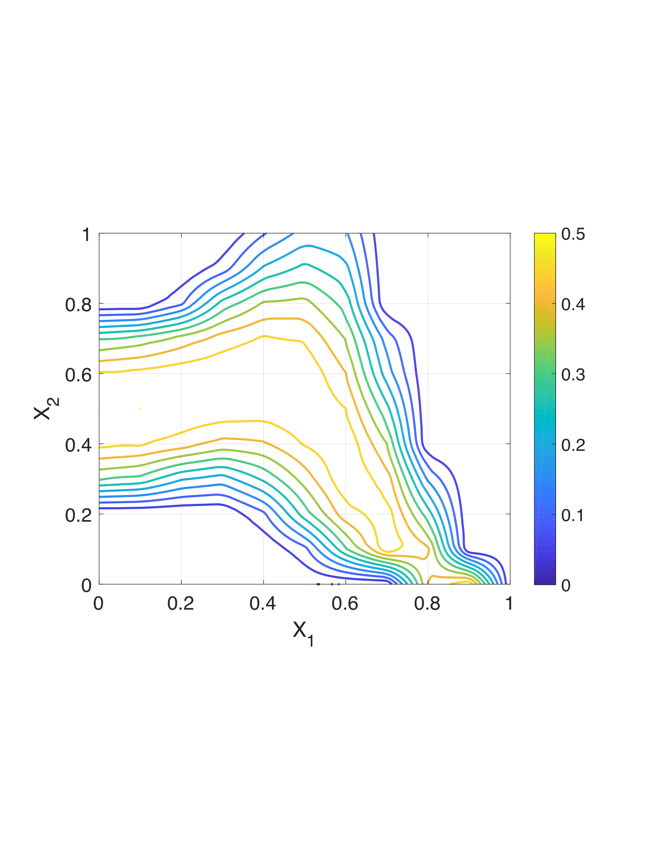
From truth samples, we calculate sample mean and covariance.
This is used as the prior distribution on phase diagrams used by all policies.
Prior mean
Prior standard deviation
(Initial estimate)
(Size of uncertainty, error bars of estimate)

Slide 20
Notation
Input variables – experimental parameters, tunable knobs quantities an experimentalist can control. Parameterizes experiments.
Experiment space – the set of all feasible experiments that could be run.
Experimental response – the experimental output. Assumed a priori unknown, and not directly observed. Sometimes called ground truth.
Experimental observation – the observed, noisy perturbation of the underlying response. Sometimes called a measurement.
For the Energy-scan problem:
Experiment parameters are energy and time
Ground truth is only a function of energy
Observations are a function of energy and time

Slide 21
Reward function
Knowledge Gradient:
A measure of information gain about optima
For the energy-scan problem, this does not respect time constraint. Will simply pick those experiments with highest potential for information gain, regardless of experiment time. Instead, we can use:
Penalized Knowledge Gradient:
A measure of information gain about optima
Time penalty

Slide 22
Priors
How much does f(E) tell us about f(E’) according to priors?
We generate several potential truths for what the kurtosis function is versus energy. We transformed these to a Gaussian Process belief model:
Pearson correlation
7
Correlation length-scale
Energy
Sample from distribution
Asymptotic region
30
Prior mean
7
Energy
30
Kurtosis
Mutual Information
7
Truths used to form prior distribution
Bits
Energy
Energy (GeV)
30
7
Energy
30
Information along diagonals = continuity of f(E)

Slide 23
Error model
We assume Normally distributed, spatially dependent, additive noise, with variance given by:
Error (Std. Dev.) vs. Energy and Time
Error, small t
Ground truth
Energy (GeV)
Kurtosis
Error, large t
Time (days)
Energy (GeV)

Slide 24
Simulation results
We simulated the main learning loop 100 times and measured performance with respect to penalty coefficient η:
We used Opportunity Cost (OC) to measure performance, which captures how far from optimal do current beliefs suggest (lower is better):
What we get if we use estimate for optimal x
Ground truth at where we think optimal is
Opportunity Cost
True optimal value
Actual optimal value
Where we think is best
Actually the best

Slide 25
Simulation results
Average opportunity cost
Average cumulative time
Opportunity cost
Cumulative Time (Days)
Number of experiments
Number of experiments

Slide 26
Simulation results
Average opportunity cost
Average cumulative time
Optimality achieved at time threshold
Opportunity cost
Cumulative Time (Days)
Time Threshold
Number of experiments until time threshold exceeded
Number of experiments until time threshold exceeded

Slide 27
Simulation results
Penalty Coefficient | # Experiments until time threshold | Optimality at time threshold
0 | 1 | 20%
0.1 | 2 | 12%
0.25 | 3 | 10%
0.5 | Did not exceed threshold | N/A
While strongly information-driven
policies do perform better with respect to OC overall, policies that balance information-gain with time constraints do better within time threshold

