Slide 1
Towards Hybrid Human-Machine Scientific Information Extraction
Roselyne Tchoua
Globus Labs Group
Department of Computer Science
University of Chicago
08/06/2018
2018 New York Scientific Data Summit (NYSDS)
Brookhaven National Laboratory
Data-Driven Discovery in Science and Industry

Slide 2
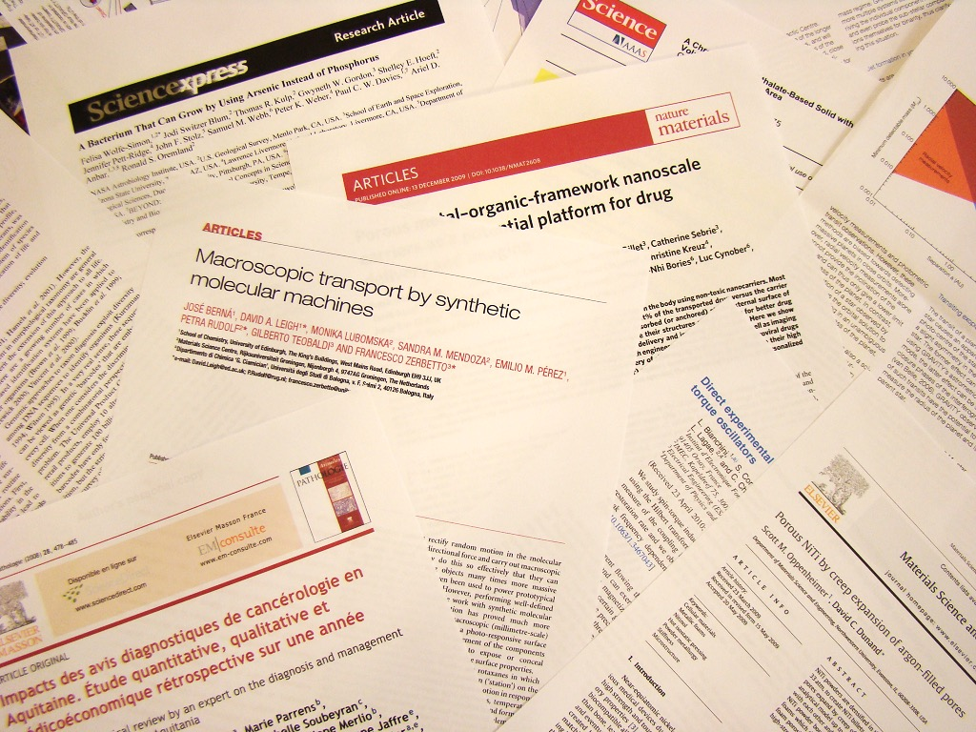
Paper Deluge!
2.5 million publications*
28,100 journals*
Scientific facts are embedded in text, figures, tables, and equations.
Inaccessible to humans, inaccessible to machines!
* M. Ware and M. Mabe. The STM report: An overview of scientific and scholarly journal publishing. Technical report, STM, 2015

Slide 3
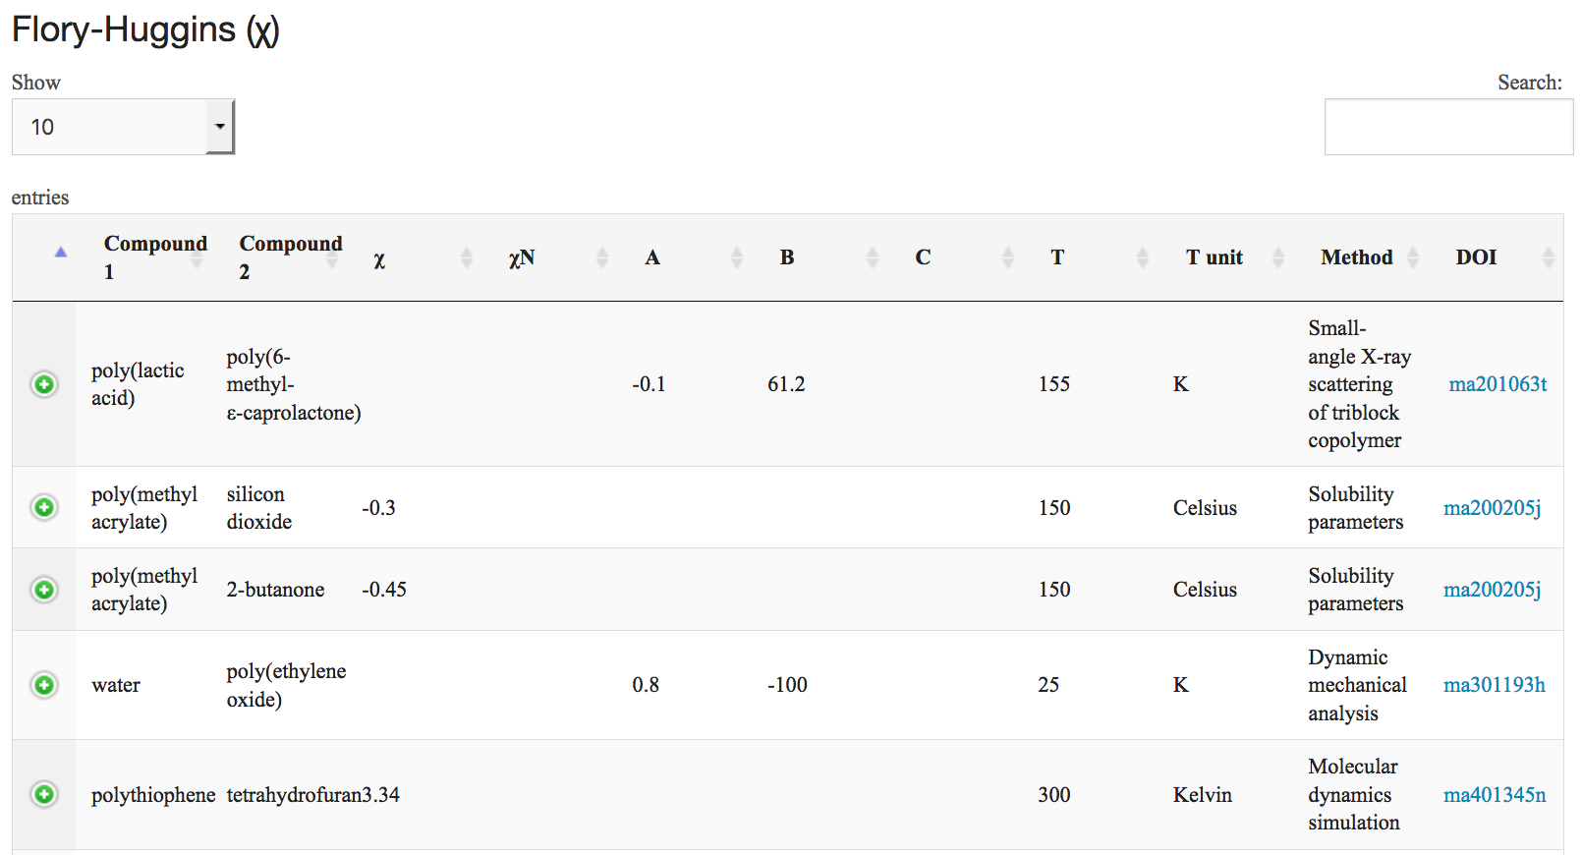
Scientific Facts
Accessible to humans, accessible to machines!
What?
  In medicine: symptoms of a disease
  In biology: properties or reactions of proteins
  In molecular engineering: properties of materials
Where?
  Textbooks
  Scientific literature
  Scientific databases
Polymer Property Predictor and Database (PPPDB)
https://pppdb.uchicago.edu/

Slide 4
How do we get there?
Methods of extraction exist but they are impractical, incomplete, challenging …
Despite considerable progress in natural language processing and machine learning, fully automated extraction solutions do not yet exist
Instead, human effort is needed to develop rules, define training sets, and validate results
How can we effectively combine automated and human methods for extracting scientific facts from the literature?
Notes:
Textbook not up to date, not machine accessible…
Databases not yet fully populated, not in all fields
Literature not fully exploited yet
Fully automated IE is not yet possible due to the complexity by which such properties are encoded in publications.

Slide 5
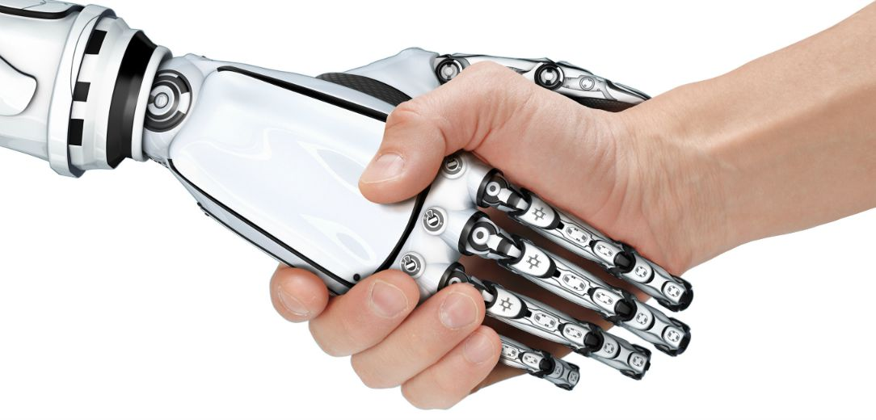
Approach
Hybrid Human-Machine Information Extraction (IE) Pipeline
Improve the machine-human partnership with respect to extraction quality and human cost
Notes:
Since we do not expect the need for human input to disappear, …

Slide 6
Outline
Materials science
Information Extraction
χDB
T_{g} IE Pipeline
PolyNER

Slide 7

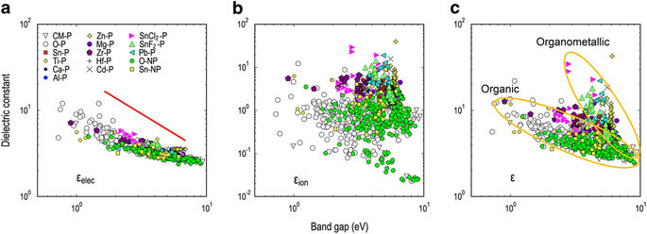
Towards Materials Informatics
In biology, bioinformatics is the solution to the “one graduate student, one gene, one PhD”* problem.
Materials informatics is the solution to the “one graduate student, one alloy/material, one PhD” problem.
*Pr. Andrew Murray from Harvard University http://www.100md.com/html/DirDu/2007/02/17/06/78.htm
Notes:
‘The invention of silicon circuits and lithium
ion batteries made computers and iPods and
iPads possible, but it took years to get those
technologies from the drawing board to the
market place. We can do it faster.’’ President
Obama was optimistic when outlining his
expectations at the launch of the Materials
Genome Initiative (MGI), a project that aims
to double the speed and reduce the cost of
discovering, developing, and deploying new
technological materials.
http://www.whitehouse.gov/blog/2012/05/14/
new-commitments-support-administration-s-
materials-genome-initiative
We’ve chosen materials science
because there are lots of important properties embedded in publications;
no great databases (lots of hand curated stuff);
Currently trial and error process
MGI… focus on doing this better.
Bioinformatics has revolutionized the field of biology!
These methods rely on access to large amount of data!

Slide 8

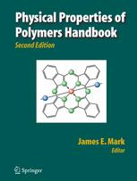
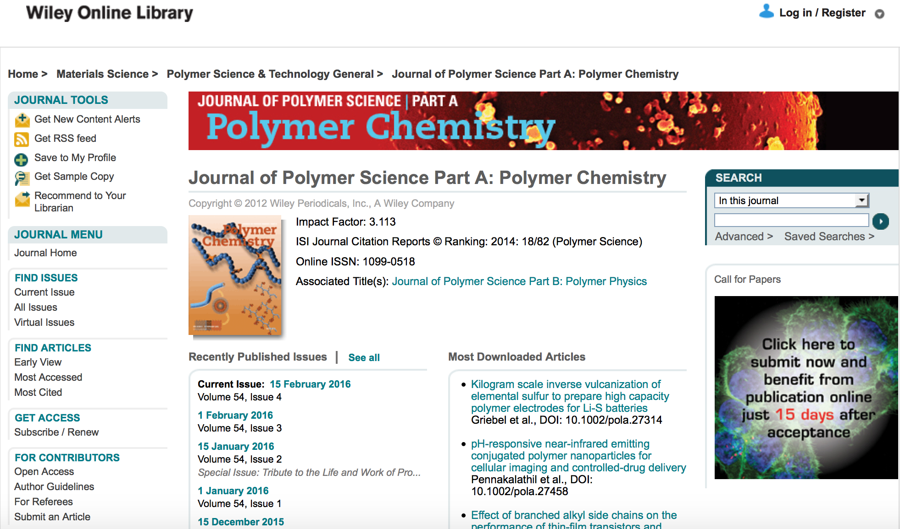
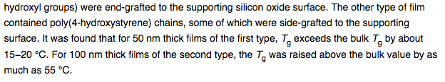

Towards Materials Informatics
Many important values exist
  encoded in text within outdated text books
  esoteric scientific articles
Automated extraction is difficult and manual extraction is time-consuming and error-prone
Published in 2003
Published in 2007
Not up to date with recent publications
Not machine accessible (e.g. modeling)
Properties of polymers embedded in the recent literature
Notes:
Data is neither accessible to human nor machines!

Slide 9
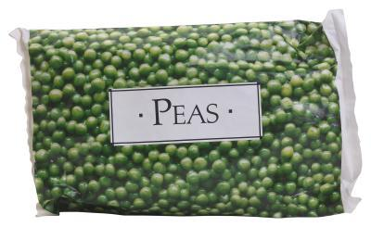

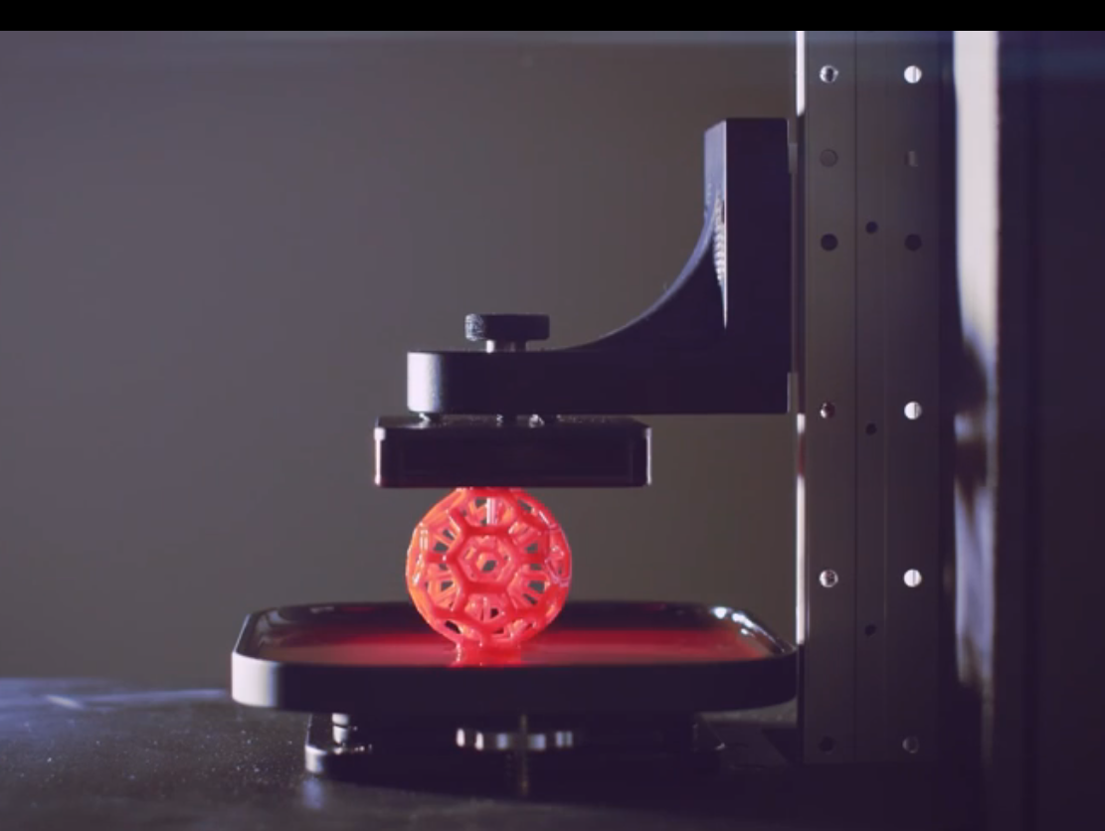
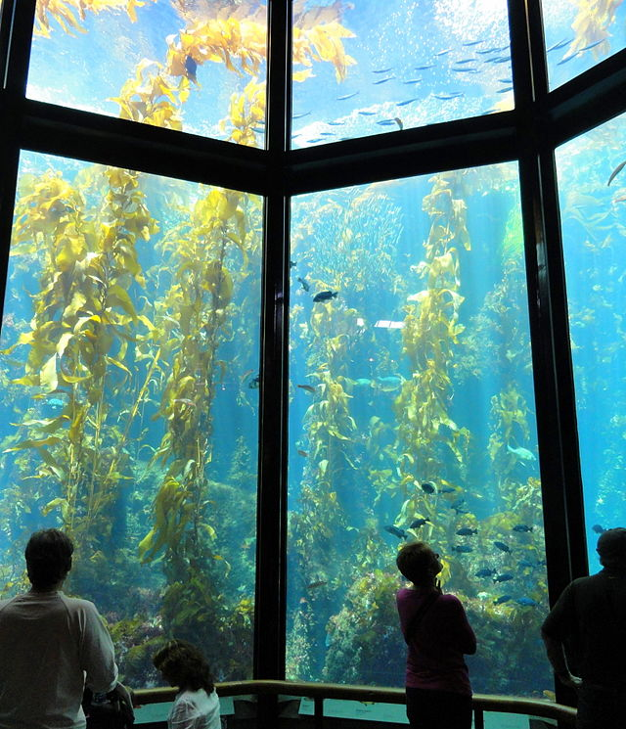


Materials Science is a broad field, focus on Polymers.
Frozen food bag
Corvette body
3D Printing
Glass for aquariums
Bullet proofing for vest
Siding
Polymers are everywhere! There are big differences in properties and applications depending on how the atoms and chains are linked together in space.
Notes:
I’m not a materials scientists and we can’t solve all of materials so we will focus on polymers
A polymer is a macromolecule, composed of many repeated subunits. Molecules are made of atoms.

Slide 10
Outline
Materials science
Information Extraction
χDB
T_{g} IE Pipeline
PolyNER

Slide 11
Information Extraction (IE)
The process of automatically extracting information from a collection of unstructured or semi-structured machine-readable documents.
"Barack Obama married Michelle Obama in...".
Person
Person
Methods | Limitations/Constraints
Ontology-based IE: guided by an ontology | Creation of grammar and lexicon is tedious and time consuming
Machine & deep learning IE | Needs a lot of training data
Crowdsourcing IE | Scale, expertise, motivation, cost…
Hybrid approaches | Leverage strengths of machines and humans
Notes:
Mention manual from NIST
The bulk of the work involved was the construction of a grammar and a lexicon, which required the development of an ontology for the signal transduction domain
Nowadays most software use a combination of rule-based and machine learning to extract information.

Slide 12
Outline
Materials science
Information Extraction
χDB (more human input)
T_{g} IE Pipeline
PolyNER

Slide 13

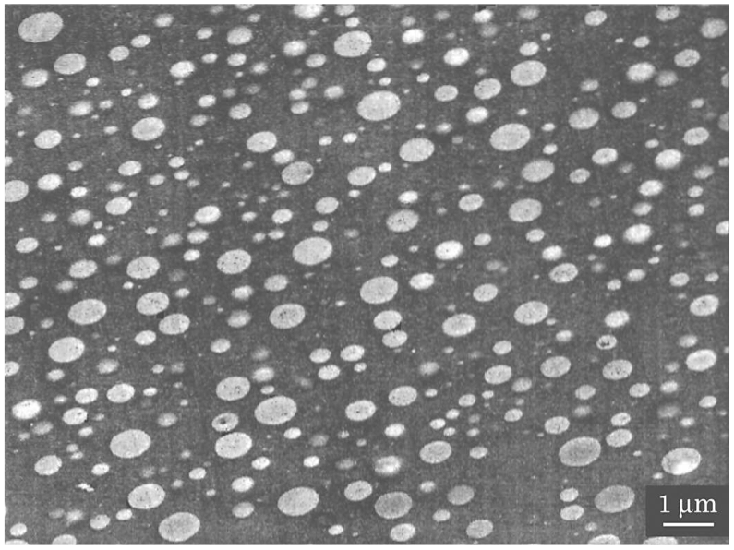
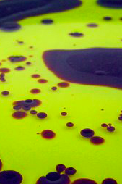
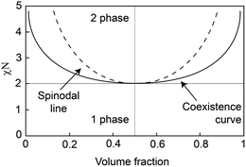
Flory-Huggins (χ) Parameter
Design of new materials is still a process of trial and error
Flory-Huggins (χ) parameter measures the interaction of compounds
  Polymer-polymer
  Polymer-solvent
Scientific fact: Polymer A and Polymer B have χ value of X
80% polyethersulfone and 20% polycarbonate
(incompatible like oil and vinegar)
Materials that self assemble are promising for high-volume cost-effective manufacturing at the nanoscale and the χ parameter controls how these ridges evolve.
Notes:
There are lots of polymer properties. We have picked a difficult one (in terms of how its represented as we’ll come to later)
Flory Huggins parameter - describes how two polymers mix or don’t mix…. Depending on the volume fraction and the temperature, they separate into two phase of blend into 1.
Understanding how these ridges evolve is controlled by the chi parameter
https://ime.uchicago.edu/features/the_promise_of_dsa_technology_for_nanoscale_manufacturing/

Slide 14
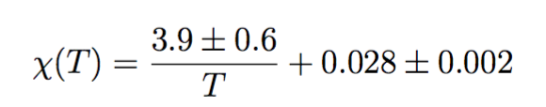
χ Parameter in the Literature
χ parameter is difficult to extract!
Notes:
Flory-Huggins (χ) parameter is particularly challenging to extract
Not only it is found in text, equations, tables and figures but also Identifying and storing the Flory-Huggins parameter requires extracting corresponding polymers, solvents, molecular masses, temperatures, methods, and errors
Χ is published under several different temperature-dependent forms (number, equations, graph)
Little consensus regarding the values partly due to the inherent deficiencies within the FH theory (also dependent on concentration – effective chi)
Flory-Huggins theory is deficient
The Flory-Huggins parameter (𝛘) is particularly complex. E.g.,
Different formats
Different forms “types”
Measured vs cited
Polymer-Polymer or Polymer-Solvent
Only meaningful with its corresponding information (e.g., compounds, temperature, mol. Masses, etc.)
Explain deficient = theory says it depends only on temperature but really it also depends on composition of the blend
Not necessarily unique to chi and illustrates the difficulty of extracting a scientific entity

Slide 15
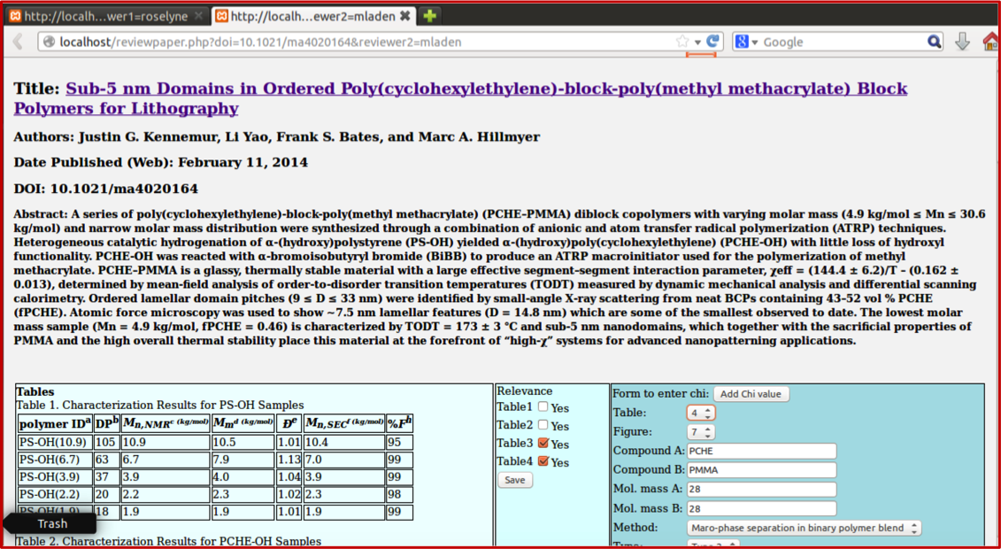
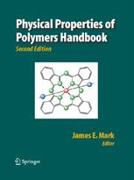
χDB: Hybrid Machine-Human Approach to Populating a DB of χ values
Crowd
Domain
Experts
GUI
DB
z
Publication
Items
Service
Repository
Curated
Items
Journals
Publications
Discovery, Download, Extraction
Crowdsourced Review
Digital Handbook
Notes:
So we decided to involve people…
Extraction is done using Flory-Huggins keyword
Crawls Journals (Macromolecules) for the past X (5) years using “Flory-Huggins” as keyword
Downloads full-text HTML
Web IE:
Metadata (e.g., title, authors, date)
Figures, equations (as figures) and tables
Registers publications and all extracted items in a MySQL database

Slide 16
Results
We required only 144 student hours to extract more 𝛘 values than are found in a major handbook.
Was this approach viable? competitive?
Physical Properties of Polymers Handbook | 𝛘DB Digital Handbook of 𝛘
134 𝛘 values | 237 𝛘 values
41 polymers | 63 polymers
Last published in 2007 | 84 𝛘 values measured from 2010 to 2015
20 weeks
144 person-hours

Slide 17
Outline
Materials science
Information Extraction
χDB
T_{g} IE Pipeline (more automation)
PolyNER

Slide 18
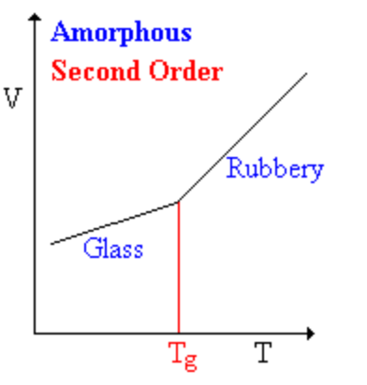
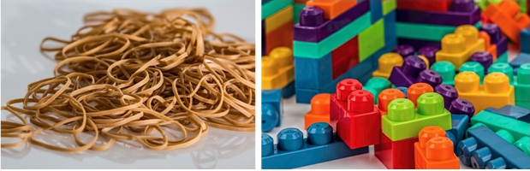
Glass Transition Temperature (T_{g})
T_{g} is Temperature at which a polymer transitions from a solid, amorphous, glassy state to a rubbery state as the temperature is increased
Volume
(((No shape or arrangement)
Mobile molecules
Trapped molecules
Temperature
*
Think of chewing gum and drinking cold water!
Synthetic rubber: Tg ~ -70ºC
Acrylonitrile butadiene styrene (ABS): Tg ~ 105ºC
* http://www.labiotheque.org/2015/10/what-polymers-are-world-of-plastic.html
Notes:
Gum: At body temperature the gum is soft and pliable, which is characteristic of an amorphous solid in the rubbery state. If you put a cold drink in your mouth or hold an ice cube on the gum, it becomes hard and rigid. The glass transition temperature of the gum is somewhere between 0ºC and 37ºC.
Tg is fast and reversible it is not the melting point. If someone asks read:
Glass Transition
Property of the amorphous region
Below T_{g}: Disordered amorphous solid with immobile molecules
Above T_{g}: Disordered amorphous solid in which portions of molecules can wiggle around
A second order transition (see below)
Melting
Property of the crystalline region
Below T_{m}: Ordered crystalline solid
Above T_{m}: Disordered melt
A first-order transition (see below)

Slide 19
Why do we need a hybrid IE approach?
Machine
Human
2.5 million publications *
28,100 journals *
Example of simply-stated scientific fact:
Subtleties in Phrasing
Domain knowledge is sometimes required
The glass transition temperature (Tg) of P3PT was determined from second DSC scan to be 37 °C, which is to be compared to a higher Tg of 66.9 °C reported for P3BT(11a) and a lower Tg of 12.1 °C reported for P3HT.(20).
PDMS has a Tg of −120 °C.
poly(1,2:3,4-di-O-isopropylidene-6-O-(2′ −formyl-4′ - vinylphenyl)-d-galactopyranose)
* M. Ware and M. Mabe. The STM report: An overview of scientific and scholarly journal publishing. Technical report, STM, 2015
Notes:
We were focusing more crowdsourcing now we want to be more hybrid
One side addresses scale and structure, the other side addresses free form, subtleties and ambiguity
Possibly mention synthesis papers where the polymer name does not appear at all, when authors are more interested in the chemical reaction instead.

Slide 20
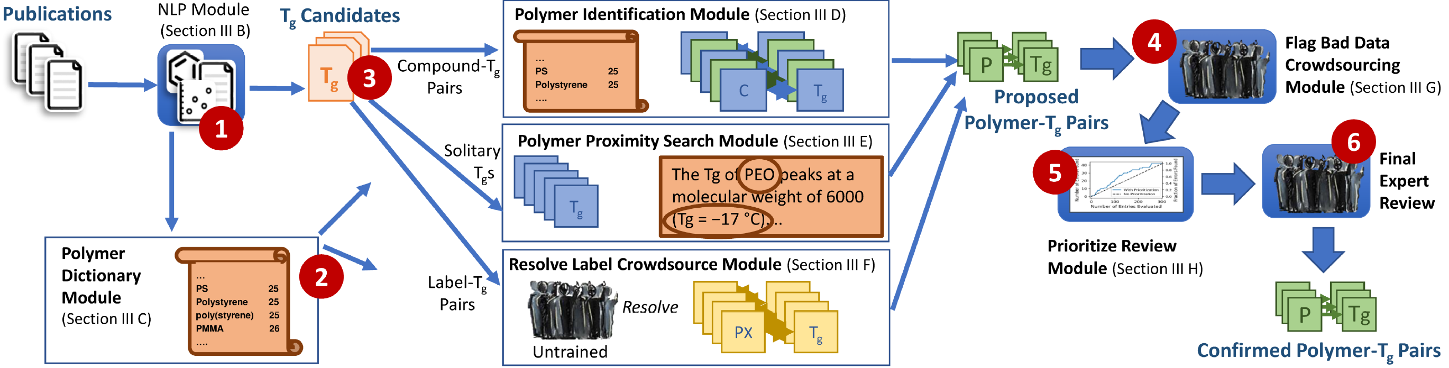
We propose a hybrid IE pipeline that leverages machines and humans strengths
Combination of rule-based, machine learning, and crowdsourcing approaches.

Slide 21
Based on Extended NLP Module to Extract T_{g} (CDE+)
ChemDataExtractor:
  Properties do not include T_{g}
    Added rules to extract T_{g}
  Does not distinguish polymers from other compounds
Other types of outputs:
  Chemical compounds with associated T_{g}
    Silica – 1475 K
  “Solitary” T_{g}s
    100ºC
  Labeled compounds such as Polymer A
    Copolymer 10 – -13.2ºC
{
“names”: [
“PDMS”,
“Polydimethylsiloxane”
],
“glass_transitions”: [
{
“units”: “°C”,
“value”: “-120”
}
]
}
Ideal T_{g} Record:
Polydimethylsiloxane (PDMS) – -120 ºC
Notes:
Trained mostly on biomedical newspapers and articles supplemented with chemistry articles – not geared towards polymers
Added rules for T_{g}
Variation for glass transition temperature: T_{g}, glass transition temp., transition temp(erature), …
Variation in temperature: T_{g} =, T_{g}: , T_{g} of, T_{g} value of …

Slide 22
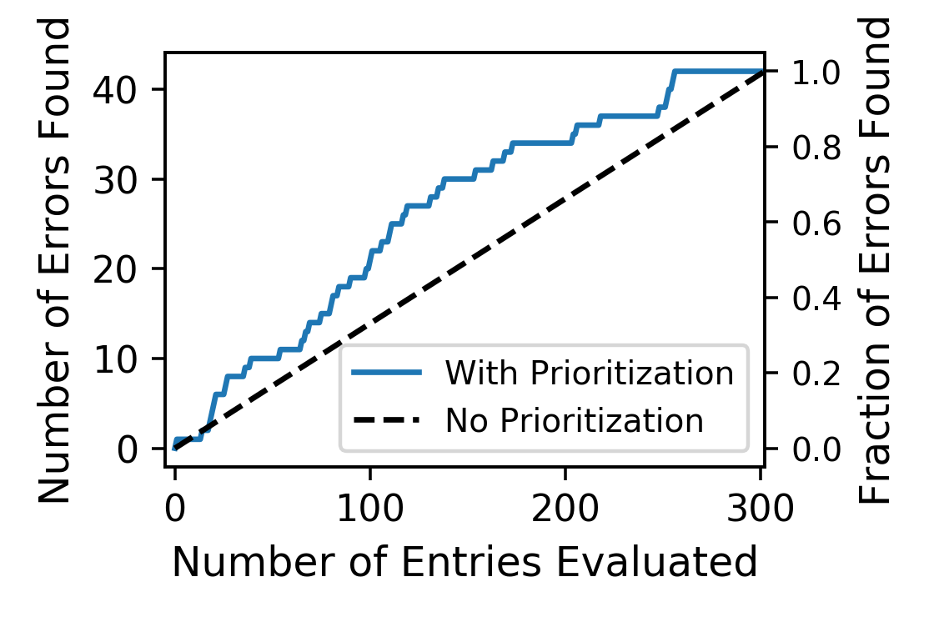
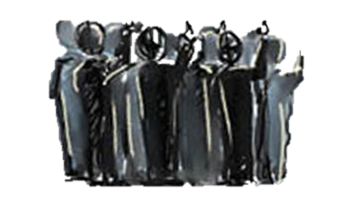
Further Processing of Irregular Outputs
Rule-based polymer Identification and dictionary:
  P(, poly
  aggregate synonyms, acronyms, singular/plural forms
  International Union of Pure and Applied Chemistry (IUPAC) naming conventions
9555 compounds
12257 synonyms
233 confirmed T_{g}
Compound | Temp.
Poly(3-pentylthiophene) | 259 ºC
 | 100 ºC
Copolymer 10 | -13.2 ºC
 | 75 ºC
PDMS | -120 ºC
PPDL-block-PLLA | -60 ºC
Quaternary ammonium | 170 K
Poly4-ket | 125 ºC
Cross-Linkable Poly(fluorene)s | 47 ºC
Silica | 1475 K
Compound | Temp.
Poly(3-pentylthiophene) | 259 ºC
Isotactic polystyrene | 100 ºC
PMPC₂₀-b-PMHPAC₇₀ | -13.2 ºC
poly(9,9-dioctylfluorene | 75 ºC
PDMS | -120 ºC
PPDL-block-PLLA | -60 ºC
Quaternary ammonium | 170 K
Poly4-ket | 125 ºC
Cross-Linkable Poly(fluorene)s | 47 ºC
Silica | 1475 K
Computer Modules
Crowdsourcing Modules
Candidates
Confirmed Pairs
Notes:
The difference between 2) and 3 a) is that we preprocess all compounds in 1) to find all acronyms, synonyms, plurals/singular etc. In 3) a we can just use the module like a “lookup table”

Slide 23
Outline
Materials science
Information Extraction
χDB
T_{g}
PolyNER (“easy” labeling & human-in-the-loop)

Slide 24
PolyNER
Named Entity Recognition (NER) is often the first step in entity relations
  ➔ NLP module missed 50% of Tg pairs because of incorrect polymer NER
  ➔ Start with NER, specifically polymer NER
How do we combine expertise from human and computers at scale?
➔ Use machine learning approach?
➔ But what if we lack training data?
➔ Keep human in the loop to adjust models
How do we generalize the hybrid approach to other scientific entities?
➔ How can we inject minimal amount of domain-specific knowledge?

Slide 25
PolyNER
Proposed Solution: Generalizable domain-informed Named Entity Recognition using machine learning

Slide 26
Sentence classification
CDE+: our polymer-aware ChemDataExtractor. It can process entire documents and look for all entities and properties, on average
  Takes ~ 52 seconds to process a document
  Polymers constitute only 0.2% of all words in a paper and appear in only about 4% of sentences
  Text/message/sentence classification is used to classify text as “spam” vs. not “spam” (binary), “baking” vs. “equipment” etc.
We use FastText* to efficiently classify sentences that contain polymers.
Bojanowski, Piotr, Edouard Grave, Armand Joulin, and Tomas Mikolov. "Enriching word vectors with subword information." arXiv preprint arXiv:1607.04606 (2016).
Joulin, Armand, Edouard Grave, Piotr Bojanowski, and Tomas Mikolov. "Bag of tricks for efficient text classification." arXiv preprint arXiv:1607.01759 (2016).
Notes:
Ensemble methods are learning algorithms that construct a. set of classifiers and then classify new data points by taking a (weighted) vote of their predictions.
Ensemble modeling is the process of running two or more related but different analytical models and then synthesizing the results into a single score or spread in order to improve the accuracy of predictive analytics and data mining applications
One common example of ensemble modeling is a random forest model. This approach to data mining leverages multiple decision trees, a type of analytical model that's designed to predict outcomes based on different variables and rules

Slide 27
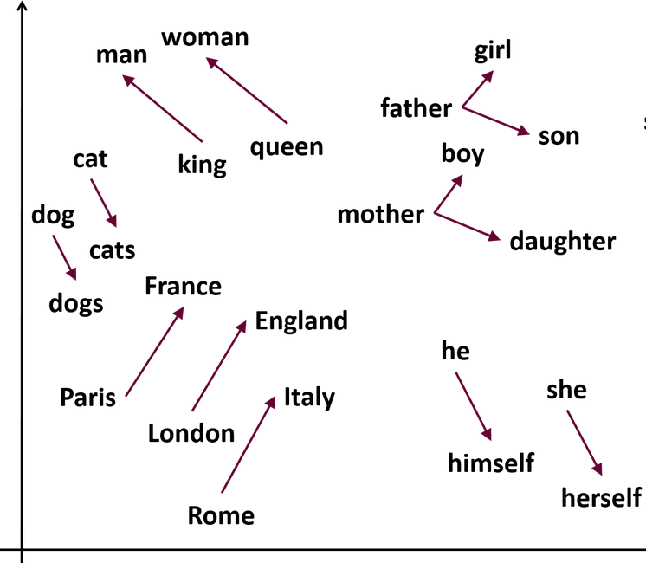
Word Embedding
Method maps each word in a sentence or document to a vector in an n-dimensional real vector space based on the linguistic context in which the word appears.
  e.g. co-occurrence frequencies of words
Word2vec (NN-based) added concept of similarity between words
Word2vec
king + man – woman = queen
Mikolov, Tomas, Ilya Sutskever, Kai Chen, Greg S. Corrado, and Jeff Dean. "Distributed representations of words and phrases and their compositionality." In Advances in neural information processing systems, pp. 3111-3119. 2013.
Notes:
String matching only gets us so far (search for “poly”)
polystyrene is a polymer but polydispersity isn’t
PS, the acronym for polystyrene does not contain poly
String matching does not capture semantics i.e. there is no context.
Polystyrene has a glass transition of 100℃
X has a glass transition of Y℃ ➔ X is a polymer
Rule-based approach is not comprehensive
Lack of training data impedes traditional ML approaches (based on annotated corpus)
Computers work better with vectors rather than strings
https://www.analyticsvidhya.com/blog/2017/06/word-embeddings-count-word2veec/

Slide 28
Candidate Generation
We use domain knowledge to generate candidate entities, in this case candidate polymers
  Polystyrene (PS) is the most commonly studied polymers in our corpus (2684 appearances in DB); next most common appears 688 times
  Hypothesis: polymers’ vectors are similar to PS vector
We used two approaches
  Corpus level: Top-500 most similar to PS
  Document level: Check each word (vector) in each selected sentence for similarity to PS > threshold T
We use Gensim* and FastText to generate word vectors
* Khosrovian, Keyvan, Dietmar Pfahl, and Vahid Garousi. "GENSIM 2.0: a customizable process simulation model for software process evaluation." In International Conference on Software Process, pp. 294-306. Springer, Berlin, Heidelberg, 2008
Notes:
➔ we hypothesize that we can get polymer candidates by simply comparing their vectors to the vector for polystyrene

Slide 29

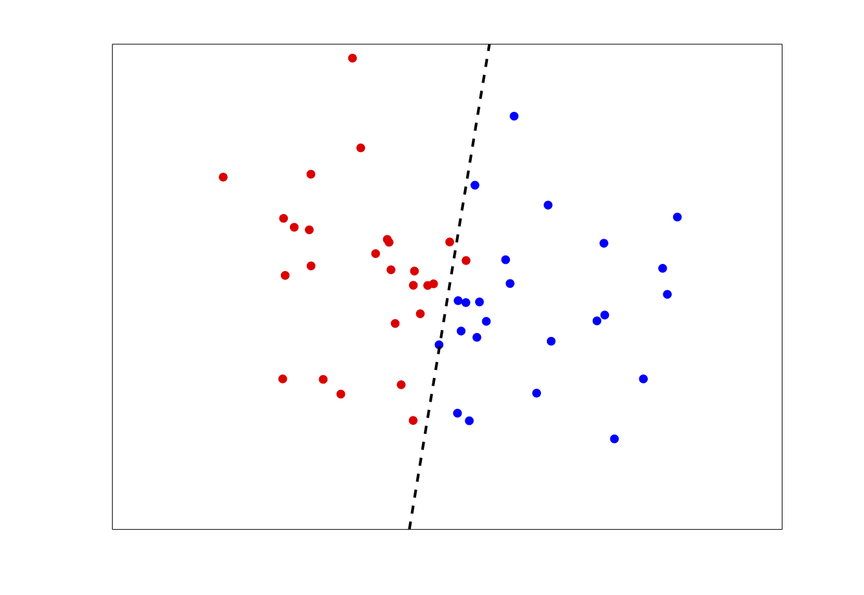
Candidate Classifier
Automated candidate generation still includes many incorrect candidates (or false positives)
Expert material scientists labeled candidates
Supervised K Nearest Neighbor classifier to further refine our results.
Automatically labeled candidates
Notes:
Still easier task than labeling entire corpus
Mention issue about recall here because all labeled data are supposedly deemed to be polymers but we don’t know what we missed

Slide 30
Results: Sentence Classification
Receiver operating characteristic (ROC) curve
Text processing
  Modest effect on precision
  Greater impact on recall
Results
  Best precision 93.1%
  Best recall: 67.4%
Precision Recall Curve

Slide 31
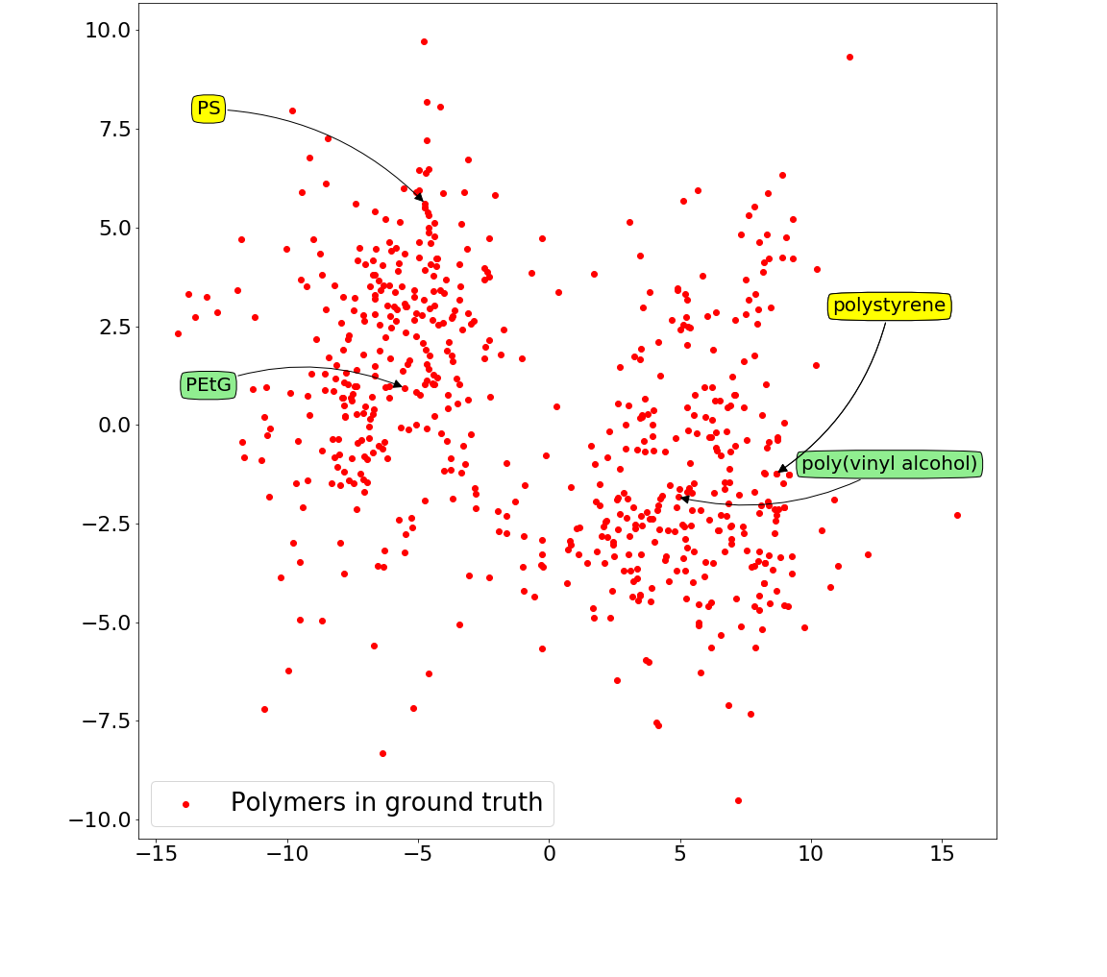
Results: Candidate Generation
Polymers from Ground Truth in Vector Space
Domain-informed candidate generation
  Use threshold of similarity to polystyrene and PS to generate candidate polymers
Results
METHOD | Precision | Recall | F-1 Score
Corpus level | 31.1% | 25.3% | 27.9%
Document level | 44.0% | 38.1% | 40.9%

Slide 32
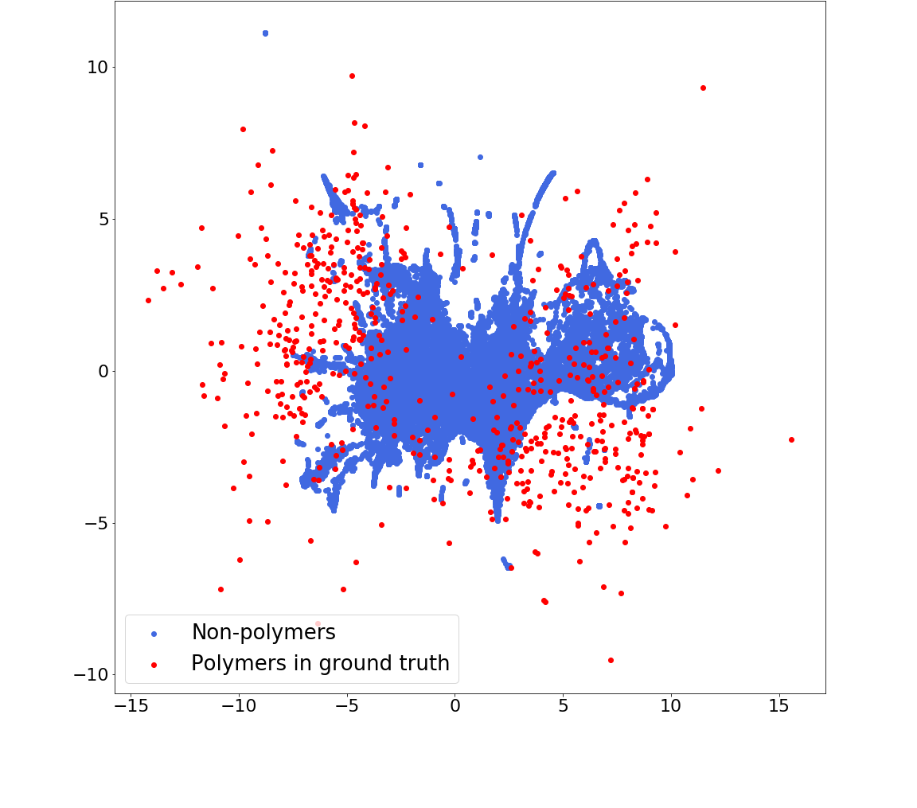
Results: Candidate Classification
Polymers and non-polymers from Ground Truth
in Vector Space
Text processing
  Strip words
  Remove regular English words
Results (classifying candidates)
  Precision 45.2%
  Recall: 53.8%

Slide 33
Results: PolyNER
Performance measured against actual polymer names extracted by experts from 100 papers
PolyNER | Precision | Recall | F₁
CDE+ | 45.3% | 59.3% | 51.4%
PolyNER | 36.2% | 47.5% | 41.1%
PolyNER ∪ CDE+ | 35.0% | 67.4% | 46.0%
PolyNER achieves comparable results to state-of-the-art software with automatic labeling and little training data

Slide 34
PolyNER Applied to Social Dataset Recognition
Domain-specific knowledge: Sequences of capitalized words
Performance measured against actual dataset names extracted from 300 papers
Results:
  Precision: 59.6%
  Recall: 58.7 %
PolyNER achieves promising results considering completely different and complex task of recognizing datasets (synonyms, varying years etc.)
Notes:
Will have to talk more about details here

Slide 35

Challenges in Scientific NER
Many scientific entities are complex:
  Lenient evaluation
    Rule-based acronym/synonym extraction
    Word-embedding acronym/synonym detection
    Partial matches to present experts
Amber Keahey
U. Chicago
Notes:
Poly[(4,4′-dinonyl-2,2′-bithiazole-5,5′-diyl)-(2,1,3-benzoselenadiazole-4,7-diyl)]
Maleic anhydride-modified polyethylene
S-poly(α-methyl-α-ethyl-β-propiolactone)s
poly[thienyl-substituted benzo[1,2-b:4,5-b′]dithiophene-pyrrolo[3,4-c]pyrrole-1,4- dione-thieno[3,4-c]pyrrole-4,6-dione]copolymers
vinylidene fluoride−trifluoroethylene copolymers
sulfonated aromatic polymers

Slide 36


Challenges in Scientific NER
Many scientific entities are complex:
  Lenient evaluation
  Human-in-the-loop with active learning
Word vectors
Labeled data
Unlabeled data
Experts
Theodore Ando
Princeton
Let the machine propose most useful data points to experts
Notes:
Poly[(4,4′-dinonyl-2,2′-bithiazole-5,5′-diyl)-(2,1,3-benzoselenadiazole-4,7-diyl)]
Maleic anhydride-modified polyethylene
S-poly(α-methyl-α-ethyl-β-propiolactone)s
poly[thienyl-substituted benzo[1,2-b:4,5-b′]dithiophene-pyrrolo[3,4-c]pyrrole-1,4- dione-thieno[3,4-c]pyrrole-4,6-dione]copolymers
vinylidene fluoride−trifluoroethylene copolymers
sulfonated aromatic polymers

Slide 37
Challenges in Scientific NER
What do we do with multi-word entities?
    Important vs. non important prefixes and suffixes (change properties?)
Unnamed entities (synthesis papers), rare entities
How do we re-integrate what we missed via automatic labeling?
e.g.:
hydride-terminated PDMS
vinylidene fluoride−trifluoroethylene copolymers
sulfonated poly(ether sulfone)s
Notes:
Poly[(4,4′-dinonyl-2,2′-bithiazole-5,5′-diyl)-(2,1,3-benzoselenadiazole-4,7-diyl)]
Maleic anhydride-modified polyethylene
S-poly(α-methyl-α-ethyl-β-propiolactone)s
poly[thienyl-substituted benzo[1,2-b:4,5-b′]dithiophene-pyrrolo[3,4-c]pyrrole-1,4- dione-thieno[3,4-c]pyrrole-4,6-dione] copolymers
vinylidene fluoride−trifluoroethylene copolymers
sulfonated aromatic polymers

Slide 38








Ian Foster
Kyle Chard
Pr. Juan de Pablo
Shrayesh Patel
Debra Audus
Thank you! Questions?
Logan Ward
Zhi Hong
Aswathy Ajith
https://pppdb.uchicago.edu/

