Slide 1
Visualization and quantum computation of Moiré superconductivity in bilayer graphene, carbon nanocones, and nanostrips
Sarah Elghazoly, Physics, Smith College, Northampton MA, 01063.
Michael McGuigan, Computational Science Initiative, Brookhaven National Laboratory, Upton NY, 11973.

Slide 2
Introduction
Graphene is a single layer of hexagonally arranged sp² hybridized carbon atoms separated by a bond length of approximately 0.142 nm. Graphene was first successfully isolated in 2004 at the University of Manchester.
Graphene has many interesting properties that make it a target for research: high electron mobility, thermal conductivity, strength and transparency.
The pi bands of sp² hybridized carbon bonds are responsible for the unique electronic properties of the material. Graphene has a Dirac cone structure for low energy bands.
By studying sp² hybridized allotropes of carbon, some insight can be gained into the nature of the material.

Slide 3
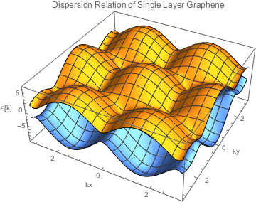
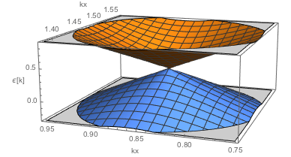
Low-energy dispersion relation of graphene at a Dirac point, where the energy is approximately linear and can be described by the equation:
Dispersion relation of single-layer graphene for nearest and next-nearest neighbor hopping. This plot was made using Mathematica and using the well-known equation for the dispersion of graphene given by:
describing the electrical conduction of charge carriers as massless fermions.

Slide 4
Motivation to Understand Carbon Based Lattice Structures
The topological features of molecules are fundamental to understanding their chemical and electrical properties and examining the potential uses of that molecule.
Molecular visualizations are intended to support our understanding of molecular properties, especially those of higher complexity.
Molecular modeling tools VMD, Avogadro and SAMSON were utilized to create carbon-based structures.
These modeling tools provide a framework for modeling, animating and optimizing molecular structures. They can provide molecular bond information and can conduct real-time interactive molecular dynamics simulations.

Slide 5
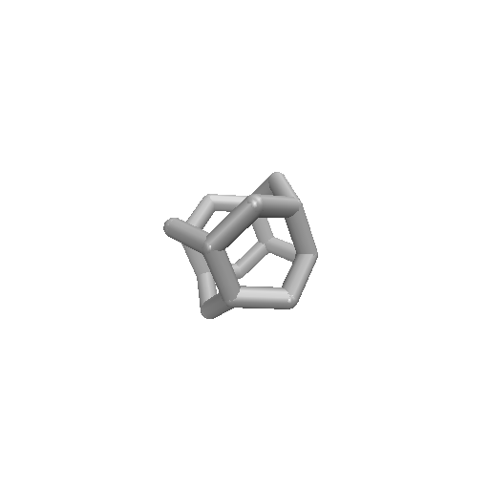
Interesting Models
Bilayer-graphene and Moiré patterns
Carbon-nanocone
Carbon nanohorn
Nanostrips and Möbius strips
N=16 carbon nanostrip in a ring formation. Visualization made using Avogadro and rendered using VMD.
N=24 carbon Möbius strip made using Avogadro and rendered on VMD.

Slide 6
Moiré Patterns in bilayer graphene
In Bernal (AB) stacked bilayer graphene, the top layer is offset by the length of one carbon-carbon bond.
Rotated Bernal stacked graphene has recently shown superconductivity at certain ‘magic angles’ of rotation [1].
Moiré patterns emerge due to the superposition of the identical lattices at different angles.
The periodicity of Moiré patterns in bilayer-twisted graphene is given by
Animation made by creating 1000 atom sheets of graphene using SAMSON and superpositioning and rotating using VMD.

Slide 7
Carbon Nanocone
Pentagonal defects in 2D graphene sheets have been experimentally produced and studied.
Carbon nanocones are an important model to study to understand the role of defects in the development of carbon based electronics, and the implementation of curved carbon structures.
Nanocones have distinct low-energy electronic properties at the apex due to topological differences that change electron transport properties.
Carbon nanohorns are a promising material for bio and chemical sensors because of their electrical conductivity with high current capacity and stability.
N=48 Nanocone created in Avogadro and rendered using VMD

Slide 8
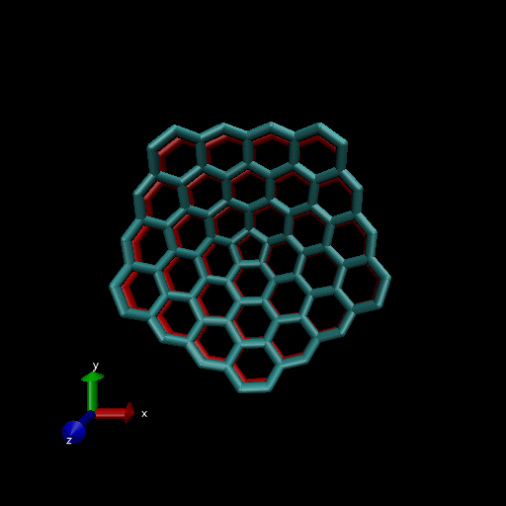
Two N=48 nanocones overlaid and rotated. Animated using VMD about a central point in the pentagonal defect.

Slide 9
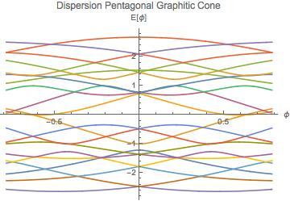
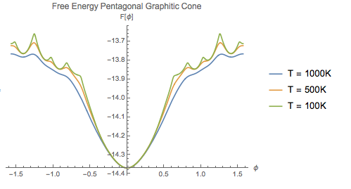
Using bond information from VMD, an adjacency matrix can be formed of an N=20 pentagonal cone. Taking the eigenvalues of this matrix yields the dispersion relation and the eigenenergies can then be used to calculate the free energy, persistent current, etc.
Energy dispersion of cone as a function of magnetic field flux perpendicular to the cone, created using Mathematica.
Fermion free energy as a function of flux calculated from the dispersion of the pentagonal cone for various temperatures.

Slide 10
Quantum Computation to Simulate Chemistry
Although quantum computers are currently able to solve only simple chemical systems of a few atoms, with increasing scope, quantum computers have prospective use for solving chemical problems intractable on classical computers with the performance of complex chemical simulations.
These complex simulations can be theoretically modeled on a quantum computer without making approximations necessary to perform on a classical computer. The qubits of a quantum computer can exist as a superposition of possible electron states unlike a classical bit. It is believed that at 49 qubits quantum supremacy will be achieved.

Slide 11
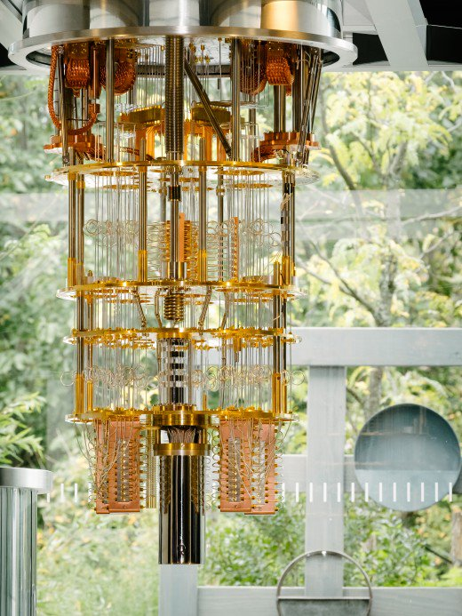
IBM QISKit (Quantum Information Science Kit) and QISKit ACQuA (Algorithms and Circuits for Quantum Applications)
The IBM Quantum Experience is an open-source project that provides a Python interface to quantum computer through the Cloud.
Through its Variational Quantum Eigensolver, the user can find the ground-state and excited state energies and wave functions.
The Variational Eigensolver has several GitHub publications: chemical bond length simulations for H2 and Li-H, as well as optimization for the traveling salesman problem.
taken from: https://www.technologyreview.com/s/609451/ibm-raises-the-bar-with-a-50-qubit-quantum-computer/

Slide 12
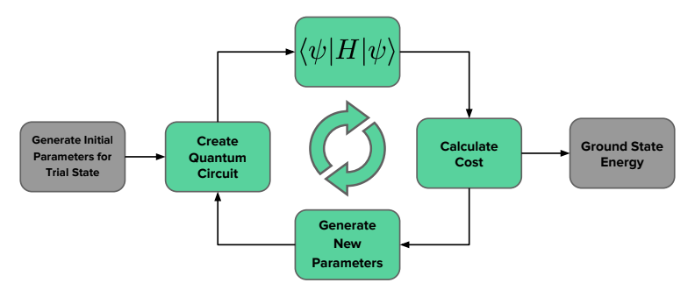
Variational Quantum Eigensolver
The Hamiltonian of the system is mapped to a qubit Hamiltonian
A trial wavefunction is picked and then a quantum circuit is applied to prepare the desired state. The quantum circuit used in the variational eigensolver is a Hadamard gate applied to each qubit to create a superimposed state, followed by a y and z rotation (R_{y} , R_{z})
Finally the energy of the trial state is estimated which is then fed into a classic optimizer (in this case the Simultaneous Perturbation Stochastic Approximation (SPSA) optimizer) which generates new control parameters with lower energy.
figure from Aditya Samaroo

Slide 13
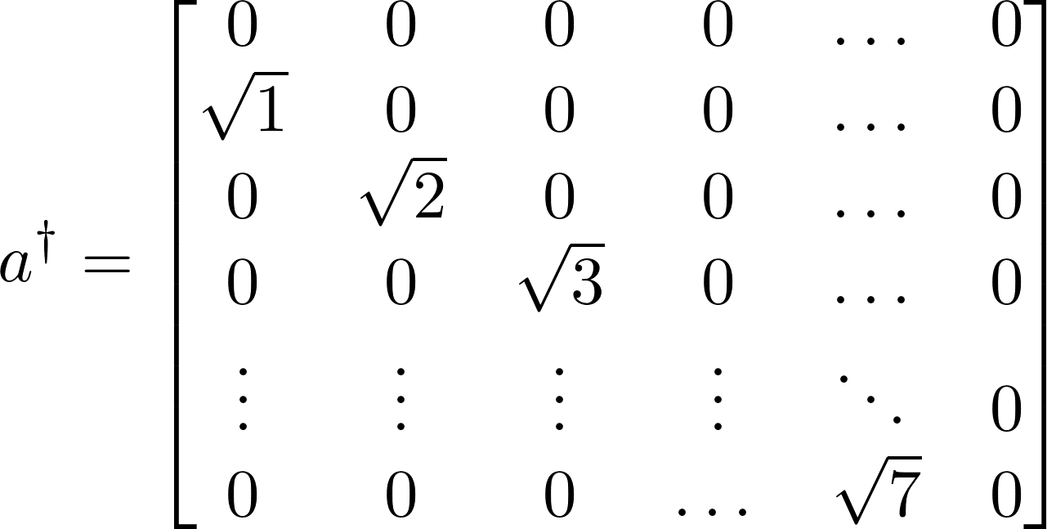
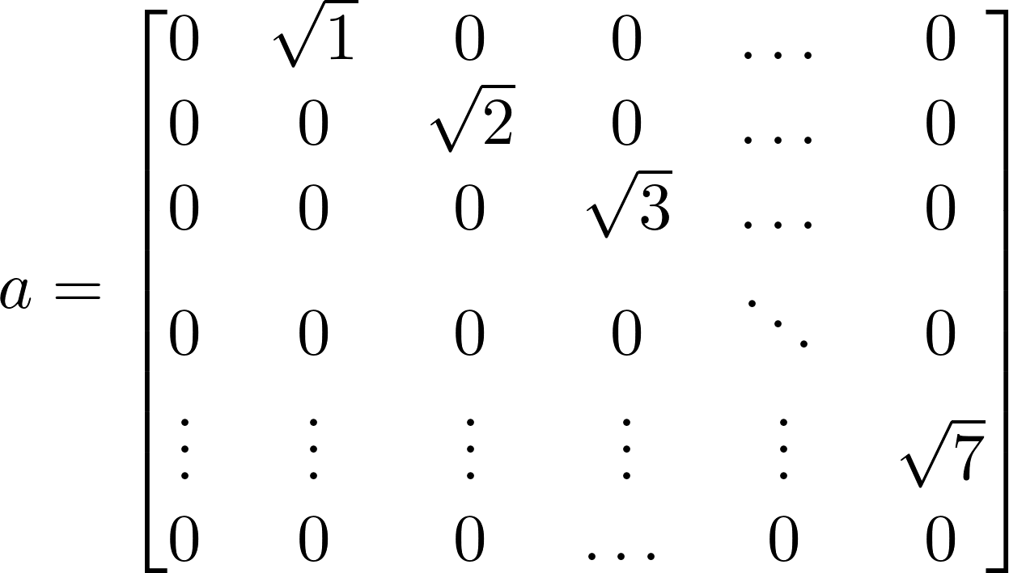
Building and factoring a Hamiltonian
Fermion Creation and Annihilation Space
Su-Schrieffer Heeger (SSH) model of polyacetylene
Boson Creation and Annihilation Space
Tight-binding model of a carbon nanoring
Gross-Neveu Model of polyacetylene

Slide 14
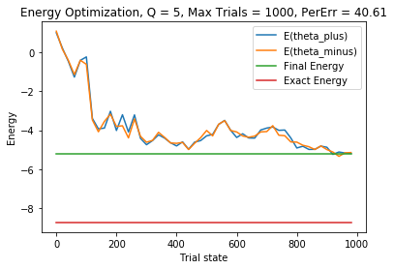
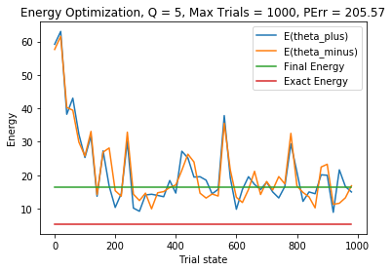
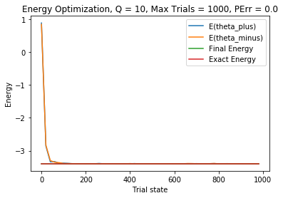
Quantum Trials
5-qubit quantum simulation of a 5 atom carbon nanoring with a quantum depth of 5, 1000 total trials, 1024 shots, and 40.61% error in the ground state energy value.
5-qubit quantum simulation of the SSH model with 2 fermions and an 8X8 boson, percent error of 205.57% with a quantum depth of 5, maximum trials of 1000.
5-qubit quantum simulation of the Gross-neveu model of polyacetylene with a percent error less than 0.01%.

Slide 15
Applications of Quantum Computational Methods to Quantum Cosmology
Charles Kocher, Department of Physics, Brown University, Providence, RI 02912
Michael McGuigan, Computational Science Initiative, Brookhaven National Laboratory, Upton NY, 11973.

Slide 16
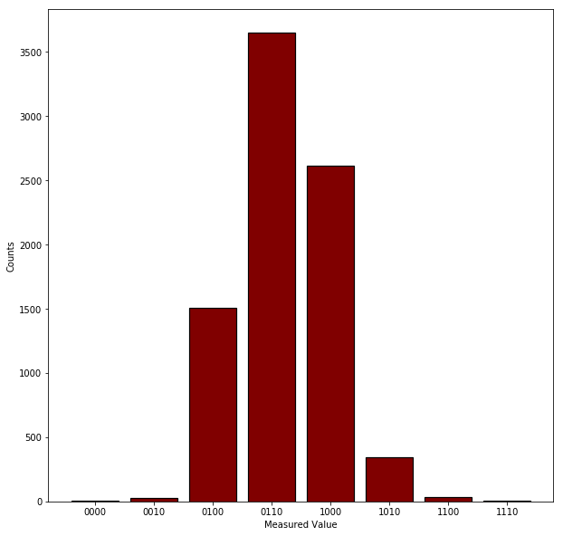
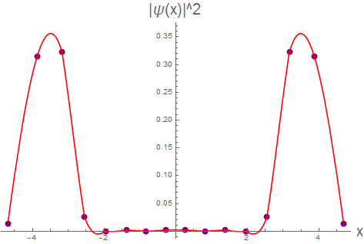
Quantum Computing Basics
Many particle two-level system.
To prepare a state, apply unitary operators in a circuit.
Measuring the circuit many times yields the state.
The state is discrete.
Left: A quantum circuit.
Right: The measurement results of the quantum circuit and the corresponding probability distribution derived from the quantum state for a given interpretation of the output.

Slide 17
Physics on the Quantum Computer
Given a Hamiltonian, how can it be studied on the quantum computer?
Use the matrix method from classical computational quantum mechanics.
Transform to the harmonic oscillator energy basis using the usual raising and lowering operators:
Truncate the number of energy eigenstates to yield a finite matrix for the Hamiltonian on a discrete lattice.
Decompose the matrix Hamiltonian into tensor products of Pauli matrices:
where e.g. and
What information can be extracted from this Hamiltonian?

Slide 18
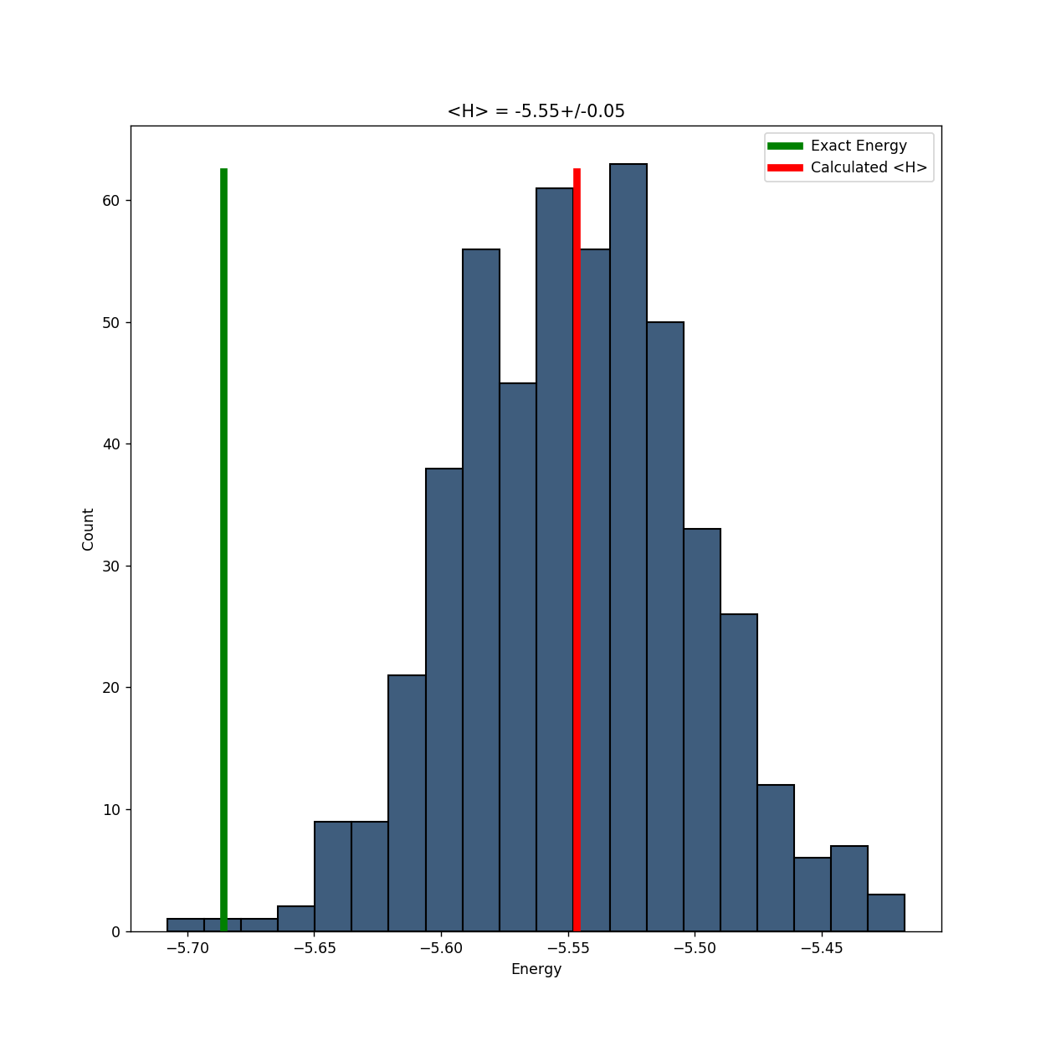
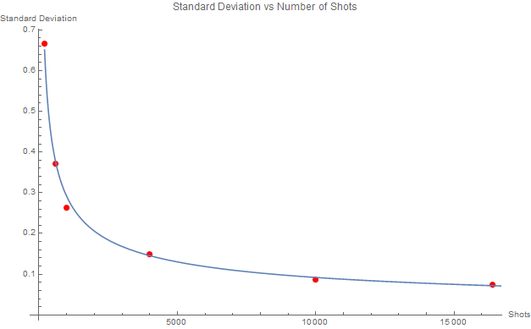
Variational Quantum Eigensolver
Use the variational principle, to produce an upper bound on the ground state energy.
Give the quantum computer a trial circuit with tunable parameters and a matrix Hamiltonian.
Minimize the expectation value on a classical computer, using the quantum computer to actually measure the expectation value
VQE returns an optimized trial circuit; average of many measurements of the expectation value gives an upper bound
Left: Spread vs. shots. Right: Distribution of measurements.
[1] A. Kandala, A. Mezzacapo, K. Temme, M. Takita, M. Brink, J. M. Chow, and J. M. Gambetta, Nature 549, 242 (2017).
[2] A. Peruzzo, J. McClean, P. Shadbolt, M.-H. Yung, X.-Q. Zhou, P. J. Love, A. Aspuru-Guzik, and J. L. Obrien, Nature communications 5, 4213 (2014).

Slide 19
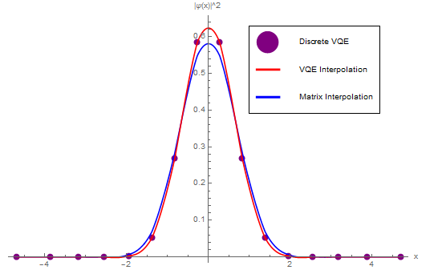
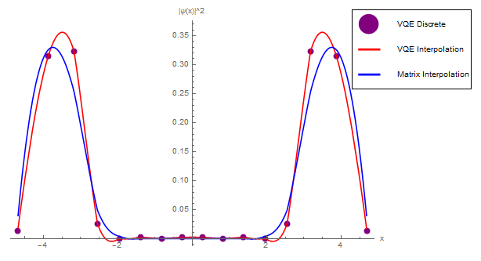
Examples from One-Dimensional Quantum Mechanics
Use IBM’s QISKit implementation of the VQE algorithm to predict the ground state energies of simple Hamiltonians in one-dimensional QM.
Harmonic oscillator:
Anharmonic oscillator:
Double-well:
Table: All bounds within 3%. Left: Anharmonic wavefunction. Right: Double-well wavefunction.

Slide 20
Quantum Cosmology in Brief
Model the dynamics of the universe without a full theory of quantum gravity.
Quantize the Einstein-Hilbert action using path integrals [3] or Wheeler-DeWitt canonical quantization [4]: H𝝍 = 0.
Focus on highly symmetric case of FRW mini-superspace with the following metric:
Consider case of a conformally coupled scalar field with three different values of Λ and k.
Λ = 0, k = +1 (closed universe)
Λ < 0, k = +1
Λ < 0, k = -1 (open universe)
Harmonic oscillators
Anharmonic oscillators
Double-wells
The quantum cosmology Hamiltonian separates into two copies of the one-dimensional Hamiltonian, but with opposite signs: H_{QC} = I⊗H_{QM} － H_{QM}⊗I. Squaring this Hamiltonian yields a positive definite matrix; the VQE will converge to states that satisfy the Wheeler-DeWitt Equation.
[3] L. J. Garay, J. J. Halliwell, and G. A. M. Marugan, Physical Review D 43, 2572 (1991).
[4] B. S. DeWitt, Phys. Rev. 160, 1113 (1967).

Slide 21
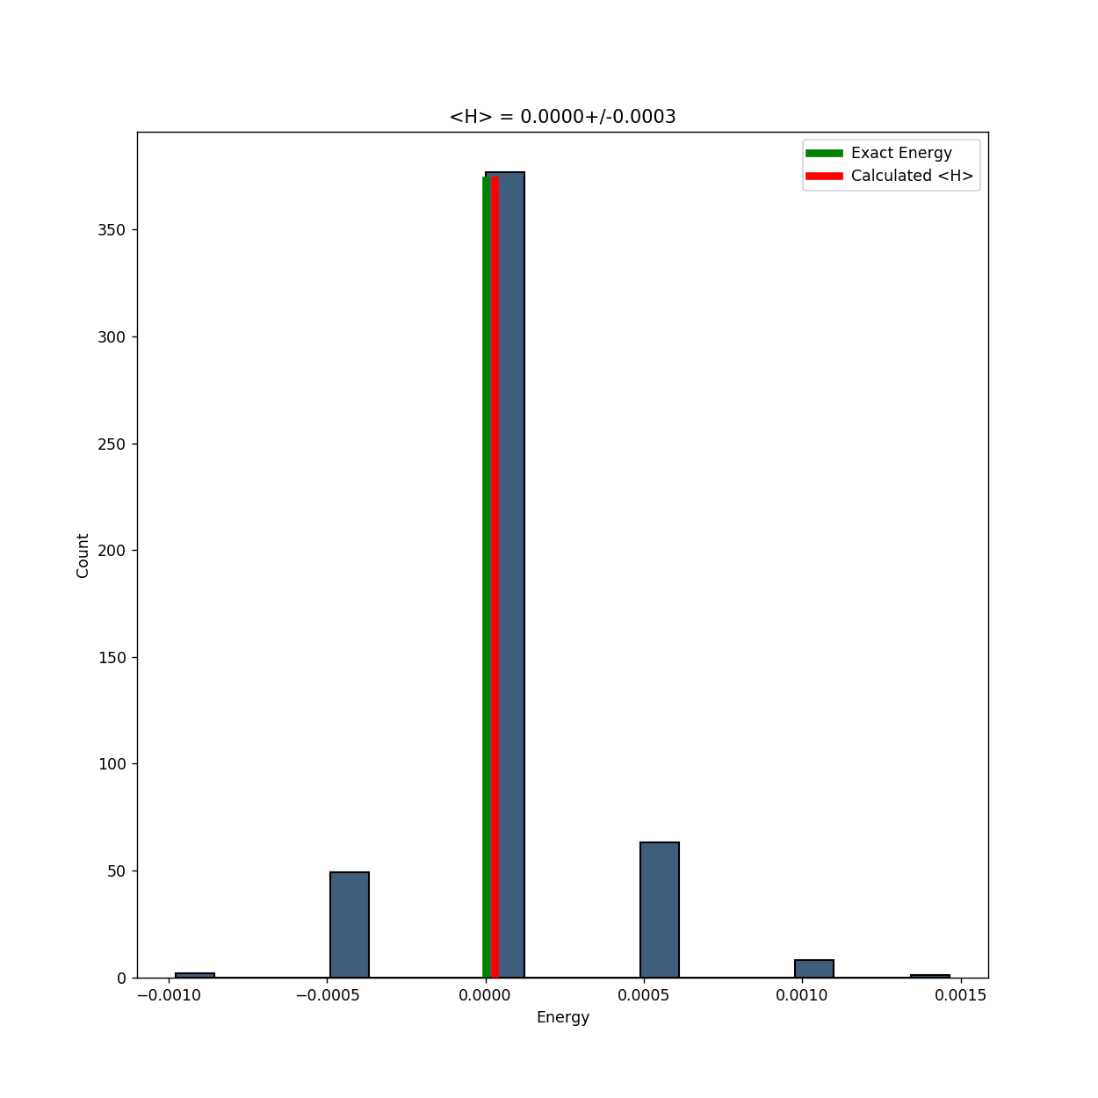
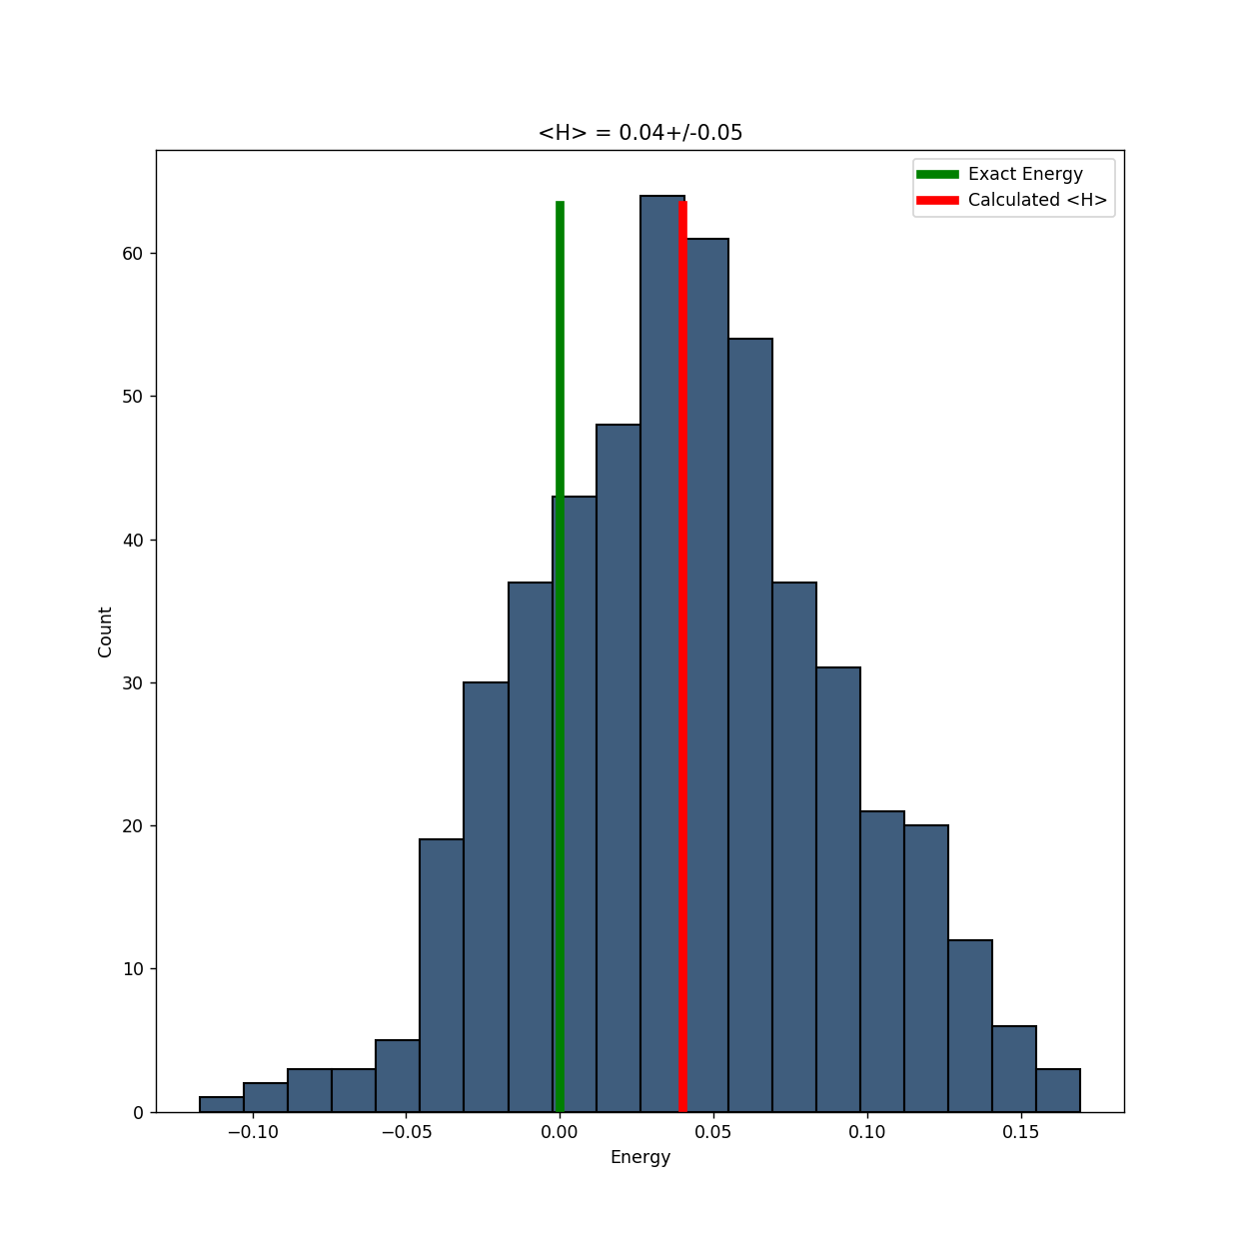
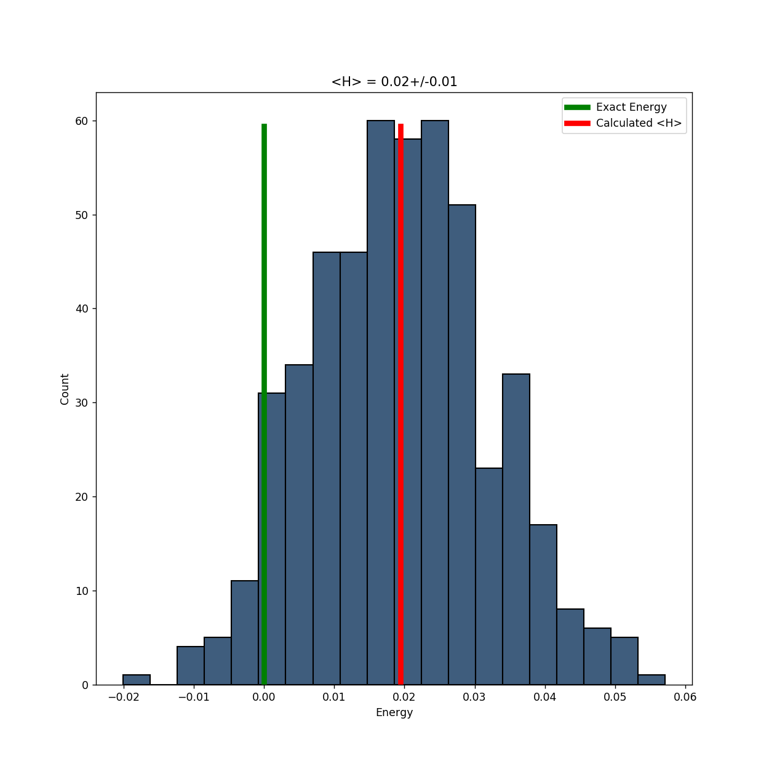
Quantum Computational Results
The VQE was able to find states that were consistent with the Wheeler-DeWitt equation for two of the three universes, as shown in the figures.
For universe 1, these states were observed to include excited states of the harmonic oscillator Hamiltonian.
We are investigating how to reconstruct the excited states of the QM Hamiltonian from this information.

Slide 22
Quantum Computation and Visualization of Hamiltonians using Discrete Quantum Mechanics and IBM QISKit
Raffaele Miceli
Department of Physics,Stony Brook University
Michael McGuigan
Computational Science Initiative, BNL

Slide 23
Outline
Motivation
Variational Quantum Eigensolver (VQE)
Discrete QM
Comparing Bases
Quantum Computing
Future Work

Slide 24
Motivation
QC is good at tackling problems that can be formulated in the language of quantum gates
VQE algorithm has seen great success in quantum chemistry
Can we use it to evaluate generic quantum Hamiltonians?

Slide 25
Variational Quantum Eigensolver

Slide 26
Description
Starts with a trial state initialized with starting parameters
Varies the parameters of the state to minimize its energy with respect to the given Hamiltonian
Optimization is done on a classical computer
Eigenvalue calculation is done by the quantum computer

Slide 27
Challenges
Quantum computation is crucial when working with large matrices
Running time for simulators increases exponentially with matrix size
Success of algorithm depends heavily on intelligent design of trial state, i.e. parameters need to be distributed in such a way that they can mimic the shape of the true ground state

Slide 28
Discrete Quantum Mechanics

Slide 29
Linear Algebra
Heisenberg discovered that the rules that govern the operators and states of quantum mechanics are those of matrix manipulation from linear algebra
To exactly duplicate the results of regular QM, the operator matrices and state vectors need to be infinitely large

Slide 30
So… how close can we get with operators and states of finite size?

Slide 31
Comparing Bases

Slide 32
Operators in Different Bases
In position basis, build position operator from lattice then use discrete Fourier transform to make momentum operator
In Gaussian energy basis, start with annihilation operator, then build position and momentum

Slide 33
Harmonic Oscillator

Slide 35
Anharmonic Oscillator

Slide 38
Supersymmetry

Slide 40
Quantum Computing

Slide 41
Brief Overview
Qubits are two state quantum systems
Superposition and entanglement
Qubit states can be altered by application of quantum logic gates
To run the VQE algorithm, we decompose the Hamiltonian into a sum of tensor products of Pauli matrices, which happen to be quantum logic gates

Slide 42
Results Quantum Computing Limitations
Run time for VQE depends heavily on the size and complexity of the original matrix, the quantum depth, and the number of optimization steps
When running on a simulator the run time was close to an hour for a 6-qubit cubic anharmonic oscillator with the other parameters kept relatively low
Tried to make the workflow for the VQE script as painless as possible
Minimized editing required to change to different Hamiltonian
Script automatically organizes results into folders for each type of Hamiltonian, outputs log file, convergence plot and circuit diagram

Slide 43
Results Quartic AHO Example Outputs
Convergence Plot
Circuit Diagram

Slide 44
Results Example Log File

Slide 45
Future Work
Designing better trial functions
More complex systems, e.g. finite temperature and new theoretical models
Run more systematic, targeted tests to probe VQE dependence on parameters
Running on IBM’s actual quantum computers rather than simulators

Slide 46
References
R. Jagannathan, T.S. Santhanam, R. Vasudevan. "Finite Dimensional Quantum Mechanics of a Particle”
Kouji Kashiwa, Robert D. Pisarski, Vladimir V. Skokov. "Critical endpoint for deconfinement in matrix and other effective models”
W. Heisenberg. ”Uber quantentheoretische Umdeutung kinematischer und mechanischer Beziehungen”
Yu R. Musin "A Supersymmetric anharmonic oscillator.”
A. Das. "Supersymmetry and Finite Temperature”
H Matsumoto, M. Tachiki, H. Umezawa. "Thermo Field Dynamics”
D. Berenstein. “A toy model for time evolving QFT on a lattice with controllable chaos”
A. Peruzzo et. Al, “A variational eigenvalue solver on a quantum processor”

Slide 47
Questions?

