Slide 1

Smaller and Faster:
Data Compression in areaDetector
Mark Rivers
GeoSoilEnviroCARS, Advanced Photon Source
University of Chicago

Slide 2
Outline
Last talk at NSLS-II was May 2018
ADCore releases since then: R3-4, R3-5, R3-6 (soon)
This talk:
  New data compression features
  Demo of data compression
  Other major features from these releases
Second talk: Enhanced Support for GenICam Cameras and Detectors

Slide 3
Data Compression Motivation
We are already in the era of “big data” with existing detectors. Eiger, Pilatus, Lambda, PCO, FLIR/Point Grey, Xspress 3, etc.
  Can all produce data faster than most disk systems can handle
  All exceed 1 Gbit network capacity, and some exceed 10 Gbit.
  Rapidly fill up disks
Will become a more serious issue with coming upgrades
  Increased count rates will allow existing detectors to run at their maximum speed
  New generations of even faster detectors will be coming
Data compression can help with these issues
  Must be fast and easy to use

Slide 4
Support for Compressed NDArrays and NTNDArrays
NDArray has 2 new fields to support compression
.codec field (struct Codec_t) to describe the compressor
  typedef enum {
  NDCODEC_NONE,
  NDCODEC_JPEG,
  NDCODEC_BLOSC,
  NDCODEC_LZ4,
  NDCODEC_BSLZ4
  } NDCodecCompressor_t;
  typedef struct Codec_t {
  std::string name; /**< Name of the codec */
  int level; /**< Compression level. */
  int shuffle; /**< Shuffle type. */
  int compressor; /**< Compressor type */
.compressedSize (size_t) field with compressed size if codec.name is not empty.
pvAccess NTNDArray has always had .compressedSize and .codec fields, but never previously implemented in servers or clients

Slide 5
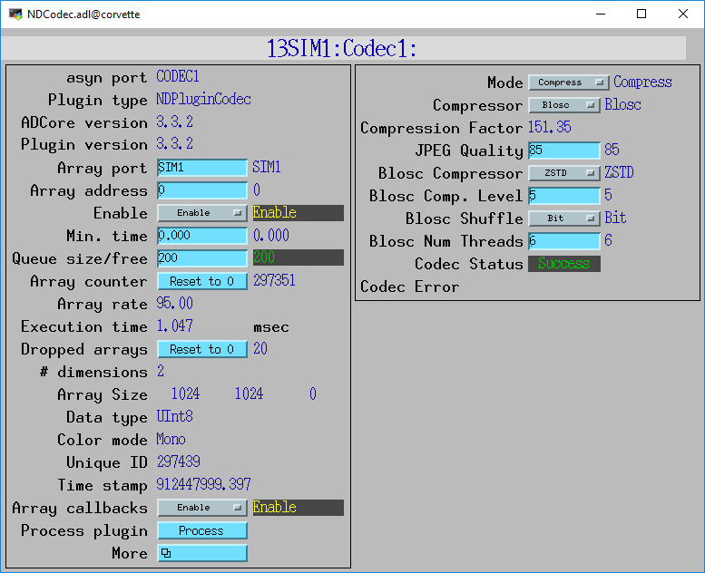
NDPluginCodec (R3-4)
New plugin for data compression and decompression
Written by Bruno Martins from FRIB
Mode:
  Compress or Decompress
Compressor:
  None
  JPEG (JPEGQuality selection)
  Blosc (many options, next slide)
  LZ4
  BSLZ4 (Bitshuffle/lz4)
CompFactor_RBV:
  Actual compression ratio
CodecStatus, CodecError
JPEG is lossy, all others lossless

Slide 6
Blosc Codec Options
BloscCompressor options. Each has different compression performance and speed
  BloscLZ
  LZ4
  LZ4HC
  Snappy
  Zlib
  Zstd
BloscCLevel
  Compression level: 0=no compression, 9=maximum compression.
  Increasing execution time with increasing level.
BloscShuffle
  Choices = None, Byte, Bit.
  Differences in speed and compression performance.
BloscNumThreads
  Number of threads used to compress each NDArray

Slide 7
LZ4 and BSLZ4 Codecs
These are the codecs used by the Eiger server from Dectris
  They don’t use the Blosc codecs, but rather the native LZ4 and Bitshuffle/LZ4 codecs.
Dectris server can optionally use these compressions for HDF5 files saved locally on their server
Dectris server always uses one of these compressions for data streamed over the ZeroMQ socket interface to the ADEiger driver
These can now be decoded directly in ADEiger, or passed as compressed NDArrays to NDPluginCodec and other plugins
Compressed arrays can be passed directly to NDFileHDF5 to be written with newly supported direct chunk write feature. More on this later.

Slide 8
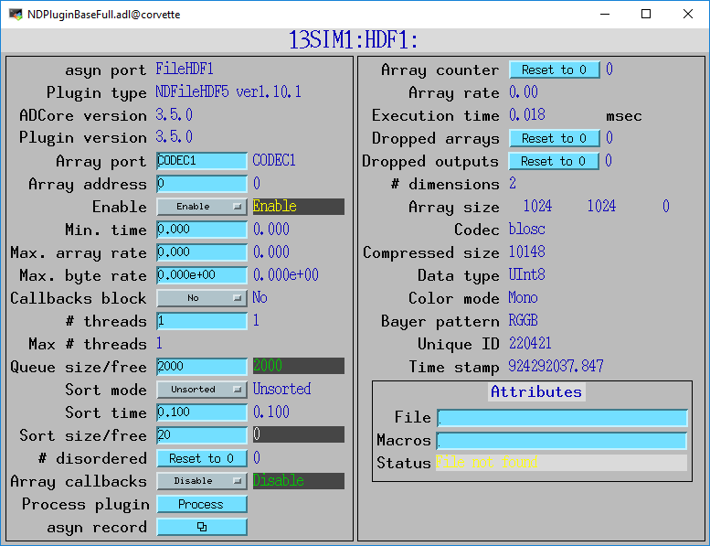
Codec Parameter Records (R3-5)
Codec_RBV and CompressedSize_RBV records to asynNDArrayDriver and hence to all plugins.

Slide 9
HDF5 Changes (R3-5)
NDFileHDF5 file writing plugin has always supported the “built-in” compression filters from HDF5:
  N-bit
  SZIP
  ZLIB
R3-3 added support for Blosc filters
New support for LZ4, Bitshuffle/LZ4, and JPEG filters
All of these compressors are called from the HDF5 library.
  Limits performance because of the overhead of the library.
New support for HDF5 Direct Chunk Write
  The NDArrays can be pre-compressed, either in NDPluginCodec, or directly by the driver (e.g. ADEiger)
  Much faster, much of the code in the HDF5 library is skipped.
Fixed a number of memory leaks, some were significant
Added FlushNow record to force flushing datasets to disk in SWMR mode

Slide 10
HDF5 Direct Chunk Write Performance
1024x1024 32-bit images
simDetector generating ~1350 frames/s = 5.4 GB/s.
Blosc LZ4 ByteShuffle compression
  Compression level 6.
  NDPluginCodec
  6 Blosc threads
  3 plugin threads.
  Compression factor is ~64
Time to save a single HDF5 file with 10,000 frames.
 | No compression | NDFileHDF5 compression | NDPluginCodec compression, direct chunk write
File size (MB) | 40,000 | 650 | 650
Total time (s) | 106 | 32 | 7.4
Frame/s | 94 | 312 | 1,351
MB/s uncompressed | 389 | 1,250 | 5,405
MB/s compressed | N.A. | 20 | 88
HDF5 library can only compress 312 frames/s
NDPluginCodec & direct chunk write keeps up with simDetector 1,350 frames/s

Slide 11
HDF5 Decompression Plugin Filters
(ADSupport R1-7)
HDF5 supports dynamic loading of compression and decompression filter libraries at run time.
The Blosc, LZ4, BSLZ4, and JPEG compressors have been built into the HDF5 library in ADSupport so that dynamic loading is not required when using NDFileHDF5.
However, to decompress HDF5 files compressed with Blosc, LZ4, BSLZ4, or JPEG with other applications dynamic loading of the filters will be required
ADSupport now builds these dynamic filter libraries for Linux, Windows, and Mac.
Must set the following environment variable to use them:
  HDF5_PLUGIN_PATH=[areaDetector]/ADSupport/lib/linux-x86_64

Slide 12
HDF5 Decompression Plugin Filters
>h5dump --properties test_hdf5_direct_chunk_3.h5
HDF5 "test_hdf5_direct_chunk_3.h5" {
GROUP "/" {
GROUP "entry" {
…
DATASET "data" {
DATATYPE H5T_STD_U32LE
DATASPACE SIMPLE { ( 100, 1024, 1024 ) / ( 100, 1024, 1024 ) }
STORAGE_LAYOUT {
CHUNKED ( 1, 1024, 1024 )
SIZE 4082368 (102.742:1 COMPRESSION)
}
FILTERS {
USER_DEFINED_FILTER {
FILTER_ID 32001
COMMENT blosc
PARAMS { 2 2 4 4194304 8 1 1 }
}
}
…
DATA {
(0,0,0): 173140, 173141, 173142, 173143, 173144, 173145, 173146,
(0,0,7): 173147, 173148, 173149, 173150, 173151, 173152, 173153,
(0,0,14): 173154, 173155, 173156, 173157, 173158, 173159, 173160,
(0,0,21): 173161, 173162, 173163, 173164, 173165, 173166, 173167,

Slide 13
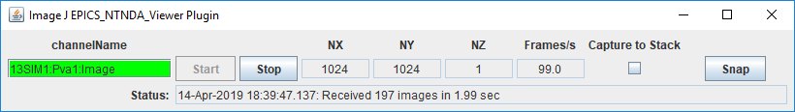
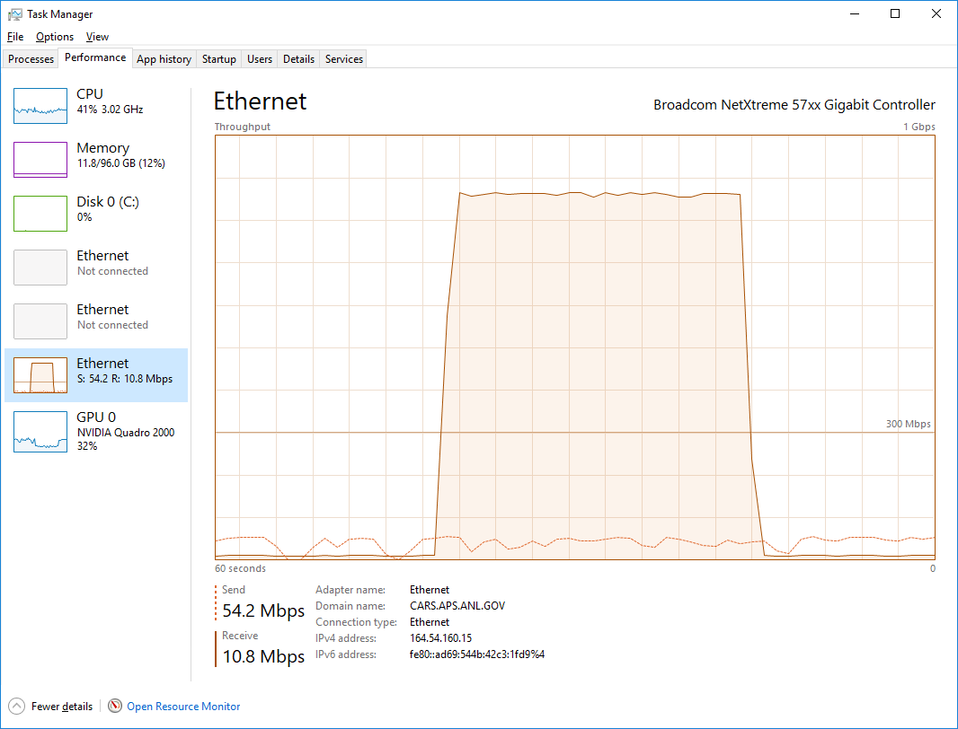
ImageJ pvAccess Viewer
Now supports displaying compressed NTNDArrays
Supports all compressions (JPEG, Blosc, LZ4, BSLZ4)
Can greatly reduce network bandwidth when the IOC and viewer are running on different machines
No compression
Blosc compression

Slide 14
ADEiger Changes
Now supports Bitshuffle/LZ4 on Stream interface over ZeroMQ
  Previously only LZ4 was supported
New StreamDecompress bo record to enable/disable decompression. If disabled:
  NDFileHDF5 can use Direct Chunk Write without ever decompressing
  NDPluginPva can send to ImageJ without ever decompressing
  NDPluginCodec can decompress for other plugins like NDPluginStats, etc.

Slide 15
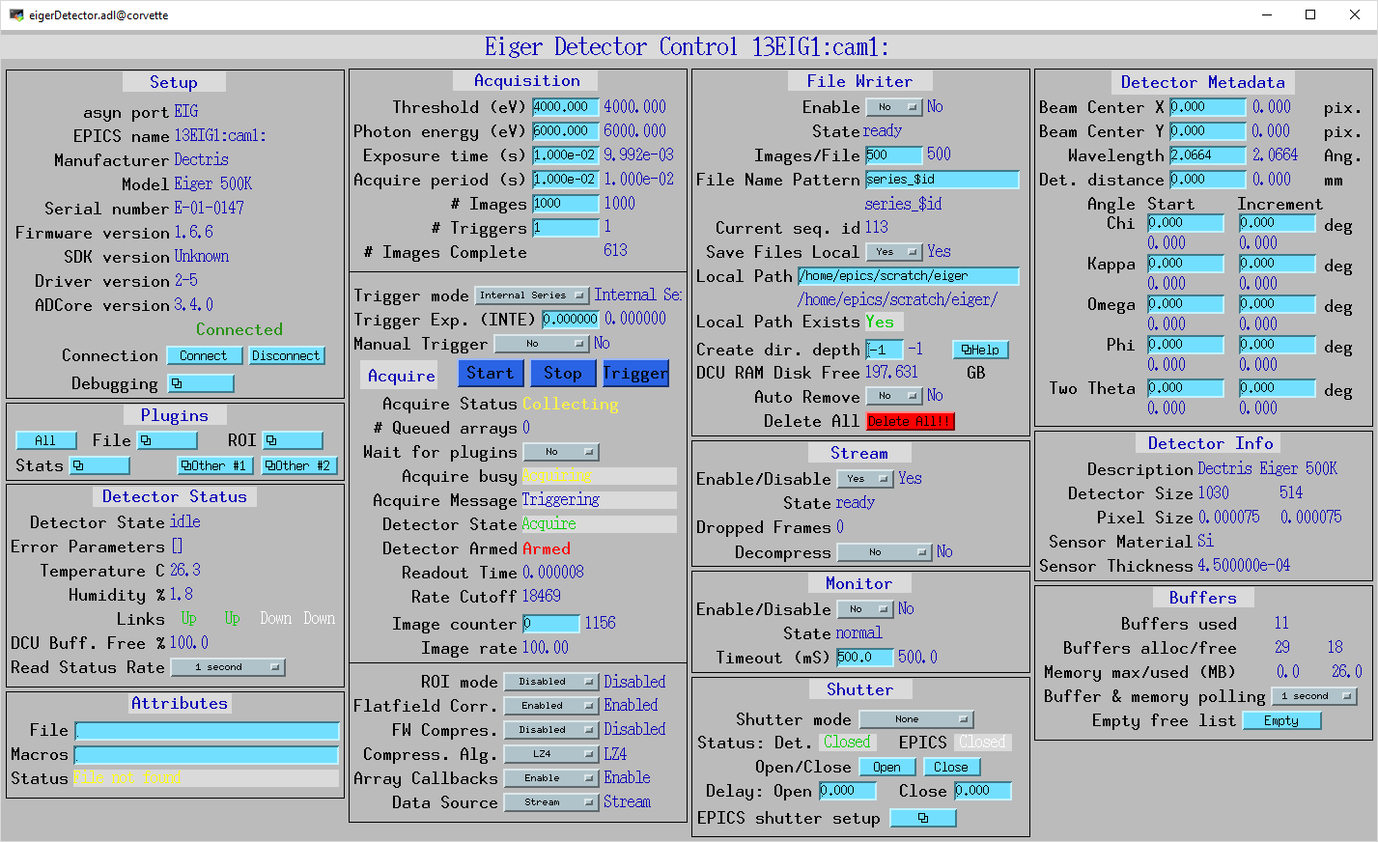
ADEiger Changes

Slide 16
Compression Demonstration
Running simDetector on Linux machine
Running medm and ImageJ on a Windows machine in my office
  Connected to Linux machine with 1 Gbit Ethernet
  Displaying here with VNC

Slide 17
Improvements in ADCore (R3-4)
New MaxByteRate record for plugins to limit “output rate”
  For most plugins this limits the byte rate of the NDArrays passed to downstream plugins
  For NDPluginStdArrays it limits the byte rate of the data callbacks to waveform records, and hence to Channel Access clients
  For NDPluginPva it limits the byte rate of the data callbacks to pvAccess clients
Optimization improvement when output arrays are sorted.
  Previously it always put the array in the sort queue, even if the order of this array was OK.
  Introduced an unneeded latency because the sort task only runs periodically.
  Caused ImageJ update rates to be slow, because it made PVA output comes in bursts, and some arrays were dropped either in the pvAccess server or client.
  Now if the array is in the correct order it is output immediately.

Slide 18
Documentation Improvements (R3-5)
Documentation was changed from manually edited HTML pages to reStructuredText (.rst) files processed with Spinx.
  Most tables are left in native HTML because .rst conversion is poor quality
Server changed from https://cars.uchicago.edu/software/epics/ to areaDetector.github.io/
Advantages:
  Easier to edit
  Nicer looking pages
New Travis CI job at top-level areaDetector
  Runs doxygen and sphinx to update the areaDetector.github.io files every time there is a push to the top-level areaDetector repository.
Thanks to Stuart Wilkins from BNL who set up the process and converted all of the files in ADCore, ADProsilica, and ADFastCCD.
Other detector repositories still need to be converted.
  Use pandoc to convert .html to .rst. Manual editing still required.

Slide 19
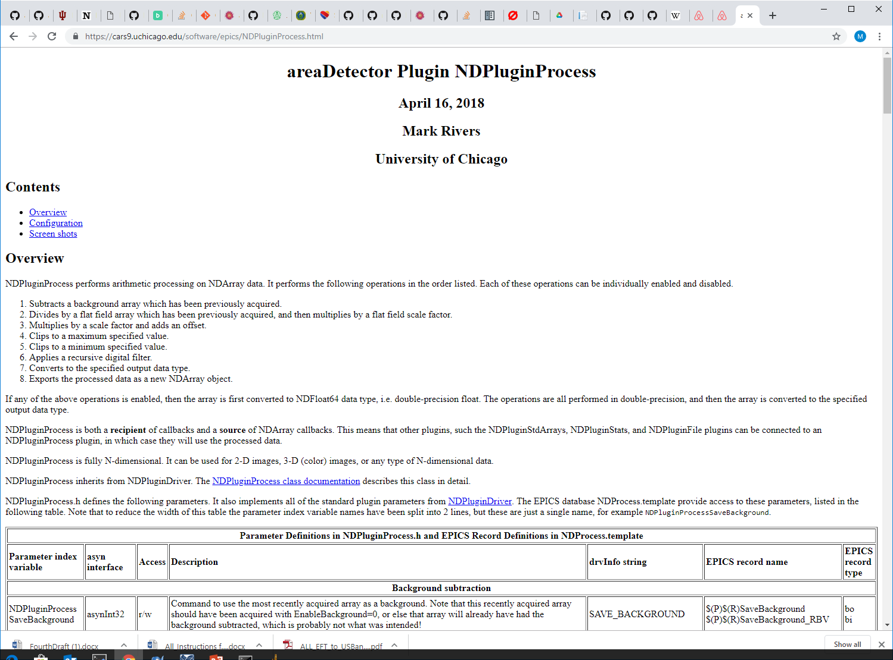

Slide 20
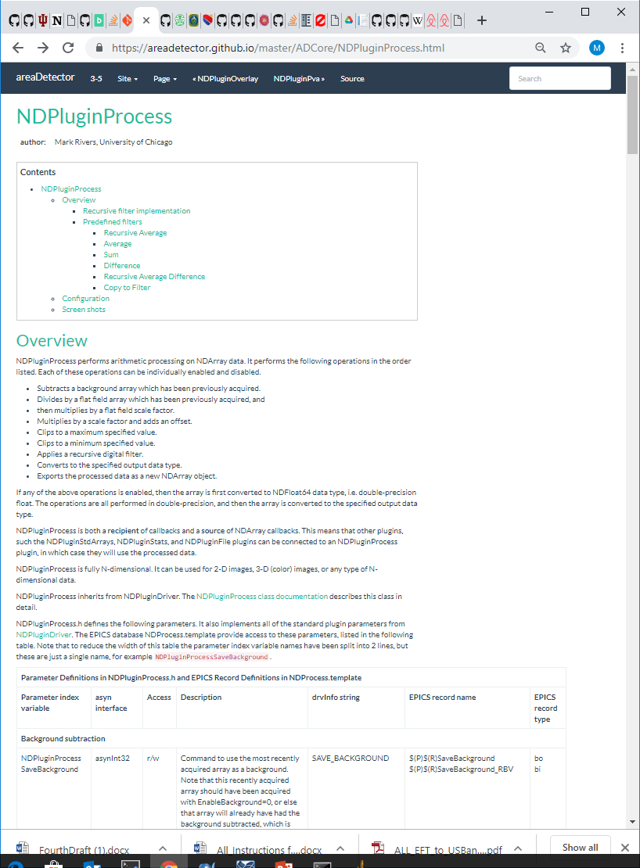

Slide 21
NDPluginAttribute Time Series (R3-5)
Previously NDPluginAttribute time series code was internal
Changed so that it now uses NDPluginTimeSeries, same change that was made to NDPluginStats in R3-5
Fewer lines of code, and adds Circular Buffer mode
The time-series waveform PVs are the same
The PVs to control the time-series (start/stop, # of points) have changed, so clients may need modifications

Slide 22
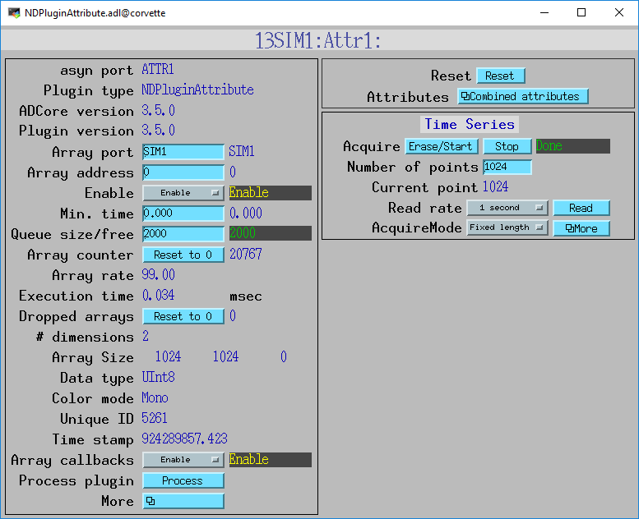
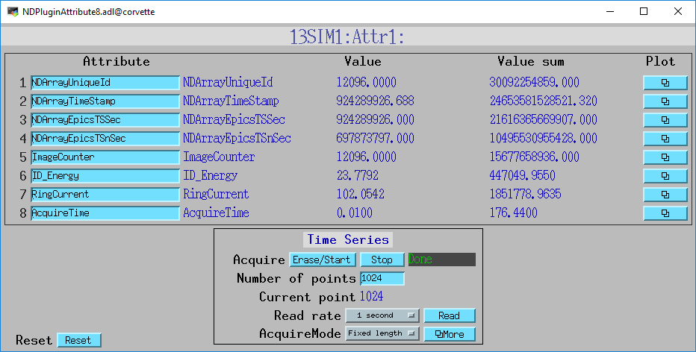
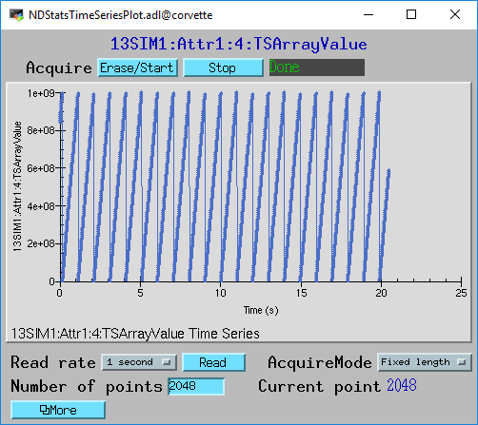
NDPluginAttribute Time Series (R3-5)

